Slide 1



Knowledge manipulation using OWL and reasoners for drug-discovery
ICBO 2013 Tutorial
July 7th 2013
Samuel Croset

Slide 2
Errata – July, 8th 2013
Here is a list of points raised during the tutorial and based on feedback from the audience. I will try to address them for a next release of the talk. Send me an email if you need clarification or have more comments croset@ebi.ac.uk - Samuel
Things that can be improved (list not comprehensive):
Direct semantics versus OWL based semantics → Could be removed from the talk. The reader can skip that.
is_a relationship as defined by GO corresponds to a rdfs:subClassOf axiom in OWL.
In OWL, is_a is not an object property, it’s a built-in primitive construct from the language defining the relashionship between sets of things. Other properties (part-of, regulates, etc…) are defined by OWL object properties.

Slide 3
Material
Files: http://bit.ly/12flbf8
Protégé 4.3: http://stanford.io/102ZBJO
Brain: http://bit.ly/TYGj4O

Slide 4
Tutorial
Ask questions!
What is OWL?
Why is it particularly interesting for life sciences?
How to use OWL?
What is OWL 2EL?
How to integrate and query biomedical knowledge?

Slide 5
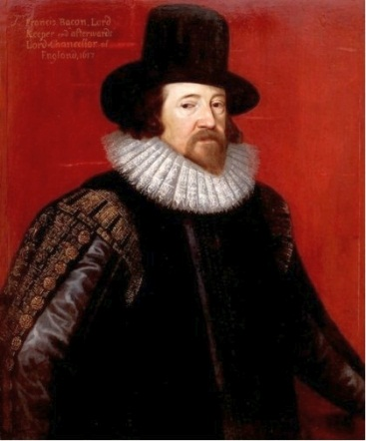

Why learning OWL?
“The scientist is not a person who gives the right answers, he's one who asks the right questions”
― Claude Lévi-Strauss
“Half of science is putting forth the right questions”
― Sir Francis Bacon

Slide 6
Why learning OWL?
“What are the human proteins that regulates the blood coagulation?”

Slide 7


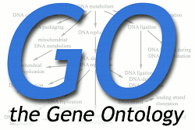
Why learning OWL?
Classification (flat file)
Database (SQL or RDF)
“What are the human proteins that regulates the blood coagulation?”
Ontology (OBO)

Slide 8
Why learning OWL?
Classification (flat file)
Database (SQL or RDF)
How do I integrate the data?
“What are the human proteins that regulates the blood coagulation?”
What does it even mean?
What are the parts?
What is composing it?
Ontology (OBO)

Slide 9
Why learning OWL?
Existing resources can already answer the question → But they need to interact
Ontologies are not only labels or annotations for biological concept (“blood coagulation”) → They help to formalize problem
We want to mix traditional ontologies with other large-scale data
We want an intuitive way to formulate the query, hiding the implementation

Slide 10
What is OWL?
The Semantic Web: RDF → URI and triples → Should improve interoperability over the Web
Need for shared schemas → ontologies
OWL → Description logics and knowledge representation, decidable, attractive and well-understood computational properties.
(OWL → Direct Semantics or RDF-based semantics)

Slide 11
What is OWL?
Confusing relations between OWL, RDF, SPARQL, reasoning, etc…
Here we deal with the Direct Semantics of OWL (no RDF) → It’s easier!
You get to use the reasoner a lot!
In OWL you build knowledge-bases or ontologies (here these terms are synonyms – in the wild people use the two).

Slide 12
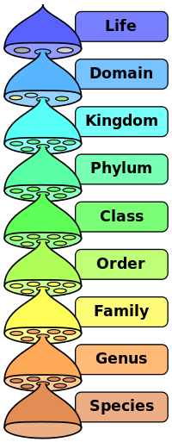
OWL and Life Sciences
Advantages versus RDF, SQL and flat files?
Formal language to represent hierarchical data
Machine reasoning
Large-scale (OWL 2EL)
Knowledge integration
Composition
Powerful query mechanism

Slide 13
OWL 2 Terminology
It’s all about definitions!
Defining things based on the relations they have
Entities: elements used to refer to real-world objects
Expressions: combinations of entities to form complex descriptions from basic ones
Axioms: the basic statements that an OWL ontology expresses → Pieces of knowledge
http://www.w3.org/TR/owl2-primer/#Modeling_Knowledge:_Basic_Notions

Slide 14
Entities
Classes: Categories and Terminology
Protein, Human, Drug, Chemical, P53, Binding site, etc… → Pretty much everything in life science.
Individuals (objects): Instances
Rex the dog, this mouse on the bench, you, etc…
Properties: Relations between individuals
Part of, regulates, perturbs, etc…

Slide 15
Axioms
Statements, pieces of knowledge → express the truth.
How classes and properties relate to each other:
All Humans are Mammals → Human is a subclass of Mammal
You should always think in terms of individuals. In biology we don’t really deal much with real individuals, yet classes/properties and axioms are built from relationships between anonymous individuals.
Our first OWL axiom: SubClassOf

Slide 16
Ontology/Knowledge-base
Set of axioms
Serialized as “.owl” file – Here using the Manchester syntax (Description logics semantics)
Example of output (look at the format, don’t try to understand the logic now):
ObjectProperty: part-of
Class: owl:Thing
Class: Cell
Class: Nucleus
SubClassOf:
part-of some Cell

Slide 17
Terminology Summary
Output in RDF (turtle – RDF-based semantics):
<demo.owl> rdf:type owl:Ontology .
:part-of rdf:type owl:ObjectProperty .
:Cell rdf:type owl:Class .
:Nucleus rdf:type owl:Class ;
rdfs:subClassOf [ rdf:type owl:Restriction ;
owl:onProperty :part-of ;
owl:someValuesFrom :Cell
] .
owl:Thing rdf:type owl:Class .

Slide 18
Terminology Summary
Class
Property
Individual
Scientist
regulates
John
Person
works in
Paris

Slide 19
Terminology Summary
John type Scientist
Paris type City
John works in Paris
Scientist subClassOf Person
Ontology/Knowledge-base
Axiom
Class
Individual
Property

Slide 20
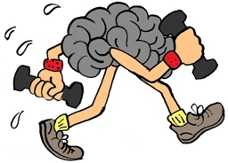
Exercise 1 – Classes and axioms
Open the file “NCBI-taxonomy-mammals.owl” with a text editor. Can you understand what’s inside?
Now open the file with Protégé and go under the tab “classes”. You can use the option “render by label” in the “View” menu.
Can you recognize the classes? What do they describe?
Can you spot the axioms? What do they capture?

Slide 21
Reasoner
A program that understand the axioms and can deduce things from it.
Used to classify the ontology.
Query engine for knowledge-bases.
More or less fast depending on the number and type of axioms.

Slide 22
Exercise 2 - Reasoning
In Protégé, go under the “DL query” tab and retrieve all descendant classes of the class Abrothrix (or NCBI_156196).
What does this query means? What about the results?

Slide 23
Comparison against mySQL
SELECT
s.*
FROM
species AS s,
species AS t
WHERE
(s.left_value BETWEEN t.left_value AND t.right_value) AND
t.common_name='abrothrix';

Slide 24
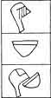
Constructs – Class expressions
Combining classes and properties to define more things (class expression) → Composition
Intersection: and
Mammal and Omnivore
Existential Restriction: some
part-of some Cell
Cuneiform script
(3000 BC):
Head
Food
http://en.wikipedia.org/wiki/Cuneiform
Eat

Slide 25
Construct: and
Mammal and Omnivore
Omnivore
Mammal
individual

Slide 26
Constructs & axioms
Human SubClassOf Mammal and Omnivore
Mammal and Omnivore
Omnivore
Human
Mammal
Pig
individual

Slide 27
Constructs & axioms
Human SubClassOf Mammal and Omnivore
This definition (Mammal and Omnivore) of the concept “Human ” is partial.
Every human must be at least a mammal and an omnivore according to our definition.
But it’s not because you are a mammal and an omnivore that you are necessary human!!

Slide 28
Construct: some
Existential restriction: Weird construct at first, but useful while dealing with incomplete knowledge
P some C: if it exists then a least one instance of C linked by P
Cell
part-of some Cell
part-of
part-of
part-of

Slide 29
Constructs & axioms
Nucleus SubClassOf part-of some Cell
“Each nucleus must be part of a cell”
part-of some Cell
part-of
Cell
Nucleus
part-of
part-of
part-of

Slide 30
Exercise 3 – Implementing the axiom
Create a new project inside Protégé.
Implement “Human SubClassOf Mammal and Omnivore”
Run the reasoner and look at the hierarchy of classes. Does it make sense?
That’s the main role of the reasoner → classifying things based on their definitions.
“Conceptual Lego”

Slide 31
OWL concepts
Class
: Basic block
Property
: Basic block
Constructor
: Used in class expressions
Class Expression
:
Class
,
Property
,
Constructor
Axiom
: Relations between these entities.

Slide 32
OWL Concepts
Axiom
TBox
(Terminological Axiom)
SubClassOf
EquivalentClasses
DisjointClasses
RBox
(Relational Axiom)
SubObjectPropertyOf
EquivalentObjectProperties
ObjectPropertyChain
TransitiveObjectProperty
…
ABox
(Assertional Axiom)
ClassAssertion…

Slide 33
Real-life example: The Gene Ontology
Open Biomedical Ontology (OBO) format originally.
Moved to OWL → Stronger semantics
Nucleus
Cell
part-of
http://www.geneontology.org/GO.ontology-ext.relations.shtml

Slide 34
GO constructs
Central pattern:
A SubClassOf P some B
Nucleus SubClassOf part-of some Cell
( )
Nucleus
Cell
part-of
http://www.geneontology.org/GO.ontology-ext.relations.shtml

Slide 35
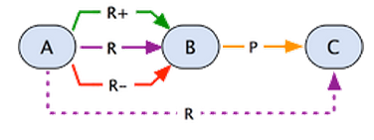
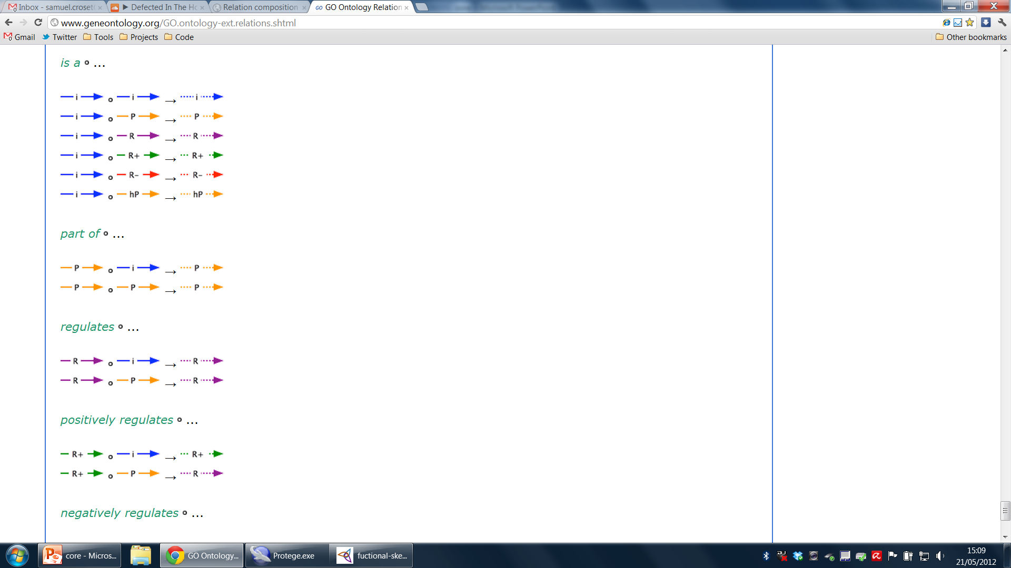
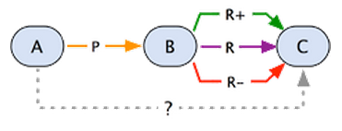
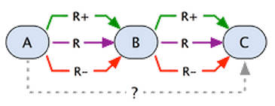
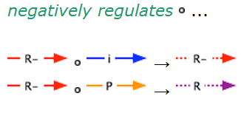
GO - RBox
http://www.geneontology.org/GO.ontology-ext.relations.shtml

Slide 36
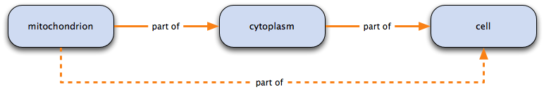
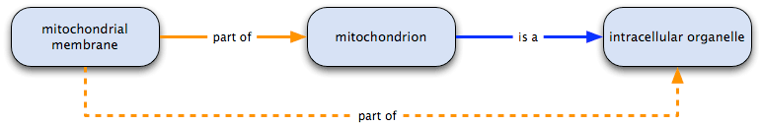
GO – Rbox: part-of
Transitivity

Slide 37
Exercise 4 – Transitive property
Open the “gene_ontology.owl” file.
What are the things that are a biological_process and part_of some 'wound healing‘ ?
Look at the class “blood coagulation, common pathway”. Is it obvious for this class to be in the results?

Slide 38
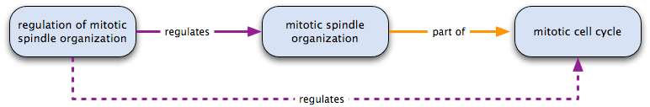
GO – Rbox: regulates
Chain

Slide 39
Exercise 5 – Chained properties
Look at the “regulates” property inside Protégé.
What are the things that are a biological_process and regulates some 'mitotic cell cycle’ ?
Look at the class “positive regulation of syncytial blastoderm mitotic cell cycle”
Is it obvious for this class to be in the results?

Slide 40
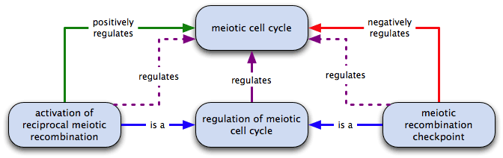
GO – Rbox: positively/negatively regulates
SubProperty

Slide 41
Exercise 6 – Sub Properties
Look at the “positively-regulates” property inside Protégé.
What are the things that are a biological_process and positively_regulates some 'mitotic cell cycle' ?
Are they different from the things that are biological_process and regulates some 'mitotic cell cycle'?

Slide 42
Exercise 7 – Verifying properties
Are we respecting the GO specifications?

Slide 43
Summary GO
Concepts are defined using one construct only (A SubClassOf P some B).
Rich RBox
OWL is helpful to represent these relations, helps to abstract away.

Slide 44
Knowledge integration
We would like to answer questions over all different source of knowledge.
“Thrombosis is a widespread condition and a leading cause of death in the UK.”
We would like to find a new protein target in order to treat thrombosis.
Here we would like to know “what are the human proteins that regulates the blood coagulation”.

Slide 45
Knowledge-bases
Species: NCBI taxonomy
Biological Process: Gene Ontology
Proteins: Uniprot

Slide 46
Exercise 8 – Integrating knowledge
Open the file uniprot.owl
Do you understand its content? Look for the class “Protein”
Now open the file “integrated.owl”
How would you formulate the question “what are the human proteins that regulates the blood coagulation” in OWL?
involved_in some (regulates some ‘blood coagulation’) and expressed_in some ‘Homo sapiens’

Slide 47
Implementation using Brain
Brain brain = new Brain();
brain.learn("data/gene_ontology.owl");
brain.learn("data/NCBI-taxonomy-mammals.owl");
brain.learn("data/uniprot.owl");
String query = "involved_in some (regulates some GO_0007596) and expressed_in some NCBI_9606“;
List<String> subClasses = brain.getSubClasses(query,false);
brain.sleep();

Slide 48
Large-scale implementation
OWL is computing intensive → OWL 2EL
Less axioms and constructs → easier for you to remember and easier for the reasoner to compute
Suited for life sciences → lots of classes, few instances

Slide 49
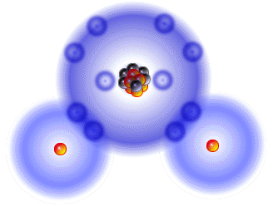
H2O
H
O
H
Expressivity
RDF
SPARQL
RDFS
OWL2 EL
OWL2
PSPACE
(all constructs)
NP
(AND, FILTER, UNION)
PTIME
PTIME
N2EXPTIME-complete
LOGSPACE
(AND, FILTER)
Tractable
Parallelism
http://www.w3.org/TR/owl2-profiles/

Slide 50
Why learning OWL?
Classification (flat file)
Database (SQL or RDF)
How do I integrate the data?
“What are the human proteins that regulates the blood coagulation?”
What does it even mean?
What are the parts?
What is composing it?
Ontology (OBO)

Slide 51
Conclusion
Ask questions!
What is OWL?
Why is it particularly interesting for life sciences?
How to use OWL?
What is OWL 2EL?
How to integrate and query biomedical knowledge?

Slide 52
Thank you!
croset@ebi.ac.uk
More questions: StackOverflow (tag “OWL”)
If you think things could be improved please send feedback, fork or contribute

