Slide 1


Catching an Attack in Action
TECH MENTORSHIP PROGRAM 2026 · CYBERSECURITY TRACK
TEAM LEAD
Nunoo Annah Frimpomaah
RED TEAM
Hauwa
Theodora Fouda Tsilla Etobe
BLUE TEAM
Nunoo Annah Frimpomaah
Thobile Mahlangu
DOCUMENTATION
Destiny Awambeng
A Red Team / Blue Team detection lab with Wazuh: simulate the attack, detect every stage, block the attacker
vs
Isolated VirtualBox lab · Wazuh 4.14.9 · November 2026
Notes:
Good morning. We are the cybersecurity team. Our project is a purple-team exercise: half of us attacked, half of us defended, and we used a free tool called Wazuh to catch the attack. Team roles: Hauwa and Theodora were the Red Team, Annah (team lead) and Thobile were the Blue Team, and Destiny led documentation.

Slide 2



The problem: small teams can't see attacks happening
Case study (fictional): Asempa Community Microfinance holds customer IDs, loan and repayment records. IT staff manage servers remotely over SSH, and there is no 24-hour security team.
Customer & loan data
Theft or fraud if an attacker gets in
Our question
Can a low-cost, open-source tool detect a password-guessing attack and an attempt to hide it, raise a clear alarm, and help stop the attacker?
Remote login (SSH)
Guessable passwords give a way in
System logs
Attackers wipe logs to hide their tracks
Who it helps: small-business IT admins, junior SOC analysts, and managers deciding what security to invest in.
Notes:
Our case study is a fictional microfinance company. It holds sensitive customer and loan data, admins log in remotely over SSH, and nobody watches the systems 24/7. The risk: someone guesses a password, gets in, and deletes the logs. Our question was whether free, open-source monitoring could catch that and help stop it.

Slide 3



What we built: a safe two-machine lab
Ubuntu VM
192.168.17.130
Kali VM
192.168.17.129
Safety rules
attack
Only our own VMs
Fake username, no password lists
Log tampering simulated, nothing deleted
No malware, no real data
No secrets in repo
Wazuh manager, indexer, dashboard
Applies our custom rules
Red Team attack launch point
The protected computer
SSH service on port 22
Wazuh agent 001 + UFW firewall
logs
Private VirtualBox network 192.168.17.0/24, with no internet targets
In scope: ports 21, 22, 80 on Kali · Wazuh custom rules and alerts · UFW firewall
Limit: two machines only, and Ubuntu was both server and attacker, to keep it simple
Notes:
Everything ran inside VirtualBox on one laptop. Ubuntu runs Wazuh, the alarm system, and was also where the Red Team launched the attack from. Kali is the computer we protect; it runs SSH and the Wazuh agent that sends its logs to Ubuntu. We kept strict safety rules: our own machines only, a fake username, and no real logs deleted.

Slide 4


Our approach: attack in three stages, detect each one
Reconnaissance
Password guessing
Cover-up (simulated)
Response
RED TEAM
Scan ports 21, 22, 80
RED TEAM
Repeated SSH logins as a fake user
RED TEAM
Write a harmless "log tampering" marker
RED TEAM
Attacker tries to connect again
BLUE TEAM
Record exposed service: only SSH is open
BLUE TEAM
Rule 100100 logs each failure → Rule 100101 Level 10
BLUE TEAM
Rule 100102 Level 12 alert (MITRE T1070.002)
BLUE TEAM
UFW blocks 192.168.17.130 on port 22
Cycle: plan scope → build lab → attack → review logs → write custom rules → test → re-run → respond → document
Notes:
We worked in a purple-team cycle. For each attack stage the Red Team acted and the Blue Team had to detect it. Stage 1 is scouting, Stage 2 is guessing passwords, Stage 3 is covering tracks, which we simulated safely with a test message. Finally the Blue Team blocked the attacker. Default Wazuh rules were not enough, so we wrote our own.

Slide 5
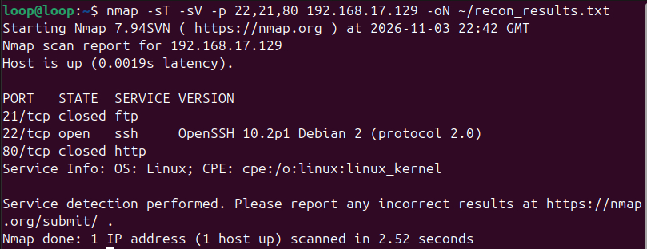
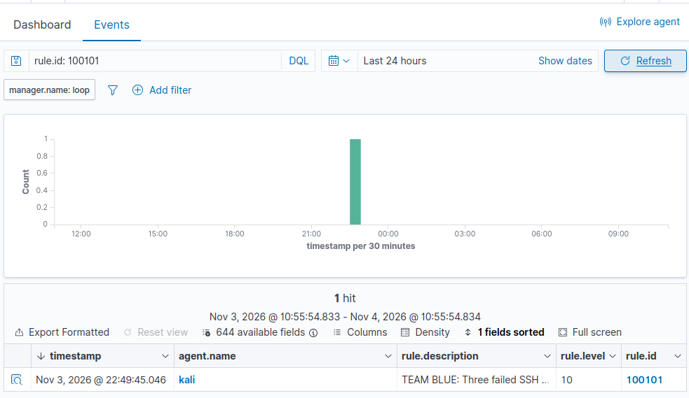
Stages 1–2: password guessing raised a Level 10 alarm
Nmap: only SSH (22) open; FTP (21) and HTTP (80) closed
19
5
10
Wazuh: Rule 100101 fired at Level 10 for three failed SSH logins (3 Nov, 22:49)
failed logins caught by our Rule 100100
Level of Wazuh's default alerts (easy to miss)
Level of our custom correlation alert
3 failures from the same IP within 120 s → one high-priority alert (MITRE T1110)
Notes:
Stage 1: the scan showed only SSH was open, so that became the attack path. Stage 2: the Red Team tried to log in repeatedly. Wazuh's built-in rules flagged each failure at only Level 5, easy to miss among hundreds of events. Our Rule 100100 caught every failure, 19 in a day, and Rule 100101 linked three failures from the same address in two minutes into one Level 10 alarm.

Slide 6
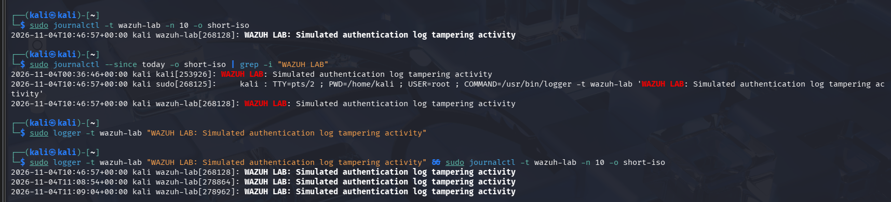
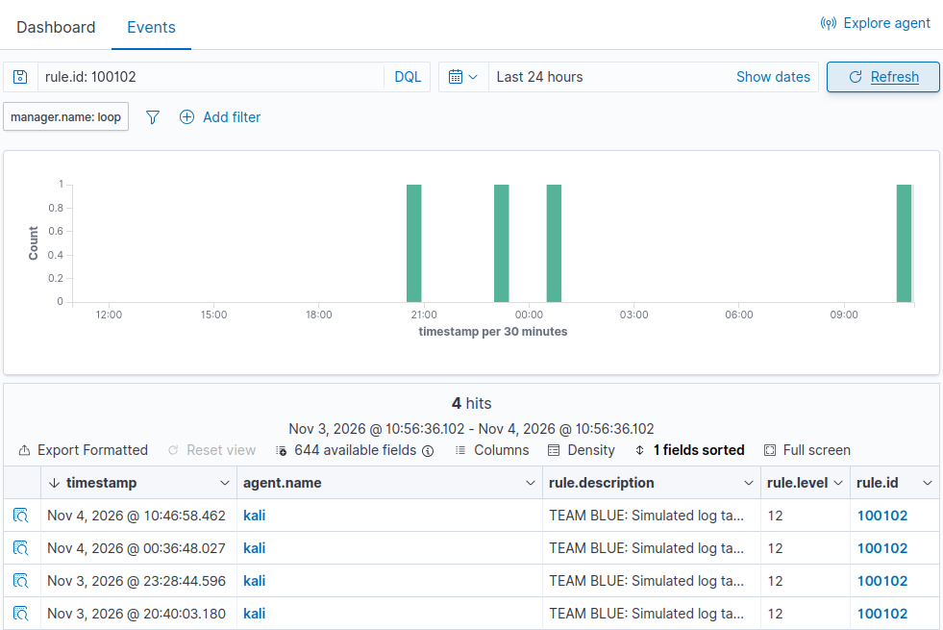
Stage 3: the cover-up attempt triggered a Level 12 alert
On Kali: the harmless WAZUH LAB marker recorded in the system journal at 10:46:57
12
alert level from Rule 100102, fired 4 separate times
Marker at 10:46:57 → alert at 10:46:58: the full path in about one second
Mapped to MITRE T1070.002 (clearing system logs)
Safe: a test message stood in for log deletion, so no real logs were touched
Notes:
Real attackers delete logs to hide. We did not delete anything; instead we wrote a clearly labelled test message into Kali's log. Our Rule 100102 caught it at Level 12, four separate times, so it is repeatable. The timestamps line up: the message was written at 10:46:57 and the alert appeared one second later.

Slide 7
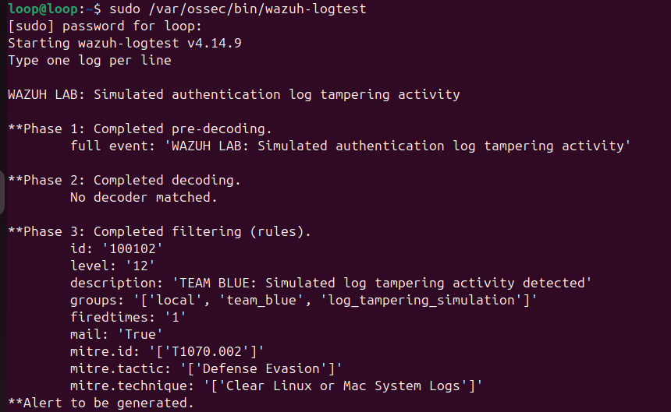

Our custom rules, and how we proved they work
Rule | Level | Detects
100100 | 5 | Each failed SSH password attempt
100101 | 10 | 3 failures, same IP, within 120 s
100102 | 12 | Simulated log-tampering marker
How we validated
Syntax check: wazuh-analysisd -t returned 0 (no errors)
Rule test: wazuh-logtest matched 100102 at Level 12
Live alerts appeared on the dashboard for all three rules
Kali log times matched the alert times (about 1 s apart)
Repeated the test: 100102 fired 4 times
wazuh-logtest: Phase 3 shows Rule 100102, Level 12, "Alert to be generated"
Notes:
These are our three rules in local_rules.xml. Two of them are at Level 10 or higher, as the brief requires. We checked them three ways: a syntax check that returned no errors, the Wazuh logtest tool showing the rule matches, and live alerts on the dashboard whose times match the Kali logs. The full file is in our repository.

Slide 8
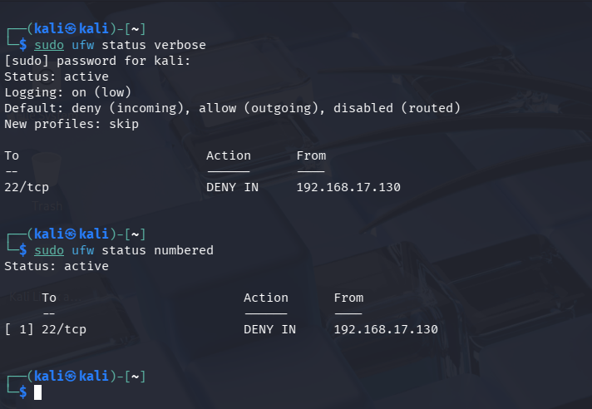
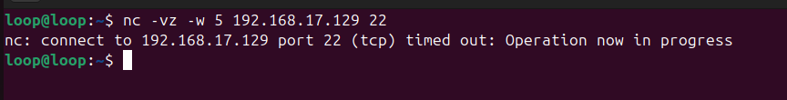
Response: attacker blocked, and the block proven
BEFORE
AFTER
Port 22 open to the attacker (192.168.17.130)
The rule we applied on Kali
sudo ufw deny from 192.168.17.130 to any port 22 proto tcp
The Wazuh agent stayed Active, so monitoring continued while the attacker was locked out.
UFW denies 192.168.17.130 on port 22, and the connection now times out
Notes:
After the Level 10 alert identified the attacker's address, the Blue Team added a firewall rule on Kali denying that address on port 22. Before, the port was open. After, the connection simply times out. Monitoring stayed on throughout. Our next improvement is to make this block happen automatically the moment the alert fires.

Slide 9


What we found and what we learned
Findings
Lessons learned
High
Password guessing on SSH: detected (L10)
Default rules see it; custom rules make it stand out
High
Log-tampering attempt: detected (L12)
Test rules before trusting them: a syntax check caught our <same_srcip /> mistake
Medium
SSH open with password login allowed
Match evidence across machines: log, then alert, then response
Low
Kali clock not time-synchronised
Simulate harmful steps safely, and still learn the lesson
Positive
Firewall block contained the attacker
Limitation: the block was applied by hand after the alert; automating it is our next step.
Notes:
Our main findings: both attack patterns were detected at high priority. The underlying weakness is that SSH accepts passwords, and we also noticed Kali's clock wasn't synchronised, which can confuse investigations. Key lessons: custom rules make attacks stand out, always test rules first (a syntax check caught one of our mistakes), and always tie evidence together across machines.

Slide 10


Next steps
Make SSH key-only, limited to admin IPs
Block the attacker automatically after a Level 10 alert
Send high alerts to email or chat
Questions?
Detect real log deletion with audit monitoring
Turn on time sync on every machine
Repository: github.com/hauwaonizeikunaiye-max/purple-team-detection-lab · Full report, local_rules.xml, attack_playbook.sh and screenshots
Notes:
To make this production-ready we would make SSH key-only, block attackers automatically, send alerts to people's phones or email, detect real log deletion, and sync clocks. Everything is in our repository. Thank you. We're happy to take your questions.

