Slide 1
ν0p_{1/2} – ν0p_{3/2} spin-orbit splitting in ²⁰O
M. Lozano-González, B. Fernández-Domínguez, J. Lois-Fuentes,
T. Roger, F. Delaunay
IGFAE-USC, GANIL and LPC-Caen
EuNPC 2025 - Caen

Slide 2
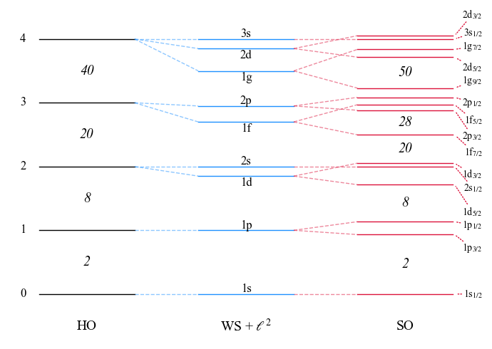

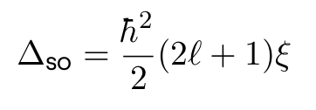
A recap on the SO splitting
Introduced by M. Goeppert-Mayer, reproduces magic numbers for stable nuclei.
SO splitting is mainly a surface effect:
which yields a l-depending gap:
⇒ Expected to evolve towards more exotic nuclei, where surface blurs

Slide 3
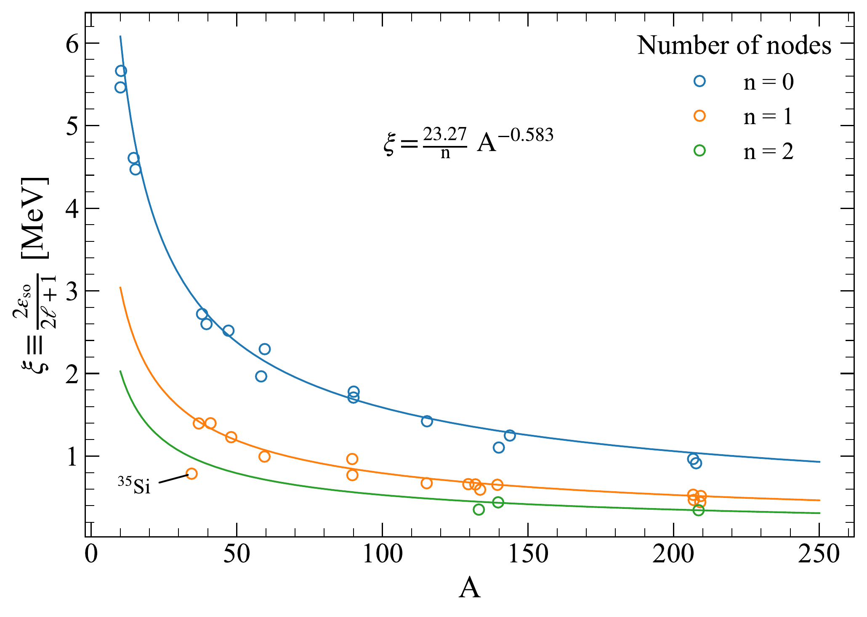
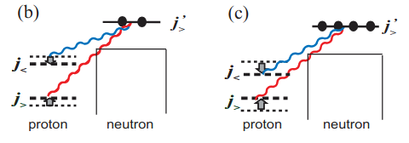
A recap on the SO splitting
G .Mairle et al. (PLB 304 (1993)) found systematic trends easily parametrizable.
Deviations from the trend are found due to:
Loosely bound orbitals
Nuclear matter depletion (³⁵Si?)
Role of tensor force
Proton-neutron interactions drive shell evolution

Slide 4
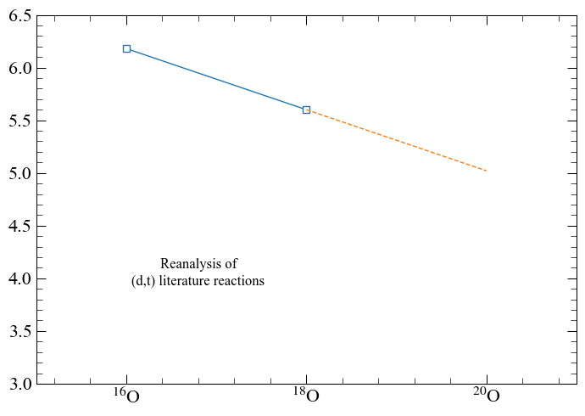
SO gap for Z = 8 isotopes
Evolution of the SO gap is plotted below for neutron-rich O isotopes.
Will ²⁰O follow the trend?
Could be determine the pn tensor contribution?

Slide 5
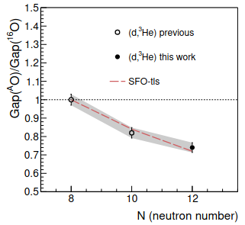
Physics case
E796 to measure transfer reactions probing single-particle occupancies in ²⁰O.
Proton removal ²⁰O(d,³He)¹⁹N to investigate persistence of Z = 6
1s_{1/2}
0d_{5/2}
j>,j<
Tensor V_{pn} reduces Z = 6 gap as neutrons are added to ν0d_{5/2}
N = 8
0p_{1/2}
j<,j<
0p_{3/2}
0s_{1/2}
Schematic view of tensor interaction in ²⁰O
J. Lois-Fuentes, PhD thesis (2023)

Slide 6
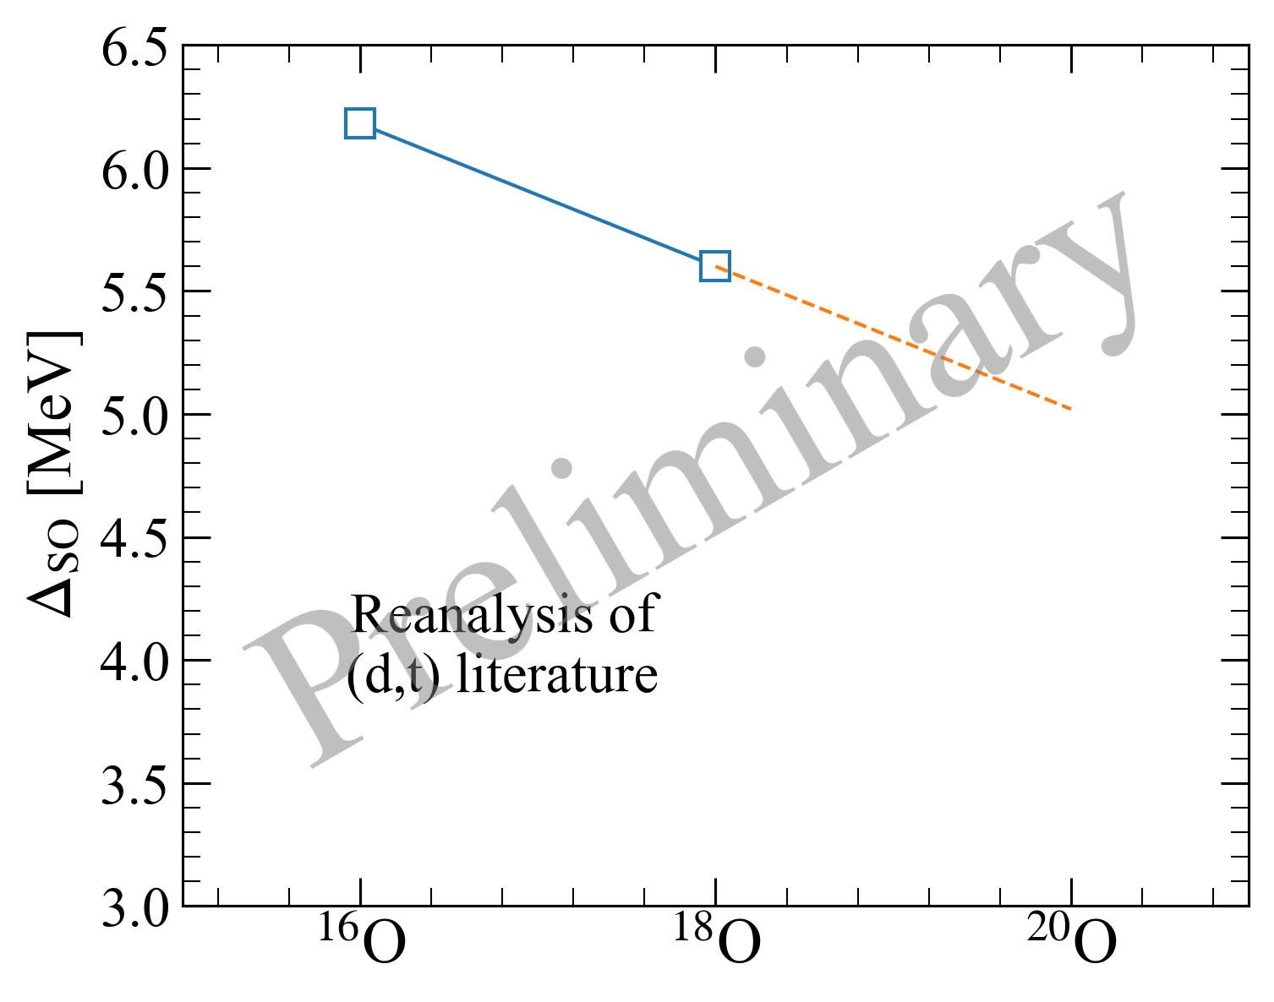
Physics case
E796 to measure transfer reactions probing single-particle occupancies in ²⁰O.
Neutron removal ²⁰O(d,t)¹⁹O to extract N = 6 SO gap
1s_{1/2}
0d_{5/2}
0p_{1/2}
Δ_{SO}
0p_{3/2}
0s_{1/2}
IPSM of ²⁰O
Reanalyis of previous data

Slide 7
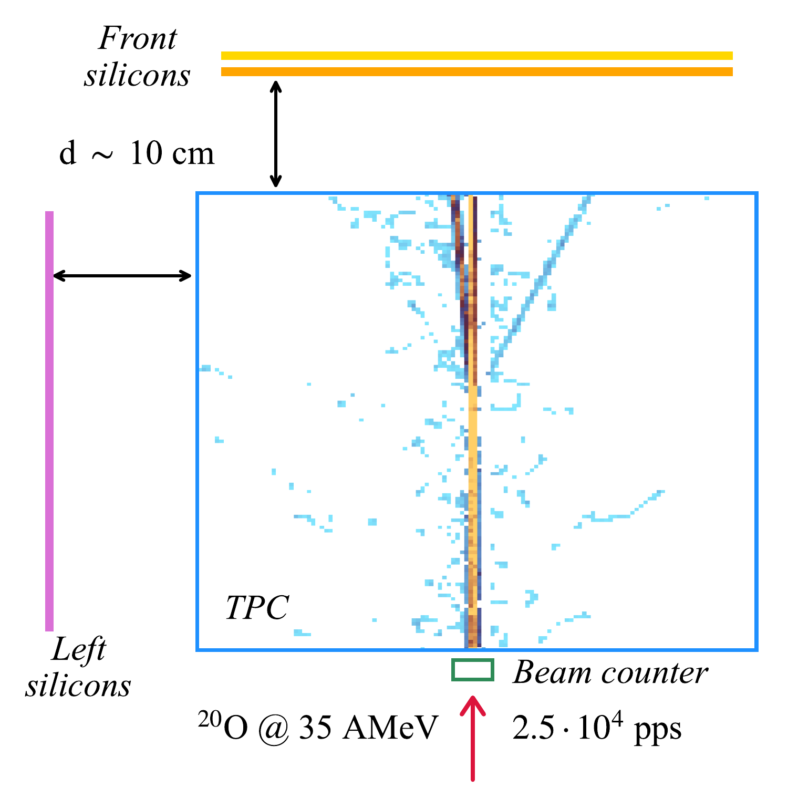
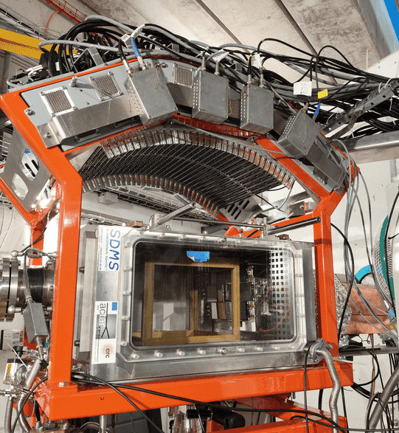
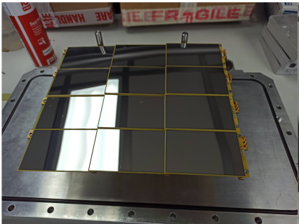
Experimental setup
E796 @ LISE in 2022. First transfer experiment with ACTAR TPC!
Silicon sizes:
80 x 50 x 0.5 mm³
Gas mixture:
90% D₂ + 10 % iC₄H₁₀
at 952 mbar

Slide 8
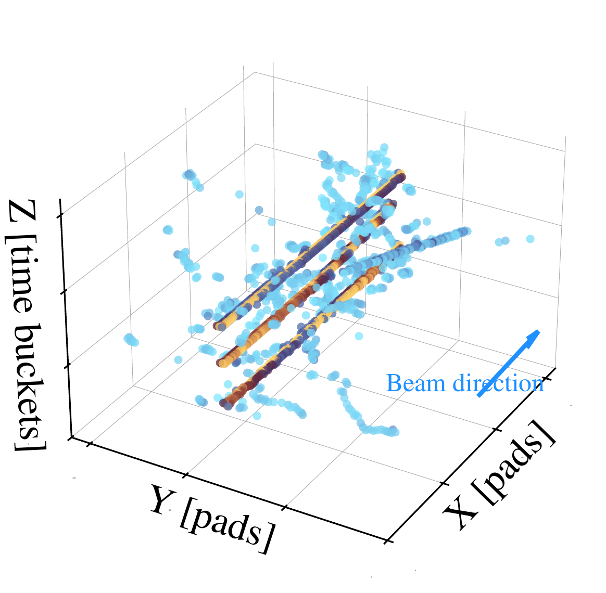
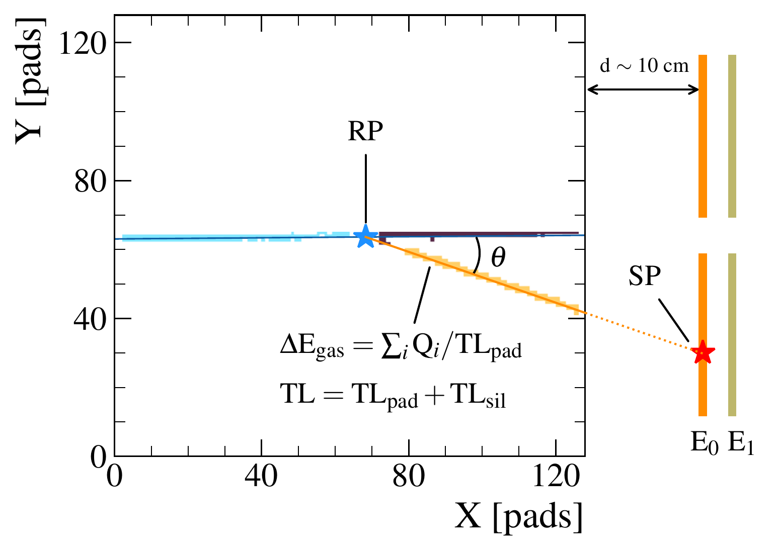
A window to the analysis
Intricate analysis to extract reactions of interest out of noisy data.
Unique advantages from the TPC:
Precise vertex determination
Improved ΔE corrections
Factor 10 in target number
Implicit PID with ΔE_{gas}

Slide 9
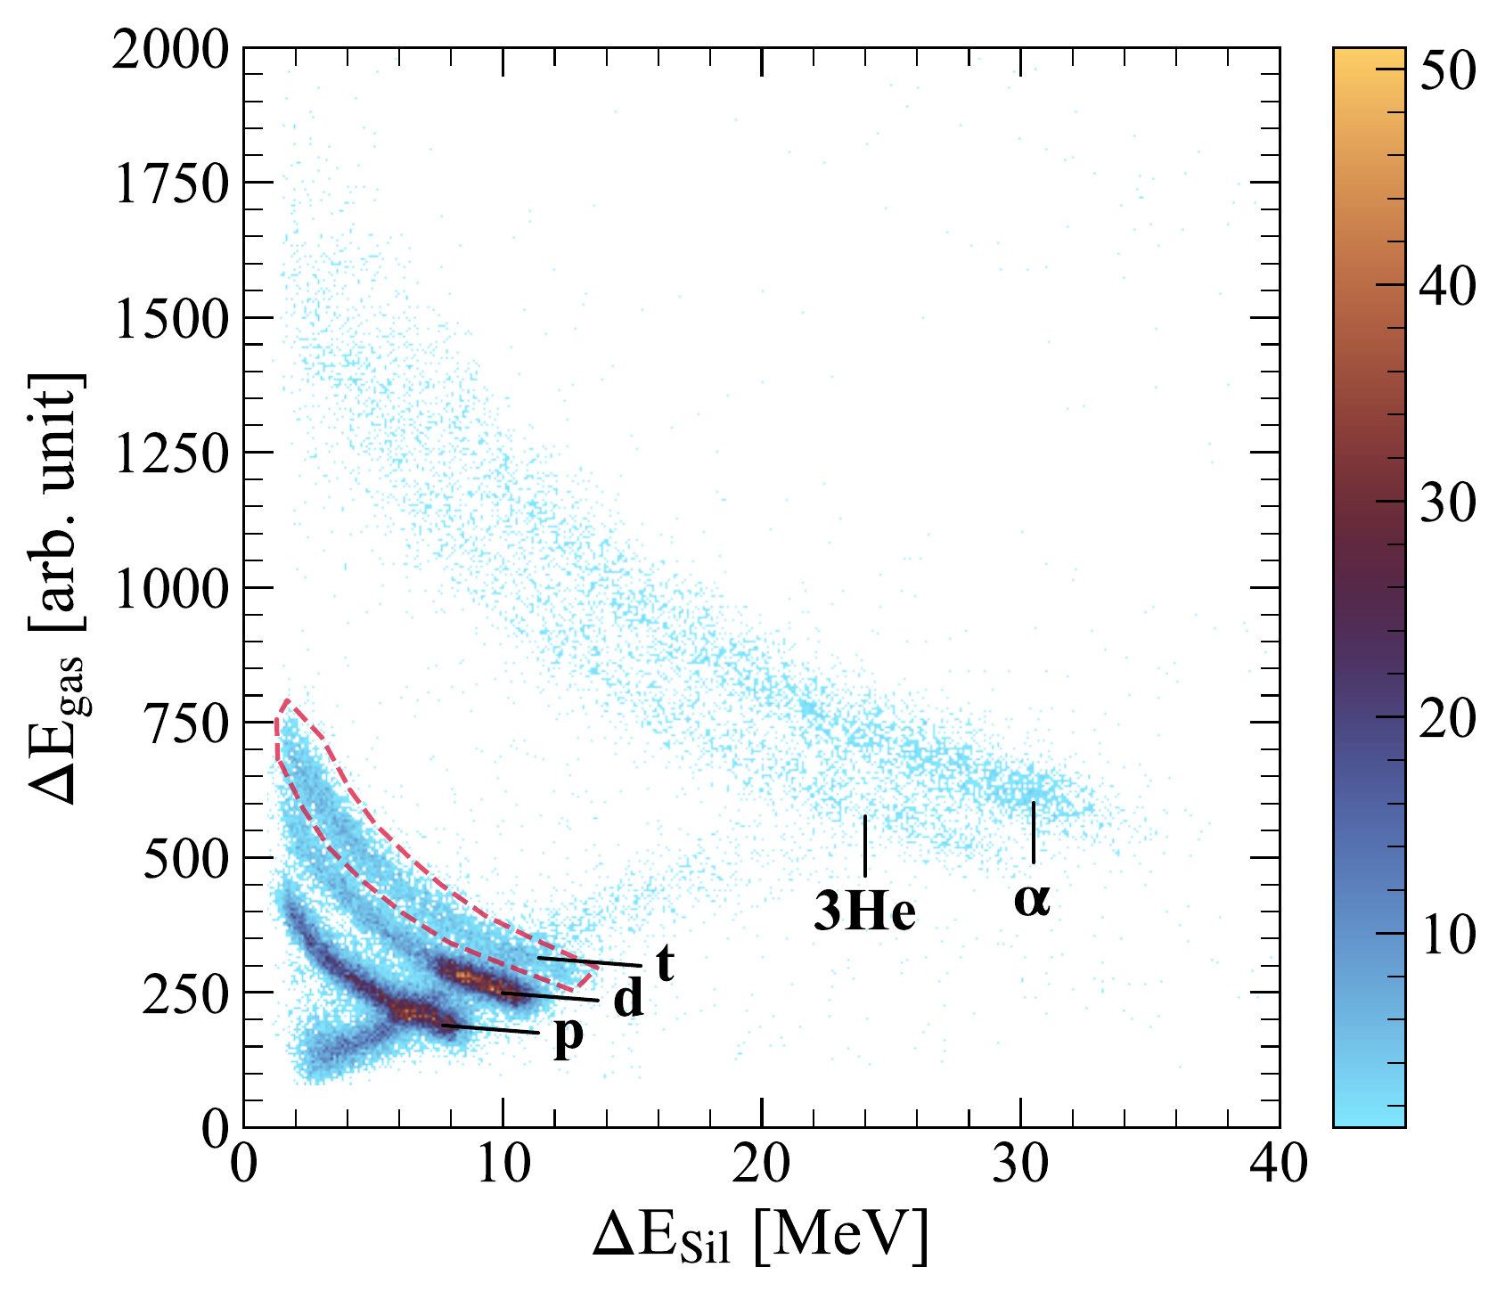
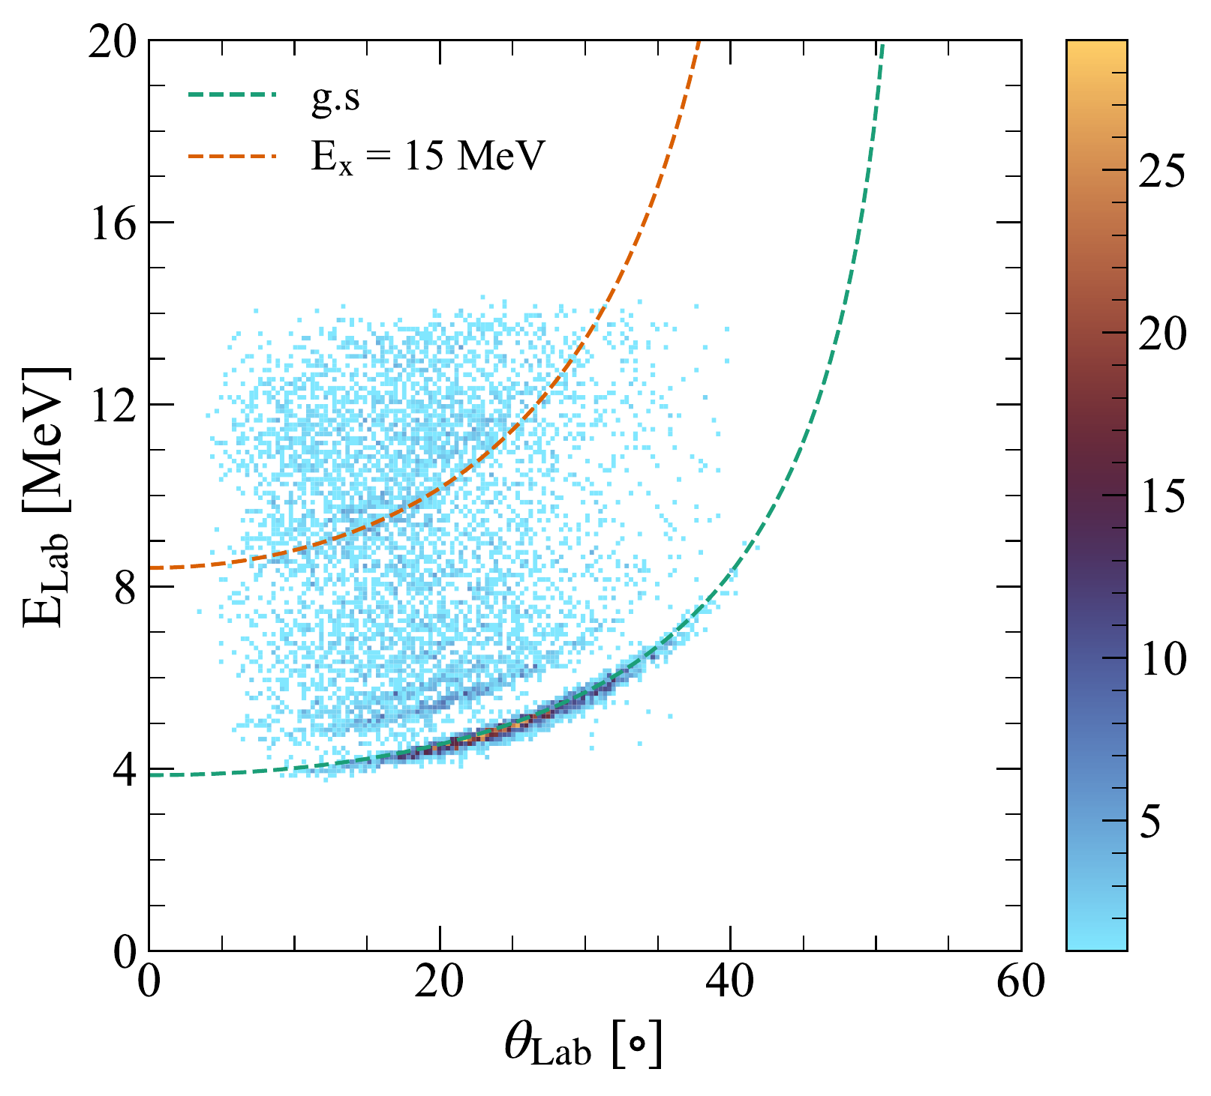
A window to the analysis
Two steps are needed after a binary reaction has been identified.
1. PID of tritons by plotting
ΔE_{gas}vs ΔE_{Sil}
2. E_{x} reconstructed by the missing-mass technique
Masked punch-through to 2nd front layer

Slide 10
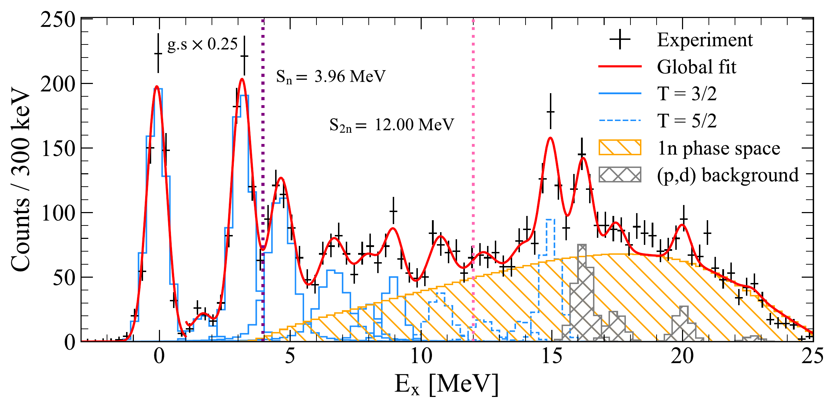
Results: E_{x} spectrum
Negligible 2n phase space contribution
11 observed states
At E_{x} > 15 MeV (p,d) contamination appears
Isospin T = 3/2 and 5/2
Assigned based on ²⁰O(d,³He)¹⁹N

Slide 11
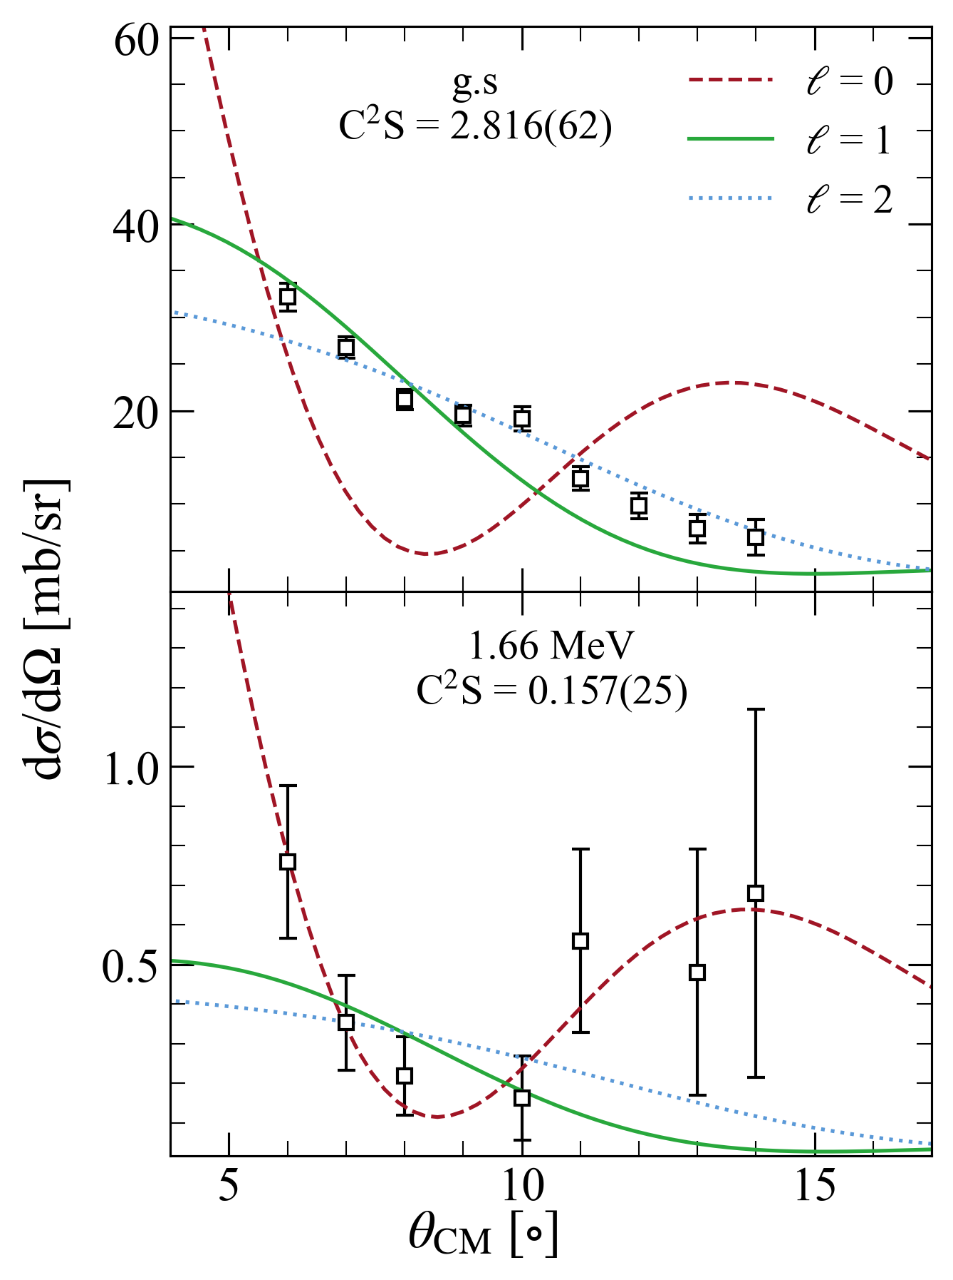

Results: cross-sections
DBWA with
OMP:
²⁰O + d: Daehnick
¹⁹O + t: Pang
d | t from ab-initio GFMC
²⁰O | ¹⁹O from standard WS
1s_{1/2}
0d_{5/2}
N = 8
1s_{1/2}
g.s: 5/2⁺, taking up 71% of the occupation
1st: 1/2⁺, with 8% of 1s_{1/2} occupancy
0d_{5/2}
N = 8

Slide 12
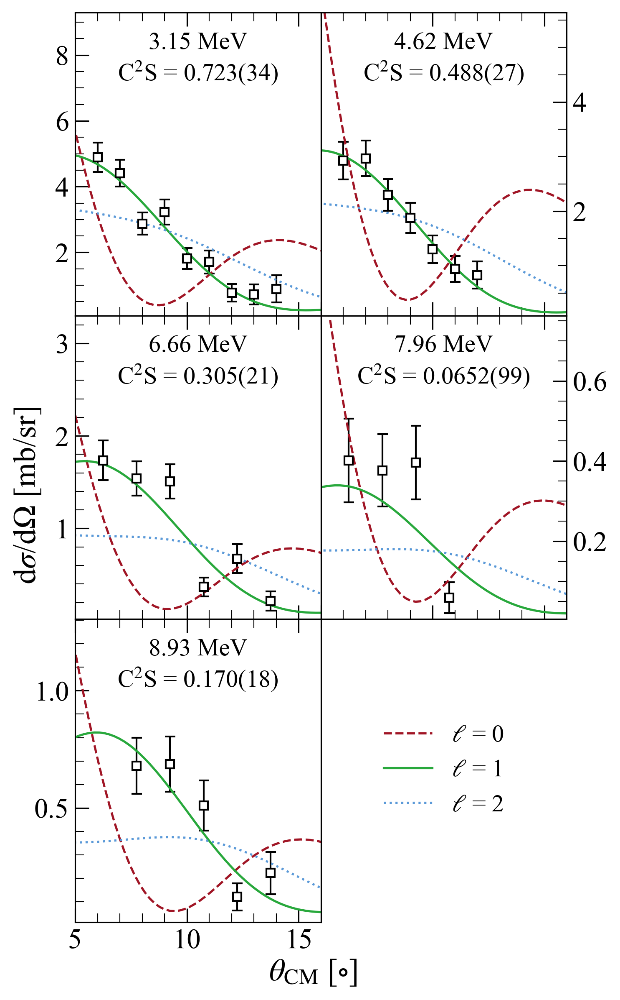
Results: cross-sections
Based on shell-model calculations (see next slide):
E_{x} = 3.1 and 4.6 MeV ⇒ 0p_{1/2}
E_{x} = 6.7, ..., 8.9 MeV ⇒ 0p_{3/2}
1s_{1/2}
0d_{5/2}
0p_{1/2}
T = 3/2 states:
0p_{1/2}: 61 % of strength
0p_{3/2}: just 14 % of occupancy!
0p_{3/2}
0s_{1/2}

Slide 13
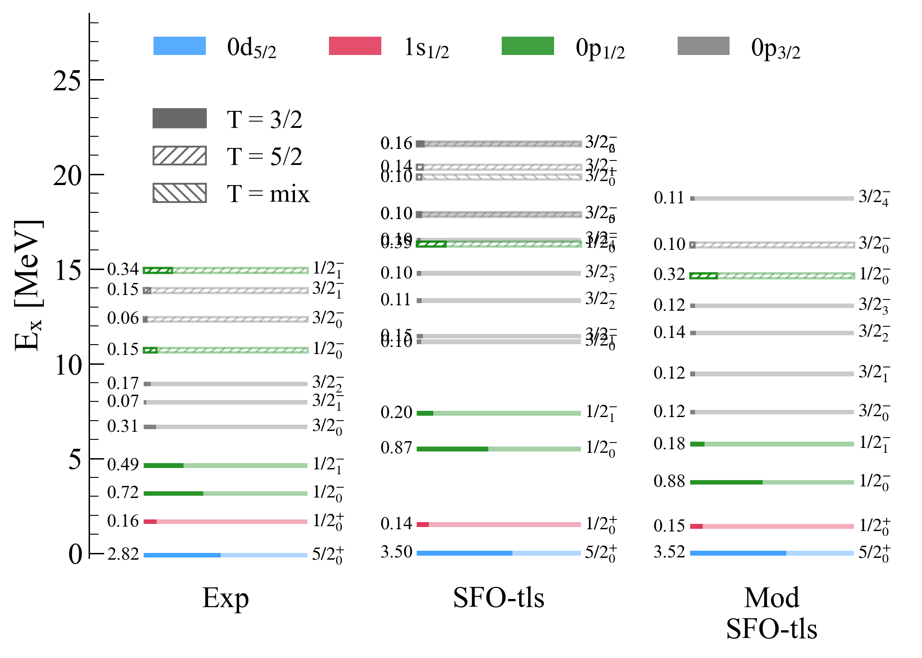
Results: comparison with models
SFO-tls interaction
T. Suzuki, T. Otsuka PRC 78 (2008)
For p-sd neutron-rich nuclei
Modified: reduced tensor νν and νπ monopole matrix el.
C²S reduced wrt SFO-tls
Great reproduction of low-lying states
0p_{3/2} less fragmented than predicted
How to accommodate T = 5/2? Bc SFo-tls predicts it a much higher Ex!!

Slide 14
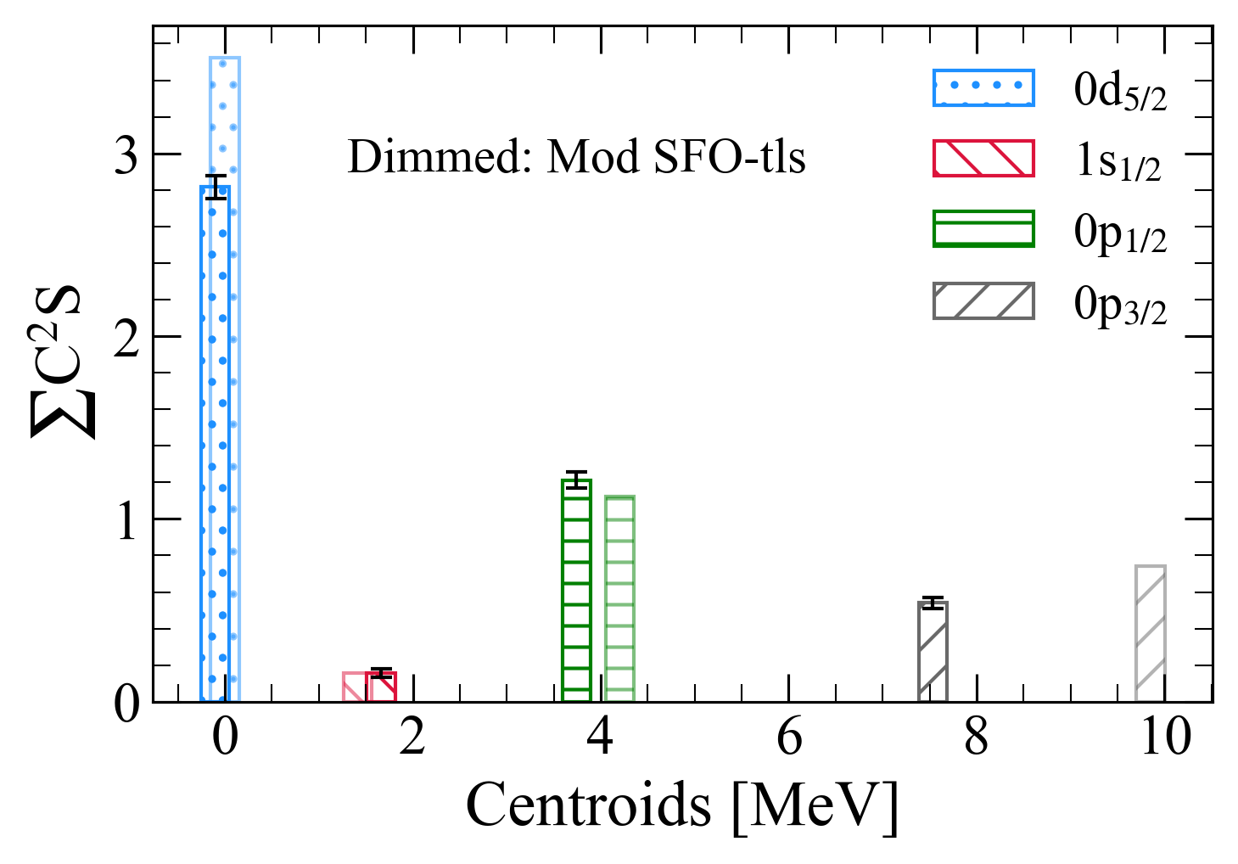
Results: centroids
Modified SFO-tls:
Excellent agreement for 0d_{5/2}, 1s_{1/2} and 0p_{1/2}
0p_{3/2} shifted towards high E_{x} and overestimated ∑C²S
With T=3/2 alone we reach really low strengths for 0p orbitals....
0p_{1/2} - 0p_{3/2} gap:
Exp: 3.79(9) MeV
Theo: 5.64 MeV
⇒ Gap is reduced by ~ 1.8 MeV!
No 0p vacancies were observed through ²⁰O(d,p)²¹O
B. Fernández-Domínguez et al. PRC 84 (2011)
No systematic errors on C2S have been included yet. Should we for the EuNPC? About 30% due to OMPs

Slide 15
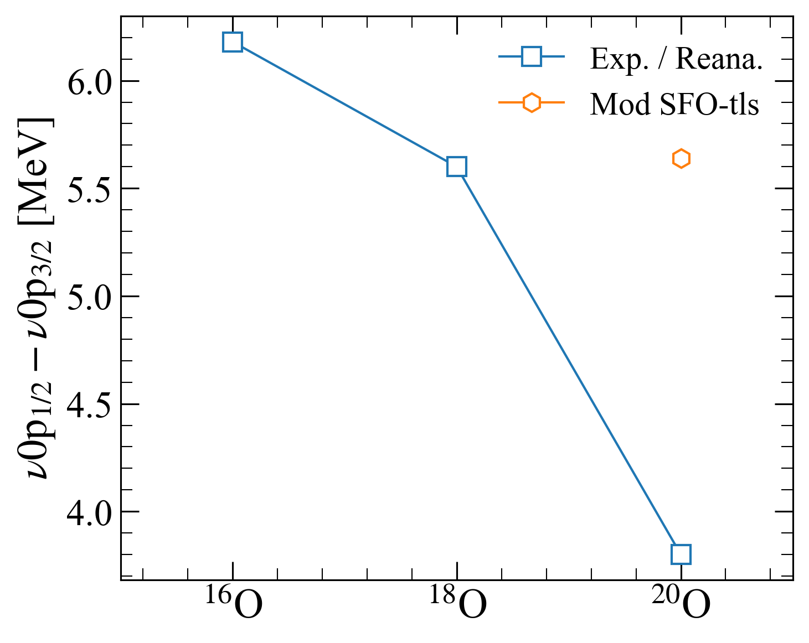
Results: gap evolution
¹⁶O(d,t): K. H. Purser et al. NPA 132 (1969). No need to reanalyze xs bc there is only one state per nlj; just take the Ex
¹⁶O(d,p): Alleged state 3/2- is not single-particle but j-forbidden stripping. See K. Hosono JPSP 25 (1968) Table II. This state is neutron 0d_{5/2} + proton 0p_{1/2}⁻¹0d_{5/2}¹ as I understood from it
¹⁸O(d,t): G. Mairle et al. NPA 280 (1977). Reanalysis of xs with our OMPs and Fresco. Major discrepancies with their paper
²⁰O(d,t): this experiment
We are lacking theo calculations for 16O and 18O

Slide 16
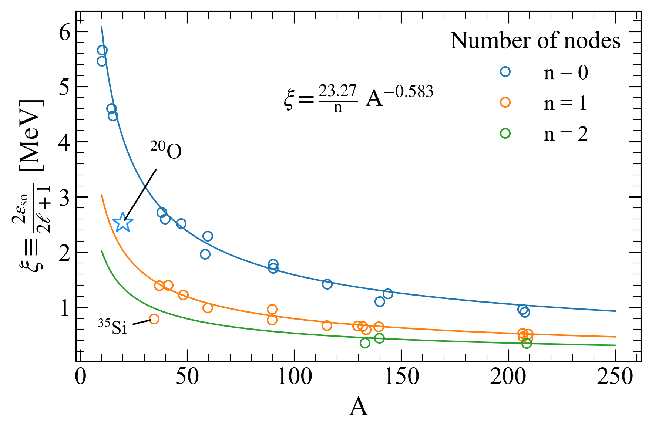
Conclusions
To be determined

Slide 17





Acknowledgements
Others pending of adding
T. Roger
J. Pancin
F. Saillant
G. Wittwer
V. Morel
Cassisa
J.C. Thomas
O. Sorlin
L. Cáceres
C. Stodel
F. de Oliveira
C. Nicole
J. Lois-Fuentes
B. Fernández-Domínguez
M. Caamaño
D. Fernández
D. Regueira
C. Cabo
H. Álvarez-Pol
Y. Ayyad
G. Mantovani
F. Delaunay
L. Achouri
J. Giovinnazzo
Ortega-Moral
S. Grevy
Q. Delignac
T. Kurtikian

Slide 18
Extra slides

Slide 19
A window to the analysis
1s_{1/2}
0d_{5/2}
N = 8
0p_{1/2}
0p_{3/2}
0s_{1/2}

Slide 20
Grazas!
Slide 3 of 3
Slide 3 of 3
Slide 3 of 3
Slide 3 of 3
Slide 3 of 3
Slide 3 of 3
Slide 3 of 3
Slide 3 of 3
Slide 3 of 3
Slide 3 of 3
Slide 3 of 3

