Slide 1
ν0p_{1/2} – ν0p_{3/2} spin-orbit splitting in ²⁰O
M. Lozano-González, B. Fernández-Domínguez, J. Lois-Fuentes,
T. Roger, F. Delaunay
IGFAE-USC, GANIL and LPC-Caen
EuNPC 2025 - Caen

Slide 2
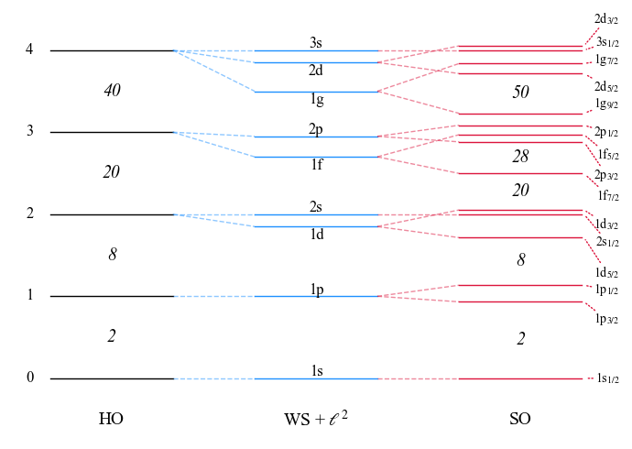

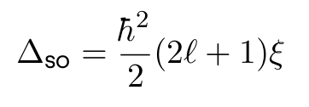
A recap on the SO splitting
Introduced by M. Goeppert-Mayer, reproduces magic numbers for stable nuclei.
SO splitting is mainly a surface effect:
which yields a l-depending gap:
⇒ Expected to evolve towards more exotic nuclei, where surface blurs

Slide 3
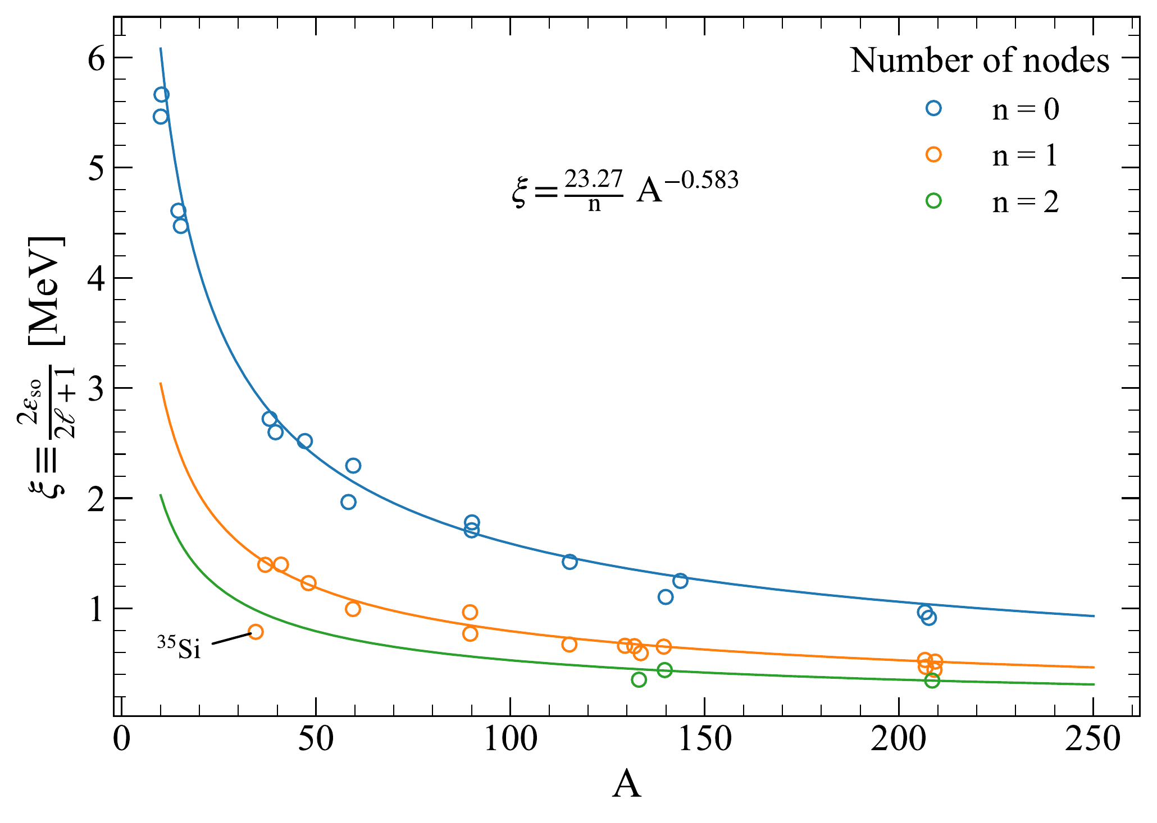
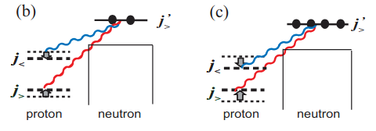
A recap on the SO splitting
G .Mairle et al. (PLB 304 (1993)) found systematic trends easily parametrizable.
Deviations from the trend are found due to:
Loosely bound orbitals
Nuclear matter depletion (³⁵Si?)
Role of tensor force
Proton-neutron interactions drive shell evolution

Slide 4
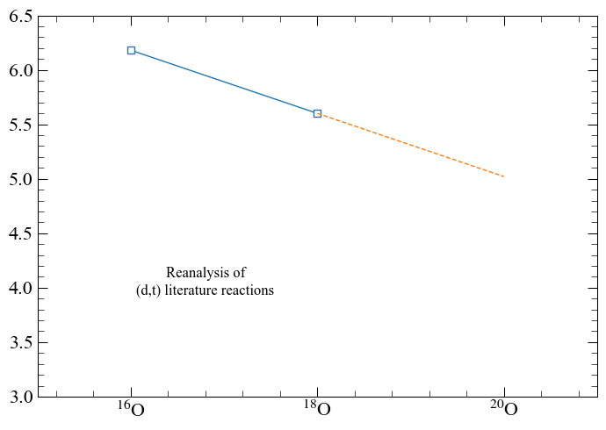
SO gap for Z = 8 isotopes
Evolution of the SO gap is plotted below for neutron-rich O isotopes.
Will ²⁰O follow the trend?
Could be determine the pn tensor contribution?

Slide 5
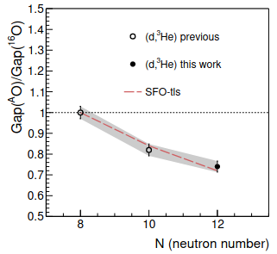
Physics case
E796 to measure transfer reactions probing single-particle occupancies in ²⁰O.
Proton removal ²⁰O(d,³He)¹⁹N to investigate persistence of Z = 6
1s_{1/2}
0d_{5/2}
j>,j<
Tensor V_{pn} reduces Z = 6 gap as neutrons are added to ν0d_{5/2}
N = 8
0p_{1/2}
j<,j<
0p_{3/2}
0s_{1/2}
Schematic view of tensor interaction in ²⁰O
J. Lois-Fuentes, PhD thesis (2023)

Slide 6
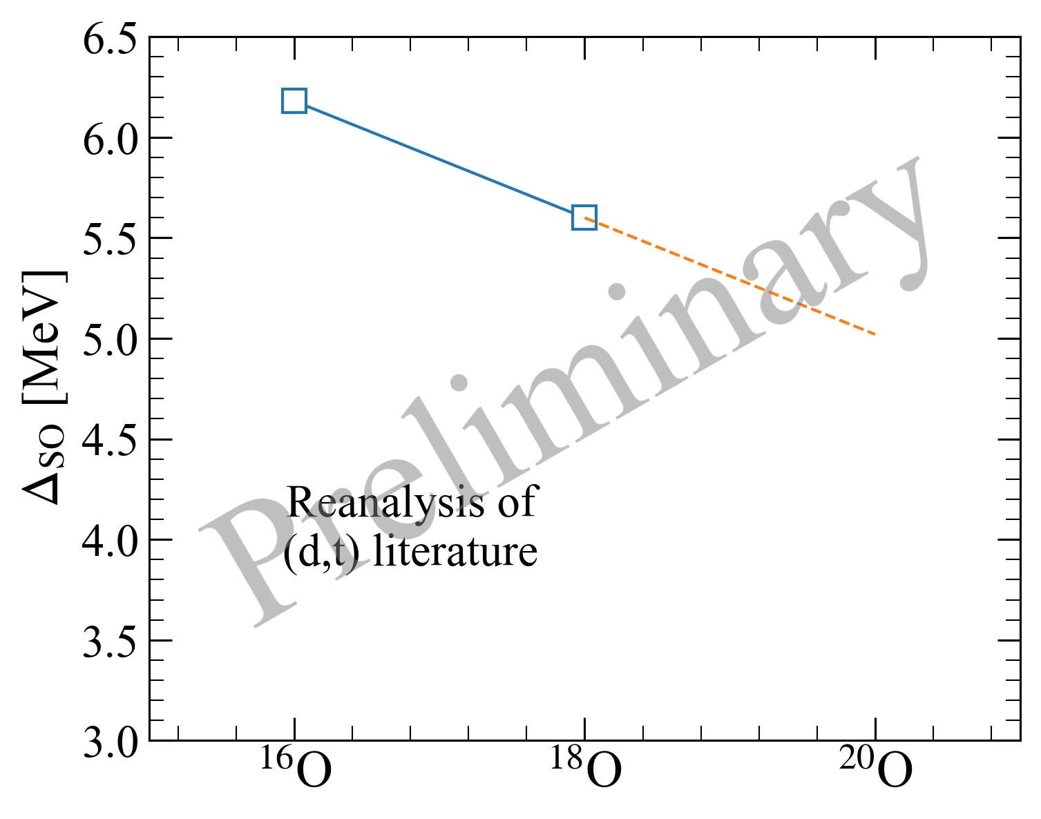
Physics case
E796 to measure transfer reactions probing single-particle occupancies in ²⁰O.
Neutron removal ²⁰O(d,t)¹⁹O to extract N = 6 SO gap
1s_{1/2}
0d_{5/2}
0p_{1/2}
Δ_{SO}
0p_{3/2}
0s_{1/2}
IPSM of ²⁰O
Reanalyis of previous data

Slide 7
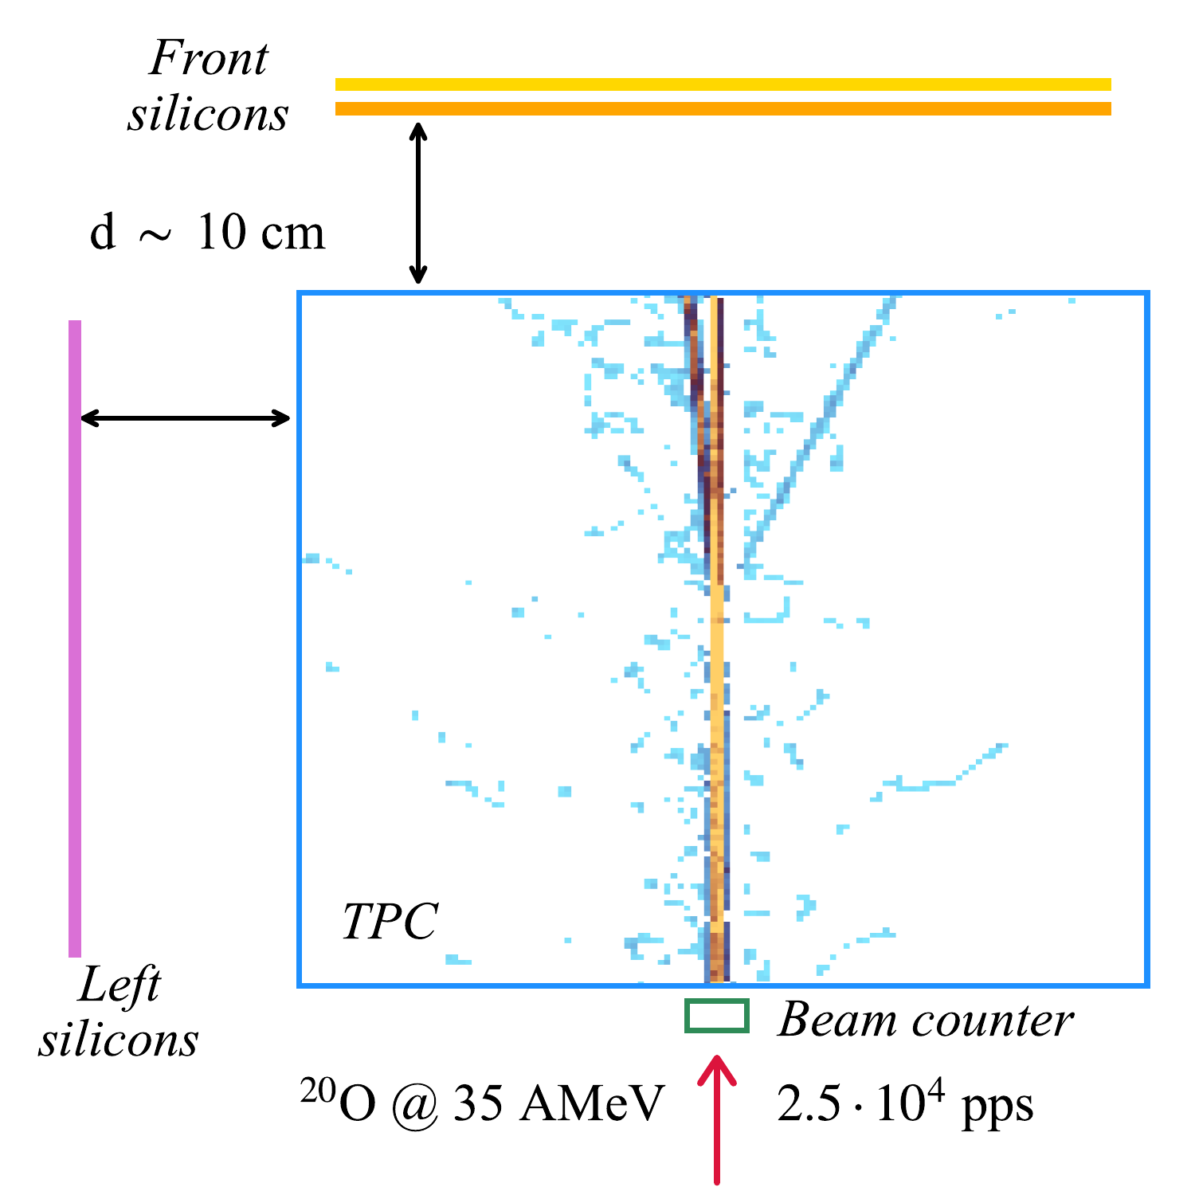
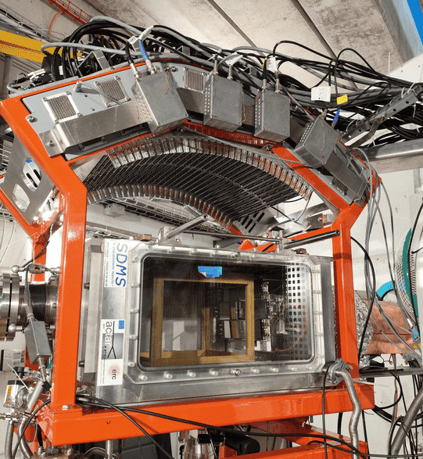
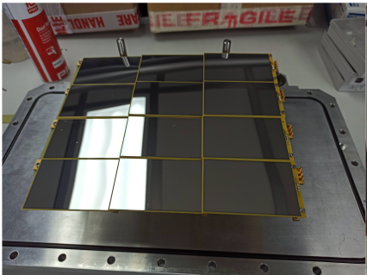
Experimental setup
E796 @ LISE in 2022. First transfer experiment with ACTAR TPC!
Silicon sizes:
80 x 50 x 0.5 mm³
Gas mixture:
90% D₂ + 10 % iC₄H₁₀
at 952 mbar

Slide 8
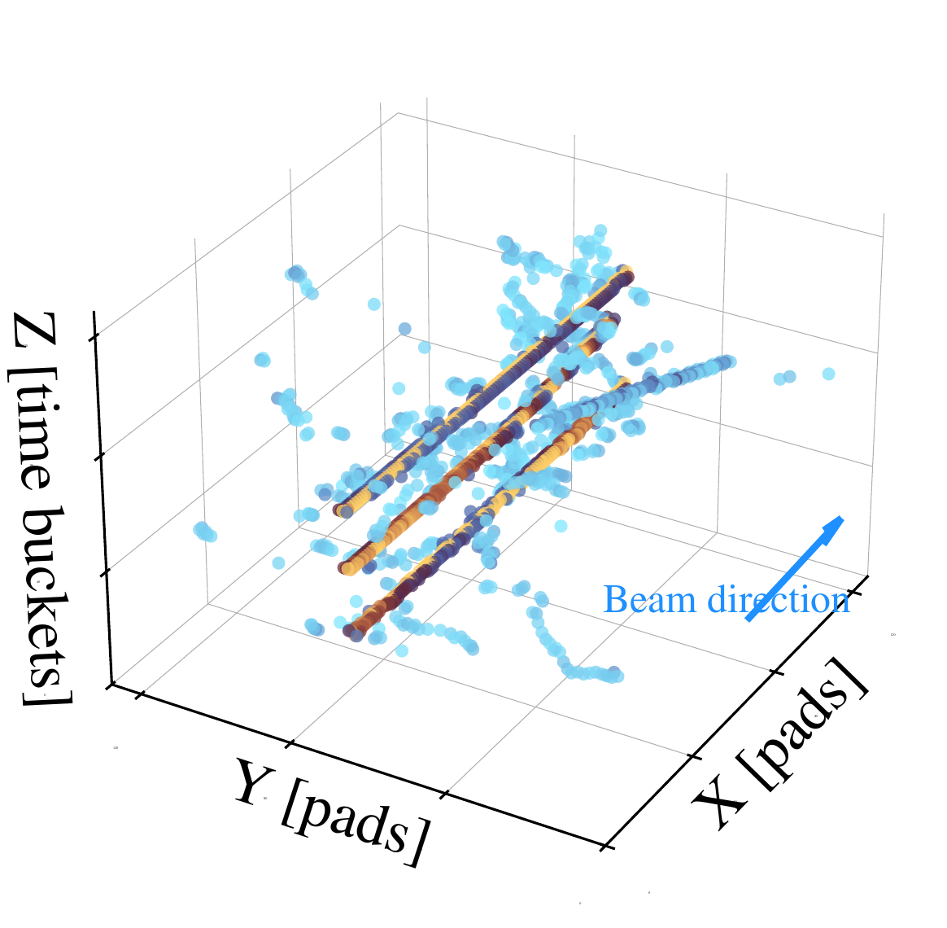
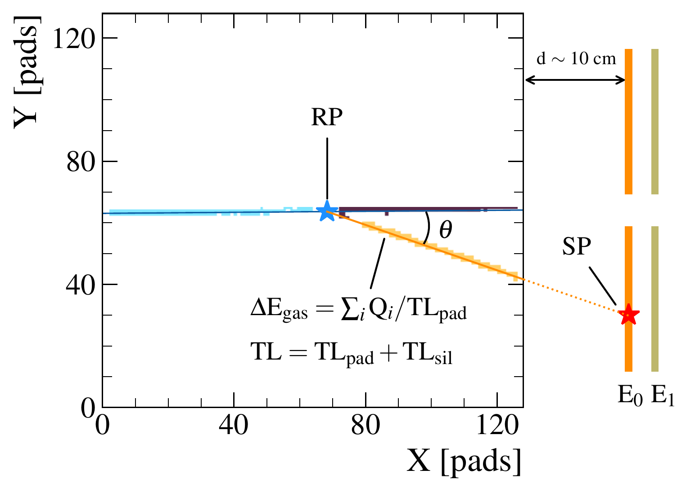
A window to the analysis
Intricate analysis to extract reactions of interest out of noisy data.
Unique advantages from the TPC:
Precise vertex determination
Improved ΔE corrections
Factor 10 in target number
Implicit PID with ΔE_{gas}

Slide 9
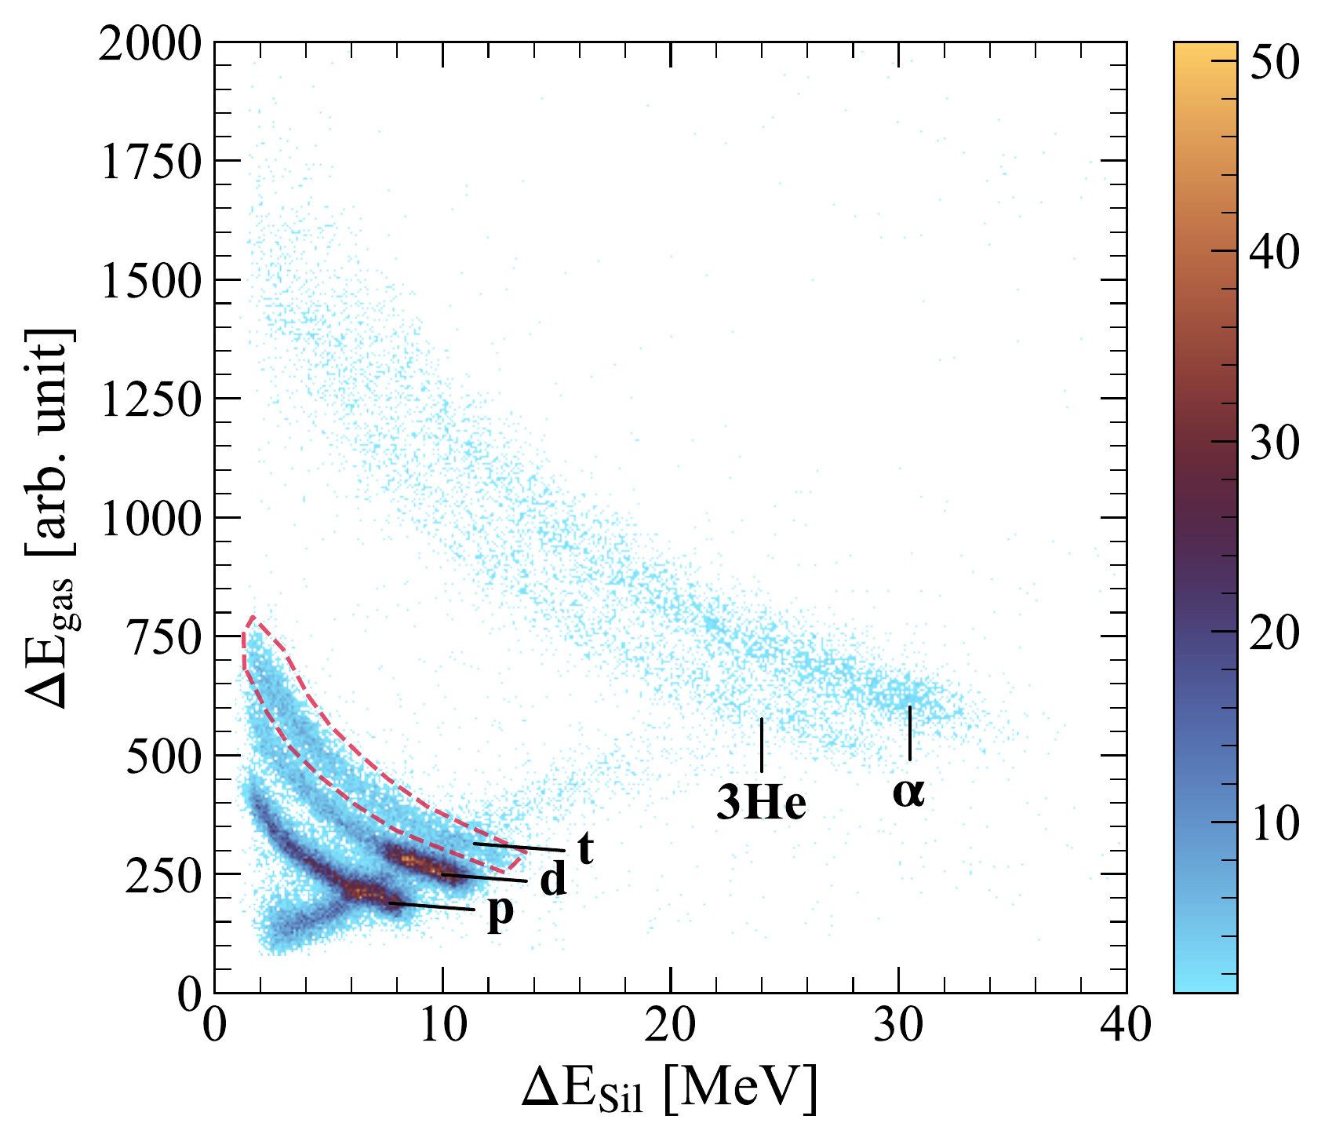
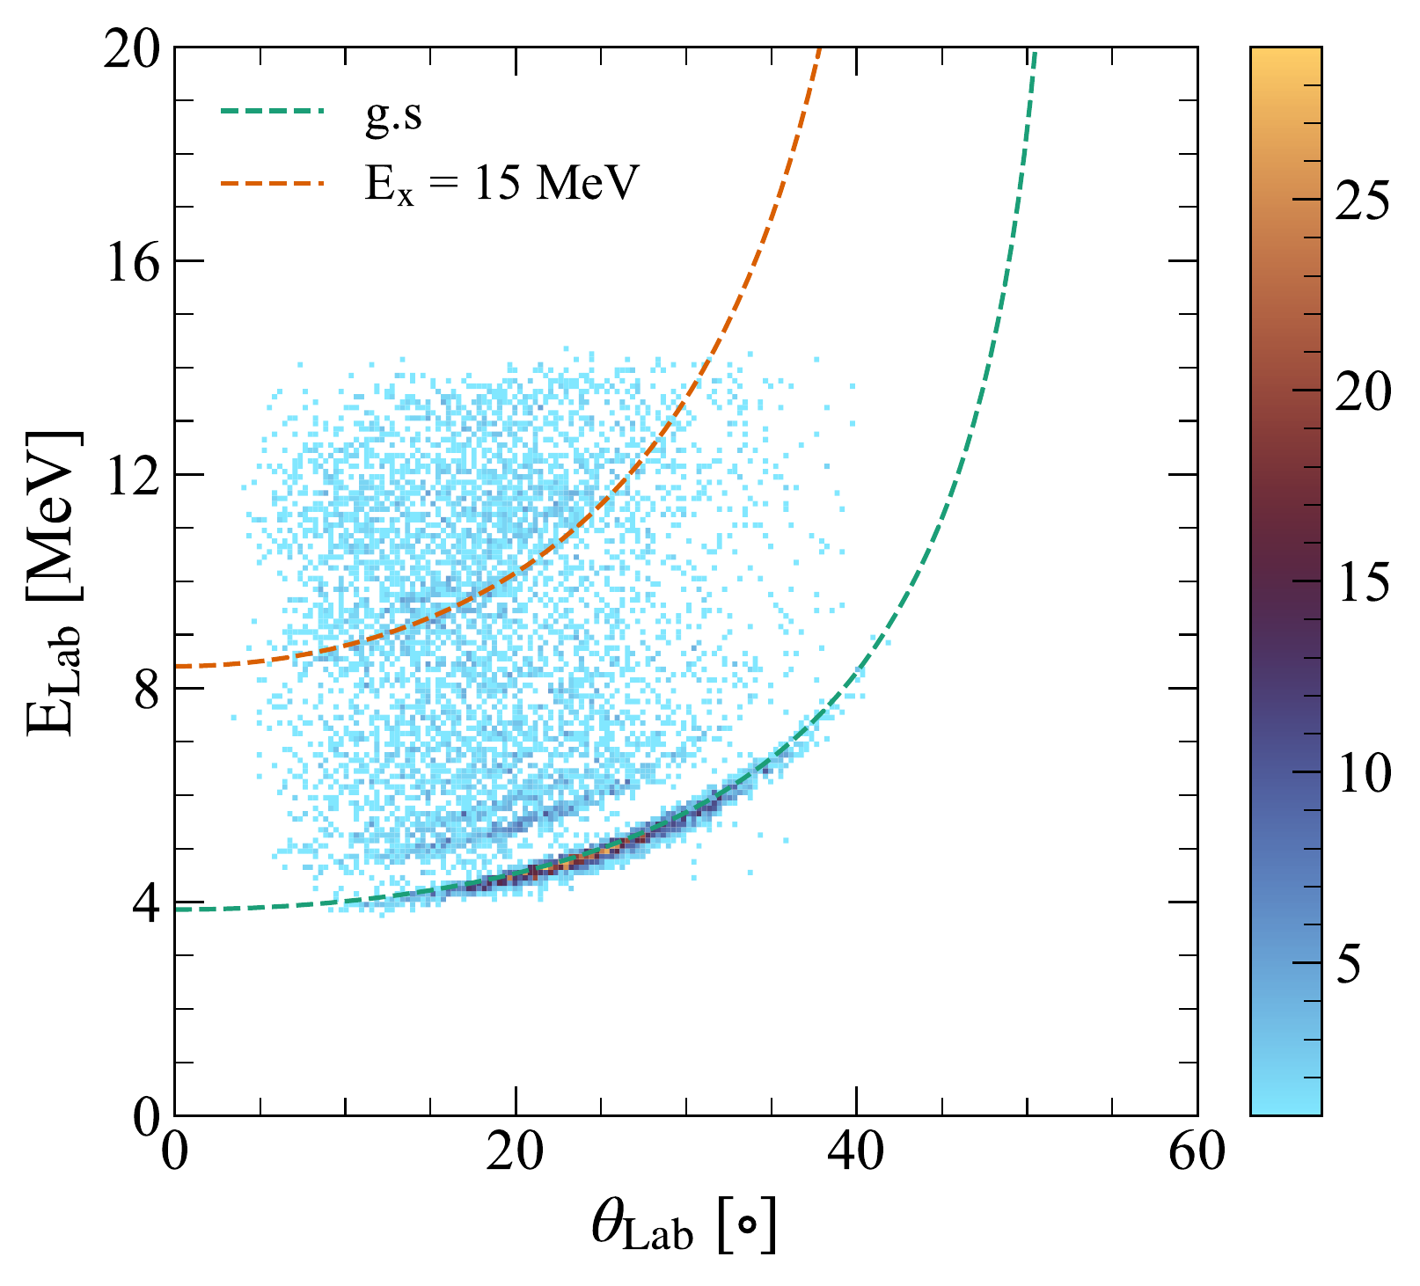
A window to the analysis
Two steps are needed after a binary reaction has been identified.
1. PID of tritons by plotting
ΔE_{gas}vs ΔE_{Sil}
2. E_{x} reconstructed by the missing-mass technique
Masked punch-through to 2nd front layer

Slide 10
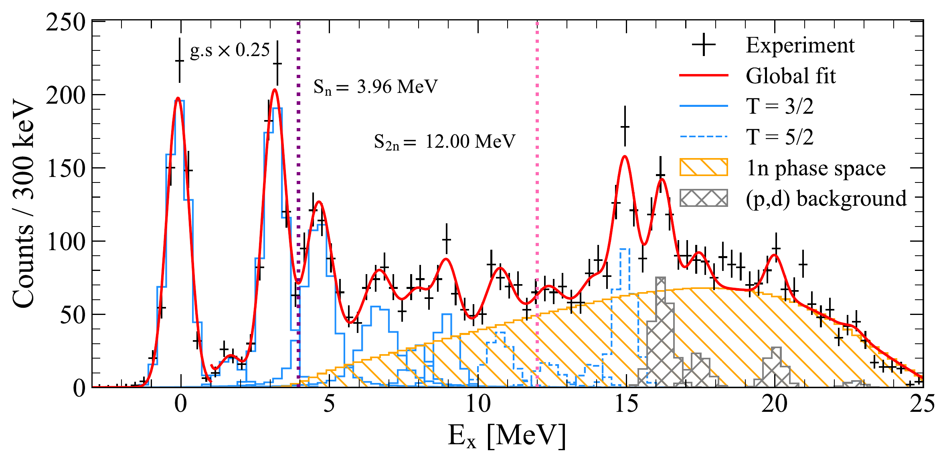
Results: E_{x} spectrum
Negligible 2n phase space contribution
11 observed states
At E_{x} > 15 MeV (p,d) contamination appears
Isospin T = 3/2 and 5/2
Assigned based on ²⁰O(d,³He)¹⁹N

Slide 11
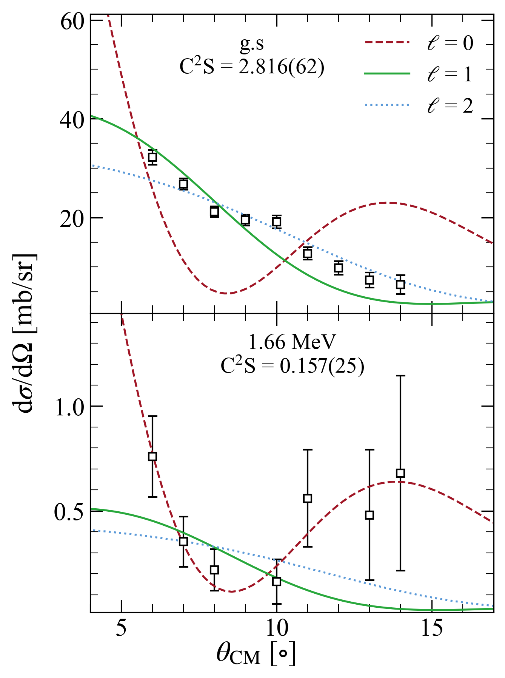

Results: cross-sections
DBWA with
OMP:
²⁰O + d: Daehnick
¹⁹O + t: Pang
d | t from ab-initio GFMC
²⁰O | ¹⁹O from standard WS
1s_{1/2}
0d_{5/2}
N = 8
1s_{1/2}
g.s: 5/2⁺, taking up 71% of the occupation
1st: 1/2⁺, with 8% of 1s_{1/2} occupancy
0d_{5/2}
N = 8

Slide 12
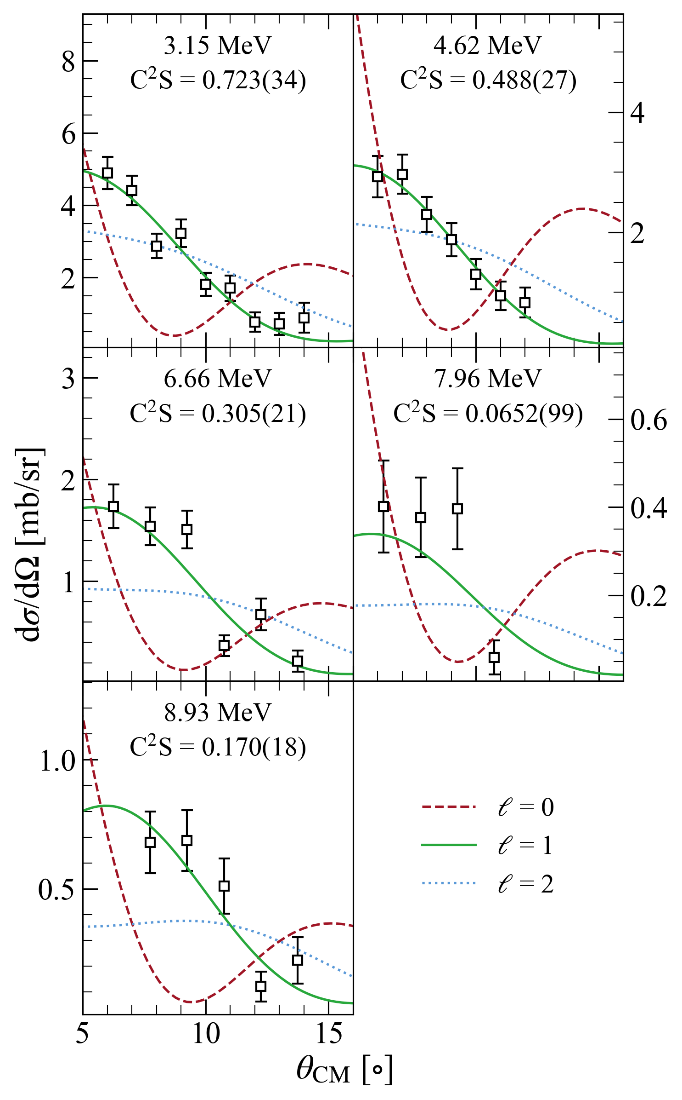
Results: cross-sections
Based on shell-model calculations (see next slide):
E_{x} = 3.1 and 4.6 MeV ⇒ 0p_{1/2}
E_{x} = 6.7, ..., 8.9 MeV ⇒ 0p_{3/2}
1s_{1/2}
0d_{5/2}
0p_{1/2}
T = 3/2 states:
0p_{1/2}: 61 % of strength
0p_{3/2}: just 14 % of occupancy!
0p_{3/2}
0s_{1/2}

Slide 13
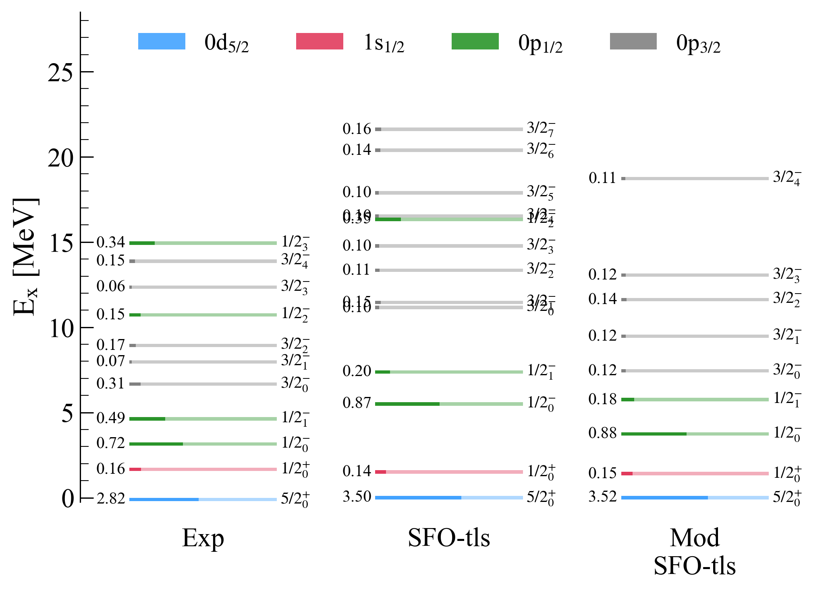
Results

Slide 14
A window to the analysis
1s_{1/2}
0d_{5/2}
N = 8
0p_{1/2}
0p_{3/2}
0s_{1/2}

Slide 15
Grazas!
Slide 3 of 3
Slide 3 of 3
Slide 3 of 3
Slide 3 of 3
Slide 3 of 3
Slide 3 of 3
Slide 3 of 3
Slide 3 of 3
Slide 3 of 3
Slide 3 of 3
Slide 3 of 3

