Slide 1
ν0p_{1/2} – ν0p_{3/2} spin-orbit splitting in ²⁰O
M. Lozano-González, B. Fernández-Domínguez, J. Lois-Fuentes,
T. Roger, F. Delaunay
IGFAE-USC, GANIL and LPC-Caen
EuNPC 2025 - Caen

Slide 2
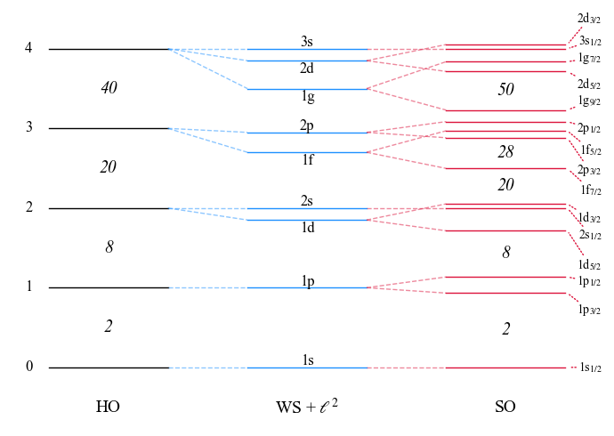

Recap: spin-orbit splitting
Introduced by M. Goeppert-Mayer, reproduces magic numbers for stable nuclei.
SO splitting is mainly a surface effect:
which yields a l-depending gap.
⇒ Expected to evolve towards more exotic nuclei, where surface blurs

Slide 3
Grazas!
Slide 3 of 3
Slide 3 of 3
Slide 3 of 3
Slide 3 of 3
Slide 3 of 3
Slide 3 of 3
Slide 3 of 3
Slide 3 of 3
Slide 3 of 3
Slide 3 of 3
Slide 3 of 3

