Slide 1
ν0p_{1/2} – ν0p_{3/2} spin-orbit splitting in ²⁰O
M. Lozano-González, B. Fernández-Domínguez, J. Lois-Fuentes,
T. Roger, F. Delaunay
IGFAE-USC, GANIL and LPC-Caen
EuNPC 2025 - Caen

Slide 2
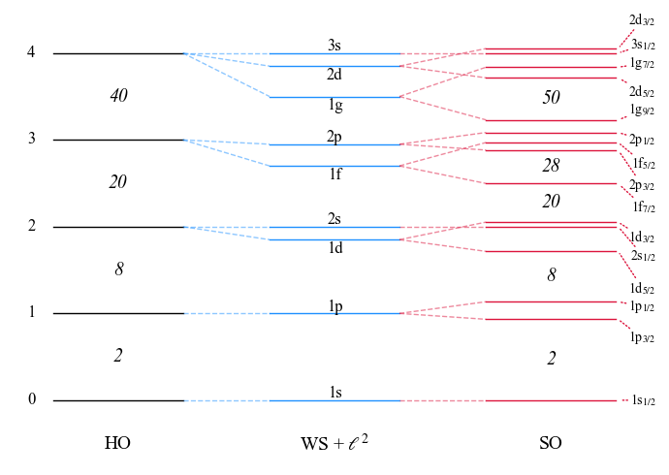

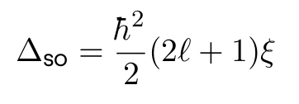
A recap on the SO splitting
Introduced by M. Goeppert-Mayer, reproduces magic numbers for stable nuclei.
SO splitting is mainly a surface effect:
which yields a l-depending gap:
⇒ Expected to evolve towards more exotic nuclei, where surface blurs

Slide 3
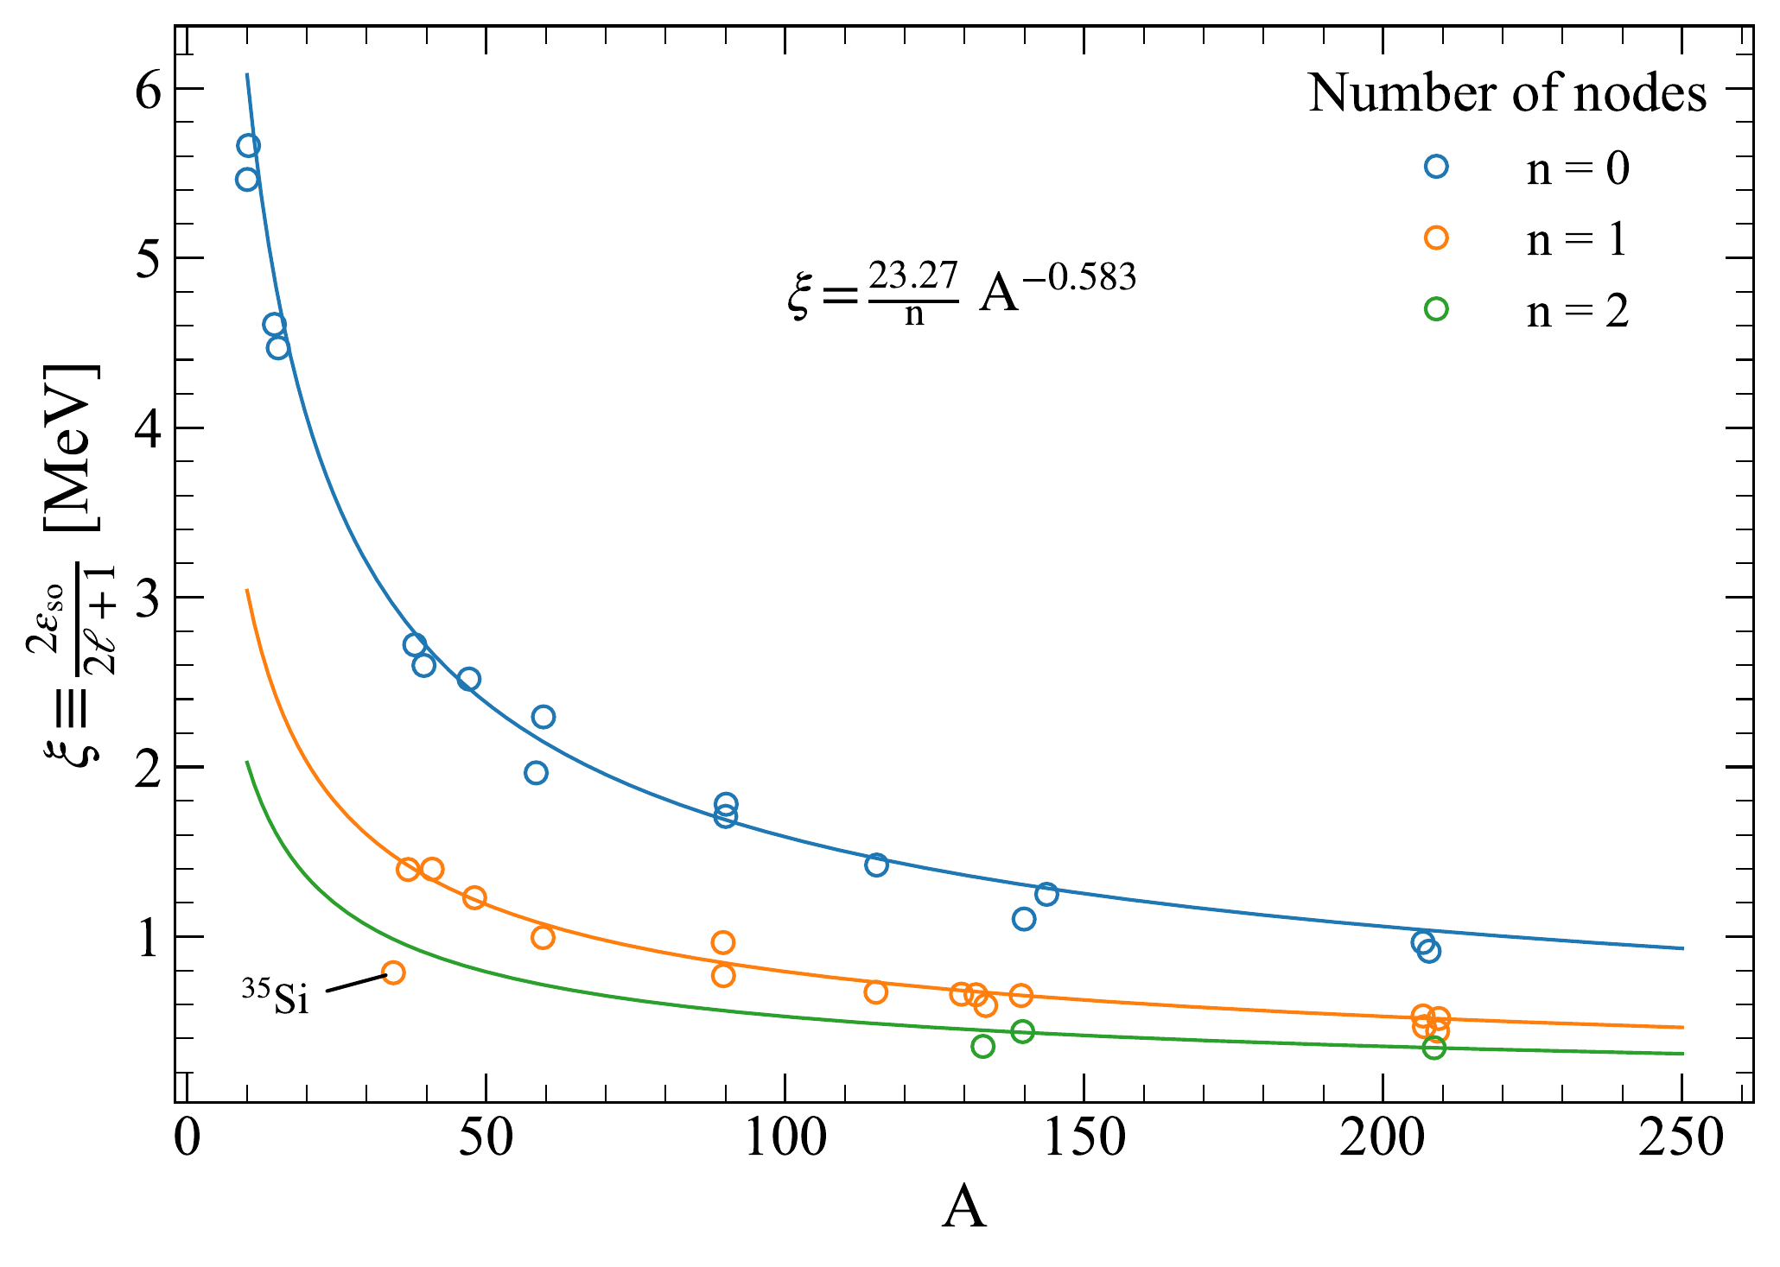
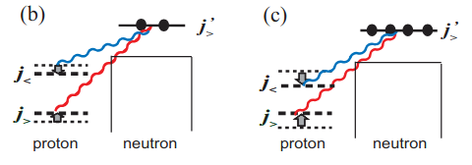
A recap on the SO splitting
G .Mairle et al. (PLB 304 (1993)) found systematic trends easily parametrizable.
Deviations from the trend are found due to:
Loosely bound orbitals
Nuclear matter depletion (³⁵Si)
Role of tensor force
Proton-neutron interactions drive shell evolution
T.Otsuka and Y. Tsunoda, JPG 43 (2016)

Slide 4
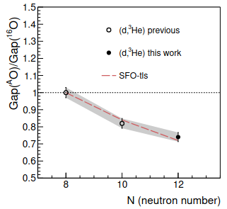
Physics case
E796 to measure transfer reactions probing single-particle occupancies in ²⁰O.
Proton removal ²⁰O(d,³He)¹⁹N to investigate persistence of Z = 6
1s_{1/2}
0d_{5/2}
j>,j<
Tensor V_{pn} reduces Z = 6 gap as neutrons are added to ν0d_{5/2}
N = 8
0p_{1/2}
j<,j<
0p_{3/2}
0s_{1/2}
Schematic view of tensor interaction in ²⁰O
J. Lois-Fuentes, PhD thesis (2023)

Slide 5
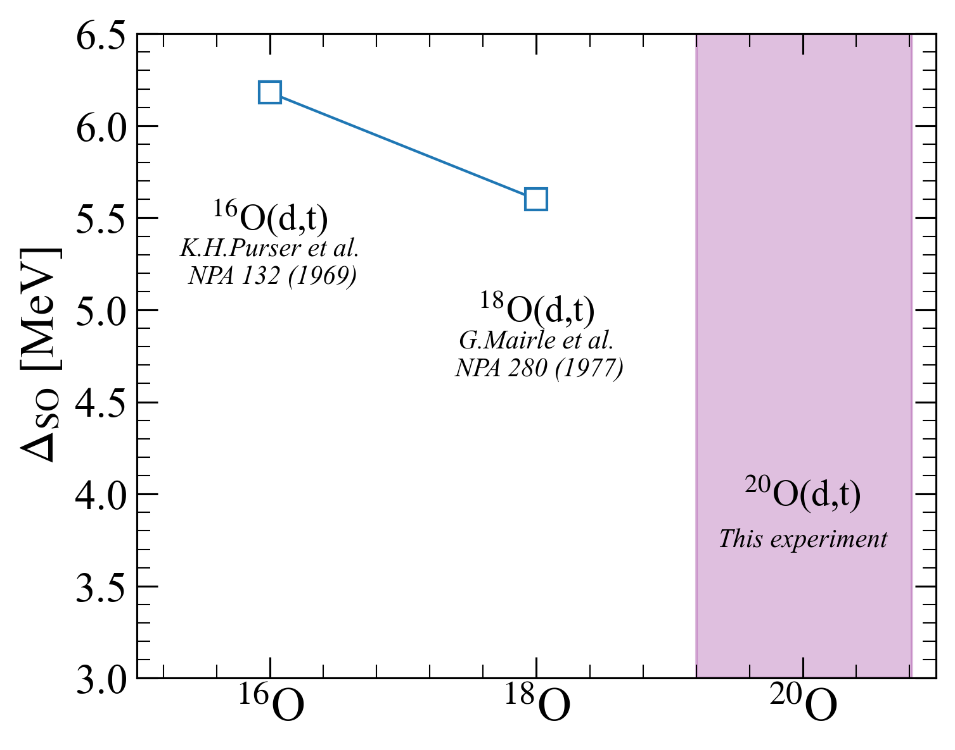
Physics case
E796 to measure transfer reactions probing single-particle occupancies in ²⁰O.
Neutron removal ²⁰O(d,t)¹⁹O to extract N = 6 SO gap
1s_{1/2}
Would the gap decrease in ²⁰O?
0d_{5/2}
0p_{1/2}
Δ_{SO}
Can we extract magnitude of tensor force?
0p_{3/2}
0s_{1/2}
IPSM of ²⁰O
Reanalyis of previous data

Slide 6
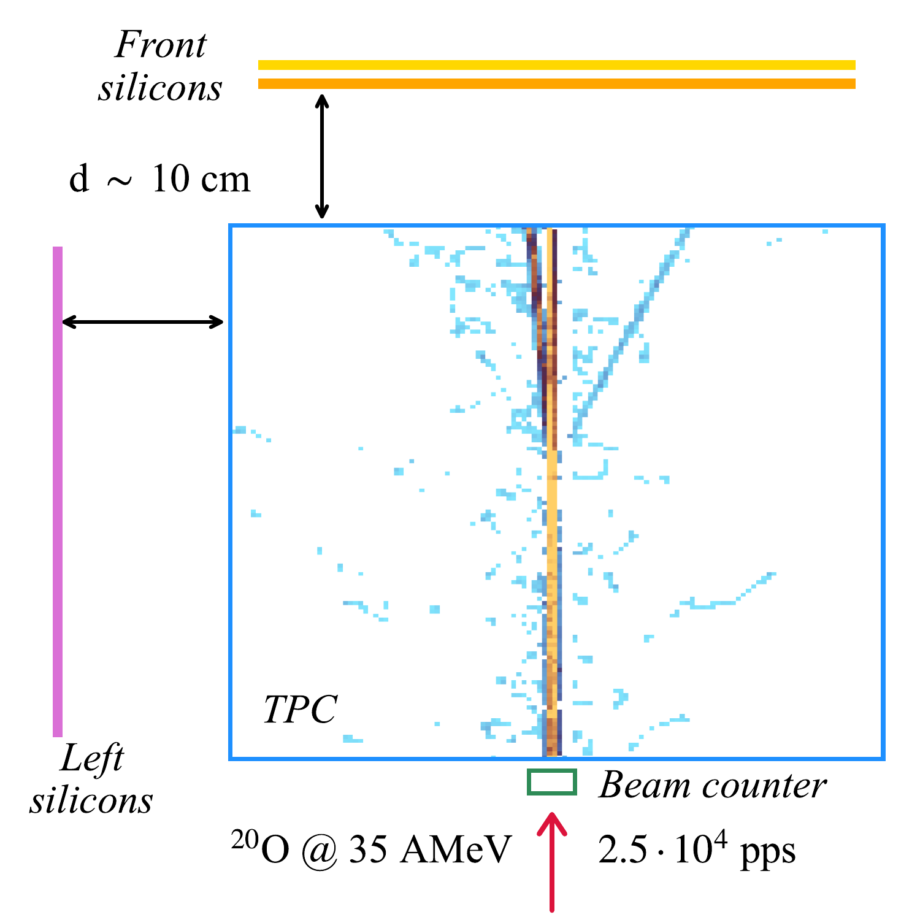
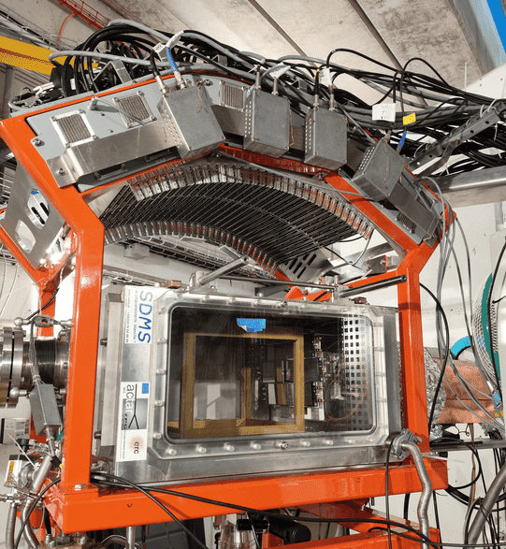
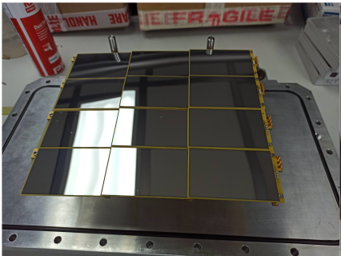
Experimental setup
E796 @ LISE in 2022. First transfer experiment with ACTAR TPC!
Silicon sizes:
80 x 50 x 0.5 mm³
Gas mixture:
90% D₂ + 10 % iC₄H₁₀
at 952 mbar

Slide 7
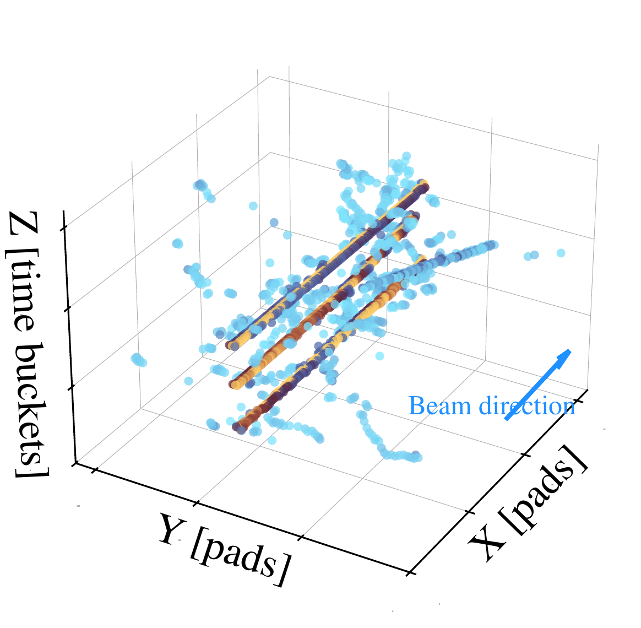
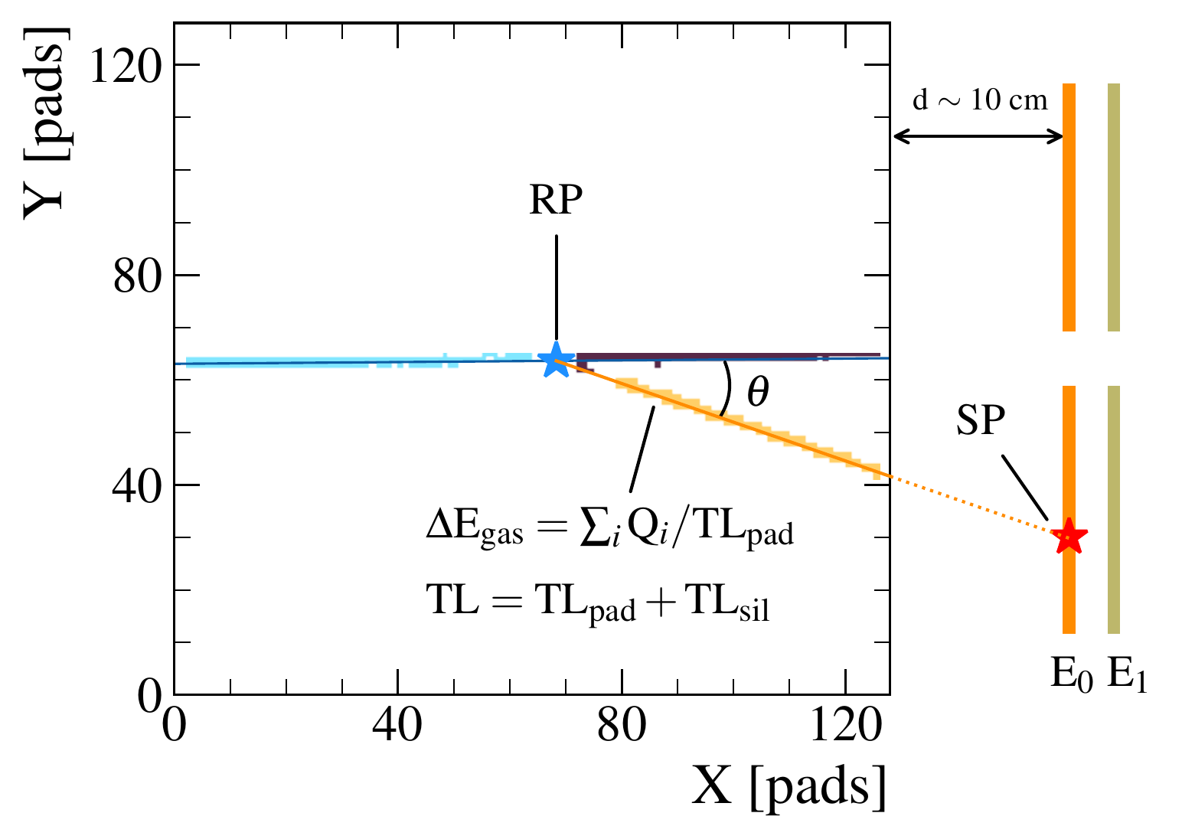
A window to the analysis
Intricate analysis to extract reactions of interest out of noisy data.
Unique advantages from the TPC:
Precise vertex determination
Improved ΔE corrections
Factor 10 in target number
Implicit PID with ΔE_{gas}

Slide 8
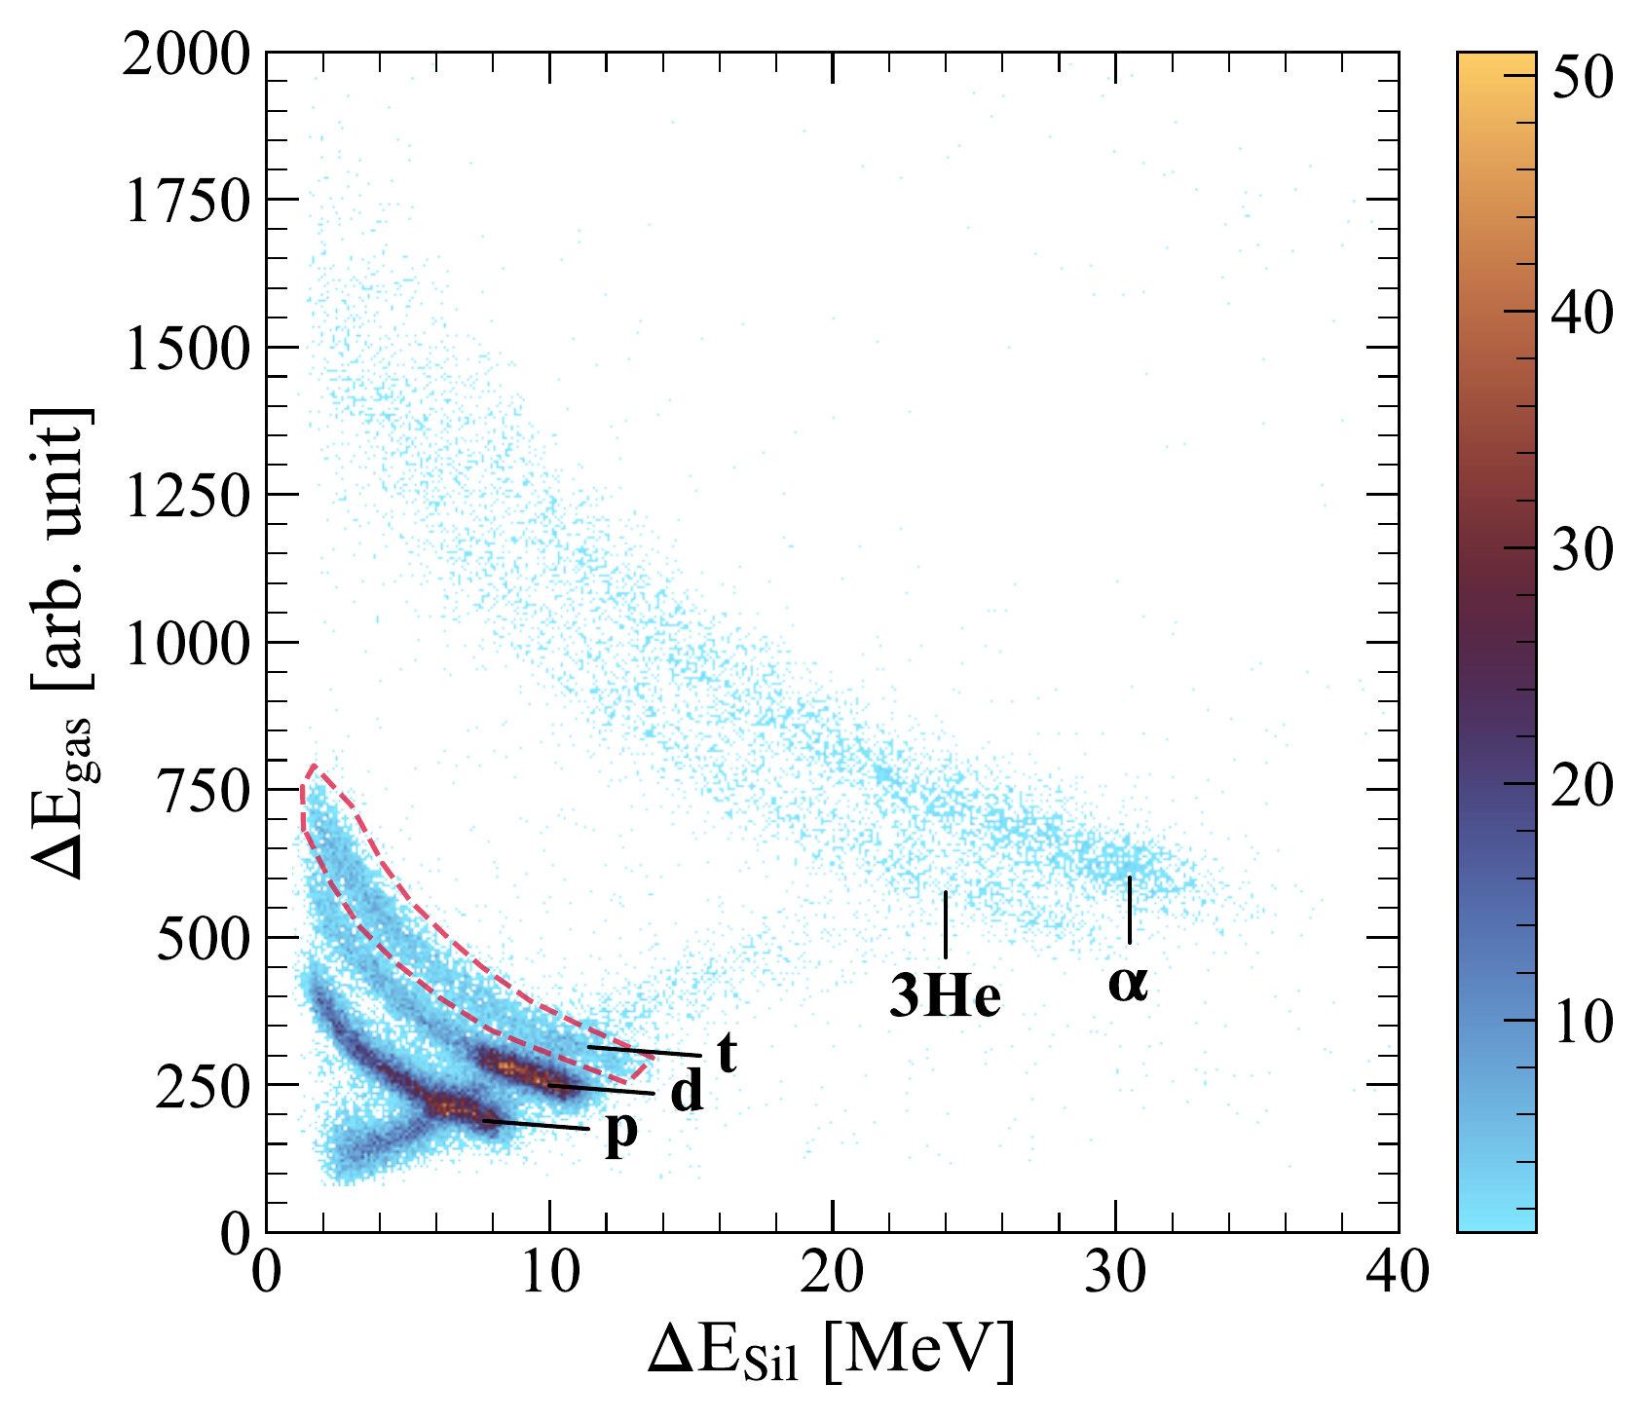
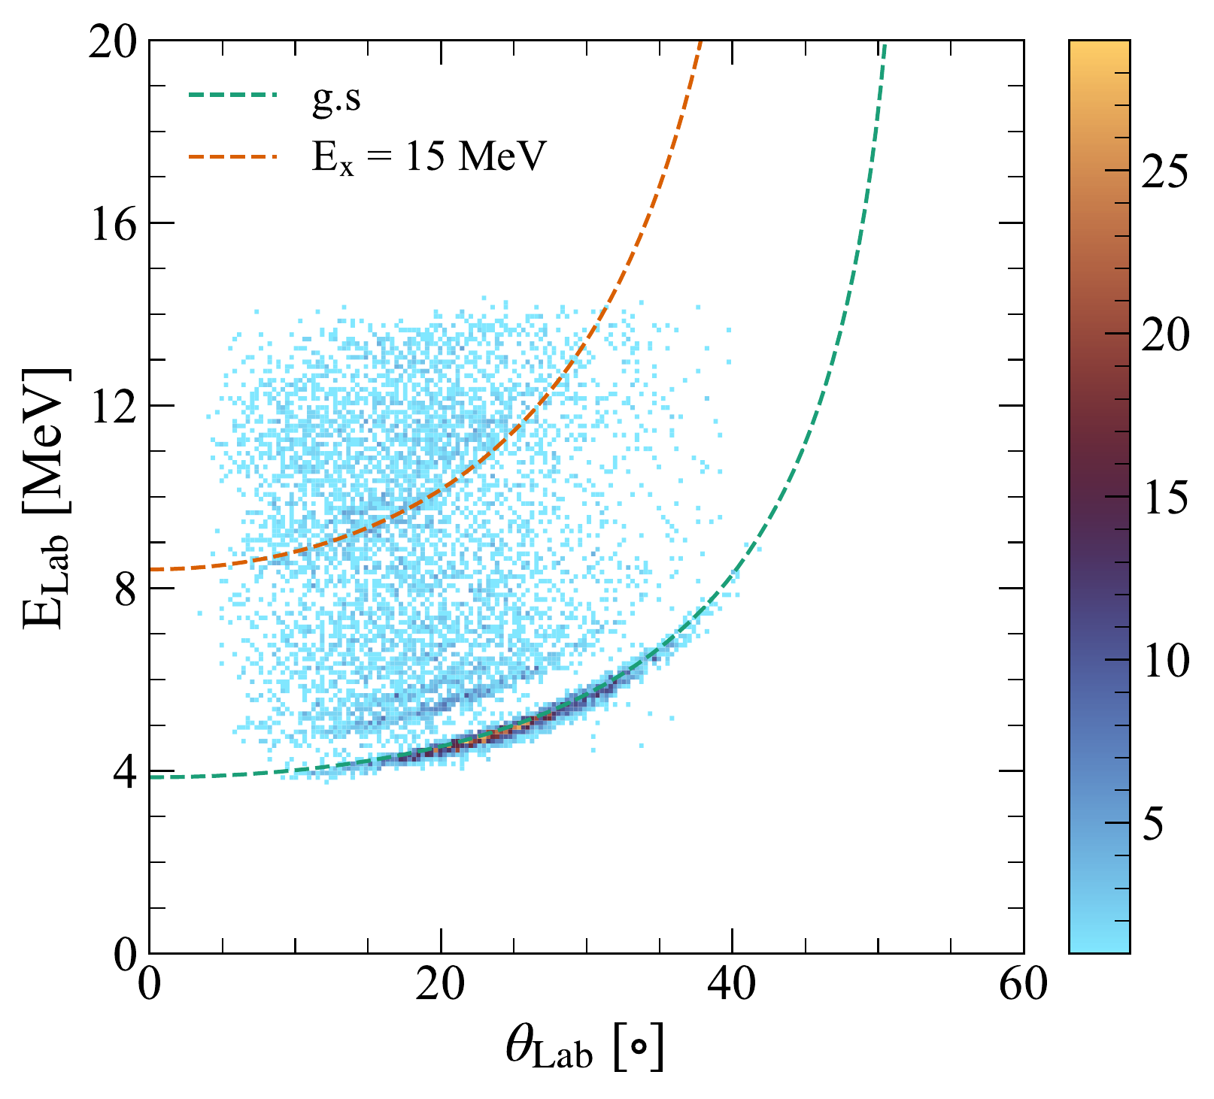
A window to the analysis
Two steps are needed after a binary reaction has been identified.
1. PID of tritons by plotting
ΔE_{gas}vs ΔE_{Sil}
2. E_{x} reconstructed by the missing-mass technique
Masked punch-through to 2nd front layer

Slide 9
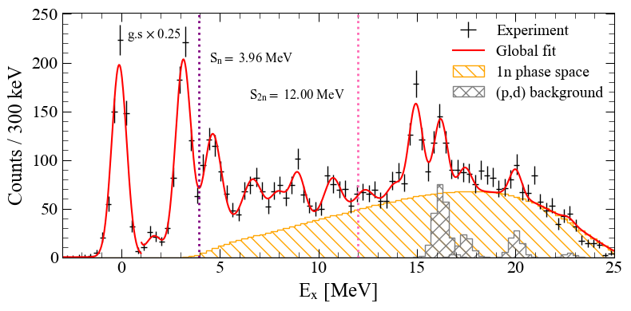
Results: E_{x} spectrum
11 observed states
At E_{x} > 15 MeV (p,d) contamination appears
1n phase space considered: ¹⁹O ⇒ ¹⁸O + n
2n phase space is negligible

Slide 10
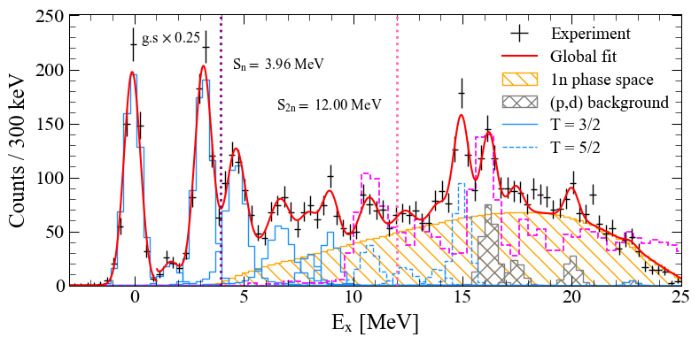
Results: E_{x} spectrum
T = 3/2 states @ E_{x} < 10 MeV
T = 5/2 at E_{x} > 10 MeV, based on comparison with ²⁰O(d,³He)¹⁹N

Slide 11
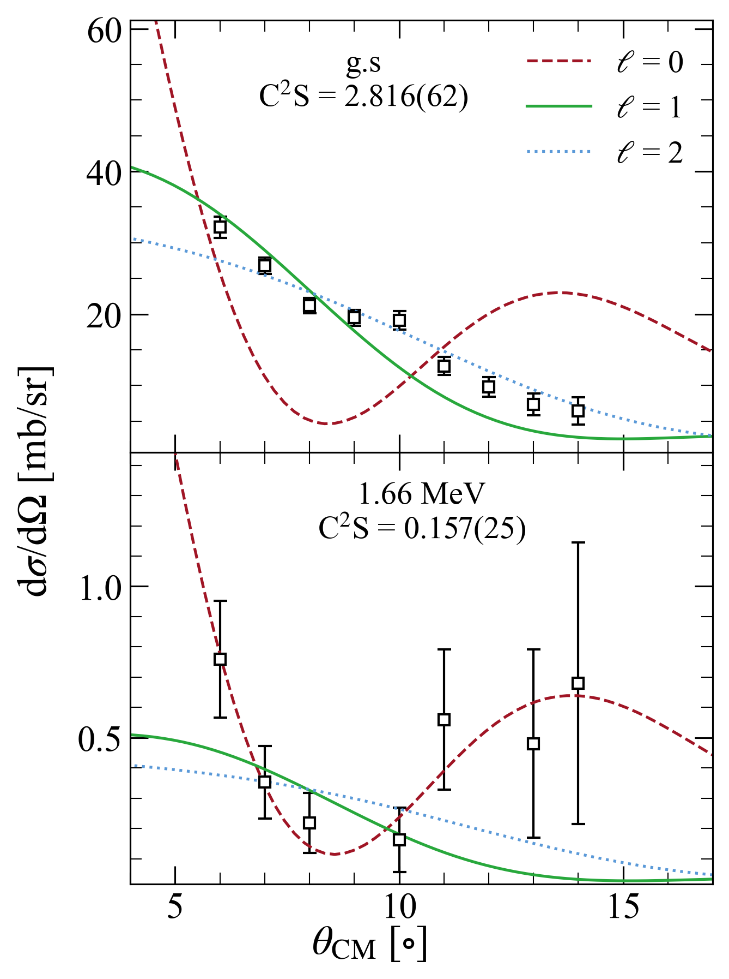

Results: cross-sections
DBWA with
OMP:
²⁰O + d: Daehnick
W. W. Daehnick et al. PRC 21 (1980)
¹⁹O + t: Pang
D.Y. Pang et al. PRC 79 (2009)
d | t from ab-initio GFMC
I. Brida et al., PRC 84 (2011)
²⁰O | ¹⁹O from standard WS
1s_{1/2}
0d_{5/2}
N = 8
1s_{1/2}
0d_{5/2}
N = 8
g.s: 5/2⁺, taking up 71% of the occupation
1st: 1/2⁺, with 8% of 1s_{1/2} occupancy

Slide 12
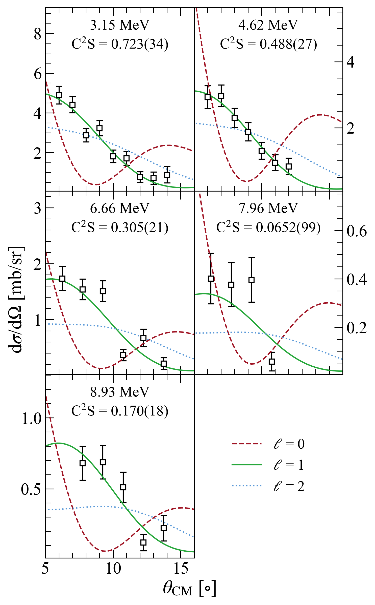
Results: cross-sections
Based on shell-model calculations (see next slide):
E_{x} = 3.1 and 4.6 MeV ⇒ 0p_{1/2}
E_{x} = 6.7, ..., 8.9 MeV ⇒ 0p_{3/2}
1s_{1/2}
0d_{5/2}
0p_{1/2}
T = 3/2 states:
0p_{1/2}: 61 % of strength
0p_{3/2}: just 14 % of occupancy!
0p_{3/2}
0s_{1/2}

Slide 13
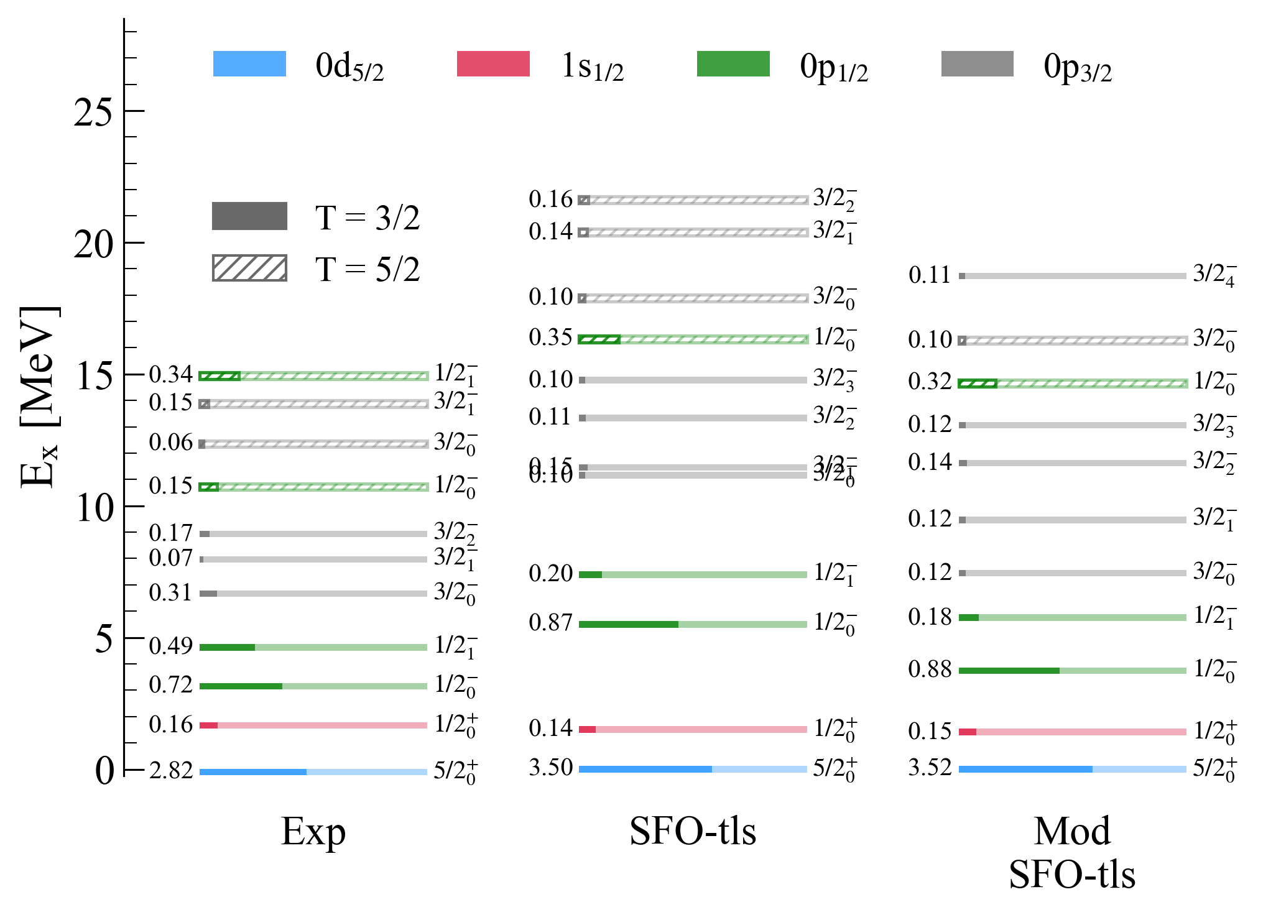
Results: comparison with models
SFO-tls interaction
T. Suzuki, T. Otsuka PRC 78 (2008)
For p-sd neutron-rich nuclei
Modified: reduced tensor νν and νπ monopole matrix el.
C²S reduced wrt SFO-tls
Great reproduction of low-lying states
0p_{3/2} less fragmented than predicted

Slide 14
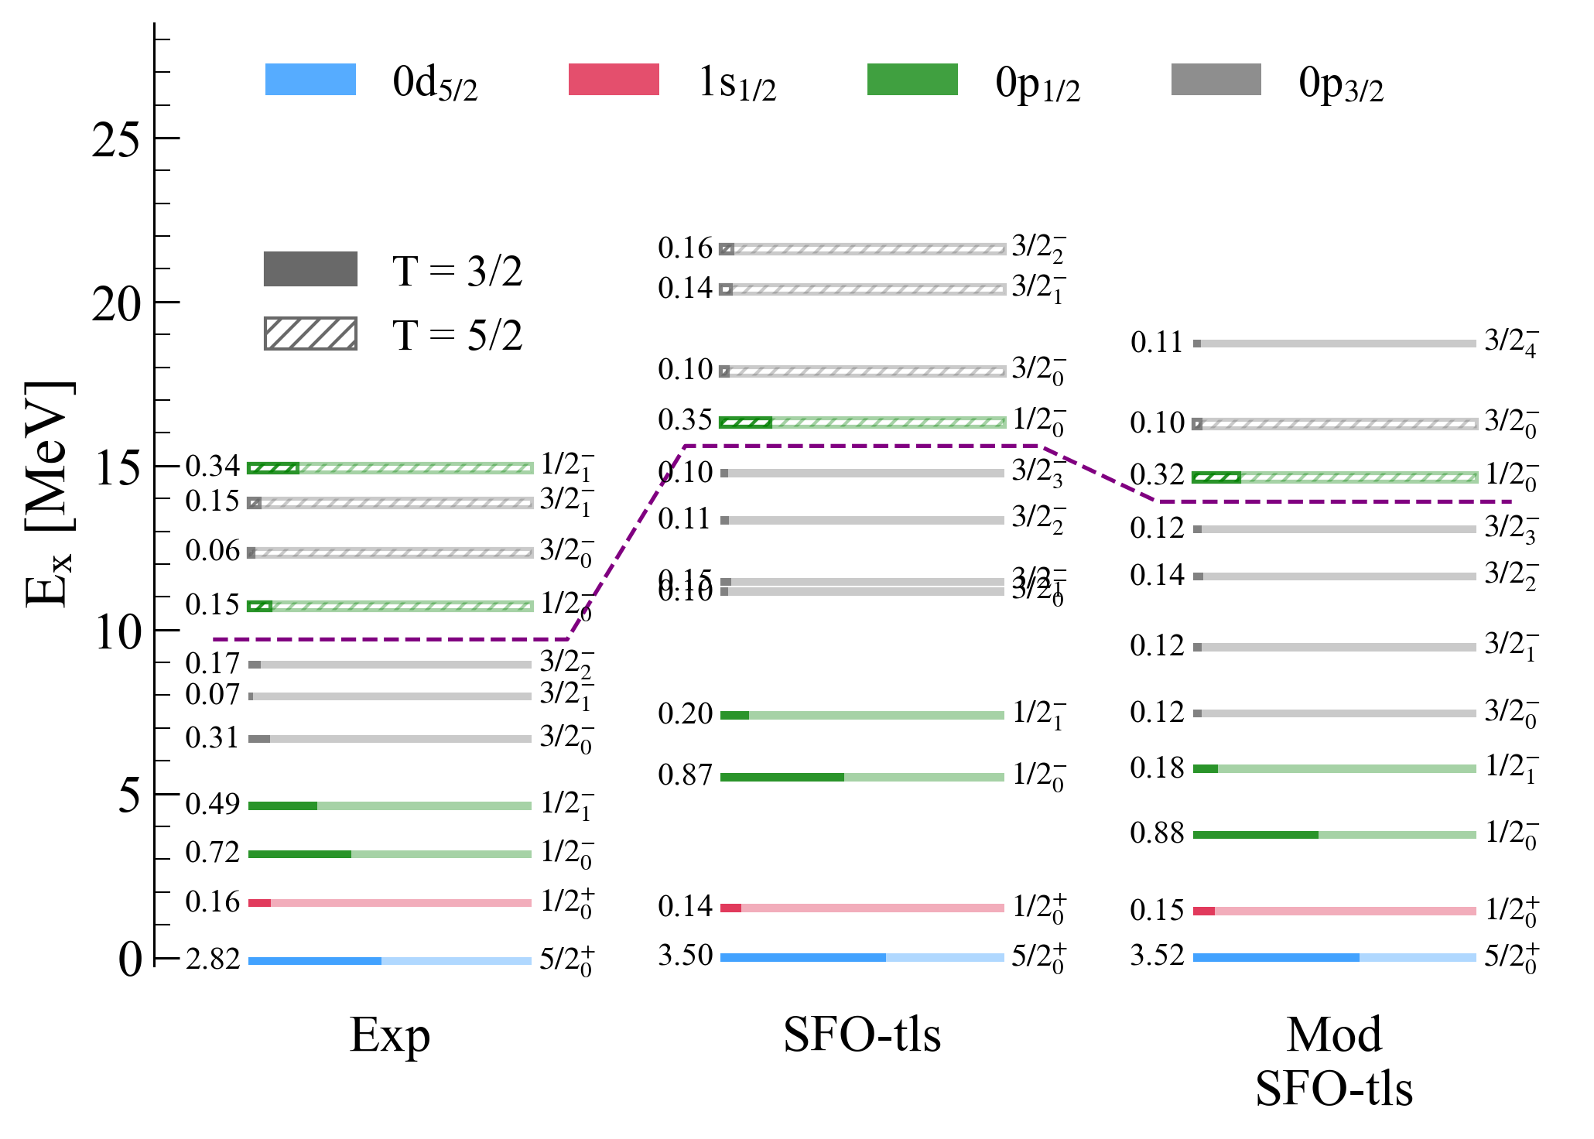
Results: comparison with models
SFO-tls interaction
T. Suzuki, T. Otsuka PRC 78 (2008)
For p-sd neutron-rich nuclei
Modified: reduced tensor νν and νπ monopole matrix el.
C²S reduced wrt SFO-tls
Great reproduction of low-lying states
0p_{3/2} less fragmented than predicted
T = 3/2 0p_{3/2} predicted at much higher E_{x}

Slide 15
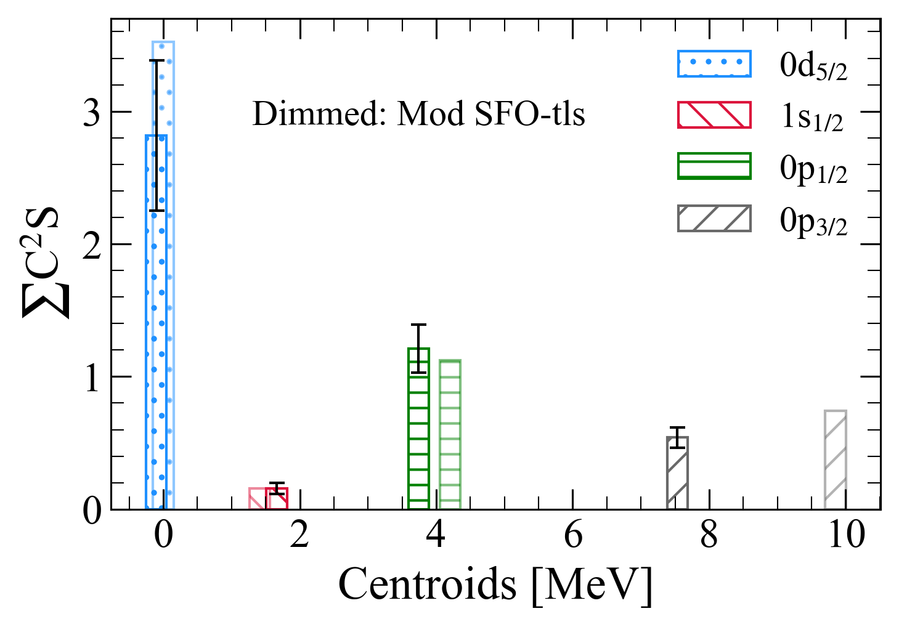
Results: centroids
Modified SFO-tls:
Excellent agreement for 0d_{5/2}, 1s_{1/2} and 0p_{1/2}
0p_{3/2} shifted towards high E_{x}
0p_{1/2} - 0p_{3/2} SO gap:
Exp: 3.79(9) MeV
Theo: 5.64 MeV
⇒ Gap is reduced by ~ 1.8 MeV!
No 0p vacancies were observed through ²⁰O(d,p)²¹O
B. Fernández-Domínguez et al. PRC 84 (2011)
Systematic error of 20% from OMPs variety has been included in error bars

Slide 16
Conclusions
²⁰O(d,t)¹⁹O reaction as a means to measure SO gap in exotic O isotopes
DWBA analysis to extract spectroscopic factors and E_{x} centroids for T=3/2 states
Comparison with SFO-tls interaction overestimates SO gap due to 0p_{3/2} states
Theoretical efforts needed to reconcile those states with experimental data!

Slide 17









Acknowledgements
T. Roger
J. Pancin
M. Fisichella
C. Nicole
F. Saillant
G. Wittwer
V. Morel
Cassisa
J.C. Thomas
O. Sorlin
L. Cáceres
C. Stodel
F. de Oliveira
J. Lois-Fuentes
B. Fernández-Domínguez
M. Caamaño
D. Fernández
D. Regueira
C. Cabo
H. Álvarez-Pol
Y. Ayyad
G. Mantovani
F. Delaunay
L. Achouri
R. Raabe
O. Poleschuk
Ceuleman
S. Fracassetti
M. Latif
D. Suzuki
B. Mauss
J. Giovinnazzo
Ortega-Moral
S. Grevy
Q. Delignac
T. Kurtikian
M. Pellegretti
T. Marchi
M. Martínez
J. Dueñas

Slide 18
Extra slides

Slide 19
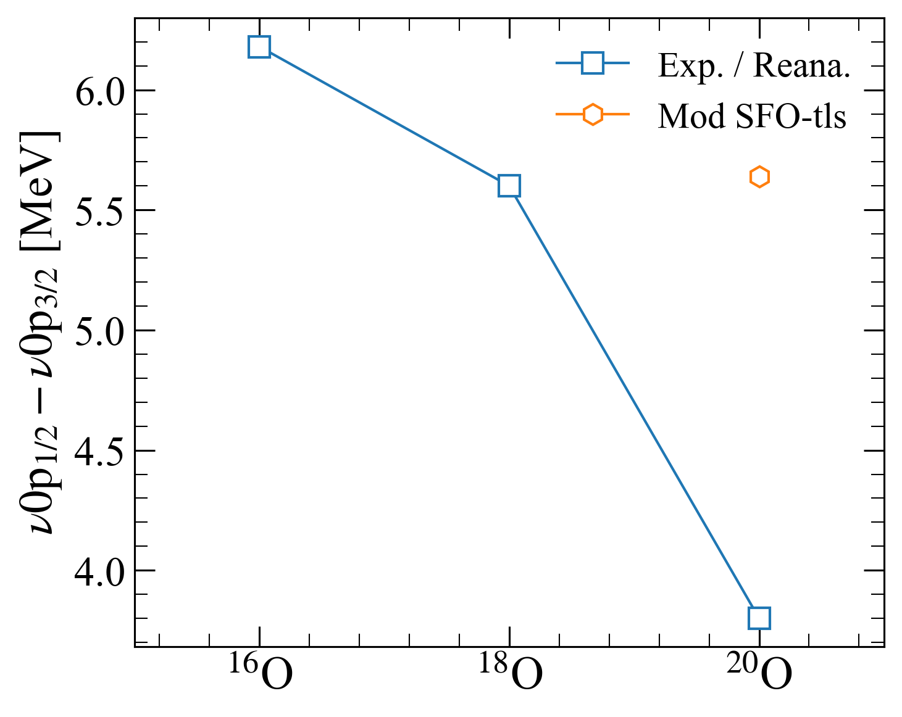
Results: gap evolution
¹⁶O(d,t): K. H. Purser et al. NPA 132 (1969). No need to reanalyze xs bc there is only one state per nlj; just take the Ex
¹⁶O(d,p): Alleged state 3/2- is not single-particle but j-forbidden stripping. See K. Hosono JPSP 25 (1968) Table II. This state is neutron 0d_{5/2} + proton 0p_{1/2}⁻¹0d_{5/2}¹ as I understood from it
¹⁸O(d,t): G. Mairle et al. NPA 280 (1977). Reanalysis of xs with our OMPs and Fresco. Major discrepancies with their paper
²⁰O(d,t): this experiment
We are lacking theo calculations for 16O and 18O

Slide 20
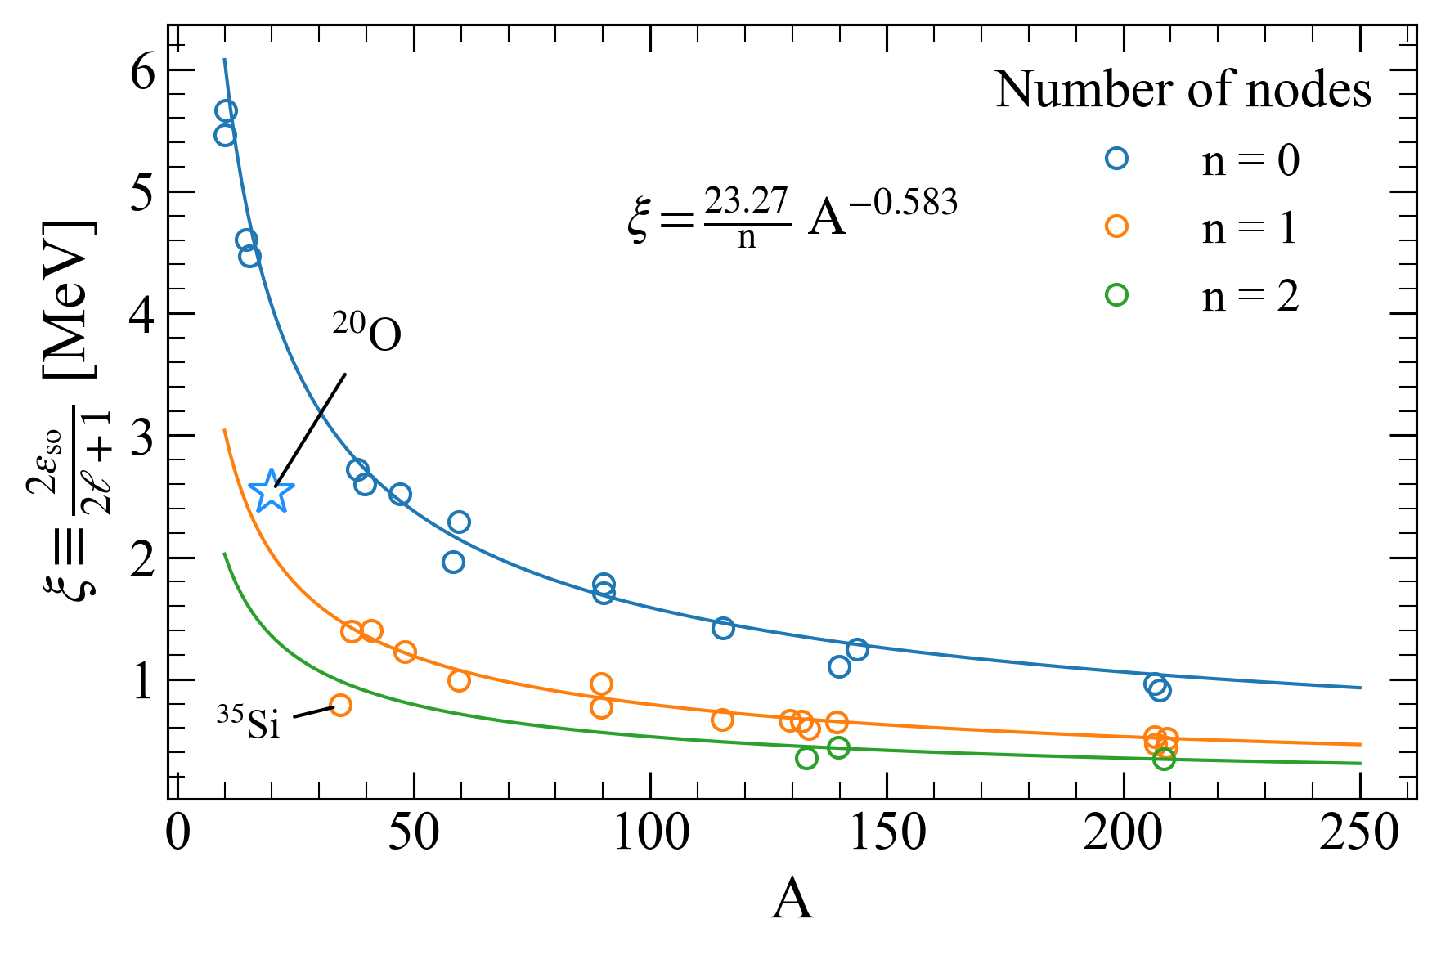
Conclusions
To be determined

Slide 21
A window to the analysis
1s_{1/2}
0d_{5/2}
N = 8
0p_{1/2}
0p_{3/2}
0s_{1/2}

