Slide 1
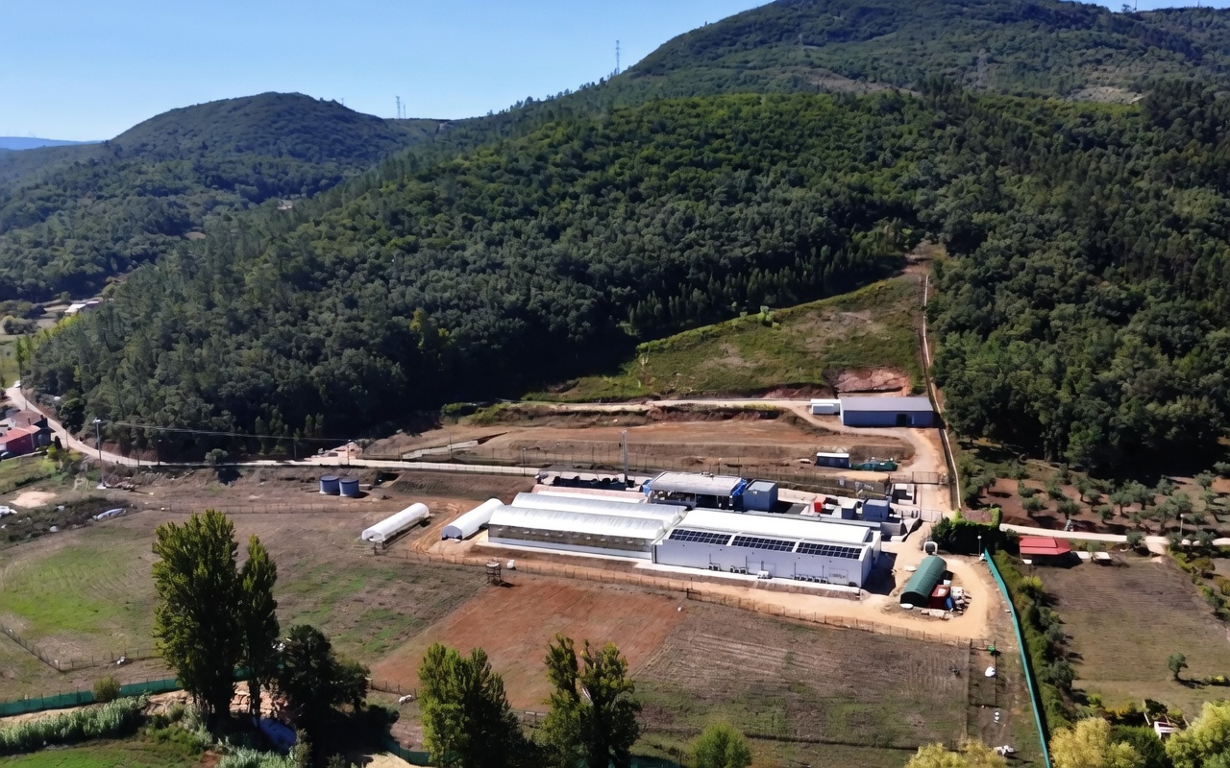
STRATEGIC INVESTMENT OPPORTUNITY
Portuguese Medical Cannabis
Production Platform
Combining Licensed Operations, State-of-the-Art Facilities,
and Explosive Market Growth
CONFIDENTIAL | 2026

Slide 2
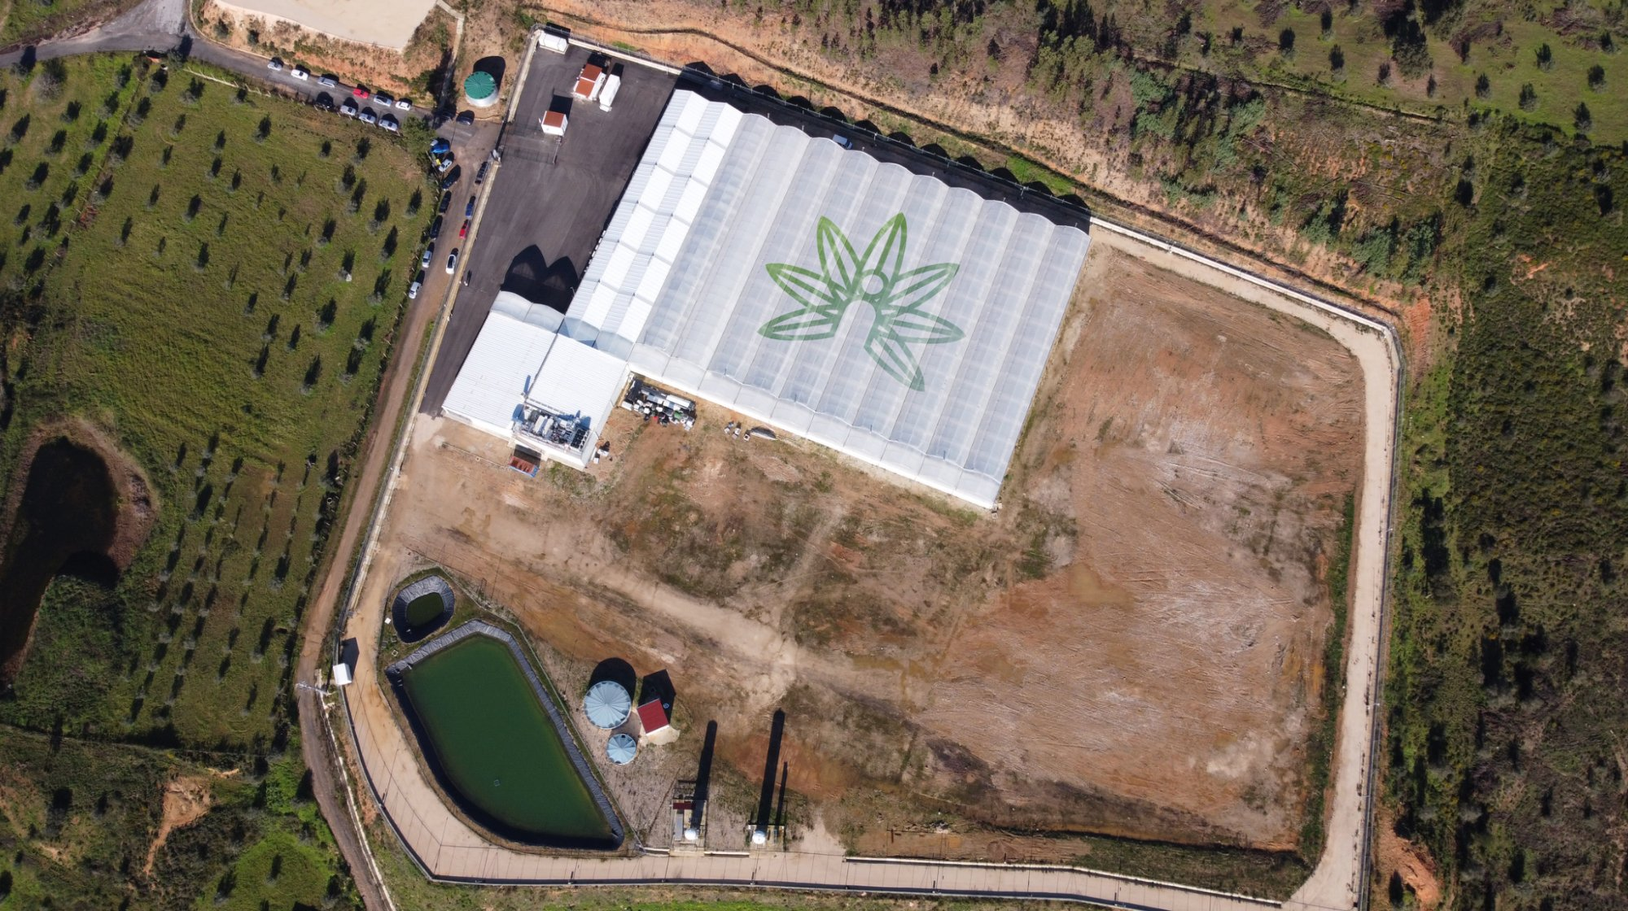
01
Market Overview & Global Trends
AGENDA
02
Recent Comparable Sales in Portugal
2026 Investment
Presentation
03
The Opportunity: Great Soul Pharma
04
MMC Coimbra – Licensed & Producing
05
Proposed Acquisition Structure
06
Use of Funds & Revenue Projections
07
Why Now? Global Market Report
08
Conclusion

Slide 3
THE MEDICAL CANNABIS MARKET
EXPLOSIVE GROWTH IN KEY REGIONS — 2026 UPDATE
€13–21B
17–26%
€670M+
26+ tons
European market
projected by 2033–34
CAGR projected
for European market
Germany market
in 2025 alone
Portugal's historical
EU export volume
🌍 EUROPE — MATURING POWERHOUSE
🌏 ISRAEL & AUSTRALIA — SURGING DEMAND
Market valued at ~USD 3–4 billion currently, with projections to USD 13–21 billion by 2033–34 (CAGR 17–26%).
Germany: largest EU market with €670M+ revenue in 2025, heading toward €1.3B by 2029. Imports exceeded 200 tons in 2025.
France, UK, Poland, Italy, and Spain all showing double-digit growth and strong regulatory momentum.
Portugal established as a key EU exporter with 26+ tons exported historically.
Israel: Reforms in late 2025 expanding patient access, rebounding toward 264,000+ patients in 2025, up to 366,000 by 2028.
Australia: ~600,000 patients in 2024–2025; annual sales tracking to exceed AUD $1 billion. Market ~USD 600–800M with 12–16% CAGR.
Combined tailwinds create an unprecedented demand surge for quality European-produced medical cannabis.

Slide 4
RECENT SALES — PORTUGUESE CANNABIS FACILITIES
COMPANY
LAND AREA
BUILDING
SALE PRICE
Hoshi
40,000 m²
3,000 m²
€12M
Strong
Comparables
Establish
Premium
Valuations
Galaxia
4,000 m²
1,000 m²
€6M
Bud Farma
80,000 m²
No build
€15M (ask)
Key Insight
These transactions highlight premium valuations for established sites in Portugal's growing export hub — validating our acquisition targets well below comparable market prices.

Slide 5
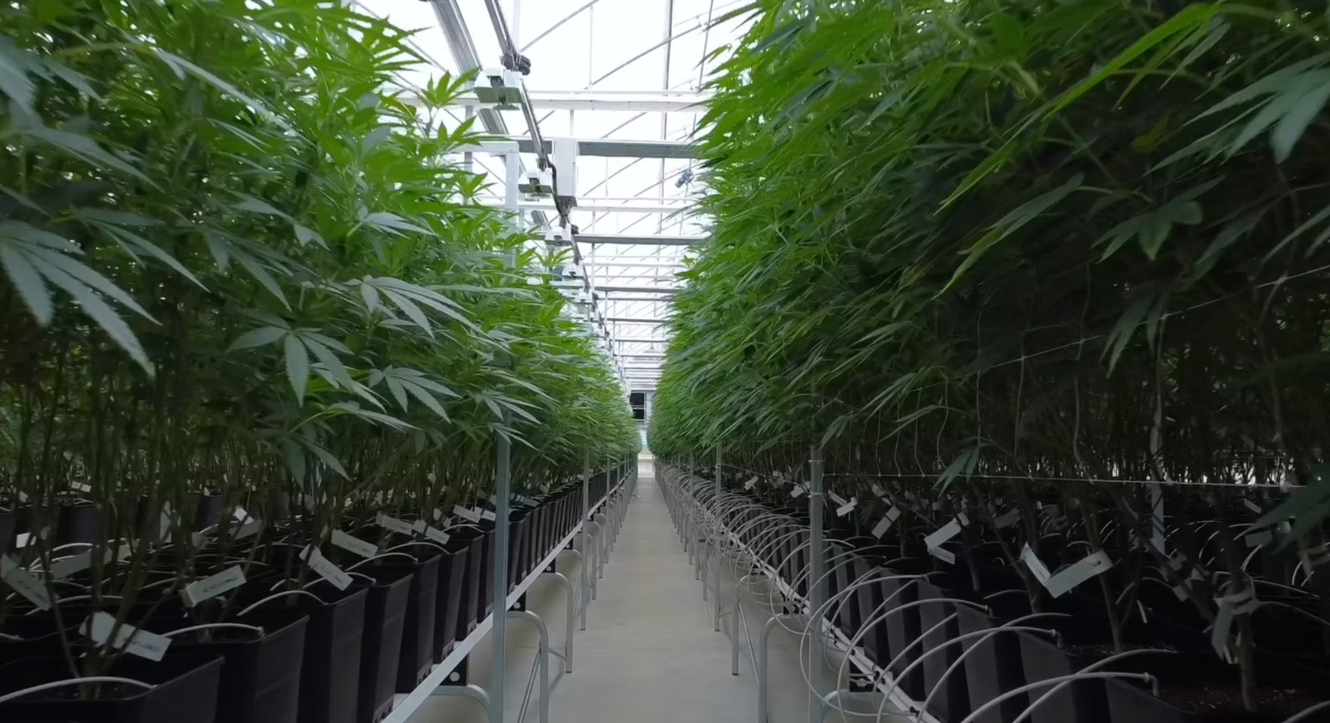
GREAT SOUL PHARMA — ORTIGA
THE OPPORTUNITY
🏭 8,000 m² Production Facility
State-of-the-art, fully equipped — drying rooms, refrigerated storage, trimming rooms and all equipment. Zero additional CapEx required.
🌱 7 High-Tech Greenhouses
1,240 m² each. 2 mother/veg rooms + 5 production GH. Conservative 800 plants × 400g × 4 harvests × 5 GH = €10.5M/year (at €1.65/g presold; target €2.20+/g).
🗺️ 100,000 m² Total Land
20,000 m² secure compound plus 80,000 m² owned land for expansion or outdoor cultivation (~10,000 plants → €3M additional annual revenue).
€10.5M+
Annual Revenue Potential
💰 Current Valuation: €11M (Unlicensed)
Massive upside with MMC license integration. Property currently valued without operational license — license synergy dramatically increases true value.

Slide 6
MMC COIMBRA — LICENSED & IN PRODUCTION
GACP-Licensed Facility
Fully operational with all regulatory approvals in place — ready for immediate scaling.
GACP
€4.4M
Licensed &
Certified
Current Revenue
Run Rate
Experienced International Team
British, German & Swiss leadership including former Bayer Pharma directors. Barry Hatcher as Managing Director.
2T/yr
600kg
Current Annual
Production
Unfilled Monthly
Demand
15 Acres of Production Land
Operating greenhouse combined with outdoor flower production — scalable to meet surging demand.
Immediate License Transfer
Great Soul to operate under MMC license, enabling immediate restart of substantial production across both facilities.
Current Valuation: €14 Million
Priced to reflect current 2 ton/year production capacity — substantial upside from unfilled 600 kg/month standing orders.

Slide 7
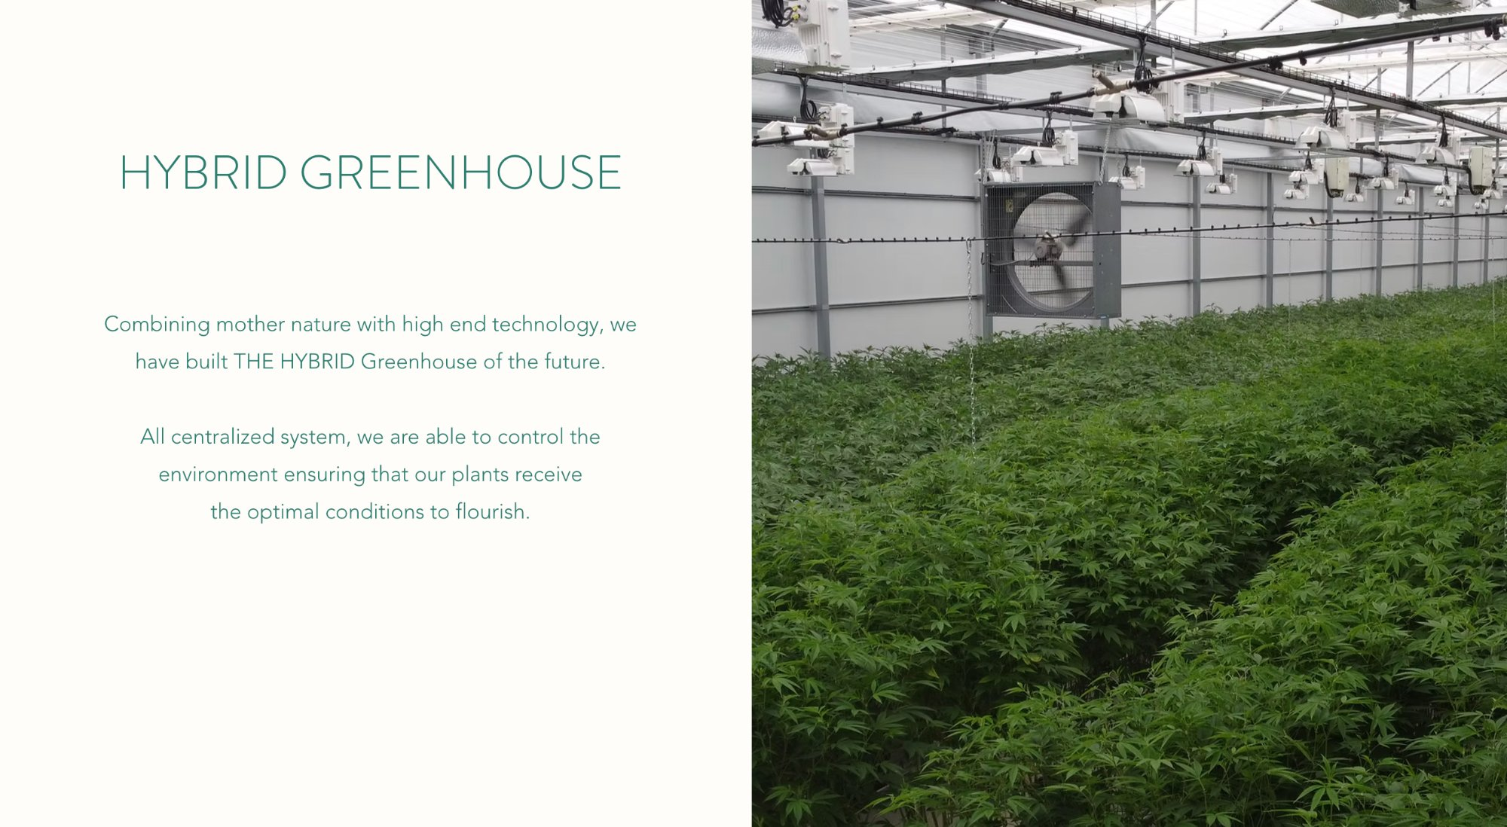
PROPOSED DEAL STRUCTURE
Compelling Value — €25M in Combined Assets for €14M Investment
75% Controlling Interest
75% Controlling Interest
Option to Acquire
Great Soul Pharma
MMC Coimbra
Remaining 25%
€5M
€8M
FMV
100% acquisition of Great Soul Pharma. Full operational and executive control from day one.
Immediate access to GACP license. Ability to scale from existing 2T/year base with unfilled orders.
Option to purchase remaining 25% in 3 years or prior to IPO at fair market value — structured for maximum investor upside.
Combined facility valuation: €25M | Total investment required: €14M | Discount to value: 44%

Slide 8
USE OF FUNDS
€14M TOTAL INVESTMENT
€8M | 57%
75% of MMC Coimbra
€5M | 36%
100% of Great Soul Pharma
€1M | 7%
First-Year Operating Expenses
TOTAL: €14,000,000 for 75% controlling interest in combined €25M asset base

Slide 9
REVENUE PROJECTIONS
€15M
Worst-Case Annual Revenue
€6.75M
Gross Profit (45% margin)
600kg/mo
MMC Standing Orders Unfilled
€2.20+/g
Upside Pricing Target

Slide 10
WHY THIS IS A COMPELLING INVESTMENT
✅ Proven Assets in Key Export Hub
⚡ Immediate Revenue from Day One
Portugal is Europe's primary medical cannabis export location — established infrastructure, regulation, and international buyer relationships.
MMC's GACP license and 600kg/month of unfilled standing orders means revenue generation begins immediately upon acquisition.
📈 Massive Market Tailwinds
💎 Exceptional Value Entry Point
Europe/Germany booming; Israel and Australia surging. Combined global demand creates an unprecedented window for Portuguese producers.
€25M in combined assets for a €14M investment — a 44% discount with expansion potential and IPO optionality built into the structure.
A HIGH-MARGIN, RESILIENT HEALTHCARE INVESTMENT IN A HIGH-GROWTH SECTOR

