Slide 1
Lab 3: Simple Linear Regression (SLR)
ŷ = a₀ + a₁x₁
ŷ = output
The ^ means predicted or estimated value, not an actual observed value.
a₀ and a₁ = regression coefficients
x₁ = input data
Given many x₁and y pairs, our goal is to compute a₀ and a₁

Slide 2
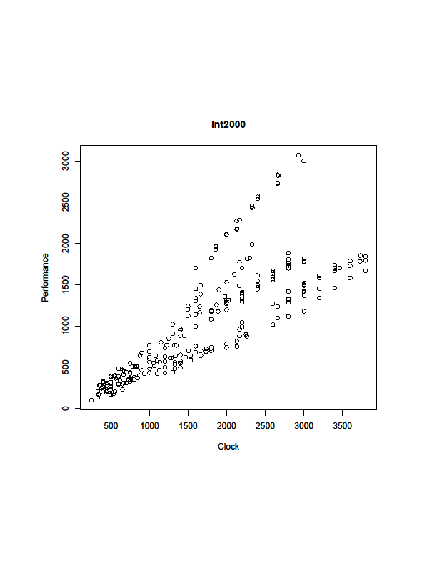
Does it look linear?
plot() function
plot(int00.dat[,"clock"],
int00.dat[,"perf"], main="Int2000",
xlab="Clock", ylab="Performance")

Slide 3
Linear model function
lm()
int00.lm <- lm (perf ~ clock)
ŷ = a₀ + a₁x₁
ŷ = perf
x₁ = clock
See example in Section 3.2
The ~ indicates a relationship between the two variables – read as “by”
“Model a linear relationship for perf by clock”

Slide 4
Linear model function
lm()
int00.lm <- lm (perf ~ clock)
ŷ = a₀ + a₁x₁
ŷ = perf
x₁ = clock
See example in Section 3.2
a₀ = 51.8
a₁ = 0.586
Final model: perf = 51.8 + 0.586 * clock

Slide 5
Plotting the regression line
plot(clock,perf)
abline(int00.lm)

Slide 6
Behind the Code
e_{i}
For i=1 to n (x_{i}, y_{i}) pairs
y_{i} = a₀ + a₁x₁ + e_{i}
e_{i} = residual
= (predicted by line) - (actual)
Minimize sum-of-squares of residuals

Slide 7
Behind the Code
Set partial derivatives to zero to find minima
Two equations, two unknowns
Solve for a₀, a₁

Slide 8
Model quality
Section 3.3
summary(int00.lm)
Residuals = actual value – fitted value
above/below line = positive/negative residual
Expect median of residuals ≈ 0
Expect residuals normally distributed around 0
Expect min, max approx same distance from 0
Residuals:
Min 1Q Median 3Q Max
-634.61 -276.17 -30.83 75.38 1299.52

Slide 9
Model quality – coefficients
Standard error = measure of total variation in residuals
If normally distributed → expect std err = 5-10x smaller than coefficient value
Small value → small variability
Pr(>|t|) = p-value = Pr(you obtain a t-value this large or larger if null hypothesis is true)
Tests null hypothesis that this variable has no correlation with dependent variable, i.e., this variable has zero effect on output
If p-value < significance level (α), sample data is sufficient to reject the null hypothesis for population
If (p-value < α) → coefficient has higher probability of non-zero effect → strong evidence it is probably useful in the model
Typically choose α = 0.05 or 0.1
Coefficients:
Estimate Std. Error t value Pr(>|t|)
(Intercept) 51.78709 53.31513 0.971 0.332
clock 0.58635 0.02697 21.741 <2e-16 ***

Slide 10
Model quality – visual indicators
***
0 < p ≤ 0.001
**
0.001 < p ≤ 0.01
*
0.01 < p ≤ 0.05
.
0.05 < p ≤ 0.1
[blank]
0.1 < p ≤ 1
Coefficients:
Estimate Std. Error t value Pr(>|t|)
(Intercept)51.78709 53.31513 0.971 0.332
clock 0.58635 0.02697 21.741 <2e-16 ***
Quick visual indicator of the significance of that coefficient.

Slide 11
Model quality – residuals
Residual standard error
Measure of total variation in residual values
If residuals are normally distributed
→Expect 1st and 3rd quantiles ≈ 1.5 * standard error
Residuals:
Min 1Q Median 3Q Max
-634.61 -276.17 -30.83 75.38 1299.52
Coefficients:
Estimate Std. Error t value Pr(>|t|)
(Intercept)51.78709 53.31513 0.971 0.332
clock 0.58635 0.02697 21.741 <2e-16 ***

Slide 12
Model quality – R² and F-statistic
Degrees of freedom = (number of observations used to generate model) – (number of coefficients)
E.g. 256 observations used to compute 2 coefficients
→ 254 degrees of freedom
R² = percentage of total variation explained by the model
0 < R² < 1
Adjusted R² – discuss later for multi-factor models
F-statistic
Compares current model to a model that has only the intercept parameter
Discussed further in Chapter 4

Slide 13
R² – A Little Deeper
R² = coefficient of determination
= Fraction of total variation explained by model

Slide 14
Residual analysis
Section 3.4
y = a₀ + a₁x₁ = f(x_{i})
fitted(int00.lm) computes
y_{f} = f(x_{i}) for all x_{i}
resid(int00.lm) computes
y_{i} – y_{f} for all outputs y_{i}
Residuals = (actual value) – (fitted value)
plot(fitted(int00.lm), resid(int00.lm))
Expect randomly distributed around 0
Note vertical lines
Different perf (y_{i} ) with same clock (x_{i})

Slide 15
Residual analysis – QQ plot
Quantile vs quantile (QQ) plot
qqnorm(resid(int00.lm))
qqline(resid(int00.lm))
Expect the points to follow a straight line if error is normally distributed
Both the residual plot and QQ plot suggest that a one-factor model
is insufficient for this data, but it still may be useful.

Slide 16
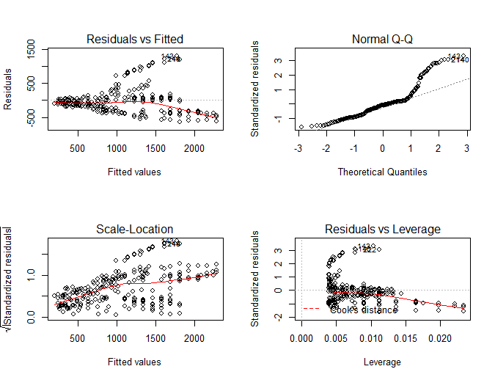
Simpler Generation of Diagnostic Plots
par(mfrow=c(2,2)) # Display four plots on two rows
plot(int00.lm) # Plot the residual diagnostics

Slide 17
To do
Read Chapter 3
Download and complete Lab 3

