Slide 1
Single Cell RNA analysis report
Bioinformatics Core Unit

Slide 2
Introduction
Terms and methodology this pipeline is based on.

Slide 3
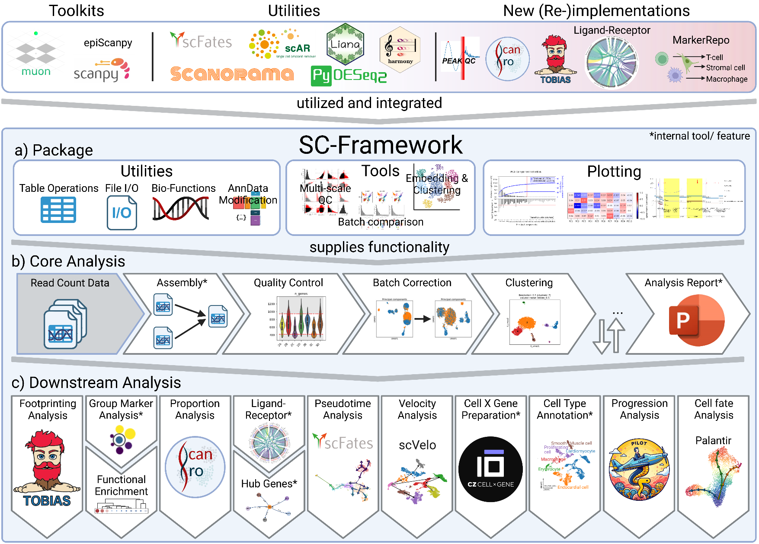
Overview
Manual: https://loosolab.pages.gwdg.de/software/sc_framework/

Slide 4
Terms and Algorithms
Observation (obs)
In scRNA-seq data an observation refers to a cell identified by a barcode unique in the dataset.
Variable (var)
A variable refers to a gene. Both var and obs can have additional metadata, e.g. cell types (obs) or “is mitochondrial” (var).
Matrix
The analysis is based on an expression matrix (obs x var) that contains the raw RNA counts for each cell over each gene.
Principle Component Analysis (PCA)
The PCA reduces the high-dimensional data by summarizing similar behaving genes into principle components (PCs). PCs that explain little of the dataset variance or PCs that correlate with technical factors are considered noise and removed.
t-distributed stochastic neighbor embedding (t-SNE)
The t-SNE further reduces the dimensions (PCs) from the PCA to a low-dimensional output (usually 2D).
More information on t-SNE
Uniform Manifold Approximation and Projection (UMAP)
UMAP takes the PCs from the PCA and reduces them into a low-dimensional, 2D or 3D, representation. It does so, by constructing a high-dimensional graph and optimizing a low-dimensional analogue to be as similar as possible. Both UMAP and t-SNE are mostly equivalent techniques to visualize high-dimensional data. They are robust, meaning they will provide highly similar results. Thus, we provide either UMAP or t-SNE.
More information on UMAP

Slide 5
Terms and Algorithms
Batch correction
Batch effects are variances in the data that are not intended by the experimental design (e.g. technical variance). They can be introduced through various sources. For example, sequencing samples at different timepoints may introduce batch effects. As batch effects could interfere with downstream analysis they are typically removed. However, it can be challenging to identify and correct for batch effects as this is highly dependent on the experimental setup of the dataset. For optimal results an experiment should be designed in a way that each condition is present in at least two different batches.
Local Inverse Simpson's Index (LISI)
The LISI measures the strength of a batch effect based on the heterogeneity in each group. Meaning, a well-mixed dataset, without any batch effect will get a high score of up to the number of batches in the dataset.
Clustering
The clustering, typically done using the leiden algorithm, sorts the cells of a dataset into groups based on their expression similarity. The resulting clusters are commonly thought to be cell types and annotated in the following steps.
Interaction score
The interaction score between a receptor and a ligand gene is calculated as the z-score of the mean expression of the receptor in its cell type and z-score of the mean expression of the ligand in its cell type. Both values are further scaled based on the number of cells in the respective cell type expressing the gene and the number of cells in the dataset belonging to the cell type. The receptor and ligand score are finally added to form the interaction score.
Quantile rank differences
The difference in rank a data point has between two groups. The two groups are divided into parts of equal probability (quantiles) and the rank of the data point, i.e. which quantile the data point belongs to, are compared between the two groups. The score ranges from -1 to 1. A score <0 means the data point is ranked higher in the first group, while >0 means it is ranked higher in the second group. The distance from 0 means how big the difference between the two ranks is.

Slide 6
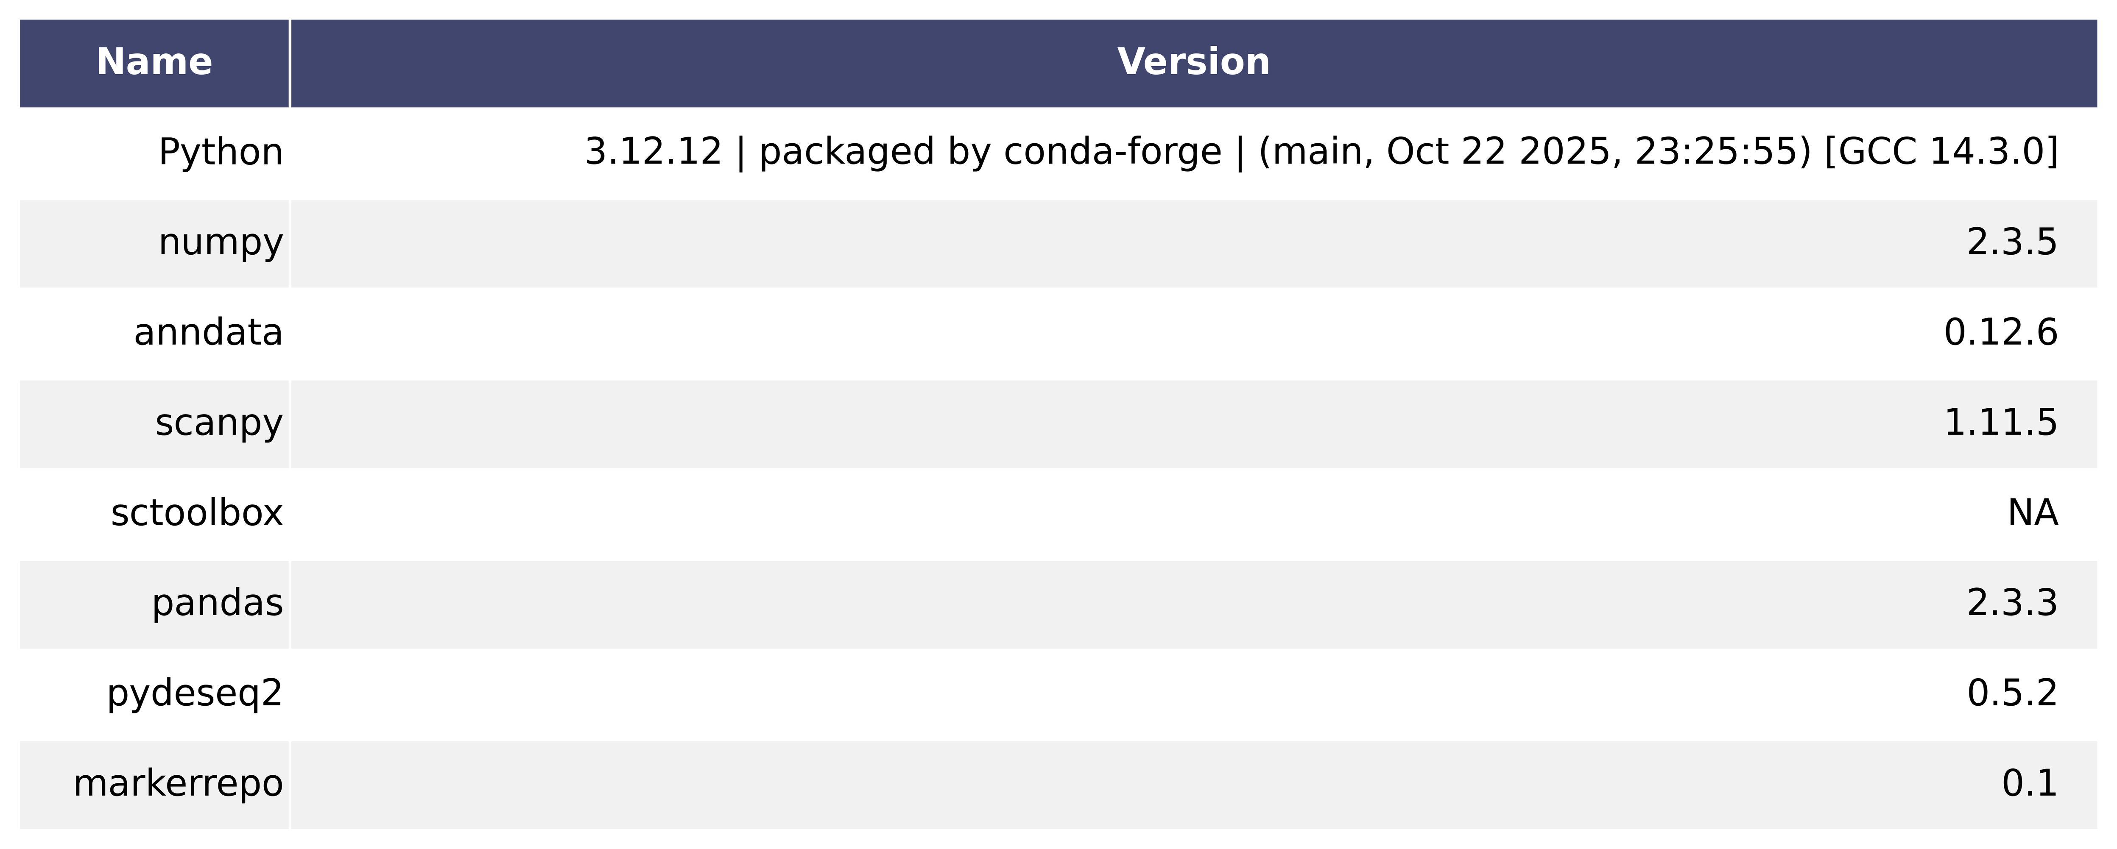
Tool Versions

Slide 7
Methods
The analysis was performed with the SC-Framework (Schultheis et al., doi: 10.5281/zenodo.11065517, version 0.14.2), utilizing the following tools as part of its integrated analysis environment. Mapped and quantified data was assembled by the SC-Framework, which created an initial dataset of 32524 genes and 3883 cells. Scrublet doublet prediction (Wolock et al., doi: 10.1016/j.cels.2018.11.005) identified 38 multiplet cells, subsequently removed from the dataset. Low quality cells were filtered based on quality control metrics with a global threshold over all samples, which caused the removal of 825 cells. 0 genes were filtered due to low quality. 3020 cells and 19581 genes were left after quality control. Variances introduced by sequencing depth were corrected through total count normalization and outliers were stabilized using the log1p. Principle Component Analysis (PCA) was conducted based on 1611 highly variable genes (HVGs). The resulting Principle Components (PCs) were filtered based on their correlation to quality metrics and explained variance. 50 PCs were retained. A neighbor graph was constructed based on the selected PCs using 20 neighbors. The data was transformed into a low-dimensional embedding using UMAP (McInnes et al., https://arxiv.org/abs/1802.03426, min_dist=0.1, spread=2.5). The clustering was done via the leiden algorithm (Traag et al., https://arxiv.org/abs/1810.08473) with a resolution of 1.1. The clustering was further refined to 16 final clusters.
Marker genes, i.e. genes predominantely expressed in one cluster/ group, were computed using Scanpy's "rank_genes_groups" (Wolf et al., doi: 10.1186/s13059-017-1382-0). The markers were further filtered to (1) be expressed in at least 25.0% of cells within the target group, (2) have a fold change >0.5, and (3) be expressed in less than 80.0% cells outside the target group. Condition specific markers were identified by applying the same function and filter to each group split by condition. Cell groups were annotated using the SC-Frameworks MarkerRepo (https://gitlab.gwdg.de/loosolab/software/annotate_by_marker_and_features), a tool to identify cell types based on matches between marker genes and its internal database.

Slide 8
Dataset Zebrafish cranial neural crest 1.5 dpf
SC-Framework Analysis

Slide 9
Dataset Assembly

Slide 10
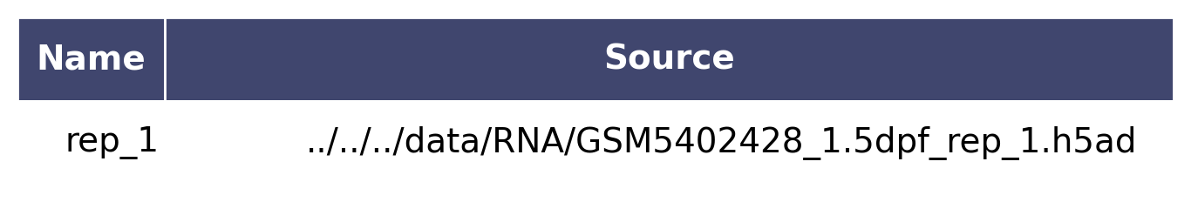
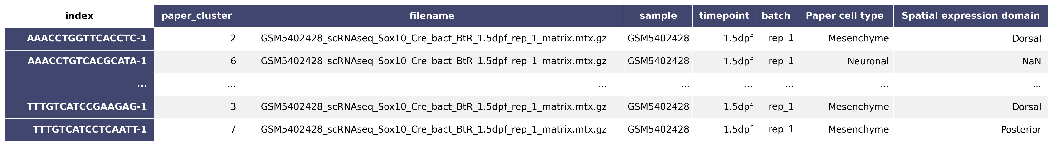
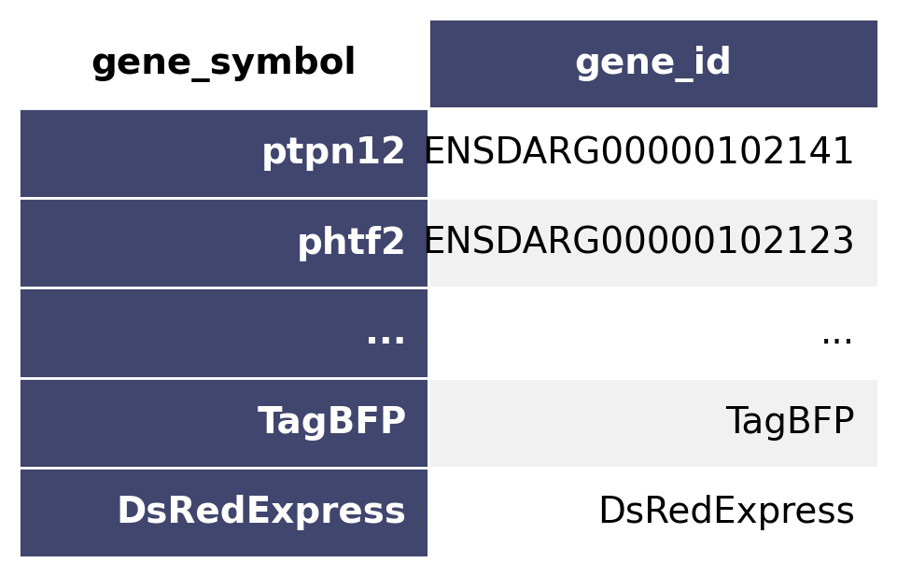
Dataset Assembly
Dataset
3883 observations x 32524 variables
Observation information: paper_cluster, filename, sample, timepoint, batch, Paper cell type, Spatial expression domain
Variable information: gene_id
Notes:
A dataset may be constructed from multiple parts (samples, sequenceing batches, etc.). The first table shows the individual parts and their location from which the dataset is constructed.
The text provides a short overview of the dataset dimensions and available information. In a typical scRNA experiment each observation translates to a cell and each variable to a gene. This means that observation information contains information about each cell, e.g. the timepoint a cell belongs to. Likewise, provides variable information details about individual genes, for example how many cells had expression of a certain gene.
Datasets can contain additional layers, i.e. data matrixes, such as raw expression or normalized expression values.The last two tables show a detailed view on the observation (obs) and variable (var) of the dataset.

Slide 11
Quality Control

Slide 12
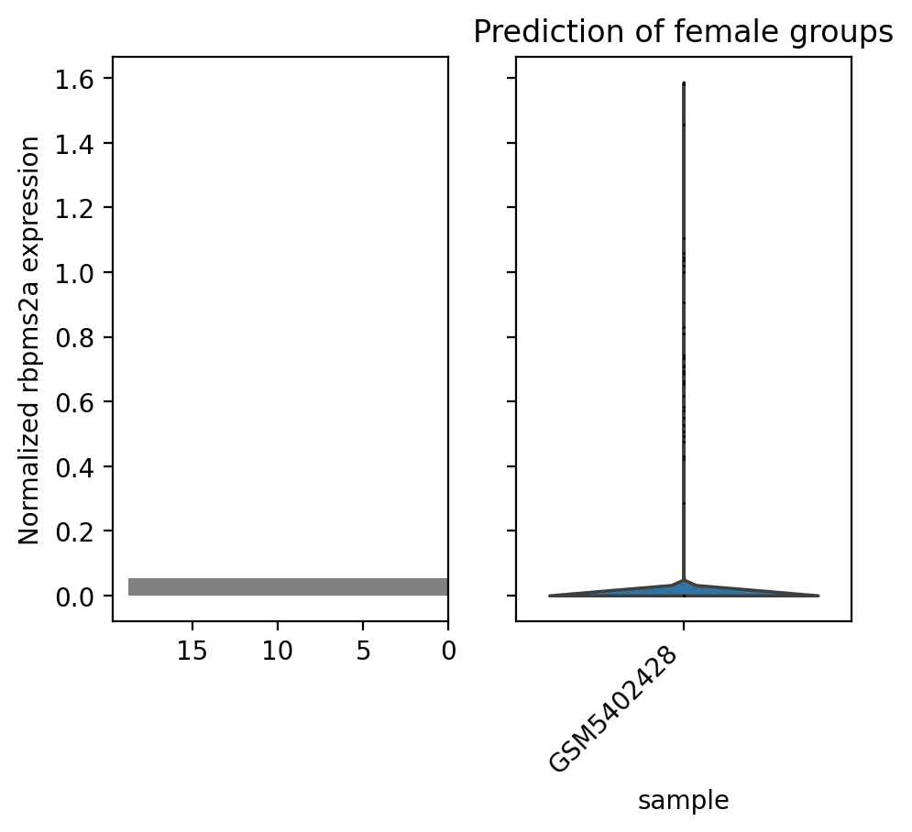
Gender prediction
Notes:
The gender of each sample is predicted based on the expression of a female gene. Female samples are shown with a red background.

Slide 13
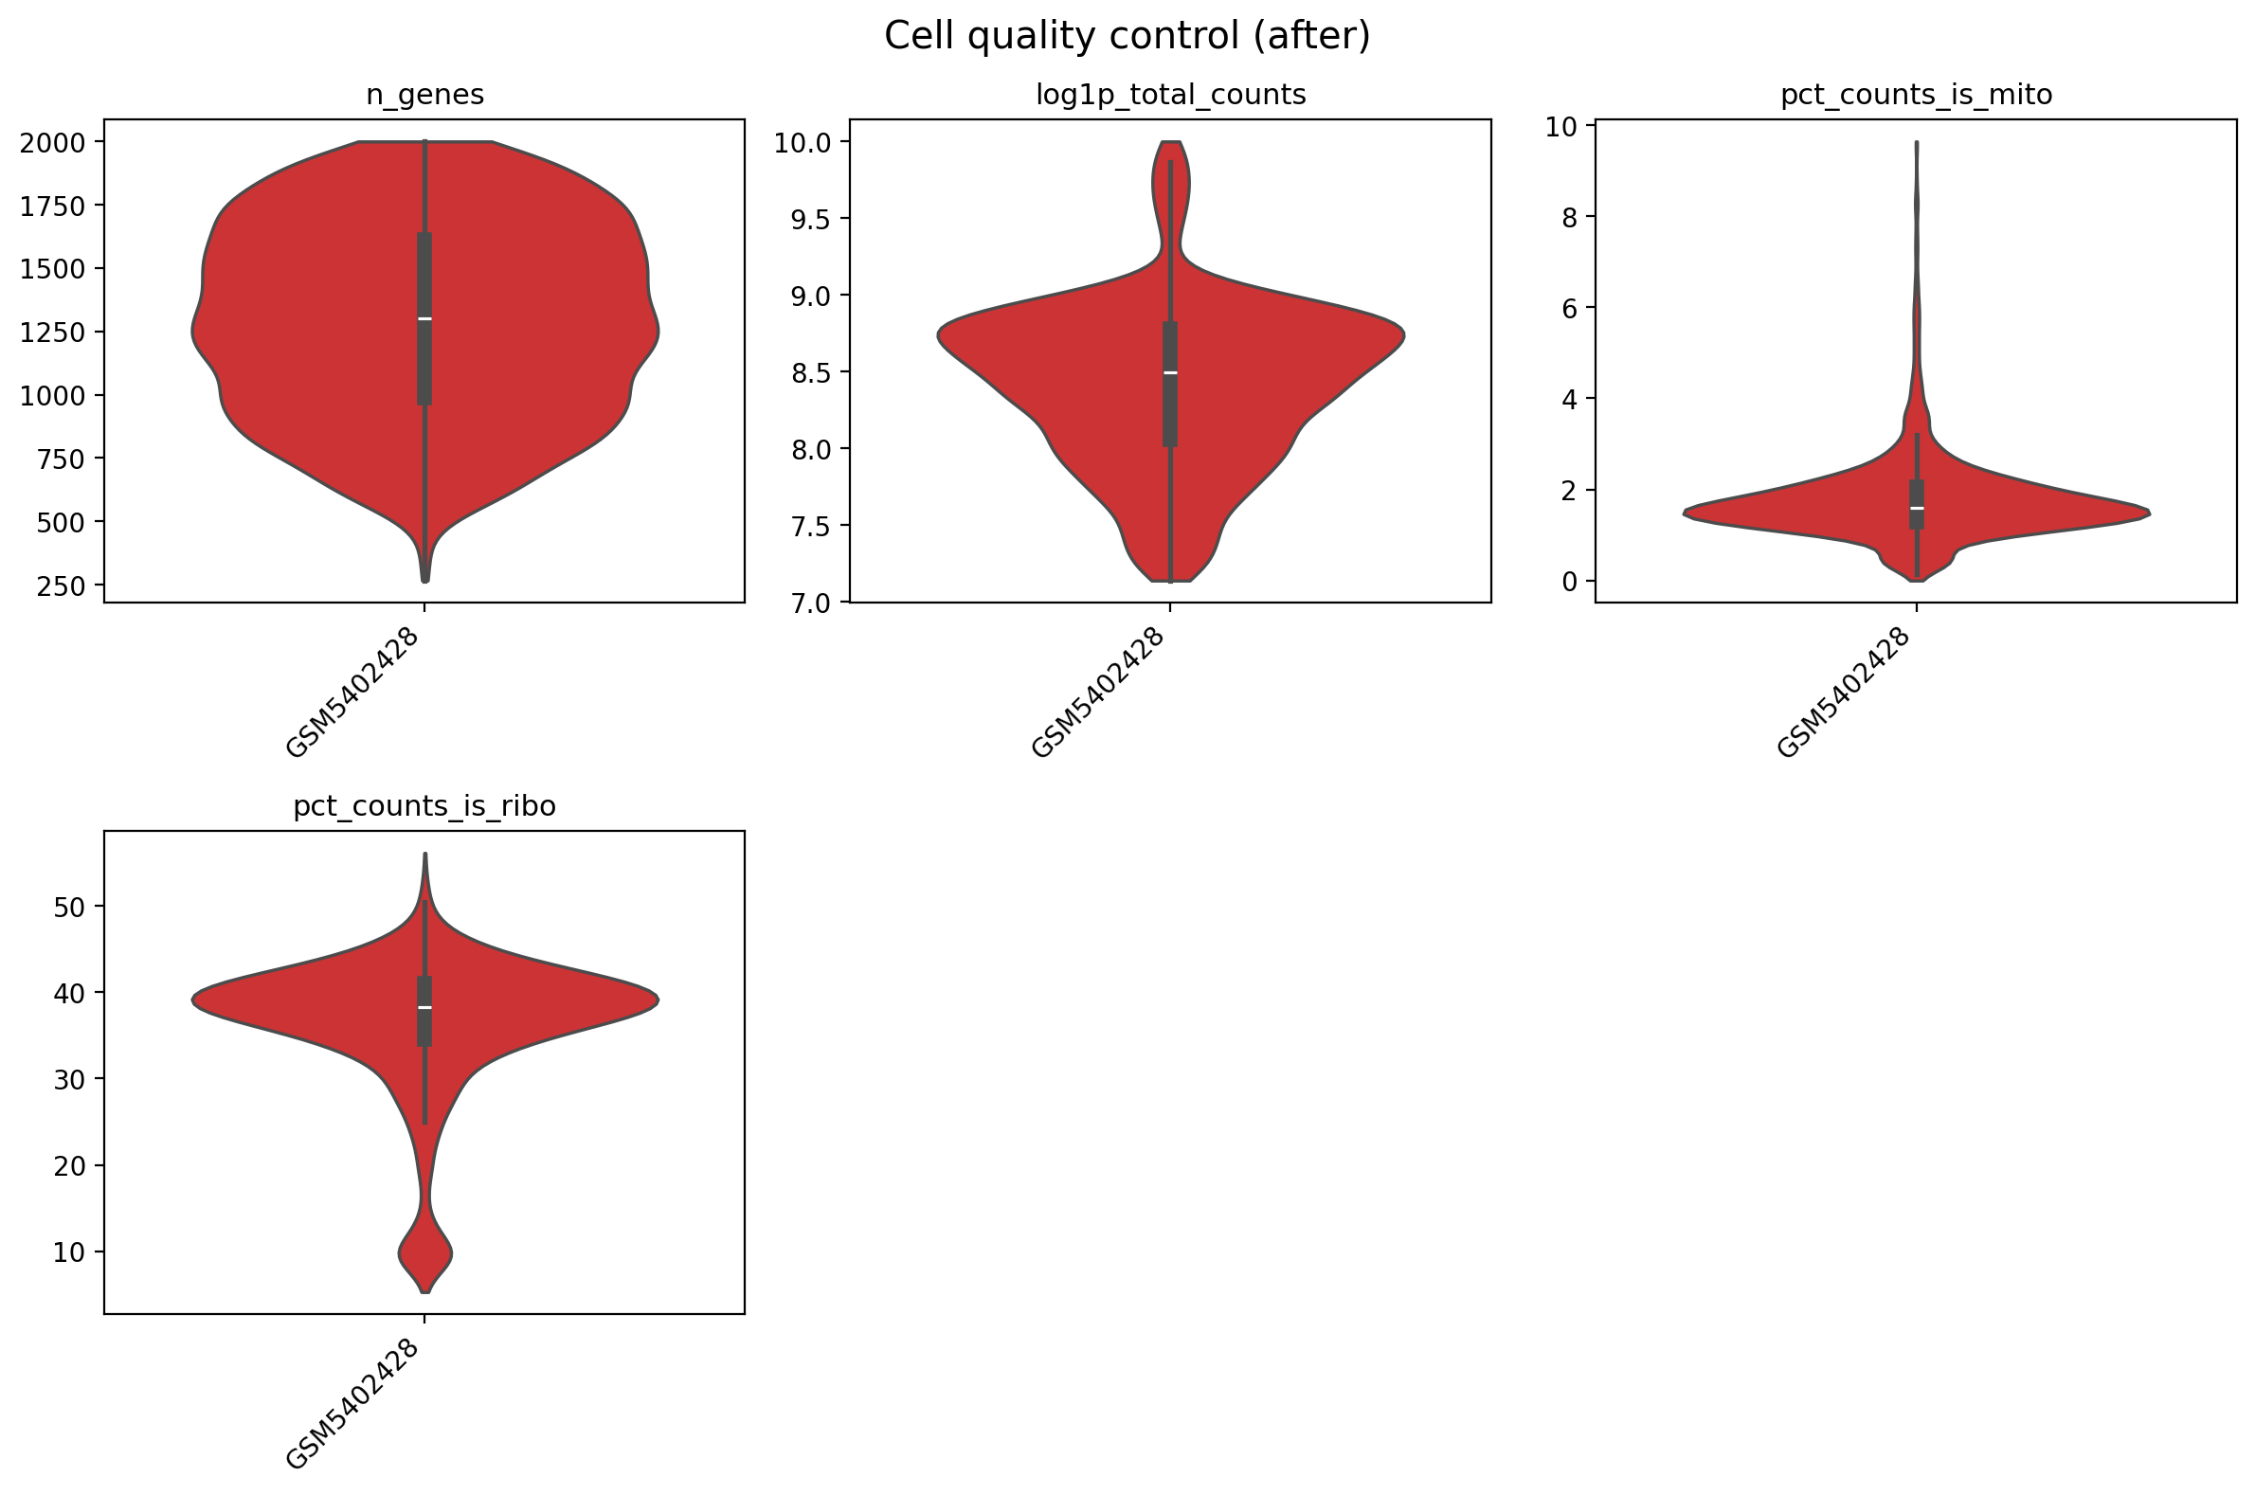
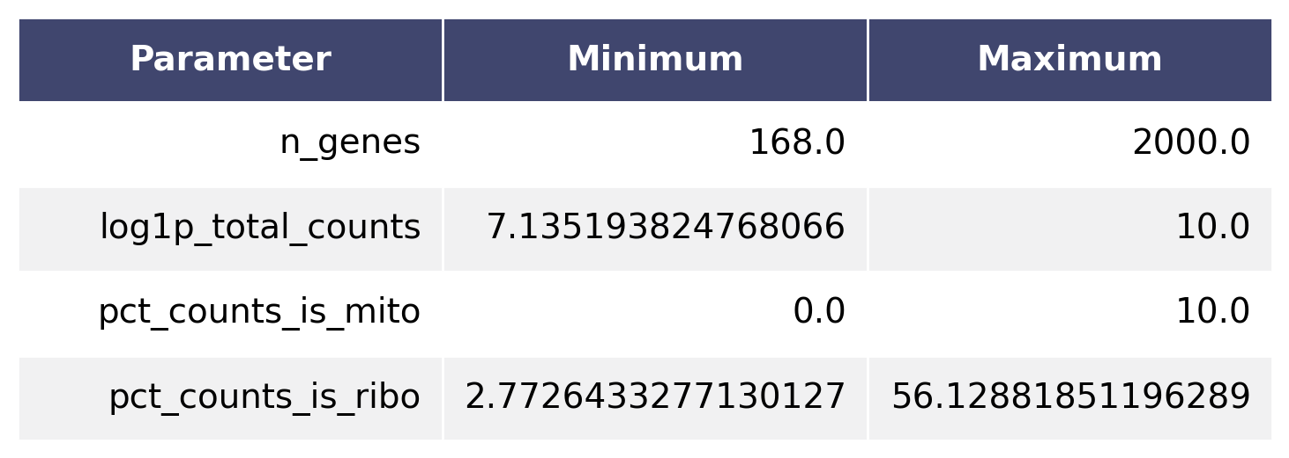
Cell filter I
Notes:
Low quality cells are removed from the dataset by applying thresholds to quality metrics. This is either done using global thresholds or thresholds for each individual sample.
Common quality metrics:
n_genes: The number of genes associated with a barcode (cell).
total_counts: The total amount of reads detected for this barcode (cell).
log1p_total_counts: Same as above but on a logarithmic scale.
total_counts_is_mito: The total amount of reads associated with mitochondrial genes.
log1p_total_counts_is_mito: Same as above but on a logarithmic scale.
pct_counts_is_mito: Percentage of mitochondrial reads per barcode (cell).
total_counts_is_ribo: The total amount of reads associated with ribosomal genes.
log1p_total_counts_is_ribo: Same as above but on a logarithmic scale.
pct_counts_is_ribo: Percentage of ribosomal reads per barcode (cell).
total_counts_is_gender: The total amount of reads associated with gender genes.
log1p_total_counts_is_gender: Same as above but on a logarithmic scale.
pct_counts_is_gender: Percentage of gender related reads per barcode (cell).

Slide 14
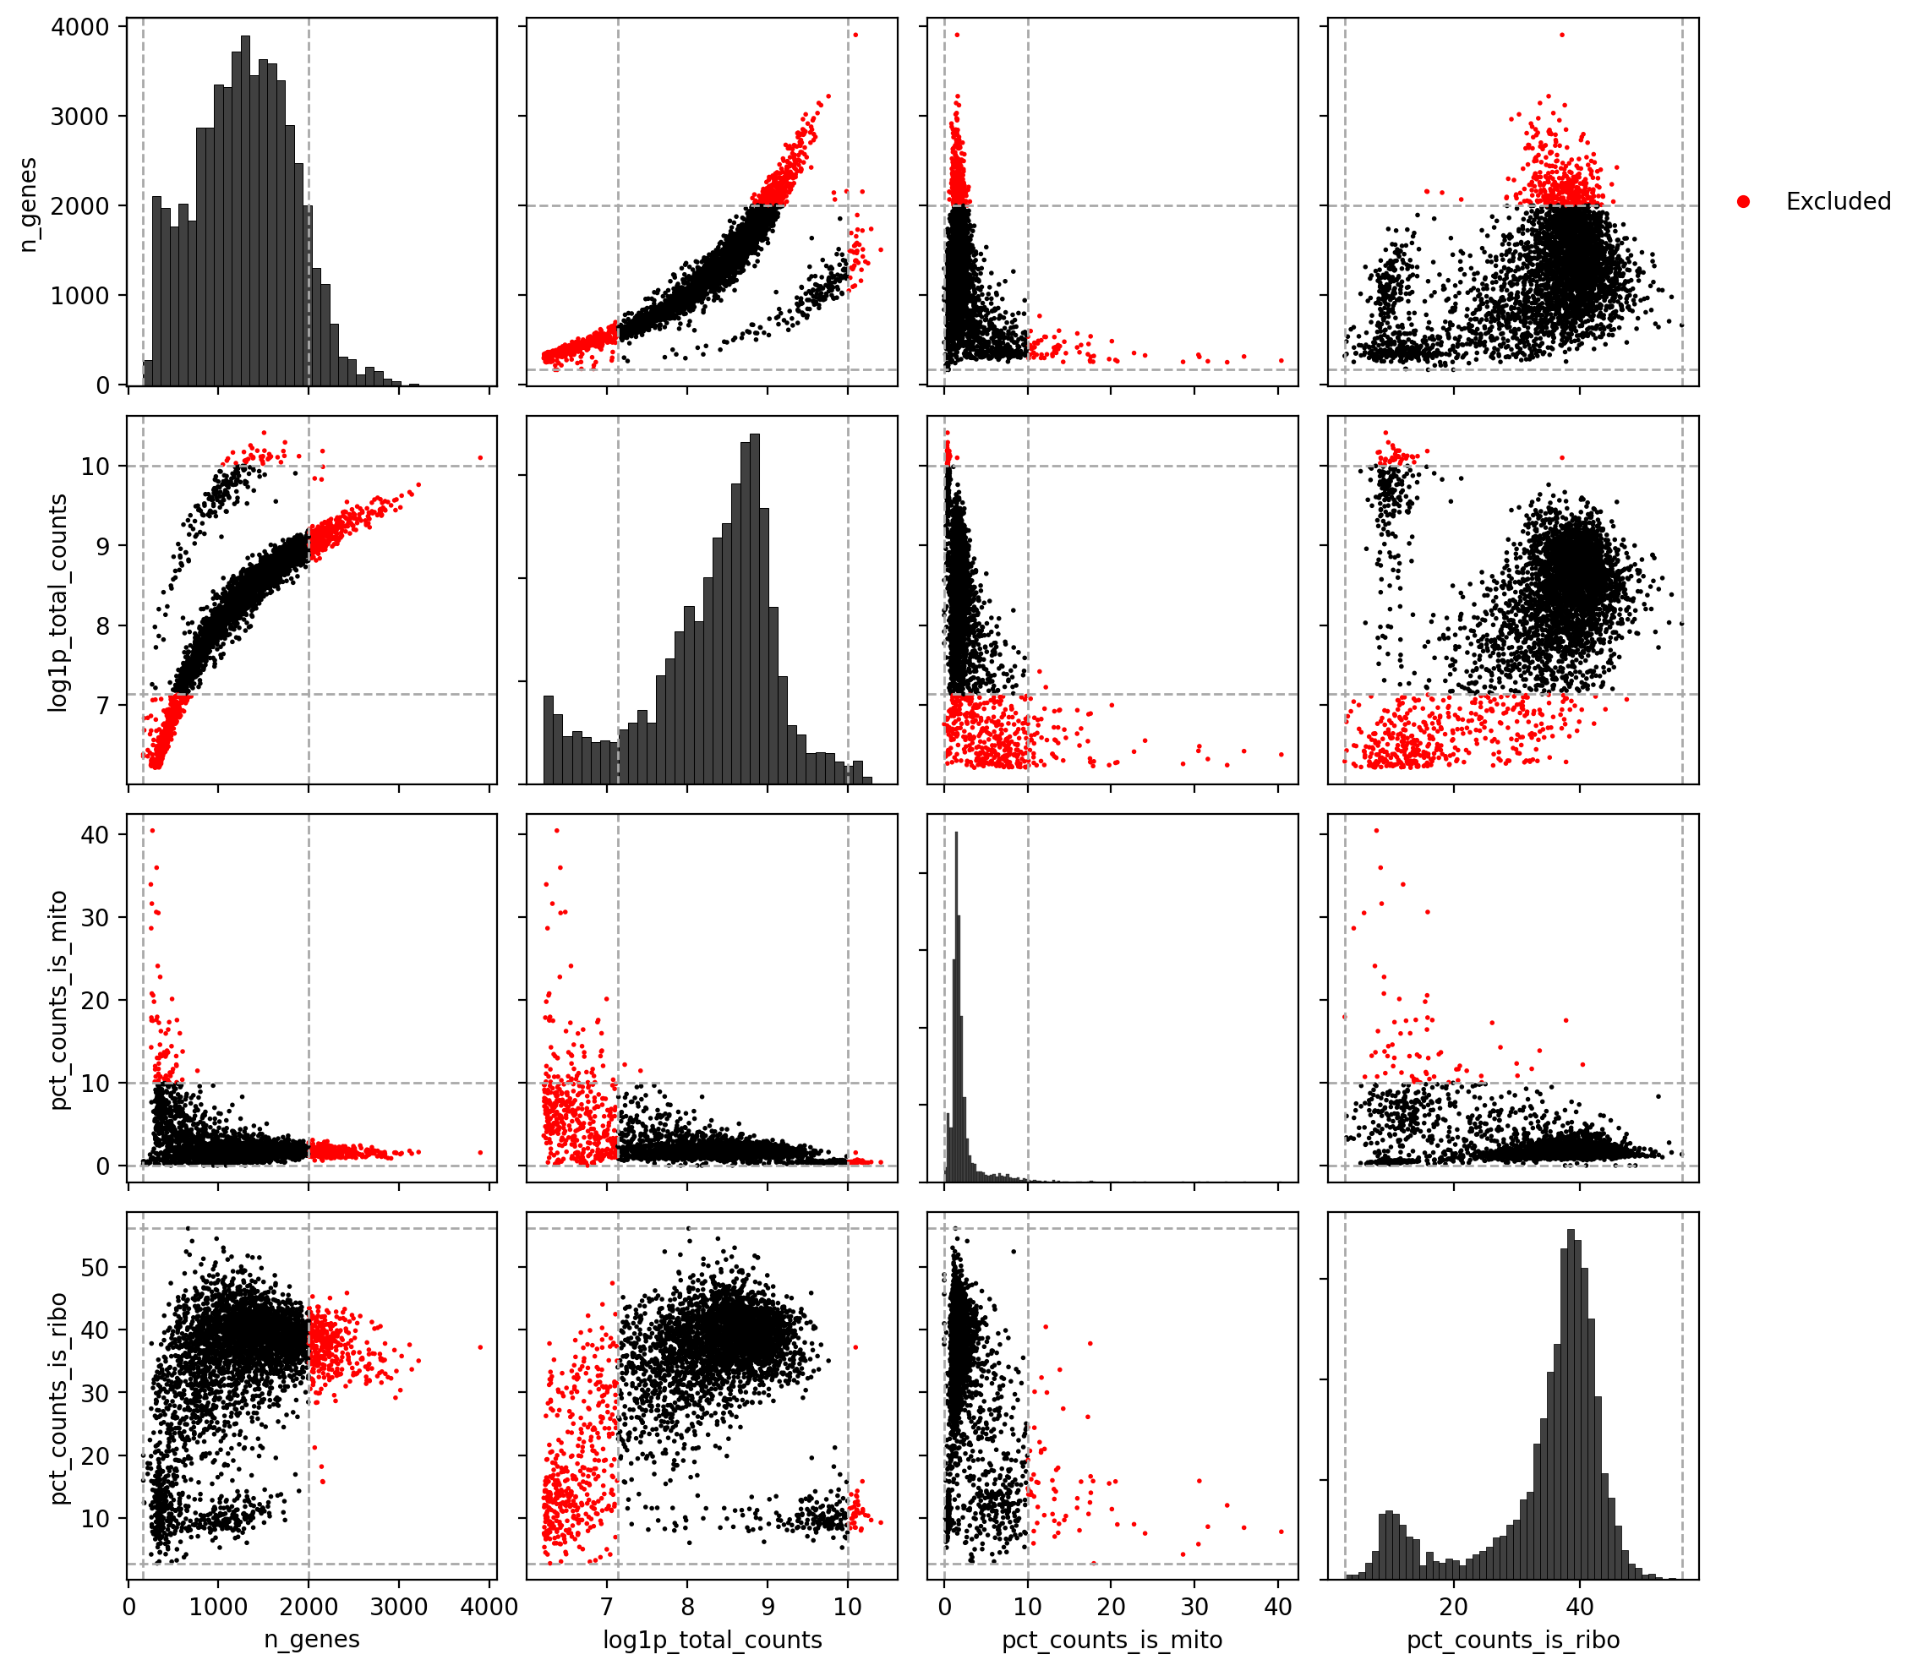
Cell filter II
Notes:
This plot provides a pairwise view of the quality metrics, their distributions, and the respective thresholds.

Slide 15
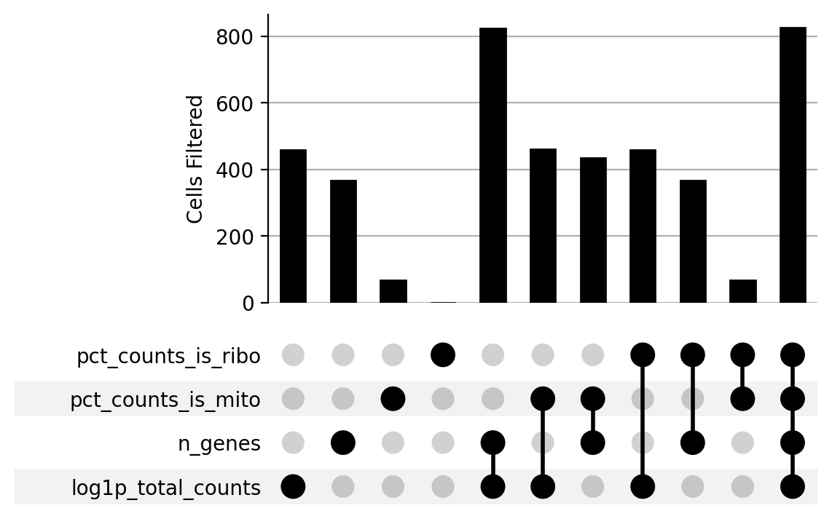
Cell filter III
Filtered 38 doublet elements from AnnData.obs (3883 -> 3845).
Filtered 825 threshold elements from AnnData.obs (3845 -> 3020).
Notes:
The UpSetPlot provides the impact each threshold has on the dataset. This is shown for each metric alone and in combination with other metrics to estimate the overlap between the filters.
The final amount of filtered cells is given in the text.
The dataset may also be filtered for doublets, observations that contain more than one cell, to avoid skewing the following analysis.

Slide 16
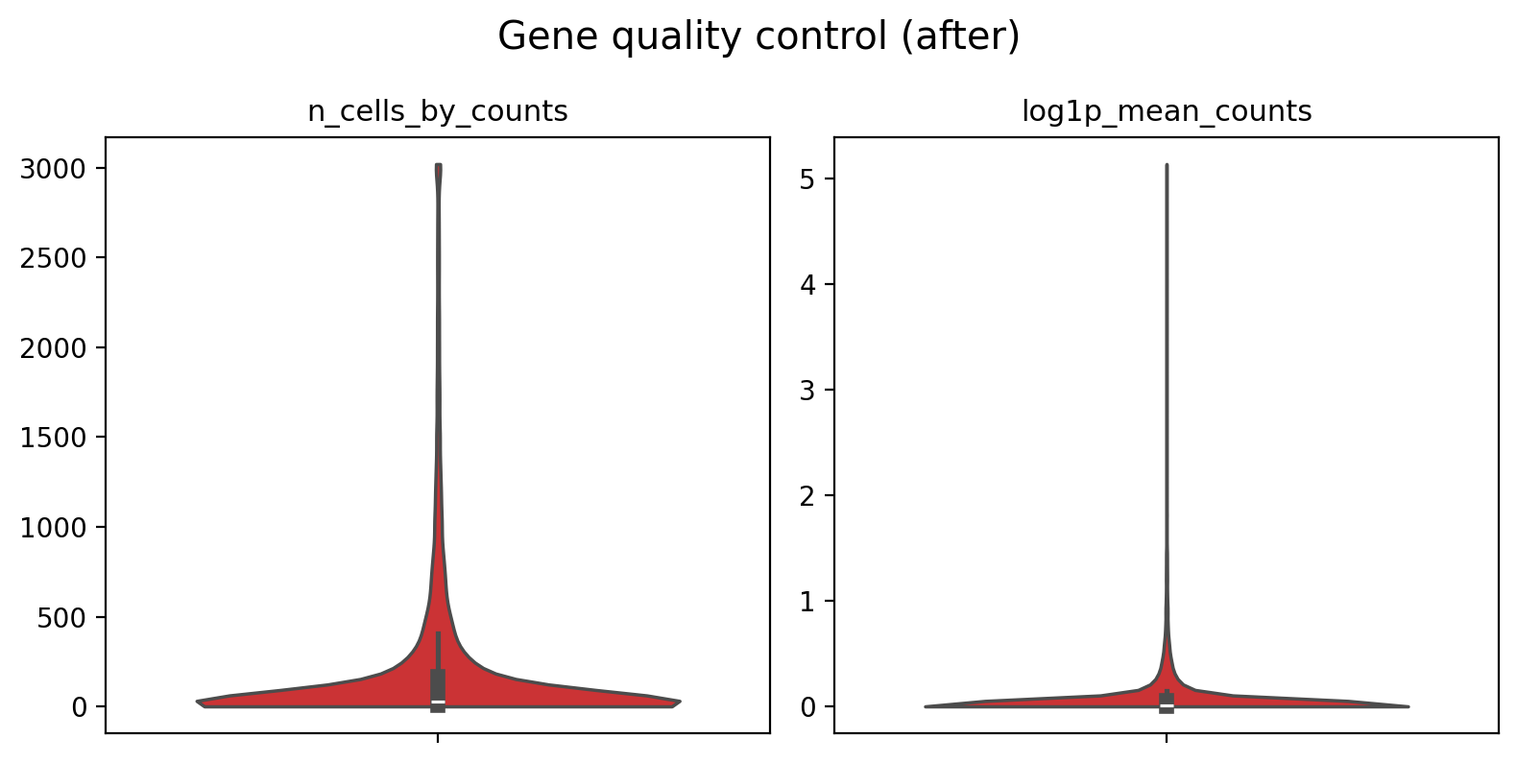
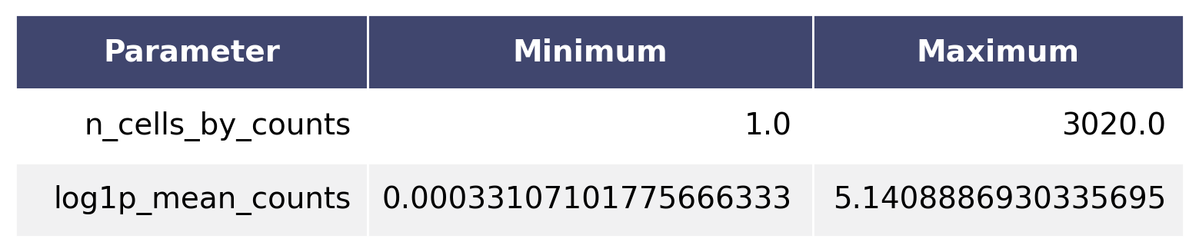
Gene filter I
Filtered 0 threshold elements from AnnData.var (19581 -> 19581).
Notes:
Similar to cell filtering, genes may also be removed from the dataset with the aid of quality metrics.
Common quality metrics:
n_cells_by_counts: The number of cells that contain reads associated with the gene.
mean_counts: The mean amount of reads over all cells.
log1p_mean_counts: Same as above but on a logarithmic scale.
pct_dropout_by_counts: Percentage of cells this gene does not appear in.
total_counts: The total amount of reads associated to this gene.
log1p_total_counts: Same as above but on a logarithmic scale.

Slide 17
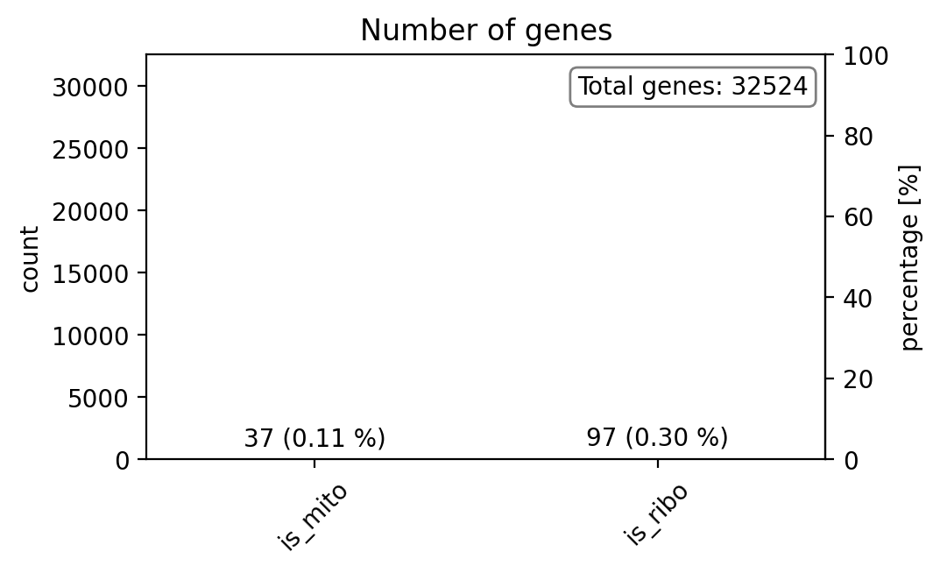
Gene filter II
The genes were identified but not removed.
Notes:
Genes are categorized into mitochondrial, ribosomal or gender related. This is either based on a list of genes or a search string e.g. genes starting with 'mt' for mitochondrial genes. Genes related to mitochondrial, ribosomal or gender functions are optionally filtered from the dataset.

Slide 18
Normalization and Noise Reduction

Slide 19
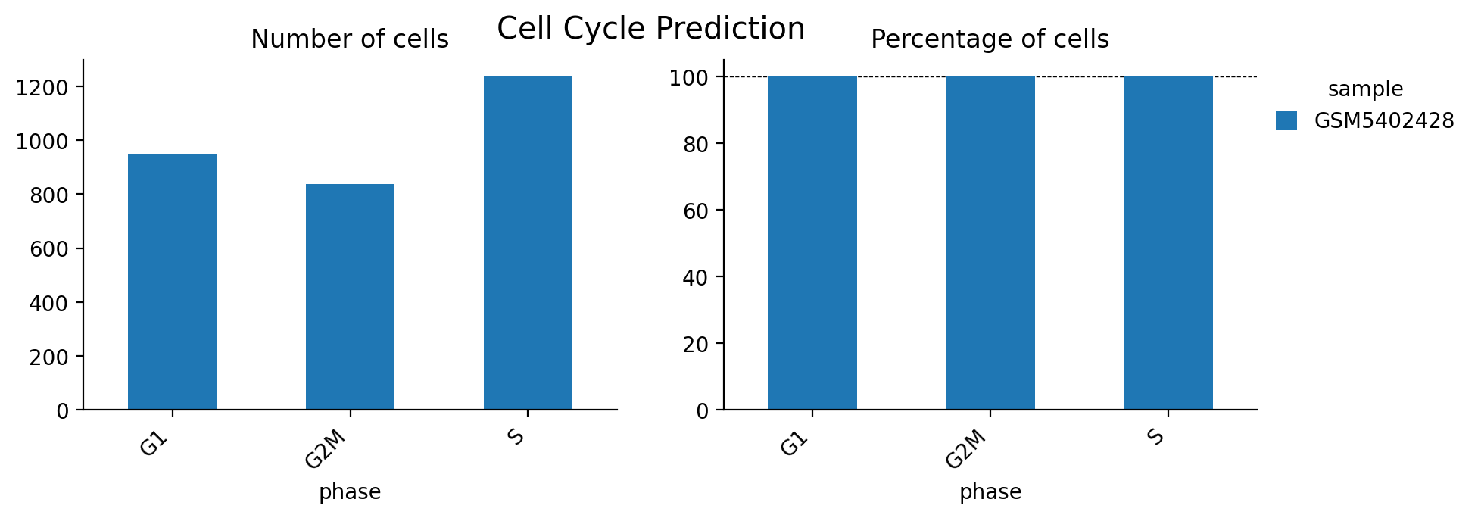
Cell Cycle
Notes:
The cell cycle phase of each cell is predicted based on the activity of known cell cycle genes. The plot shows the distribution of cell cycle phases across the samples.

Slide 20
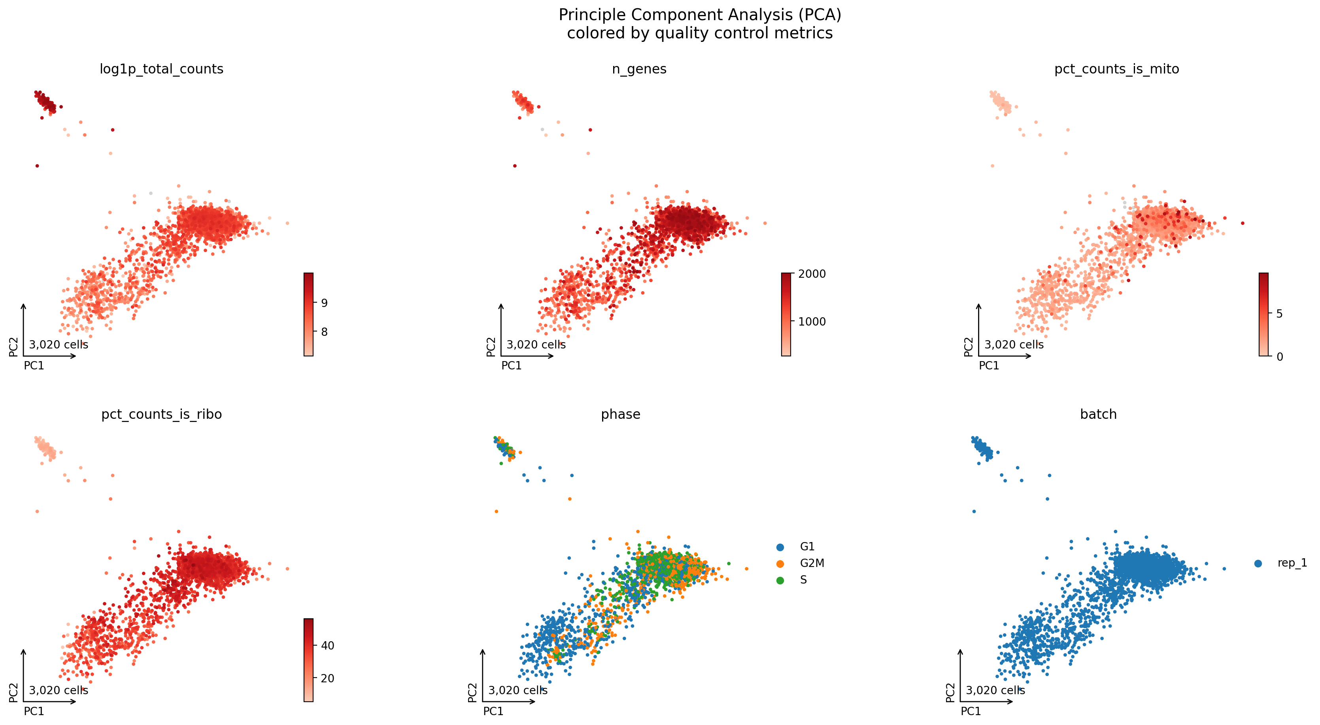
PCA
Notes:
A principle component analysis (PCA) is computed to reduce the dimensionality by reorganizing the data into principle components (PCs). The plot shows the first two PCs with each dot (cell) colored for quality metrics.
There should be no gradient or grouping visible to provide a clean biological signal.

Slide 21
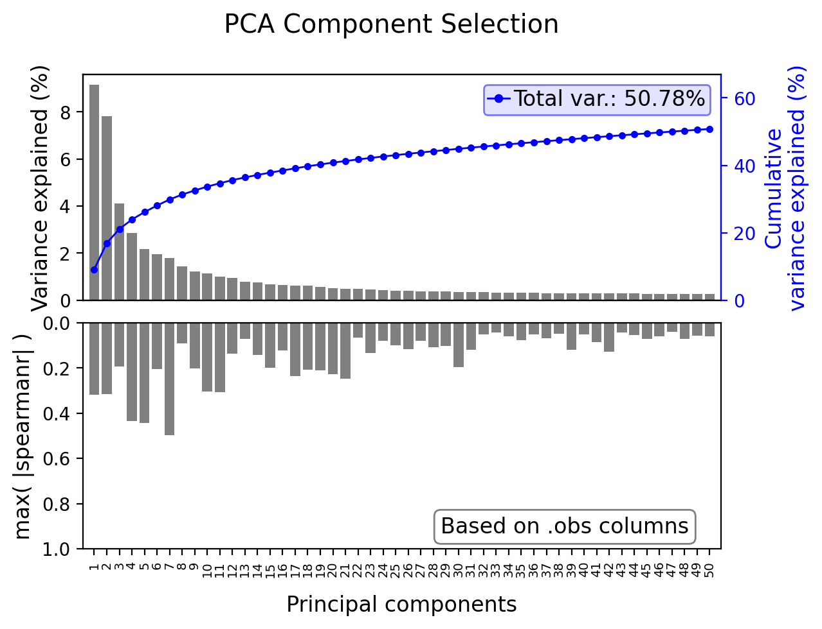
PCA - component subset
Notes:
Each principle component (PC) is evaluated based on its correlation to quality metrics and variance. PCs exceeding one of the two thresholds are filtered from the dataset, indicated as a lightgrey bar.
Removing PCs helps to reduce technical or other unwanted noise to create a clean biological signal.

Slide 22
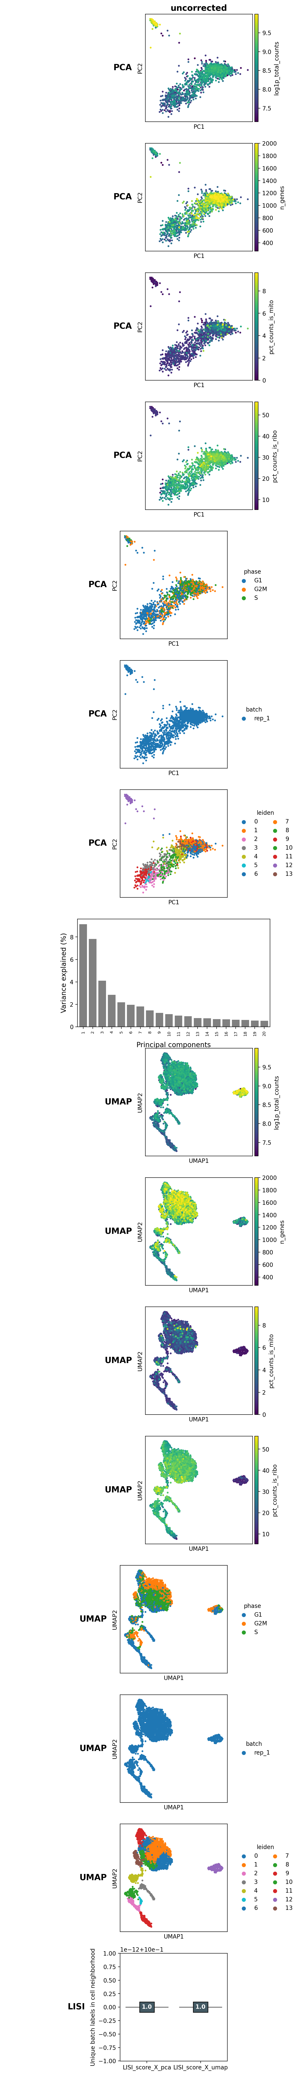
Batch correction
Selected uncorrected batch correction method.
Notes:
Batch correction aims to reduce technical differences in the dataset. For example, two separate sequencing runs may show as two distinct groups despite being biologically similar. There are multiple batch correction methods available with different concepts causing them to perform differently for each dataset. The plot compares multiple batch correction methods (columns) to select the optimal one for the dataset.
The plot shows PCAs and preliminary UMAPs to assess how well the batches are mixed after batch correction. The bottom plots show the LISI score, a measurement for the 'mixedness' of the batches (maximum = number of batches). A high LISI is not a sufficient indicator, the PCA and UMAP shapes should be included into the consideration as well.

Slide 23
Embedding and Clustering

Slide 24
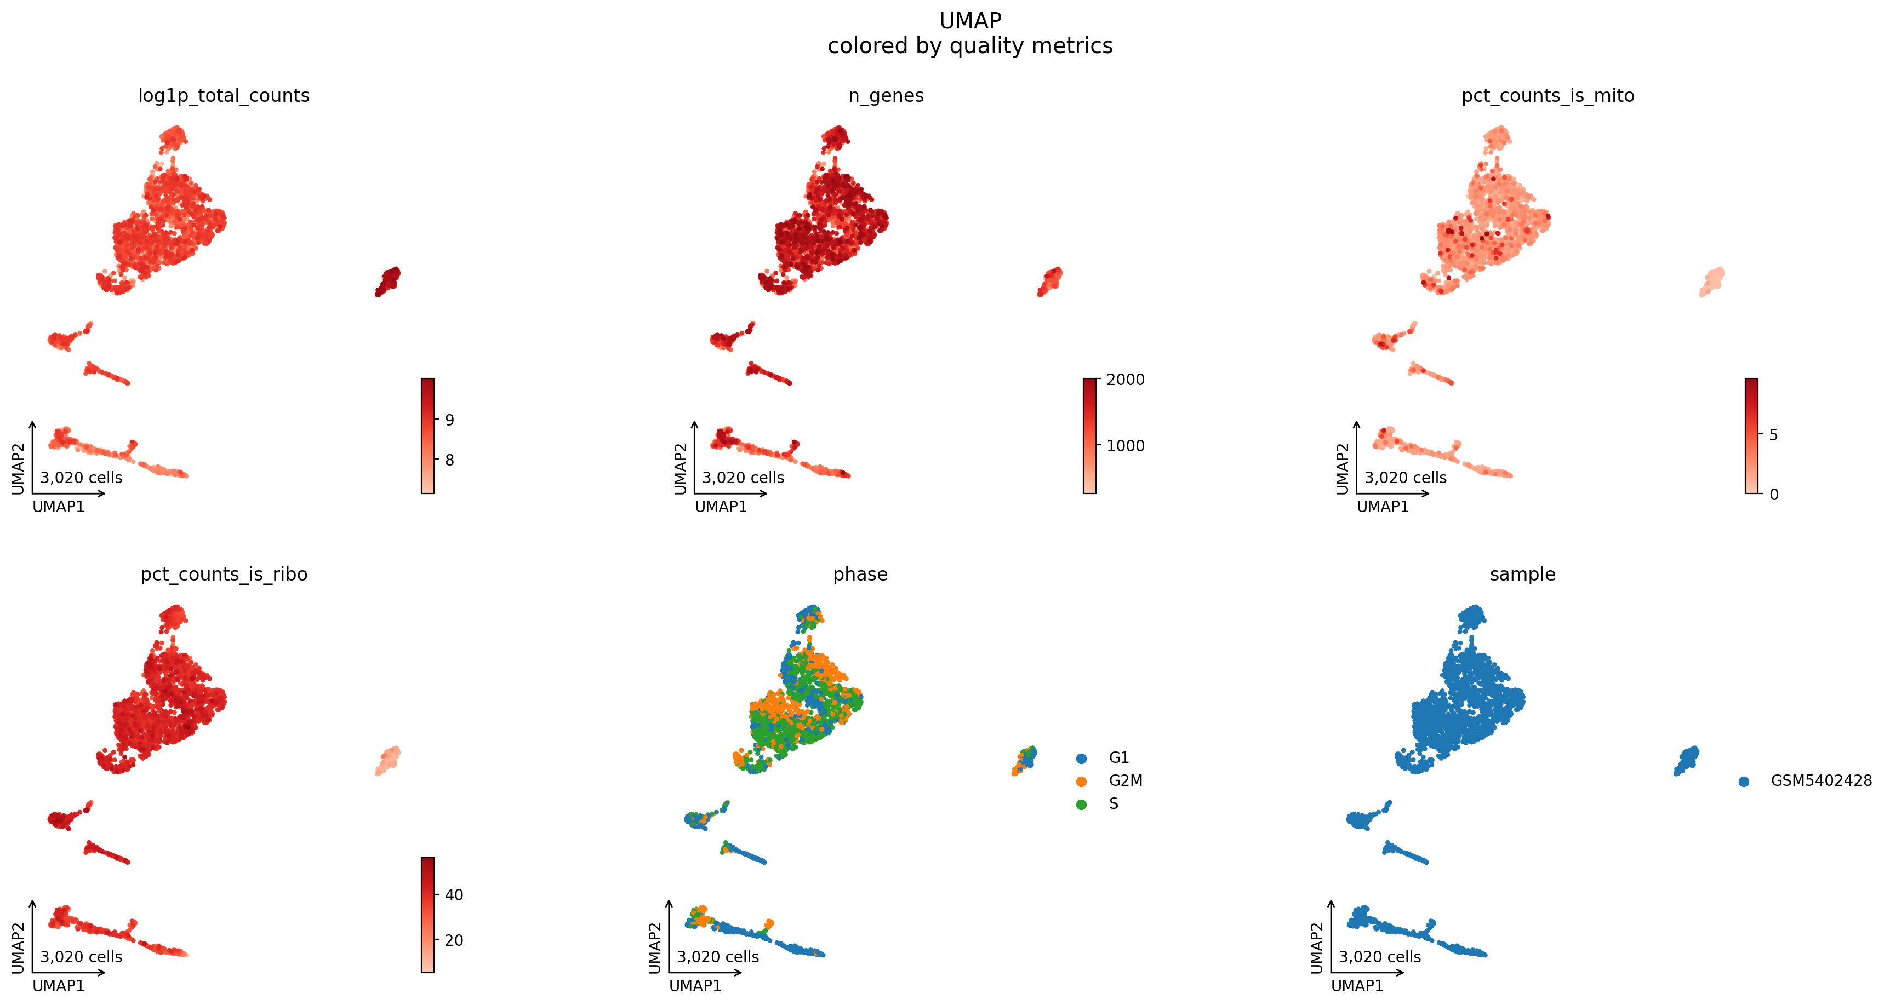
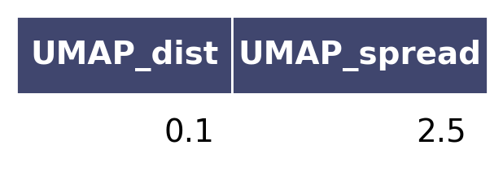
Embedding I
Notes:
The final dimension reduction step is to compute a 2D embedding of the dataset. This can either be a Uniform Manifold Approximation and Projection (UMAP) or distributed stochastic neighbor embedding (t-SNE).
Both methods rely on two main parameters to compute the respective embedding, which are shown in the table. The plot shows the embedding colored for various quality measurements. Ideally, there shouldn't be a gradient or grouping visible, unless expected through the experimental design.
Note: Dot = Cell

Slide 25
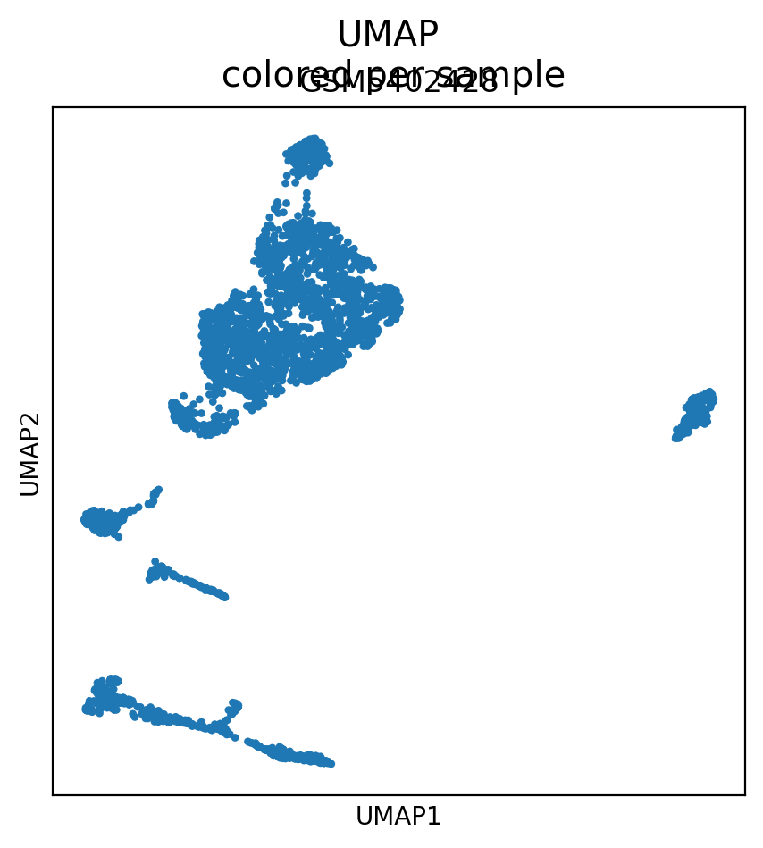
Embedding II
Notes:
This plot shows how the cells for each sample/ condition are distributed across the dataset.

Slide 26
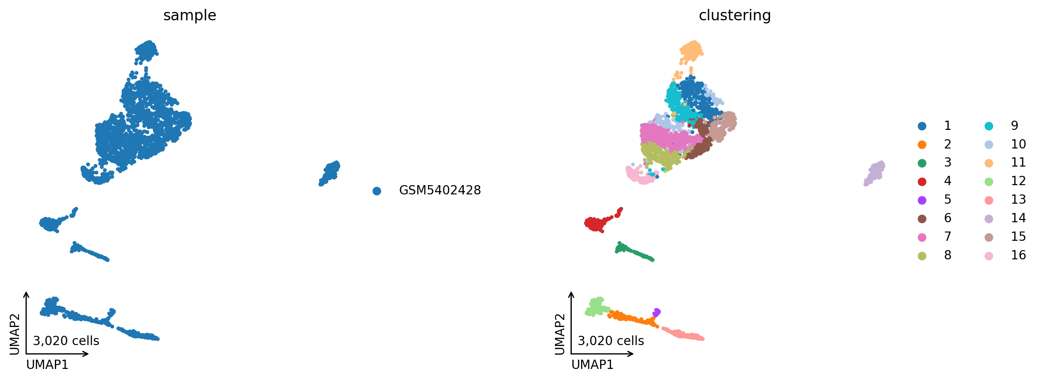
Clustering I
Notes:
The embedding colored for sample/ condition (left) and cells assigned to clusters (right). Clustering is typically done using the leiden algorithm.

Slide 27
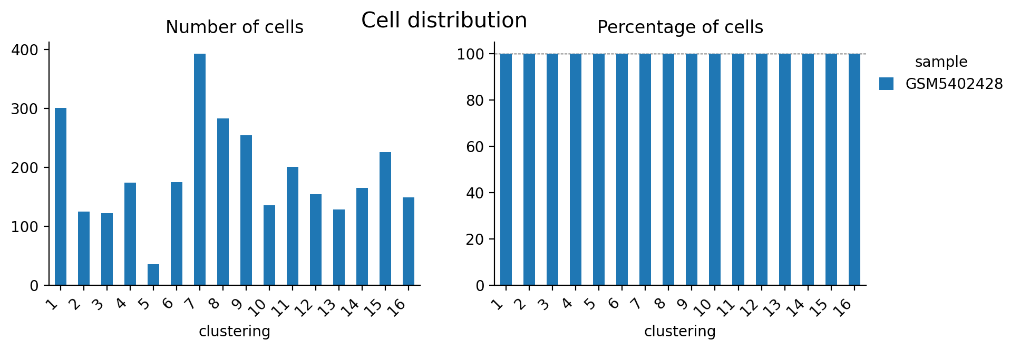
Clustering II
Notes:
Here, the number of cells per clusters is shown. The color shows the proportion of cells assigned to samples/ conditions.
Small clusters or clusters predominantly from one sample/ condition may be outliers or part of a bigger cluster, as such, they may be removed or combined with another cluster. However, this is tied to the expectations of the individual dataset and must be decided on a case-by-case basis.

Slide 28
Group Marker prediction

Slide 29
Top Marker Genes
Notes:
The top marker genes for each group, e.g. a clustering or cell types, presented in heatmap and dotplot style.
Good quality marker genes are exclusively expressed in one group, meaning they show up in only one row of the plots.
A dataset with groups that are well separated by gene markers shows a 'stair-like' pattern in the plots.
Groups with shared markers might be combined to provide better separated groups.

Slide 30
Top Marker Expression per Group I
Notes:
The top marker for each group (row). The first embedding shows the location of the group and the following plots show the respective gene expression binned into hexagonal tiles.

Slide 31
Top Marker Expression per Group II
Notes:
The top marker for each group (row). The first embedding shows the location of the group and the following plots show which cells express the gene.

Slide 32
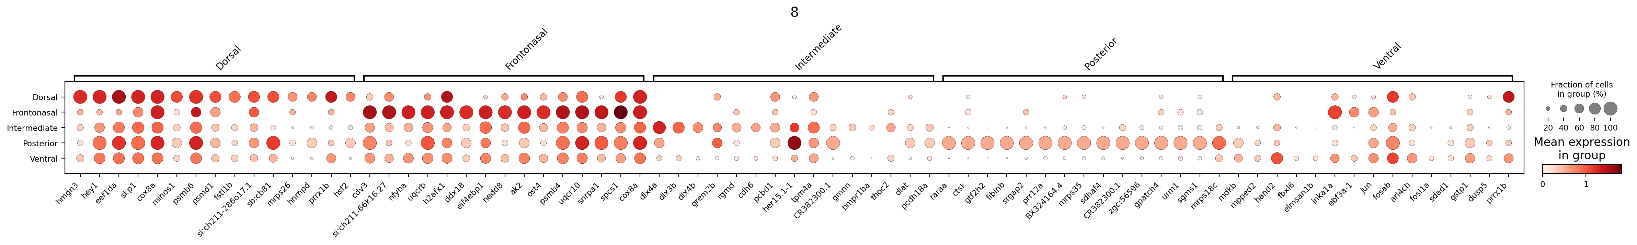
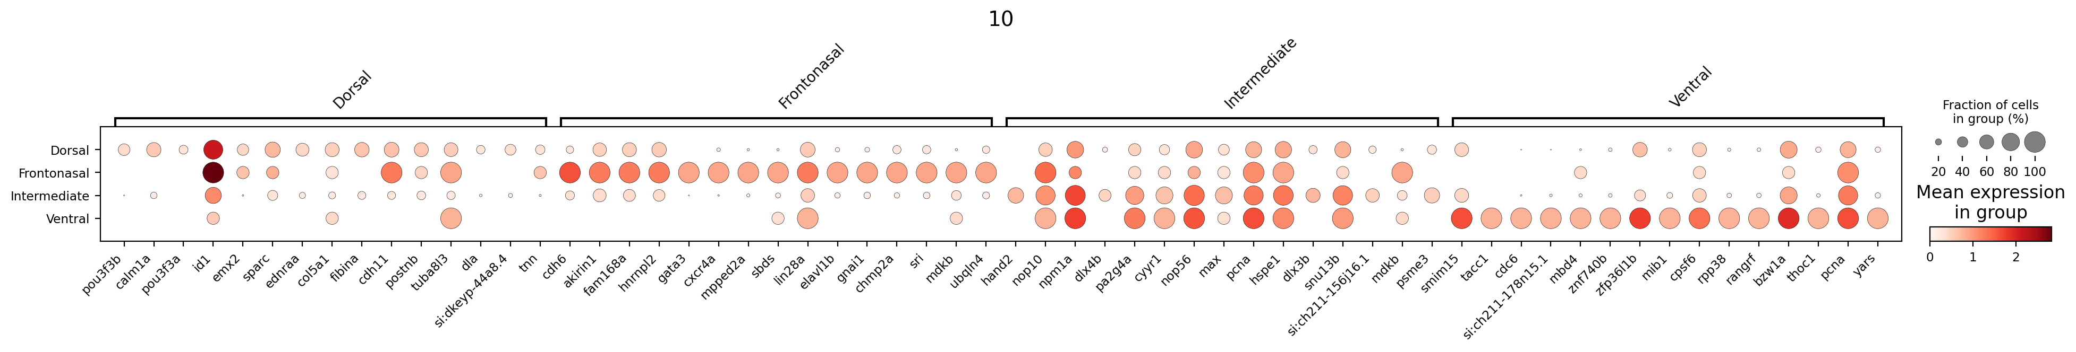
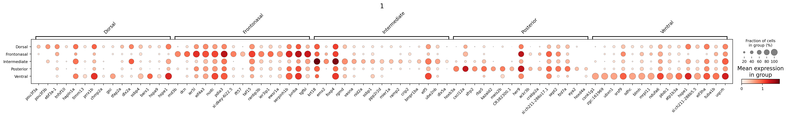
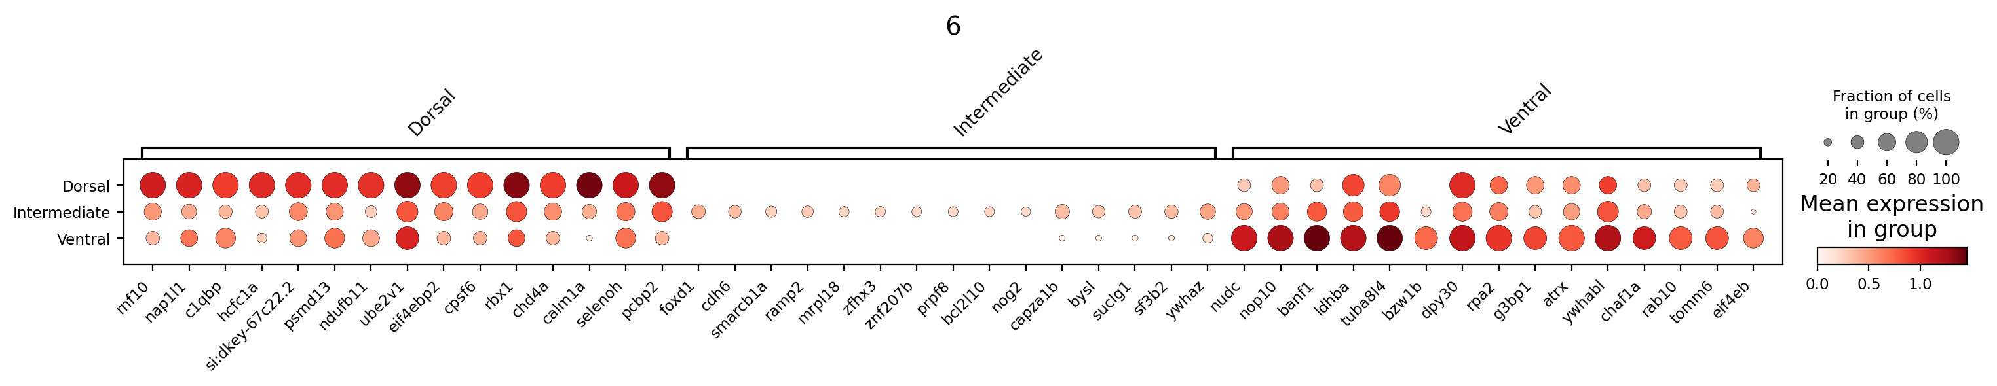
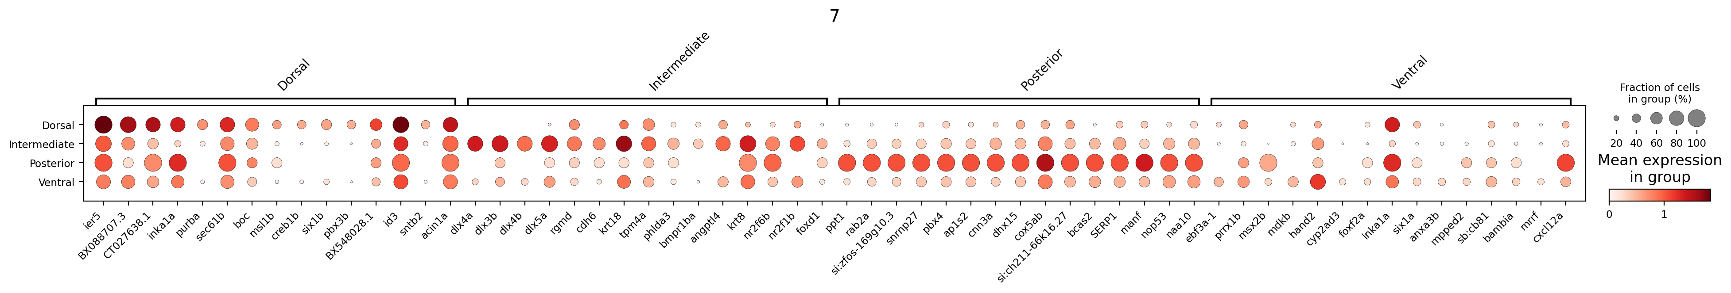
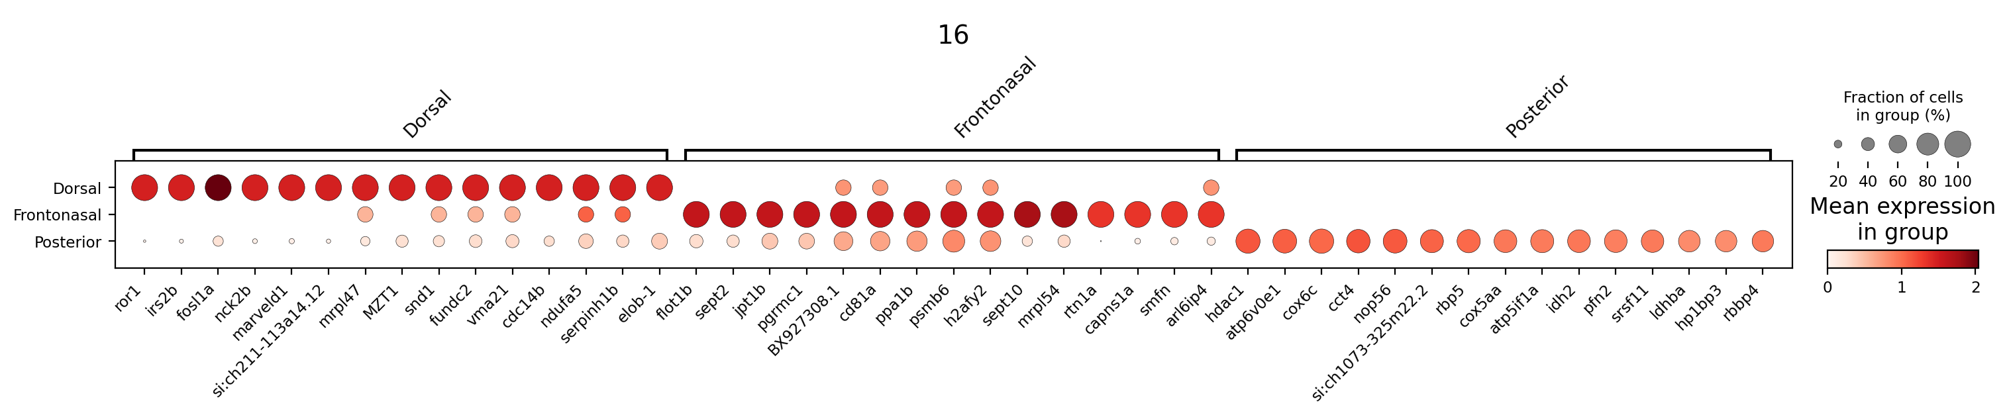
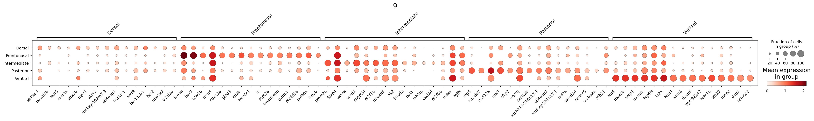
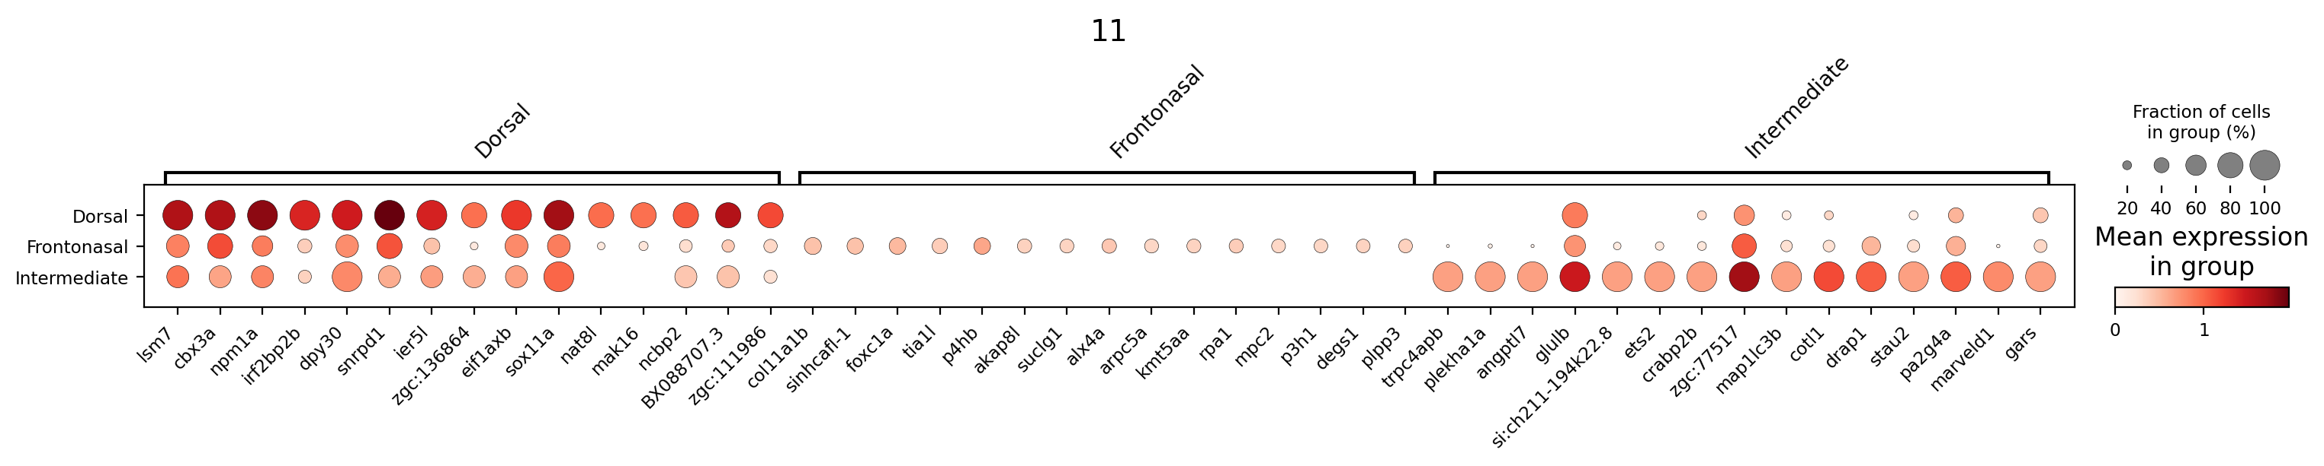
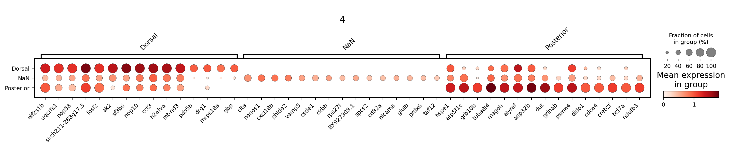
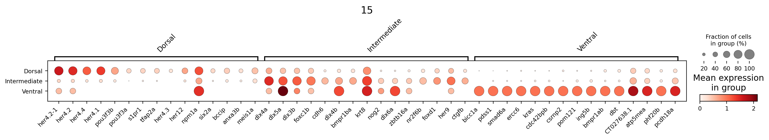
Condition Markers
Notes:
This slide shows marker genes that separate the condition within a group. A dotplot is shown for each group where condition markers are found.

Slide 33
Cell Type Annotation

Slide 34
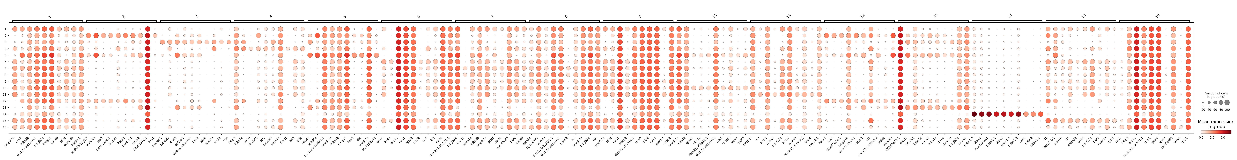
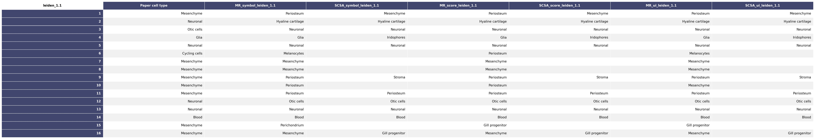
Cell Type Annotation
Notes:
The dotplot shows the groups to assign cell types and their respective top gene markers.
The table shows different annotation versions (columns) based on different algorithms. The Annotation is either based on SCSA or on the SC-Framework internal marker repo (MR).

Slide 35
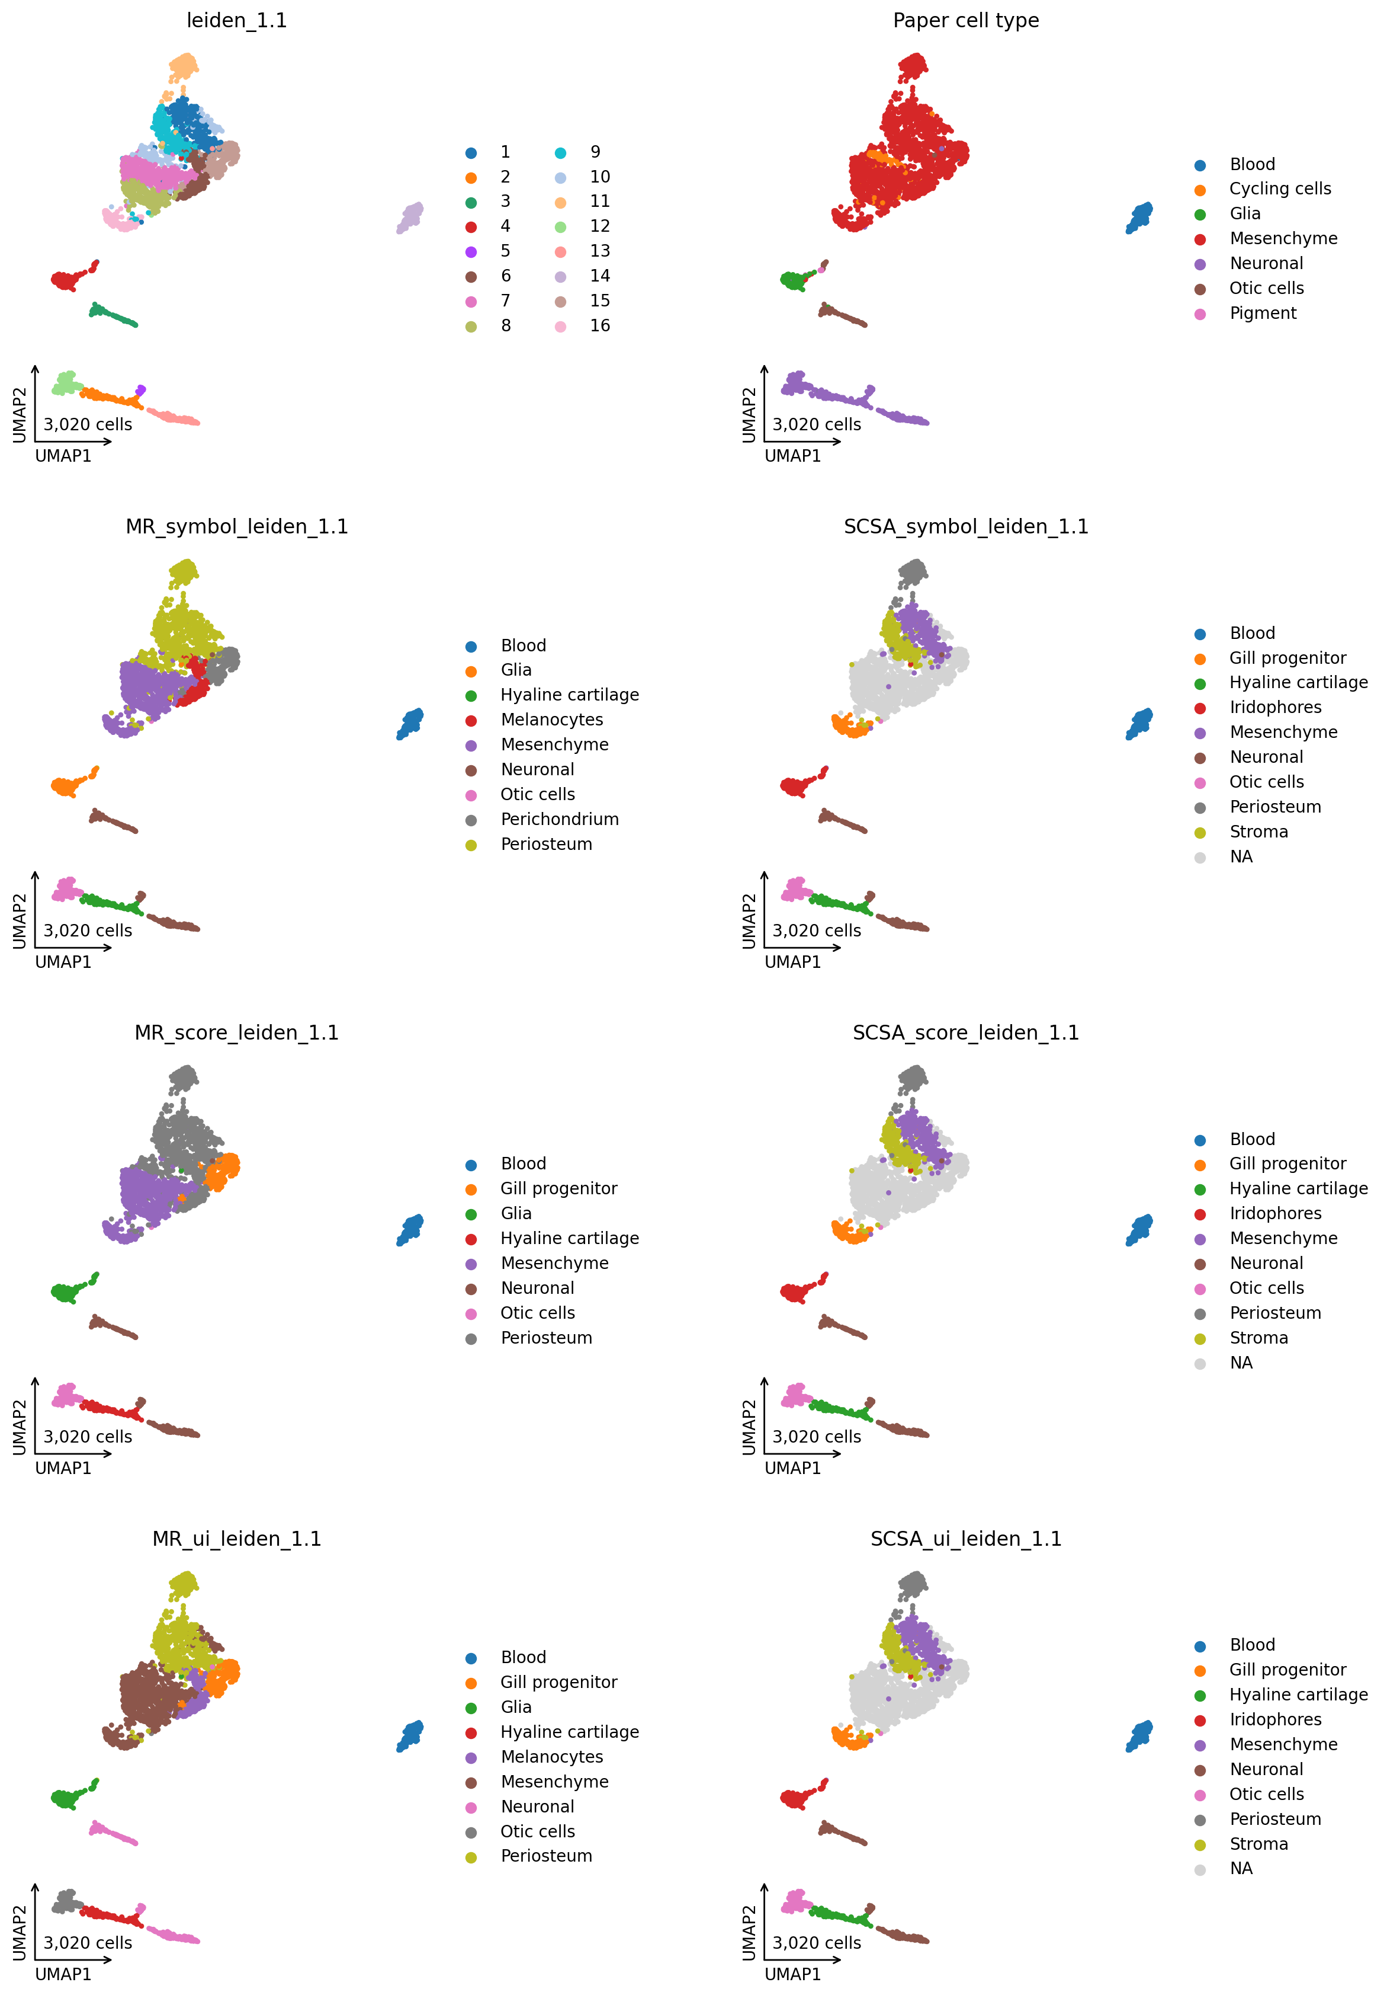
Cell Type Annotation
Notes:
The first embedding is colored for the initial groups, while the following embeddings show the different annotation versions from the previous slides.

