Slide 1
WP3 04.02.22

Slide 2
Tasks done during the week
Received bam from WP2
  Currently clustering
    Running quite slowly, multithreading?
Grouped TFs into families
  Not exactly the same as in bindetect_figures but very close
  Problems with meaningfully naming the families
    JASPER families, protein classes?

Slide 3
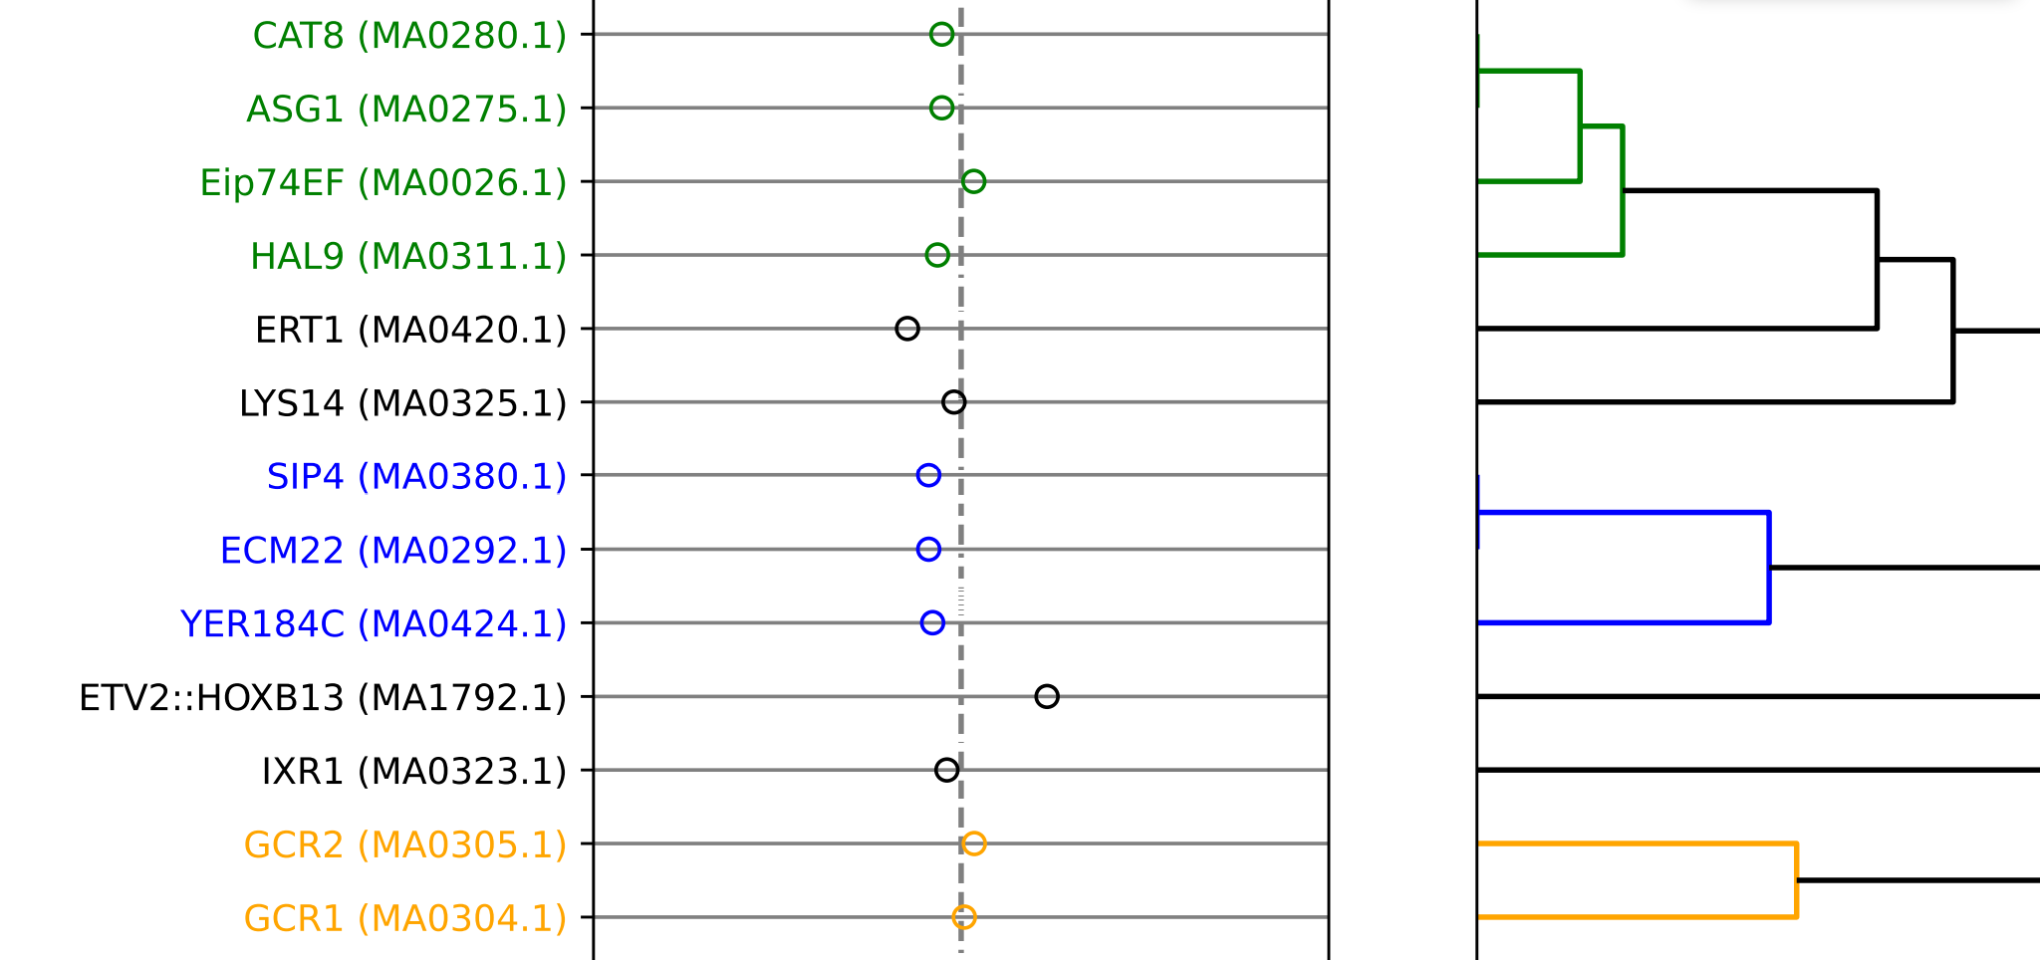


Slide 4
ToDos
Trying out new and improved snakemake pipeline with the new data after clustering
Ironing out a few small problems regarding TF families and file compatibility

