Slide 1
WP3 04.03.22

Slide 2
Tasks done during the week
Ran our tools with the available files

Slide 3
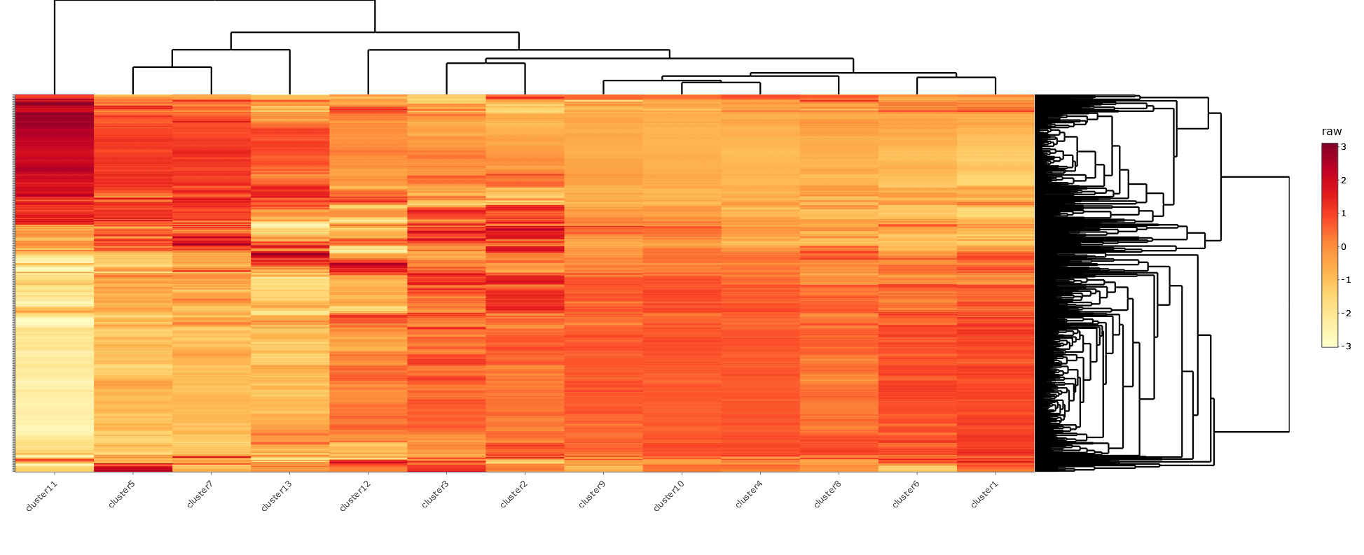
Gastrocnemius medialis

Slide 4
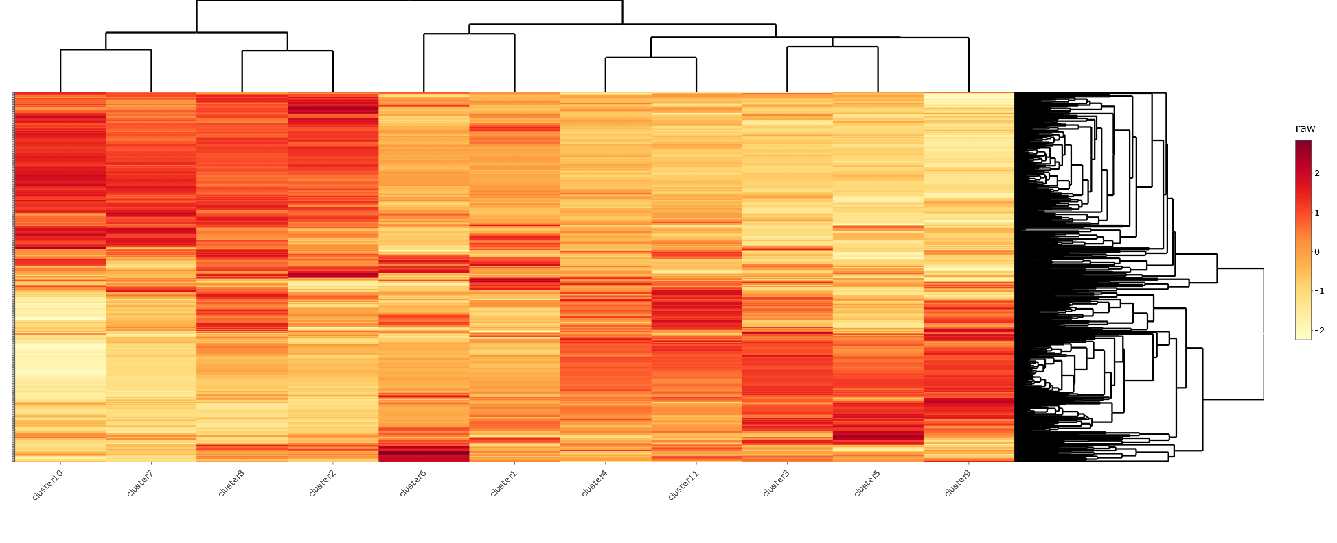
Lower Leg Skin

Slide 5
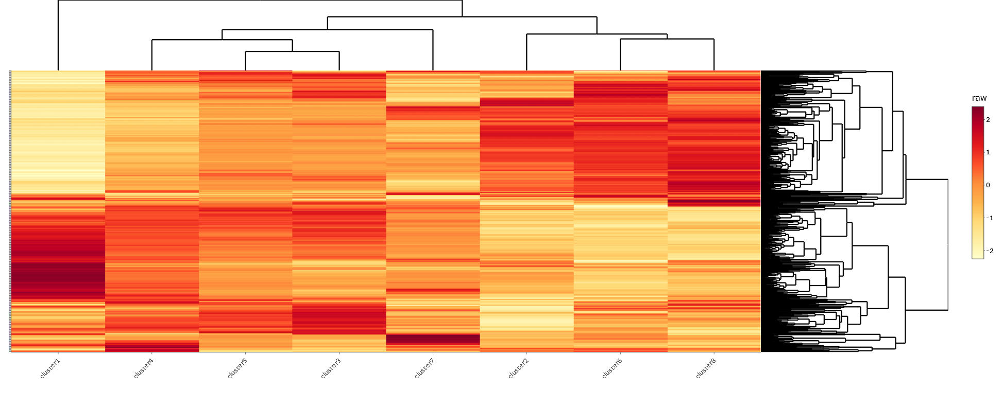
Omental Fat Pad

Slide 6
