Slide 1
WP3 11.02.22

Slide 2
Tasks done during the week
Rewrote clustering script
  Runtime: 12h → 20 min
Ran snakemake pipeline with right lobe of liver data
  Diabled plotting for runtime: 3d → 1d
Attempted proper hierarchical clustering for TF families
Adapted scripts to new data
Wrote script to compare TF profile similarity

Slide 3
Workflow
All.bam
Clustering.py
Cluster1.bam
Cluster2.bam
Etc.
TOBIAS
ATACorrect
TOBIAS
ScoreBigwig
TOBIAS
BINDetect
Cell
Assignment
Table
TF_families.py
Bindetect
_distances.txt
Of different runs
Profile
Similarity.py
ImportantTFs
PerCluser.tsv
DefiningTF.py
ClusterComparison
.tsv
Compare
Cluster
Score.py
bindetect_results.txt
Biological
Implications?
Wilson
Heatmap
Visualisation

Slide 4
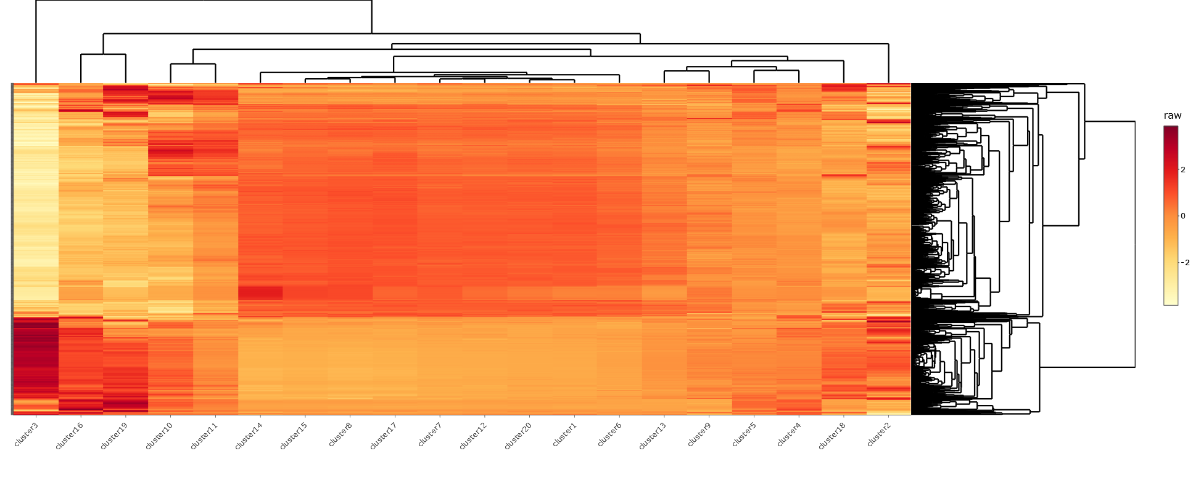
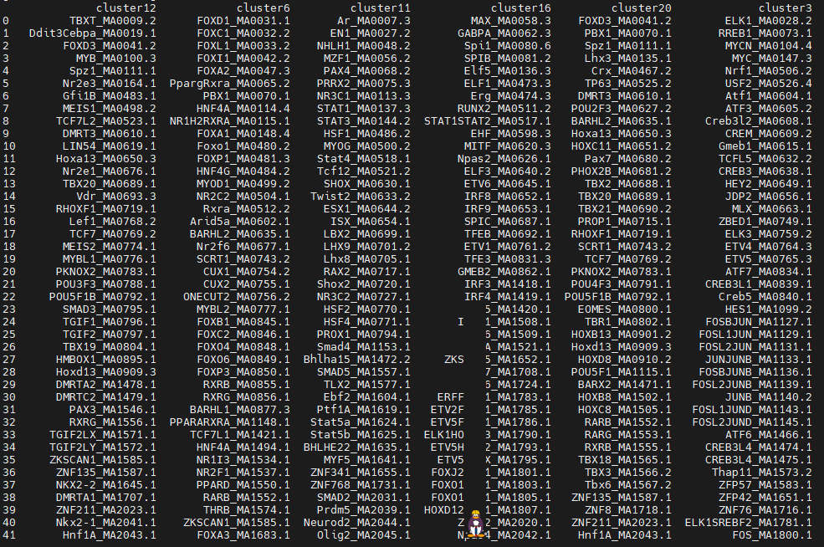
Wilson Heatmap
Defining Transcription Factors

Slide 5
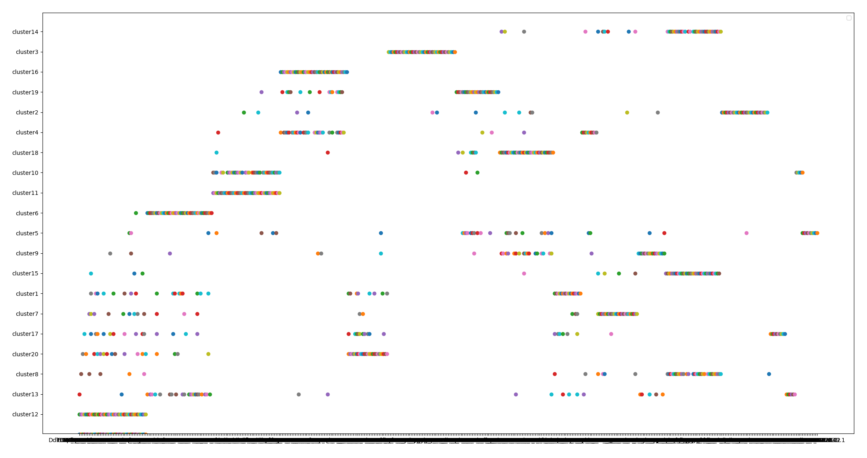
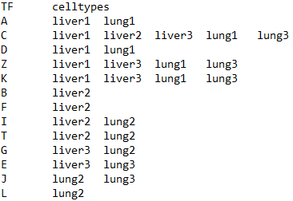
Overlapping Defining Transcription Factors between clusters

Slide 6
Biological Questions / Goals of Analysis
How does the transcription factor profile correspond to cell type?
Do similar cell types in different tissues also have a similar TF profile?
  Can cell type assignment be verified by this?
  Usable to predict unknown cell types?

Slide 7
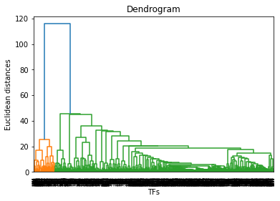
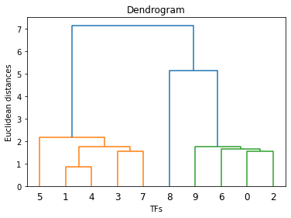
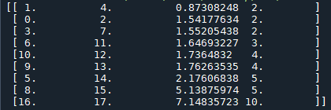
Problems
Have not been able to convert hierarchical clustering to TF families
Used Scipy

Slide 8
ToDos
Fix TF families with hierarcical clustering
Improve visualisation (Profile Similarity)
Naming the clusters
  Requires names from WP1/2
  tsv with # and cell type should already work with clustering script
Clean up code and documentation

