Slide 1
WP3 18.02.22

Slide 2
Tasks done during the week
Successfull TF family clustering!
  Added the option to use them for the other scripts
Slight adjustment of defining TF profile similarity plot
  One more dimension via color
    How often does this TF appear in all clusters?
    Tried to simulate upset plot without the bars
Worked on documentation / Readme

Slide 3
Workflow
All.bam
Clustering.py
Cluster1.bam
Cluster2.bam
Etc.
TOBIAS
ATACorrect
TOBIAS
ScoreBigwig
TOBIAS
BINDetect
Cell
Assignment
Table
TF_families.py
Bindetect
_distances.txt
Of different runs
Profile
Similarity.py
ImportantTFs
PerCluser.tsv
DefiningTF.py
ClusterComparison
.tsv
Compare
Cluster
Score.py
bindetect_results.txt
Biological
Implications?
Wilson
Heatmap
Visualisation

Slide 4
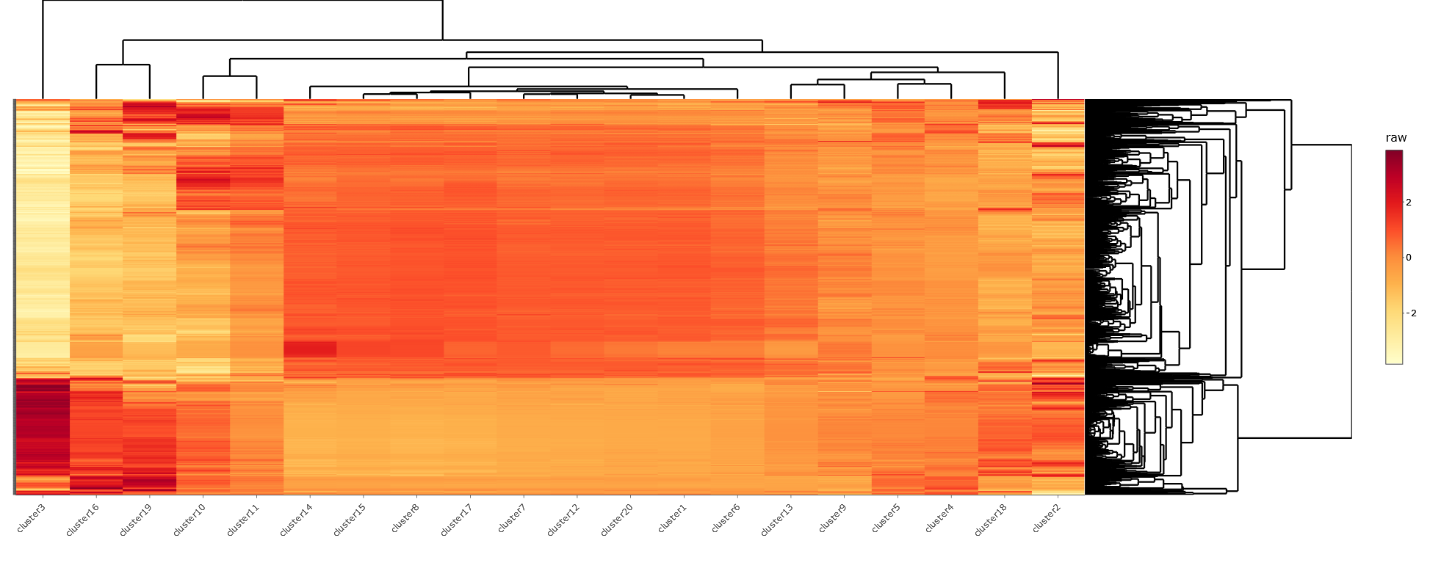
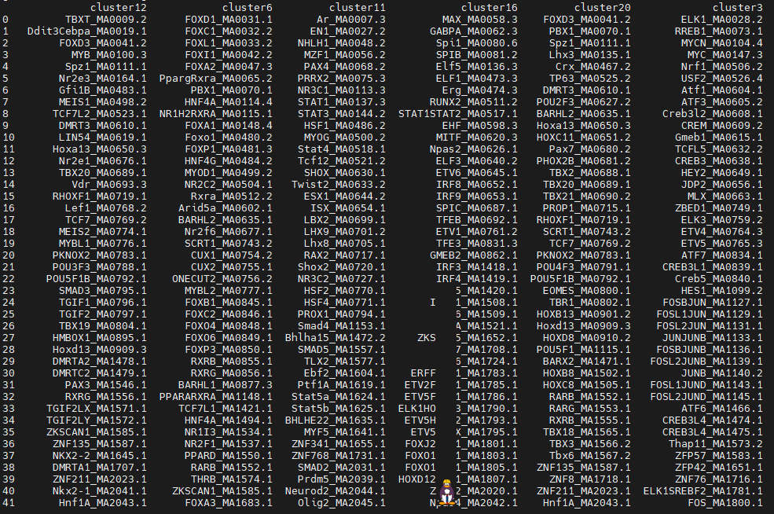
Previously…
Without Family Clustering
Wilson Heatmap
Defining Transcription Factors

Slide 5
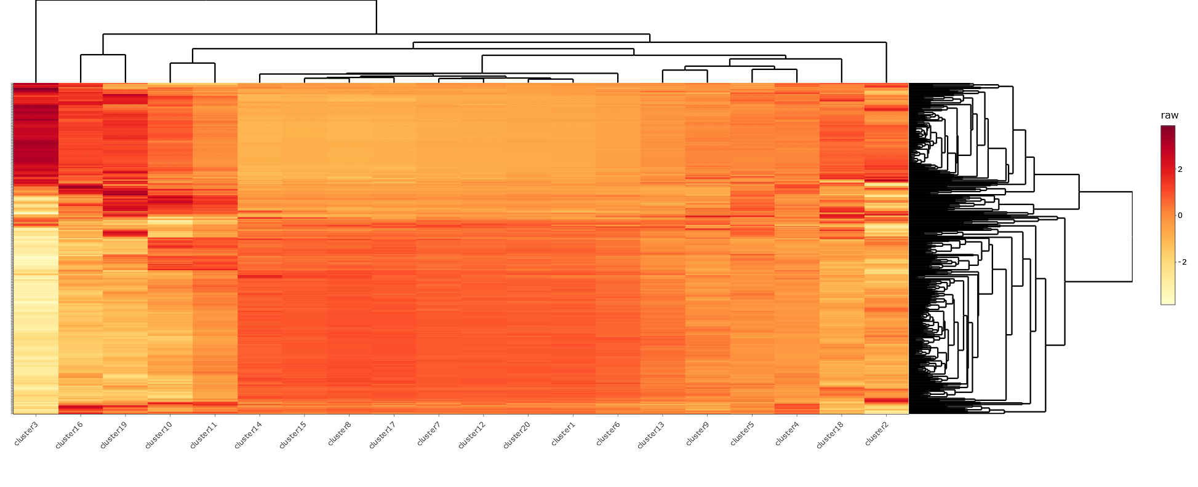
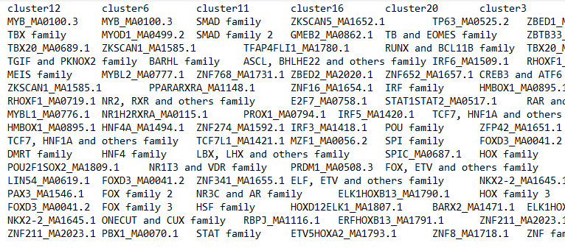

Slide 6
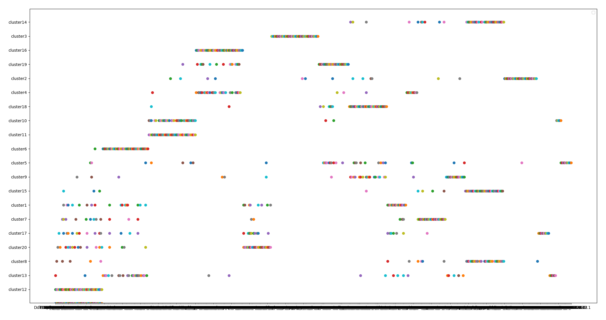
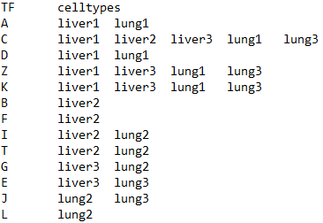
Overlapping Defining Transcription Factors between clusters
Previously…
Without Family Clustering

Slide 7
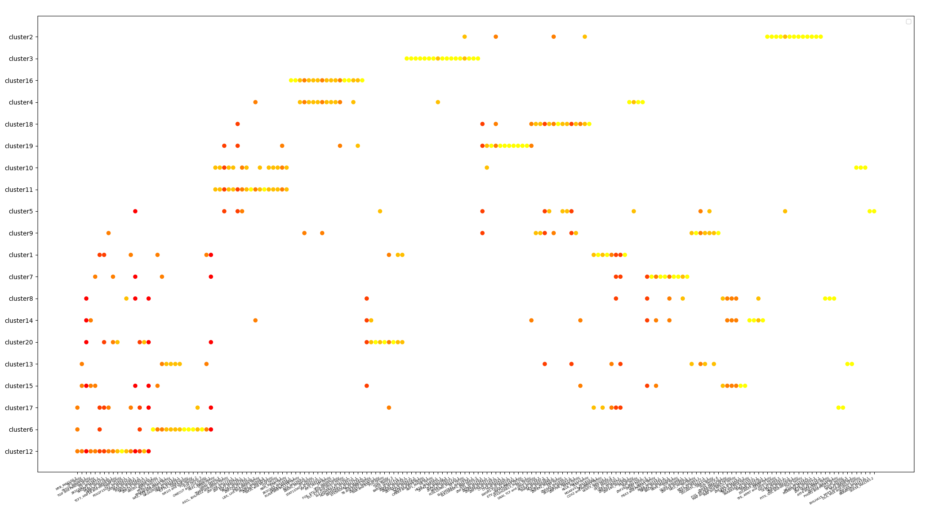

Slide 8
ToDos
Fix bug with empty TF family scores
Improve plots?
Clean up code and finish documentation
Work on different tissues provided by previous WPs to compare them to each other!

