Slide 1
WP3 25.02.2022

Slide 2
Tasks done during the week
Wrote a bash script to sort bams
Started working on different tissues
  Pankreas done
Bubble plot: bubble size now corresponds to family size

Slide 3
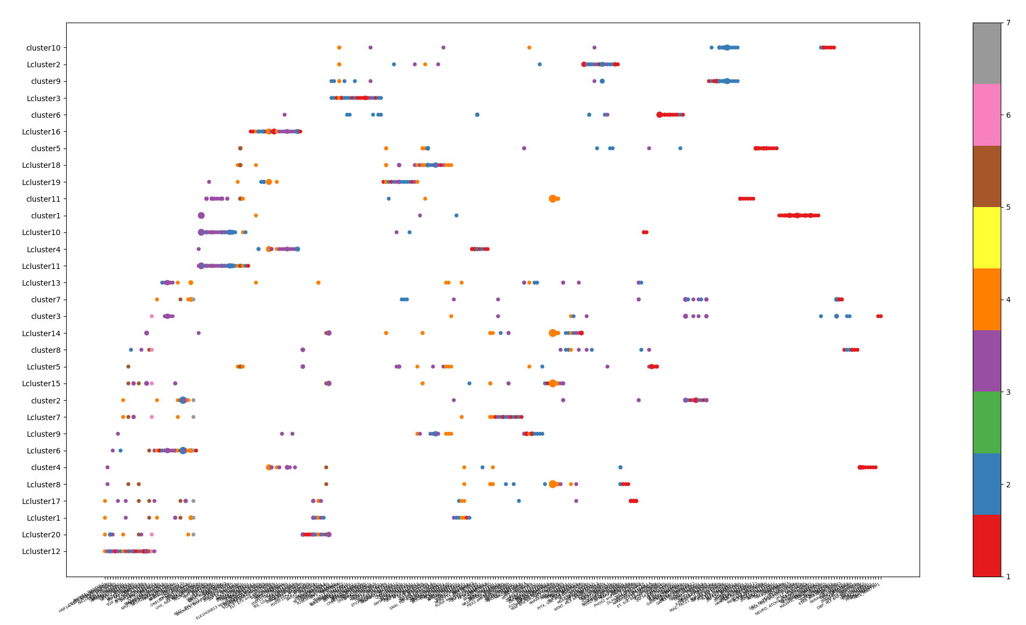

Slide 4
Research Questions
How does the transcription factor profile of different cell types look like, how does it differ?
Do similar cell types in different tissues show a similar TF profile?
If there are patterns to be observed, are there cell types that have comparable TF profile while their biological function might not be similar at first glance?
Do these analyses differ when conducted with either the transcription factors by themselves or by clustering those with similar motives into families?

Slide 5
