Slide 1
An automatically generated presentation

Slide 2
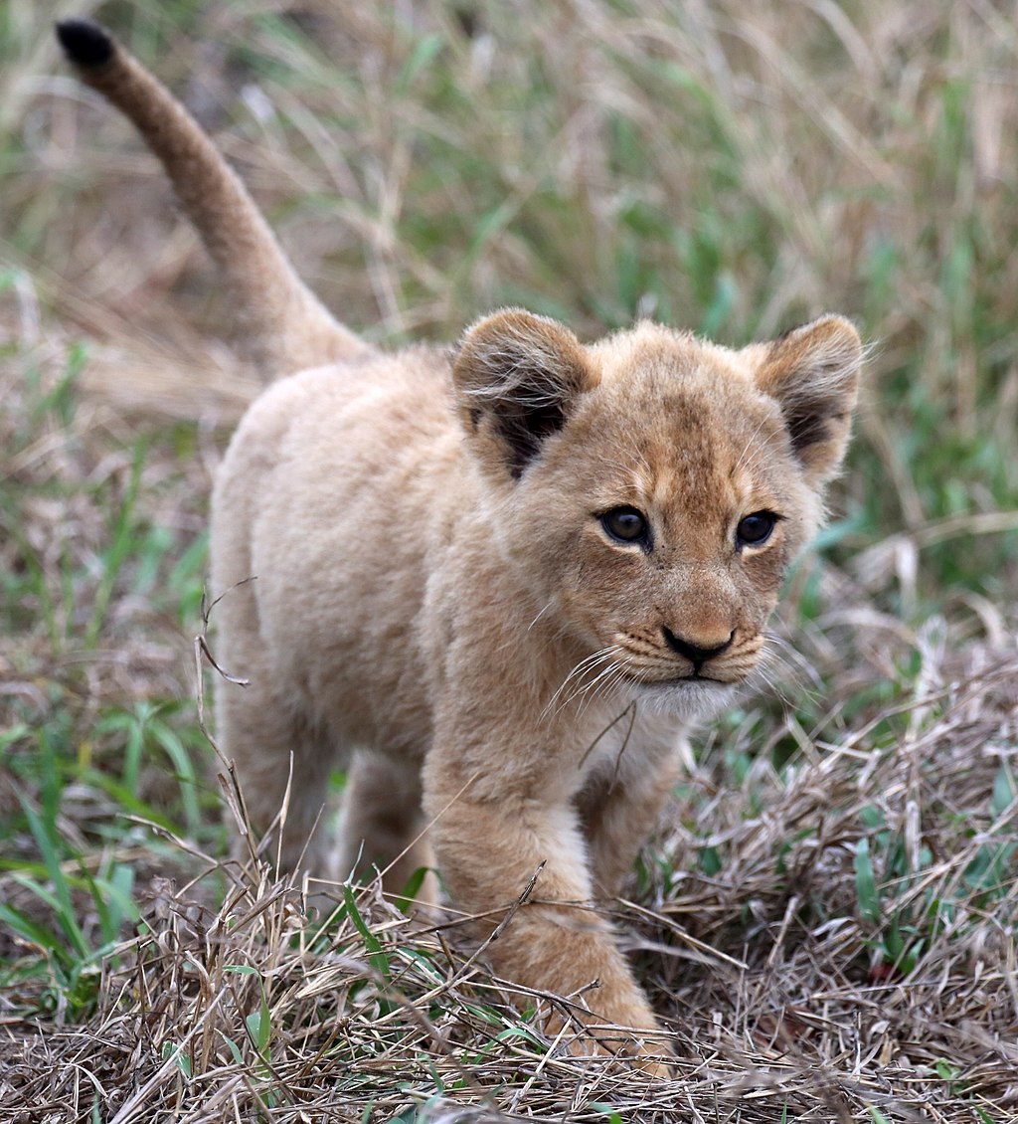
A lion

Slide 3
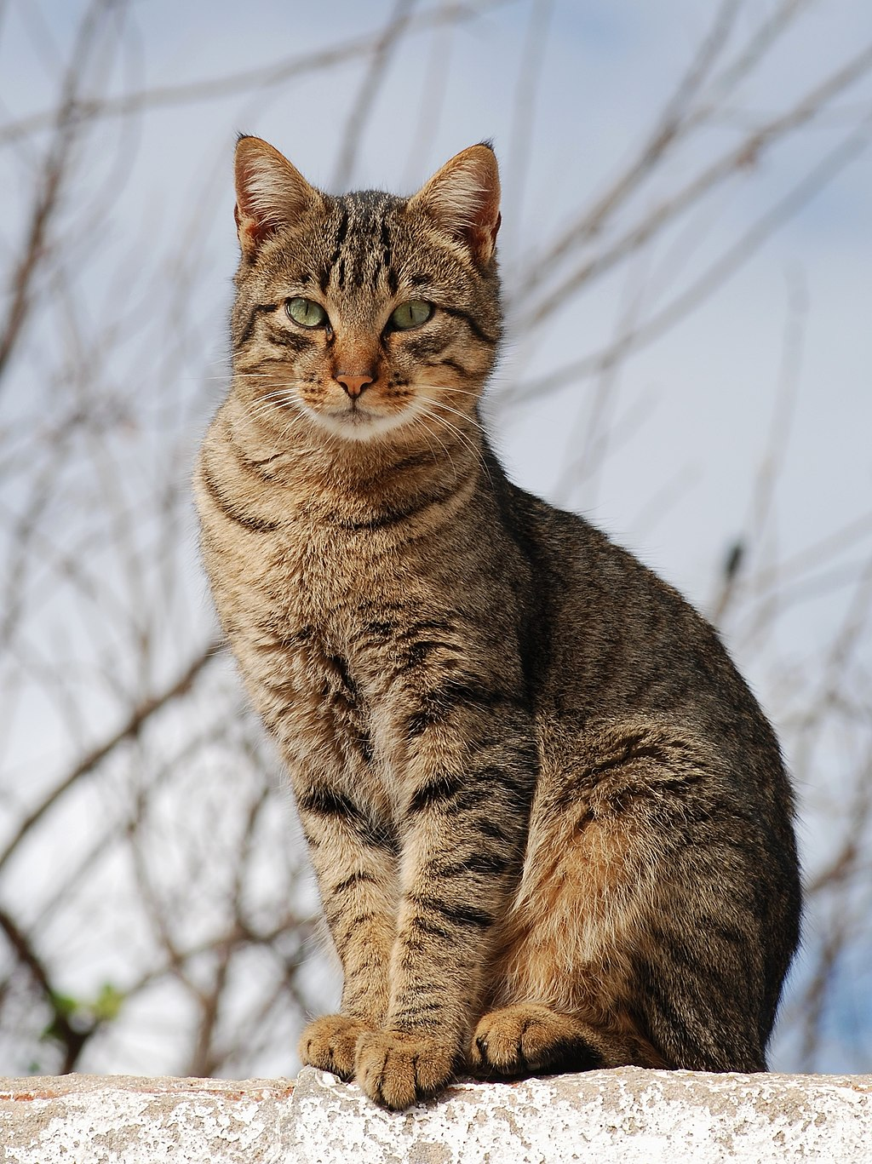
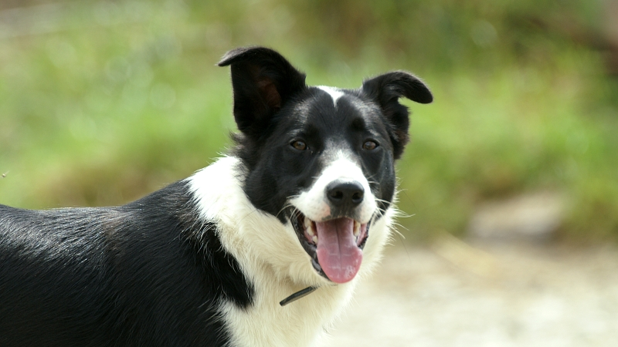
Pets

Slide 4
A lion (vertical layout)
Some text below the picture

Slide 5
A lion (specific height ratios)
Using 'height_ratios' controls how much vertical space the picture has

Slide 6
A lion (horizontal layout)
Some text next to the picture

Slide 7
A lion (specific width ratios)
Using 'width_ratios' controls how much vertical space the picture has

Slide 8
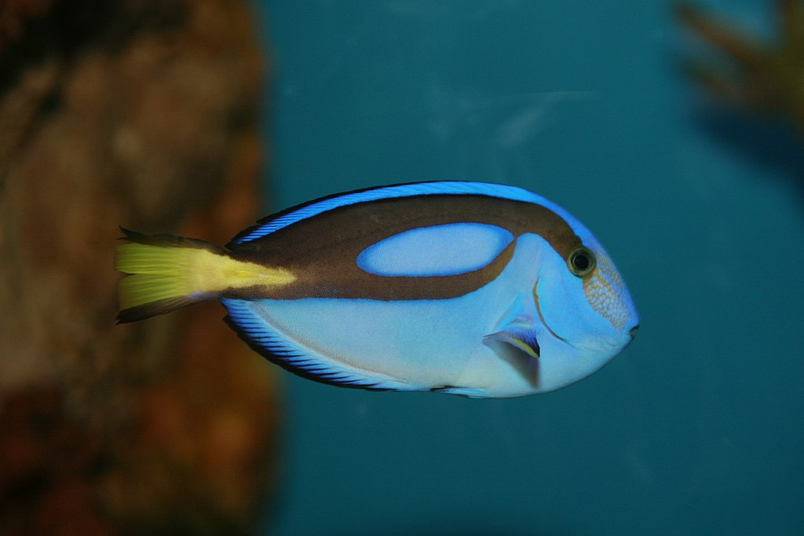
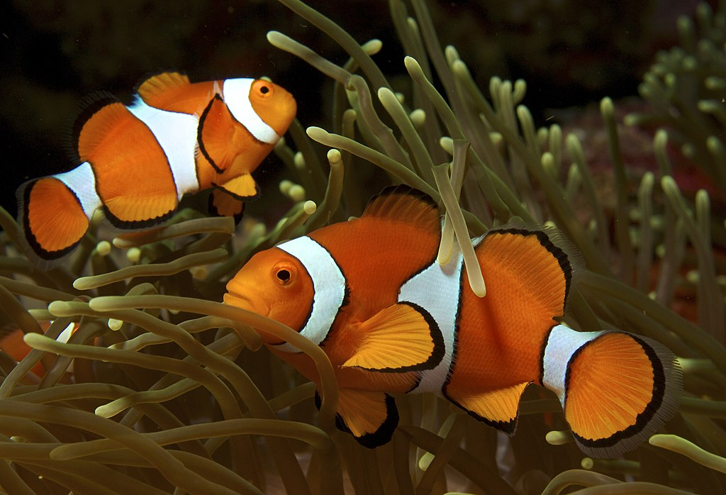
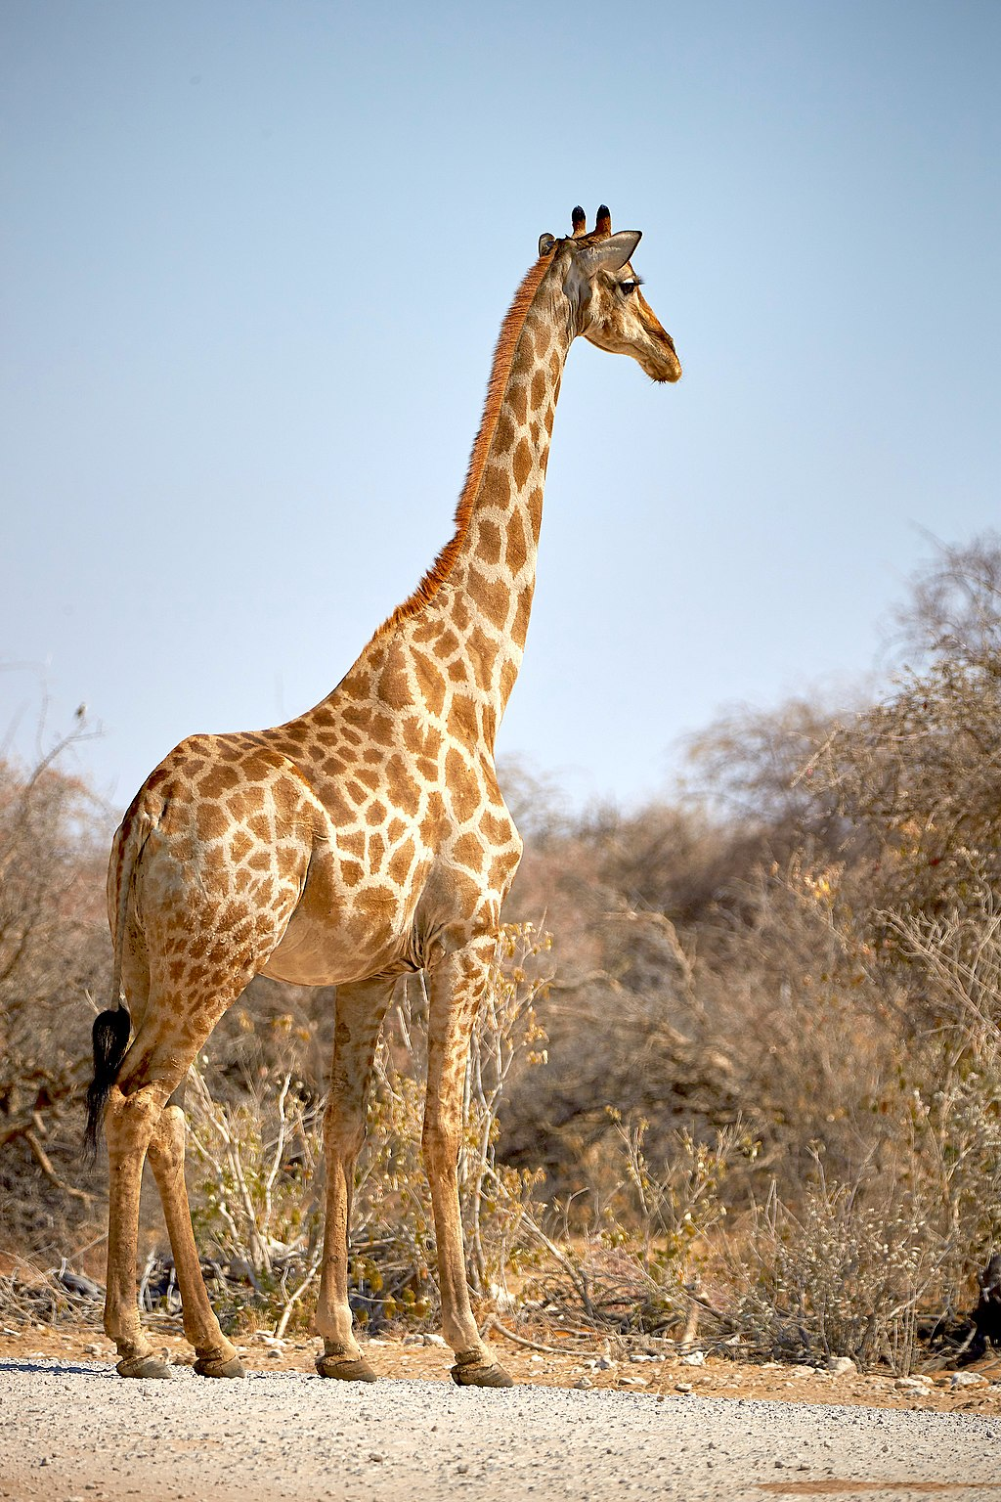
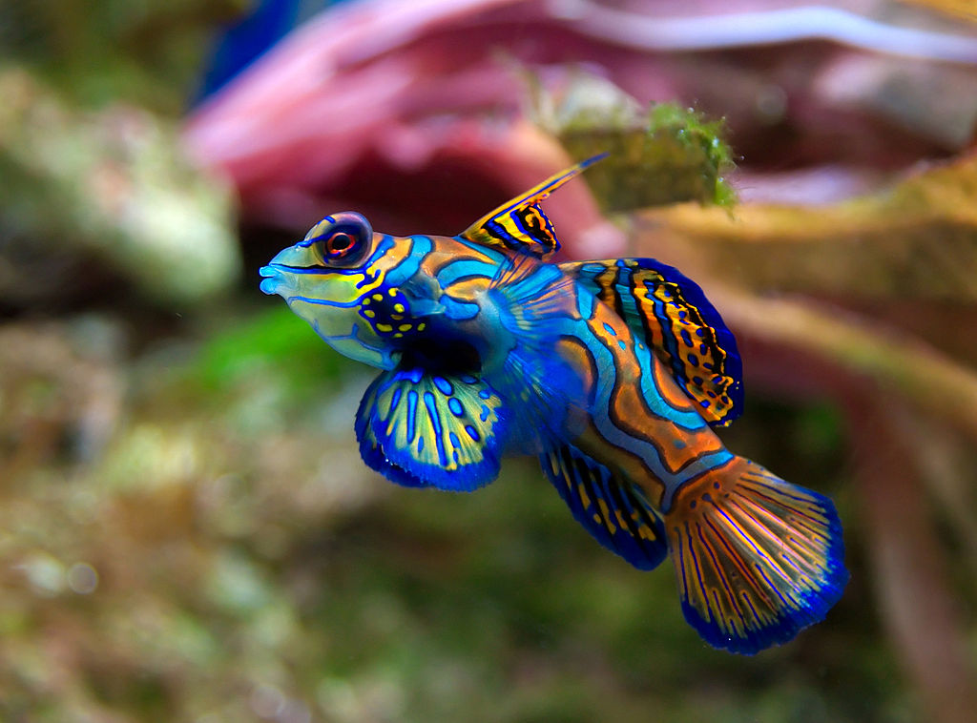
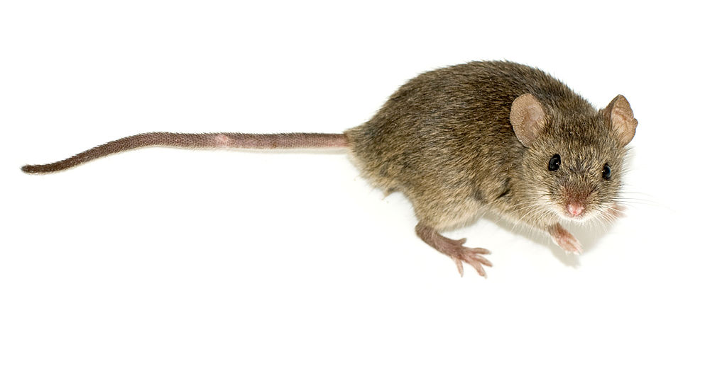
A grid of animals

Slide 9
A grid (no inner margins)

Slide 10
A grid (no outer margins)

Slide 11
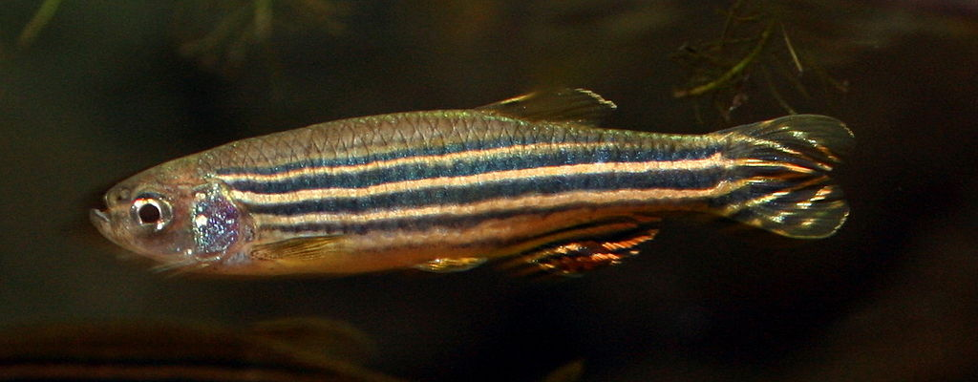
Fish
Fish are aquatic, craniate, gill-bearing animals that lack limbs with digits. Included in this definition are the living hagfish, lampreys, and cartilaginous and bony fish as well as various extinct related groups. Approximately 95% of living fish species are ray-finned fish, belonging to the class Actinopterygii, with around 99% of those being teleosts.

Slide 12
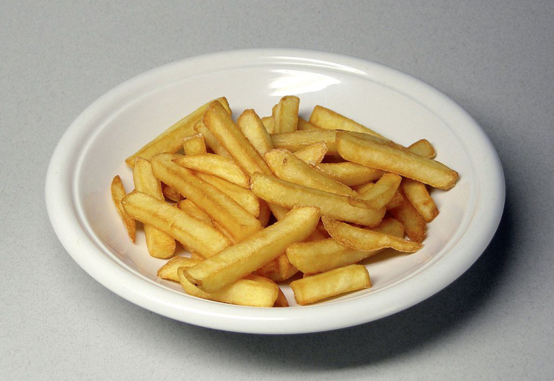
Fish and chips
The chips came from a .pdf

Slide 13
Testing custom layouts
dkjfn

Slide 14
Custom content layout 1

Slide 15
Custom content layout 2

Slide 16
Custom content layout 3

