Slide 1

IMAGE UPSCALING w/ BICUBIC INTERPOLATION
Loo Tan Rong
49003377

Slide 2
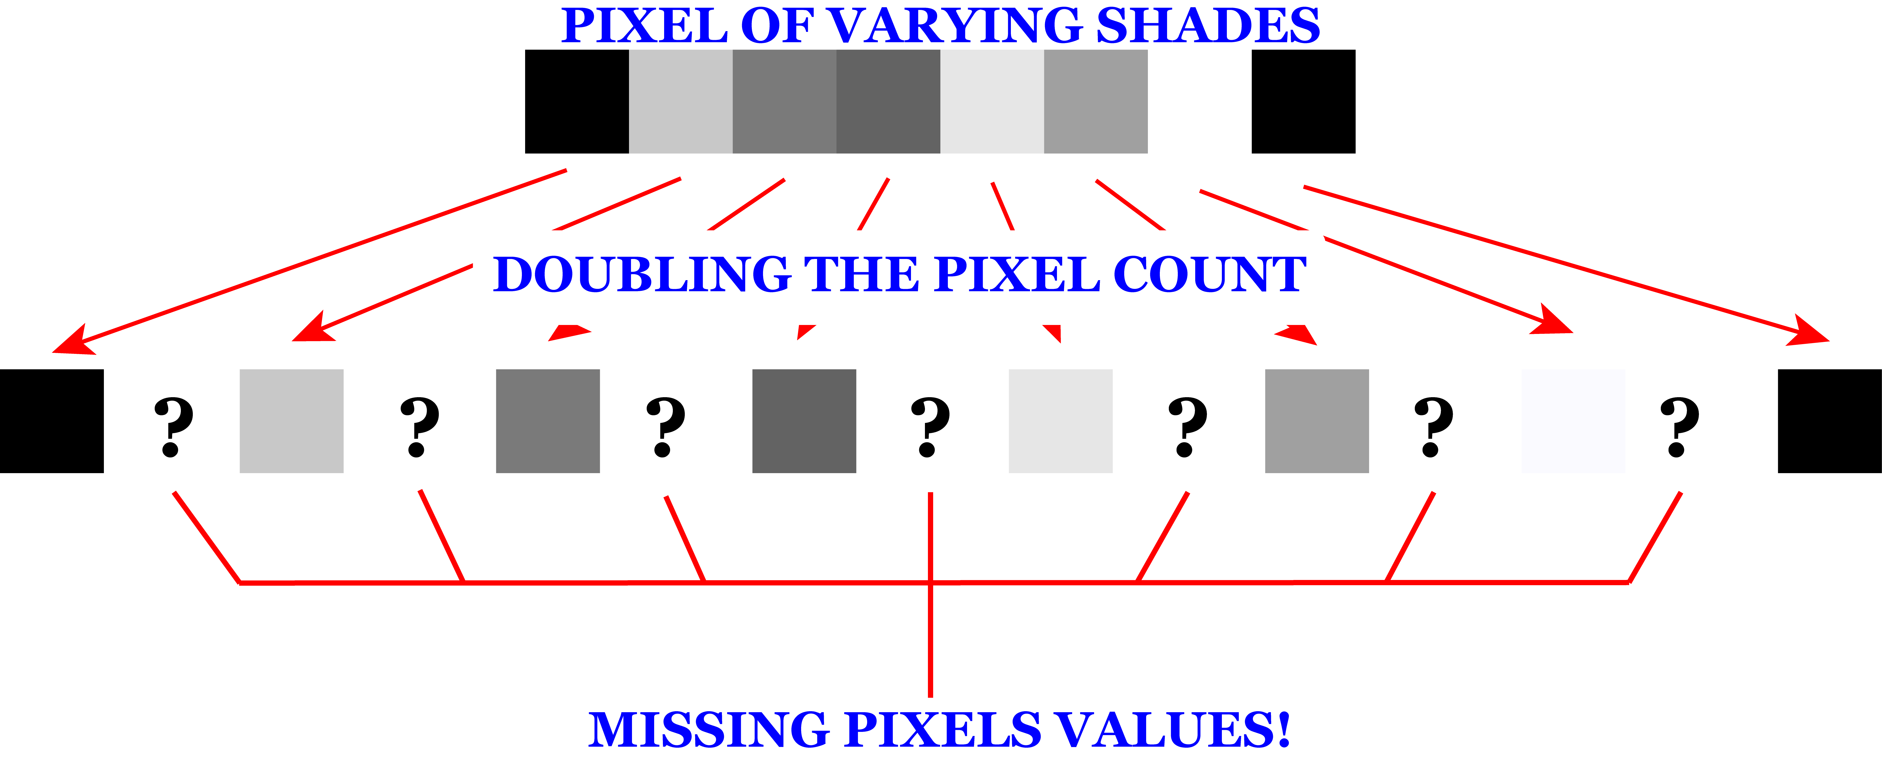

Slide 3
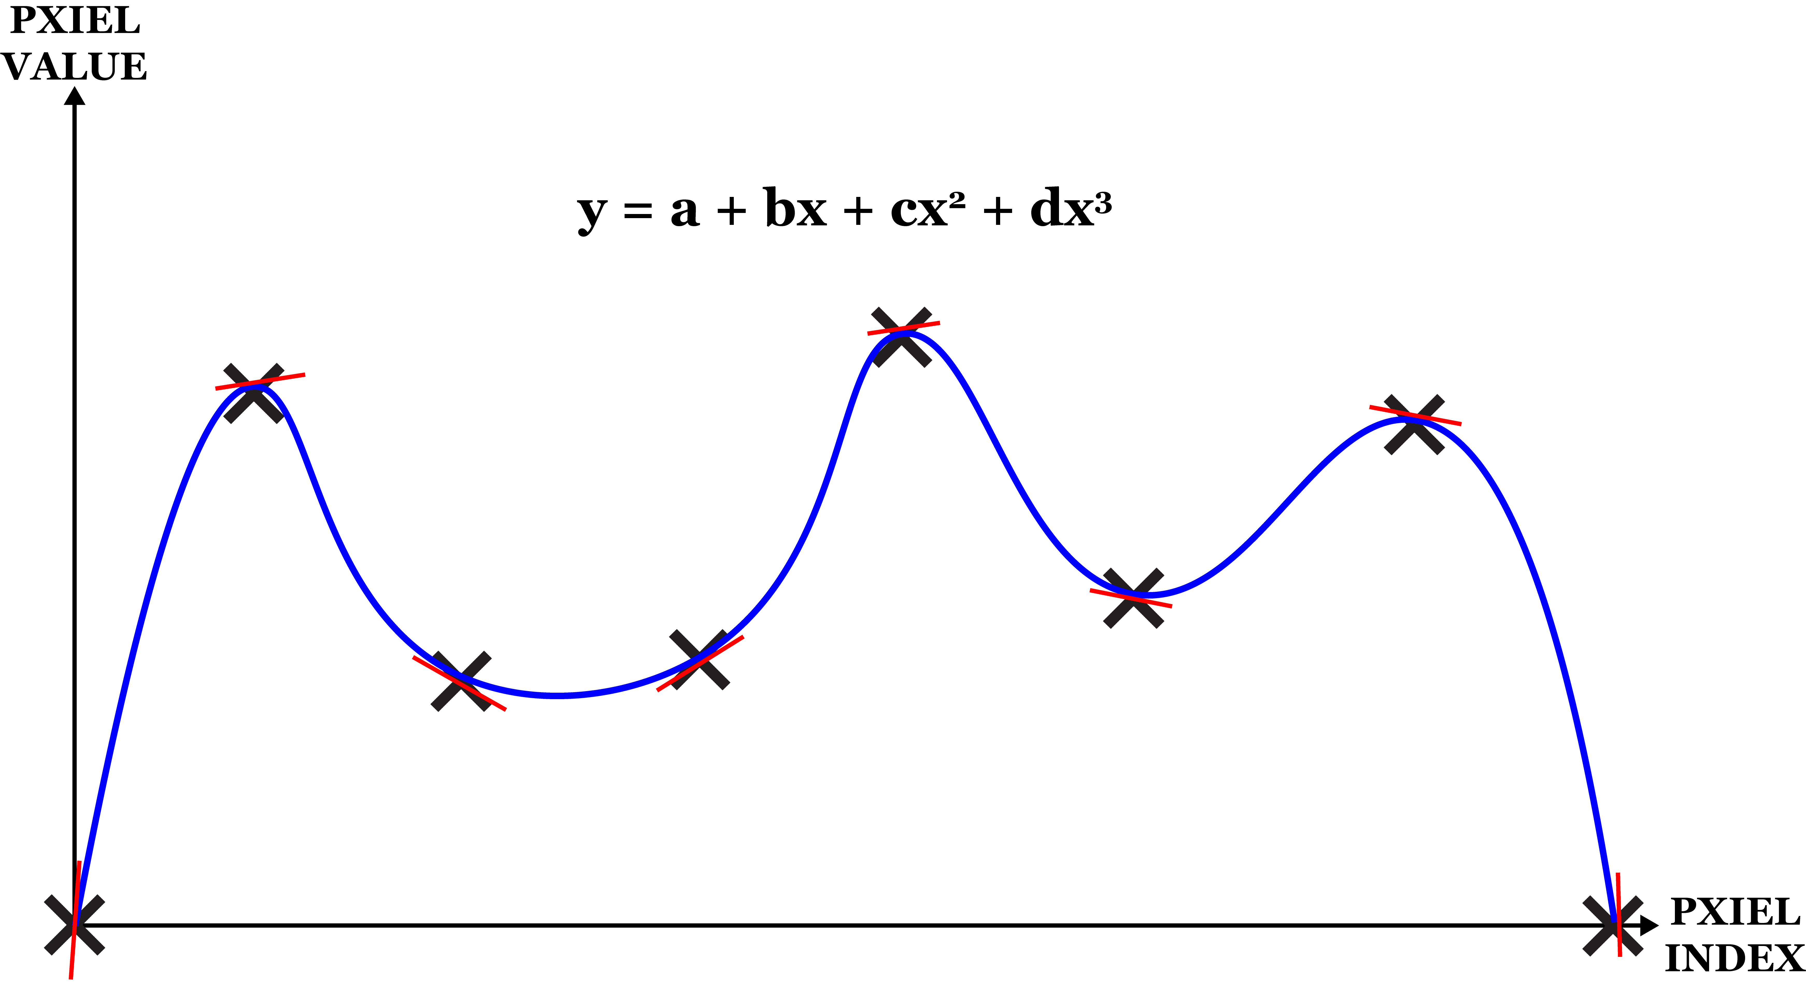

Slide 4
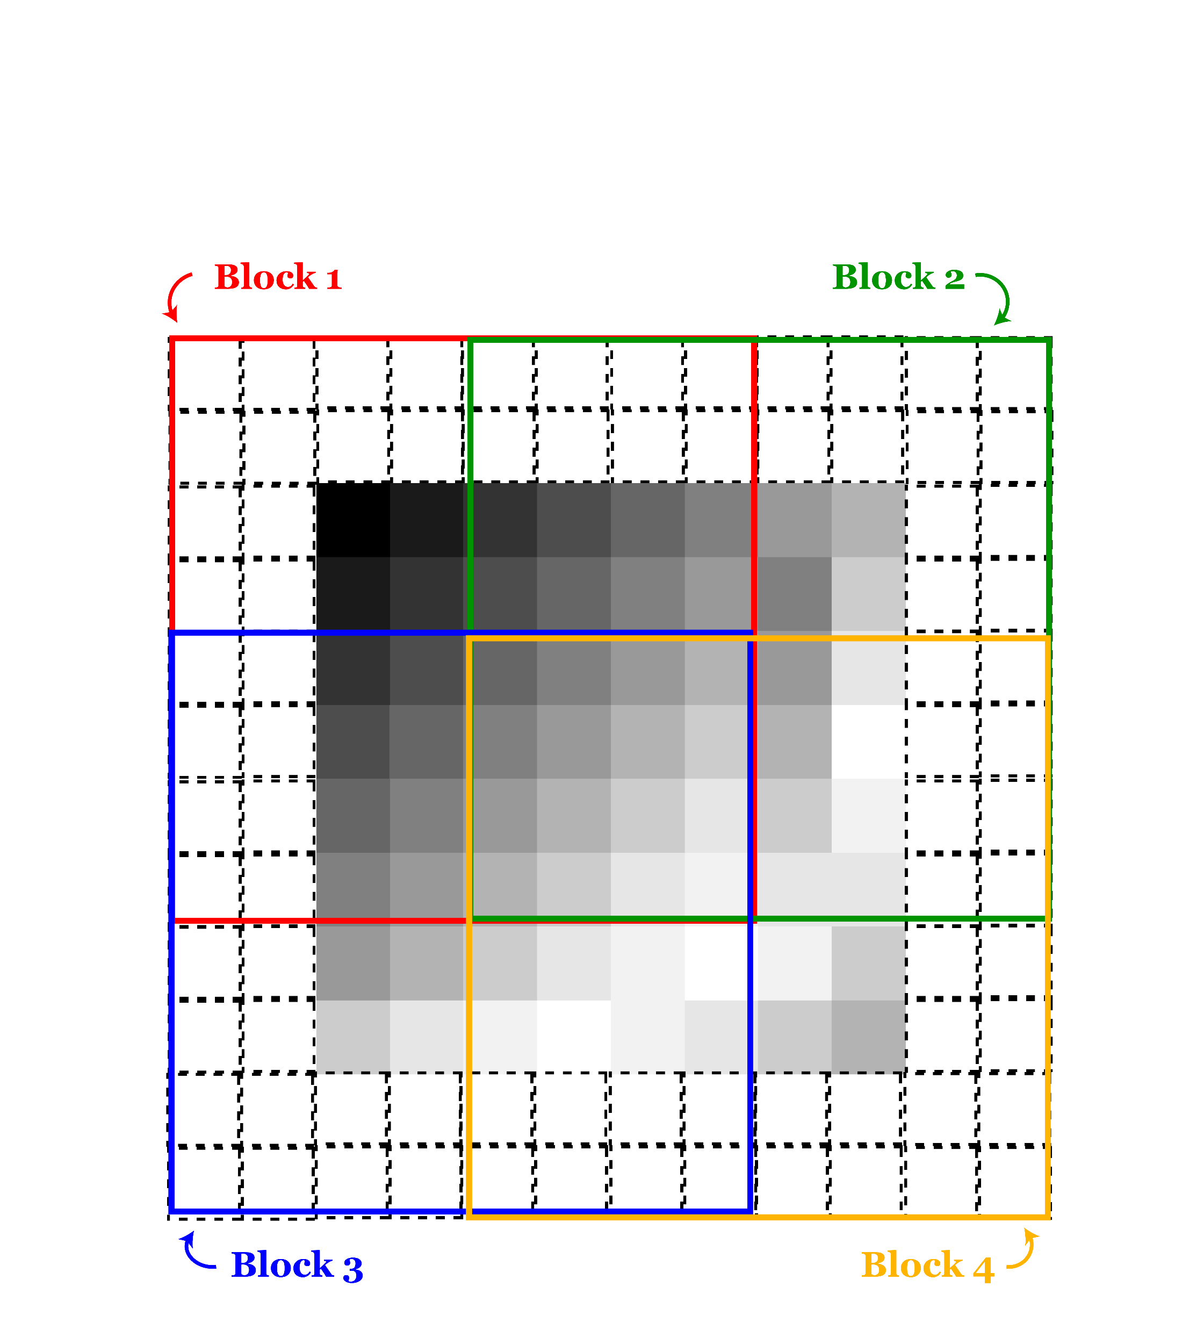
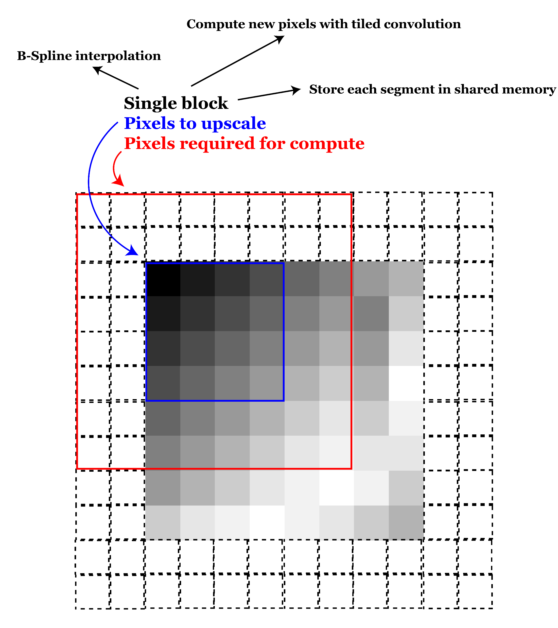

Slide 5
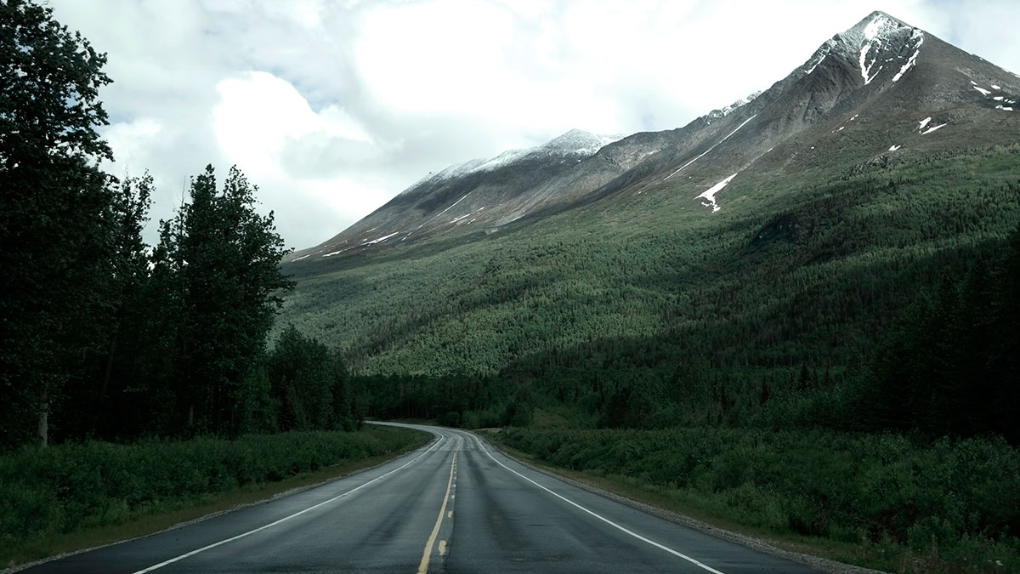
Thank you!
Hope you enjoyed my presentation

