Slide 1
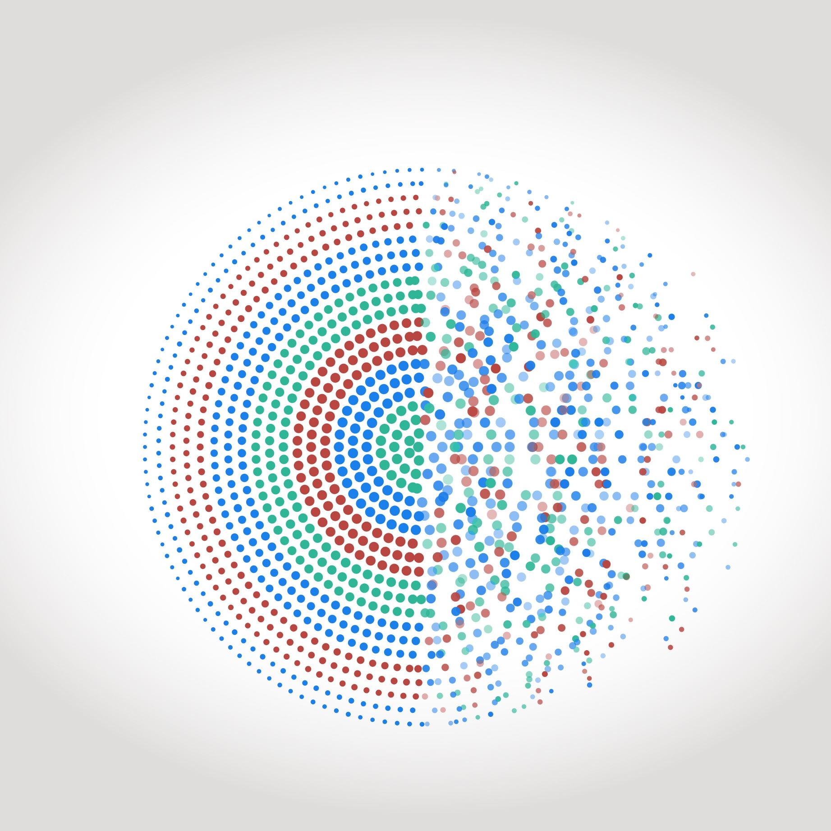
Storyboard 1: pre-login

Slide 2
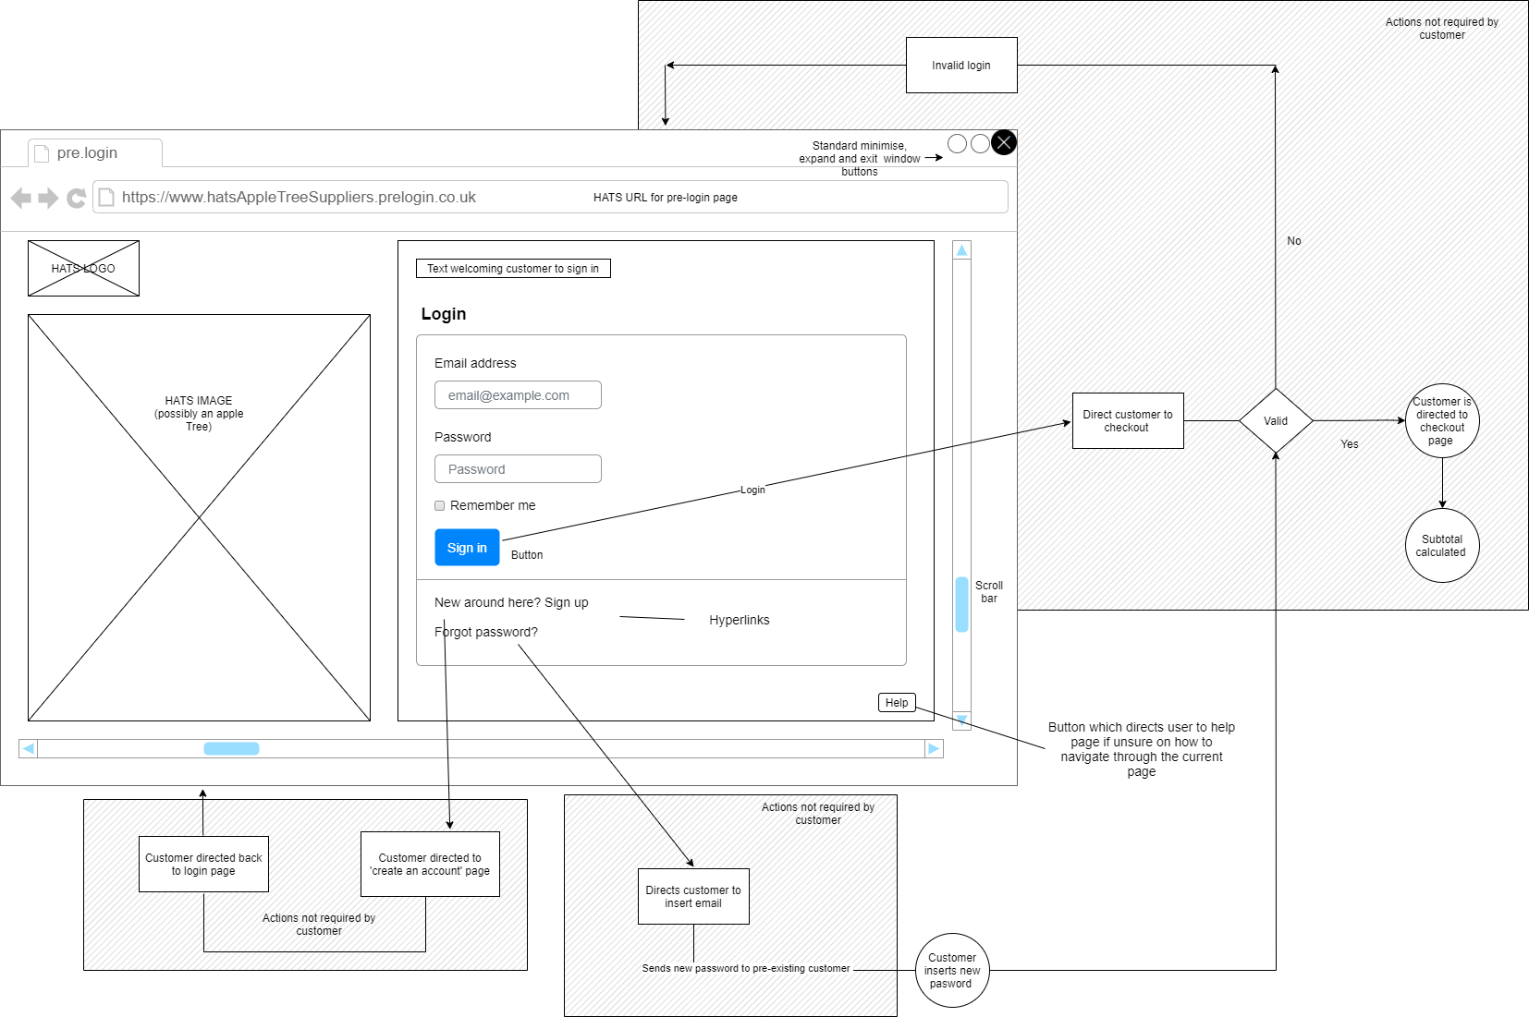

Slide 3
Storyboard 2: post-login screen

Slide 4
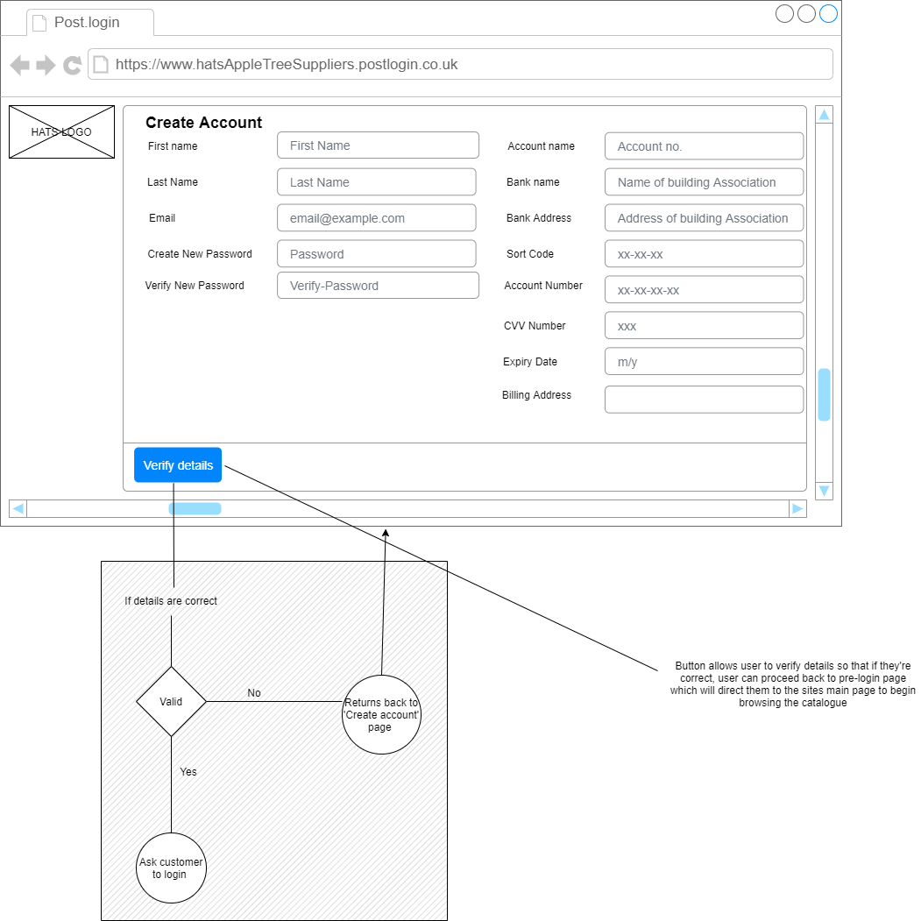

Slide 5
Storyboard 3: main screen

Slide 6
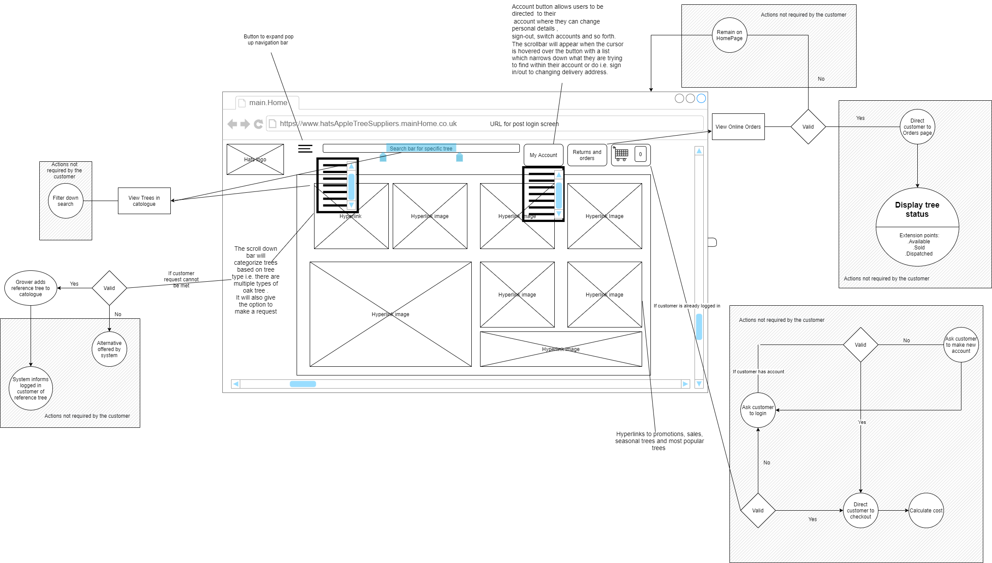

Slide 7
Storyboard 4: process that can be selected by customer

Slide 8
