Slide 1
EDES 301
MIDI Controller Proposal
10/4/2026
Justin Lopato

Slide 2
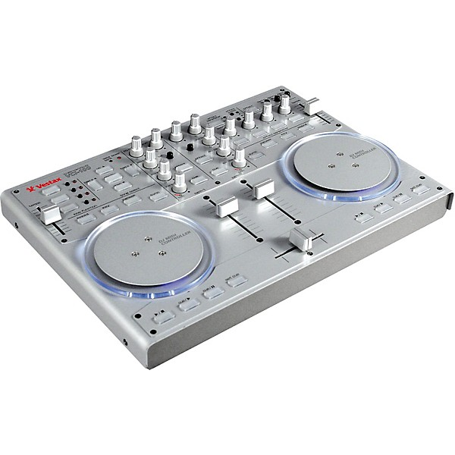
Background Information
  A MIDI controller serves as an interface for interacting with software for playing & recording music.
  They come in multiple form factors depending on the use case (turn tables for DJing, buttons for triggering samples, etc.
  Existing DIY examples exist, but I want to create one like the one to the right ->
  I also want to add the ability to have audio with a basic USB sound card

Slide 3
System Block Diagram
Fader x3 (slide potentiometers)
PocketBeagle
USB to Host
Analog GPIO
EQ Knobs x4 (rotary potentiometers)
I2C
Jog wheels (rotary encoders)
USB
Digital GPIO
Sound Card
Buttons
LCD Display

Slide 4
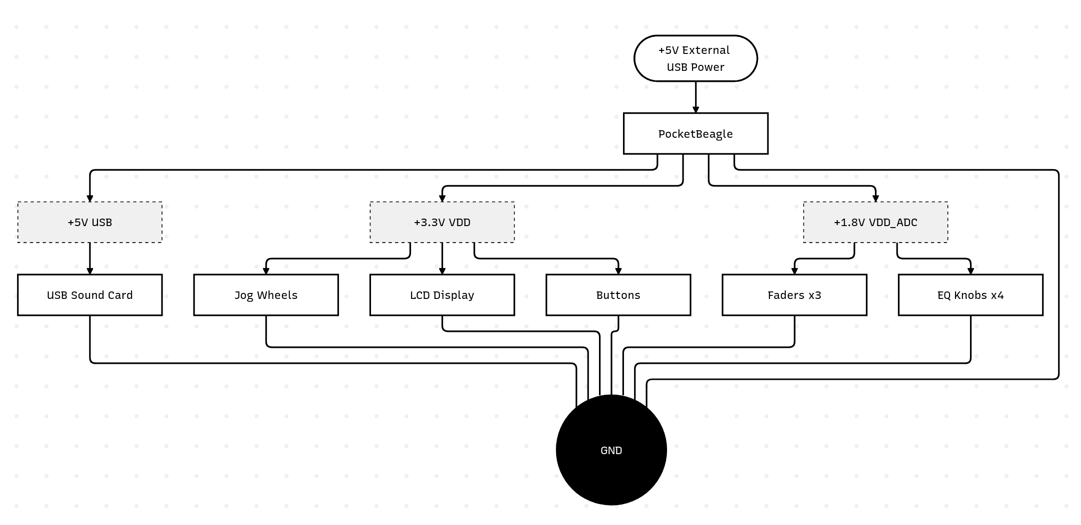
Power Block Diagram

Slide 5
Components / Budget
Component | EDES301 to Buy? | Cost
PTA3043-2015CPB103 30mm 10k Slide Potentiometer x3 | Y | $5.79
PTA3043-2015CPB103 60mm 10k Slide Potentiometer x2 | Y | $4.40
AS5600 Magnetic Angle Sensor x2 | Y | $11.9
USB Sound Card | Y? | $8.99
Buttons | N | $0
3D Printed Parts | N | $0
7 Segment LCD Display | N | $0

