Slide 1
Agent-Based Infrastructures for
Diachronic Digital Humanities
Cohort
Agents for retrieving, comparing and documenting textual evidence
Shu-Kai Hsieh¹² · Da-Chen Lian¹² · Chunki Lim¹ · Lang-Ching Yeh¹
¹ Graduate Institute of Linguistics, National Taiwan University, Taipei, Taiwan
² Co-Intelligence Humanities AI Future Lab
Cohort · PNC 2026
01
Notes:
SAY: Cohort helps researchers find passages, compare them and keep a record of the investigation.
NEXT: Thank Michael Radich and introduce the data.
BACKGROUND
Opening. Authors: Shu-Kai Hsieh, Da-Chen Lian, Chunki Lim and Lang-Ching Yeh. All are affiliated with the Graduate Institute of Linguistics, National Taiwan University. Shu-Kai Hsieh and Da-Chen Lian also list the Humanistic-AI lab, College of Liberal Arts, National Taiwan University. Affiliations follow the supplied abstract; name spellings follow the presenter’s correction. This is a presentation of working research tools, with a bounded example, not a claim to solve translator ascription.
The title is **Agent-Based Infrastructures for Diachronic Digital Humanities**. Present the software through the activities named in the abstract: retrieve corpus material, analyse it, align passages, develop interpretations, preserve provenance, and let researchers make decisions.
A plain opening you can use:
> Cohort lets a researcher ask agents to find and compare passages, then inspect their proposals and sources. I’ll show the tools, the records they produce, and the decisions the researcher can make. Our examples use early Chinese Buddhist texts and a question about translator ascriptions.
An **ascription** assigns a text to a translator. The broader research question is whether computational evidence can help assess those assignments. This presentation does not identify an unknown translator. It shows the operations available for investigating that question.
Michael Radich supplied the corpus, working catalogue labels and curated string list used in the comparison. Acknowledge that contribution when introducing the material. The talk concerns Cohort’s infrastructure; it does not report a completed solution to his research programme.

Slide 2
Acknowledgement
Data provided by Prof. Michael Radich of Heidelberg University
Texts
Catalogue
Vocabulary
A modified, selected
CBETA-derived corpus
Translator labels and
mixed historical groups
Curated strings for
Dharmarakṣa 竺法護 research
02
Notes:
SAY: Thank you, Michael Radich, for sharing the texts, catalogue and string list. The groups come from catalogue labels; Cohort computes the comparisons.
BACKGROUND
SAY: Thank you to Michael Radich for sharing the material that made these examples possible.
NEXT: Introduce the functions.
BACKGROUND
Explain the restriction before presenting a ranking. CBETA is much larger than this dataset. The counts below come from the current selection ledger, before target withholding.
CBETA is the wider electronic collection. The running instance’s Corpus reader is configured for Radich’s local text collection, derived from CBETA. It is not a search across everything available on CBETA Online. The **CBETA ↗** link opens an external edition separately.
Vocabulary comparison uses a still narrower selection from the supplied catalogue to build comparison profiles. A **profile** is a table of string counts for one group. The groups are inherited catalogue labels, not clusters discovered by an AI.
The current selection ledger reports **368 corpus units in 13 comparison groups** before withholding the target’s work or additional texts. Eleven group labels name translators. Two collect material by historical category. A unit may be a short work or a chapter of a larger work, so 368 units does not mean 368 independent books.
To qualify initially, a labelled unit must have at least 2,000 Chinese characters, and a group must have at least five qualifying units. Texts marked as having an uncertain translator are excluded from these reference profiles. Their wording supplies the frequent-string vocabulary instead. Missing text files and rejected units are counted in the selection ledger.
These are implementation choices for this experiment. They do not establish that the remaining groups are equally representative or that their inherited ascriptions are infallible. After withholding, some groups can have little material left; the interface flags these as thin. Groups with no usable profile are listed as not judged.
Say:
> The ranking compares this text against the groups available in this dataset. A translator absent from those groups cannot appear in the answer.
The catalogue has more labels than the ranked list. “Thirteen groups” describes the usable comparison profiles, not the number of translators in Buddhist history or the size of CBETA.
Radich supplied the research corpus derived from CBETA, its working catalogue labels, and the short-string list assembled for Dharmarakṣa 竺法護 vocabulary research. Cohort computes profiles, rankings, alignments and embedding retrieval results. Do not attribute those computed results to him.

Slide 3
Cohort’s goal
Let researchers leverage agents to explore new possibilities and directions while ensuring data provenance
Today’s presentation
Use Buddhist texts to show the functions,
where results can mislead, and the researcher’s role.
03
Notes:
SAY: We built Cohort so researchers can direct agents and inspect the evidence behind their proposals. Today I will show the functions on Chinese Buddhist texts, including results that can mislead. The goal is to make the system and its limits clear enough for researchers to judge where it could help their own work.
We are presenting research infrastructure. We are not reporting a new translator attribution. Michael Radich supplied the materials and research context; we are responsible for these software examples and calculations.

Slide 4
Agent support for diachronic research
Study texts and their relationships across time.
Find and compare
passages
Search exact phrases, retrieve related passages,
and inspect shared wording.
Develop research
proposals
Suggest explanations, alternatives
and follow-up searches.
Inspect sources,
checks and decisions
Trace proposals to evidence.
The researcher decides what to accept.
04
Notes:
SAY: Diachronic means across time. We want agents to help find texts, compare their content and wording, and propose explanations. The sources and checks remain available for inspection, and the researcher decides what to accept.
These are the activities named in the submitted abstract. The four boxes describe functions, not an automatic pipeline that writes a graph at every step. In this presentation alignment locates exact shared wording; it does not provide a full edition-variant collation. Dates and known textual relationships come from scholarship.

Slide 5
Functions
Corpus
Find passages and read them in context.
Vocabulary comparison
Compare a text’s wording with texts labelled by translator.
Inquiry
Give agents a research question and inspect their actions.
Graph
Follow links between sources, proposals and decisions.
Findings
Read the agents’ proposals, citations and checks.
05
Notes:
SAY: Corpus is for finding and reading passages. Vocabulary comparison compares wording. Inquiry starts an agent investigation. Findings presents its proposals. Graph shows their sources and relationships.
These tabs cover the abstract’s retrieval, analysis, alignment, interpretation and researcher decisions. The next slides show each tab and the operation behind it.

Slide 6
Example research questions
Two Lotus translations
Text and later commentary
Dharmarakṣa 竺法護 · T0263
Kumārajīva 鳩摩羅什 · T0262
Can we find related passages
when the wording differs?
Yin chi ru jing 陰持入經 · T0603
Body, mind and senses
Could shared wording mislead us
about who translated this text?
Using known questions lets us know how the tool performs
06
Notes:
SAY: We know that a later commentary repeats wording from T0603. Could shared wording mislead us about who translated this text? The Lotus example asks whether we can find related passages across two translations.
T0603 is traditionally associated with An Shigao 安世高. We are checking a known case, not attributing an unknown text. Dates and the commentary relationship come from scholarship.

Slide 7
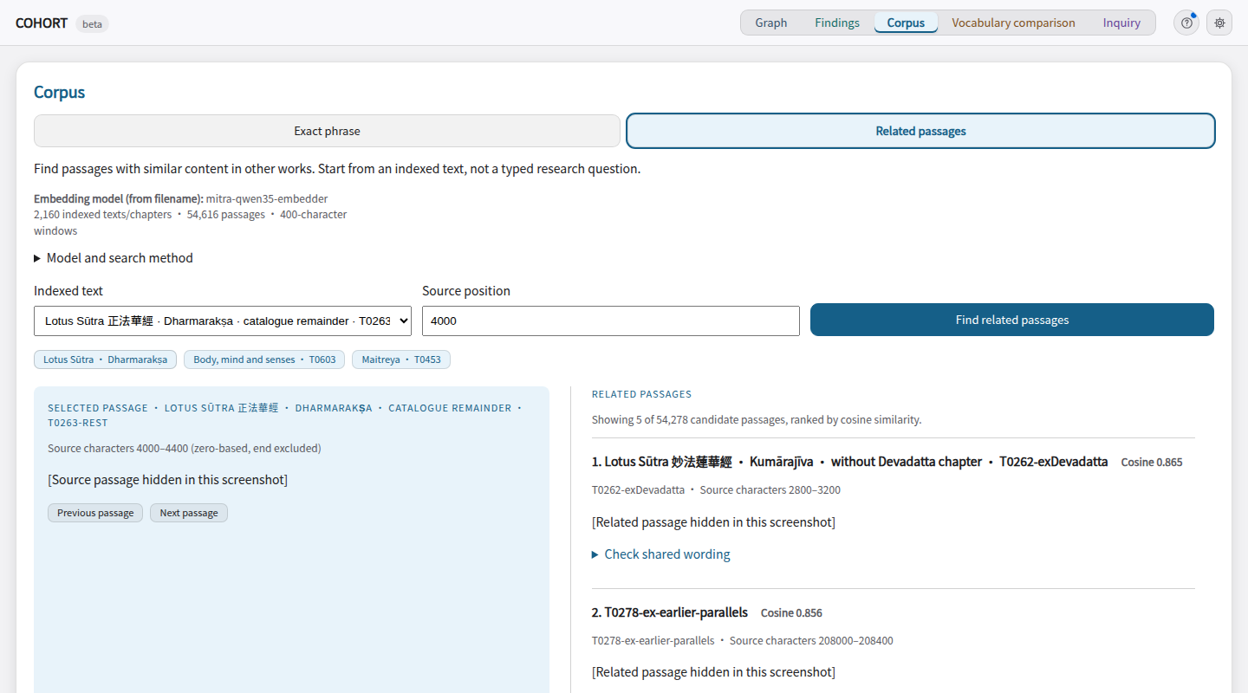
Corpus
Find passages and read them in context.
Interface
How to use it
Exact phrase
or
Indexed passage
Find matches
Read and compare passages
Exact search or stored-vector retrieval
Browsing does not add graph records.
Screenshot: source passages hidden where applicable. Diagram: schematic.
07
Notes:
SAY: Find passages and read them in context.
SAY: This is where we retrieve passages and read their context. I will show one Lotus comparison in the application.
BACKGROUND
The selected passage is on the left; related results scroll on the right. This is the stored-embedding mode, not exact-phrase search. Source text is hidden in the screenshot.
VISUAL: The screenshot orients the audience; the diagram explains the operation. Read the diagram first. Its arrows show UI workflow, not evidence-graph edge types. In Corpus the two top boxes are alternative search modes; in Vocabulary comparison and Inquiry they are inputs used together.

Slide 8
Passage retrieval
How related passages are found
mitra-qwen35-embedder
Selected passage
Cosine similarity
Related passages
Use its stored vector
Compare with other works
Rank candidates to read
08
Notes:
SAY: An embedder has already converted passages to vectors. We compare those stored vectors, then read the candidates. The worker language model is separate.
BACKGROUND
Use a saved semantic_neighbors action if available. Read its target and returned candidate IDs. Do not call this translator identification. The diagram is the tool workflow, not a new measured run.
These are tools available to agents; they are not separate top-level tabs.
**Semantic neighbours** searches an embedding index. An embedding is a numerical representation used to retrieve passages with similar content. It supplies candidates to inspect. It does not establish who translated a passage. A nearest neighbour is the closest among the candidates searched; that alone does not make it a useful match.
**Align passages** compares two selected texts for exact shared Chinese-character sequences and returns matching runs with source positions. Normalisation removes material such as punctuation from that comparison. Shared wording can suggest reuse, a common source or a recurring formula. Its direction and historical explanation require further evidence.
T0603 is the *Yin chi ru jing* 陰持入經, traditionally associated with **An Shigao 安世高**. T1694 is the *Yin chi ru jing zhu* 陰持入經註, a commentary on it. The character 註 in the title means commentary, and the relationship is identified in scholarship. Cohort did not discover the genre from a similarity score. See the scholarly references at the end of this guide.
In a saved run, show the action that retrieved candidates and the action that compared T0603 with T1694. Explain the tool inputs before the result. If the worker searched a short string taken from an earlier alignment, say that it reused a retrieved string. Do not describe a previously observed match as an independent prediction.
The tools for comparing edition apparatus require the appropriate XML source configuration. The current plain-text setup supports the exact-overlap example; do not present it as a full textual-variant collation or a reconstruction of a text’s genealogy.
## Technical reference: what runs in each tab
| Tab | What runs | What it saves |
|---|---|---|
| Corpus | Exact phrase search reads the local corpus. Related passages compares stored embedding vectors. Shared-wording checks locate matching character sequences. | Browsing alone adds nothing to the evidence graph. Investigate this passage fills an Inquiry draft. |
| Vocabulary comparison | Counts strings in the target and scores it against catalogue-labelled group profiles. The target’s whole work is withheld; you can exclude other works. | Calculations alone add no graph nodes. The ranking changes with the vocabulary and reference material. |
| Inquiry | A language-model worker chooses tools and proposes claims or conjectures. A separate reviewer uses a different model family to check proposals. | The question, recorded proposals, citations, checks and run activity. Reopen completed runs under Run results. |
| Findings | Reads the saved claims and conjectures, their cited passages and recorded checks. | It displays the existing investigation; opening the tab does not run another worker. |
| Graph | Draws saved records and their relationships. Show exploration adds recorded tool activity. | Accepting or rejecting an eligible record saves a researcher decision. Hiding nodes only changes the view. |
Graph and Vocabulary comparison also have an AI analyst. It can use read-only tools and continue a conversation about the selected view. Its explanation does not automatically become a graph proposal.
### The embedder and the worker are different models
The configured embedding file is `mitra-qwen35-embedder.npz`. It holds vectors computed before the session. Corpus → Related passages compares the selected passage’s vector with other stored vectors using cosine similarity. Higher scores mean closer vectors; read the returned passages to decide whether the relationship is useful.
Inquiry workers and the view analyst can search these embeddings with `semantic_neighbors`. They use them only if they call that tool. Exact phrase search, string-frequency rankings, citation checks and graph drawing do not use the embedder.
The filename identifies the embedder as `mitra-qwen35-embedder`. The legacy index does not record its exact model revision. Its coverage and training limitations are described under Semantic analysis and alignment below. The worker and reviewer model names are shown separately in Inquiry and in saved run records.
The index has no recorded model revision. Do not claim that the example texts were absent from training.

Slide 9
Across time · two Lotus translations
Example: related content, little shared wording
Earlier Lotus translation
Later Lotus translation
cosine 0.865
Dharmarakṣa 竺法護 · T0263-rest
Source position 4000
Kumārajīva 鳩摩羅什 · T0262-exDevadatta
Source position 2800
Exact match wouldn’t find this pair
Longest exact shared sequence: 3 Chinese characters
09
Notes:
TIME CUE: Compare material from different periods. Ask whether shared wording reflects transmission, reuse or revision. Dates and the direction of borrowing need historical evidence.
SAY: These two Lotus windows are close in the embedding index, but their longest exact shared sequence is only three Chinese characters. Retrieval gives us a pair to read; alignment shows where wording matches.
BACKGROUND
Historical orientation: An Shigao worked in the second century CE. Scholarship identifies T1694 as a later commentary, probably from the third century; do not treat the date as inferred by Cohort. Its title repeats 陰持入經 and adds 註, commentary. This is why shared wording may reflect transmission over time rather than the same translator.
Explain the titles. T0603 is the Yin chi ru jing, associated with An Shigao. T1694 is its commentary; this relationship is known from scholarship. The tool locates shared runs, not the historical direction of borrowing.
These are tools available to agents; they are not separate top-level tabs.
**Semantic neighbours** searches an embedding index. An embedding is a numerical representation used to retrieve passages with similar content. It supplies candidates to inspect. It does not establish who translated a passage. A nearest neighbour is the closest among the candidates searched; that alone does not make it a useful match.
**Align passages** compares two selected texts for exact shared Chinese-character sequences and returns matching runs with source positions. Normalisation removes material such as punctuation from that comparison. Shared wording can suggest reuse, a common source or a recurring formula. Its direction and historical explanation require further evidence.
T0603 is the *Yin chi ru jing* 陰持入經, traditionally associated with **An Shigao 安世高**. T1694 is the *Yin chi ru jing zhu* 陰持入經註, a commentary on it. The character 註 in the title means commentary, and the relationship is identified in scholarship. Cohort did not discover the genre from a similarity score. See the scholarly references at the end of this guide.
In a saved run, show the action that retrieved candidates and the action that compared T0603 with T1694. Explain the tool inputs before the result. If the worker searched a short string taken from an earlier alignment, say that it reused a retrieved string. Do not describe a previously observed match as an independent prediction.
The tools for comparing edition apparatus require the appropriate XML source configuration. The current plain-text setup supports the exact-overlap example; do not present it as a full textual-variant collation or a reconstruction of a text’s genealogy.
SAY: The methods give us different things: candidate passages, vocabulary rankings and a way to test exclusions.
NEXT: Explain the limitations.
BACKGROUND
The first count concerns T0263-rest and T0262-exDevadatta, not every passage in complete editions. Nearest means first under vector similarity among indexed other works. This is an illustrative case selected after inspecting outputs, not a retrieval accuracy benchmark. Vocabulary excludes the target’s entire Taishō work, but other dependence and genre effects remain. Reverse control: T0262-exDevadatta ranks with Dharmakṣema 曇無讖 under both vocabularies, not its catalogue label Kumārajīva 鳩摩羅什. Mention that failure verbally: agreement for one example does not validate attribution. Measurements: scripts/check_method_examples.py; docs/presentation/method-examples.json.

Slide 10
String frequencies
What vocabulary comparison calculates
Vocabulary list
Target text
Reference groups
A list of discriminative strings used to score texts.
Count each selected string in the target.
Repeated occurrences contribute repeatedly.
Count the same strings in reference texts with catalogue group labels.
Use relative frequencies; exclude the target’s own work.
Rank groups by how well their string frequencies fit the target.
10
Notes:
SAY: We start with texts labelled by translator in Radich’s catalogue. We pool the string counts for each label into a comparison group. Two groups instead contain mixed historical material. The vocabulary list tells us which strings to count. We compare the target’s pattern of use with those groups.
SAY: The list tells us which strings to count. Cohort compares the target’s usage with catalogue-labelled groups. It does not rank texts by how many dictionary words they contain.
BACKGROUND
Open Vocabulary comparison and use the T0603 example. Explain the vocabulary as short character strings, then show the full ranking. The example resets to curated strings and no additional exclusions.
Diagram: Vocabulary comparison controls](diagrams/evidence.svg)
1. Select **Vocabulary comparison** and click the **T0603** example. The example resets the vocabulary to the curated strings and clears additional exclusions.
2. Open **Vocabulary and method**. Explain that “vocabulary” means the list of two-, three- and four-character strings being counted. These are not necessarily words.
3. Read the highest-ranked group and the next group, then the visible full ranking below them. Full names and Chinese names are included.
4. Leave the vocabulary unchanged while testing an exclusion.
The three options are:
| Option | How strings were selected | Limitation |
|---|---|---|
| Radich’s curated strings | A list assembled for work on a Dharmarakṣa 竺法護 dictionary | Coverage differs across translators; it is not a neutral sample of everyone’s wording |
| Frequent corpus strings | Frequent short strings from texts whose translator is uncertain, without consulting translator labels | Subject matter and stock expressions can drive resemblance |
| Combined lists | The union of the two lists | Combining them does not remove either selection problem |
Use the **curated list** for the checked T0603 before-and-after comparison. It is already the default. Frequent strings provide a different view worth investigating, not an automatically better answer. The numbers below belong only to the curated-list calculation.
A profile records how frequently each selected string occurs in one comparison group. Cohort scores the target’s matching strings against each profile. Repeated occurrences contribute repeatedly. Related strings can overlap, so they are not independent pieces of evidence.
The full ranking’s **Score relative to leader** is a total score difference: the leader is 0 and the other values are negative. The headline **Score difference** is the lead over the runner-up divided by the number of distinct matched strings. The two displays use different scales. Neither is a probability, and neither has a validated cutoff for assigning a translator.
**Highlighting groups** sets which two groups determine the passage colours. It does not change the overall ranking. The highlighted pair can differ from the top two, so read its labels. Leave this setting alone during the exclusion comparison unless explaining that specific control.
These choices change what the method counts. Curated is the setting for the checked exclusion example, not a claim that it is universally best.
Diagram: Vocabulary comparison controls](diagrams/evidence.svg)
1. Select **Vocabulary comparison** and click the **T0603** example. The example resets the vocabulary to the curated strings and clears additional exclusions.
2. Open **Vocabulary and method**. Explain that “vocabulary” means the list of two-, three- and four-character strings being counted. These are not necessarily words.
3. Read the highest-ranked group and the next group, then the visible full ranking below them. Full names and Chinese names are included.
4. Leave the vocabulary unchanged while testing an exclusion.
The three options are:
| Option | How strings were selected | Limitation |
|---|---|---|
| Radich’s curated strings | A list assembled for work on a Dharmarakṣa 竺法護 dictionary | Coverage differs across translators; it is not a neutral sample of everyone’s wording |
| Frequent corpus strings | Frequent short strings from texts whose translator is uncertain, without consulting translator labels | Subject matter and stock expressions can drive resemblance |
| Combined lists | The union of the two lists | Combining them does not remove either selection problem |
Use the **curated list** for the checked T0603 before-and-after comparison. It is already the default. Frequent strings provide a different view worth investigating, not an automatically better answer. The numbers below belong only to the curated-list calculation.
A profile records how frequently each selected string occurs in one comparison group. Cohort scores the target’s matching strings against each profile. Repeated occurrences contribute repeatedly. Related strings can overlap, so they are not independent pieces of evidence.
The full ranking’s **Score relative to leader** is a total score difference: the leader is 0 and the other values are negative. The headline **Score difference** is the lead over the runner-up divided by the number of distinct matched strings. The two displays use different scales. Neither is a probability, and neither has a validated cutoff for assigning a translator.
**Highlighting groups** sets which two groups determine the passage colours. It does not change the overall ranking. The highlighted pair can differ from the top two, so read its labels. Leave this setting alone during the exclusion comparison unless explaining that specific control.
This list gives catalogue membership labels, not a ranking. The two mixed categories are not individual translators. Counts are before target withholding.
CBETA is the wider electronic collection. The running instance’s Corpus reader is configured for Radich’s local text collection, derived from CBETA. It is not a search across everything available on CBETA Online. The **CBETA ↗** link opens an external edition separately.
Vocabulary comparison uses a still narrower selection from the supplied catalogue to build comparison profiles. A **profile** is a table of string counts for one group. The groups are inherited catalogue labels, not clusters discovered by an AI.
The current selection ledger reports **368 corpus units in 13 comparison groups** before withholding the target’s work or additional texts. Eleven group labels name translators. Two collect material by historical category. A unit may be a short work or a chapter of a larger work, so 368 units does not mean 368 independent books.
To qualify initially, a labelled unit must have at least 2,000 Chinese characters, and a group must have at least five qualifying units. Texts marked as having an uncertain translator are excluded from these reference profiles. Their wording supplies the frequent-string vocabulary instead. Missing text files and rejected units are counted in the selection ledger.
These are implementation choices for this experiment. They do not establish that the remaining groups are equally representative or that their inherited ascriptions are infallible. After withholding, some groups can have little material left; the interface flags these as thin. Groups with no usable profile are listed as not judged.
Say:
> The ranking compares this text against the groups available in this dataset. A translator absent from those groups cannot appear in the answer.
The catalogue has more labels than the ranked list. “Thirteen groups” describes the usable comparison profiles, not the number of translators in Buddhist history or the size of CBETA.
Do not compute the headline margin by dividing the already rounded gap displayed in a table. The backend computes it from unrounded scores before display rounding.
Diagram: Vocabulary comparison controls](diagrams/evidence.svg)
1. Select **Vocabulary comparison** and click the **T0603** example. The example resets the vocabulary to the curated strings and clears additional exclusions.
2. Open **Vocabulary and method**. Explain that “vocabulary” means the list of two-, three- and four-character strings being counted. These are not necessarily words.
3. Read the highest-ranked group and the next group, then the visible full ranking below them. Full names and Chinese names are included.
4. Leave the vocabulary unchanged while testing an exclusion.
The three options are:
| Option | How strings were selected | Limitation |
|---|---|---|
| Radich’s curated strings | A list assembled for work on a Dharmarakṣa 竺法護 dictionary | Coverage differs across translators; it is not a neutral sample of everyone’s wording |
| Frequent corpus strings | Frequent short strings from texts whose translator is uncertain, without consulting translator labels | Subject matter and stock expressions can drive resemblance |
| Combined lists | The union of the two lists | Combining them does not remove either selection problem |
Use the **curated list** for the checked T0603 before-and-after comparison. It is already the default. Frequent strings provide a different view worth investigating, not an automatically better answer. The numbers below belong only to the curated-list calculation.
A profile records how frequently each selected string occurs in one comparison group. Cohort scores the target’s matching strings against each profile. Repeated occurrences contribute repeatedly. Related strings can overlap, so they are not independent pieces of evidence.
The full ranking’s **Score relative to leader** is a total score difference: the leader is 0 and the other values are negative. The headline **Score difference** is the lead over the runner-up divided by the number of distinct matched strings. The two displays use different scales. Neither is a probability, and neither has a validated cutoff for assigning a translator.
**Highlighting groups** sets which two groups determine the passage colours. It does not change the overall ranking. The highlighted pair can differ from the top two, so read its labels. Leave this setting alone during the exclusion comparison unless explaining that specific control.

Slide 11
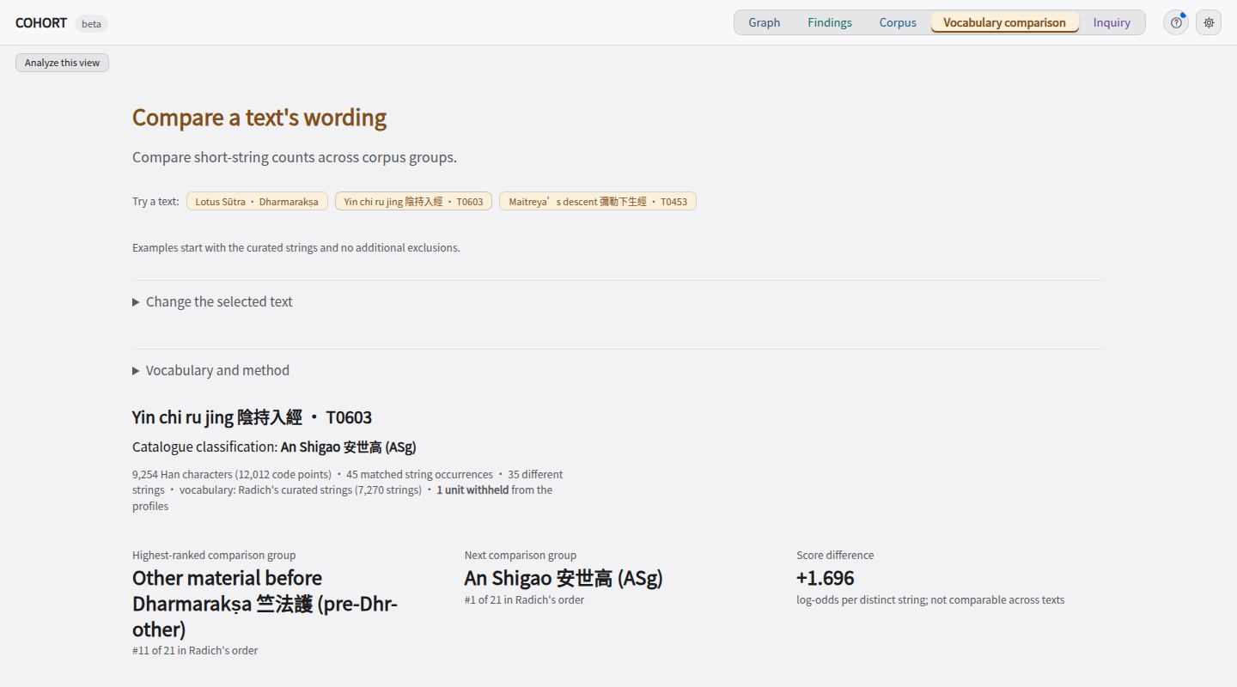
Vocabulary comparison
Compare a text’s wording with texts labelled by translator.
Interface
How to use it
Target + strings
Labelled texts
Compare string frequencies
Rank the catalogue groups
Exclude a comparison text and repeat.
The vocabulary selects which strings count.
Screenshot: source passages hidden where applicable. Diagram: schematic.
11
Notes:
SAY: Compare a text’s wording with texts labelled by translator.
SAY: Read the group names beside A and B. Highlighting is the contribution to their score difference. The strings can occur in both groups. Strong colour is not certainty.
BACKGROUND
This compares a text against pooled groups using string counts, not embeddings. Use the live view for exclusions. Source passages are hidden in the screenshot.
VISUAL: The screenshot orients the audience; the diagram explains the operation. Read the diagram first. Its arrows show UI workflow, not evidence-graph edge types. In Corpus the two top boxes are alternative search modes; in Vocabulary comparison and Inquiry they are inputs used together.

Slide 12
Across time · earlier text and later commentary
T0603: remove the later commentary
With T1694
Without T1694
First: Other material before
Dharmarakṣa 竺法護
Margin over next group: 1.696
First: An Shigao 安世高
Margin over next group: 0.096
T1694 is a commentary on T0603 with large spans of overlap, artificially boosting similarity.
12
Notes:
TIME CUE: Compare material from different periods. Ask whether shared wording reflects transmission, reuse or revision. Dates and the direction of borrowing need historical evidence.
SAY: T1694 is in the mixed early-material group. Removing it changes that group’s profile and the leader. The target and vocabulary stay fixed. The margin is the score gap divided by distinct matched strings; it is not a probability.
BACKGROUND
This calculation illustrates a historical-dependence problem: the later commentary contains wording from the earlier text, but belongs to another reference group. Excluding it makes An Shigao 安世高 the top-ranked group, matching the accepted attribution, by a small uncalibrated margin. It is one known-answer check, not evidence of reliable attribution on unknown texts.
T1694 is assigned to the mixed pre-Dharmarakṣa 竺法護 group. Its shared wording contributes to that group’s profile. Removing it changes the reference profile, not T0603. An Shigao 安世高 worked in the second century CE; Dharmarakṣa 竺法護 later, in the late third and early fourth centuries. “Before Dharmarakṣa 竺法護” is a catalogue category, not his own work.
Live action: enter T1694 and click Repeat comparison. Keep curated vocabulary fixed. The leading group changes, so both names must be read. This demonstrates sensitivity to included material, not successful attribution.
Under **Does the result depend on another text?**, enter **T1694** in **Exclude additional texts** and click **Repeat comparison**. The target remains T0603; only the reference material changes. **Restore these texts** removes the additional exclusion.
The reproduced results on 9 September 2026 are:
| Setup | Highest-ranked group | Next group | Per-string margin |
|---|---|---|---:|
| Curated strings, no additional exclusion | Other material before Dharmarakṣa 竺法護 | An Shigao 安世高 | 1.696 |
| Same strings, T1694 excluded | An Shigao 安世高 | Other material before Dharmarakṣa 竺法護 | 0.096 |
T1694 contributes to the mixed group in the first row. “Other material before Dharmarakṣa 竺法護” is a catalogue category for early material, not one competing translator. Excluding the commentary changes the leader and greatly reduces the lead.
Say:
> Including this commentary has a large effect on the ranking. Once we remove it, the initial leading group no longer comes first. We need to inspect the shared passages and the composition of the comparison groups before using this as evidence about a translator.
Do not translate 0.096 into a probability or call it a statistically established tie. An Shigao 安世高’s new first place does not establish his authorship. The comparison does not determine which text borrowed from which.
The before-and-after table is calculated by the application. If it fails to load, the slide contains the recorded aggregate result and its settings. Do not substitute a value from another vocabulary. Additional exclusions currently take exact corpus unit IDs; a collection identifier is not a promise that all its chapters will be removed. The target’s own work is withheld automatically.
An Shigao 安世高 worked in the second century CE. Dharmarakṣa 竺法護 worked in the late third and early fourth centuries. The pre-Dharmarakṣa 竺法護 group is an inherited catalogue category; T1694 belongs to it in the supplied data. This label does not settle the debated date or authorship of the commentary. Explain the chronological ordering without attempting to date every group.

Slide 13
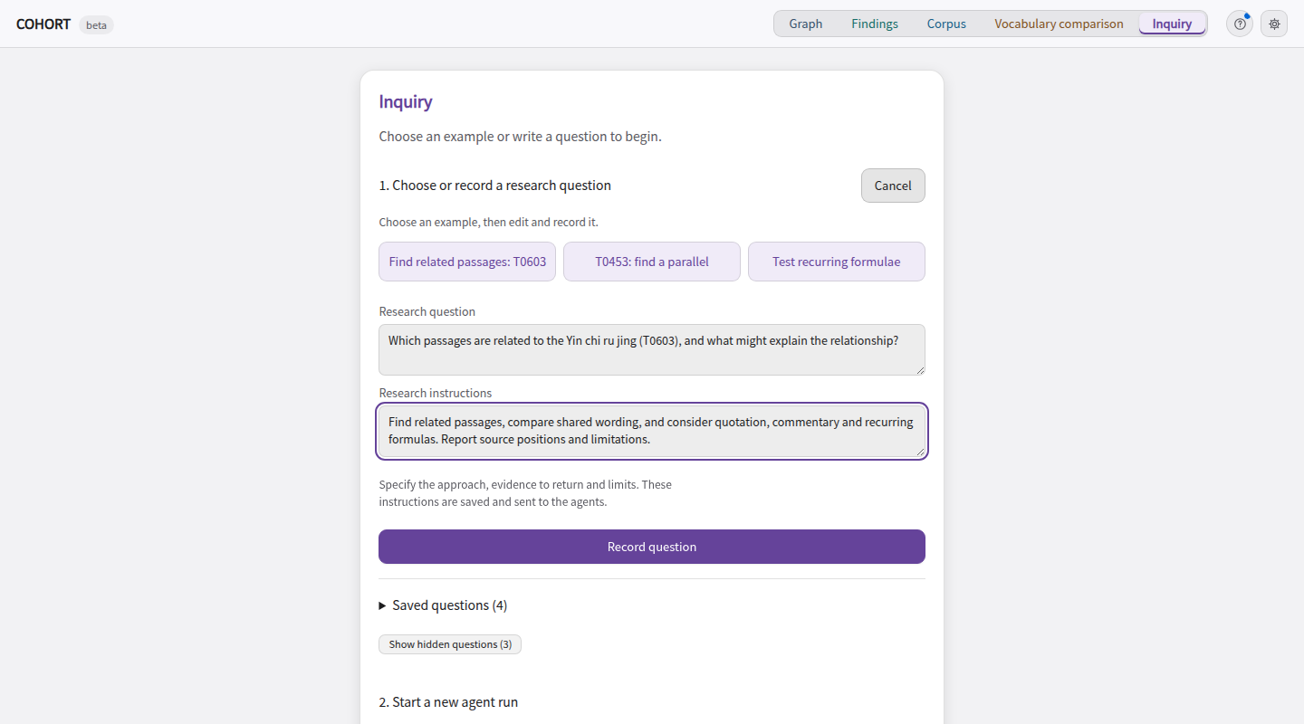
Inquiry
Give agents a research question and inspect their actions.
Interface
How to use it
Question
Instructions
Worker calls tools
Save actions and proposals
A separate reviewer records checks.
Reopen completed work in Run results.
Screenshot: source passages hidden where applicable. Diagram: schematic.
13
Notes:
SAY: Give agents a research question and inspect their actions.
SAY: Suggested inputs fill a draft. Inquire starts the workers. This screenshot contains an unsent draft; I will inspect a saved run in the application.
BACKGROUND
Show the distinction between a research question and research instructions. The screenshot shows an unsent draft; no new model run was started. Run history was hidden for this capture.
VISUAL: The screenshot orients the audience; the diagram explains the operation. Read the diagram first. Its arrows show UI workflow, not evidence-graph edge types. In Corpus the two top boxes are alternative search modes; in Vocabulary comparison and Inquiry they are inputs used together.

Slide 14
Interpretation · reuse, revision and transmission
New research directions
Agents can compare material, suggest explanations and propose follow-up searches.
Read and compare
Propose
Inspect and decide
Retrieve passages
Summarise observations
Possible explanations
Questions to investigate
Read the cited sources
Choose what to pursue
Graph
Keeps proposals linked to passages, checks and researcher decisions.
14
Notes:
TIME CUE: Compare material from different periods. Ask whether shared wording reflects transmission, reuse or revision. Dates and the direction of borrowing need historical evidence.
SAY: The worker can pull material together, suggest explanations we might want to examine, and propose a next search. These are possibilities for research. We inspect the cited passages and recorded checks before deciding what to pursue.
EXAMPLE: When a commentary shares wording with an earlier text, the worker could suggest reuse, a common source or a recurring formula. A useful next step is to search other texts for the same wording, or repeat the vocabulary comparison with the commentary excluded. These are examples of questions an agent can propose, not a claim that the saved run discovered a new historical relationship.
GROUNDING: The Graph stores links between passages and proposals, source locations, author/model records, checks and researcher decisions. It lets us inspect the basis of a proposal. It does not make an interpretation true. A reviewer can verify that a quotation occurs while still making a mistaken judgement about what it supports.
ROLES: The Inquiry worker calls tools and records proposals. A reviewer from a different model family records checks. The separate analyst in Graph and Vocabulary comparison can explain outputs and make further read-only tool calls; its response does not automatically become a graph proposal.
DIAGRAM: This is a high-level workflow, not the Graph's edge vocabulary or a promise that every retrieved passage is saved. The researcher chooses what to pursue; opening a tab does not execute this sequence.

Slide 15
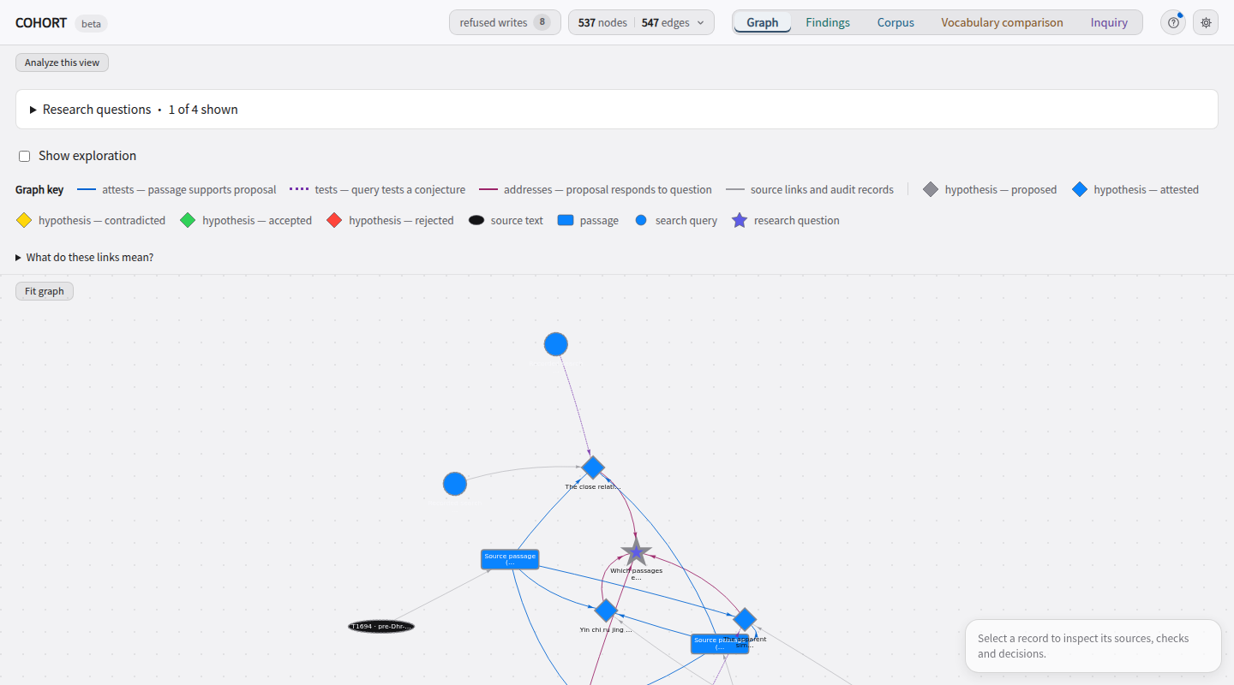
Graph
Graph: connect proposals to sources and checks.
Interface
How to use it
Select a research question
Inspect linked records
Accept or reject a record
Show exploration adds recorded tool activity.
Filtering the view does not delete records.
Screenshot: source passages hidden where applicable. Diagram: schematic.
15
Notes:
SAY: Follow links between sources, proposals and decisions.
SAY: The graph is already populated by saved work. It is not a display of every corpus text. Selecting a node shows its author, model and records.
BACKGROUND
Follow records and their relationships. Source-passage labels and query phrases are hidden in this screenshot; graph records and topology are otherwise unchanged.
### Why a query can point straight to a proposal
There is no required Query → Witness → Passage → Hypothesis chain. The graph records different relationships:
- Witness → Passage, labelled **contains**: where the passage comes from. Internally, this is stored in the reverse direction as `part_of`.
- Passage → Claim or conjecture, labelled **attests**: the passage is cited as support.
- Query → Claim or conjecture, labelled **searched for**: a search ran while preparing that proposal.
- Query → Conjecture, labelled **tests**: the author recorded a query and an expected result for a later test. This link alone does not mean the test ran or passed.
- Claim or conjecture → Research question, labelled **addresses**: which question the proposal concerns.
For a claim, the proposal tool runs a grounding search and saves its phrase and hit count. It refuses the claim if there are no hits. It does not automatically save each hit as a witness or passage, or link the query to those hits. Citation gathering is a separate operation. A hit therefore shows that wording was found; it does not establish that the proposed interpretation follows from it.
For a conjecture, the tool records an earlier search under “prior art” and a separate proposed test. Here “prior art” means a corpus search made before proposing the conjecture, not a search of published scholarship.
The UI uses “hypothesis” as a heading for claims and conjectures. A conjecture is not a container assembled from claim nodes. Read its own citations, explanation and proposed test.
VISUAL: The screenshot orients the audience; the diagram explains the operation. Read the diagram first. Its arrows show UI workflow, not evidence-graph edge types. In Corpus the two top boxes are alternative search modes; in Vocabulary comparison and Inquiry they are inputs used together.

Slide 16
Graph relationships · schematic
Relationships between nodes
contains
attests
Source record
Passage
Claim / conjecture
addresses
searched for
or tests
Query
Research question
16
Notes:
SAY: Supporting passages and investigation records are separate links. A grounding search saves a query and hit count but does not automatically make nodes for every result. A tests arrow records a planned test; check whether it ran.
BACKGROUND
### Why a query can point straight to a proposal
There is no required Query → Witness → Passage → Hypothesis chain. The graph records different relationships:
- Witness → Passage, labelled **contains**: where the passage comes from. Internally, this is stored in the reverse direction as `part_of`.
- Passage → Claim or conjecture, labelled **attests**: the passage is cited as support.
- Query → Claim or conjecture, labelled **searched for**: a search ran while preparing that proposal.
- Query → Conjecture, labelled **tests**: the author recorded a query and an expected result for a later test. This link alone does not mean the test ran or passed.
- Claim or conjecture → Research question, labelled **addresses**: which question the proposal concerns.
For a claim, the proposal tool runs a grounding search and saves its phrase and hit count. It refuses the claim if there are no hits. It does not automatically save each hit as a witness or passage, or link the query to those hits. Citation gathering is a separate operation. A hit therefore shows that wording was found; it does not establish that the proposed interpretation follows from it.
For a conjecture, the tool records an earlier search under “prior art” and a separate proposed test. Here “prior art” means a corpus search made before proposing the conjecture, not a search of published scholarship.
The UI uses “hypothesis” as a heading for claims and conjectures. A conjecture is not a container assembled from claim nodes. Read its own citations, explanation and proposed test.
The arrows here follow schema direction: passage part_of source; passage attests proposal; proposal addresses question. Shapes are simplified but match node types. Use one selected record rather than narrating the entire graph.
Diagram: Graph relationships](diagrams/graph.svg)
Use the question checkboxes to show the investigation you are discussing. Hiding a question changes the view; it does not delete its records. Several proposals can address one question. An older session can also contain earlier questions.
Select a single node. Its inspector shows the record’s type, status, worker, model, sources and relationships. New records can show the worker’s action reason. The historical model name describes the recorded call, not a later profile setting.
| Shape or link | Meaning |
|---|---|
| Star | A research question |
| Diamond | A claim or conjecture |
| Rectangle | A located passage |
| Ellipse | A source record, called a witness in the schema |
| Dot | A search query |
| `part_of` | A passage belongs to a source record |
| `attests` | A passage is offered as support for a proposal |
| `addresses` | A proposal addresses a question |
| `searched_for` | A recorded search used in proposing a claim or conjecture |
| `tests` | A query is offered as a test of a conjecture |
A search pointing to a claim records retrieval activity; it does not itself prove the claim. The **Show exploration** overlay adds works inspected in recorded tool activity, including some that were never attached as evidence. It is not a map of every source available in the corpus or every thought the model had.
**Verified with an exact span** means a recorded check found the quoted passage at its source location. Repeated verification attempts remain in the history but are not presented as multiple independent witnesses.

Slide 17
Provenance
An evidence graph connects proposals to evidence
Inspect a proposal
Follow a claim or conjecture to its cited passages and source texts. A link does not make the proposal true.
Inspect text relationships
Quotation: reproduced wording. Parallel: corresponding passages. Descent: one text or version proposed to derive from another.
Review the record
See who proposed it, which citations were checked, and whether the researcher accepted or rejected it.
Future work: edge prediction
Suggest a quotation or parallel to investigate, with passages to check.
17
Notes:
SAY: The graph helps us trace proposals back to sources, inspect recorded relationships between sources, and retain the history of checks and decisions. A possible next step is edge prediction: suggesting a relationship worth investigating. We have not implemented or evaluated that capability.
TERMINOLOGY: Cohort has typed nodes, typed edges and record metadata. These are familiar graph-data techniques. The project deliberately calls this an evidence graph because translator and historical assertions remain contested. This does not mean that all knowledge graphs must contain only certain facts; it explains the terminology and epistemic contract of this application. See docs/design.md principles 1–2 and section 10.
DEPENDENCIES: Recorded quotes, parallel_of and descends_from relationships help expose related material. A graph cannot display a dependency that nobody has recorded, and an independence flag is not proof that sources are historically independent. Repeated checks are not independent witnesses.
EDGE PREDICTION: In graph research, link prediction scores possible missing relationships between nodes. A future Cohort feature could propose a candidate quotation or textual parallel, retrieve the relevant passages and send it for review. A predicted link would be a proposal, not historical evidence by itself. Current semantic-neighbour retrieval compares passage vectors; it is not a trained graph link-prediction model. The source-grounded edge-proposal workflow would also need implementation and evaluation.
BACKGROUND READING: Hogan et al., Knowledge Graphs (2021), https://arxiv.org/abs/2003.02320; Daza et al., Inductive Entity Representations from Text via Link Prediction (2021), https://arxiv.org/abs/2010.03496.
EXISTING CHECKS AND DECISIONS
SAY: Finding a quotation at its source is one check. Whether it supports the interpretation requires reading. Accepting a passage does not accept every connected proposal.
BACKGROUND
Do not click Accept just to create an ending. Show available controls and explain their actual eligibility rules. The reviewer cannot be treated as a reliable semantic validator; explain the current limitation if asked.
| Status | Meaning |
|---|---|
| Proposed | Submitted for consideration |
| Attested | The required promotion checks for that record type passed |
| Accepted | The researcher approved this record under Cohort’s citation rules |
| Rejected | The researcher rejected this record with a reason |
A **contradiction** relationship is distinct from a researcher’s rejection. Colour alone is insufficient: some imported experiment records also have calculated assessment colours. Read the selected record’s status.
An eligible attested record can be accepted. Accepting a passage changes that passage’s status; it does not accept every connected claim. Rejecting a record preserves it and the reason rather than deleting a source text. Reopening a rejected record also requires a reason.
The reviewer is fallible. In the current implementation, its tool re-fetches cited passages and checks their spans, but the reviewer does not have a complete evidence-reading workflow before choosing its semantic verdict. A reviewer’s statement that it checked an interpretation or reproduced a calculation is not enough to establish that it did so. The researcher should inspect the passages and numerical output directly. This limitation remains open; do not say it has been repaired by changing model names.
The Vocabulary comparison tab does not currently offer a grounded `quotes` or `parallel_of` edge proposal for later acceptance. Accepting a graph record also does not change Vocabulary comparison profiles. The exclusion above is a separate researcher-controlled calculation.
Return to diachronic research through the distinction between supplied history and computed observations. The question asks how wording travels between texts produced at different times. Cohort locates and compares that wording; the current implementation does not date texts or reconstruct language change. Applying it to uncertain texts would require independent chronological and textual evidence.

Slide 18
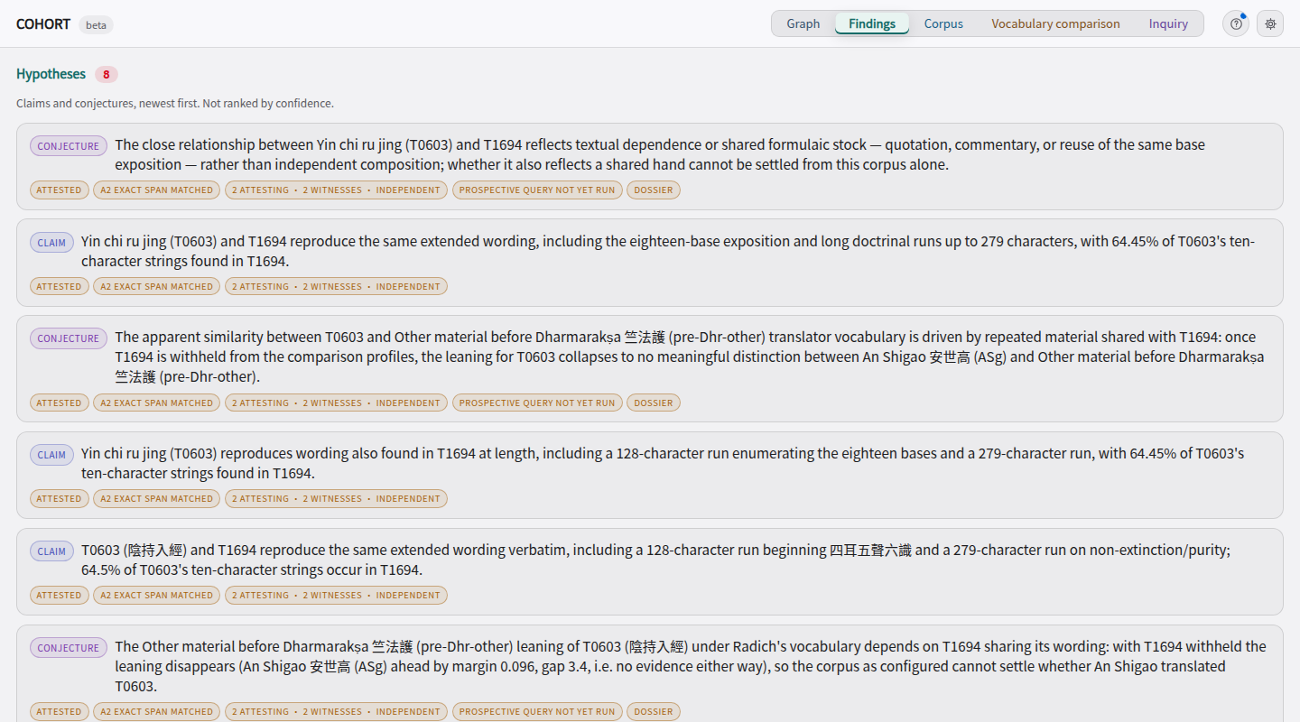
Findings
Read the agents’ proposals, citations and checks.
Interface
How to use it
Open a saved proposal
Cited passages
Checks
Read its explanation
and alternatives.
Follow a citation into Graph to inspect its source.
Inspect one proposal at a time.
Screenshot: source passages hidden where applicable. Diagram: schematic.
18
Notes:
SAY: Read the agents’ proposals, citations and checks.
SAY: Findings is a readable view of saved proposals. A conjecture adds an explanation, limits and a proposed test; it is not a container made of claims.
BACKGROUND
These are saved proposals, not established conclusions. The conjecture review found weaknesses; do not imply attested means correct. No proposal was accepted for the screenshot.
VISUAL: The screenshot orients the audience; the diagram explains the operation. Read the diagram first. Its arrows show UI workflow, not evidence-graph edge types. In Corpus the two top boxes are alternative search modes; in Vocabulary comparison and Inquiry they are inputs used together.

Slide 19
Live application
Cohort
Find
Lotus passages and shared wording
1
Compare
T0603 with and without its commentary
2
Inspect
Inquiry → Graph → Findings
3
19
Notes:
SAY: Now I will use the same functions on the saved material.
APPLICATION: Corpus → Lotus related passages and shared wording (3 min). Vocabulary comparison → T0603, exclude T1694 (3 min). Inquiry → saved action; Graph → sources and checks; Findings → one proposal (4 min). Then return to the final slide (20). Do not accept a weak scholarly proposal to demonstrate a button.

Slide 20
Results and limits
Results and limits
What the tools managed
Issues and reminders
The Lotus search found a passage in another translation despite little exact shared wording.
T0262 Lotus: known translator Kumārajīva 鳩摩羅什; vocabulary ranks Dharmakṣema 曇無讖 first.
Removing T0603’s commentary changes which vocabulary group ranks first.
Getting one text right does not show that the method reliably identifies unknown translators.
The graph brings proposals, cited passages and recorded checks together.
Researchers still need to assess the interpretation and whether its tests are useful.
20
Notes:
SAY: We have useful candidate retrieval, inspectable comparisons and a record of agent work. We also have an incorrect vocabulary result and weak conjectures. These need evaluation with researchers, not a stronger claim on the slide.
BACKGROUND
SAY: The methods give us different things: candidate passages, vocabulary rankings and a way to test exclusions.
NEXT: Explain the limitations.
BACKGROUND
The first count concerns T0263-rest and T0262-exDevadatta, not every passage in complete editions. Nearest means first under vector similarity among indexed other works. This is an illustrative case selected after inspecting outputs, not a retrieval accuracy benchmark. Vocabulary excludes the target’s entire Taishō work, but other dependence and genre effects remain. Reverse control: T0262-exDevadatta ranks with Dharmakṣema 曇無讖 under both vocabularies, not its catalogue label Kumārajīva 鳩摩羅什. Mention that failure verbally: agreement for one example does not validate attribution. Measurements: scripts/check_method_examples.py; docs/presentation/method-examples.json.
SAY: These tools help us inspect the material. They do not settle the historical interpretation.
NEXT: End the presentation.
BACKGROUND
Close on the concrete division of labour. No scheduled audience Q&A. We have shown retrieval, comparison and a record of investigation. We have not validated translator attribution, inferred dates or proved a transmission genealogy. Training overlap is unknown: the embedding model card describes Buddhist Chinese training but does not identify CBETA texts. The index lacks a recorded model revision and source hashes at generation time; its UI discloses that. The present source spans can be read and checked. Stop after the final point.
Leave time for questions. Ask which operation would help the audience with material they already work on. The Q3 branch is described in a reference slide; do not imply it is merged or that its real-corpus findings were reproduced in this review.
Diachronic research studies change through time. Translator ascriptions, the reuse of earlier texts and commentary relationships are historical questions. This dataset also supplies an ordering of its catalogue groups.
Cohort currently supports retrieval, comparison and documentation for those questions. It does not infer dates, estimate a trajectory of language change, or reconstruct a transmission tree. Present dating and transmission modelling as further work. Do not describe a similarity ranking as a chronology.
A useful discussion question is: which controls would make this comparison useful in your research? Possible answers include separating genre, revising the reference groups, excluding repeated sources and comparing editions. Each requires data preparation and scholarly choices in addition to agent tooling.
This is a plain-language adaptation of Radich’s Q3, not a quotation. It asks whether disputed works can be associated with Paramārtha or another reference point. Reuse, genre and revision are explanations to investigate, not branch findings. The present branch calculates feature occurrence and neighbourhoods but does not establish a dated transmission history.
The inspected branches are feat/rq3 at 39bcc98 and feat/rq3-force at 2f8b97c. They are not in the current presentation app. The focused synthetic suite passed 104 tests; lint and type checks fail. The researcher review documents chapter dependence and limits of the claimed genre control. Real-corpus Q3 numbers were not reproduced in this review. Do not present the scripted seed as an autonomous agent run.

Slide 21
Thank you
Cohort · PNC 2026
21

