Slide 1
ADVANCED QUESTION PAPER GENERATION SYSTEM
PROJECT MEMBERS
JOYAN SERRAO
ATIF KHAN
OFRIN LOPES
SAUJANYA PATIL
PROJECT GUIDE
MS.RUJUTA VARTAK

Slide 2
Problem Definition
Totally based on the database.
Time consuming and require human efforts.
No Mapping.
Chance of Repetition.

Slide 3
Scope Of The Project
PDF to CSV file conversion.
Syllabus PDF will be in single subject table format.
PDF FILE
WORD FILE
EXCEL FILE
CSV FILE
FILE CONVERSION

Slide 4
Scope Of The Project
Features and roles played by members in Advance Question Paper Generation System:
Administrator | Provides updates and notifications about syllabus.
Faculty | Receives updates and notifications.

Slide 5
Project Description
Preprocessing
File Conversion according to university format.
CSV file will be imported to database.
Finally Select the appropriate field(column) to generate paper.
String Tokenized
The string tokenized class allows an application to break a string into tokens. The tokenization method is much simpler when it is used by the StringTokenizer class.
Delimiters can be comma, semi-colon etc.

Slide 6
Project Description (Cont…)
Requirements
Software requirements
1. Net beans Integrated Development Environment (IDE)
2. Java Development Kit (JDK)
Hardware requirements
1. 1 GB RAM
2. Dual Core
3. Windows 7/XP/Vista

Slide 7
FLOW-DIAGRAM
Syllabus
Engine
Pattern
Composer
Generate Paper

Slide 8
Implementation
Step-wise Procedure
Syllabus Engine
Pattern Composer
Generate Question Paper

Slide 9
Implementation(Cont…)
Algorithms
String Tokenized Algorithm
Algorithm take a string in comma separated format , which allow to separate it with a delimiter.
Take a string array and make object of StringTokenizer class
This class tokenize string using delimiter comma (,) and generates tokens.
Searching
This algorithm will search the keyword in the Syllabus.
Randomly selected keyword are searched in sylabus.
If (heading)number.number format then it is topic.

Slide 10
Implementation(Cont…)
Mapping Algorithm
Read’s the generalized table which has number of questions according to numbers of hours.
Map the hour’s column using SQL operation.

Slide 11
MODULE | TOPIC | HOURS
1 | 1 | 2
2 | 2 | 3
3 | 3 | 1.5
4 | 4 | 4
5 | 5 | 2.5
6 | 6 | 2
SYLLABUS ENGINE
MODULE | NO.OF QUESTIONS
1 | 1
2 | 2
3 | 1
4 | 3
5 | 2
6 | 1
HOURS FOR TOPIC
2
3
1.5
4
2.5
1
PATTERN COMPOSER

Slide 12
Expected Results
Demerits of Existing System
The existing system generates question paper based on set of questions that are stored in the database by just randomly selecting the questions from each module.
1.Limited question.
2.If syllabus changes then will need to change all the questions from the database.

Slide 13
Expected Results(Cont…)
Merits of proposed System
1)Questions are un-predictable in question paper.
2)Proposed System offers variety of questions.
3)Simply a PDF file is required to generate paper.

Slide 14
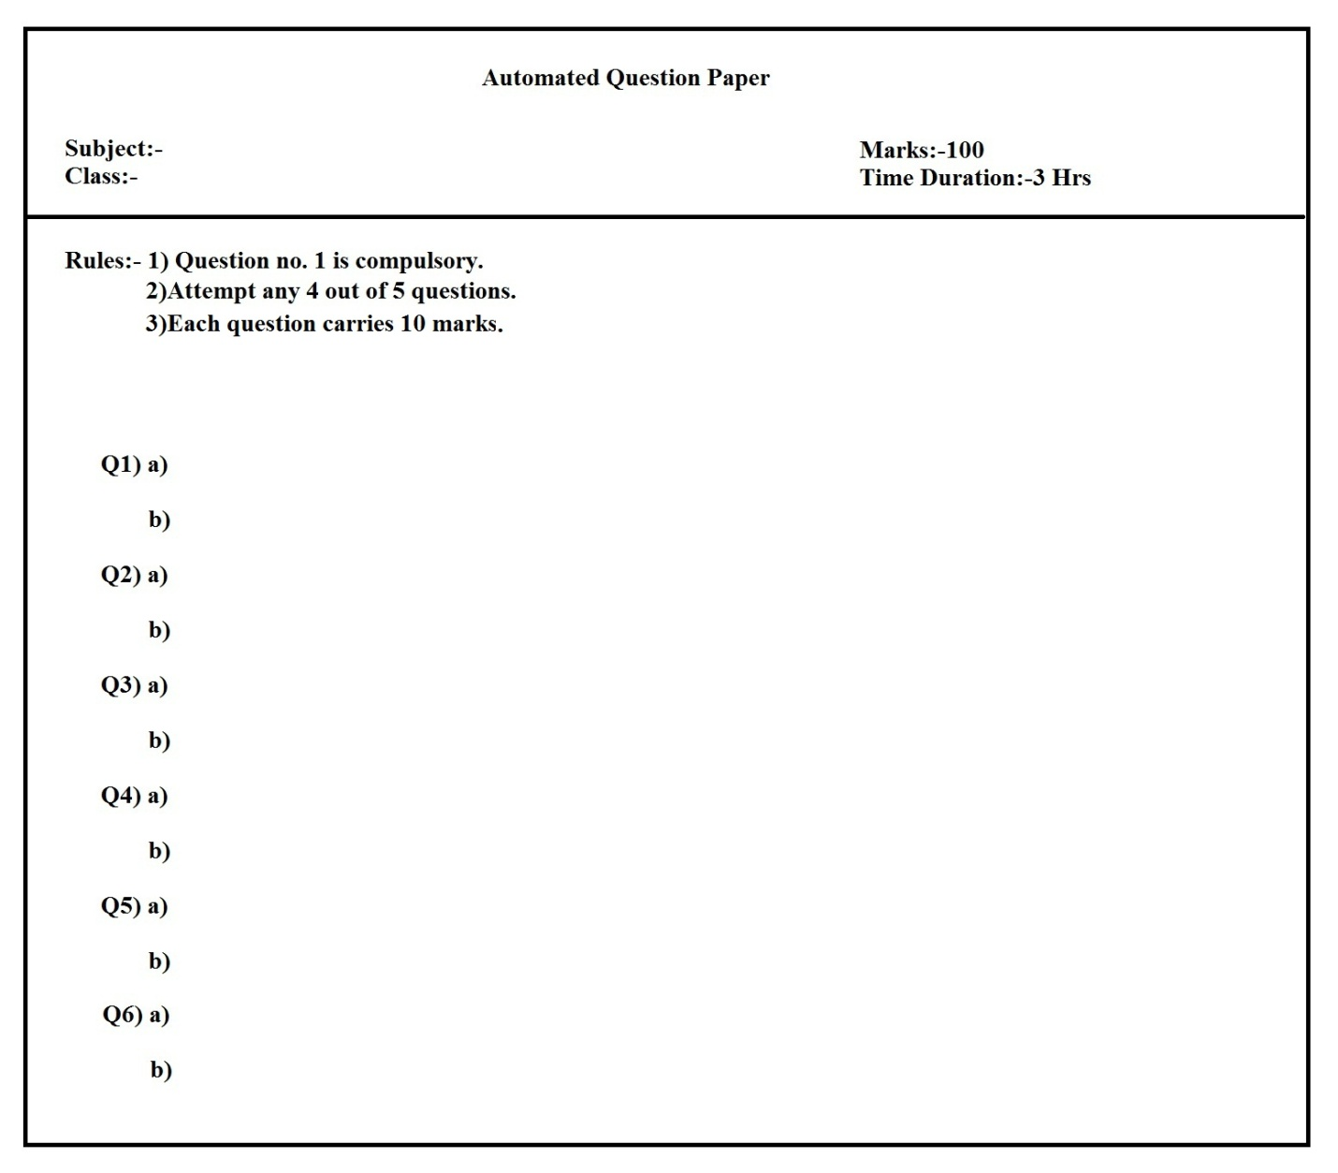
Above figure Question paper Template represents general template of question paper in which there will be 6 questions comprising of 2 sub questions of 10 marks each according to rules.

Slide 15
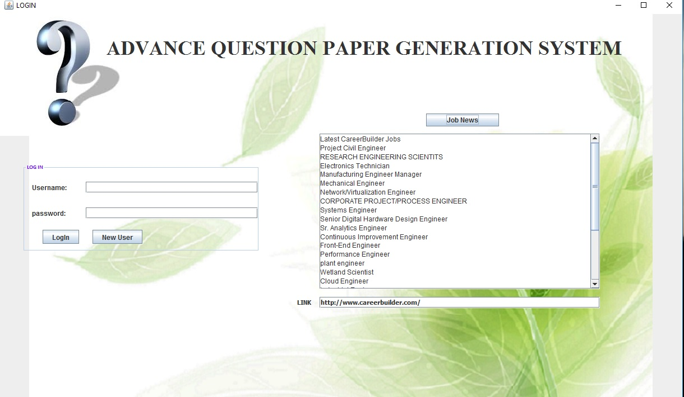
Above represents the login window of Advance Question Paper Generation System

Slide 16
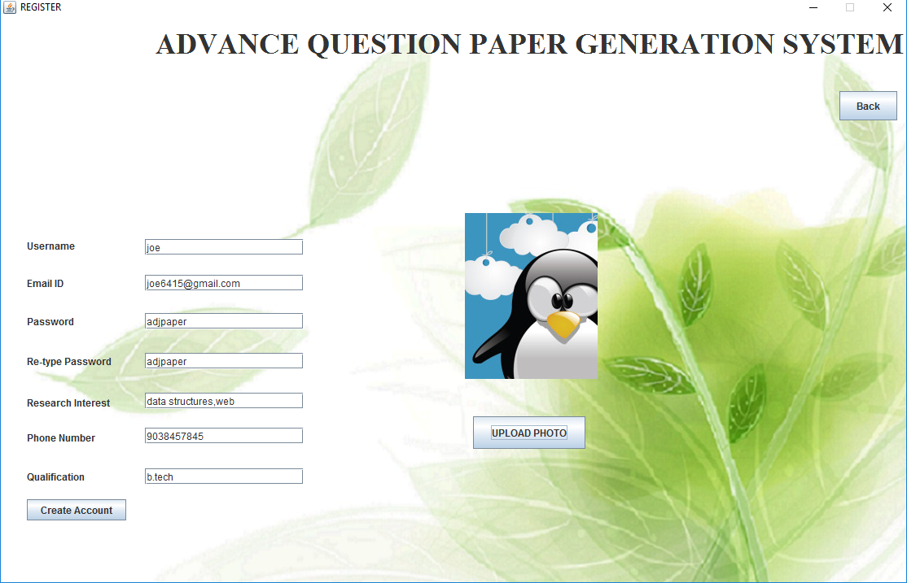
Above Fig represents the register window of Advance Question Paper Generation System

Slide 17
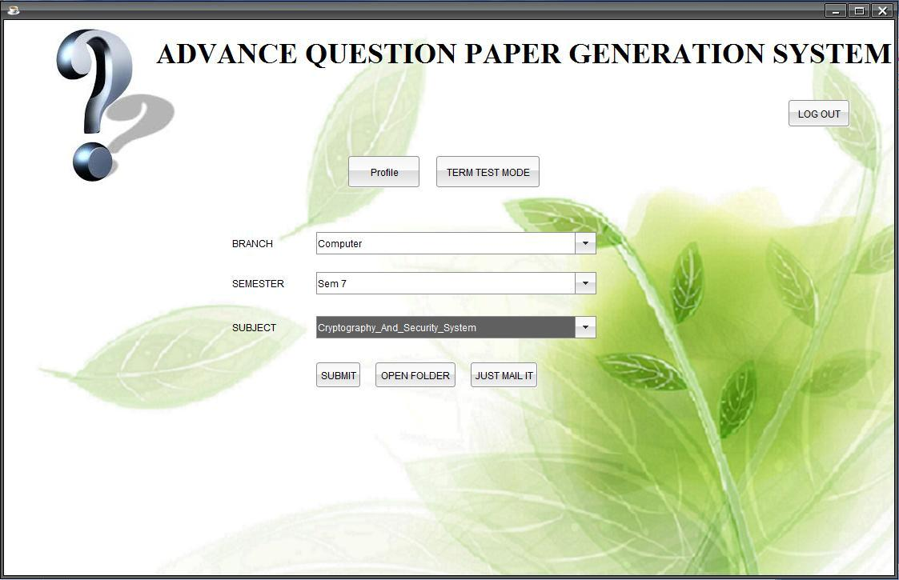
Above Fig represents the Mumbai University mode window of Advance Question Paper Generation System

Slide 18
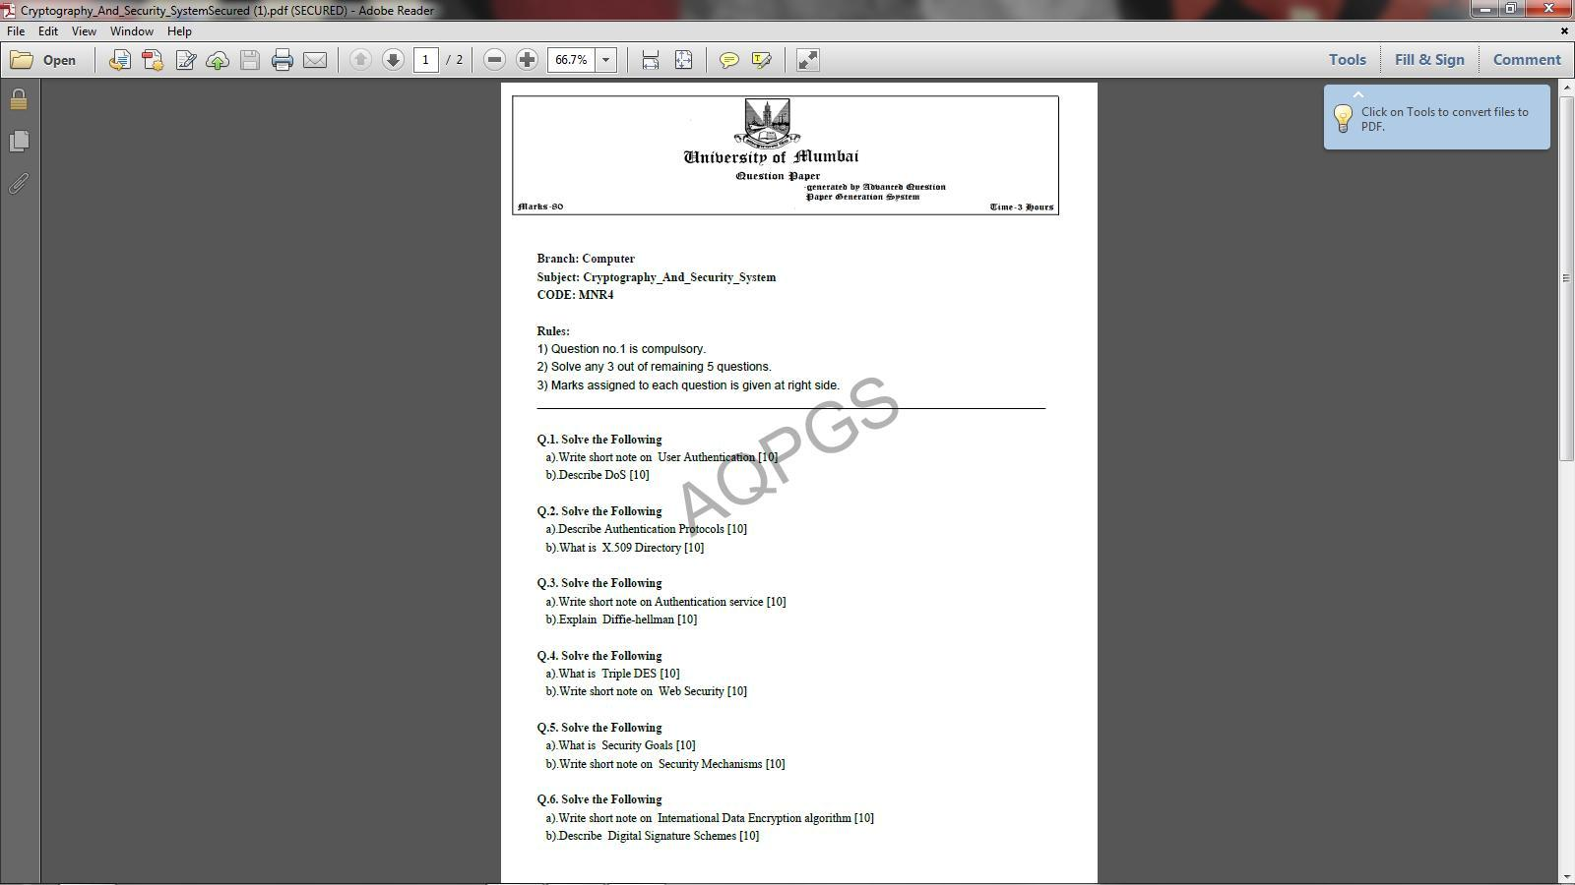
Above Fig shows the generated question paper of subject Cryptography and system security for Mumbai University of 80 marks

Slide 19
Conclusion
To create effective question it is important to automate the complete procedure of question paper generation. Proposed system uses searching algorithm and questions can be generated that are relevant to syllabus and generate a question paper according to weight age of each chapter. Thus system simplifies the whole process of question paper generation.
Future Scope
Natural Language Processing
Better Security

Slide 20
References
[1] Peijiang Chen, ”Construction of Test Question Database for Electrical and Electronic Technology”, International Conference on Electronic & Mechanical Engineering and Information Technology, IEEE, August 2011, p 5.
[2] Syahaneim Marzukhi, Muhammad Firdaus Sulaiman. “Automatic Generation Question System to Enhance Preparation of Learning Assessment”, p 6.
[3] Fang Yuan, Bo Liu,. “A New Method of Information Extraction from PDF Files”, The Fourth International Conference on Machine learning and Cybernetics, IEEE, August 2005, p 4.
[4] Vaibhav M. Kale, Arvind W Kiwelekar. “An algorithm for question paper template generation in question paper generation system”. IEEE, 2013, p 8.

Slide 21
THANK YOU

