Slide 1
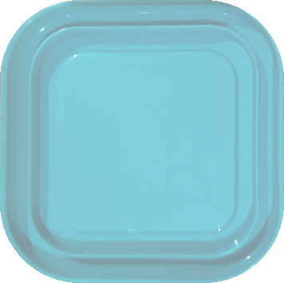


WU1 – all vs. equal – 16 count – blue/yellow

Slide 2
WU1 – all vs. equal – 16 count – yellow/blue

Slide 3
WU2 – all vs. small error – 16 count – blue/yellow

Slide 4
WU2 – all vs. small error – 16 count – yellow/blue

Slide 5
WU3 – all vs. small error – 16 count – blue/yellow

Slide 6
WU3 – all vs. small error – 16 count – yellow/blue

Slide 7
WU4 – almost all vs. large error – 16 count – blue/yellow

Slide 8
WU4 – almost all vs. large error – 16 count – yellow/blue

Slide 9
WU5 – almost all vs. large error – 16 count – blue/yellow

Slide 10
WU5 – almost all vs. large error – 16 count – yellow/blue

Slide 11

1 – equal vs. small error – 4 count – blue/yellow

Slide 12
1 – equal vs. small error – 4 count – yellow/blue

Slide 13
2 – equal vs. small error – 8 count – blue/yellow

Slide 14
2 – equal vs. small error – 8 count – yellow/blue

Slide 15
3 – equal vs. small error – 16 count – blue/yellow

Slide 16
3 – equal vs. small error – 16 count – yellow/blue

Slide 17
4 – equal vs. large error – 4 count – blue/yellow

Slide 18
4 – equal vs. large error – 4 count – yellow/blue

Slide 19
5 – equal vs. large error – 8 count – blue/yellow

Slide 20
5 – equal vs. large error – 8 count –yellow/blue

Slide 21
6 – equal vs. large error – 16 count – blue/yellow

Slide 22
6 – equal vs. large error – 16 count – yellow/blue

Slide 23
7 – ratio vs. small error – 4 count – blue/yellow

Slide 24
7 – ratio vs. small error – 4 count – yellow/blue

Slide 25
8 – ratio vs. small error – 8 count – blue/yellow

Slide 26
8 – ratio vs. small error – 8 count – yellow/blue

Slide 27
9 – ratio vs. small error – 16 count – blue/yellow

Slide 28
9 – ratio vs. small error – 16 count – yellow/blue

Slide 29
10 – ratio vs. large error – 8 count – blue/yellow

Slide 30
10 – ratio vs. large error – 8 count – yellow/blue

Slide 31
11 – ratio vs. large error – 16 count – blue/yellow

Slide 32
11 – ratio vs. large error – 16 count – yellow/blue

Slide 33
12 – same size, different proportion – 8 count – blue/yellow

Slide 34
12 – same size, different proportion – 8 count – yellow/blue

Slide 35
13 – same size, different proportion – 16 count – blue/yellow

Slide 36
13 – same size, different proportion – 16 count – yellow/blue

Slide 37
14 – same size, different proportion – 16 count – blue/yellow

Slide 38
14 – same size, different proportion – 16 count – yellow/blue

Slide 39
15 – same size, different proportion – 16 count – blue/yellow

Slide 40
15 – same size, different proportion – 16 count – yellow/blue

