Slide 1
Flatiron School Module 1 Project
IMDb Web-Scraping Analysis on the TOP 250 films of All-Time Sorted by Votes in Descending Order
Christian Lopez
Notes:
- Hello my name is Christian Lopez and I will be presenting my web-scraping analysis on the TOP 250 films of all-time based on votes

Slide 2
Problem Statement:
Microsoft, having created a movie-studio, is looking to venture into the film-making industry and make a name for themselves in the space
They are in search of actionable insights that will guide them in the decision-making process
The findings I will present will guide them in the right direction and hopefully shed some knowledge on what the movie industry is looking for
Notes:
Microsoft wants to enter the film-making space and produce quality content of their own
They want insights that will aid them in their decision-making process. They hope those insights will point them in the right direction.
My hope is that this analysis will serve of tremendous value and shed some light on what the film industry is looking for

Slide 3
Business Value:
What genre of film to allocate our valuable resources to?
Zero-in on possible hires pertaining to directors and actors
Any possible features the film should have? Any interesting insights?
Notes:
The questions we hope dive into are:
What genre of film should we focus on?
What directors and actors should we hire and what is driving those decisions?
Are there any other interesting insights that we should take into consideration when creating this film?

Slide 4
Methodology:
Acquired relevant data using web-scraping technique with numpy, requests, and BeautifulSoup
Built dataframes and cleaned data using pandas, and re
Constructed visualizations using seaborn, matplotlib, and plotly
Notes:
The methodology was fairly straight-forward and simple with a little practice with Python
First, I used a web-scraping technique that makes use of requests, numpy, and BeautifulSoup to acquire the data, otherwise referred to as data wrangling.
Second, I built the dataframes I would use during the data exploration phase. This was accomplished using the Pandas module and re or “regular expressions”. I also used Pandas to clean the data and get rid of irrelevant or unusable data points.
Third, I used Seaborn, Matplotlib, and Plotly to construct the visualizations that helped us arrive at our findings.

Slide 5
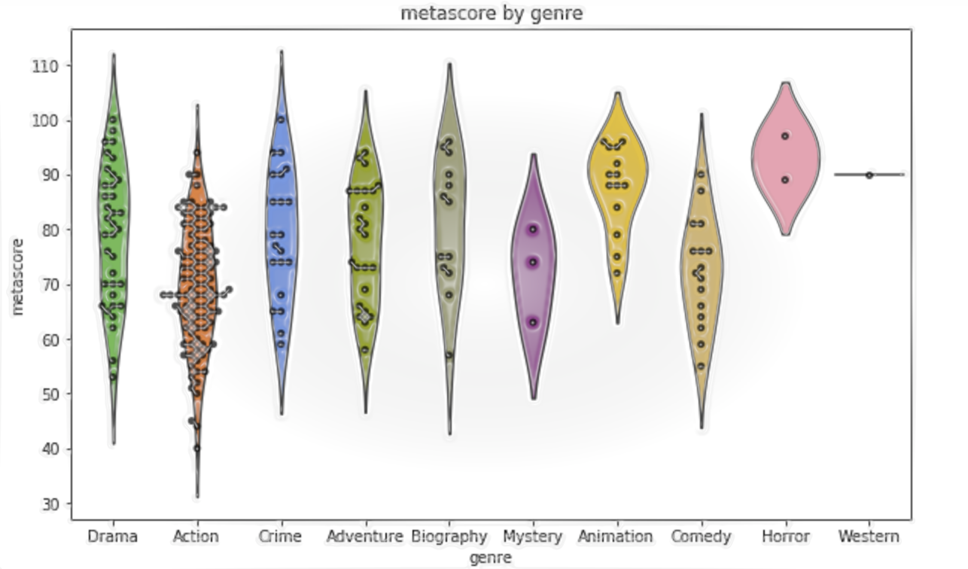
Finding 1:
The action genre is the most promising
Notes:
- The action genre seems to be the most promising in terms of breaking into film industry. The action genre contains many more data points then do the other genres. Although action doesn't have the films with the highest metascores, they are represented much more amongst the films in the TOP 250 IMDb movies of all-time. If a company decided to go ahead and produce an action-packed film, their chances of making it into the TOP 250 would be far higher than if they were to go with any other genre.

Slide 6
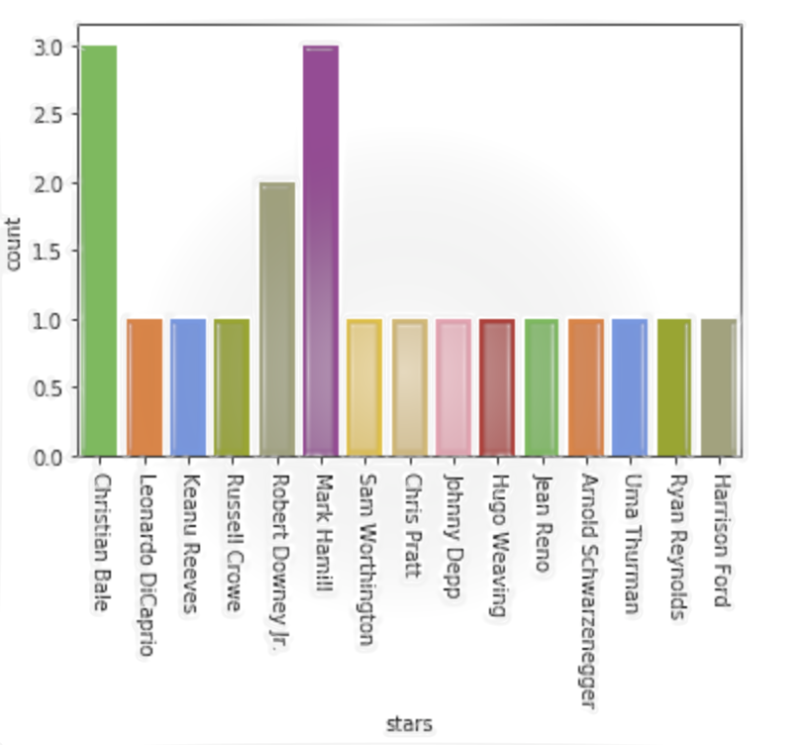
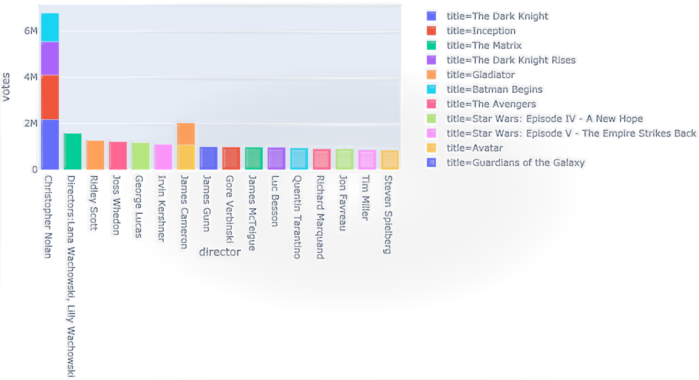
Finding 2:
.
Christopher Nolan. And Christian Bale would be the perfect director-actor duo to hire
Notes:
The director that seems to garner the most votes in the action genre appears to be Christopher Nolan when looking at the TOP 20 action films. The Dark Knight is his most successful film with almost double the votes compared to his other films.
It'd be my recommendation for the company to hedge their bets and hire Christopher Nolan as their director if they aspire to break in.
When looking at the top actors for the TOP 20 action films, we see three names stick out above the rest. They are Christian Bale, Mark Hamill, and Robert Downey Jr. If the company had to go with one of these stars, I would recommend they go with Christian Bale. The next slide will drive my point a little clearer.

Slide 7
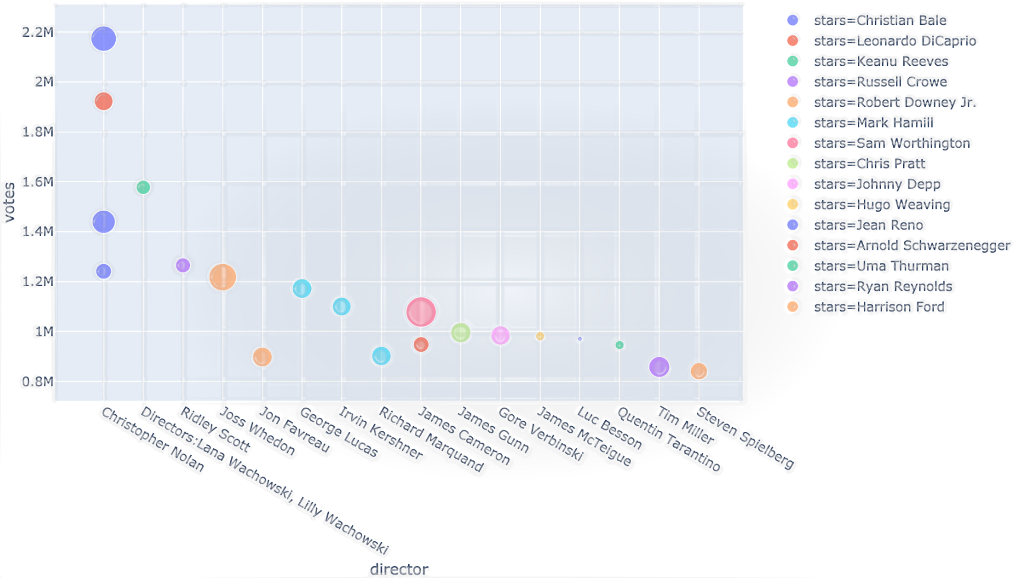
Finding 2 Cont.
Notes:
- As you may have become aware by looking at the scatterplot above, Christian Bale's appearances in the Batman Begins, The Dark Knight Rises, and the Dark Knight all have more votes than do the films where Mark Hamill is in. Those being Star Wars: Episode IV- A New Hope, Star Wars: Episode V- The Empire Strikes Back, and Star Wars: Episode VI- Return of the Jedi. The film with the least votes for Christian Bale has more votes than the movie starring Mark Hamill with the most votes. Also, Christian Bale's films are all directed by Christopher Nolan, whereas Mark Hamill's films are directed by three different directors. Without a doubt, the Christopher Nolan-Christian Bale duo would be a banger in the industry and would disrupt the space in a positive way. The company's venture would certainly reap the rewards.

Slide 8
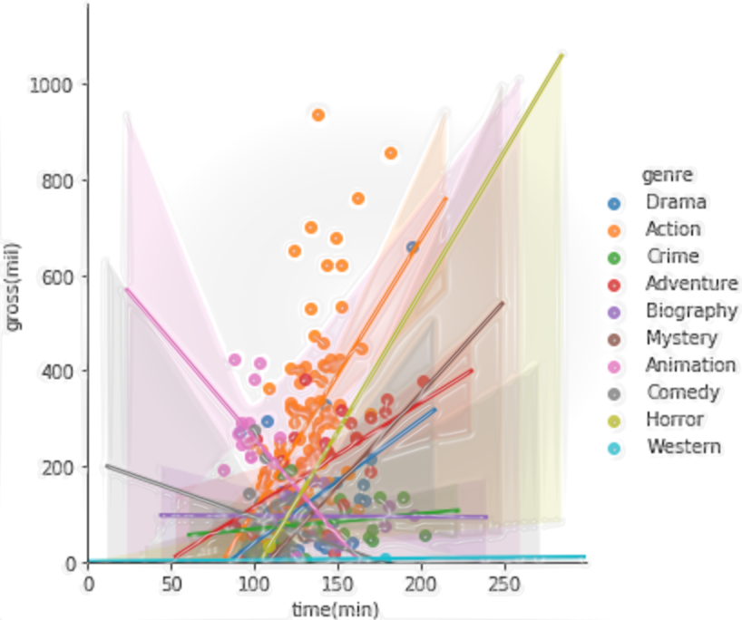
Finding 3:
The longer the film, the higher grossing the film will be
Notes:
I came across an interesting insight while conducting my data analysis. After performing a correlation plot staging time vs. gross per genre, what can be derived is that the films tend to have a higher gross as the timespan of the film increases. What this tells us is that when making this action film, we should focus on making the film somewhat longer.

Slide 9
Future Work:
Explore a larger sample size in IMDb
Focus on more recent ranking instead
Consider the company’s film-making budget
Notes:
Future work should include exploring more than the TOP 250 films. There would be more insightful conclusions to derive from a greater dataset. Maybe even comparing different datasets from different databases would be interesting.
Also, only looking at the films from the year before could possibly be a more representative sample.
The conclusions I arrived at for this exploratory analysis doesn't consider any sort of film-making budget that the company might have allocated for the venture. That could also play a major role on this project and have a major impact on the project as a whole. Just something to keep in mind.

