Slide 1
Downstream
From Raw Counts to Omics Analysis

Slide 2
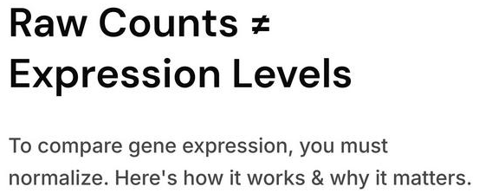

Slide 3
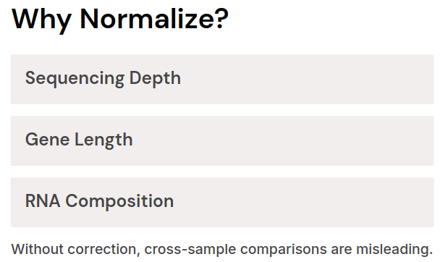
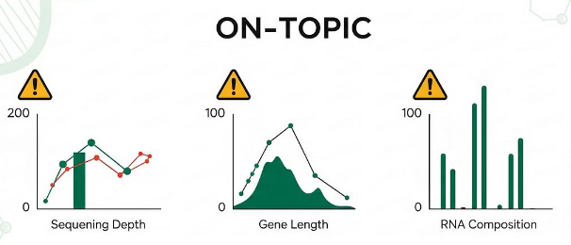

Slide 4
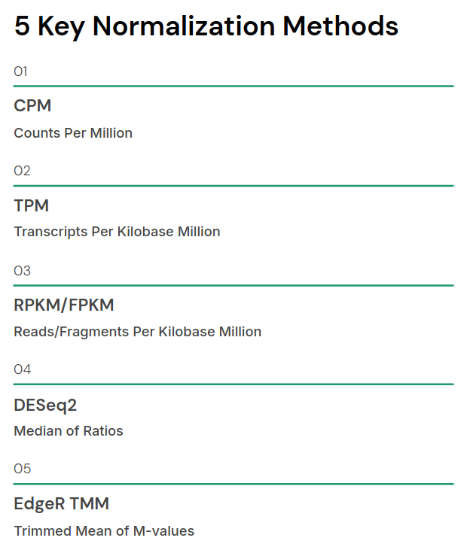

Slide 5
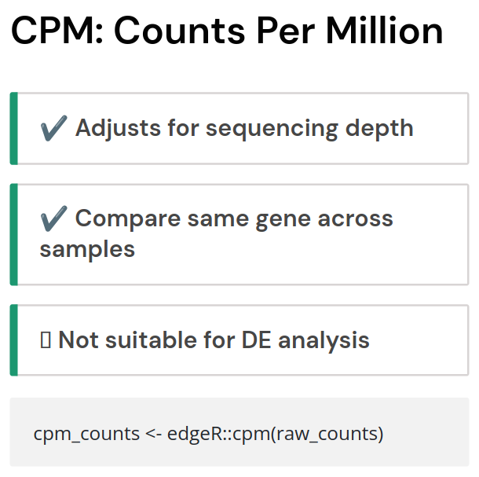

Slide 6
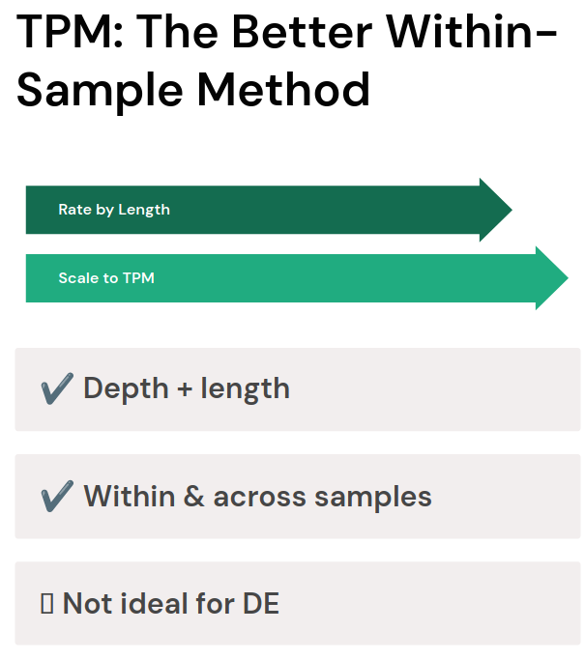

Slide 7
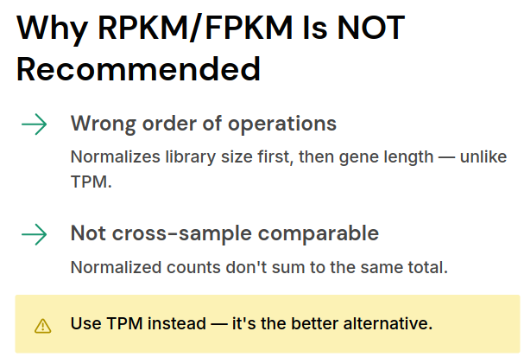

Slide 8
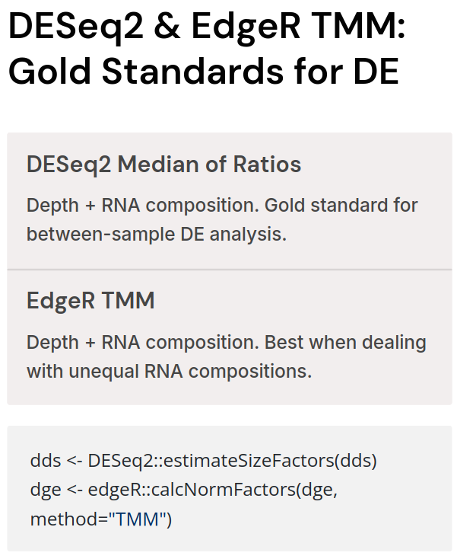

Slide 9
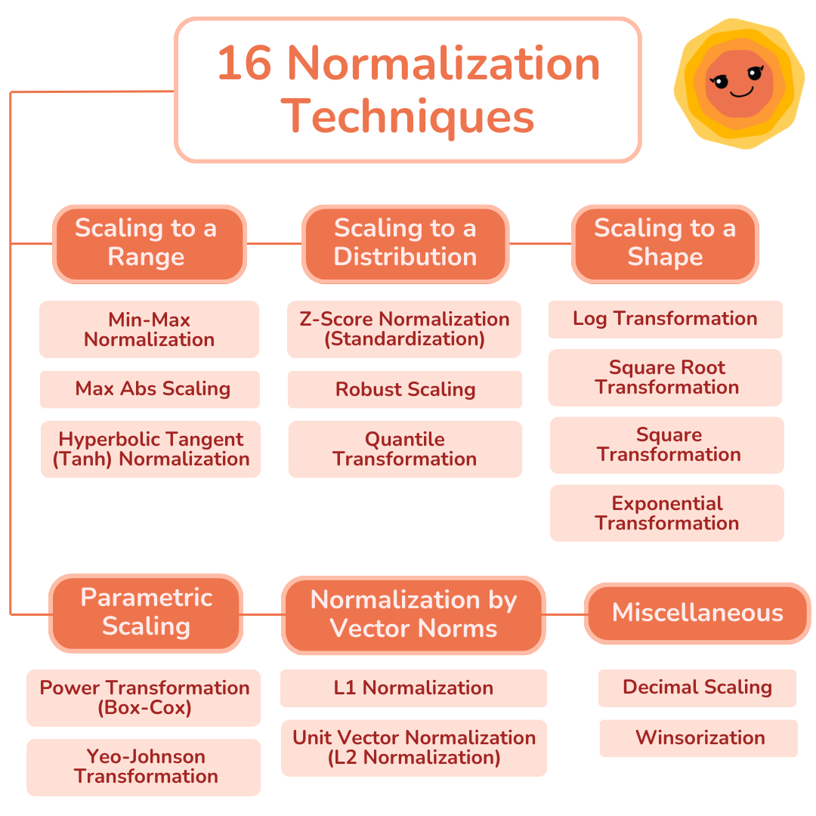
Other Normalization methods

Slide 10
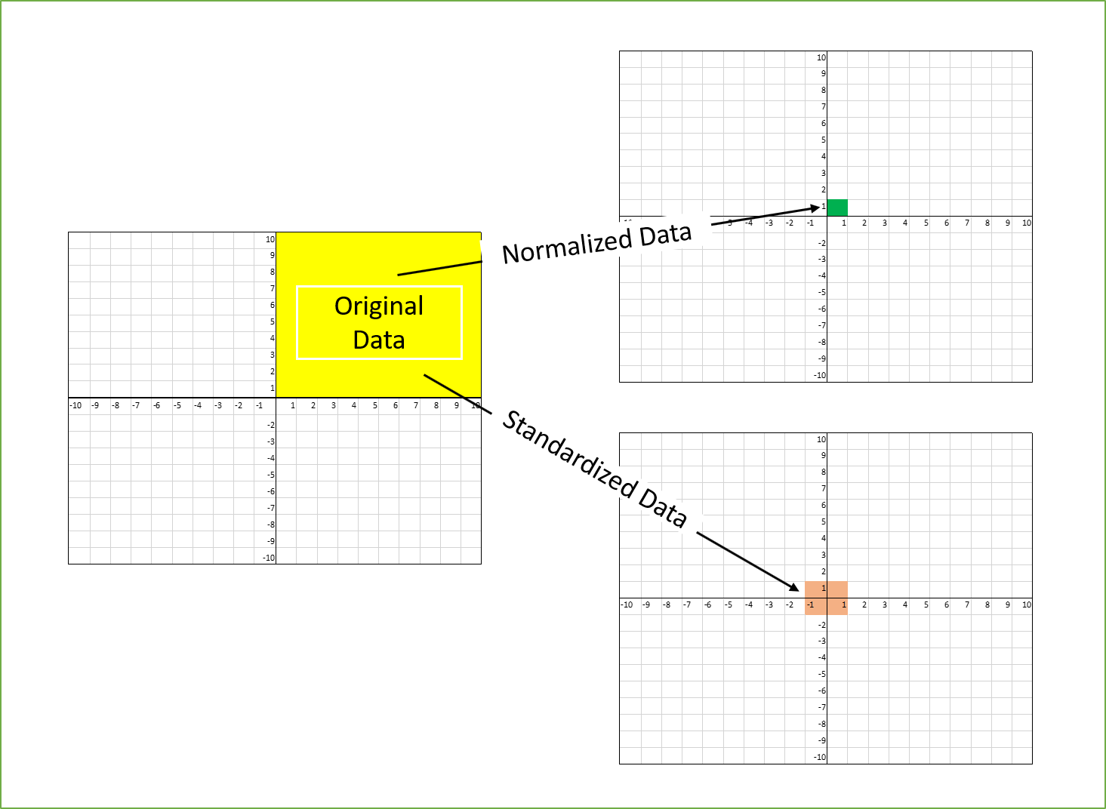

Slide 11
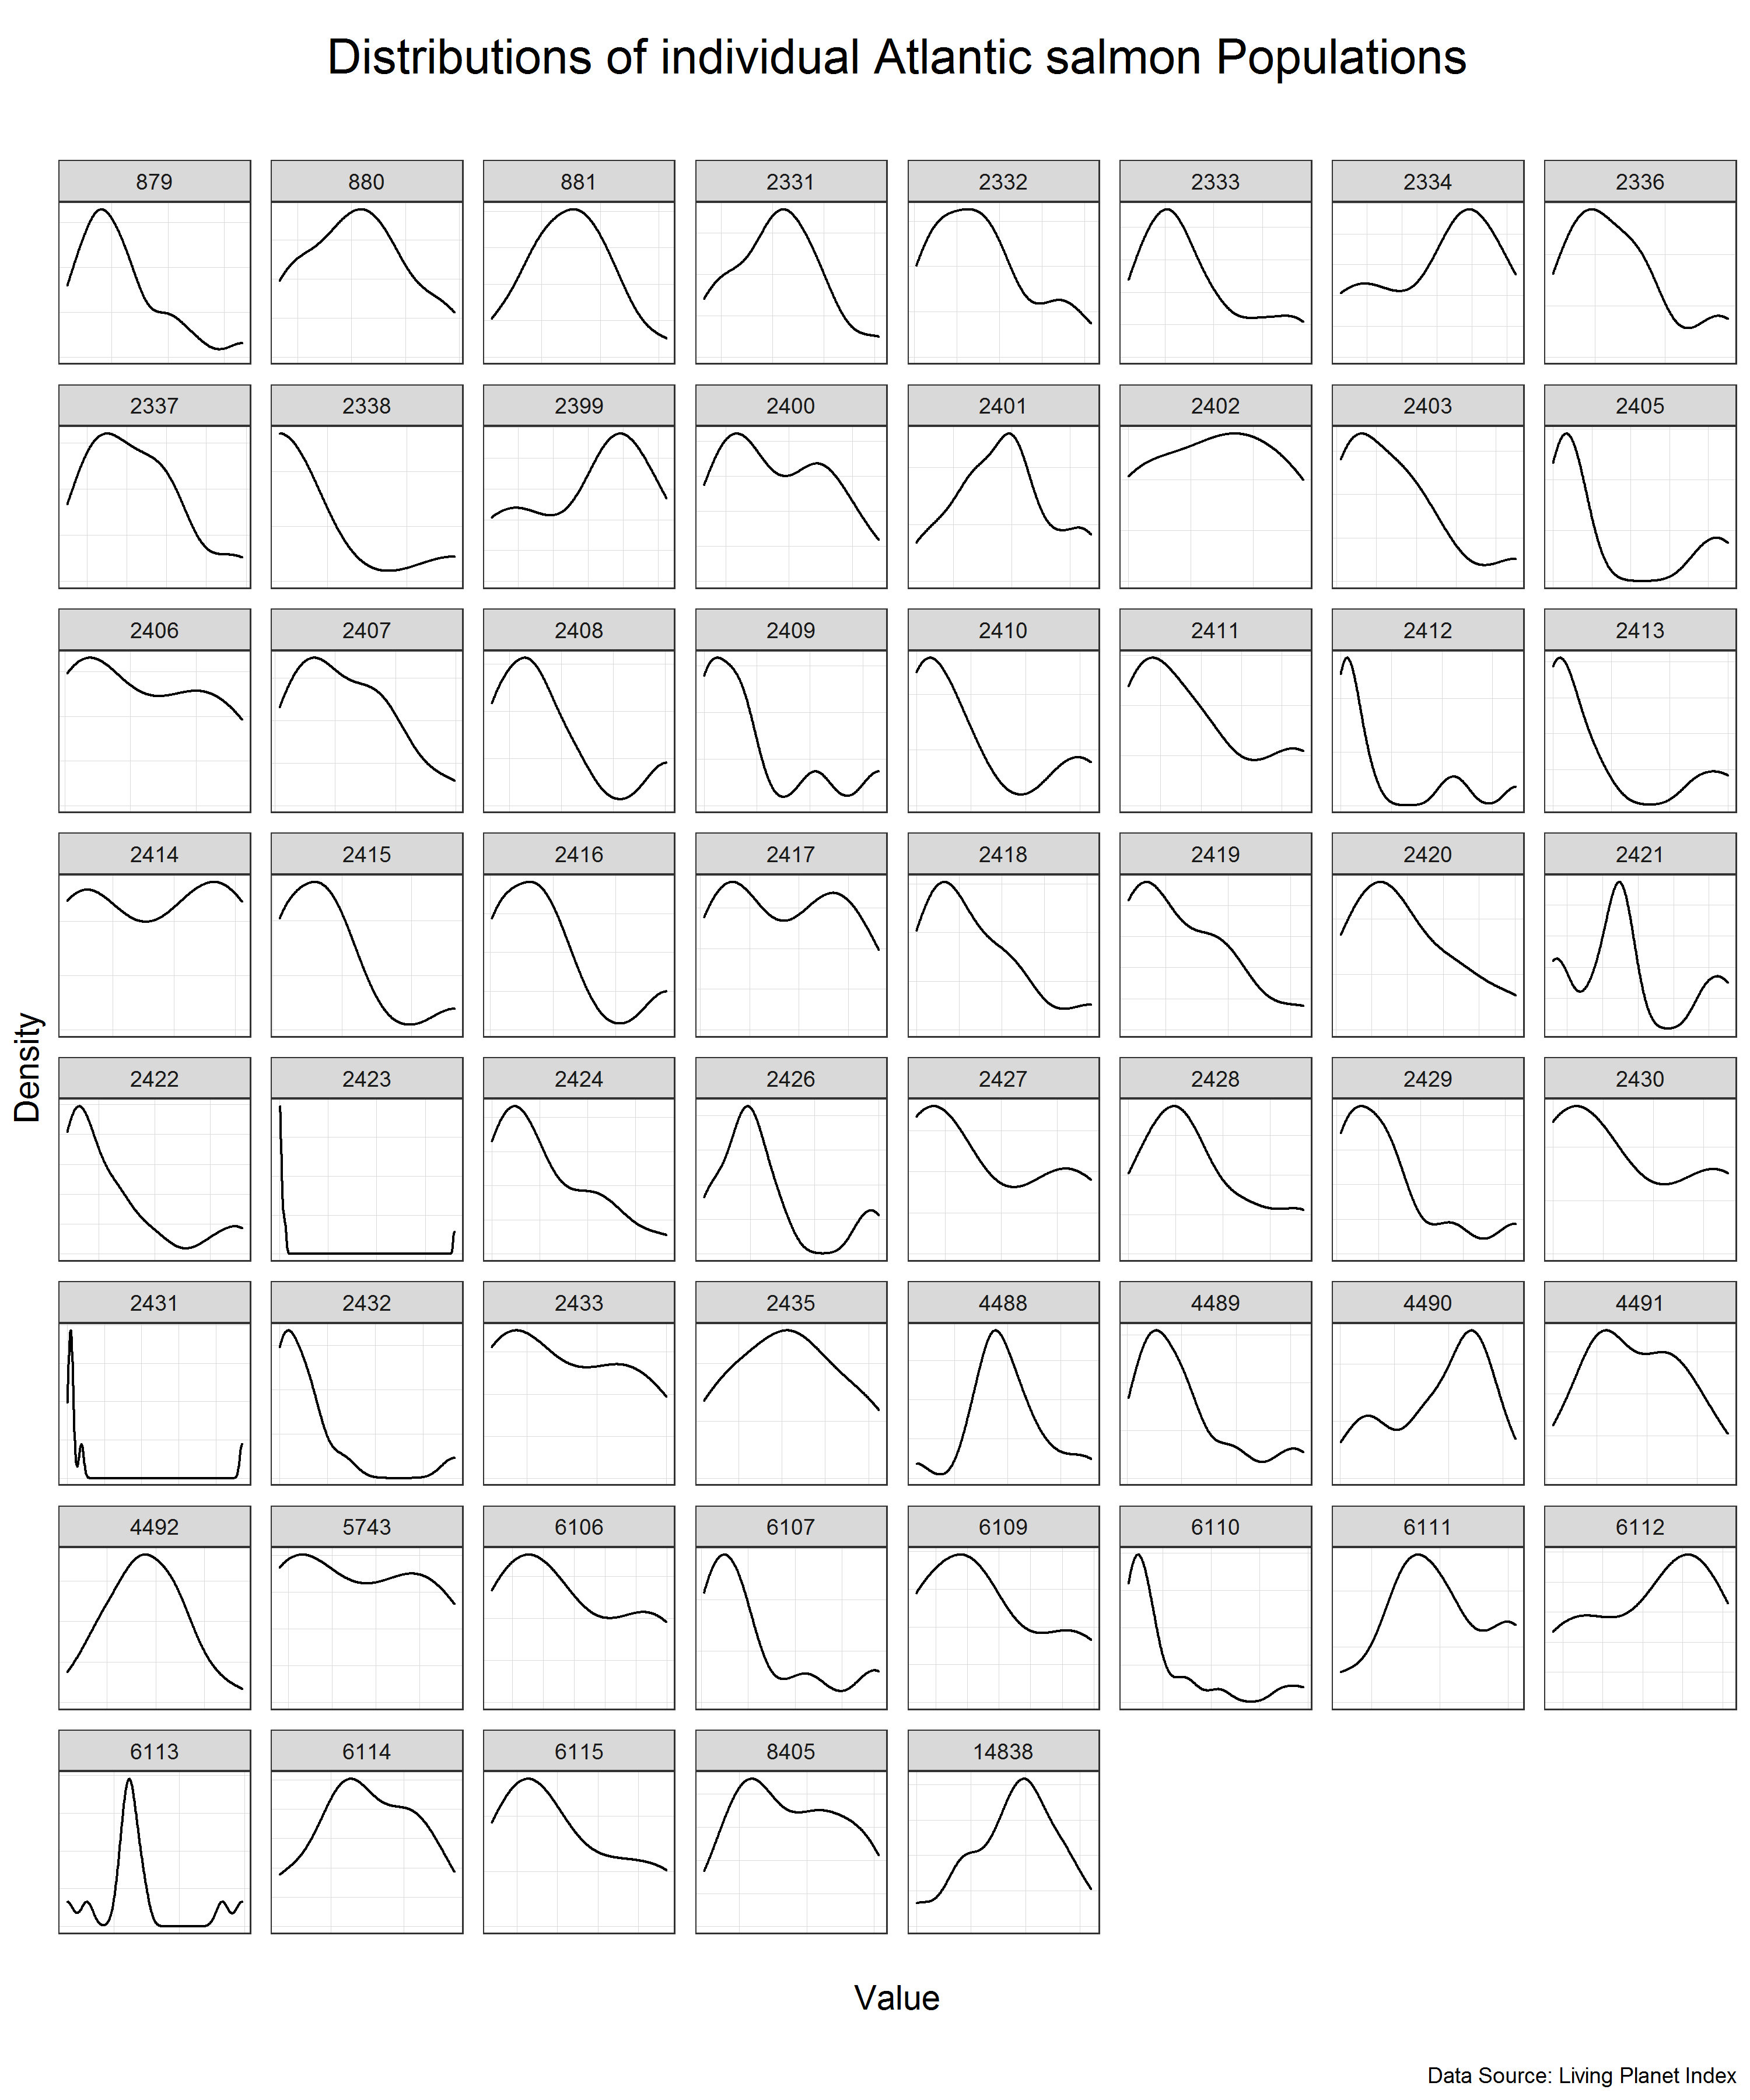
We can see that the individual populations have different distributions but many of them are close to normal distribution on their own scale. This means that we can use standardization to scale the data.
Standardization is a scaling procedure defined as subtracting the mean from the original data and dividing them by standard deviation. This shifts the centre of the distribution to 0 and scales standard deviation to 1. It is especially useful for data which are already normally distributed, in fact, the name of the procedure derives from the term standard normal. Normal distribution is defined by its mean and standard deviation which means that given these two parameters you can draw the exact curve describing the distribution (this fact alone is one of the main reasons why normal distribution is so popular, it is really easy to measure mean and standard deviation). Standard normal refers to a normal distribution with mean = 0 and standard deviation = 1.

Slide 12
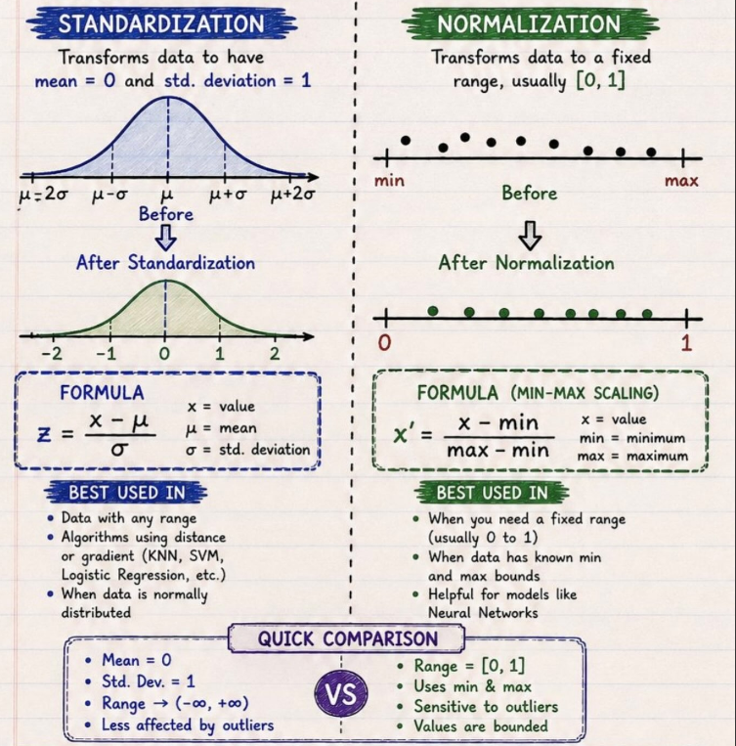
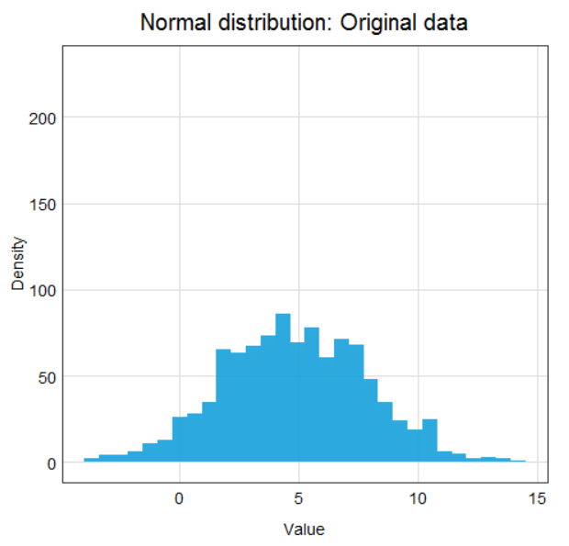
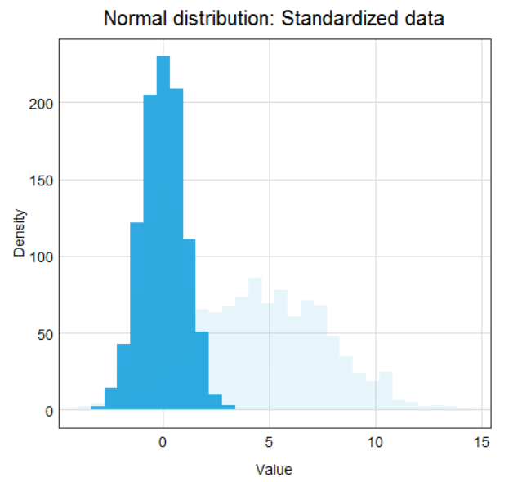
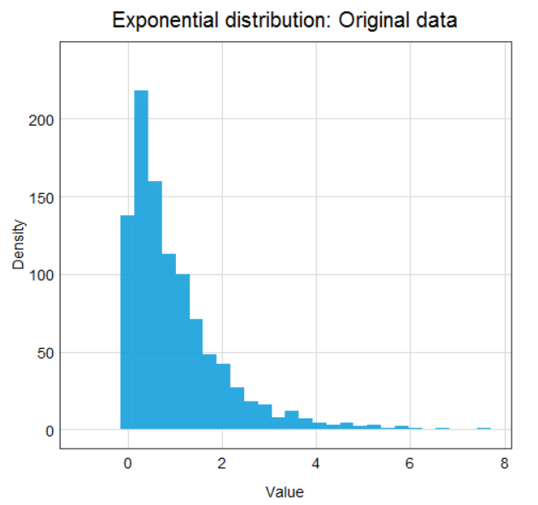
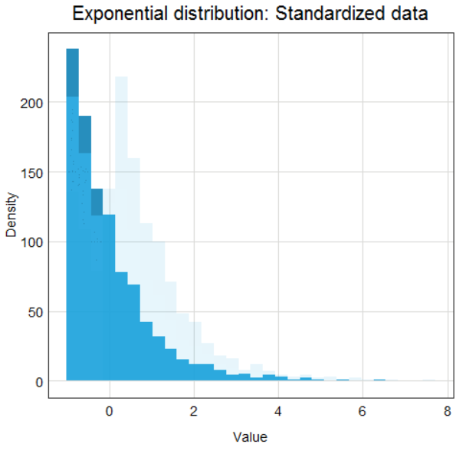

Slide 14
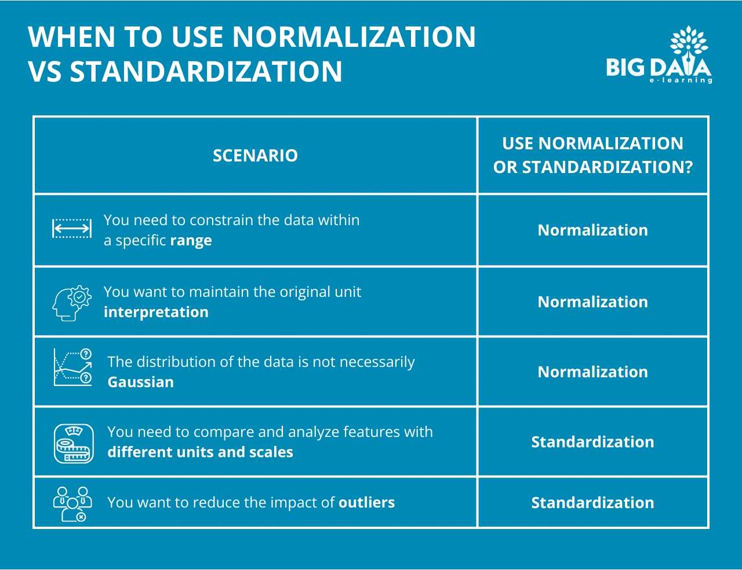

Slide 15
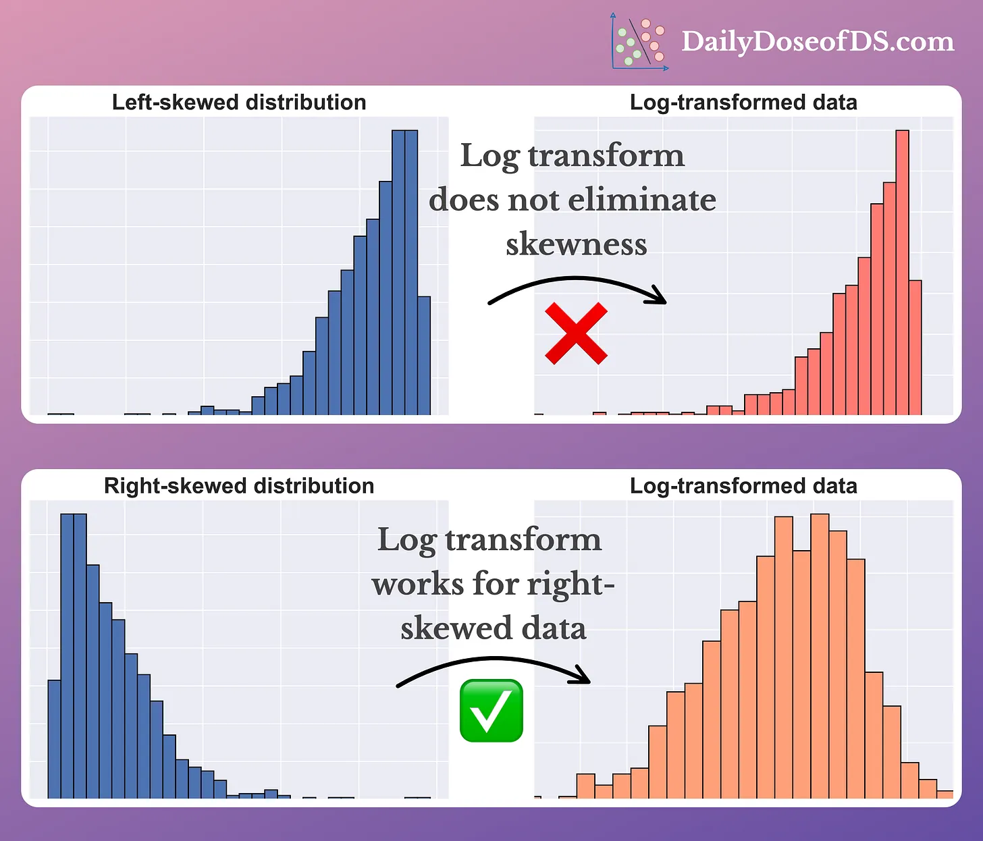
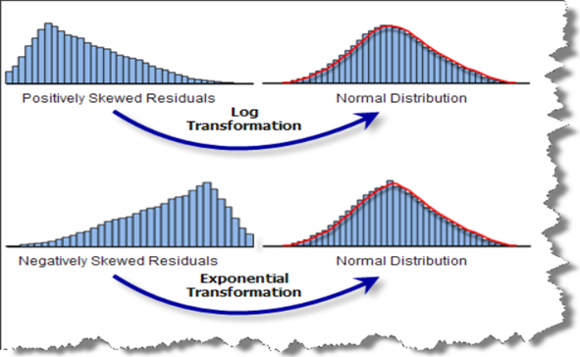

Slide 16
