Slide 1
Bioinformatics
Basic Tips
Maria Teresa Lopez Cascales

Slide 2
Linear algebra is so important
Matrices are everywhere in Bioinformatics
RNAseq: Gene x sample matrix with read counts
Single-cell: Gene by cell matrix read counts
ChIPseq: Peak by sample reads per peak
Drug response: Drug by sample with IC50 values

Slide 3
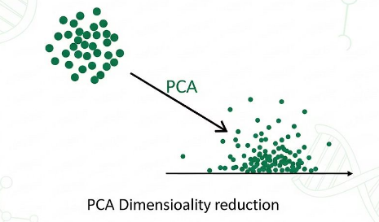
Matrices power every workflow
PCA: Dimensionality reduction
Clustering: Visualization of cell populations
Matrix factorization: Applied to scRNAseq data

Slide 4
Functional Programming
Functions over loops
  Take inputs, return outputs
Readable code
  Be clear, explain your objetive
Fewer bugs: Simple logic means less to break

Slide 5
Why it matters in bioinformatics
Many datasets, many projects
Faster execution
Easier maintenance

Slide 6
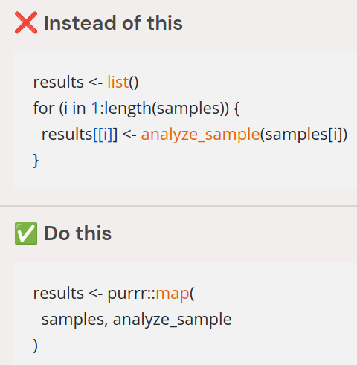
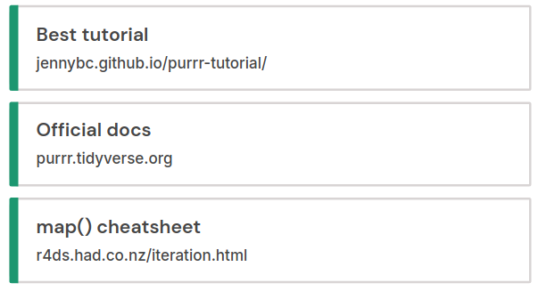
Meet puurrr:map()
The {puurrr} package replace loops with functional mapping

Slide 7
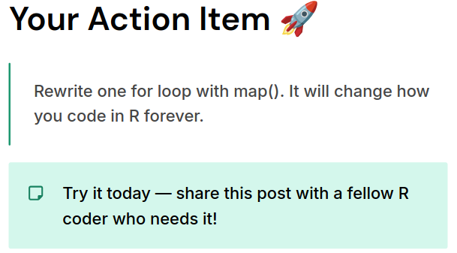

Slide 8
Bioinformatics is not a
Push-button Job
The reality behind every figure in a paper is far more complex than it looks

Slide 9
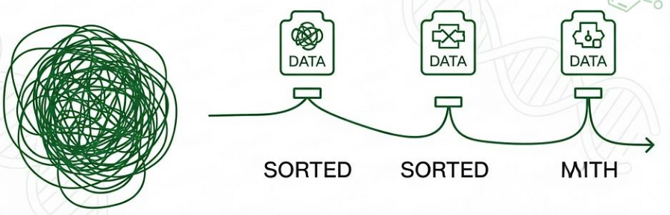
What we actually do
BEFORE every ANALYSIS
01. Understand the biology
02. Assess experimental design
03. QC raw sequencing data
04. Clean messy metadata
05. Only then analysis begin.
  Raw data is always messy
clean

Slide 10
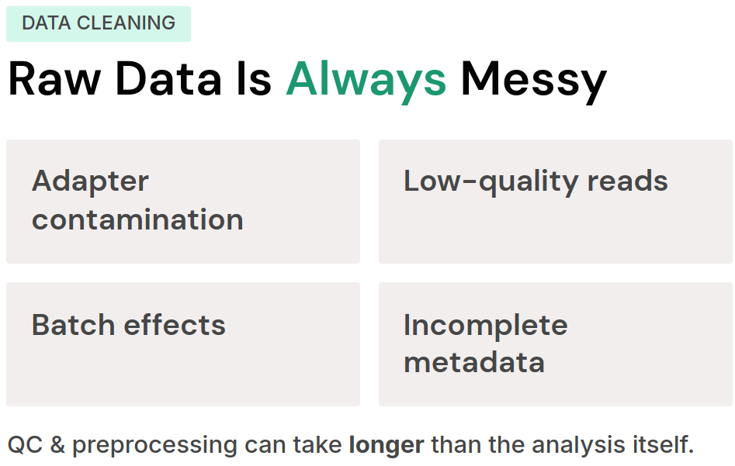

Slide 11
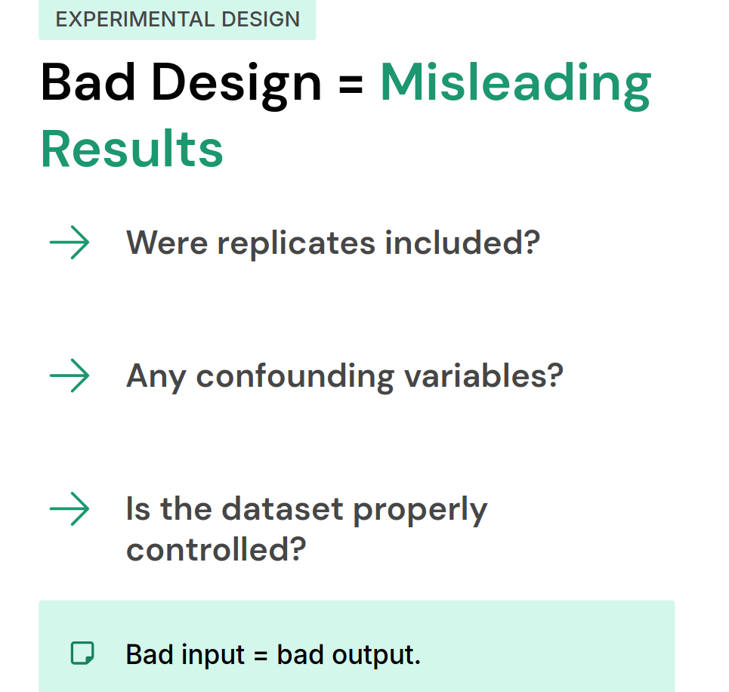

Slide 12
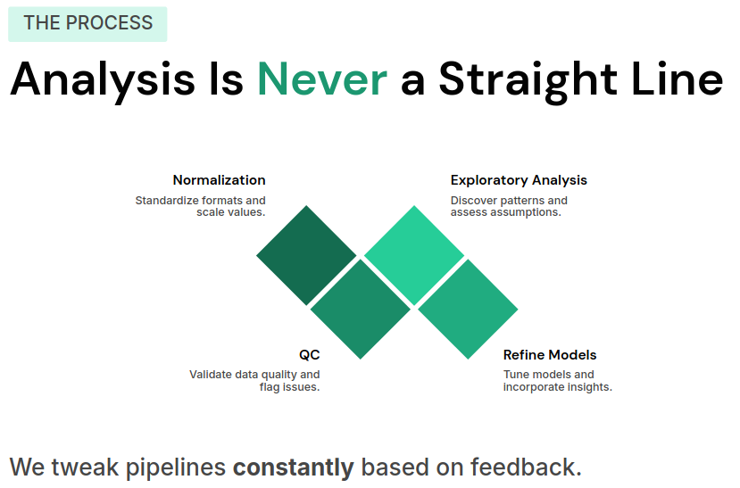

Slide 13


Slide 14
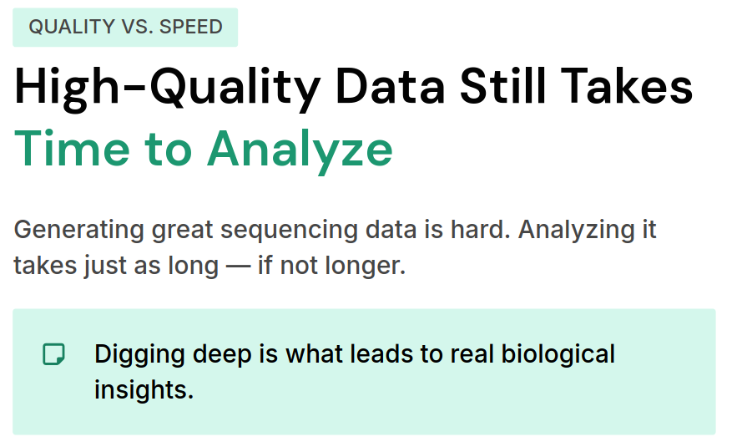

Slide 15
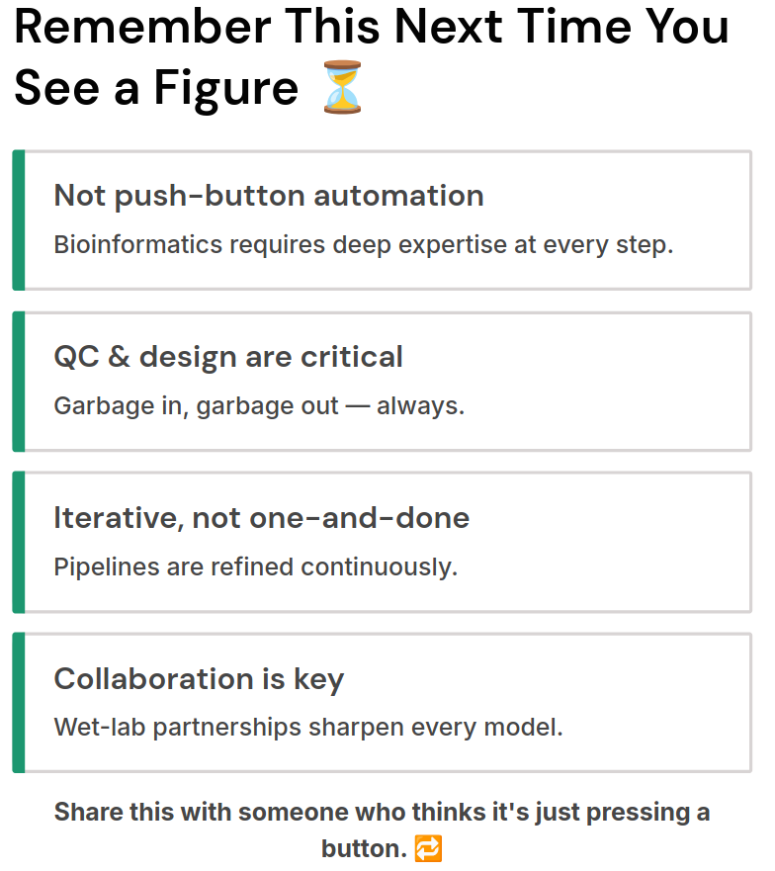

Slide 16
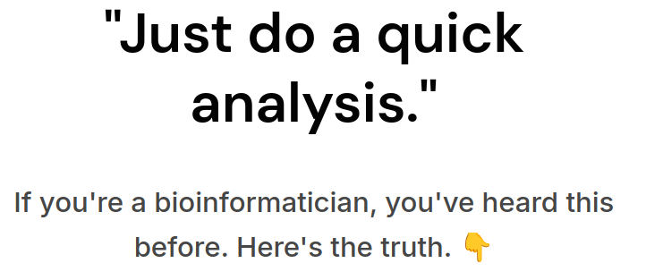
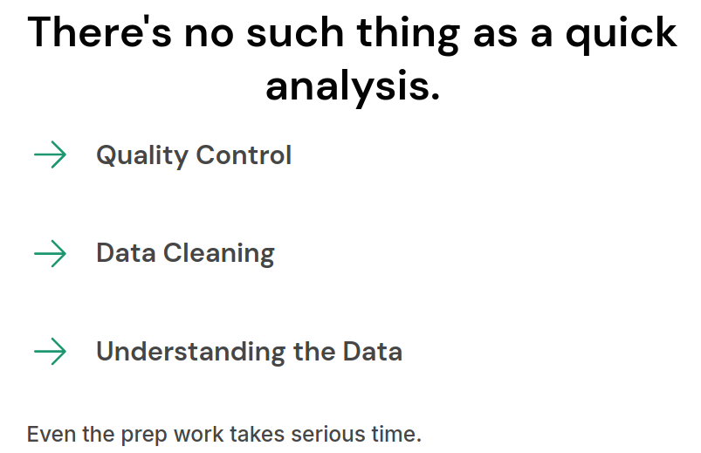

Slide 17
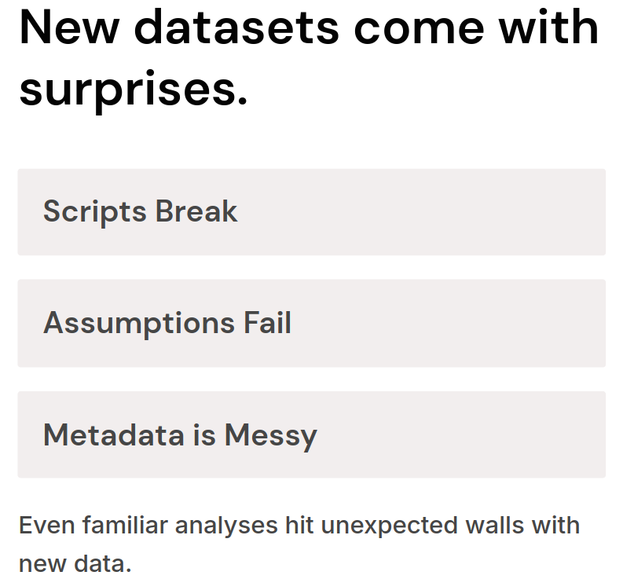

Slide 18
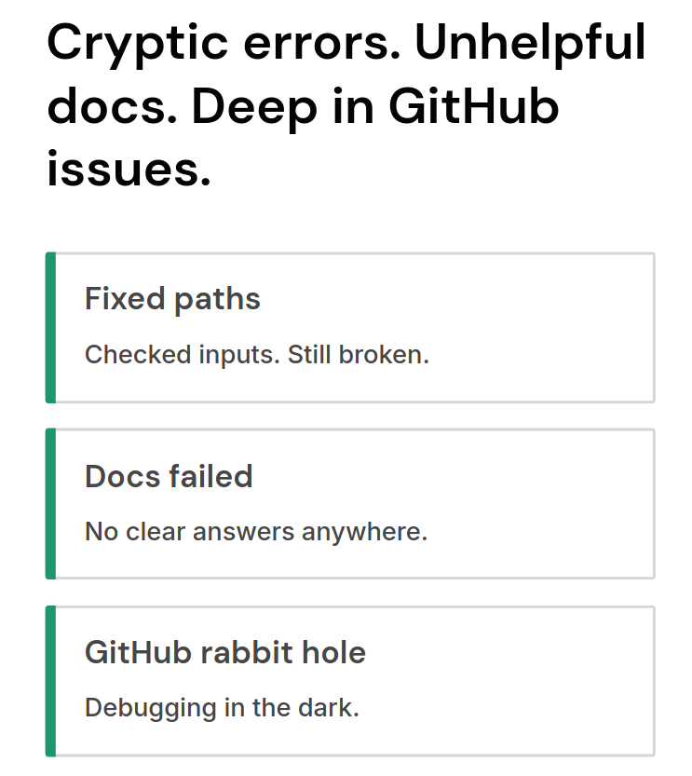
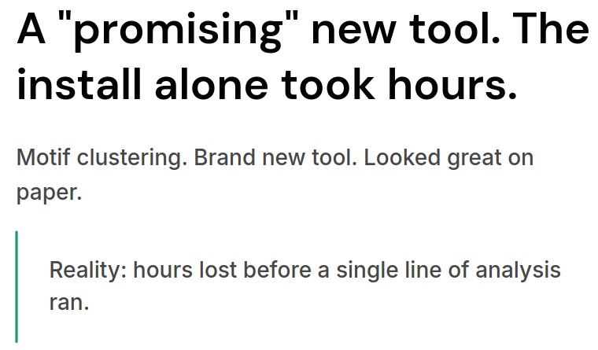

Slide 19
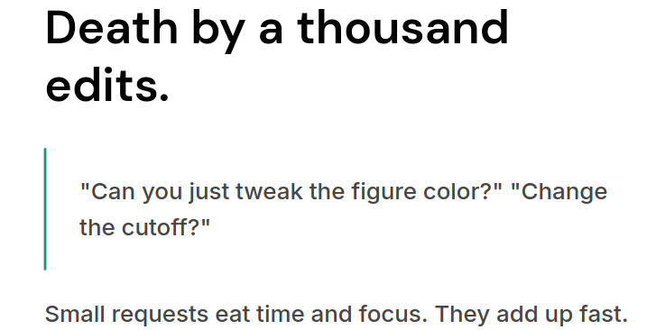

Slide 20
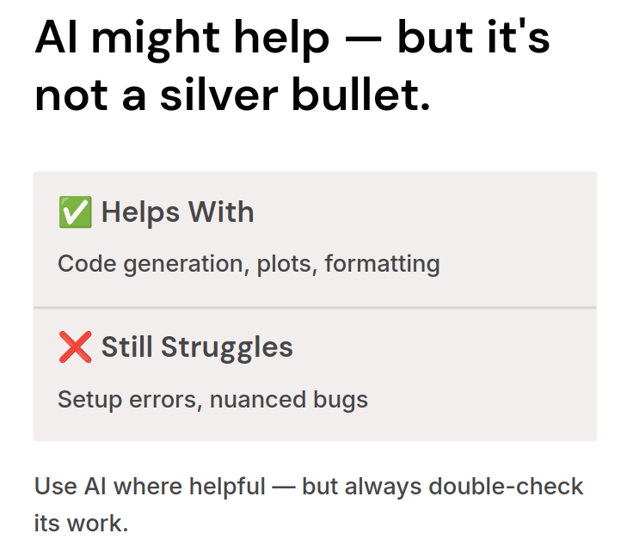

Slide 21
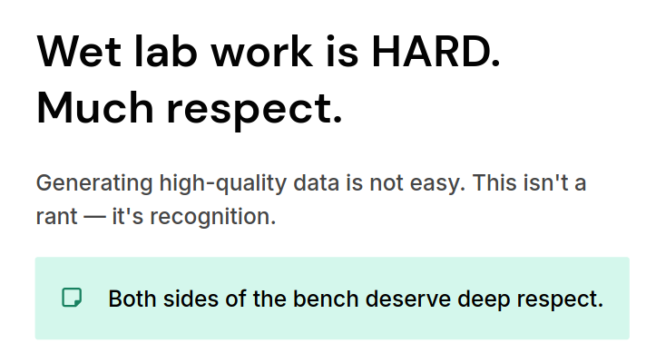

Slide 22
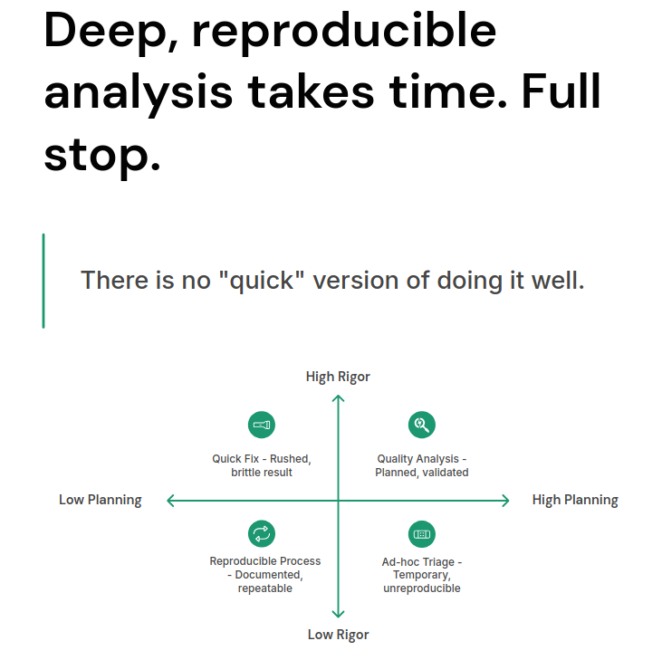

Slide 23
