Slide 1
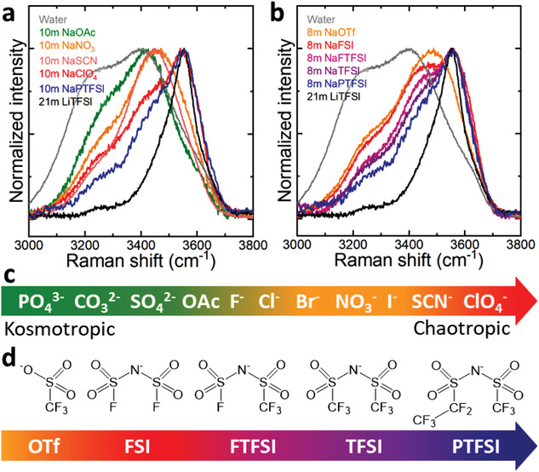
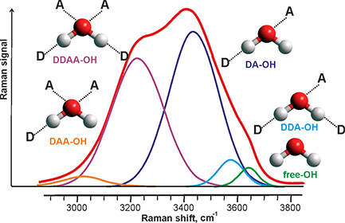
00
Chaotropic means:
Lower DDAA
Higher DDA

Slide 3
Expectation
Lithium Acetate
Lithium Nitrate
Lithium Perchlorate

Slide 4
DDA/DDAA
Ac: 0.75
NO3: 1.62
ClO4: 2.79
Ac: 1.86
NO3: 1.37
ClO4: 1.11
Ac: 1.40
NO3: 2.22
ClO4: 3.10

