Slide 1
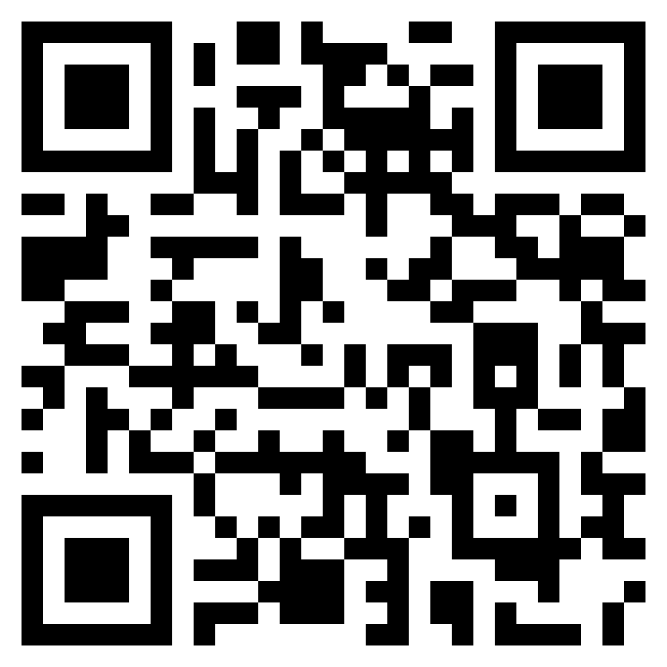
Pedro Ivan Lopez
Software Engineer
pedroivanlopez.com
m@pedroivanlopez.com
@lopezpdvn
@lopezpdvn
Web
Email
Twitter
GitHub

Slide 2
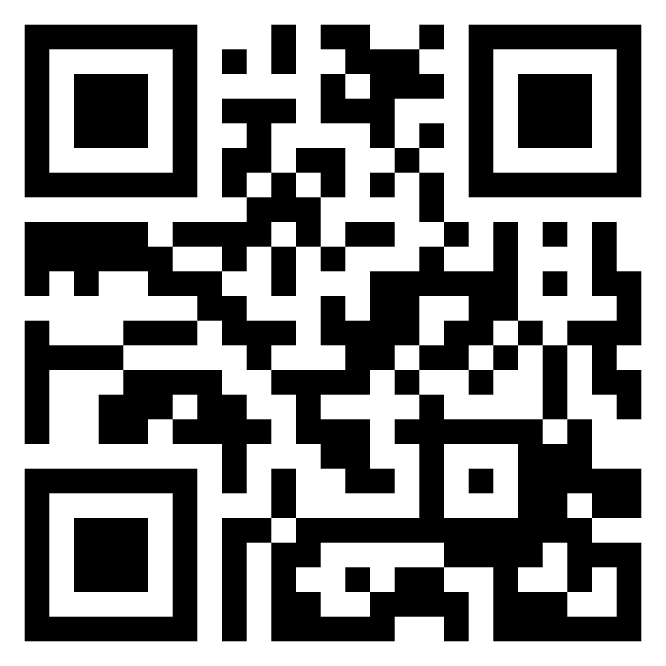
Website URL
vCard URL

