Slide 1
New Sediment Management Standards Guidance: Sediment Cleanup Users Manual II (SCUM II)
A Comprehensive Seminar on the 25th Anniversary of the Model Toxics Control Act (MTCA): Evolving Issues In Implementation, Litigation and Legislation
September 24, 2015
Hotel 1000 Seattle
Dr. Allison Geiselbrecht

Slide 2
SMS Updates Overview
New SMS promulgated Sept 2013
Applicable at all sediment sites in WA (pre-CAP)
Goals of new SMS:
Incentivize cleanups of sediment source areas within bay-wide contamination
Address human health risks
Promulgate freshwater criteria
Define framework for watershed-wide cleanup and source control
Early in implementation
Final Sediment Cleanup Users Manual II (SCUM II) available

Slide 3
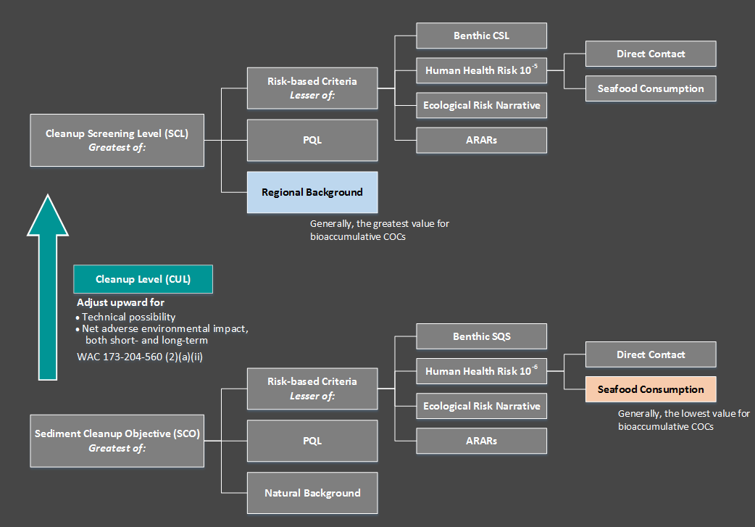
Sediment Cleanup Levels

Slide 4
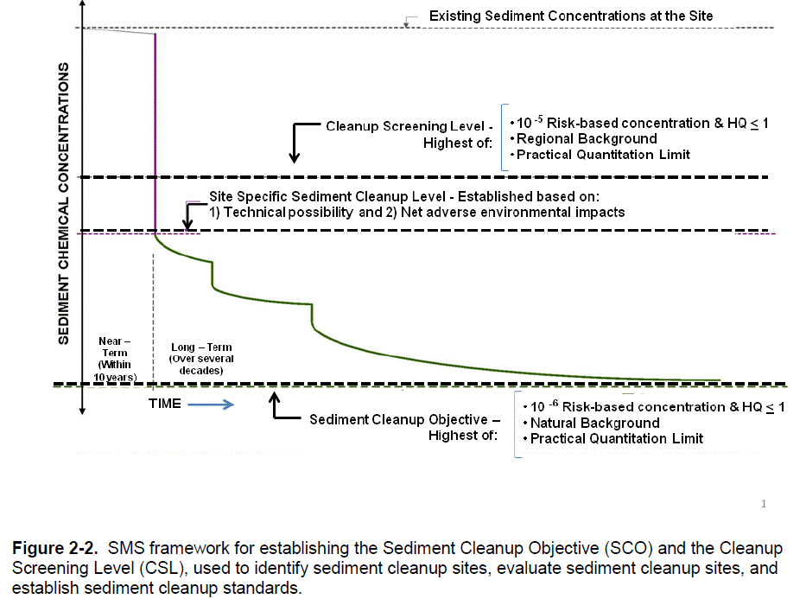
Long-Term Goal – Achieve CSO

Slide 5
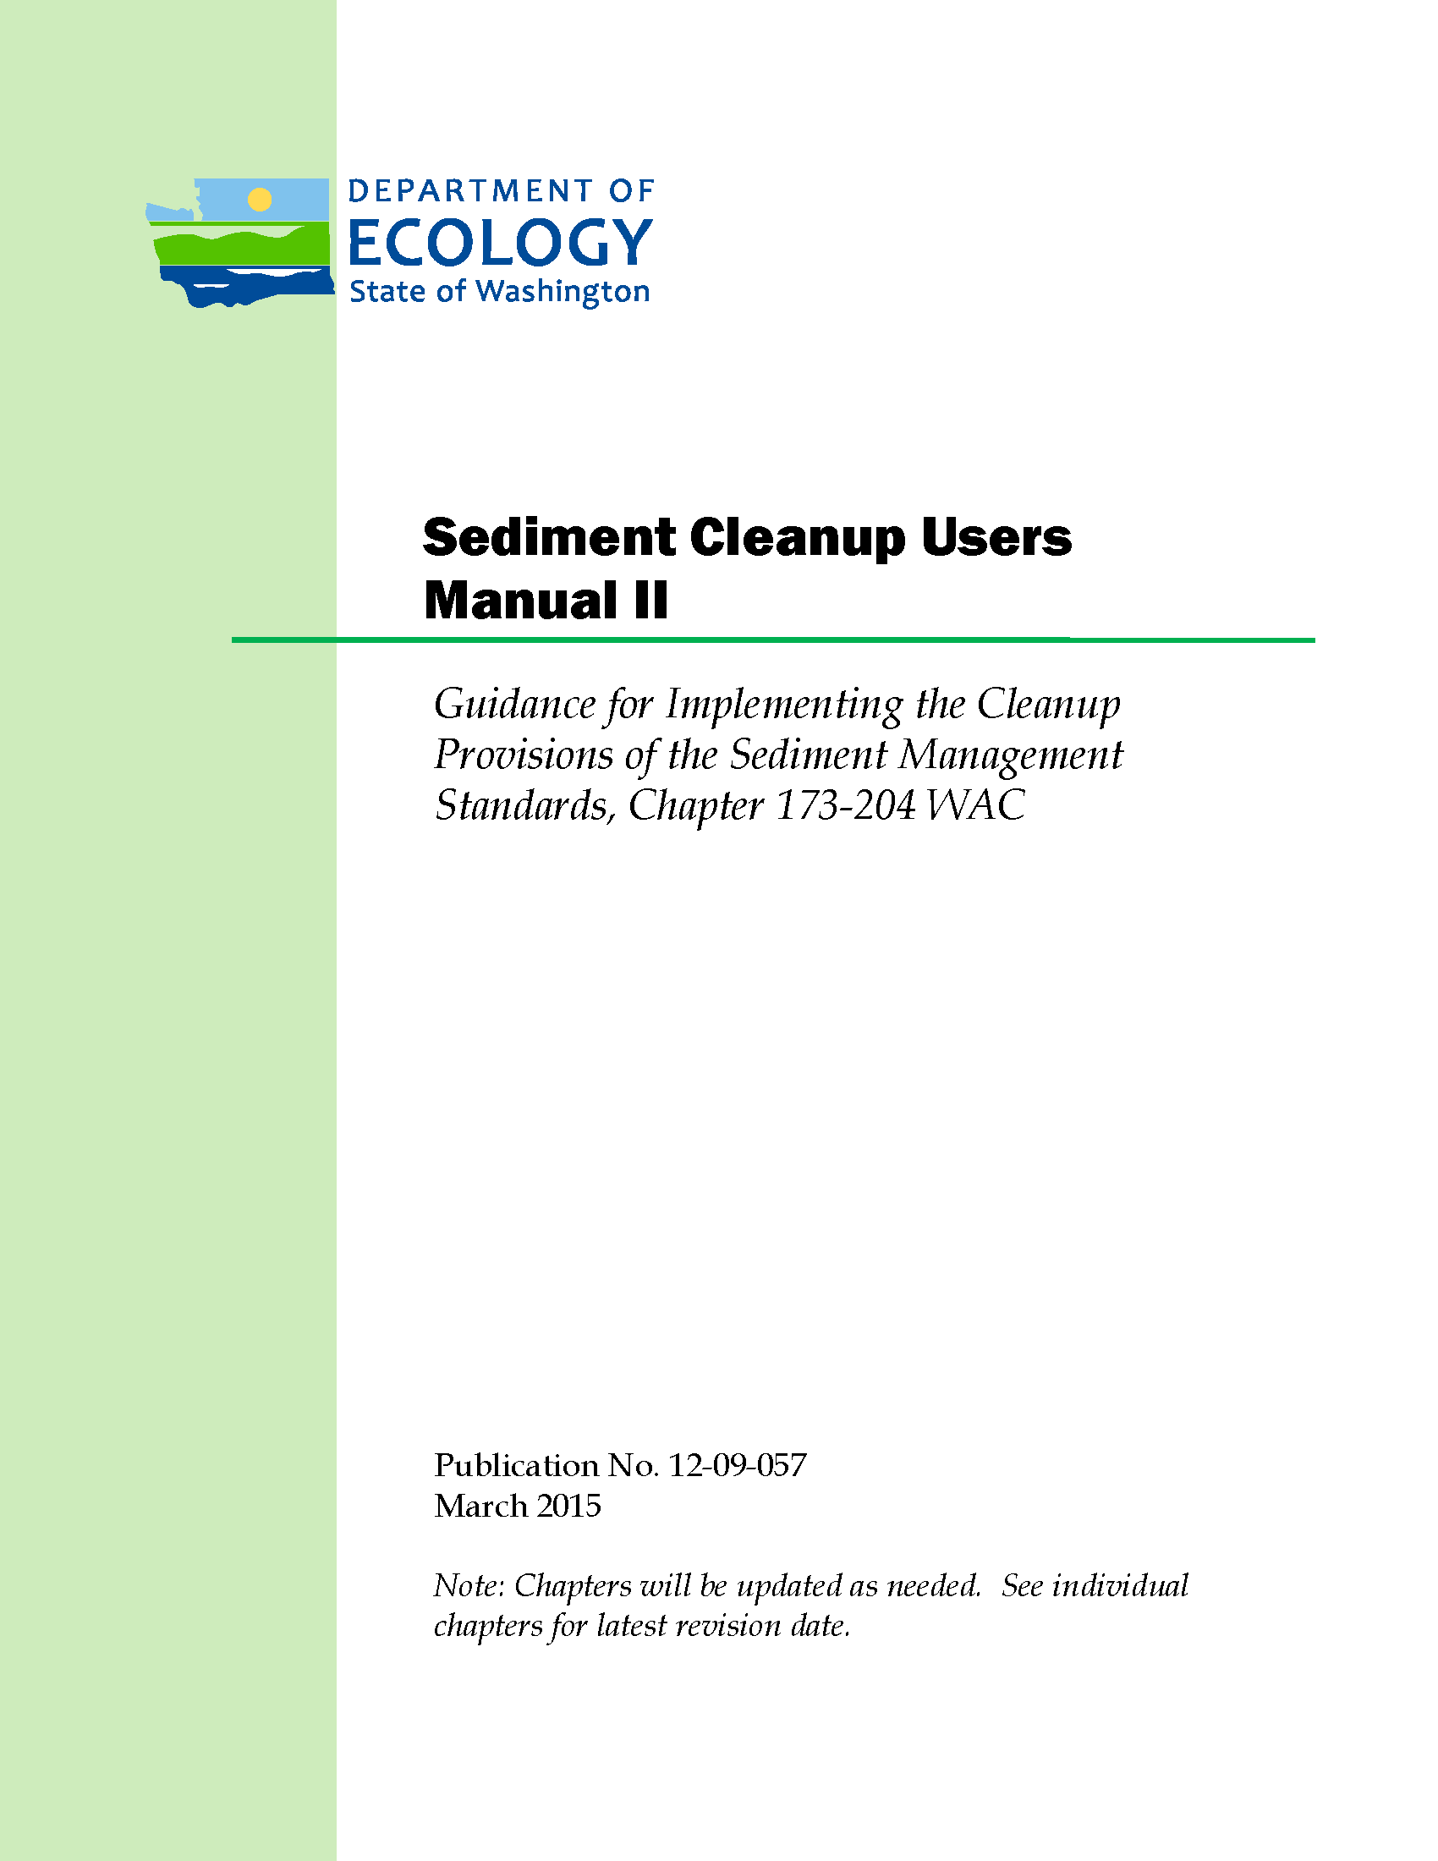
Sediment Cleanup Users Manual II
Final version available March 2015
Contains implementation details for SMS

Slide 6
New-ish Concepts
Numerical compliance – SWACs, point-by-point
Regional background
Sediment cleanup units (SCUs)
Sediment recovery zones (SRZs)
Emphasis on source control and recontamination

Slide 7
Numerical Compliance Concepts
Sediment cleanup level – established at the SCO, the CSL, or at a level in between. Can be adjusted upward from SCO without exceeding CSL (WAC 173-204-560(2)(a)(iii)), based on technical possibility and net adverse environmental impacts
Three parts to cleanup standard – cleanup level (number), depth in sediments, area of compliance
WAC 173-204-560(7)(a) and (c)
Ability to use tissue analyses for compliance
Ability to use averaging approach for bioaccumulative chemicals
Surface weighted average concentrations (SWACs) allowed for bioaccumulative chemicals

Slide 8
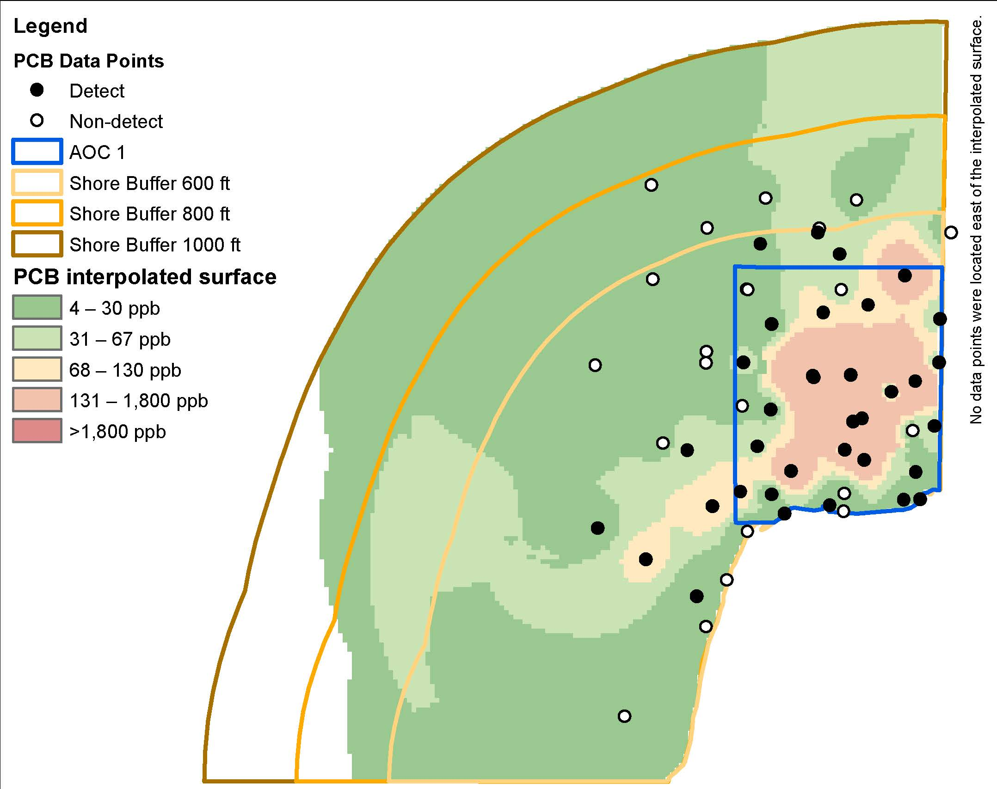
Example: SWACs versus Point-by-Point

Slide 9
Regional Background
WAC 173-204-505(16): “‘Regional background’ means the concentration of a contaminant within a department-defined geographic area that is primarily attributable to diffuse sources, such as atmospheric deposition or storm water, not attributable to a specific source or release.”
Implementation uneven and expensive
North Olympic Peninsula (Port Angeles)
Port Gardner (Everett)
Bellingham Bay
Lower Duwamish/Elliott Bay (?)

Slide 10
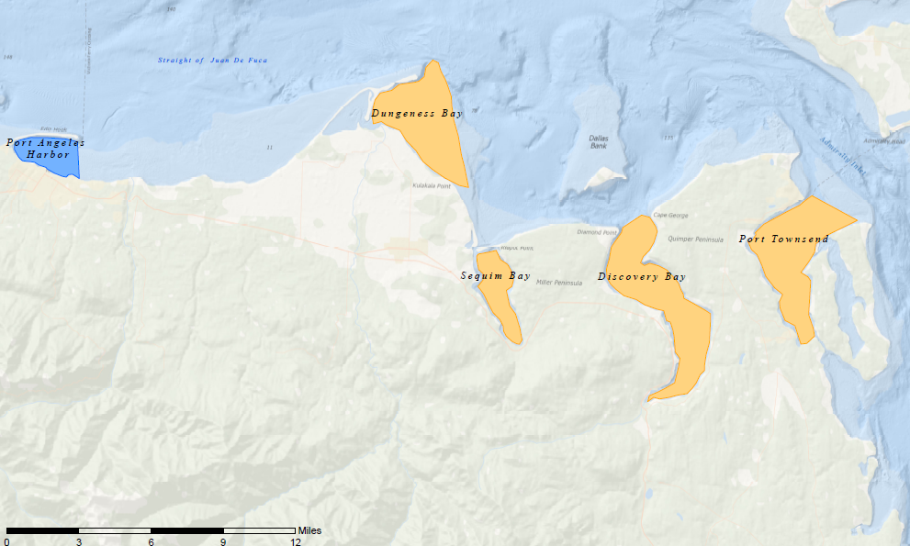
Example: North Olympic Peninsula

Slide 11
SCUM II Regional Background Options
Use Ecology-led study results for that area
As per Port Gardner, Bellingham Bay, etc.
Funding?
Use Ecology-led study from a similar area
Use new data
Use existing pooled data from similar areas

Slide 12
Sediment Cleanup Units (SCUs)
WAC 173-204-505(20): SCU “means a discrete subdivision of a sediment site designated by the department for the purpose of expediting cleanups.”
Flexibility on how defined
If it can be proven that sources are controlled and recontamination is not under PLP’s control, could settle responsibility
Source control and recontamination risk critical
Burden on PLP to prove source control

Slide 13
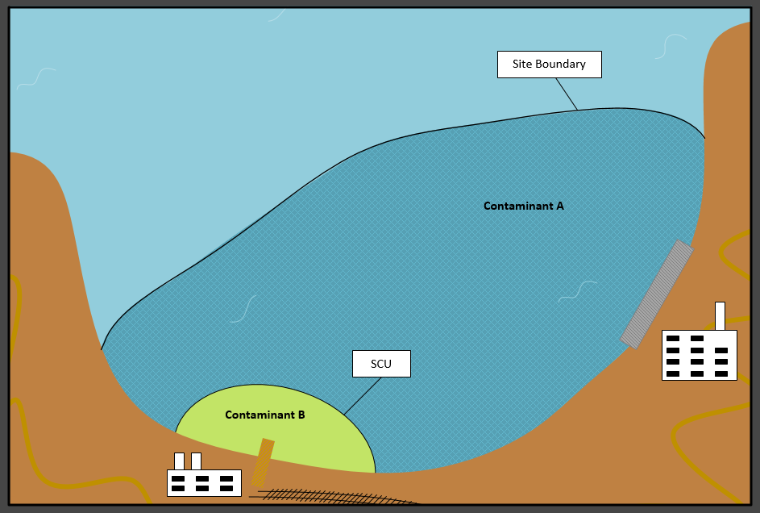
Example: SCU

Slide 14
Sediment Recovery Zones
The selected sediment remedy must meet the CUL in 10 years from the completion of remedial construction (WAC 173-204-570(5)(a))
If Ecology determines that the sediment remedy cannot meet the CUL in 10 years, it must establish the sediment recovery zone (SRZ), which is described in WAC 173-204-590.
Subject to renewal every 10 years
Flexibility about restoration time frame

Slide 15
Sediment Recovery Zones
Chapter 14 in SCUM II
SRZ must be specifically authorized by Ecology as part of CAP/CD
Requires ongoing monitoring, potentially including tissue data if site is larger
If still exceeding CULs, Ecology may:
“…accept PLPs sources are controlled when the PLP can reasonably demonstrate that their sources…will not result in contaminating sediment above the sediment cleanup level.”
Add a PLP to the site, or create a new site, within the SRZ

Slide 16
What’s not Clear about SRZs
Full impact on NPDES permits, particularly municipal dischargers
NPDES monitoring requirements?
Permitting new dischargers? Existing permits?
Land use and redevelopment?
Intersection with upland cleanups?
Options for “closure” with SRZ?
PLP-funded mechanism for long-term monitoring?

Slide 17
Source Control and Recontamination
Numerical criteria have dropped, sometimes drastically – addressing bioaccumulative risk
SRZs, SCUs rely on source control – but now relative to much lower numbers
SCUM II – Chapter 13.2 – Source Control
Creosoted structures and pilings
Issue of whether sources are under the PLP’s control – what discharges are under the authority or responsibility of the PLPs
How to “prove” sources are controlled

Slide 18
New Sediment Management Standards Guidance: Sediment Cleanup Users Manual II (SCUM II)
A Comprehensive Seminar on the 25th Anniversary of the Model Toxics Control Act (MTCA): Evolving Issues In Implementation, Litigation and Legislation
September 24, 2015
Hotel 1000 Seattle
Dr. Allison Geiselbrecht

