Slide 1

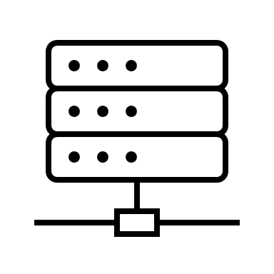
requests
responses
CLIENT
SERVER

Slide 2


























