Slide 2

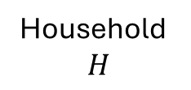

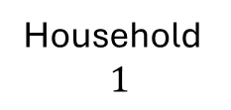

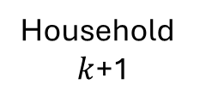

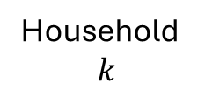

$$m_{k+1}=m_{k}−1$$
Household
$$1$$
Household
$$k$$
Household
$k$+1
Household
$$H$$
…
…
$$m_{1}=1$$
$$m_{k}=4$$
$$m_{k+1}=3$$
$$m_{H}=1$$

