Slide 2


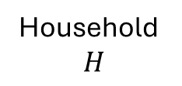


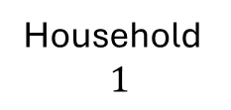


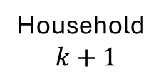

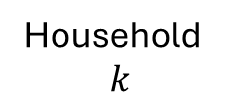

$$m_{k+1}=m_{k}−1$$
Household
$$1$$
Household
$$k$$
Household
$$k+1$$
Household
$$H$$
…
…
$$m_{1}=1$$
$$m_{k}=4$$
$$m_{H}=1$$
$$m_{1}=1$$
$$m_{1}′=1$$
$$m_{k}=4$$
$$m_{k}′=3$$
$$m_{k+1}=3$$
$$m_{k+1}′=4$$
$$m_{H}=2$$
$$m_{H}′=2$$

Slide 3



$$m_{k+1}<m_{k}−1$$
Household
$$1$$
Household
$$k$$
Household
$$k+1$$
Household
$$H$$
…
…
$$m_{1}=1$$
$$m_{1}′=1$$
$$m_{k}=5$$
$$m_{k}′=4$$
$$m_{k+1}=2$$
$$m_{k+1}′=3$$
$$m_{H}=2$$
$$m_{H}′=2$$

Slide 4


$$m_{k+1}>m_{k}−1$$
Household
$$1$$
Household
$$k$$
Household
$$k+1$$
Household
$$H$$
…
…
$$m_{1}=1$$
$$m_{1}′=1$$
$$m_{k}=2$$
$$m_{k}′=1$$
$$m_{k+1}=2$$
$$m_{k+1}′=3$$
$$m_{H}=2$$
$$m_{H}′=2$$

Slide 5
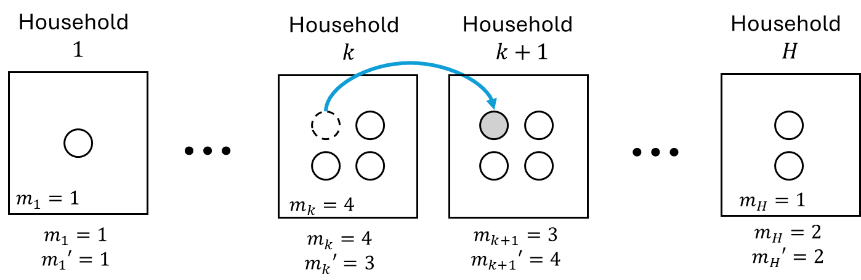
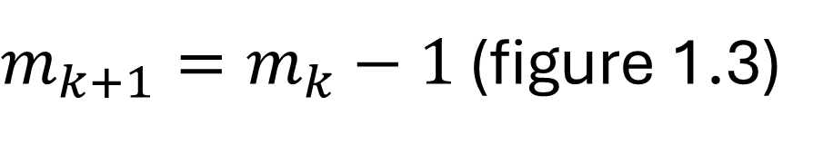
$m_{k+1}=m_{k}−1$ (figure 1.3)

Slide 6
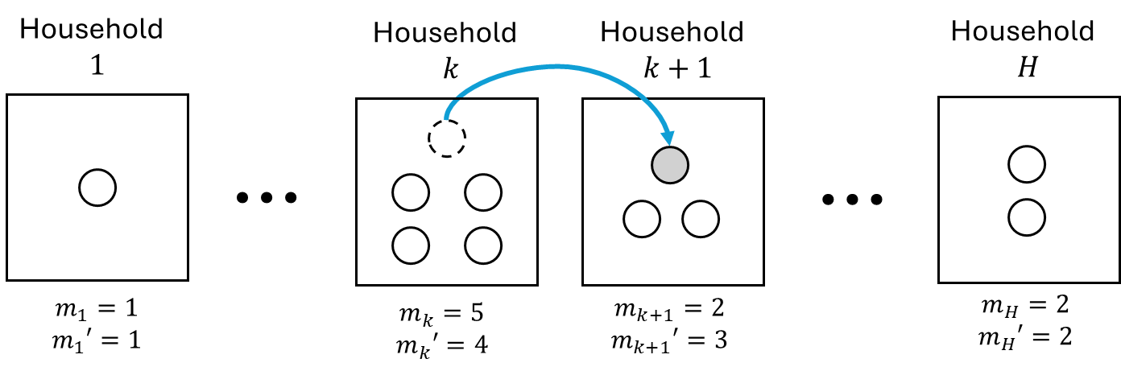
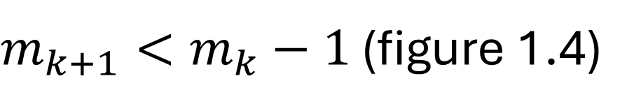
$m_{k+1}<m_{k}−1$ (figure 1.4)

Slide 7
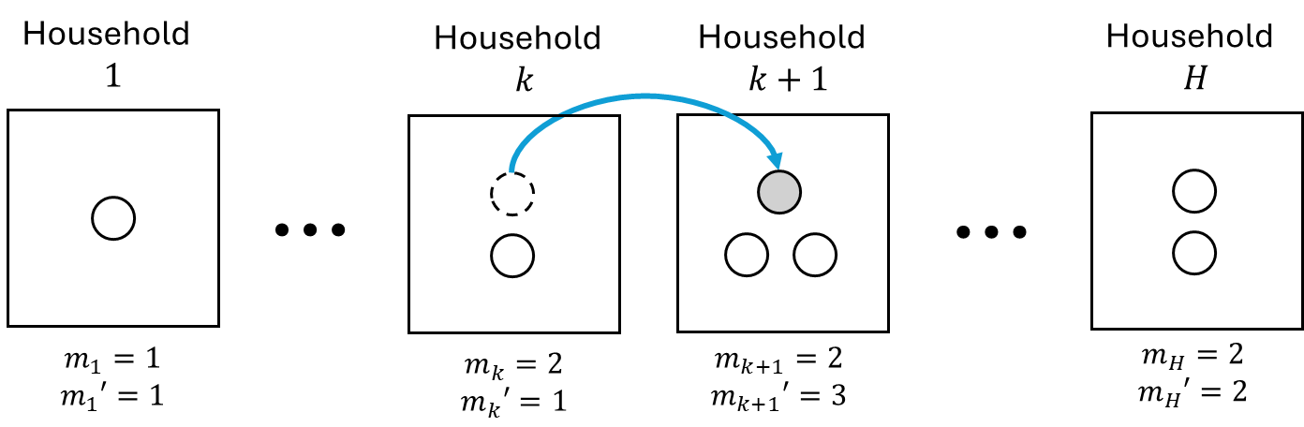
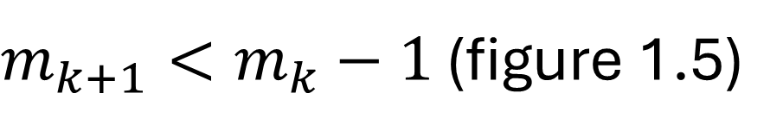
$m_{k+1}<m_{k}−1$ (figure 1.5)

