Slide 2
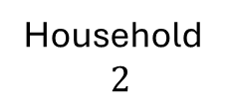
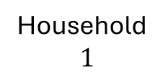



Person-level average household size
Household
$$1$$
Household
$$2$$
$$m_{1}=3$$
$$m_{2}=1$$
$$M_{h}= \frac{P}{H}$$

Slide 3


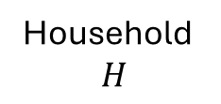


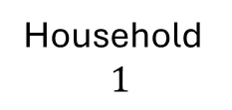


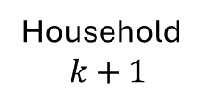

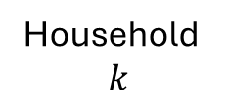

$$m_{k+1}=m_{k}−1$$
Household
$$1$$
Household
$$k$$
Household
$$k+1$$
Household
$$H$$
…
…
$$m_{1}=1$$
$$m_{k}=4$$
$$m_{H}=1$$
$$m_{1}=1$$
$$m_{1}′=1$$
$$m_{k}=4$$
$$m_{k}′=3$$
$$m_{k+1}=3$$
$$m_{k+1}′=4$$
$$m_{H}=2$$
$$m_{H}′=2$$

Slide 4



$$m_{k+1}<m_{k}−1$$
Household
$$1$$
Household
$$k$$
Household
$$k+1$$
Household
$$H$$
…
…
$$m_{1}=1$$
$$m_{1}′=1$$
$$m_{k}=5$$
$$m_{k}′=4$$
$$m_{k+1}=2$$
$$m_{k+1}′=3$$
$$m_{H}=2$$
$$m_{H}′=2$$

Slide 5


$$m_{k+1}>m_{k}−1$$
Household
$$1$$
Household
$$k$$
Household
$$k+1$$
Household
$$H$$
…
…
$$m_{1}=1$$
$$m_{1}′=1$$
$$m_{k}=2$$
$$m_{k}′=1$$
$$m_{k+1}=2$$
$$m_{k+1}′=3$$
$$m_{H}=2$$
$$m_{H}′=2$$

Slide 6


Slide 7
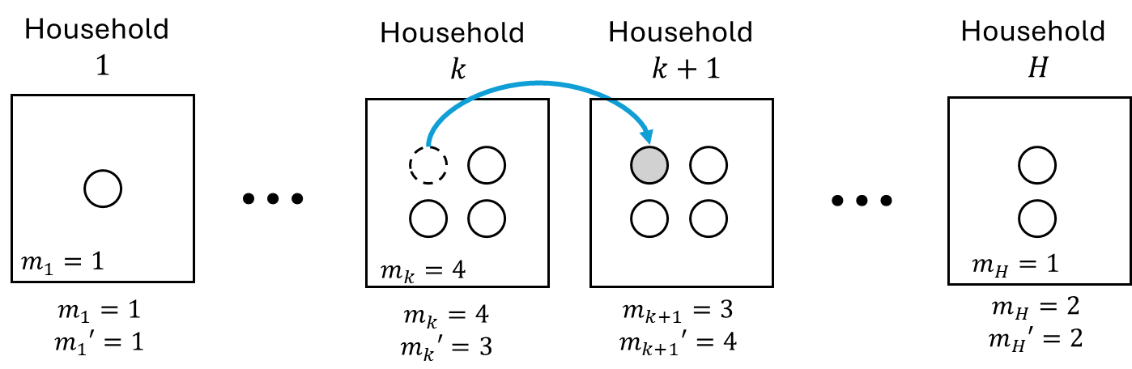
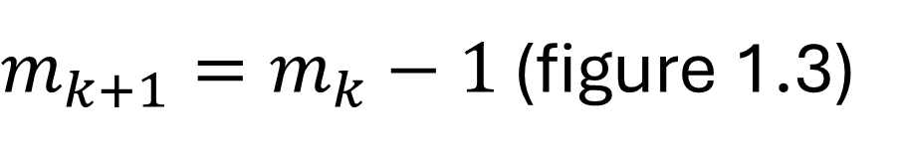
$m_{k+1}=m_{k}−1$ (figure 1.3)

Slide 8
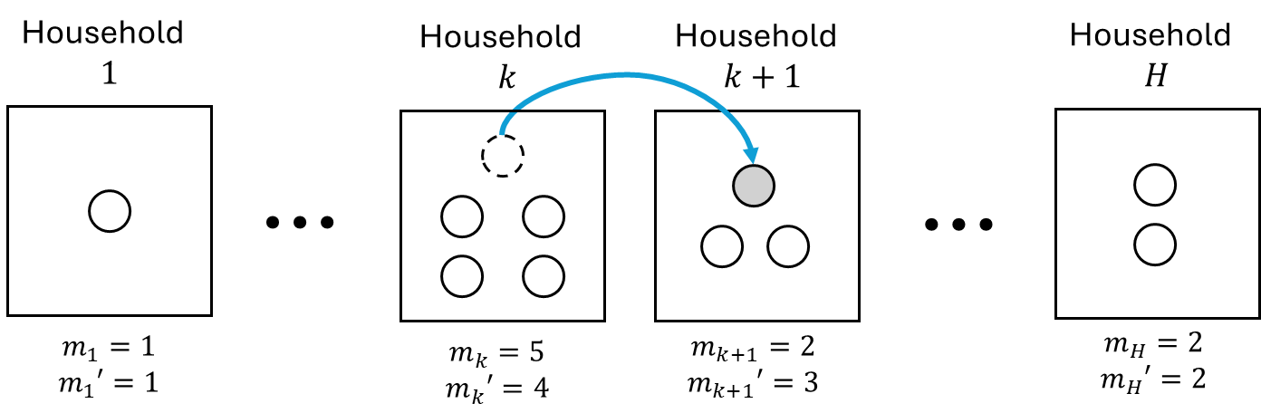
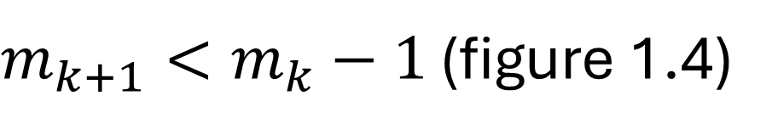
$m_{k+1}<m_{k}−1$ (figure 1.4)

Slide 9
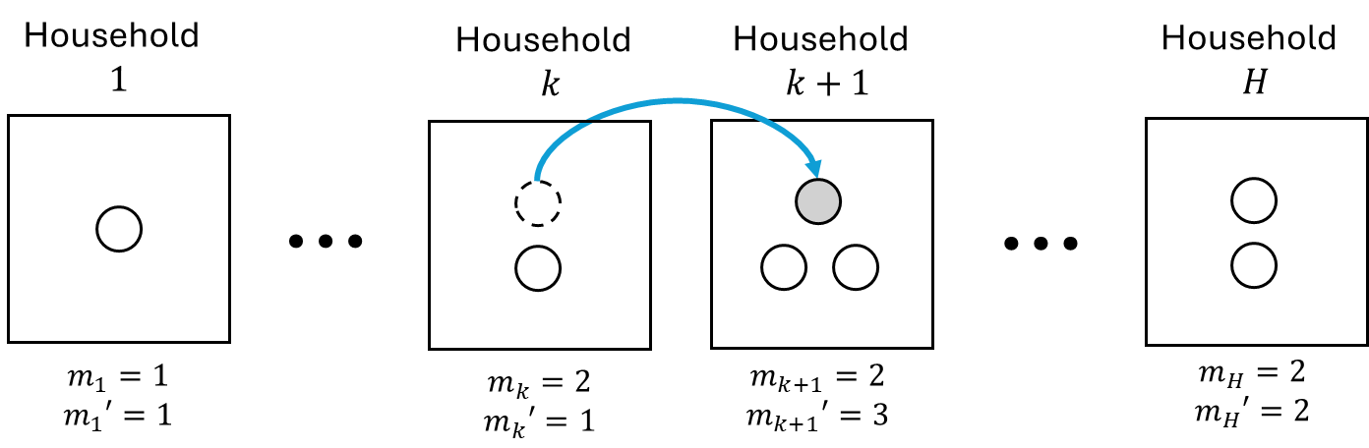
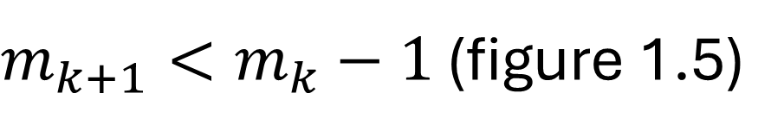
$m_{k+1}<m_{k}−1$ (figure 1.5)

