Slide 1

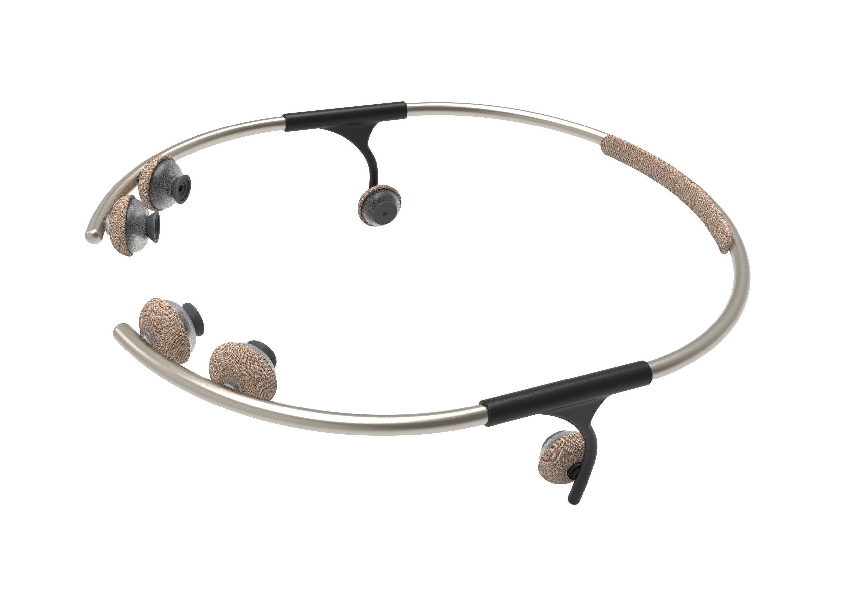

Roadmap Neoxa 3
Juin 2025

Slide 2
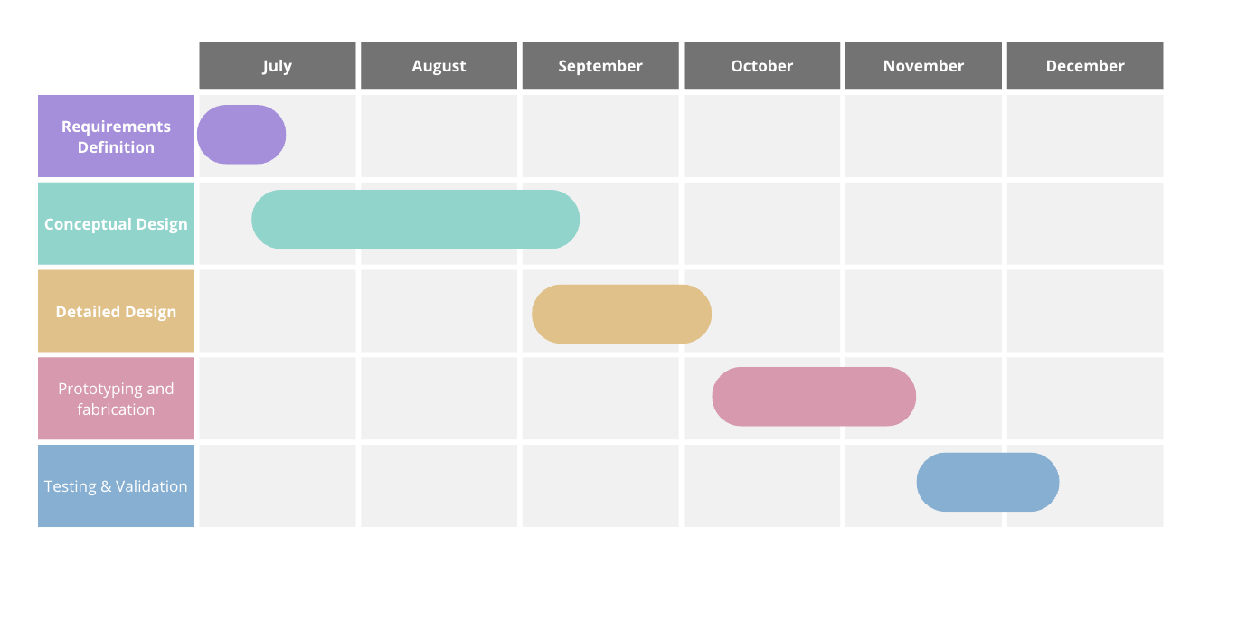
Objective
Goal: 5 Tested & Functional Prototypes Ready by December 1st, 2025
Collaborators: Sofiatech | NXP | Ova Design
Project Overview:
Evolve the current device into a new design featuring a structured, miniaturized PCB.
Assess feasibility focusing on capability trade-offs to achieve minimal size without compromising essential functions.
Meeting Objective: Align on technical approach, define feasibility criteria, and outline key milestones towards the prototype development.
Inverse Planning Due to Summer Downtime
Adjusted to account for reduced activity in August (vacations, supplier delays).
Key design work and alignment completed before September to mitigate risks.
01

Slide 3
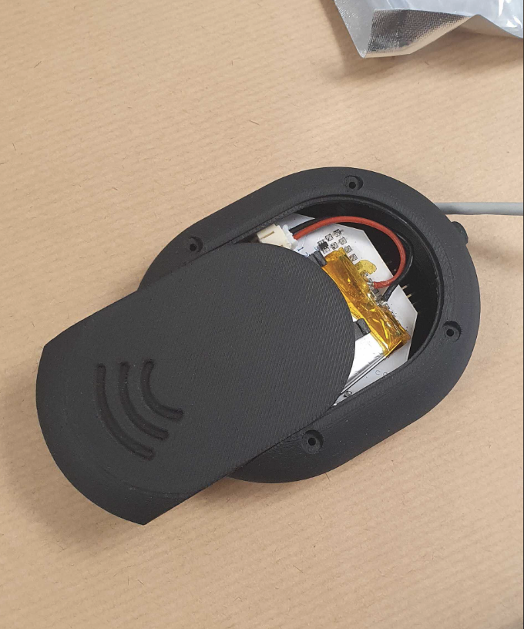
Neoxa 2
The development of Neoxa 3 is based on the experience and insights gained from the previous version, Neoxa 2. While Neoxa 2 served as a valuable proof of concept, several limitations and technical challenges were identified during its development and testing phases. These findings have directly informed the upgrade roadmap for Neoxa 3.
Limitations in Neoxa 2:
Mechanical Design Constraints
Signal Quality
Upgrades for Neoxa 3
Optimized Sensor Layout
Miniaturized PCB Design
Embedded Processing
Reliable Connectivity: firmware /BLE
01

Slide 4
Targets for our device
Sensors
EEG (Electroencephalography)
PPG (Photoplethysmography)
Bone Conduction Audio*
Nordic nRF52840 | Cortex-M4 64 MHz | 12 bits, 200 kSPS | 256 KB RAM / 1 MB Flash | BLE 5.0
Nordic nRF5340 | Dual Cortex-M33 | 12 bits, 200 kSPS | 512 KB RAM / 1 MB Flash | BLE 5.2
Texas Instruments CC2640R2F | Cortex-M3 48 MHz | 12 bits, 200 kSPS | 20 KB RAM / 128 KB Flash | BLE 5.0
Espressif ESP32 | Dual Tensilica LX6 240 MHz | 12 bits, 1 MSPS (ADC) | 520 KB RAM / 4 MB Flash | BLE 4.2 / 5.0
Core Capabilities
On-chip filtering and signal processing
Real-time AI inference
Data storage
BLE communication
NXP QN9090 / QN9080 (QN series) | Cortex-M4F 48 MHz | 12 bits, 500 kSPS ADC | 256 KB RAM / 512 KB Flash | BLE 5.1
Components
AFE EEG, AFE PPG, Bone conduction
Microcontroller
Data storage-flash memory
Power supply, battery module
Compatible with biomedical signals
02

Slide 5



Data acquisition
AFE for EEG
TI ADS1299
8 channels, ADC 24-bit, low consumption, low noise
Texas instruments
NAFEx1388 NXP **
High input impedance and low-noise AFE
MAX30101
Maxim Integrated
AFE4404
Texas Instruments
AFE for PPG
LED and photodiode for optical signal acquisition
Requires low-noise AFE with amplifier and ADC
Optimized for low power consumption in continuous monitoring
Bone conduction audio
Lightweight and compatible with wearable design constraints
Technically feasible integration within current architecture
May require an additional amplifier stage for proper output
Open question: can the existing SoC handle both acquisition and audio output?
Evaluation needed for power consumption and interference with EEG module
03

Slide 6
Requirements for PCB
Form Factor: Must fit within dimensions of 5 mm (width) x 50 mm (length) x 25 mm (height).
Mechanical Layout: Dual-sided configuration — PCB and battery on opposite sides for compactness.
Battery
Component Selection: Preferably use components from NXP for integration and support.
Mobile App Integration:
Development in C++ is planned.
Evaluate availability of libraries or SDKs for mobile app communication.
Investigate cross-platform SDKs for iOS and Android support.
Platform Compatibility: Must be compatible with both Windows and Mac environments for development and usage.
EEG Sampling Rate: Target 500 Hz sampling frequency for enhanced signal resolution. Acceptable fallback: 256 Hz, aligning with common wearable device standards.
04

Slide 7
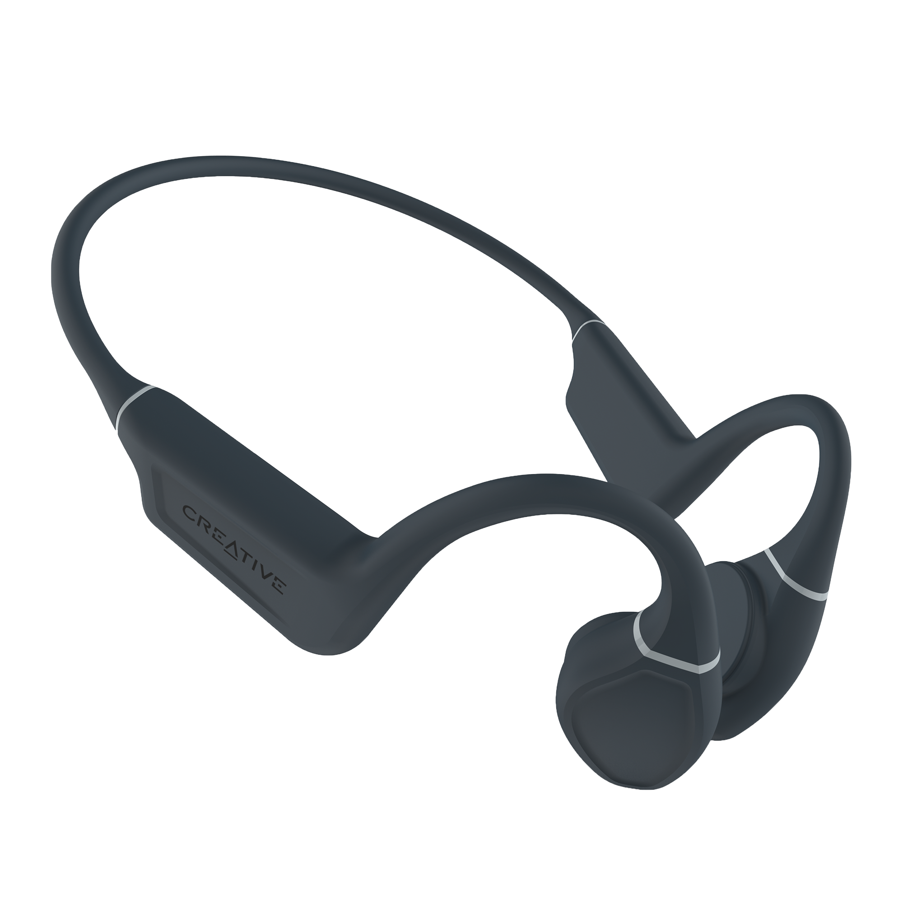
Design
Width 5 mm
50 mm
25 mm
05

Slide 8
Points to define
Functional
Next steps HABS
Power on with a button-switch
Led indicator to know if it is powered on/of
Led indicator for connectivity
Roles, Interactions, and Roadmap Definition
Organising the roadmap and expected deliverables
Reporting of test results and feedback from coordination to technical teams for iterative improvements.
Technical
Achievable battery life
Rechargeable battery must be accessible via USB-C (or micro-USB) port for charging.
Charging circuit must be embedded on the PCB.
LED indicator for charging status
SOFIATECH :
Responsible for the electronic design including circuit design, PCB fabrication, firmware and ensuring technical feasibility and electrical compliance.

