Slide 1
ESSILOR Smartglasses

Slide 2
Development Goals for EEG Smart Glasses
Active EEG Electrodes
Improve signal quality with less noise and in-situ amplification for more accurate brain activity monitoring.
Evaluate different electrode materials such as conductive printed elastomeric electrodes, or advanced materials like graphene, to optimize signal quality, comfort, and manufacturing scalability.
PPG Nosepad Sensor
Integrate a PPG sensor in the nosepad to enable further feature extraction from a stable facial contact point.
Frontal Reference Electrode
Position the reference electrode at the front of the frame for consistent and low-impedance referencing ( temporal electrodes will become crucial for neural information)
EOG Electrodes (Optional)
Explore the integration of EOG electrodes for eye movement tracking, depending on technical feasibility and alignment with Essilor’s eye-tracking roadmap. This feature may be omitted if alternative eye-tracking technologies are provided by Essilor.
Bone Conduction Audio
Add bone conduction technology for discreet, open-ear audio playback (e.g., for future project HABS music)
Miniaturized Electronics
Miniaturize the PCB and processors to ensure seamless integration into the temple arms of the glasses, preserving comfort, aesthetics, and wearability.
Local storage to ensure privacy. Communication via wifi or Bluetooth to retrieve data

Slide 3
Key points target
Ergonomics
Weight
Comfort
Aesthetics
Durability
Performance
Good signal
Accurate positioning of electrodes
Electronics integration
Communication
On device data processing
Storage
Safety and privacy
Which processes is HABS involved in?
What level of decision-making authority does HABS have?
How much internal development is handled by Essilor?
Is HABS responsible only for software, or also hardware?
Notes:
1. Ergonomics
Comfortable fit for long-term wear
Adjustable components to adapt to different face shapes
2. Durability
Robust materials resistant to daily wear and sweat
Waterproof or sweat-resistant design
3. Weight
Lightweight materials to reduce fatigue
Balanced distribution for stable placement on the face
4. Comfort
Soft contact points (e.g., nosepads, ear rests)
Use of hypoallergenic materials
5. Aesthetics
Modern, stylish design to encourage regular use
Discreet integration of sensors and electronics
6. Sensor Performance
High-quality EEG electrodes (active, dry, low-noise)
Accurate PPG sensors positioned for reliable readings
7. Electronics Integration
Miniaturized PCB and processors embedded in the frame
Efficient power management for extended battery life
8. Data Processing & Privacy
On-device (edge) processing to reduce latency and protect data
Secure wireless communication (e.g., Bluetooth Low Energy)
9. Additional Features
Optional EOG for eye tracking (depending on feasibility)
Bone conduction audio for hands-free sound delivery
10. Manufacturing & Scalability
Use of 3D printing or injection molding for frame parts
Cost-effective materials and assembly processes

Slide 4
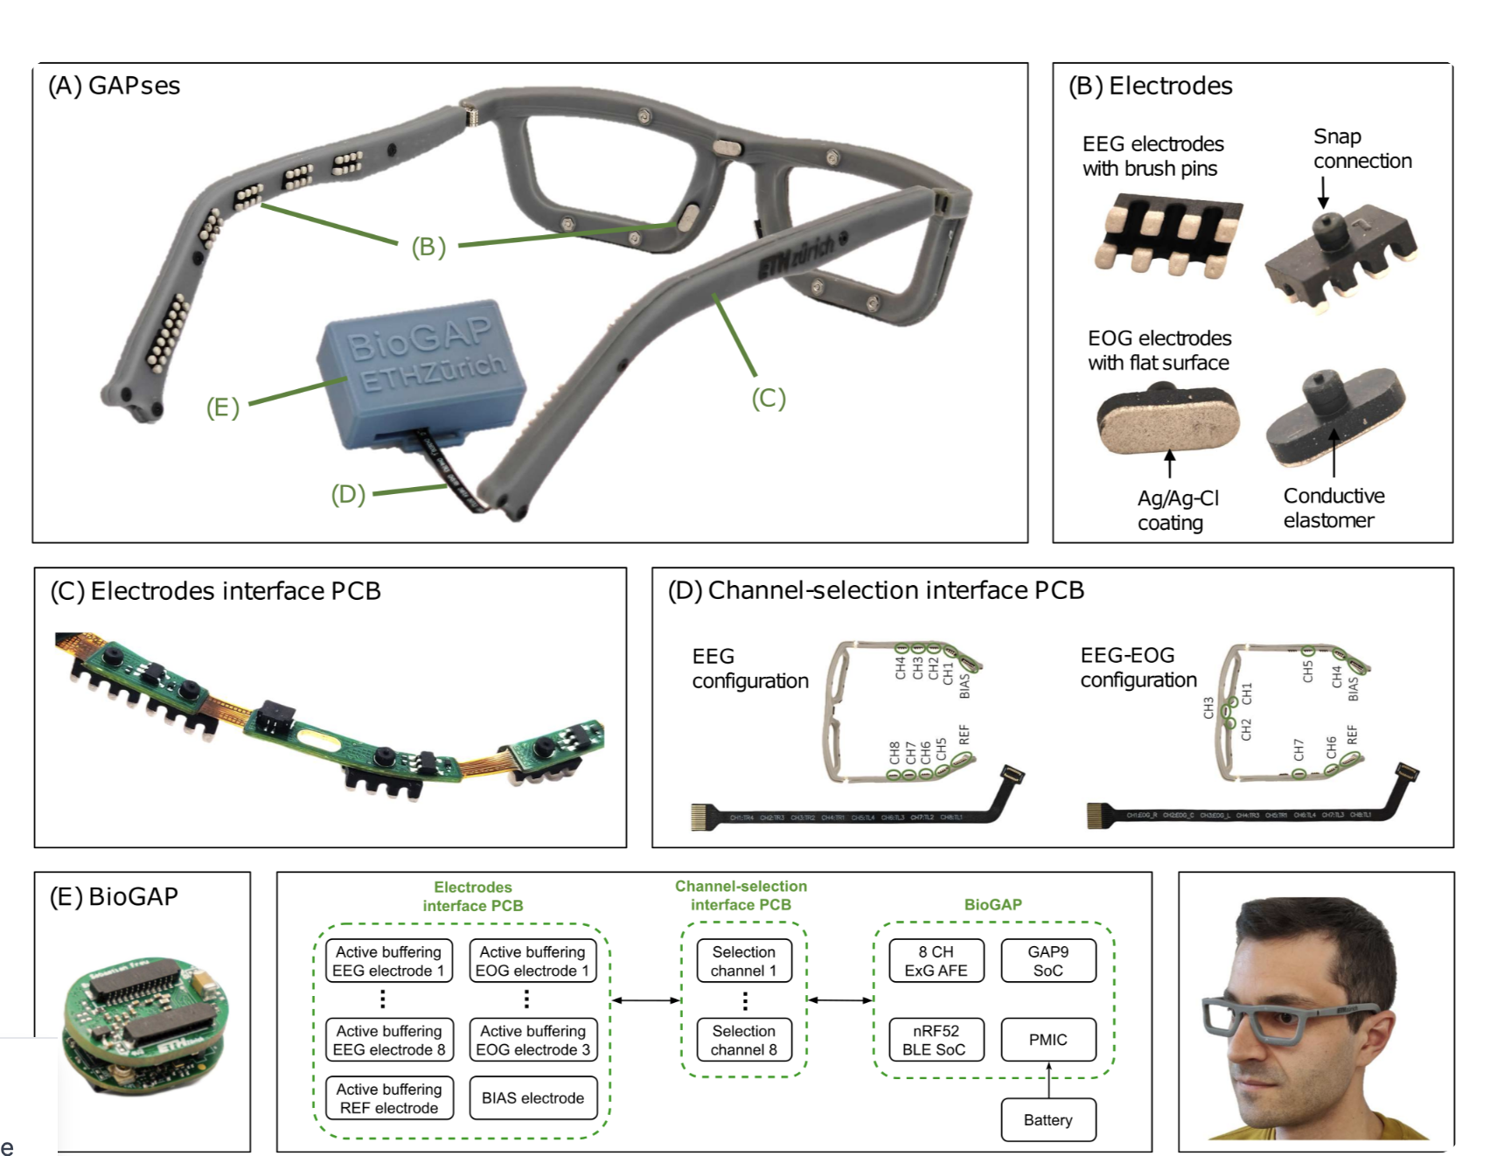
Gapses
Custom Dry Electrodes: Made from conductive elastomer with silver-silver chloride coating, allowing extended wear without gels or skin irritation. Flat electrodes for EOG, brush-style for EEG to penetrate hair and ensure skin contact.
BioGAP Platform: Features two SoCs—GAP9 for DSP and machine learning, and a Nordic BLE chip—plus the ADS1298 AFE, enabling 24-bit resolution across up to 8 EEG channels.
On-Edge Processing: The GAP9 RISC-V processor enables local signal processing, enhancing privacy and reducing wireless transmission. Includes smart power management (clock gating, voltage scaling) for extended battery life.
S. Frey et al., "GAPses: Versatile Smart Glasses for Comfortable and Fully-Dry Acquisition and Parallel Ultra-Low-Power Processing of EEG and EOG," in IEEE Transactions on Biomedical Circuits and Systems, vol. 19, no. 3, pp. 616-628, June 2025, doi: 10.1109/TBCAS.2024.3478798. keywords: {Electroencephalography;Electrooculography;Electrodes;Glass;Smart glasses;Wireless communication;Biomedical monitoring;Wireless sensor networks;Sensors;Monitoring;BCI;EEG;embedded deployment;EOG;HMI;smart glasses;wearable devices},

Slide 5
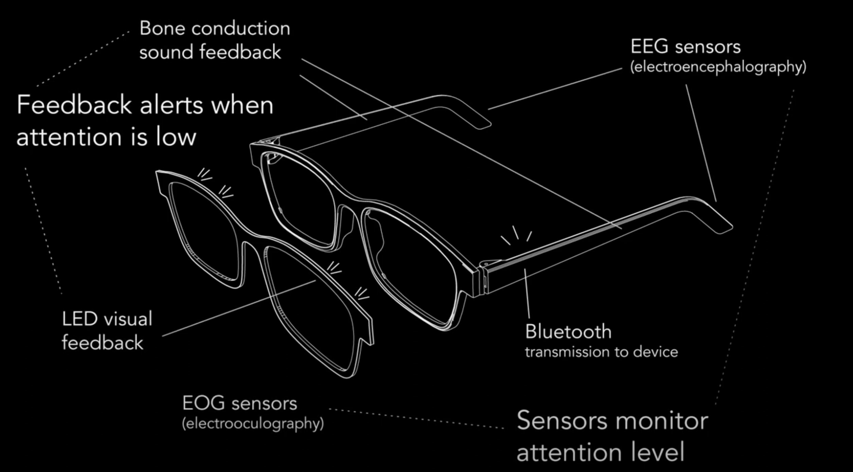
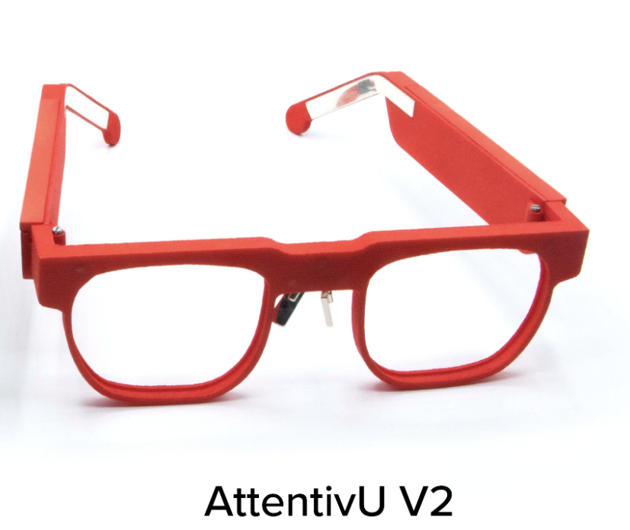
Attentiv U V2
Key Features:
EEG and EOG sensors
Operates standalone and offline, ensuring data privacy.
Local data storage
Lighter design for improved comfort
Small PCB
Integrated Bone conduction
WiFi connectivity alongside Bluetooth
https://www.attentivu.com/glasses-v2

Slide 6
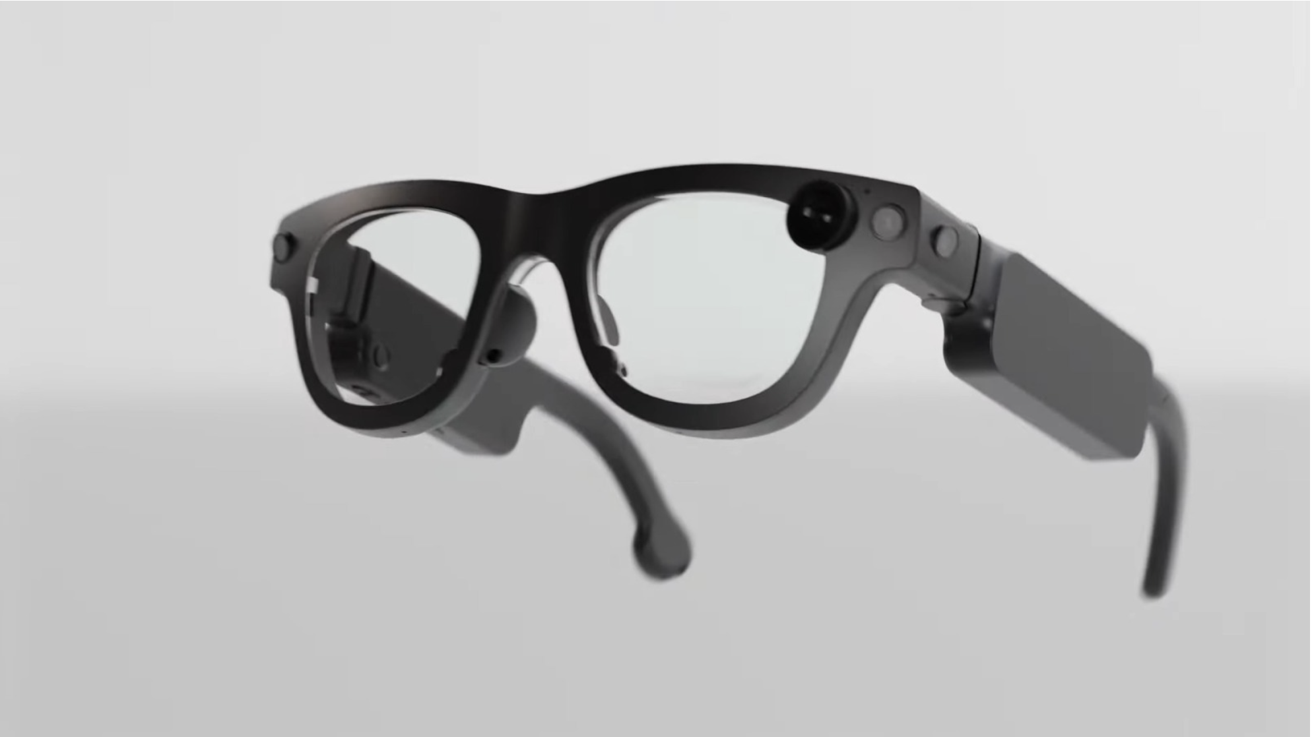
Aria Gen 2
Key highlights
PPG Sensor in Nosepad
Advanced Sensor Suite: Includes RGB camera, 6DOF SLAM cameras for spatial tracking, eye-tracking cameras, spatial microphones, IMUs, barometer, magnetometer, and GNSS for precise location and motion sensing.
On-Device Processing: Custom chips enable SLAM enhancing privacy and responsiveness.
Lightweight & Portable
Audio Features: Open-ear speakers with noise cancellation and a contact microphone
NO EEG SENSOR
https://www.extremetech.com/electronics/meta-unveils-aria-gen-2-smart-glasses-with-built-in-heart-rate-monitor

