Slide 1
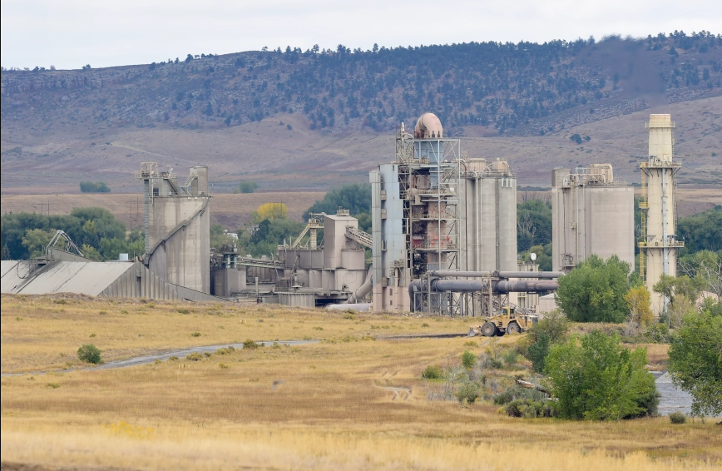
PUBLIC TRIAL BRIEF
Reverse the Rescission
CEMEX changed the plant operation. The truck traffic proves it.
A simplified case for Boulder County citizens: reinstate the April 10, 2024 termination determination.
Prepared from the CEMEX Lyons public archive. Verify against original records before official filing.

Slide 2
OPENING STATEMENT
This case is not complicated.
For decades, the plant depended on local and adjoining raw-material supply. CEMEX replaced that system with distant trucked feedstock. That is an altered nonconforming use, and the traffic numbers are the proof.
1
Historic use
2
What changed
3
Why it matters
Local quarry and conveyor logistics anchored the cement plant operation.
After local sources ran down and Dowe Flats closed, raw materials shifted to highway trucks.
Article 4-1003.C.1.d reaches alterations that create or threaten hazard, nuisance, neighborhood impacts, or increased need for services.
Sources: Silvestro letters to Dale Case, July 9 and Dec. 20, 2024; Boulder County Land Use Code Article 4-1003.C.1.d; CEMEX Historical Data.xlsx.
2

Slide 3
THE TIMELINE
The old operation is gone.
1994
2018-20
Sept. 30, 2022
April 10, 2024
Plant becomes nonconforming. Dowe Flats approval required conveyor logistics that reduced road hauling.
CEMEX begins relying on Wyoming limestone as Dowe Flats limestone runs out.
Dowe Flats closes. Raw materials shift further to external highway trucks.
County terminates nonconforming status based on altered operations and increased truck impacts.
CEMEX wants the County to compare traffic as if the operation stayed the same. The record shows the opposite.
Sources: CEMEX Historical Data.xlsx, Data Dec18 and Inbound Material Modes; PT0658 annual reports; Boulder County April 10, 2024 Notice; Silvestro letters.
3

Slide 4
THE TRAFFIC SPECTRUM
The key years show the arc from 1994 to 2026.
Inbound raw-material ADTs
Total ADTs, plus 2026 inbound-only floor
625
1,283
498
452
729
306
641
625
456
1994 total baseline
54
1994 inbound baseline
1994
baseline
2019-22
avg
2023
2024-25
Wyoming
2025-26*
Wyoming
1994
total
2019-22
avg
2023
calc.
June
2023
2025-26*
inbound floor
The right-hand 2026 point is not total traffic. It is Wyoming limestone alone. Even that inbound-only floor exceeds the entire 1994 plant baseline.
Sources: CEMEX Historical Data.xlsx, Data Dec18 rows 3, 5, 6, 7; PT0658 annual reports; PT0658_Wyoming_Traffic_Calculations.csv. *2025-26 report is marked under review.
4

Slide 5
THE DECISIVE NUMBERS
One comparison wins the case.
54
625
456
1994 inbound raw-material ADTs
2025-26 Wyoming limestone ADTs*
entire 1994 plant total ADTs
Wyoming limestone alone is about 11.6x the 1994 inbound baseline.
That number is before shale, finished product, employees, vendors, or any other plant traffic.
The inbound-only 2026 floor is already higher than the 1994 total plant baseline.
Dale Case's no-increase premise cannot survive the 2026 PT0658 math.
Sources: CEMEX Historical Data.xlsx, Data Dec18 row 3; PT0658 annual reports; PT0658_Wyoming_Traffic_Calculations.csv. *2025-26 report is marked under review.
5

Slide 6
CEMEX'S DEFENSES
The defenses are distractions from the changed operation.
Background traffic
SH-66 background volumes do not answer the question: what traffic did CEMEX itself generate?
Landis report
It mixes units, omits 1994, relies on weak regression, and ignores the actual inbound trend.
Stantec backpedal
CEMEX submitted the study to CDOT. A later memo cannot erase the observed June 2023 spike.
Estoppel / takings
The 2002 letter preserved only lawful nonconforming status. CEMEX never had a right to expand it.
A rescission should not rest on excuses that do not confront the central fact: CEMEX replaced local supply with heavy truck deliveries.
Sources: Silvestro letters, July 9 and Dec. 20, 2024; CEMEX Historical Data.xlsx, Landis Flaws; Boulder County Oct. 8, 2002 letter; Landis and Stantec materials.
6

Slide 7
THE LAW
The legal rule fits the facts.
Article 4-1003.C.1.d
Trial-lawyer translation
A nonconforming use loses protection for any alteration that creates or threatens hazard or nuisance, adversely affects neighborhood character, or intensifies the use or need for services.
The altered use is the new feedstock logistics.
The truck traffic is the evidence and consequence.
The 1994 baseline does not protect a materially different operation.
The County may reverse the rescission on corrected findings.
Article 4-1003.H.1 puts the burden on CEMEX to show it has not unlawfully altered or expanded the use.
Silvestro's key point: CEMEX is wrong to limit the Code to onsite structural changes.
Sources: Boulder County Land Use Code Article 4-1003.C.1.d and H.1; Silvestro letters; Fire House Car Wash, 30 P.3d 762.
7

Slide 8
The County should reverse the rescission.
The corrected record shows a changed operation, dramatic raw-material truck traffic, and a flawed no-increase rationale. The April 10, 2024 termination should be reinstated or reissued with corrected findings.
Requested action synthesized from ZON-23-0003 record, CEMEX Historical Data.xlsx, PT0658 annual reports, Silvestro letters, and Boulder County April 10, 2024 Notice.
8

Slide 9
CORE EXHIBITS
The proof package
Traffic workbook
CEMEX Historical Data.xlsx: Data Dec18, ADT summary, total ADTs, post-Dowe ADTs, Landis Flaws, Inbound Material Modes.
Wyoming tonnage
PT0658 annual reports and PT0658_Wyoming_Traffic_Calculations.csv.
County record
April 10, 2024 termination notice; Stantec and Landis materials; Boulder County 2002 letter.
Legal letters
James R. Silvestro letters for GNL/SOSVV dated July 9, 2024 and December 20, 2024.
Public-facing note: this is an advocacy synthesis. Attach the primary PDFs and workbook tables before any official filing.
Selected sources from the local CEMEX Lyons public archive.
9

