Slide 1
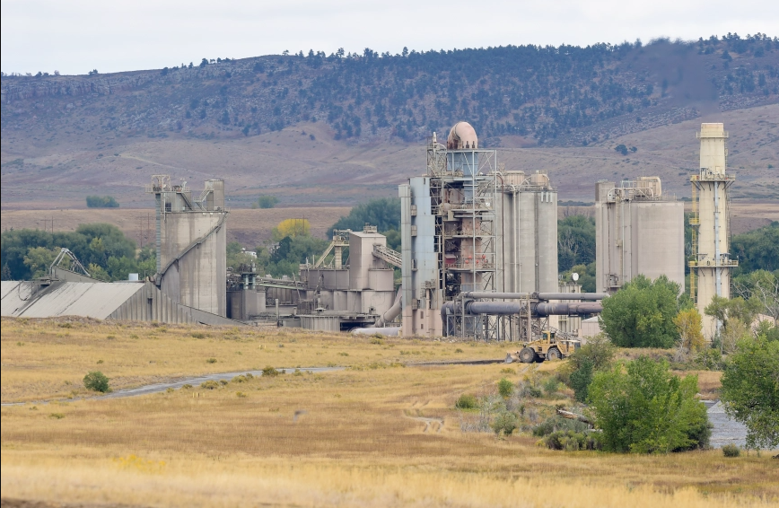
TARGETED PUBLIC BRIEF
Reverse the Rescission
The 1994 traffic comparison does not support Dale Case's conclusion that CEMEX Lyons traffic has not increased.
A narrower, fact-centered brief for reinstating the April 10, 2024 termination determination.
Prepared from the CEMEX Lyons public archive. Verify against original records before official filing.

Slide 2
THESIS
Accept the 1994 comparison for argument's sake. It still favors termination.
The rescission rationale should fail on its own chosen ground: when traffic is normalized as Average Daily Trips in passenger-car equivalents, modern CEMEX traffic is materially higher than the 1994 baseline.
456
729
+273
+60%
+397
1994 baseline total ADTs
2023 calculated total ADTs
increase vs 1994
increase vs 1994
inbound raw-material ADTs
The strongest evidence is not overall background traffic. It is CEMEX-generated traffic, especially raw-material deliveries caused by the loss of local/conveyor supply.
PT0658 Wyoming limestone tonnage confirms the magnitude: 518,482 tons in 2024-25 equals about 20,739 loaded 25-ton trucks, 41,479 truck movements, and 498 ADTs.
The 1994 comparison is not a shield for CEMEX. Properly calculated, it is evidence that the use was altered and intensified.
Sources: CEMEX Historical Data.xlsx, Data Dec18 summary rows 3, 6, 7; PT0658 annual reports and PT0658_Wyoming_Traffic_Calculations.csv; Boulder County April 10, 2024 Notice.
2

Slide 3
MEASUREMENT
The right unit is ADTs in passenger-car equivalents
Why Landis-style raw truck counts understate the impact
A simple formula
Boulder County and CDOT analyze access impacts as Average Daily Trips.
A truck entering and leaving the plant creates two trips.
A heavy truck is converted to passenger-car equivalents.
One heavy-truck round trip can represent six ADTs under the workbook's normalization.
Annual truck volume / workdays x 2 trips x 3 PCE
Example from the Landis-flaws worksheet: 20,106 truck trips in 2023 divided by 251 workdays is about 80, not 67. Converted to ADTs, that is about 481, not 402.
If Dale Case relied on unnormalized truck-volume comparisons, the conclusion is not comparing like with like.
Sources: CEMEX Historical Data.xlsx, Data Dec18 assumptions; Landis Flaws rows 5 and 12; Exhibit - Corrected Landis Repo.
3

Slide 4
TOTAL TRAFFIC
Total CEMEX traffic is higher than the 1994 baseline
Total ADTs, normalized to passenger-car equivalents
The no-increase premise fails several ways
1,283
2019-22 average is about 185 ADTs above 1994.
Post-Dowe actual monthly average is about 170 ADTs above 1994.
2023 calculated annual ADTs are about 273 above 1994.
The Stantec June 2023 figure is roughly 827 ADTs above 1994.
729
641
626
456
Even a conservative 1994 baseline does not rescue the rescission.
1994 baseline
2019-22 avg
Post-Dowe avg
2023 calc.
June 2023
Sources: CEMEX Historical Data.xlsx, Data Dec18 rows 3, 5, 6 and data table; Exhibit - Post Dowe Flats ADTs row 15; April 10, 2024 Notice citing Stantec June 2023.
4

Slide 5
RAW-MATERIAL DELIVERIES
The operational-change evidence is much stronger than total traffic
Inbound raw-material ADTs
This is the case
452
In 1994, the record shows about 54 inbound raw-material ADTs. In 2023, the calculated inbound raw-material ADTs are about 452.
306
321
+397
+729%
additional inbound ADTs
increase vs 1994
54
A traffic comparison that buries this change inside total plant operations misses the point of Article 4-1003.C.1.d.
1994 inbound
2019-22 inbound avg
Post-Dowe inbound avg
2023 inbound calc.
Sources: CEMEX Historical Data.xlsx, Data Dec18 rows 3, 5, 6, 7; Exhibit - Post Dowe Flats ADTs row 15; Inbound Material Modes sheet.
5

Slide 6
WYOMING PT0658
PT0658 tonnage turns the supply-chain change into truck traffic
Wyoming limestone, converted to 25-ton truck-equivalent ADTs
The calculation
625
tons / 25 = loaded trucks
498
loaded trucks x 2 = movements
426
424
movements x 3 PCE / 250 workdays = ADTs
293
236
2024-25 reported 518,482 tons: about 20,739 loaded 25-ton trucks, 41,479 truck movements, and 498 ADTs.
123
*2025-26 report is marked under review.
2019-20
2020-21
2021-22
2022-23
2023-24
2024-25
2025-26*
Sources: PT0658 annual reports, 2020 through 2026; PT0658_Wyoming_Traffic_Calculations.csv. Formula uses 25-ton trucks, two movements per loaded truck, 3 PCE factor, and 250 workdays.
6

Slide 7
WYOMING PT0658
Wyoming limestone alone overwhelms the 1994 inbound baseline
Inbound raw-material ADTs vs. PT0658 25-ton truck-equivalent ADTs
This is the missing comparison
625
1994 inbound raw-material baseline: about 54 ADTs.
PT0658 2024-25 Wyoming limestone alone: about 498 ADTs, before shale and other materials.
That is roughly 9.2x the 1994 inbound baseline.
The under-review 2025-26 PT0658 figure implies about 625 ADTs, roughly 11.6x the 1994 inbound baseline.
498
54
This directly undercuts Dale Case's no-increase view: modern raw-material trucking is far beyond the 1994 operation.
1994 inbound
2024-25 PT0658
2025-26 PT0658*
CEMEX-era PT0658 reports from Sept. 14, 2018 through Feb. 27, 2025 total about 2.13 million tons: roughly 85,329 loaded 25-ton trucks and 170,658 truck movements.
Sources: CEMEX Historical Data.xlsx, Data Dec18 row 7; PT0658 annual reports; PT0658_Wyoming_Traffic_Calculations.csv. *2025-26 report is marked under review.
7

Slide 8
SUPPLY CHAIN CHANGE
1994 is not equivalent to the modern trucked-feedstock operation
1994
2022-23
Why it matters
About 56,739 tons externally trucked.
About 361,766 tons conveyed or hauled locally.
Inbound raw-material ADTs: about 54.
Local supply still anchored the plant operation.
Dowe Flats closes September 30, 2022.
Raw materials shift to external highway trucks.
Workbook shows limestone from Wyoming and shale from Arcosa/Boulder County.
PT0658 reported 304,715 tons in 2022-23 and 518,482 tons in 2024-25.
Inbound raw-material ADTs jump into the 300-450 range.
The nonconforming use was not merely producing cement. Its historic operation depended on local quarry/conveyor logistics. Replacing that system with regional truck deliveries is a material alteration.
Dale Case's view collapses the exact factual distinction the Code is meant to police.
Sources: CEMEX Historical Data.xlsx, Data Dec18 row 40 and Inbound Material Modes rows 5-14; PT0658 annual reports; Boulder County Resolution 2022-075.
8

Slide 9
LANDIS PROBLEMS
The Landis-based no-increase conclusion is not reliable
Omitted 1994
The flaws worksheet states the plant became nonconforming on October 18, 1994, but the Landis comparison omits 1994.
Weak regression
Historic pre-1994 truck volumes are estimated, not actual, and the model extrapolates across different operating eras.
Mixed units
CDOT background traffic, truck volumes, daily trucks, and ADTs are not normalized to the same impact unit.
Wrong equivalence
2019-22 Dowe Flats plus Wyoming supply is not equivalent to 1994 limited Larimer supply plus Lyons/local operations.
Bad arithmetic
Appendix B's daily truck calculations are identified as wrong, including the 2023 example.
Ignored spike
The Stantec June 2023 logs show 1,283 ADTs and should not disappear from the analysis.
A rescission should not rest on a consultant report with unresolved math, unit, baseline, and data-selection problems.
Sources: CEMEX Historical Data.xlsx, Landis Flaws rows 5, 8-14, 17-23, 26-27; GNL/SOSVV Dec. 20, 2024 letter; Landis report, Nov. 5, 2024.
9

Slide 10
JUNE 2023 EVIDENCE
The Stantec June 2023 spike is corroboration, not the whole case
Stantec ADTs cited in April 2024 termination notice
How to use this evidence
1,283
Do not make June 2023 the only proof. Stantec later argued its study was a limited access analysis.
Use it as an actual observed spike showing what the new supply chain can do.
Then anchor the case in annual/monthly CEMEX data and inbound raw-material ADTs.
Together, the data show both acute spikes and structural traffic growth.
593
The County's original April 2024 termination had a real factual basis. The corrected 1994 comparison strengthens it.
June 2022
June 2023
Sources: Boulder County April 10, 2024 Notice; Stantec Nov. 7, 2024 memo; CEMEX Historical Data.xlsx, Exhibit - Total ADTs and Exhibit - Post Dowe Flats ADTs.
10

Slide 11
SILVESTRO LEGAL FRAME
The strongest legal frame: traffic is proof of an altered operation
1
What changed
2
Why traffic matters
3
Why CEMEX defenses fail
CEMEX shifted the plant from local/adjoining raw-material supply to distant, trucked feedstock. That is the operational alteration.
Offsite truck impacts are the evidence and consequence of that alteration: hazard, nuisance, neighborhood impact, and need for services.
Background road traffic, estoppel, takings, and due-process rhetoric do not erase CEMEX's burden to prove it stayed within the nonconforming use.
Silvestro's additive point: CEMEX is wrong to say only onsite structural changes matter. Article 4-1003.C.1.d reaches any other alteration of the use with offsite hazard, nuisance, neighborhood, or service impacts.
Sources: James R. Silvestro letters to Dale Case, July 9, 2024 and Dec. 20, 2024; Boulder County Land Use Code Article 4-1003.C.1.d and H.1; Fire House Car Wash, 30 P.3d 762.
11

Slide 12
LEGAL CONSEQUENCE
Article 4-1003.C.1.d does not require a crash epidemic
The trigger
Why the rescission should be reversed
Any alteration of the nonconforming use that creates or threatens hazard or nuisance, adversely affects neighborhood character, or intensifies the use of land or need for services.
Traffic is not the land use; it is proof that CEMEX altered how the land use operates.
The decisive category is inbound raw material, where the increase is dramatic.
Background traffic on SH-66 does not rebut CEMEX-generated raw-material traffic.
CEMEX bears the burden to show it has not expanded beyond the nonconforming use.
The April 2024 termination should be reinstated or reissued on corrected findings.
The raw-material trucking shift fits this clause because it changes how the industrial use operates and pushes impacts onto public roads and neighbors.
Sources: Boulder County Land Use Code Article 4-1003.C.1.d and H.1; Silvestro letters, July 9, 2024 and Dec. 20, 2024; CEMEX Historical Data.xlsx.
12

Slide 13
REQUESTED ACTION
A stronger reversal request: correct the baseline, reinstate termination
1
Correct the factual finding
Find that CEMEX-generated traffic has increased compared to 1994 when normalized as ADTs/PCEs.
2
Adopt the legal frame
Find that truck traffic is evidence of the altered operation: distant raw-material sourcing by highway truck.
3
Add PT0658 as an exhibit
Use Wyoming tonnage and 25-ton truck math to show the trucked-feedstock operation dwarfs 1994 inbound traffic.
4
Reinstate or reissue termination
Restore the April 10, 2024 determination with corrected findings and preserve appeal rights.
Public message: the County should not rescind a valid termination based on a traffic conclusion the record itself contradicts.
Synthesis of ZON-23-0003 record, Silvestro letters, CEMEX Historical Data.xlsx, PT0658 annual reports, and Boulder County April 10, 2024 termination notice.
13

Slide 14
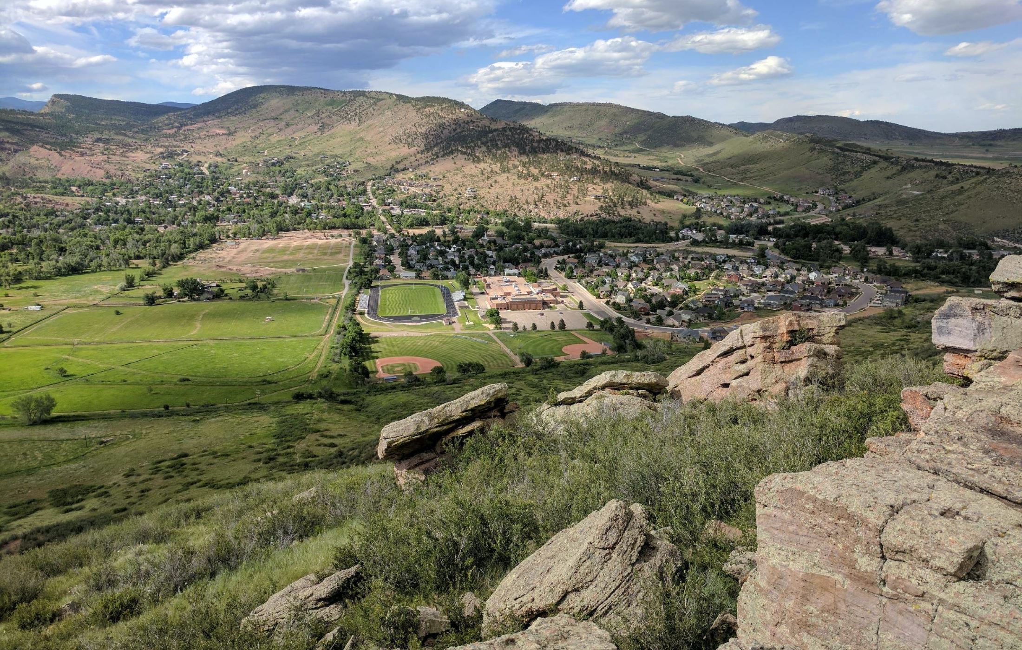
PUBLIC EXPLANATION
The plain-English story
The question
The data
The remedy
No. The plant changed how it gets raw materials. The truck traffic is the proof: total ADTs are up, inbound ADTs are way up, and Wyoming limestone alone dwarfs the old baseline.
Did CEMEX stay within the historic grandfathered use?
Reverse the rescission and reinstate termination on corrected findings.
Public explanation derived from cited traffic workbook, Silvestro letters, PT0658 annual reports, Boulder County record, and Land Use Code Article 4-1003.
14

Slide 15
SELECTED SOURCES
Selected sources for the revised traffic brief
CEMEX Historical Data.xlsx: Data Dec18, Exhibit - ADT Summary, Exhibit - Total ADTs, Exhibit - Post Dowe Flats ADTs, Landis Flaws, Inbound Material Modes.
Wyoming Mine PT0658 annual reports, 2020 through 2026; PT0658_Wyoming_Traffic_Calculations.csv.
Boulder County Community Planning & Permitting, Notice of Termination of Nonconforming Status, April 10, 2024.
Landis Evans + Partners, CEMEX Lyons Plant Traffic Study, November 5, 2024.
Stantec supplemental memo, November 7, 2024, and Stantec access traffic study figures cited by Boulder County.
James R. Silvestro letters to Dale Case for GNL/SOSVV, July 9, 2024 and December 20, 2024.
Martin Marietta/SOSVV Board of Adjustment precedent packets regarding lapse and estoppel, 2022.
Boulder County Land Use Department letter to CEMEX, October 8, 2002.
Boulder County Land Use Code Article 4-1003.
Boulder County Resolution 2022-075 denying SU-22-0003.
This deck is a public-education and advocacy synthesis. Before official filing, attach the underlying workbook tables and primary PDFs as exhibits.
Prepared from local workspace materials in the CEMEX Lyons public archive.
15

