Slide 1
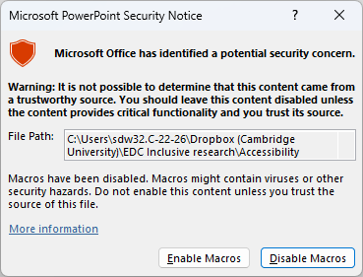
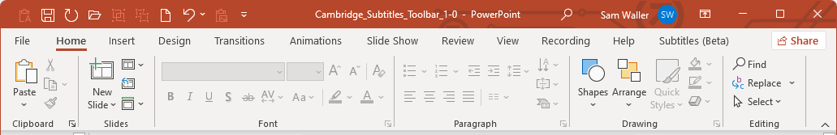
Welcome to the Cambridge subtitles toolbar
IMPORTANT: Macros must be enabled before you can use this file to create subtitles.
If you see either of the prompts below, you will need to click on the button to enable macros
As soon as you open this file, you should see a new tab in your ribbon called ‘Subtitles’
See the next slide for a live demonstration

Slide 2
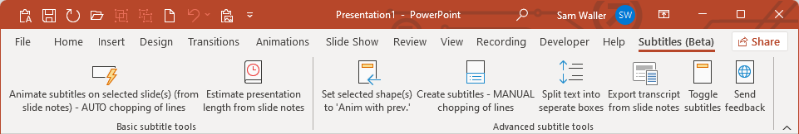
Demonstration
To demonstrate the creation of subtitles, click on the ‘Subtitles’ tab in your ribbon, and then click on ‘Animate subtitles on selected slide(s) ..’
You will see a subtitle box appear on the bottom of this slide. In order to see how the subtitles are animated, press SHIFT+F5 to enter slideshow mode, and then advance through the animations in the same way as you normally advance through slides.
If clicking on the button doesn’t do anything, make sure you have enabled macros in this file (see Slide 1), or contact your IT support for help.
The remaining slides in this file describe how to use this toolbar in detail.
Notes:
This is some text in the slide notes that will form the subtitles.
Each paragraph of the slide notes will become a separate subtitle.
This is the 3rd subtitle that will appear on the slide.

Slide 3
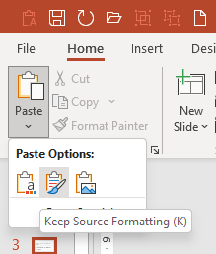
Using the subtitles toolbar
You will need to make the slides for your presentation in this file. If you make them in a separate file, copy them into this file, using ‘paste with source formatting’, as shown opposite:
If your other presentation has slides that are a different aspect ratio to this presentation, then before you paste the slides, you will need to change the slide size of this presentation so that it matches your other presentation (Click Design > Slide Size.)
Contents of this user manual
Basic subtitle animation
Estimating presentation length
Advanced subtitle tools

Slide 4
Basic subtitle animation

Slide 5
Basic subtitle animation – Overall purpose
The button titled ‘Animate subtitles on selected slide(s) (from slide notes) – AUTO chopping of lines’ will produce animated text boxes that run along the bottom of the slide, using text that has been entered into the slide notes.
Simply enter the text for the subtitles into the slide notes, and then click this button to make the subtitles.
If you need to make any changes to the subtitles, edit the text in the slide notes, and then click this button again.

Slide 6
Basic subtitle animation – Splitting paragraphs to make short subtitles
Separate subtitles will be produced for each paragraph in the slide notes. If a paragraph in the slide notes it would cause a subtitle to be longer than a single line of text along the bottom of the slide, the existing paragraphs are split up, until everything fits
Example – BEFORE clicking on ‘animate subtitles’, the slide notes contains a single paragraph, as shown below.
AFTER clicking on button to ‘animate subtitles’, this paragraph has been split up.

Slide 7
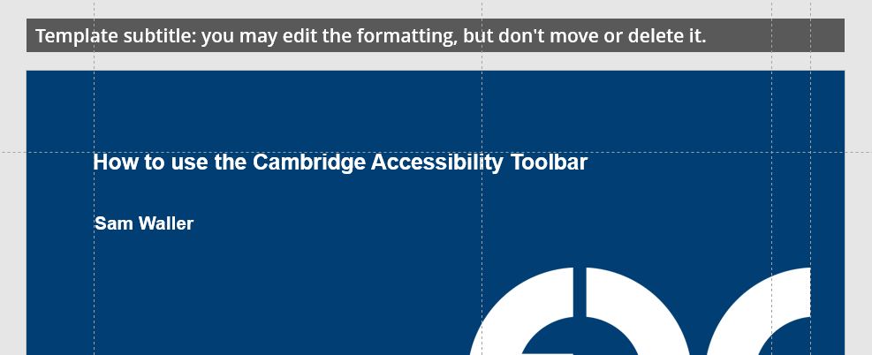
Basic subtitle animation – Subtitle formatting
The 1st time the button is clicked, a template subtitle will be automatically produced above the top of slide 1.
This template subtitle will not be visible to your audience. If you want to change any of the formatting of the subtitles, change it on the template, and then click the button again to make the subtitles on the corresponding slides.

Slide 8
Basic subtitle animation – Combining subtitles with slide animations
If your slide content has animations, you will usually want to synchronise these with the subtitles animations, so that the slide content and the corresponding subtitles appear together at exactly the same time.
The easiest way to achieve this is to use multiple slides to mimic the animated content. For example, if you wanted the text Apple, Banana and Orange to animate on the slides, at the same time as their corresponding subtitles:
Slide 1 would have the text ‘Apple’, and the slide notes ‘this is an apple’
Slide 2 would have the text ‘Apple’ and ‘Banana’, and the slide notes ‘this is a banana’.
Slide 3 would have the text ‘Apple’, ‘Banana’ and ‘Orange’, and the slide notes ‘this is an orange’.
If you want to achieve the same effect without duplicating the slides, see the instructions for using the Advanced subtitle tools’

Slide 9
Estimating presentation length

Slide 10
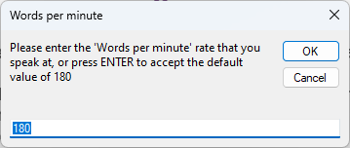
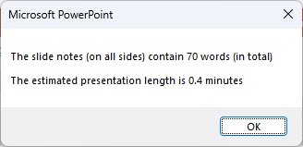
Estimating presentation length – Overall purpose
The button titled ‘Estimate presentation length from slide notes’ is particularly useful for presentation planning. When you click this button, it will ask you to enter your speaking rate, or press enter to accept the default of 180 words per minute.
The presentation length is estimated by counting up all the words in all of the slide notes on all of the slides.

Slide 11
Advanced subtitle tools

Slide 12
Advanced subtitle tools – Overall purpose
The primary purpose of the advanced tools are to streamline the workflow for synchronising slide animations so that they occur simultaneously with subtitle animations
Achieving this makes extensive use of the buttons titled
Set selected shapes to ‘anim with prev.’
Create subtitles – MANUAL chopping of lines
Split text into separate boxes

Slide 13
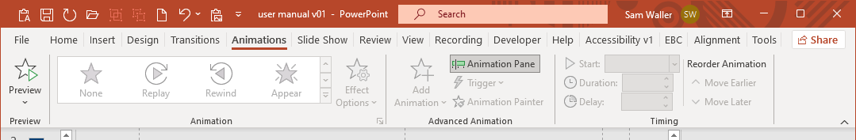
Understanding how PowerPoint controls animations
Before learning how to synchronise the animation of subtitles and slide content, it is first necessary to understand how to use the ‘animation pane’ to control animations on slides.
In order to follow the worked examples on the next slides, you should toggle the ‘animation pane’ on, using the dedicated button within the animation ribbon, as shown below.

Slide 14

Understanding how PowerPoint controls animations
Suppose you make a text box containing the word Apple, and a picture of an apple, and you wanted to animate these so that they appeared together. One approach to achieving this is to group them both together and then click the ‘Appear’ button within the Animations ribbon.
Although this approach initially seems straightforward, this approach is not future proof, because the animation sequence is disrupted any time any of the objects in the sequence are grouped or ungrouped.
The example opposite is a single grouped object that has been animated.
Apple

Slide 15
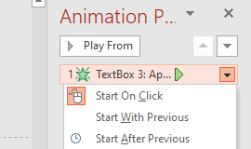
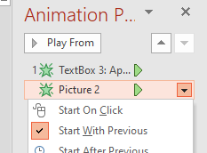
Understanding how PowerPoint controls animations
A better approach is to select both objects at the same time and then click the ‘Appear’ button within the Animations ribbon.
If you look at the animation pane you will see that the text box has the number 1 next to it, but ‘Picture 2’ doesn’t have a number next to it. It is very important to understand the significance of this!
The text box has the number one next to it because it’s animation property is ‘start on click’. You can confirm this by selecting the text box animation effect in the animation pane, and then click the down arrow on the right-hand side.
Conversely, if you do the same for ‘Picture 2’, you will see this has the animation property ‘Start with previous’.
Creating and editing advanced animation sequences is much less onerous if you totally understand of these properties!
Apple

Slide 16

Understanding how PowerPoint controls animations
Whenever a single object is animated, the default animation property is ‘start on click’.
Whenever multiple objects are simultaneously selected and then animated, one of them is set to ‘start on click’ and the remainder are set to ‘start with previous’.
Each object on the slide has a number shown next to it, which is the number of clicks needed to make this object visible. The example on the right shows how this looks when there are 2 objects that are ‘start on click’ and 2 objects that are ‘start with previous’.
Apple
Banana

Slide 17
Understanding how PowerPoint controls animations
£1
Supposing you now wanted to add a third object (like the text £1) to appear simultaneously with the apple, without clearing all of the previously existing animations and starting again! The best way of achieving this is to:
  Create the third object
  Give the third object an ‘Appear’ animation
  In the animation pane, click on the animation event that has just appeared at the bottom, click the down arrow and change the property to ‘start with previous’.
  Drag and drop this animation effect so that it sits just after the click event of the text box containing the word ‘Apple’.
Apple
The animation pane on the right-hand side of this slide shows the result of doing all the above.
Banana

Slide 18
Understanding advanced subtitle animations
£1
Supposing you now wanted some subtitles for the voice-over to accompany this slide. Before any objects appear, you might want to say something like ‘this store sells a variety of fruits, which have been sourced locally’.
When the picture of the Apple, the price and the text label ‘Apple’ appears, you might want to say ‘apples are available for a pound’.
When the picture of the banana, the price and the text label ‘Banana’ appears, you might want to say ‘bananas are available for 20 pence.
This slide currently shows what would happen if you set up the animations assuming there was no voice over, and added the voice-over into the slide notes, and then used the toolbar button to animate the subtitles
Apple
20p
Banana
This store sells a variety of fruits,
which have been sourced locally.
Apples are available for a pound.
Bananas are available for 20p
Notes:
This store sells a variety of fruits,
which have been sourced locally.
Apples are available for a pound.
Bananas are available for 20p

Slide 19
Understanding advanced subtitle animations
£1
When there are lots of subtitles and text boxes, the animation pane gets quite confusing!
In order to try and help the user understand what’s going on, when the button to animate subtitles is clicked, the name of every text box animation event within the animation pane is set to be identical to the contents of that text box. If the text box only contains 1 or 2 words then you will see the same text appearing twice, with a : in between.
Conversely, subtitles within the animation pane appear differently. The name starts with a numeral, then a “;” and then the text of the subtitle. The indicates the animation ordering of the subtitles.
The first line of the subtitles doesn’t exist in the animation pane, because this object simply exists on the slide and is visible from the start.
Apple
20p
Banana
This store sells a variety of fruits,
which have been sourced locally.
Apples are available for a pound.
Bananas are available for 20p
Notes:
This store sells a variety of fruits,
which have been sourced locally.
Apples are available for a pound.
Bananas are available for 20p

Slide 20
Understanding advanced subtitle animations
£1
In order to fix the animation ordering for this slide, the easiest approach is to:
  Drag an area to simultaneously select all of the slide objects that are animated (but not any of the subtitles).
  In the Accessibility ribbon, click the button to Set selected shapes to ‘anim with prev.’
  Drag and drop each of the subtitle click events so that they precede the slide objects that should be animated simultaneously with this subtitle.
This slide shows the outcome of doing all of the above.
Apple
20p
Banana
This store sells a variety of fruits,
which have been sourced locally.
Apples are available for a pound.
Bananas are available for 20p
Notes:
This store sells a variety of fruits,
which have been sourced locally.
Apples are available for a pound.
Bananas are available for 20p

Slide 21
Understanding how to animate long text boxes
Sometimes you will have bullet points on the slide, and you want to animate each bullet point together with the corresponding subtitles. The achieve this:
Create a single text box with all of the bullet points
Click on the button within the accessibility ribbon to ‘split text into separate boxes’.
With all of the text boxes selected, click on the button to Set selected shapes to ‘anim with prev.’
Write the subtitles in the slide notes, and use the technique mentioned in the previous slides to sort out all the animation order

Slide 22
Understanding how to animate long text boxes
Here is an example of a bullet point list:
This is the 1st bullet
This is the 2nd bullet
This is the 3rd bullet
Here is an example of a bullet point list:
This is the 1st bullet
This is the 2nd bullet
This is the 3rd bullet
This is the default way that PowerPoint creates a list
This is the same list after clicking on the button to ‘split text into separate boxes’, so that they can be independently animated

Slide 23
Hints and tips for advanced subtitle animation
The button titled Create subtitles – MANUAL chopping of lines is useful when you want perfect control of the 1st word that appears within each subtitle. This button won’t add line breaks into the subtitles, instead it will show long subtitles that may contain with 2 or 3 lines. Once you have seen these, you can make your own decisions as to where to add the line breaks into the slide notes.
After you have added more line breaks, you should click this button again to see the results, until all subtitles are a single line

Slide 24
Hints and tips for advanced subtitle animation
If you have lots of subtitles and lots of animations, and you change the slide notes so that one of the subtitles becomes longer than a single line, it’s best to use the Animate the subtotals - AUTO chopping of lines button.
This button will split the long single line into shorter lines and update the animation sequence so that everything that is intended to be animated together stays together.

Slide 25
Creating presentations that might be used by multiple different presenters
Subtitles are particularly useful for a presenter that is not completely familiar with the slide content, especially if there are lots of animations!
However, presenters who have extensively practised the presentation may prefer to present without subtitles.
Rather than having two separate files (with and without the subtitles), a better approach is enable different presenters to toggle the subtitles on or off as they please, using the dedicated button, as shown below.
Clicking this button moves all of the subtitles off of the bottom of the slide, so they are not visible to the audience. However any animation sequences including the subtitles are preserved

Slide 26
Creating a transcript of your talk
If you are making a video of your presentation, some people will find it helpful to have a plain text transcript of the talk. The following dedicated button opens up a notepad file that contains all of the text in all of the slide notes in the presentation, with headings to indicate where the slight changes occur

