Slide 1
Towards effective beamline monitoring in diverse information space: RPi + Tango + Memcached
K. Glazyrin

Slide 2


The life of the beamline scientist
Starts in the middle of the night on a weekend
You wake in the middle of the night
after leaving the beamline at 1am
Something got wrong
Users are in panic..

Slide 3
The life of the beamline scientist
is most often about – how to make things work
What could be wrong, how do I fix it?
What is the next step?
Can I do it remotely?
Etc. etc.

Slide 4
Decision making – we need
Overview of information (heterogeneous sources)
Our approach
Collectors of information
Agents sorting and merging data
Hardware level
Agents storing data
Software level
Agents representing data

Slide 5

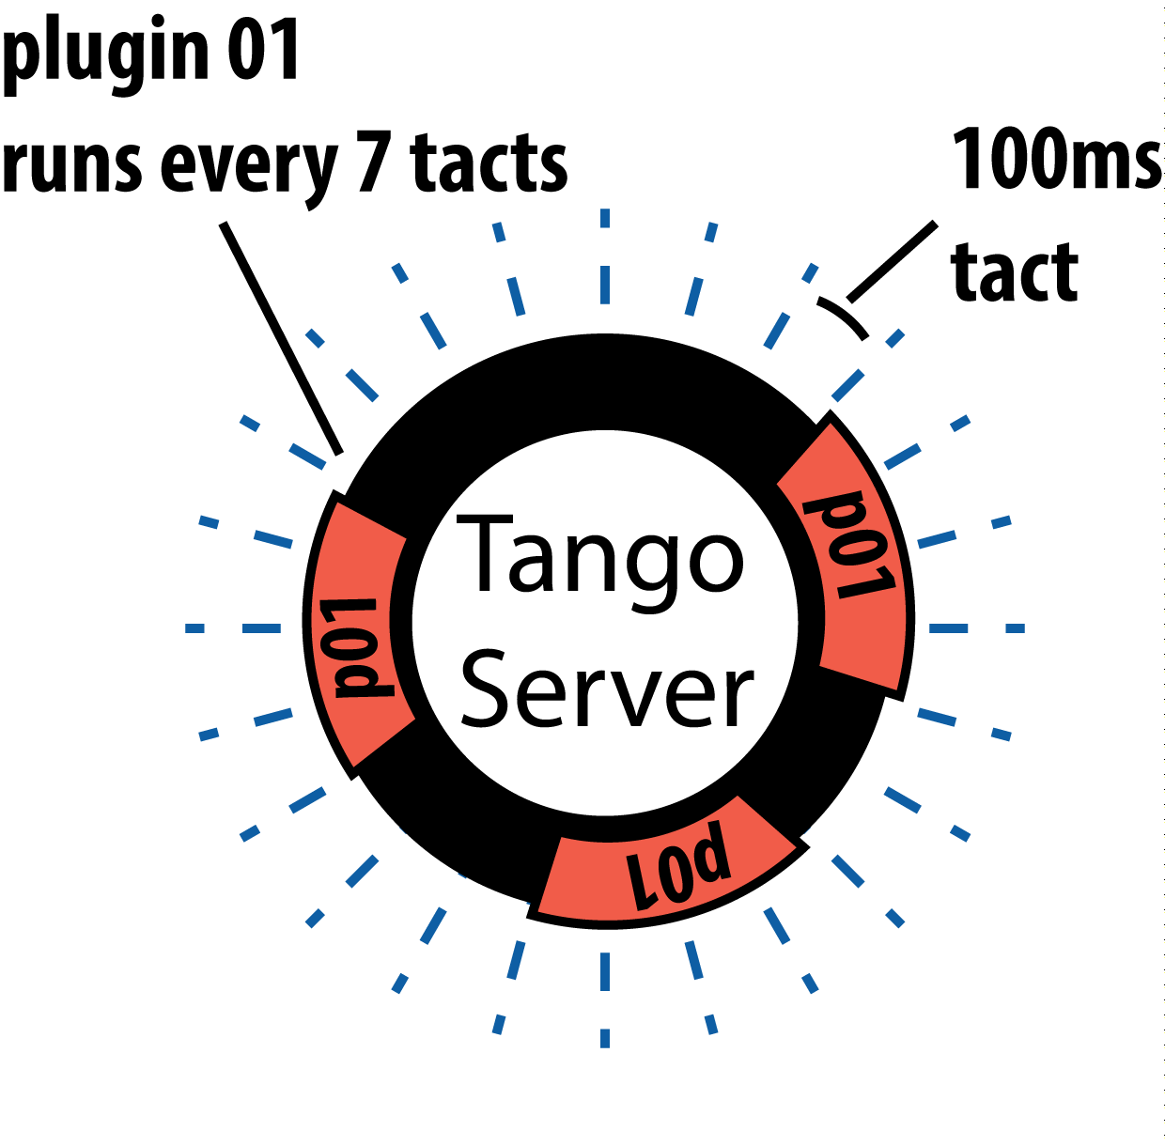
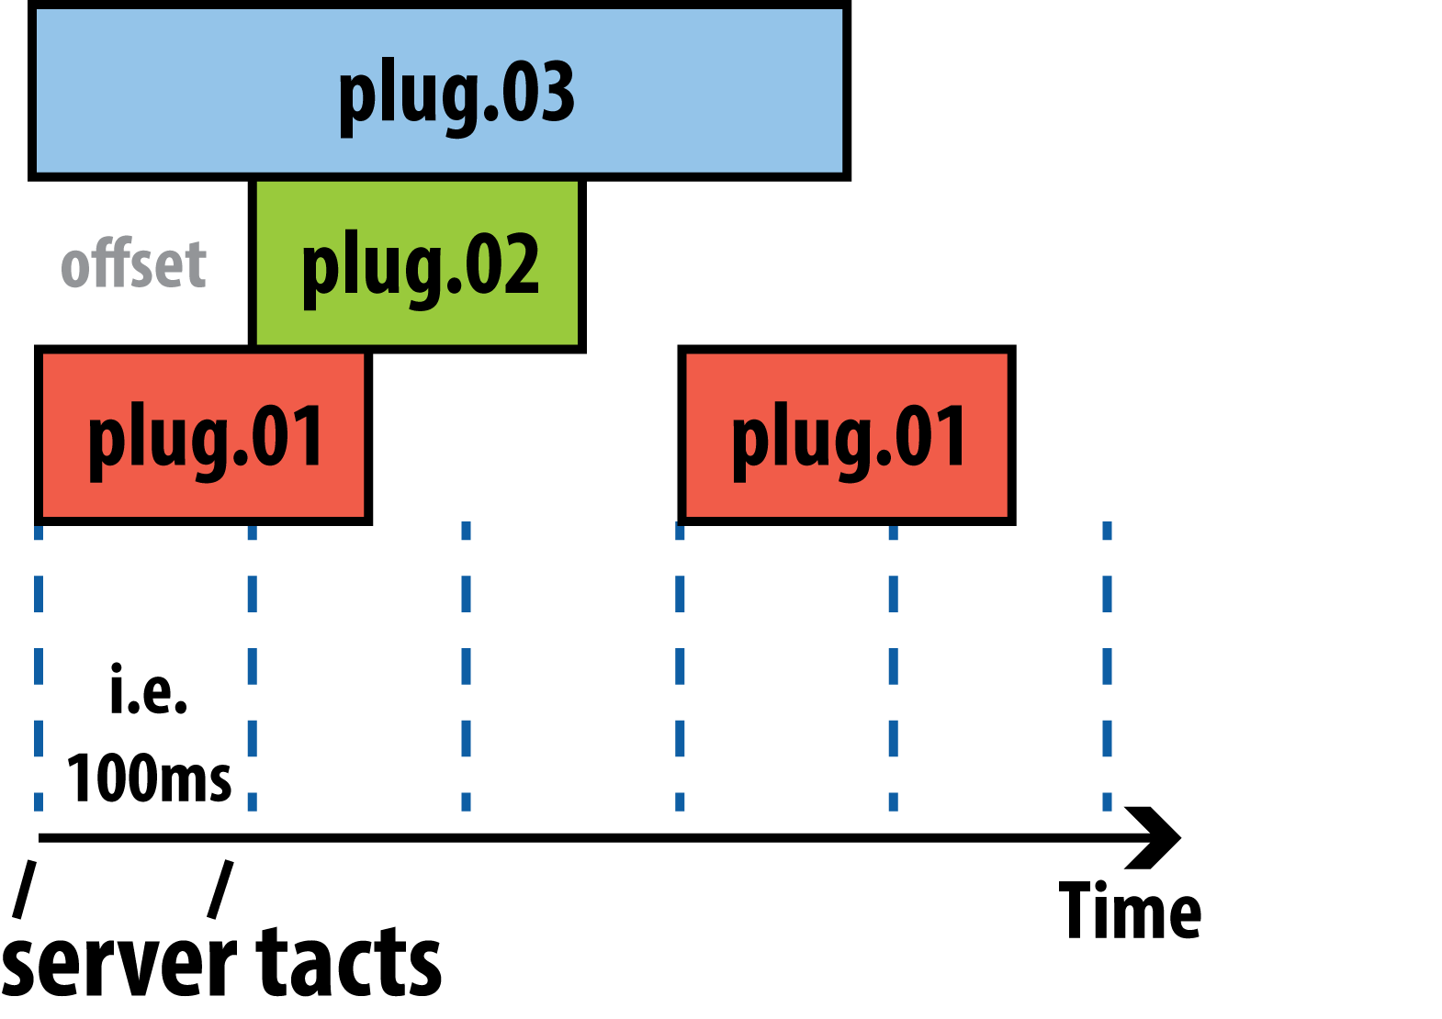


Software/Hardware level
Custom Tango Server (operates on plugin level)
Python Server runs plugins (specific tasks) at certain intervals
Server does not take care about task of a plugin
Plugin is a STANDALONE program
Plugins can collect, merge, transform data

Slide 6

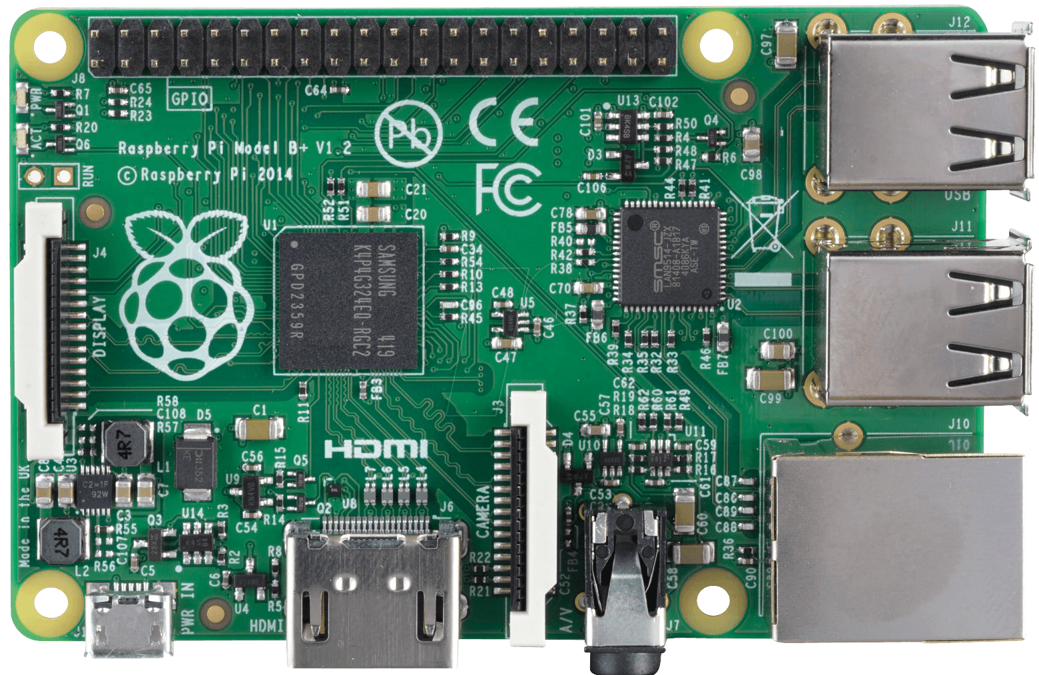

Software/Hardware level
Raspberry PI + Memcached + Tango – cost efficient, scalable, low maintenance
Key→Value
Memcached is open-source latency free RAM based storage
(ideal – small datasets)
haspp02oh1:10000/p02/dcm/energy→42670
Larger JSON based data sets for adult GUI programs is not an issue

Slide 7
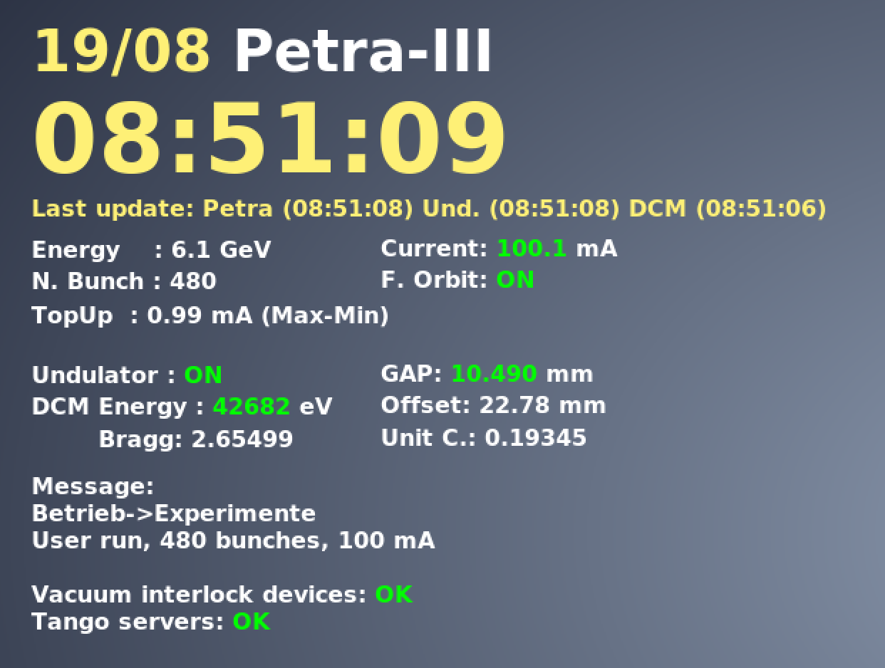
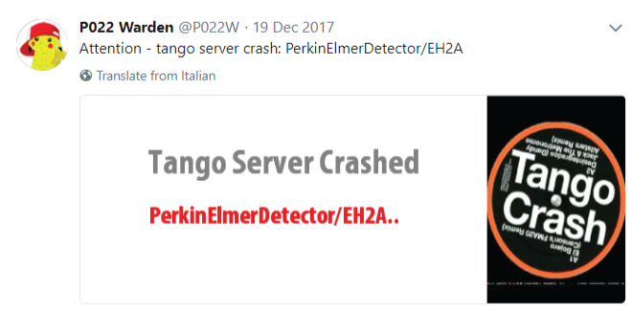

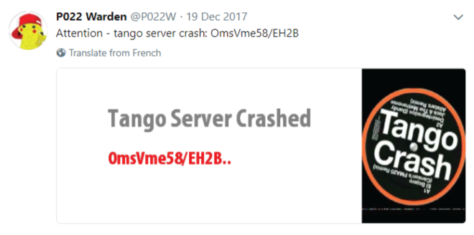

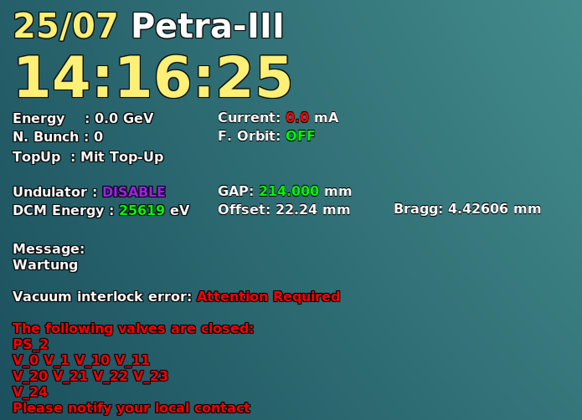
Software level – data representation
Within the limited resource of P02.2 beamline of Petra-III we implemented several resource efficient clients:
Control hutch monitoring (scientist/user) based on conky
Reporting client (Twitter bot) based on crontab

Slide 8

Perspectives

Slide 9
Perspectives
Custom plugin based tango server allows `online` data extraction and analysis (i.e. RAM drive)
Custom plugin based tango server allows merging of data sets coming from heterogeneous sources (QXRD meta data (Win7) + external data (TCP/IP) → NEXUS) : Poor man pre-HiDRA
Etc.

Slide 10
Thank you!

Slide 11


