Slide 1
Automated Reasoning for Security Protocols
Rob Lorch
4/23/26

Slide 2


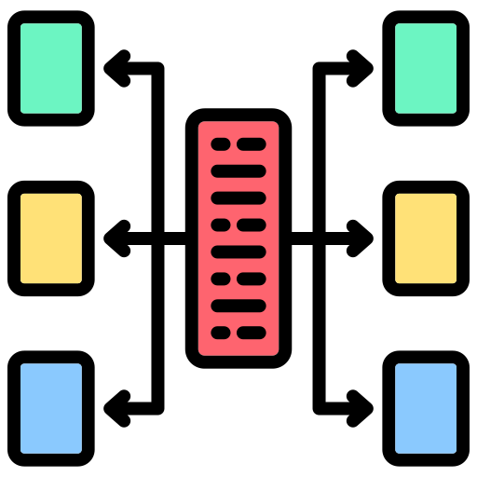



Introduction & Motivation
Most of the Internet runs on layers of security protocols
DNSSEC
TLS
X.509
4G LTE/5G
Uptane
More

Slide 3
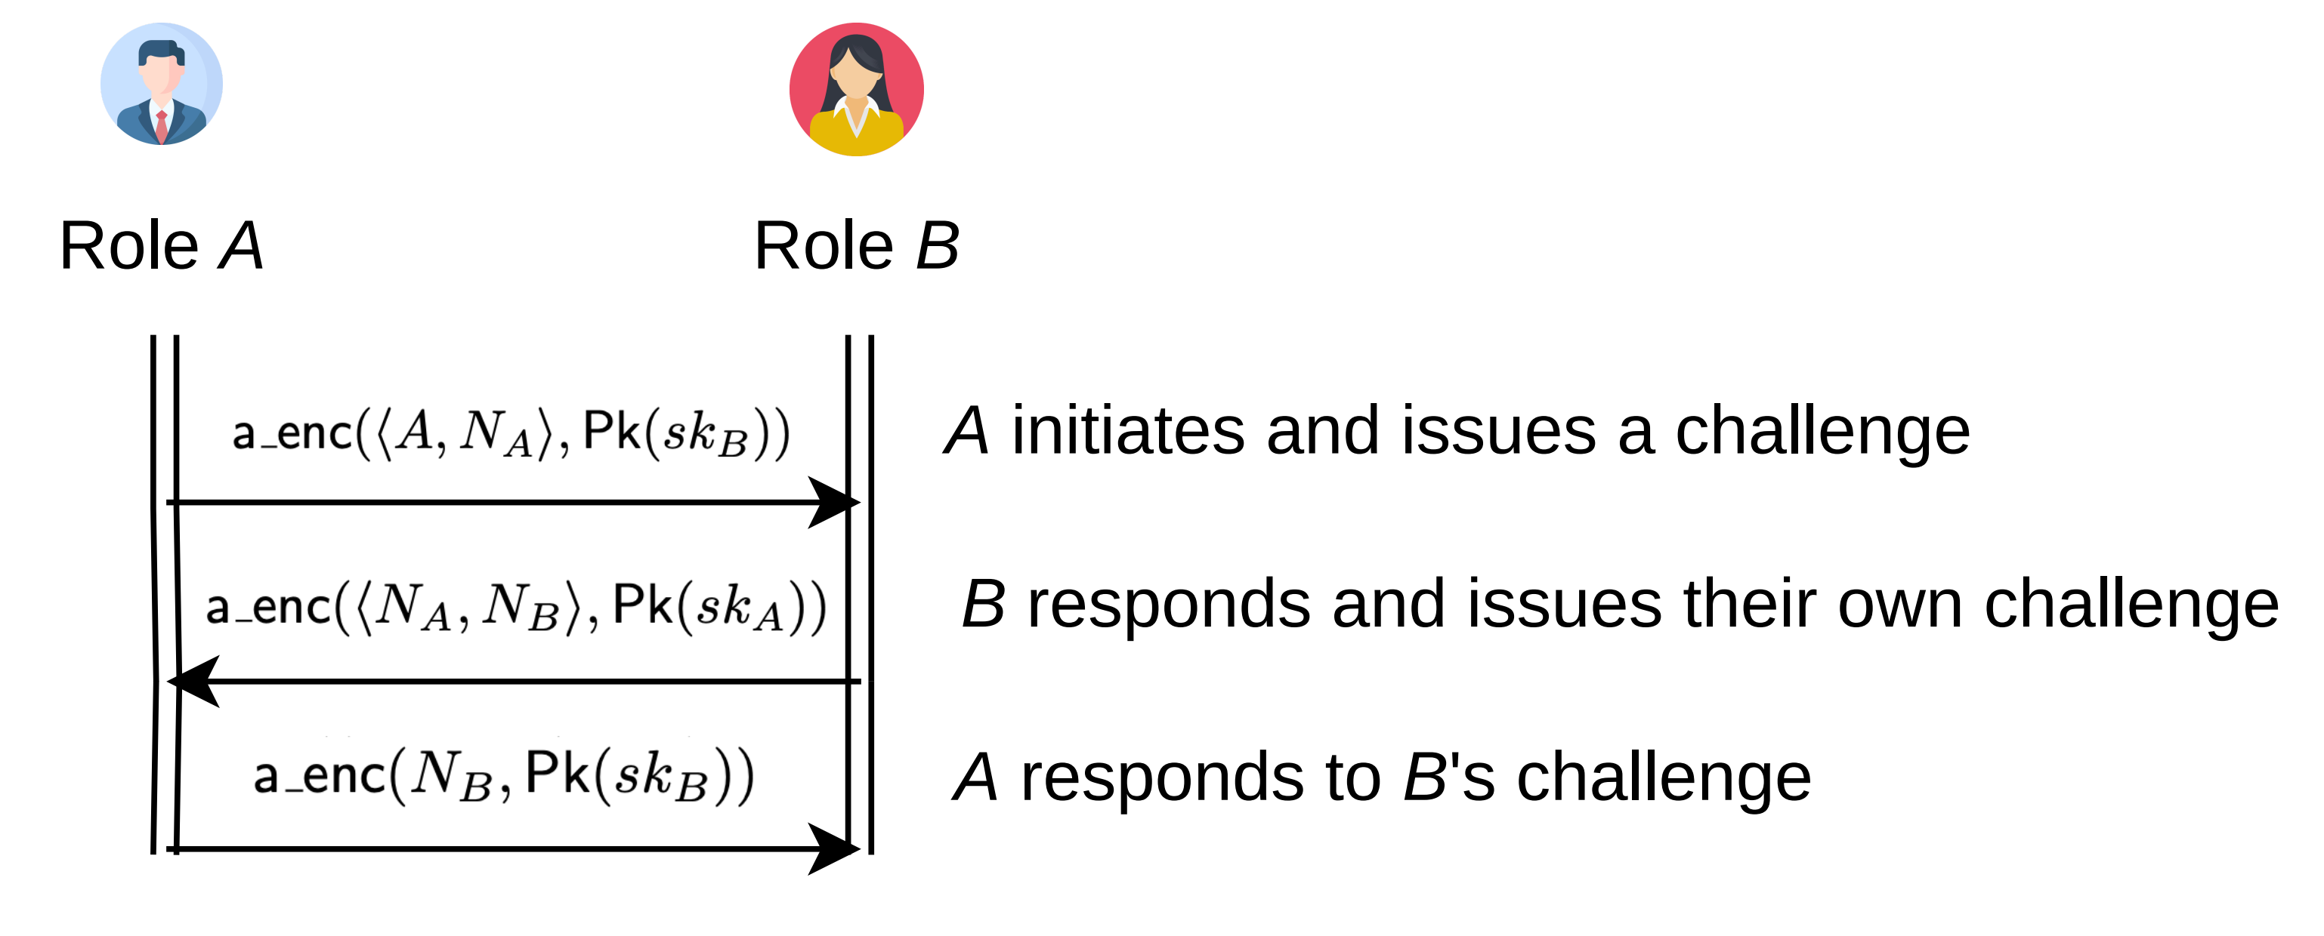


Introduction & Motivation
Security protocols are hard to get right
Needham-Schroeder public key
mutual authentication protocol
Undiscovered vulnerability in production for 17 years
Discovered with automated reasoning tools!

Slide 4


Introduction & Motivation
Modern protocols are orders of magnitude more complicated!
Victories of SOTA
(automated protocol analysis)
Drawbacks of SOTA (automated protocol analysis)
Needham-Schroeder analysis with full automation
Nontrivial protocols require knowledge of internal workings of tools
Properties of WireGuard, SSH, Signal, and TLS formally verified
Certain classes of protocols are still not amenable to (semi-)automated analysis

Slide 5
Roadmap
Talk objectives
Cryptographic protocol verification background
Automated reasoning for protocols
Breaking, fixing, and breaking Needham-Schroeder
Making reasoning tractable
Discussion, Research Questions, & Conclusion
Appendix: Making reasoning expressive

Slide 6



Talk Objectives
Mechanize & automate reasoning about cryptographic protocol security
Proofs of security
Attack traces for insecurity
Reason expressively!
Unbounded setting
Protocol features (primitives, control flow, …)
Identify open research questions
Compositional reasoning
More expressivity, e.g. theory reasoning

Slide 7
Roadmap
Talk objectives
Cryptographic protocol verification background
Automated reasoning for protocols
Breaking, fixing, and breaking Needham-Schroeder
Making reasoning tractable
Discussion, Research Questions, & Conclusion
Appendix: Making reasoning expressive

Slide 8
Mathematical Cryptography: Primitives & Protocols
Example protocol: Alice-Bob notation

Slide 9
Mathematical Cryptography: Primitives & Protocols
Example protocol: roles

Slide 10
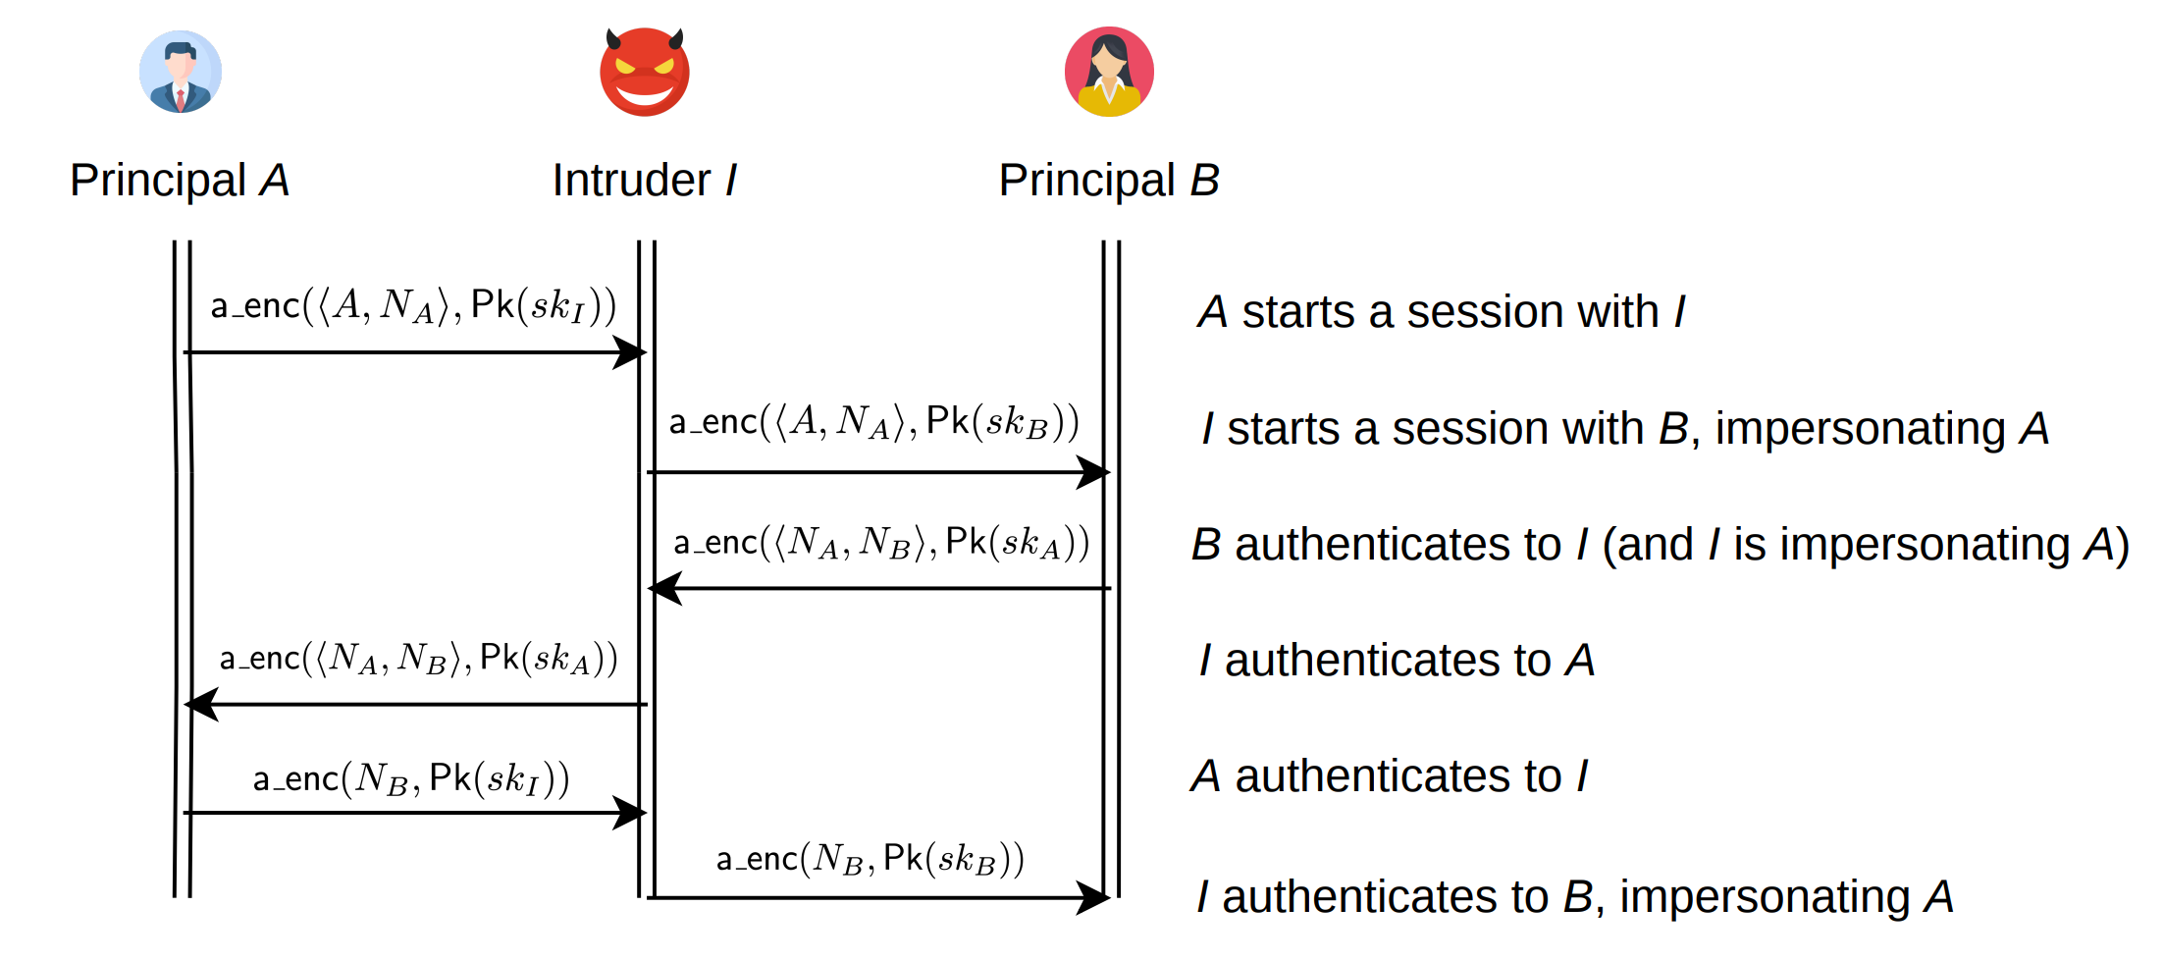
Mathematical Cryptography: Primitives & Protocols
Example protocol: trace, session, principal, adversary

Slide 11
Mathematical Cryptography: Primitives & Protocols
Example protocol: trace, session, principal, adversary

Slide 12
Mathematical Cryptography: Primitives & Protocols
Example protocol: trace, session, principal, adversary
Parallel sessions

Slide 13

Mathematical Cryptography: Primitives & Protocols
Example protocol: trace, session, principal, adversary
Sequential sessions

Slide 14
Mathematical Cryptography: Primitives & Protocols
Example protocol: trace, session, principal, adversary

Slide 15
Mathematical Cryptography: Primitives & Protocols
Example protocol: trace, session, principal, adversary

Slide 16
Mathematical Cryptography: Primitives & Protocols
Cryptographic protocol vs primitive

Slide 17
Mathematical Cryptography: Primitives & Protocols
Cryptographic protocol vs primitive

Slide 18
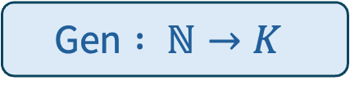
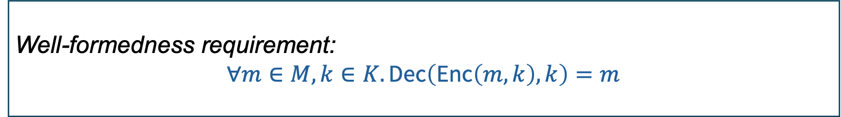
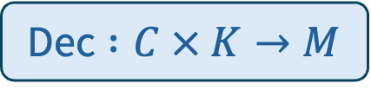
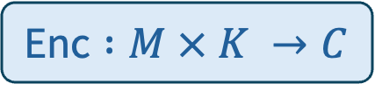
Mathematical Cryptography: Primitives & Protocols
How to define security for a cryptographic primitive?
Consider symmetric key encryption and decryption
$$\text{Gen} : ℕ→K$$
$$\text{Enc} :M × K →C$$
$$\text{Dec} :C × K→M$$
Sets of bit strings
Well-formedness requirement:
$$∀m∈M, k∈K. \text{Dec}\left(\text{Enc}\left(m, k\right), k\right)=m$$

Slide 19
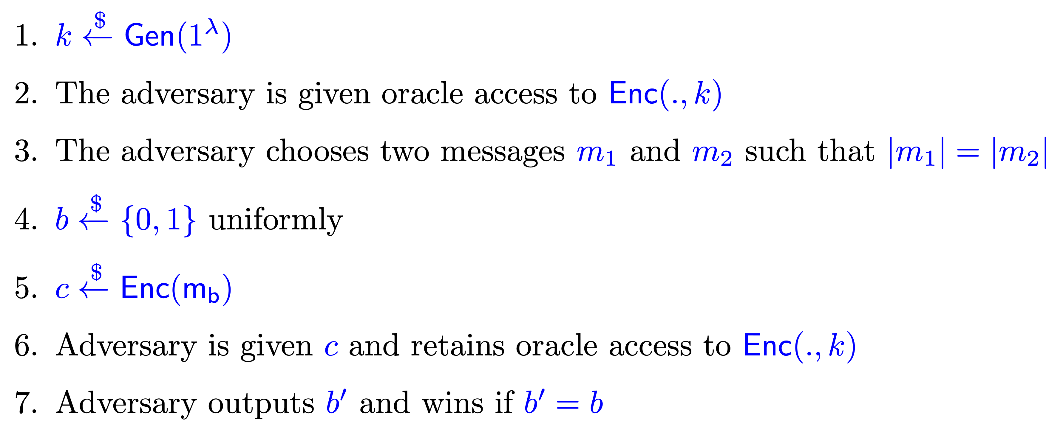

Mathematical Cryptography: Security of Primitives
We play a cryptographic game between a challenger and an adversary
Scheme is IND-CPA secure iff $\operatorname{Pr}\left[Adversary wins game\right]≤\frac{1}{2}+negl\left(λ\right)$

Slide 20



Mathematical Cryptography: Security of Primitives
We play a cryptographic game between a challenger and an adversary
Scheme is IND-CPA secure iff $\operatorname{Pr}\left[\text{Adversary} \text{wins} \text{game}\right]≤\frac{1}{2}+\text{negl}\left(λ\right)$
Notion of security depends on the game

Slide 21
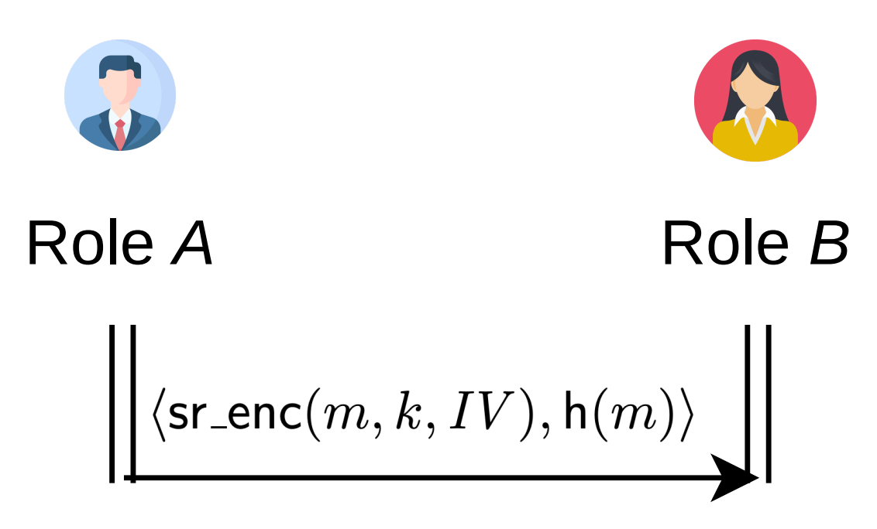
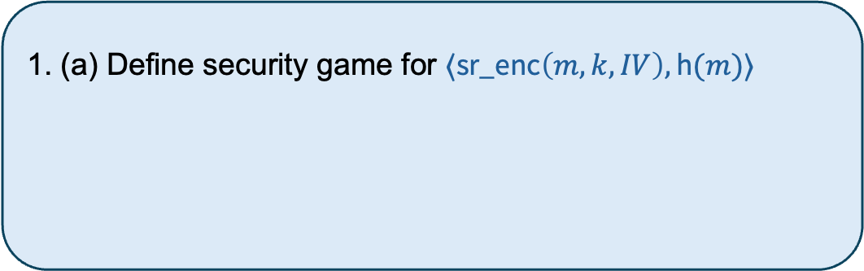
Mathematical Cryptography: Primitives & Protocols
How to define security for a cryptographic protocol?
(a) Define a protocol-level game
(b) Assume primitives are secure
1. (a) Define security game for $⟨\text{sr}\text{_}\text{enc}\left(m, k, IV\right), \text{h}(m)⟩$
2. (b) Assume $sr_enc(.,.,.)$is IND-CPA secure
3. (b) Assume $h(.)$collision-resistant & one-way function
4. Adversary can count how many times each message
is sent!

Slide 22
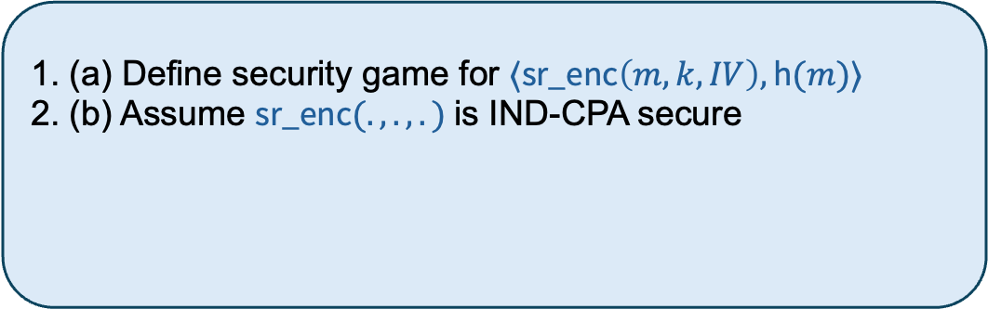
Mathematical Cryptography: Primitives & Protocols
How to define security for a cryptographic protocol?
(a) Define a protocol-level game
(b) Assume primitives are secure
1. (a) Define security game for $⟨\text{sr}\text{_}\text{enc}\left(m, k, IV\right), \text{h}(m)⟩$
2. (b) Assume $\text{sr}\text{_}\text{enc}(.,.,.)$is IND-CPA secure
3. (b) Assume $h(.)$collision-resistant & one-way function
4. Adversary can count how many times each message
is sent!

Slide 23
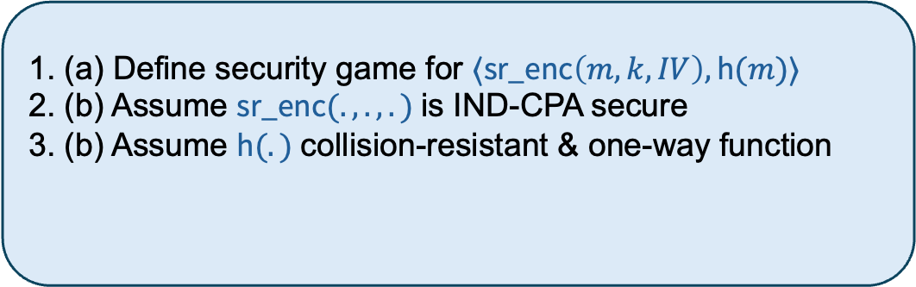
Mathematical Cryptography: Primitives & Protocols
How to define security for a cryptographic protocol?
(a) Define a protocol-level game
(b) Assume primitives are secure
1. (a) Define security game for $⟨\text{sr}\text{_}\text{enc}\left(m, k, IV\right), \text{h}(m)⟩$
2. (b) Assume $\text{sr}\text{_}\text{enc}(.,.,.)$is IND-CPA secure
3. (b) Assume $\text{h}(.)$collision-resistant & one-way function
4. Adversary can count how many times each message
is sent!

Slide 24
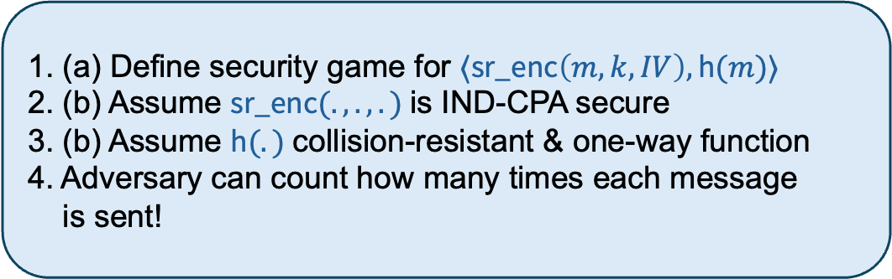
Mathematical Cryptography: Primitives & Protocols
How to define security for a cryptographic protocol?
(a) Define a protocol-level game
(b) Assume primitives are secure
1. (a) Define security game for $⟨\text{sr}\text{_}\text{enc}\left(m, k, IV\right), \text{h}(m)⟩$
2. (b) Assume $\text{sr}\text{_}\text{enc}(.,.,.)$is IND-CPA secure
3. (b) Assume $\text{h}(.)$collision-resistant & one-way function
4. Adversary can count how many times each message
is sent!

Slide 25
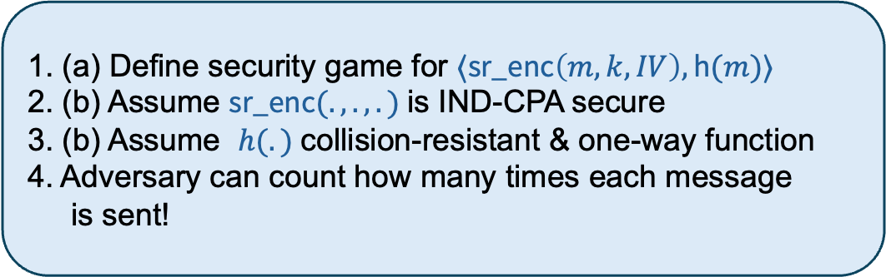
Mathematical Cryptography: Primitives & Protocols
Secure primitives do not necessarily imply a secure protocol
How to define security for a cryptographic protocol?
(a) Define a protocol-level game
(b) Assume primitives are secure
We assume primitives are secure and focus on protocol verification
1. (a) Define security game for $⟨\text{sr}\text{_}\text{enc}\left(m, k, IV\right), \text{h}(m)⟩$
2. (b) Assume $\text{sr}\text{_}\text{enc}(.,.,.)$is IND-CPA secure
3. (b) Assume $h(.)$collision-resistant & one-way function
4. Adversary can count how many times each message
is sent!
Primitives can always be analyzed separately

Slide 26
Threat Models
We use threat models to classify protocol analysis techniques (i.e., sets of assumptions about adversarial capabilities)

Slide 27
Threat Models
Computational adversary capabilities
Computational model
Closely follows mathematical cryptography
Adversaries are probabilistic polynomial time (PPT) Turing machines (limiting computational power)
Exploiting weaknesses of primitives
Symbolic model (a.k.a. Dolev-Yao model)
Assumes primitives are perfectly secure
Considers non-probabilistic (often weaker) security properties
Exploiting protocol weaknesses
Non-polynomial computation
Symbolic adversary capabilities

Slide 28
Threat Models
Computational adversary capabilities
Computational model
Closely follows mathematical cryptography
Adversaries are probabilistic polynomial time (PPT) Turing machines (limiting computational power)
Exploiting weaknesses of primitives
Computational model reasoning (with PPT TMs and cryptographic games) is not currently amenable to automation, so most automation efforts focus on the symbolic model
Due to this, we focus on the symbolic model in this talk
Symbolic model (a.k.a. Dolev-Yao model)
Assumes primitives are perfectly secure
Considers non-probabilistic (often weaker) security properties
Exploiting protocol weaknesses
Non-polynomial computation
Symbolic adversary capabilities

Slide 29
Symbolic Model
Principals communicate with symbolic terms rather than bit strings (as in computational model)
$$\text{enc}\left(n_{a}, k\right), \text{dec}\left(\text{enc}\left(n_{a}, k\right),k\right), …$$
Just a syntactic symbol; no computational interpretation

Slide 30
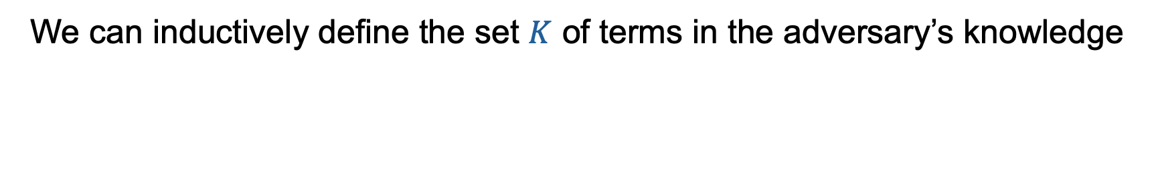
Symbolic Model
We can inductively define the set $K$ of terms in the adversary’s knowledge
$t$ is marked public
$$t∈K$$

Slide 31
Symbolic Model
We can inductively define the set $K$ of terms in the adversary’s knowledge
$t$ was sent on the network
$$t∈K$$

Slide 32


Symbolic Model
We can inductively define the set $K$ of terms in the adversary’s knowledge
$m∈K$ $k∈K$
$\text{enc}(m, k)∈K$ $k∈K$
$$\text{enc}(m, k)∈K$$
$$m∈K$$

Slide 33






Symbolic Model
We can inductively define the set $K$ of terms in the adversary’s knowledge
$t_{1}∈K$ $t_{2}∈K$
$$⟨t_{1},t_{2}⟩∈K$$
$$⟨t_{1},t_{2}⟩∈K$$
$$⟨t_{1}, t_{2}⟩∈K$$
$$t_{1}∈K$$
$$t_{2}∈K$$

Slide 34
Roadmap
Talk objectives
Cryptographic protocol verification background
Automated reasoning for protocols
Breaking, fixing, and breaking Needham-Schroeder
Making reasoning tractable
Discussion, Research Questions, & Conclusion
Appendix: Making reasoning expressive

Slide 35
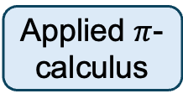
Protocol Reasoning in the Symbolic Model
Way to formalize protocols (language & semantics)
Way to formalize properties (language & semantics)
We focus on Tamarin’s formal foundations for ease of presentation, but will still seek to learn general lessons about symbolic model verification
Multiset rewriting
Applied $π$-calculus
Fixed set of props
Variant of FOL
Programs
Equivalences
Threat model
Algorithm to search for attacks against (or proofs of) properties in given threat model
Symbolic model
Computational model
Backwards search
Resolution
CCSA model
Type checking
Induction on traces

Slide 36
Formalizing Security Protocols in the Symbolic Model
Model protocol state with a multiset of facts that evolves at each rewrite rule application
Initial state
State 1
State 2
(Multiset)
Rewrite rule
Rewrite rule
Each rewrite rule is a protocol step
Rewrite rule
State n (attack!)
State 3
Rewrite rule
Rewrite rule

Slide 37
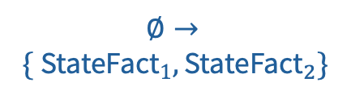

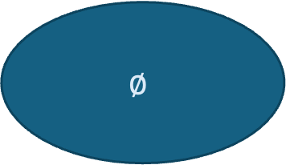

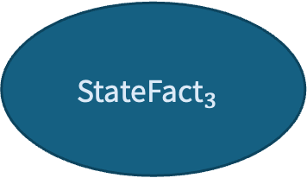
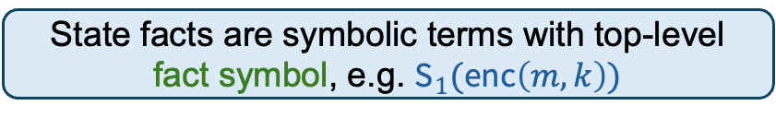
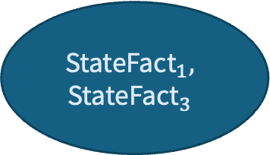
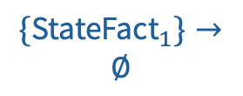
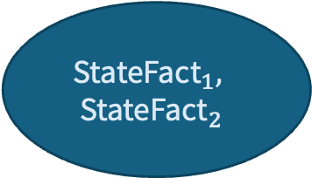


Formalizing Security Protocols in the Symbolic Model
Each rule also has a multiset of labels referenced later when specifying properties
Every principal’s state is recorded in the global protocol state at each step
Model protocol state with a multiset of facts that evolves at each rewrite rule application
$$∅$$
$$\text{StateFac}{\text{t}}_{1},$$
$$\text{StateFac}{\text{t}}_{2}$$
$$\text{StateFac}{\text{t}}_{1},$$
$$\text{StateFac}{\text{t}}_{3}$$
$$ℓ$$
$$∅→$$
$$\{ \text{StateFac}{\text{t}}_{1},\text{StateFac}{\text{t}}_{2}\}$$
$$ℓ$$
$$\{\text{StateFac}{\text{t}}_{2}\}→$$
$$\{\text{StateFac}{\text{t}}_{3}\}$$
$$ℓ$$
This captures the notion of a protocol trace in the multiset rewriting formalism
$$\{\text{StateFac}{\text{t}}_{1}\}→$$
$$∅$$
State facts are symbolic terms with top-level fact symbol, e.g. ${\text{S}}_{1}(\text{enc}\left(m, k\right))$
State n (attack!)
$$\text{StateFac}{\text{t}}_{3}$$
Rewrite rule
Rewrite rule

Slide 38
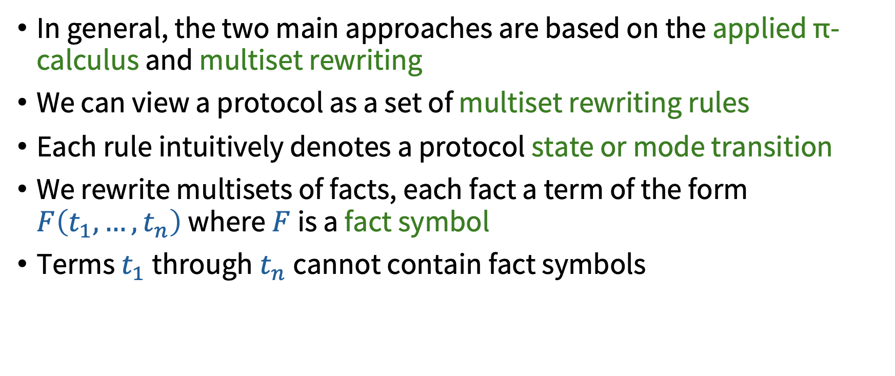
Formalizing Security Protocols in the Symbolic Model
In general, the two main approaches are based on the applied π-calculus and multiset rewriting
We can view a protocol as a set of multiset rewriting rules
Each rule intuitively denotes a protocol state or mode transition
We rewrite multisets of facts, each fact a term of the form $F\left(t_{1},…,t_{n}\right)$ where $F$ is a fact symbol
Terms $t_{1}$through$t_{n}$cannot contain fact symbols

Slide 39
Formalizing Security Protocols in the Symbolic Model
Distinguished (built-in) fact symbols
$\text{In}$, $\text{Out}$, $\text{Fr}$, and $\text{K}$ (built-in adversary modeling)
Adversary rules
$\left\{\text{Out}\left(x\right)\right\}→\{!\text{K}(x)\}$, $\left\{!\text{K}\left(x\right)\right\}→\{\text{In}(x)\}$, $\left\{!\text{K}\left(t_{1}\right), !\text{K}(t_{2})\right\}→\{\text{! }\text{K}\left(\text{enc}\left(t_{1},t_{2}\right)\right)\}$, …
Honest rules
$\left\{\text{In}\left(N_{A}\right), !\text{KeyB}\left(k\right)\right\}→^{\{\text{MyEnc}\left(N_{A}\right)\}}\left\{\text{Out}\left(\text{enc}\left(N_{A}, k\right)\right)\right\}$, …
Protocol-specific (user) fact symbols
! $\text{KeyB}\text{(.)}$

Slide 40
Formalizing Security Protocols in the Symbolic Model
Given a set of rewrite rules $R$, we can define a labeled transition relation $→_{R}^{α}$
$$l→^{α}r∈ginsts(R) l⊆^{\#}S$$
$$S→_{R}^{α}\left({S \backslash }^{\#} l\right)∪^{\#}r$$

Slide 41
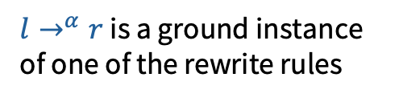
Formalizing Security Protocols in the Symbolic Model
Given a set of rewrite rules $R$, we can define a labeled transition relation $→_{R}^{α}$
$l→^{α}r$ is a ground instance of one of the rewrite rules
$$l→^{α}r∈ginsts(R) l⊆^{\#}S$$
$$S→_{R}^{α}\left({S \backslash }^{\#} l\right)∪^{\#}r$$

Slide 42

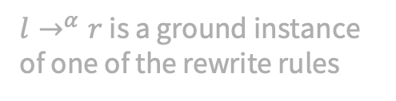
Formalizing Security Protocols in the Symbolic Model
Given a set of rewrite rules $R$, we can define a labeled transition relation $→_{R}^{α}$
$l→^{α}r$ is a ground instance of one of the rewrite rules
The current state contains $l$
$$l→^{α}r∈ginsts(R) l⊆^{\#}S$$
$$S→_{R}^{α}\left({S \backslash }^{\#} l\right)∪^{\#}r$$

Slide 43

Formalizing Security Protocols in the Symbolic Model
Given a set of rewrite rules $R$, we can define a labeled transition relation $→_{R}^{α}$
$l→^{α}r$ is a ground instance of one of the rewrite rules
The current state contains $l$
$$l→^{α}r∈ginsts(R) l⊆^{\#}S$$
$$S→_{R}^{α}\left({S \backslash }^{\#} l\right)∪^{\#}r$$
Update global state by removing l and introducing r

Slide 44
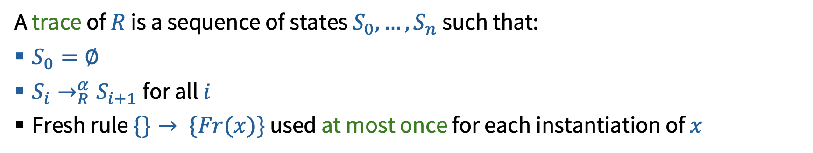
Formalizing Security Protocols in the Symbolic Model
Given a set of rewrite rules $R$, we can define a labeled transition relation $→_{R}^{α}$
$l→^{α}r$ is a ground instance of one of the rewrite rules
The current state contains $l$
$$l→^{α}r∈ginsts(R) l⊆^{\#}S$$
$$S→_{R}^{α}\left({S \backslash }^{\#} l\right)∪^{\#}r$$
Update global state by removing l and introducing r
A trace of $R$ is a sequence of states $S_{0}, …, S_{n}$such that:
$S_{0}=∅$
$S_{i}→_{R}^{α}S_{i+1}$for all $i$
Fresh rule $\{\}→ \{Fr(x)\}$ used at most once for each instantiation of $x$

Slide 45
Formalizing Needham-Schroeder
How to formalize a protocol in a set of multiset rewriting rules?

Slide 46
Formalizing Needham-Schroeder
How to formalize a protocol in a set of multiset rewriting rules?
First, a means of key generation (implicit in Alice-Bob notation)
$\left\{\text{Fr}(sk)\right\}→\{\text{!}\text{Sk}\left(id, sk\right), \text{!}\text{Pk}\left(id, \text{pk}\left(sk\right)\right), \text{Out}(⟨id, \text{pk}(sk)⟩)\}$

Slide 47

Formalizing Needham-Schroeder
How to formalize a protocol in a set of multiset rewriting rules?
Next step takes $\text{StA}\text{1}(A,B,N_{A})$ as a premise
Enforces an ordering constraint
First, a means of key generation (implicit in Alice-Bob notation)
$\left\{\text{Fr}(sk)\right\}→\{\text{!}\text{Sk}\left(id, sk\right), \text{!}\text{Pk}\left(id, \text{pk}\left(sk\right)\right), \text{Out}(⟨id, \text{pk}(sk)⟩)\}$
A rule for each honest step
$$\left\{\text{Fr}\left(N_{A}\right), !\text{Pk}\left(A,pk_{A}\right),!\text{Pk}(B,pk_{B})\right\}→\{\text{Out}\left(\text{a}\text{_}\text{enc}\left(\left\langle A,N_{A}\right\rangle ,pk_{B}\right)\right),\text{StA}\text{1}\left(A, B, N_{A}\right),\}$$

Slide 48
Formalizing Needham-Schroeder
How to formalize a protocol in a set of multiset rewriting rules?
Next step takes $\text{StA}\text{1}(A,B,N_{A})$ as a premise
Enforces an ordering constraint
First, a means of key generation (implicit in Alice-Bob notation)
$\left\{\text{Fr}(sk)\right\}→\{\text{!}\text{Sk}\left(id, sk\right), \text{!}\text{Pk}\left(id, \text{pk}\left(sk\right)\right), \text{Out}(⟨id, \text{pk}(sk)⟩)\}$
A rule for each honest step
$$\left\{\text{Fr}\left(N_{A}\right), !\text{Pk}\left(A,pk_{A}\right),!\text{Pk}(B,pk_{B})\right\}→\{\text{Out}\left(\text{a}\text{_}\text{enc}\left(\left\langle A,N_{A}\right\rangle ,pk_{B}\right)\right),\text{StA}\text{1}\left(A, B, N_{A}\right),\}$$

Slide 49
Formalizing Needham-Schroeder
How to formalize a protocol in a set of multiset rewriting rules?
Adversary rules built in!
First, a means of key generation (implicit in Alice-Bob notation)
$\left\{\text{Fr}(sk)\right\}→\{\text{!}\text{Sk}\left(id, sk\right), \text{!}\text{Pk}\left(id, \text{pk}\left(sk\right)\right), \text{Out}(⟨id, \text{pk}(sk)⟩)\}$
A rule for each honest step
$$\left\{\text{Fr}\left(N_{A}\right), !\text{Pk}\left(A,pk_{A}\right),!\text{Pk}(B,pk_{B})\right\}→\{\text{Out}\left(\text{a}\text{_}\text{enc}\left(\left\langle A,N_{A}\right\rangle ,pk_{B}\right)\right),\text{StA}\text{1}\left(A, B, N_{A}\right),\}$$

Slide 50

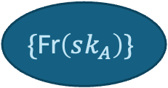
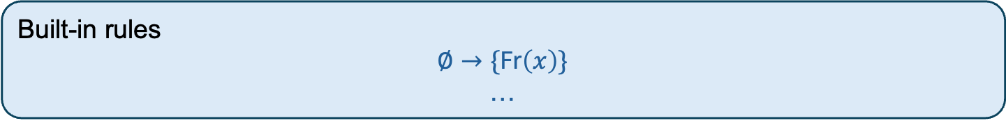
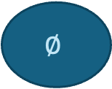
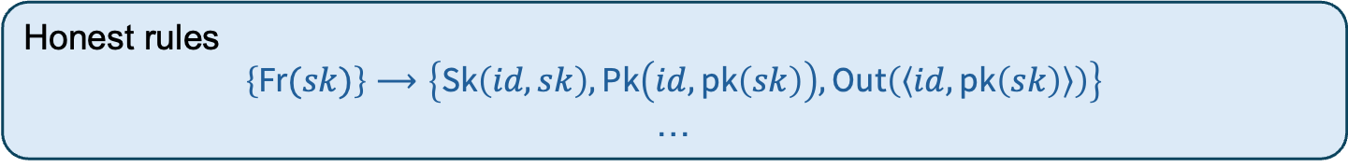
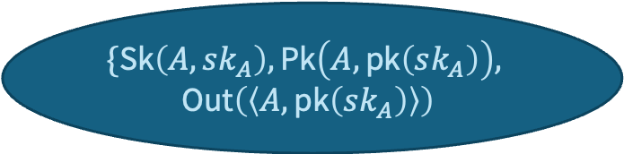

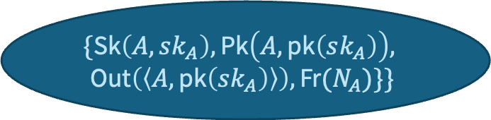
Formalizing Needham-Schroeder
How to generate a trace?
Honest rules
$$\left\{\text{Fr}(sk)\right\}⟶\left\{\text{Sk}\left(id, sk\right), \text{Pk}\left(id, \text{pk}\left(sk\right)\right), \text{Out}\left(\left\langle id, \text{pk}\left(sk\right)\right\rangle \right)\right\}$$
…
Built-in rules
$$∅→\{\text{Fr}\left(x\right)\}$$
…
$$\left\{\text{Fr}(sk_{A})\right\}⟶\left\{!\text{Sk}\left(A, sk_{A}\right), !\text{Pk}\left(A, \text{pk}\left(sk_{A}\right)\right), \text{Out}\left(\left\langle A, \text{pk}\left(sk_{A}\right)\right\rangle \right)\right\}$$
$$∅$$
$$\{\text{Fr}\left(sk_{A}\right)\}$$
$$\{\text{Sk}\left(A,sk_{A}\right),\text{Pk}\left(A,\text{pk}\left(sk_{A}\right)\right),$$
$$\text{Out}\left(\left\langle A,\text{pk}\left(sk_{A}\right)\right\rangle \right)$$
$$∅→ \left\{\text{Fr}(sk_{A})\right\}$$
$$\{\text{Sk}\left(A,sk_{A}\right),\text{Pk}\left(A,\text{pk}\left(sk_{A}\right)\right),$$
$$\text{Out}\left(\left\langle A,\text{pk}\left(sk_{A}\right)\right\rangle \right), \text{Fr}(N_{A})\}\}$$
$$∅→ \left\{\text{Fr}(N_{A})\right\}$$

Slide 51
Formalizing Security Properties in the Symbolic Model
Security properties can be partitioned into trace properties and hyper properties
Typical security properties are safety (“something bad never happens”), not liveness (“something good eventually happens”)

Slide 52
Formalizing Security Properties in the Symbolic Model
We can encode protocols, but how do we find security problems?
We encode properties in a variant of first-order logic
Notes:
<transition point – formalizing properties (in presentation) >
<connect to previous point>
Order-sorted FOL (many-sorted FOL with subsorting)

Slide 53
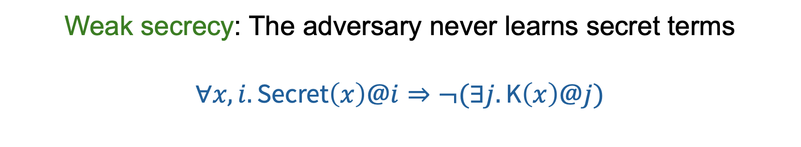
Formalizing Security Properties in the Symbolic Model
Weak secrecy: The adversary never learns secret terms
$$∀x, i. \text{Secret}\left(x\right)@i⇒¬(∃j.\text{K}\left(x\right)@j)$$
Predicate symbols refer to fact symbols in protocol description

Slide 54
Formalizing Security Properties in the Symbolic Model
Weak secrecy: The adversary never learns secret terms
$$∀x, i. \text{Secret}\left(x\right)@i⇒¬(∃j.\text{K}\left(x\right)@j)$$
We include an additional argument to each predicate representing a timepoint

Slide 55

Formalizing Security Properties in the Symbolic Model
Weak secrecy: The adversary never learns secret terms
$$∀x, i. \text{Secret}\left(x\right)@i⇒¬(∃j.\text{K}\left(x\right)@j)$$
$x$ is secret at time $i$

Slide 56
Formalizing Security Properties in the Symbolic Model
Weak secrecy: The adversary never learns secret terms
$$∀x, i. \text{Secret}\left(x\right)@i⇒¬(∃j.\text{K}\left(x\right)@j)$$
Built-in capturing adversary knowledge

Slide 57
Formalizing Security Properties in the Symbolic Model
Weak secrecy: The adversary never learns secret terms
$$∀x, i. \text{Secret}\left(x\right)@i⇒¬(∃j.\text{K}\left(x\right)@j)$$
If a term $x$ is secret at any time $i$, then it is never in the adversary knowledge base

Slide 58





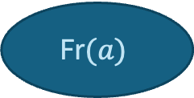

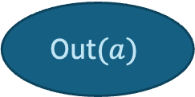
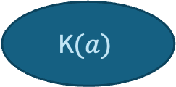
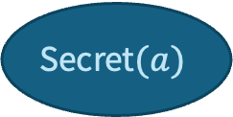

Formalizing Security Properties in the Symbolic Model
Weak secrecy: The adversary never learns secret terms
$$∀x, i. \text{Secret}\left(x\right)@i⇒¬(∃j.\text{K}\left(x\right)@j)$$
$$\{\text{Secret}\left(a\right)\}$$
$$\{\text{K}\left(a\right)\}$$
$$∅→ \left\{\text{Fr}(a)\right\}$$
$$\{\text{Fr}\left(a\right)\}→ \left\{\text{Secret}(a)\right\}$$
$$\{\text{Secret}\left(a\right)\}→ \left\{\text{Out}(a)\right\}$$
$$\{\text{Out}\left(a\right)\}→ \left\{\text{K}(a)\right\}$$
$$∅$$
$$\text{Fr}(a)$$
$$\text{Secret}(a)$$
$$\text{Out}(a)$$
$$\text{K}(a)$$
Step 0
Step 1
Step 2
Step 3

Slide 59

Formalizing Security Properties in the Symbolic Model
Non-injective agreement: If principal $A$ accepted data item $d$ apparently from principal $B$, then previously principal $B$ sent data item $d$ apparently to principal $A$
$$∀A, B, t, i. \text{Accept}\left(A, B, t\right)@i⇒(∃j. \text{Sent}\left(B,A,t\right)@j \& j<i)$$

Slide 60

Formalizing Security Properties in the Symbolic Model
Injective agreement: There is an injective mapping from data items accepted by principal $A$ apparently from principal $B$, to data items sent from principal $B$ apparently to principal $A$
$∀A, B, t, i. \text{Accept}\left(A, B, t\right)@i⇒(∃j. Sent\left(B,A,t\right)@j \& j<i)$ &
$$¬(∃A_{2},B_{2},i_{2}.\text{Accept}\left(A_{2},B_{2},t\right)@i_{2}\& i_{2}≠i)$$
No replay attacks!

Slide 61
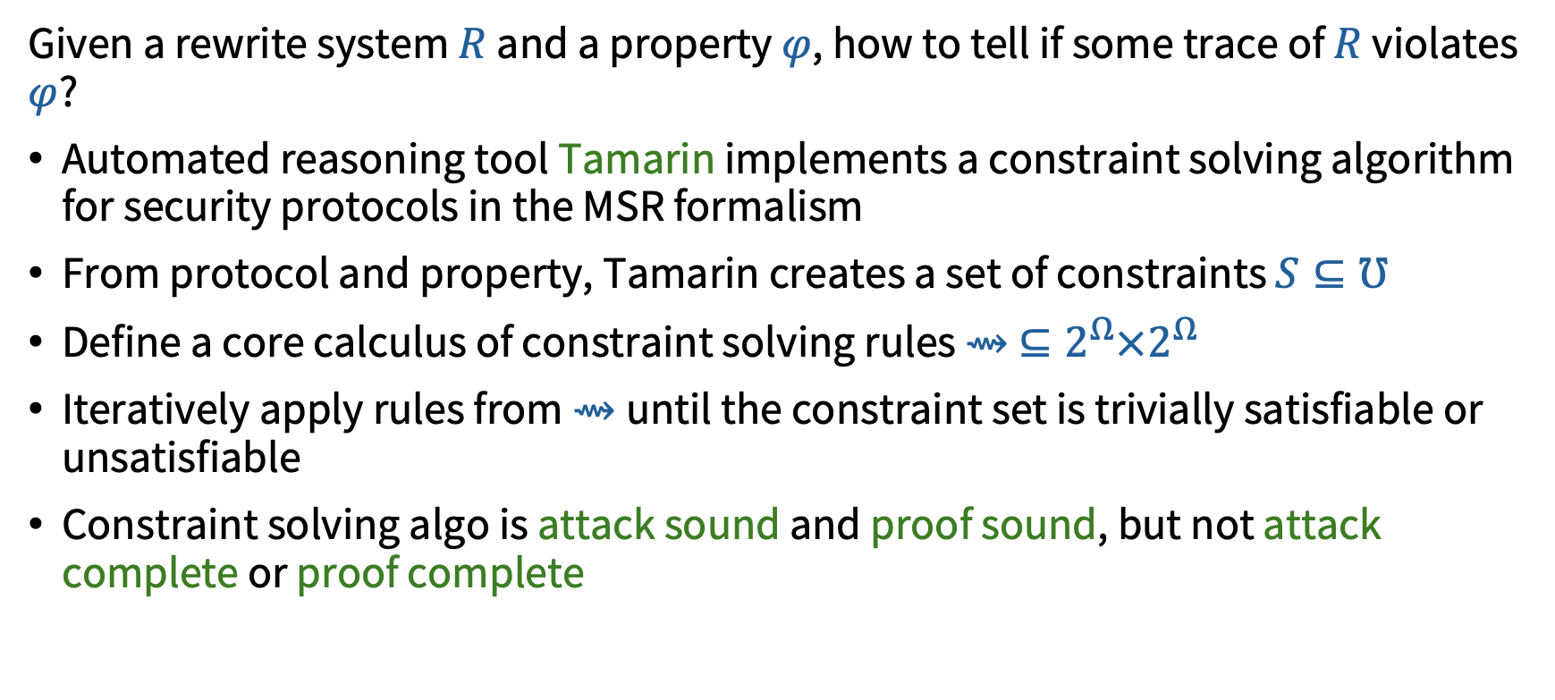
Automated Property Satisfaction/Violation
Given a rewrite system $R$ and a property $φ$, how to tell if some trace of $R$ violates $φ$?
Automated reasoning tool Tamarin implements a constraint solving algorithm for security protocols in the MSR formalism
From protocol and property, Tamarin creates a set of constraints $S⊆℧$
Define a core calculus of constraint solving rules $⇝ ⊆2^{Ω}×2^{Ω}$
Iteratively apply rules from $⇝$until the constraint set is trivially satisfiable or unsatisfiable
Constraint solving algo is attack sound and proof sound, but not attack complete or proof complete

Slide 62
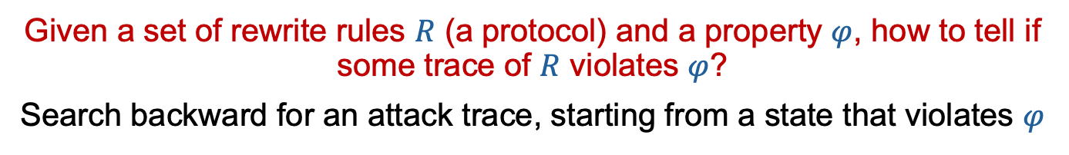

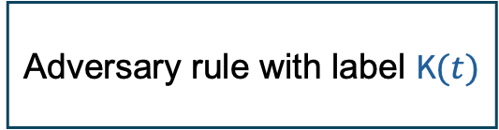
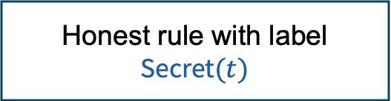
Automated Property Satisfaction/Violation
Given a set of rewrite rules $R$ (a protocol) and a property $φ$, how to tell if some trace of $R$ violates $φ$?
Search backward for an attack trace, starting from a state that violates $φ$
?
?
Adversary rule with label $\text{K}(t)$
Honest rule with label $\text{Secret}(t)$
Algo relies on ability to perform unification of facts
i.e., find $σ$ such that
$$\text{F}\left(t_{1}, …, t_{n}\right)σ= \text{F}\left(t_{1}^{′}, …, t_{n}′\right)σ$$
$$\{\text{K}\left(N_{A}\right), \text{Secret}\left(N_{A}\right)\}$$

Slide 63
Roadmap
Talk objectives
Cryptographic protocol verification background
Automated reasoning for protocols
Breaking, fixing, and breaking Needham-Schroeder
Making reasoning tractable
Discussion, Research Questions, & Conclusion
Appendix: Making reasoning expressive

Slide 64
Needham-Schroeder Public Key Protocol
What kinds of bugs can Tamarin find?

Slide 65
Needham-Schroeder Public Key Protocol
What kinds of bugs can Tamarin find?

Slide 66
Needham-Schroeder Public Key Protocol
What kinds of bugs can Tamarin find?

Slide 67
Needham-Schroeder Public Key Protocol
What kinds of bugs can Tamarin find?

Slide 68
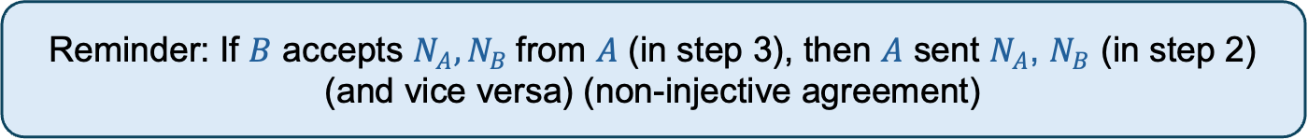
Needham-Schroeder Public Key Protocol
What kinds of bugs can Tamarin find?
We have achieved mutual authentication!(?)
Reminder: If $B$ accepts $N_{A}, N_{B}$from $A$ (in step 3), then $A$ sent $N_{A}$, $N_{B}$ (in step 2)
(and vice versa) (non-injective agreement)

Slide 69



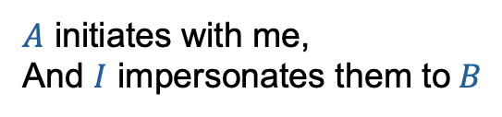
First Attack on Needham-Schroeder
$$1. A→B:\text{a}\text{_}\text{enc}(\left\langle A,N_{A}\right\rangle , \text{p}\text{k}(sk_{B}))$$
$$2. B→A:\text{a}\text{_}\text{enc}(\left\langle N_{A},N_{B}\right\rangle , \text{p}\text{k}(sk_{A}))$$
$$3. A→B:\text{a}\text{_}\text{enc}(N_{B}, \text{p}\text{k}(sk_{B}))$$
$A$ initiates with me,
And $I$ impersonates them to$B$
Notes:
In the “B authenticates to I (impersonating A)” step, B is also issuing a challenge. I steals that challenge and has A do it for him. A won’t notice because he doesn’t see an identity mismatch.
A starts a session with I
I starts a session with B, impersonating A
B authenticates to I (and I is impersonating A)
I authenticates to A
A authenticates to I
I authenticates to B, impersonating A

Slide 70
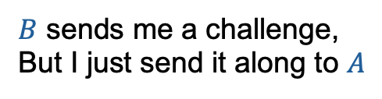
First Attack on Needham-Schroeder
$$1. A→B:\text{a}\text{_}\text{enc}(\left\langle A,N_{A}\right\rangle , \text{p}\text{k}(sk_{B}))$$
$$2. B→A:\text{a}\text{_}\text{enc}(\left\langle N_{A},N_{B}\right\rangle , \text{p}\text{k}(sk_{A}))$$
$$3. A→B:\text{a}\text{_}\text{enc}(N_{B}, \text{p}\text{k}(sk_{B}))$$
$B$ sends me a challenge,
But I just send it along to $A$
Notes:
In the “B authenticates to I (impersonating A)” step, B is also issuing a challenge. I steals that challenge and has A do it for him. A won’t notice because he doesn’t see an identity mismatch
A starts a session with I
I starts a session with B, impersonating A
B authenticates to I (and I is impersonating A)
I authenticates to A
A authenticates to I
I authenticates to B, impersonating A
.

Slide 71

First Attack on Needham-Schroeder
$$1. A→B:\text{a}\text{_}\text{enc}(\left\langle A,N_{A}\right\rangle , \text{p}\text{k}(sk_{B}))$$
$$2. B→A:\text{a}\text{_}\text{enc}(\left\langle N_{A},N_{B}\right\rangle , \text{p}\text{k}(sk_{A}))$$
$$3. A→B:\text{a}\text{_}\text{enc}(N_{B}, \text{p}\text{k}(sk_{B}))$$
$A$ responds to the challenge without protest
Notes:
In the “B authenticates to I (impersonating A)” step, B is also issuing a challenge. I steals that challenge and has A do it for him. A won’t notice because he doesn’t see an identity mismatch
A starts a session with I
I starts a session with B, impersonating A
B authenticates to I (and I is impersonating A)
I authenticates to A
A authenticates to I
I authenticates to B, impersonating A
.

Slide 72

First Attack on Needham-Schroeder
$$1. A→B:\text{a}\text{_}\text{enc}(\left\langle A,N_{A}\right\rangle , \text{p}\text{k}(sk_{B}))$$
$$2. B→A:\text{a}\text{_}\text{enc}(\left\langle N_{A},N_{B}\right\rangle , \text{p}\text{k}(sk_{A}))$$
$$3. A→B:\text{a}\text{_}\text{enc}(N_{B}, \text{p}\text{k}(sk_{B}))$$
$A$knows they are communicating with$I$, but $B$ believes they are communicating with $A$
Notes:
In the “B authenticates to I (impersonating A)” step, B is also issuing a challenge. I steals that challenge and has A do it for him. A won’t notice because he doesn’t see an identity mismatch
A starts a session with I
I starts a session with B, impersonating A
B authenticates to I (and I is impersonating A)
I authenticates to A
A authenticates to I
I authenticates to B, impersonating A
.

Slide 73



First Attack on Needham-Schroeder
$$1. A→B:\text{a}\text{_}\text{enc}(\left\langle A,N_{A}\right\rangle , \text{p}\text{k}(sk_{B}))$$
$$2. B→A:\text{a}\text{_}\text{enc}(\left\langle N_{A},N_{B}\right\rangle , \text{p}\text{k}(sk_{A}))$$
$$3. A→B:\text{a}\text{_}\text{enc}(N_{B}, \text{p}\text{k}(sk_{B}))$$
Impersonation should be noticed by $A$!
The message should be bound to $B$’s identity
Using ${\left\langle N_{A}, N_{B}, B\right\rangle }^{3}$ prevents the attack
Notes:
In the “B authenticates to I (impersonating A)” step, B is also issuing a challenge. I steals that challenge and has A do it for him. A won’t notice because he doesn’t see an identity mismatch.
A starts a session with I
I starts a session with B, impersonating A
B authenticates to I (and I is impersonating A)
I authenticates to A
A authenticates to I
I authenticates to B, impersonating A

Slide 74


Needham-Schroeder Public Key Protocol
Bind message to sender ID
Using a triple ${\left\langle N_{A}, N_{B}, B\right\rangle }^{3}$ prevents the attack.
What about $⟨N_{A}, {⟨N}_{B},B⟩⟩$?
Insecure!

Slide 75


Type Confusion Attack on Needham-Schroeder
$$1. A→B:\text{a}\text{_}\text{enc}(\left\langle A,N_{A}\right\rangle , \text{p}\text{k}(sk_{B}))$$
$$2. B→A:\text{a}\text{_}\text{enc}(\left\langle N_{A},{⟨N}_{B},B⟩\right\rangle , \text{p}\text{k}(sk_{A}))$$
$$3. A→B:\text{a}\text{_}\text{enc}(N_{B}, \text{p}\text{k}(sk_{B}))$$
Intruder initiates
Notes:
In the “B authenticates to I (impersonating A)” step, B is also issuing a challenge. I steals that challenge and has A do it for him. A won’t notice because he doesn’t see an identity mismatch.
I initiates, impersonating P_2 and replacing the first nonce with their identity I (see step 4)
P_1 responds as expected
I forwards the response to P_2 unchanged
P_2 took the previous message as an initiation, confusing <N_P1, P1> with a nonce! P_2 responds, leaking N_P1 to I. (P_2 encrypts with I’s public key because I is the first component of the encryption, which we smuggled in earlier)
I has successfully impersonated P_2!

Slide 76
Type Confusion Attack on Needham-Schroeder
$$1. A→B:\text{a}\text{_}\text{enc}(\left\langle A,N_{A}\right\rangle , \text{p}\text{k}(sk_{B}))$$
$$2. B→A:\text{a}\text{_}\text{enc}(\left\langle N_{A},{⟨N}_{B},B⟩\right\rangle , \text{p}\text{k}(sk_{A}))$$
$$3. A→B:\text{a}\text{_}\text{enc}(N_{B}, \text{p}\text{k}(sk_{B}))$$
Response is confused as an initiation!
Notes:
In the “B authenticates to I (impersonating A)” step, B is also issuing a challenge. I steals that challenge and has A do it for him. A won’t notice because he doesn’t see an identity mismatch.
I initiates, impersonating P_2 and replacing the first nonce with their identity I (see step 4)
P_1 responds as expected
I forwards the response to P_2 unchanged
P_2 took the previous message as an initiation, confusing <N_P1, P1> with a nonce! P_2 responds, leaking N_P1 to I. (P_2 encrypts with I’s public key because I is the first component of the encryption, which we smuggled in earlier)
I has successfully impersonated P_2!

Slide 77

Type Confusion Attack on Needham-Schroeder
$$1. A→B:\text{a}\text{_}\text{enc}(\left\langle A,N_{A}\right\rangle , \text{p}\text{k}(sk_{B}))$$
$$2. B→A:\text{a}\text{_}\text{enc}(\left\langle N_{A},{⟨N}_{B},B⟩\right\rangle , \text{p}\text{k}(sk_{A}))$$
$$3. A→B:\text{a}\text{_}\text{enc}(N_{B}, \text{p}\text{k}(sk_{B}))$$
$P_{2}$ responds thinking $I$initiated with them, but it leaks $N_{P_{1}}$
Notes:
In the “B authenticates to I (impersonating A)” step, B is also issuing a challenge. I steals that challenge and has A do it for him. A won’t notice because he doesn’t see an identity mismatch.
I initiates, impersonating P_2 and replacing the first nonce with their identity I (see step 4)
P_1 responds as expected
I forwards the response to P_2 unchanged
P_2 took the previous message as an initiation, confusing <N_P1, P1> with a nonce! P_2 responds, leaking N_P1 to I. (P_2 encrypts with I’s public key because I is the first component of the encryption, which we smuggled in earlier)
I has successfully impersonated P_2!

Slide 78

Type Confusion Attack on Needham-Schroeder
$$1. A→B:\text{a}\text{_}\text{enc}(\left\langle A,N_{A}\right\rangle , \text{p}\text{k}(sk_{B}))$$
$$2. B→A:\text{a}\text{_}\text{enc}(\left\langle N_{A},{⟨N}_{B},B⟩\right\rangle , \text{p}\text{k}(sk_{A}))$$
$$3. A→B:\text{a}\text{_}\text{enc}(N_{B}, \text{p}\text{k}(sk_{B}))$$
$I$ has impersonated $P_{2}$ to $P_{1}$
Notes:
In the “B authenticates to I (impersonating A)” step, B is also issuing a challenge. I steals that challenge and has A do it for him. A won’t notice because he doesn’t see an identity mismatch.
I initiates, impersonating P_2 and replacing the first nonce with their identity I (see step 4)
P_1 responds as expected
I forwards the response to P_2 unchanged
P_2 took the previous message as an initiation, confusing <N_P1, P1> with a nonce! P_2 responds, leaking N_P1 to I. (P_2 encrypts with I’s public key because I is the first component of the encryption, which we smuggled in earlier)
I has successfully impersonated P_2!

Slide 79

Type Confusion Attack on Needham-Schroeder
$$1. A→B:\text{a}\text{_}\text{enc}(\left\langle A,N_{A}\right\rangle , \text{p}\text{k}(sk_{B}))$$
$$2. B→A:\text{a}\text{_}\text{enc}(\left\langle N_{A},{⟨N}_{B},B⟩\right\rangle , \text{p}\text{k}(sk_{A}))$$
$$3. A→B:\text{a}\text{_}\text{enc}(N_{B}, \text{p}\text{k}(sk_{B}))$$
What is the problem?
$${\text{Rule}}_{1}=\{…\}→\{\text{Out}\left(\text{a}\text{_}\text{enc}\left(\left\langle A, N_{A}\right\rangle , \text{p}\text{k}(sk_{B})\right)\right),…$$
$${\text{Rule}}_{2}=\left\{…\right\}→\{\text{Out}\left(\text{a}\text{_}\text{enc}\left(\left\langle N_{A}, ⟨N_{B}, B⟩\right\rangle , \text{p}\text{k}(sk_{A})\right)\right),…$$
Unifiable!
$$σ=\{N_{A}^{Fr}↦{\left\langle N_{B}^{Fr},B^{Pub}\right\rangle }^{Msg}, …\}$$
With more sort information, the unifier is not well-sorted (step 2 expects a fresh atomic value and gets a pair message)
Notes:
In the “B authenticates to I (impersonating A)” step, B is also issuing a challenge. I steals that challenge and has A do it for him. A won’t notice because he doesn’t see an identity mismatch.
For sortedness – more formally, function inputs should be contravariant (we can accept the same sort or a subsort; we don’t know how to handle a more general sort)

Slide 80


Type Confusion Attack on Needham-Schroeder
Is this a design-level bug or a parsing bug?
Design-level bug!
Parsing bug!
Detectable in an abstract model
Does not affect all implementations
Should not assume parsers
are implemented well
No reasonable parser is affected
Compact binary formats do not include explicit type information
Tamarin leaves it up to the user
$${\text{Rule}}_{3}= \{\text{In}\left(\text{a}\text{_}\text{enc}\left(\left\langle N_{A}, ⟨N_{B}, B⟩\right\rangle , \text{p}\text{k}(sk_{A})\right)\right),…$$
$${\text{Rule}}_{3}′=\{\text{In}\left(\text{a}\text{_}\text{enc}\left(\left\langle N_{A}^{Fr}, ⟨N_{B}^{Fr}, B^{Pub}⟩\right\rangle , \text{p}\text{k}(sk_{A}^{Fr})\right)\right),…$$
Notes:
In the “B authenticates to I (impersonating A)” step, B is also issuing a challenge. I steals that challenge and has A do it for him. A won’t notice because he doesn’t see an identity mismatch.
For sortedness – more formally, function inputs should be contravariant (we can accept the same sort or a subsort; we don’t know how to handle a more general sort)

Slide 81
Roadmap
Talk objectives
Cryptographic protocol verification background
Automated reasoning for protocols
Breaking, fixing, and breaking Needham-Schroeder
Making reasoning tractable
Discussion, Research Questions, & Conclusion
Appendix: Making reasoning expressive

Slide 82

Making Reasoning Tractable: Strong Typing Assumption
Symbolic model (unbounded) protocol security is undecidable
How can we use typing information to make reasoning easier?

Slide 83
Making Reasoning Tractable: Strong Typing Assumption
One can heuristically cut the search space by only considering well-typed attacks… this is called the strong typing assumption
When is the strong typing assumption sound?
Maybe you don’t care about soundness… fair enough
But definitely not always!

Slide 84




Making Reasoning Tractable: Strong Typing Assumption
Can we guarantee the absence of type confusion attacks?
Tagging scheme:
Update each term $\text{f}(t_{1},…, t_{n})$ to $\text{f}({⟨{\text{tag}}_{i},t}_{1}⟩,…, t_{n})$ and have participants check tags
$P_{2}$expends${ \text{tag}}_{1}$ but gets${\text{tag}}_{2}$ (attack fails)
$I$cannot alter the tag due to encryption…
But what if they could?
Type confusion even with tagging?
Notes:
If the intruder could modify the tag, then one could have a successful

Slide 85



Making Reasoning Tractable: Strong Typing Assumption
Does tagging prevent type confusion?
$$1. A→B:\text{a}\text{_}\text{enc}(⟨{\text{tag}}_{1},\left\langle A,N_{A}\right\rangle ⟩ \text{p}\text{k}(sk_{B}))$$
$$2. B→A:⟨{\text{tag}}_{2},\left\langle N_{A},⟨N_{B}, B⟩\right\rangle ⟩$$
What if the tag is not cryptographically protected?
$$3. A→B:\text{a}\text{_}\text{enc}({⟨{\text{tag}}_{3},N}_{B}⟩, \text{p}\text{k}(sk_{B}))$$
The protocol becomes obviously insecure, but we’re targeting a deeper question:
Does tagging prevent type confusion?
Notes:
What’s the point of type confusion? If a principal (who gets confused, like P2) actually tries to destruct, then the attack will fail. But if the principal tries to forward, some other participant may act insecurely. But if no cryptographic protection, then we can do the same attack without type confusion at the forwarding step!

Slide 86

Making Reasoning Tractable: Strong Typing Assumption
Does tagging prevent type confusion?
$$1. A→B:\text{a}\text{_}\text{enc}(⟨{\text{tag}}_{1},\left\langle A,N_{A}\right\rangle ⟩ \text{p}\text{k}(sk_{B}))$$
$$2. B→A:⟨{\text{tag}}_{2},\left\langle N_{A},⟨N_{B}, B⟩\right\rangle ⟩$$
$$3. A→B:\text{a}\text{_}\text{enc}({⟨{\text{tag}}_{3},N}_{B}⟩, \text{p}\text{k}(sk_{B}))$$
The type confusion attack works again, despite tagging…

Slide 87

Making Reasoning Tractable: Strong Typing Assumption
Does tagging prevent type confusion?
$$1. A→B:\text{a}\text{_}\text{enc}(⟨{\text{tag}}_{1},\left\langle A,N_{A}\right\rangle ⟩ \text{p}\text{k}(sk_{B}))$$
With this tagging scheme, type confusion attacks imply existence of well-typed attacks [Heather et al.]
$$2. B→A:⟨{\text{tag}}_{2},\left\langle N_{A},⟨N_{B}, B⟩\right\rangle ⟩$$
$$3. A→B:\text{a}\text{_}\text{enc}({⟨{\text{tag}}_{3},N}_{B}⟩, \text{p}\text{k}(sk_{B}))$$
We can find another attack without type confusion!
And it’s always possible!
Heather, James, Gavin Lowe, and Steve Schneider. "How to prevent type flaw attacks on security protocols." Journal of Computer Security 11.2 (2003): 217-244.
Notes:
What’s the point of type confusion? If a principal (who gets confused, like P2) actually tries to destruct, then the attack will fail. But if the principal tries to forward, some other participant may act insecurely. But if no cryptographic protection, then we can do the same attack without type confusion at the forwarding step!

Slide 88
Making Reasoning Tractable: Strong Typing Assumption
How to learn from this if our protocol doesn’t have tagging?
Generalization: one can soundly discount type confusion attacks if opaque subterms are not unifiable [Chrétien et al.]
Intuitively, this has the same effect as tagging!
Chrétien, Rémy, et al. "Typing messages for free in security protocols." ACM Transactions On Computational Logic (TOCL) 21.1 (2019): 1-52.
Notes:
What’s the point of type confusion? If a principal (who gets confused, like P2) actually tries to destruct, then the attack will fail. But if the principal tries to forward, some other participant may act insecurely. But if no cryptographic protection, then we can do the same attack without type confusion at the forwarding step!

Slide 89


Making Reasoning Tractable: Strong Typing Assumption
How does the strong typing assumption help reasoning?
Adversary destructed from $\text{K}(⟨\left\langle t_{1},t_{2}\right\rangle , t_{3}⟩)$
Meta-level argument:
Nested pairs will be rejected by honest participants
Adversary does not learn “new” knowledge from nested pairs
Therefore, nested pairs need not be considered
Adversary destructed from $\text{K}(⟨t_{1},t_{2}⟩)$
$$\{\text{K}\left(N_{A}\right), \text{Secret}\left(N_{A}\right)\}$$
Chrétien, Rémy, et al. "Typing messages for free in security protocols." ACM Transactions On Computational Logic (TOCL) 21.1 (2019): 1-52.
Notes:
What’s the point of type confusion? If a principal (who gets confused, like P2) actually tries to destruct, then the attack will fail. But if the principal tries to forward, some other participant may act insecurely. But if no cryptographic protection, then we can do the same attack without type confusion at the forwarding step!

Slide 90
Making Reasoning Tractable: Strong Typing Assumption
How does the strong typing assumption help reasoning?
Adversary destructed from $\text{K}(⟨\left\langle t_{1},t_{2}\right\rangle , t_{3}⟩)$
Meta-level argument:
Nested pairs will be rejected by honest participants
Adversary does not learn “new” knowledge from nested pairs
Therefore, nested pairs need not be considered
Adversary destructed from $\text{K}(⟨t_{1},t_{2}⟩)$
$$\{\text{K}\left(N_{A}\right), \text{Secret}\left(N_{A}\right)\}$$
Chrétien, Rémy, et al. "Typing messages for free in security protocols." ACM Transactions On Computational Logic (TOCL) 21.1 (2019): 1-52.
Notes:
What’s the point of type confusion? If a principal (who gets confused, like P2) actually tries to destruct, then the attack will fail. But if the principal tries to forward, some other participant may act insecurely. But if no cryptographic protection, then we can do the same attack without type confusion at the forwarding step!

Slide 91
Making Reasoning Tractable: Strong Typing Assumption
How does the strong typing assumption help reasoning?
Adversary destructed from $\text{K}(⟨\left\langle t_{1},t_{2}\right\rangle , t_{3}⟩)$
Meta-level argument:
Nested pairs will be rejected by honest participants
Adversary does not learn “new” knowledge from nested pairs
Therefore, nested pairs need not be considered
Adversary destructed from $\text{K}(⟨t_{1},t_{2}⟩)$
$$\{\text{K}\left(N_{A}\right), \text{Secret}\left(N_{A}\right)\}$$
Chrétien, Rémy, et al. "Typing messages for free in security protocols." ACM Transactions On Computational Logic (TOCL) 21.1 (2019): 1-52.
Notes:
What’s the point of type confusion? If a principal (who gets confused, like P2) actually tries to destruct, then the attack will fail. But if the principal tries to forward, some other participant may act insecurely. But if no cryptographic protection, then we can do the same attack without type confusion at the forwarding step!

Slide 92
Making Reasoning Tractable: Other Metatheorems
There are four general strategies to make reasoning more tractable
Heuristically cut search space (no guarantees)
Sacrifice completeness for decidability
Typing for free
Bound sessions
Bound term depth
Bound nonce set
Sacrifice soundness for termination
Syntactically restrict protocols for decidability
Information flow
Abstract interpretation
Ping-pong protocols
Depth-bounded protocols

Slide 93
Roadmap
Talk objectives
Cryptographic protocol verification background
Automated reasoning for protocols
Breaking, fixing, and breaking Needham-Schroeder
Making reasoning tractable
Discussion, Research Questions, & Conclusion
Appendix: Making reasoning expressive

Slide 94

Discussion & Research Questions
RQ1. How to incorporate compositional reasoning?
RQ2. How to incorporate dedicated theory reasoning?
RQ3. How to reason about control flow beyond Alice-Bob?
RQ4. How to gracefully recover interactivity if automation fails?
Idea: Frame protocol verification as program verification

Slide 95

Discussion & Research Questions
RQ1. How to incorporate compositional reasoning?
Tamarin pools all steps and participants into shared global state
Challenge: Automatically inferring decompositions is hard
Insight: Cryptographic protocols often have similar shapes, and steps have similar invariants
Deductive verification engines support assume/guarantee-style compositional reasoning

Slide 96




Discussion & Research Questions
RQ1. How to incorporate compositional reasoning?
Session
State
Adversary knowledge
Honest step 1
Honest step 2
Honest step n
Adversary step
Environment multiplexer

Slide 97
Discussion & Research Questions
RQ2. Can dedicated theory reasoning be feasible in practice?
Tamarin’s search modulo equational theories does not scale in practice
Challenge: How to incorporate scalable dedicated theory reasoning?
Insight: deductive verification tools (often) natively reason modulo theories with an SMT backend

Slide 98
Discussion & Research Questions
RQ3. How to reason about control flow beyond Alice-Bob?
Tamarin’s analysis of looping protocols often causes nontermination
Challenge: How to reason about loops with symbolic bounds?
Insight: deductive verification tools natively support loops and use loop invariants to help prove properties

Slide 99

Discussion & Research Questions
RQ4. Is it possible to gracefully recover interactivity for difficult proofs?
Tamarin’s monolithic proofs are hard for humans to digest

Slide 100
Discussion & Research Questions
RQ4. Is it possible to gracefully recover interactivity for difficult proofs?
Tamarin’s monolithic proofs are hard for humans to digest
Challenge: How to localize verification failures?
Insight: deductive verification engines can often isolate individual failing postconditions within individual functions
Deductive verification engines may be embedded in ITPs, giving an escape hatch

Slide 101
Conclusion
Even with idealized primitives, cryptographic protocol verification is hard – we didn’t even touch hyper properties!
Current work is impressive but faces fundamental limitations with scalability, (practical) expressivity, and usable interactivity
We need advances both in terms of theory and verification tooling

Slide 102
Thanks! Questions?

Slide 103





Formalizing Security Properties in the Symbolic Model
Injective agreement: There is an injective mapping from data items accepted by principal $A$ apparently from principal $B$, to data items sent from principal $B$ apparently to principal $A$
$∀A, B, t, i. \text{Accept}\left(A, B, t\right)@i⇒(∃j. Sent\left(B,A,t\right)@j \& j<i)$ &
$$¬(∃A_{2},B_{2},i_{2}.\text{Accept}\left(A_{2},B_{2},t\right)@i_{2}\& i_{2}≠i)$$
Too strong?
Sent by $B$
Accepted by $A$
$$d$$
$$d$$
$$d$$
$$d$$

Slide 104
Formalizing Security Properties in the Symbolic Model
Injective agreement: There is an injective mapping from data items accepted by principal $A$ apparently from principal $B$, to data items sent from principal $B$ apparently to principal $A$
$∀A, B, t, i. \text{Accept}\left(A, B, t\right)@i⇒(∃j. Sent\left(B,A,t\right)@j \& j<i)$ &
$$¬(∃A_{2},B_{2},i_{2}.\text{Accept}\left(A_{2},B_{2},t\right)@i_{2}\& i_{2}≠i)$$
Too strong?
Sent by $B$
Accepted by $A$
$$d$$
$$d$$
$$d$$
$$d$$

Slide 105






Formalizing Security Properties in the Symbolic Model
Injective agreement: There is an injective mapping from data items accepted by principal $A$ apparently from principal $B$, to data items sent from principal $B$ apparently to principal $A$
$∀A, B, t, i. \text{Accept}\left(A, B, t\right)@i⇒(∃j. Sent\left(B,A,t\right)@j \& j<i)$ &
$$¬(∃A_{2},B_{2},i_{2}.\text{Accept}\left(A_{2},B_{2},t\right)@i_{2}\& i_{2}≠i)$$
Too strong?
Sent by $B$
Accepted by $A$
Sent by $A$
Accepted by $B$
$$d$$
$$d$$
$$d$$
$$d$$
$$d$$
$$d$$
$$d$$
$$d$$

Slide 106

Formalizing Security Properties in the Symbolic Model
Injective agreement: There is an injective mapping from data items accepted by principal $A$ apparently from principal $B$, to data items sent from principal $B$ apparently to principal $A$
$∀A, B, t, i. \text{Accept}\left(A, B, t\right)@i⇒\left(∃j. Sent\left(B,A,t\right)@j \& j<i\right) \&$
$$¬(∃A_{2},B_{2},i_{2}.\text{Accept}\left(A_{2},B_{2},t\right)@i_{2}\& i_{2}≠i)$$
Too strong?
Sent by $B$
Accepted by $A$
Sent by $A$
Accepted by $B$
Every message must incorporate freshness to satisfy injective agreement!
$$d$$
$$d$$
$$d$$
$$d$$
$$d$$
$$d$$
$$d$$
$$d$$

Slide 107

Formalizing Security Properties in the Symbolic Model
What about hyper properties?
Current tools don’t have a generic (hyper) property specification language!
$\text{Equiv} P_{1} P_{2}$ for some notion of equivalence between two protocols

Slide 108
Automated Property Satisfaction/Violation
Why not use a general-purpose model checker?
1. Need symbolic terms of recursive ADTs
2. Need to model Dolev-Yao adversary knowledge
3. Need to model inter- and intra-session adversary influence

Slide 109





Automated Property Satisfaction/Violation
Can use equational theories for expressivity
?
?
$$E_{⊕}=\left\{\begin{aligned}x⊕x=0, x⊕0=x, \\ x⊕\left(y⊕z\right)=\left(x⊕y\right)⊕z, x⊕y=y⊕x\end{aligned}\right\}$$
Adversary rule with label $\text{K}(t)$
Honest rule with label $\text{Secret}(t)$
Find $σ$ such that
$$\text{F}\left(t_{1}, …, t_{n}\right)σ=_{E} \text{F}\left(t_{1}^{′}, …, t_{n}′\right)σ$$
$$\{K\left(N_{A}\right), \text{Secret}\left(N_{A}\right)\}$$

Slide 110
Automated Property Satisfaction/Violation
Can use equational theories for expressivity
?
?
$$E_{PA}=\left\{x+0=x, x+s\left(y\right)=s(x+y)\right\}$$
How scalable?
Adversary rule with label $\text{K}(t)$
Honest rule with label $\text{Secret}(t)$
When is unification decidable?
Find $σ$ such that
$$\text{F}\left(t_{1}, …, t_{n}\right)σ=_{E} \text{F}\left(t_{1}^{′}, …, t_{n}′\right)σ$$
$$\{K\left(N_{A}\right), \text{Secret}\left(N_{A}\right)\}$$

Slide 111


First Attack on Needham-Schroeder
$$1. A→B:\text{a}\text{_}\text{enc}(\left\langle A,N_{A}\right\rangle , \text{p}\text{k}(sk_{B}))$$
$$2. B→A:\text{a}\text{_}\text{enc}(\left\langle N_{A},N_{B}\right\rangle , \text{p}\text{k}(sk_{A}))$$
$$3. A→B:\text{a}\text{_}\text{enc}(N_{B}, \text{p}\text{k}(sk_{B}))$$
In our formalization, the attack does not actually work yet…
$\left\{\text{Fr}(sk)\right\}→\{\text{Sk}\left(id, sk\right), \text{Pk}\left(id, \text{pk}\left(sk\right)\right), \text{Out}(⟨id, \text{pk}(sk)⟩)\}$
$\left\{\text{Sk}(id, sk)\right\}→^{\{\text{Reveal}(id)\}}\{\text{Out}(⟨id, sk⟩)\}$
$I$ must decrypt to forward
Key compromise of $A$ or $B$ not required!
Notes:
In the “B authenticates to I (impersonating A)” step, B is also issuing a challenge. I steals that challenge and has A do it for him. A won’t notice because he doesn’t see an identity mismatch.

Slide 112
Making Reasoning Tractable: Strong Typing Assumption
Thm: With this tagging scheme, type confusion attacks imply existence of well-typed attacks [Heather et al.]
Pf sketch:
Define function that translates (possibly) ill-typed attack trace to well-typed attack trace.
For each message sent in the trace, there are two cases.
Case 1. There is (honest) cryptographic protection.
Can’t be tampered by adversary, but honest agents only create well-tagged terms anyway.
Case 2. There is no (honest) cryptographic protection.
Utilize lack of cryptographic protection to forge a well-tagged term that executes the attack.
Replace ill-tagged terms with (fresh) well-tagged terms
(relevant ill-tagged terms are rejected anyway).
Heather, James, Gavin Lowe, and Steve Schneider. "How to prevent type flaw attacks on security protocols." Journal of Computer Security 11.2 (2003): 217-244.
Notes:
What’s the point of type confusion? If a principal (who gets confused, like P2) actually tries to destruct, then the attack will fail. But if the principal tries to forward, some other participant may act insecurely. But if no cryptographic protection, then we can do the same attack without type confusion at the forwarding step!

Slide 113
Making Reasoning Tractable: Strong Typing Assumption
Thm: With this tagging scheme, type confusion attacks imply existence of well-typed attacks [Heather et al.]
Pf sketch:
Define function that translates (possibly) ill-typed attack trace to well-typed attack trace.
For each message sent in the trace, there are two cases.
Case 1. There is (honest) cryptographic protection.
Can’t be tampered by adversary, but honest agents only create well-tagged terms anyway.
Case 2. There is no (honest) cryptographic protection.
Utilize lack of cryptographic protection to forge a well-tagged term that executes the attack.
Replace ill-tagged terms with (fresh) well-tagged terms
(relevant ill-tagged terms are rejected anyway).
Heather, James, Gavin Lowe, and Steve Schneider. "How to prevent type flaw attacks on security protocols." Journal of Computer Security 11.2 (2003): 217-244.
Notes:
What’s the point of type confusion? If a principal (who gets confused, like P2) actually tries to destruct, then the attack will fail. But if the principal tries to forward, some other participant may act insecurely. But if no cryptographic protection, then we can do the same attack without type confusion at the forwarding step!

Slide 114
Making Reasoning Tractable: Strong Typing Assumption
Thm: With this tagging scheme, type confusion attacks imply existence of well-typed attacks [Heather et al.]
Pf sketch:
Define function that translates (possibly) ill-typed attack trace to well-typed attack trace.
For each message sent in the trace, there are two cases.
Case 1. There is (honest) cryptographic protection.
Can’t be tampered by adversary, but honest agents only create well-tagged terms anyway.
Case 2. There is no (honest) cryptographic protection.
Utilize lack of cryptographic protection to forge a well-tagged term that executes the attack.
Replace ill-tagged terms with (fresh) well-tagged terms
(relevant ill-tagged terms are rejected anyway).
Heather, James, Gavin Lowe, and Steve Schneider. "How to prevent type flaw attacks on security protocols." Journal of Computer Security 11.2 (2003): 217-244.
Notes:
What’s the point of type confusion? If a principal (who gets confused, like P2) actually tries to destruct, then the attack will fail. But if the principal tries to forward, some other participant may act insecurely. But if no cryptographic protection, then we can do the same attack without type confusion at the forwarding step!

Slide 115
Making Reasoning Tractable: Strong Typing Assumption
Thm: With this tagging scheme, type confusion attacks imply existence of well-typed attacks [Heather et al.]
Pf sketch:
Define function that translates (possibly) ill-typed attack trace to well-typed attack trace.
For each message sent in the trace, there are two cases.
Case 1. There is (honest) cryptographic protection.
Can’t be tampered by adversary, but honest agents only create well-tagged terms anyway.
Case 2. There is no (honest) cryptographic protection.
Utilize lack of cryptographic protection to forge a well-tagged term that executes the attack.
Replace ill-tagged terms with (fresh) well-tagged terms
(relevant ill-tagged terms are rejected anyway).
Heather, James, Gavin Lowe, and Steve Schneider. "How to prevent type flaw attacks on security protocols." Journal of Computer Security 11.2 (2003): 217-244.
Notes:
What’s the point of type confusion? If a principal (who gets confused, like P2) actually tries to destruct, then the attack will fail. But if the principal tries to forward, some other participant may act insecurely. But if no cryptographic protection, then we can do the same attack without type confusion at the forwarding step!

Slide 116
Making Reasoning Tractable: Strong Typing Assumption
Thm: With this tagging scheme, type confusion attacks imply existence of well-typed attacks [Heather et al.]
Pf sketch:
Define function that translates (possibly) ill-typed attack trace to well-typed attack trace.
For each message sent in the trace, there are two cases.
Case 1. There is (honest) cryptographic protection.
Can’t be tampered by adversary, but honest agents only create well-tagged terms anyway.
Case 2. There is no (honest) cryptographic protection.
Utilize lack of cryptographic protection to forge a well-tagged term that executes the attack.
Replace ill-tagged terms with (fresh) well-tagged terms
(relevant ill-tagged terms are rejected anyway).
Heather, James, Gavin Lowe, and Steve Schneider. "How to prevent type flaw attacks on security protocols." Journal of Computer Security 11.2 (2003): 217-244.
Notes:
What’s the point of type confusion? If a principal (who gets confused, like P2) actually tries to destruct, then the attack will fail. But if the principal tries to forward, some other participant may act insecurely. But if no cryptographic protection, then we can do the same attack without type confusion at the forwarding step!

Slide 117
Roadmap
Talk objectives
Cryptographic protocol verification background
Automated reasoning for protocols
Breaking, fixing, and breaking Needham-Schroeder
Making reasoning tractable
Discussion, Research Questions, & Conclusion
Appendix: Making reasoning expressive

Slide 118

Making Reasoning Expressive
Our current handling of encryption and decryption does not generalize
Many protocols use other primitives, like exclusive or (denoted $⊕$)
We can try to encode properties with multiset rewriting
$$\left\{K\left(t_{1}⊕t_{2}\right)\right\}→\{K(t_{2}⊕t_{1})\}$$
What if we have $K(t_{1}⊕\left(t_{2}⊕t_{3}\right))$?
We want $K(t_{1}⊕\left(t_{3}⊕t_{2}\right))$ to be derivable, but this requires some form of congruence…
This looks more like a term rewriting problem…

Slide 119




Making Reasoning Expressive
We can capture the algebraic properties of exclusive or with an equational theory
$$E_{⊕}=\left\{\begin{aligned}x⊕x=0, x⊕0=x, \\ x⊕\left(y⊕z\right)=\left(x⊕y\right)⊕z, x⊕y=y⊕x\end{aligned}\right\}$$
We can use equality modulo $E$: While $x⊕y≠y⊕x$, we have $x⊕y=_{E_{⊕}}y⊕x$
Now just update the semantics and property logic to use equality modulo $E_{⊕}$!
But what about the search algorithm?
$$l→^{α}r∈ginsts_{E}(R) l⊆^{\#}S$$
$$R ≔ \left\{St_{1}\left(X\right), St_{2}\left(Y\right)\right\}→\{St_{3}\left(X⊕Y\right)\}$$
$$\left\{St_{1}\left(C_{1}\right), St_{2}\left(C_{2}\right)\right\}→\left\{St_{3}\left(C_{1}⊕C_{2}\right)\right\}∈ginsts(R)$$
$$S→_{R}^{α}\left({S \backslash }^{\#} l\right)∪^{\#}r$$
$$\left\{St_{1}\left(C_{1}\right), St_{2}\left(C_{2}\right)\right\}→\left\{St_{3}\left(C_{2}⊕C_{1}\right)\right\}∈ginsts_{E}(R)$$
Notes:
$t_{1}=_{E}t_{2}$means that $(t_{1}, t_{2})$ is in the smallest congruence relation containing $E$ that is closed under substitutions

Slide 120



Making Reasoning Expressive
But what about the search algorithm?
Recall we need to perform unification of facts
?
?
Adversary rule producing $K(t)$
Honest rule producing $Secret(t)$
Process relies on Tamarin being able to perform unification on facts
$$\{K\left(N_{A}\right), Secret\left(N_{A}\right)\}$$
I.e., find $σ$ such that $F\left(t_{1}, …, t_{n}\right)σ= F\left(t_{1}^{′}, …, t_{n}′\right)σ$

Slide 121

Making Reasoning Expressive
Orient equations from left to right, obtaining a rewrite system from the equational theory
$$E_{⊕}=\left\{x⊕x=0, …\right\},$$
$$R_{⊕}=\{x⊕x→0, … \}$$
Rewrite systems define (uni-)directional evaluation rules for symbolic terms
$$\left(a⊕b\right)⊕a→_{R_{⊕}}\left(b⊕a\right)⊕a→_{R_{⊕}}b⊕\left(a⊕a\right)→_{R_{⊕}}b⊕0→_{R_{⊕}}b$$

Slide 122






Making Reasoning Expressive
Convergence is important for reasoning
$$t_{1}$$
$$t$$
$$t′$$
$$t_{2}$$
$\text{+ }$termination
With convergence, terms have normal forms:
$$π_{1}\left\langle enc\left(dec\left(m,k\right),k\right), C\right\rangle →enc\left(dec\left(m,k\right),k\right)→m$$
$$π_{1}\left\langle enc\left(dec\left(m,k\right),k\right), C\right\rangle →π_{1}⟨m, C⟩→m$$
So, $π_{1}\left\langle enc\left(dec\left(m,k\right),k\right), C\right\rangle ↓ =m$
Notes:
Notice on the LHS of the equation there is normalization arrow, on the RHS there is no normalization

Slide 123

Making Reasoning Expressive
Consider the problem: $t_{1}=_{E}^{?} t_{2}$
If $R_{E}$is convergent, we know $t_{1}=_{E} t_{2}$ iff $t_{1}↓_{R_{E}} =t_{2}↓_{R_{E} }$
What about unification (finding substitution $σ$ s.t. $t_{1}σ=_{E} t_{2}σ$)? Just normalize and then perform syntactic unification?
Let’s try unifying $dec(enc(dec(x, k_{1}), k_{2}), k_{2})$ and $y$
Normalize to $dec\left(x, k_{1}\right)$and $y$
With syntactic unification, we find $σ =\{ y↦ dec\left(x, k_{1}\right) \}$
What about $σ^{′}=\{ x↦ enc\left(y, k\right) \}$
Syntactic unification won’t find this solution! It relies on knowledge of the equational theory
In general, there could be multiple “MGUs” modulo $E$!

Slide 124








Making Reasoning Expressive
If $R_{E}$ has convergence and the finite variant property, we can repair our strategy for unification modulo $E$
$$t_{1}$$
For any substitution $σ$, We can find $i$, $σ′$ such that
$$tσ↓_{R_{E}} =t_{i}σ^{′}$$
Variants characterize “shapes” a term can take after substitution and equational reasoning
No equational reasoning!
Variants
$$t$$
$$t′$$
$$t_{1}$$
$$t_{2}$$
$$t_{n}$$
$$t_{2}$$
$$t$$
$\text{+ }$termination
Notes:
Notice on the LHS of the equation there is normalization arrow, on the RHS there is no normalization

Slide 125





Making Reasoning Expressive
Goal: find unifiers for $t_{1}$and $t_{2}$
Variants
$$t_{1,1}$$
$$t_{1,2}$$
$$t_{1,n}$$
$$t_{2,1}$$
$$t_{2,2}$$
$$t_{2,m}$$
Variants
$$t_{1}$$
$$t_{2}$$
Pairwise syntactic unification
Collect all unifiers!
Unifying $dec\left(x, k\right)$and $y$ modulo E yields
$\left\{ y↦m \right\}$ and $\{ y↦dec\left(x,k\right) \}$
Notes:
Notice on the LHS of the equation there is normalization arrow, on the RHS there is no normalization

Slide 126

Making Reasoning Expressive
If $E$ has convergence and the finite variant property, we are good!
But $E_{⊕}$is not convergent…
$$E_{⊕}=\left\{\begin{aligned}x⊕x=0, x⊕0=x, \\ x⊕\left(y⊕z\right)=\left(x⊕y\right)⊕z, x⊕y=y⊕x\end{aligned}\right\}$$

Slide 127

Making Reasoning Expressive
If $E$ has convergence and the finite variant property, we are good!
But $E_{⊕}$is not convergent…
Partition it!
$$E_{⊕−AC}=\left\{x⊕x=0, x⊕0=x\right\}$$
$$E_{AC}=\left\{x⊕\left(y⊕z\right)=\left(x⊕y\right)⊕z, x⊕y=y⊕x\right\}$$
Now $E_{⊕−AC}$ has convergence and FVP!
Thankfully, variants modulo AC and unification modulo AC are already addressed in the literature
Hence, we can lift the previous algo to proceed with $E_{⊕−AC}$ “modulo AC”

Slide 128
Making Reasoning Expressive
In general, how can Tamarin reason about special operators?
Introduce new function symbols
Axiomatize via equational theory
Borrow results from term rewriting literature to make reasoning faster
Q: How would I apply this recipe to arithmetic?
One can encode Peano or Presburger arithmetic...
Does this work? Can we do better?
Q: Can we adapt the search strategy to reason compositionally?

Slide 129
Appendix: Tamarin Property Specification Language
Language syntax and semantics

Slide 130
Appendix: CCSA Model
Computionally complete symbolic attacker (CCSA)
Fundamental tradeoffs
You can reason with full precision but lose automation (computational)
You can make simplifying assumptions but lose proof soundness (symbolic)
You can maintain automation and proof soundness but lose attack soundness (CCSA) (proof soundness arguably more important; but sometimes a lower bar is better)
BC logic, subterm reasoning/eval predicate and axiomation, cryptographic axioms, and so on

Slide 131
Appendix: BAN Logic
Acronym
Missed Needham-Schroeder bug (analysis in paper that introduced the logic!)
Relies on manual annotations of assumptions at each protocol step
Shifts adversarial reasoning largely from the logic to the user

