Slide 1
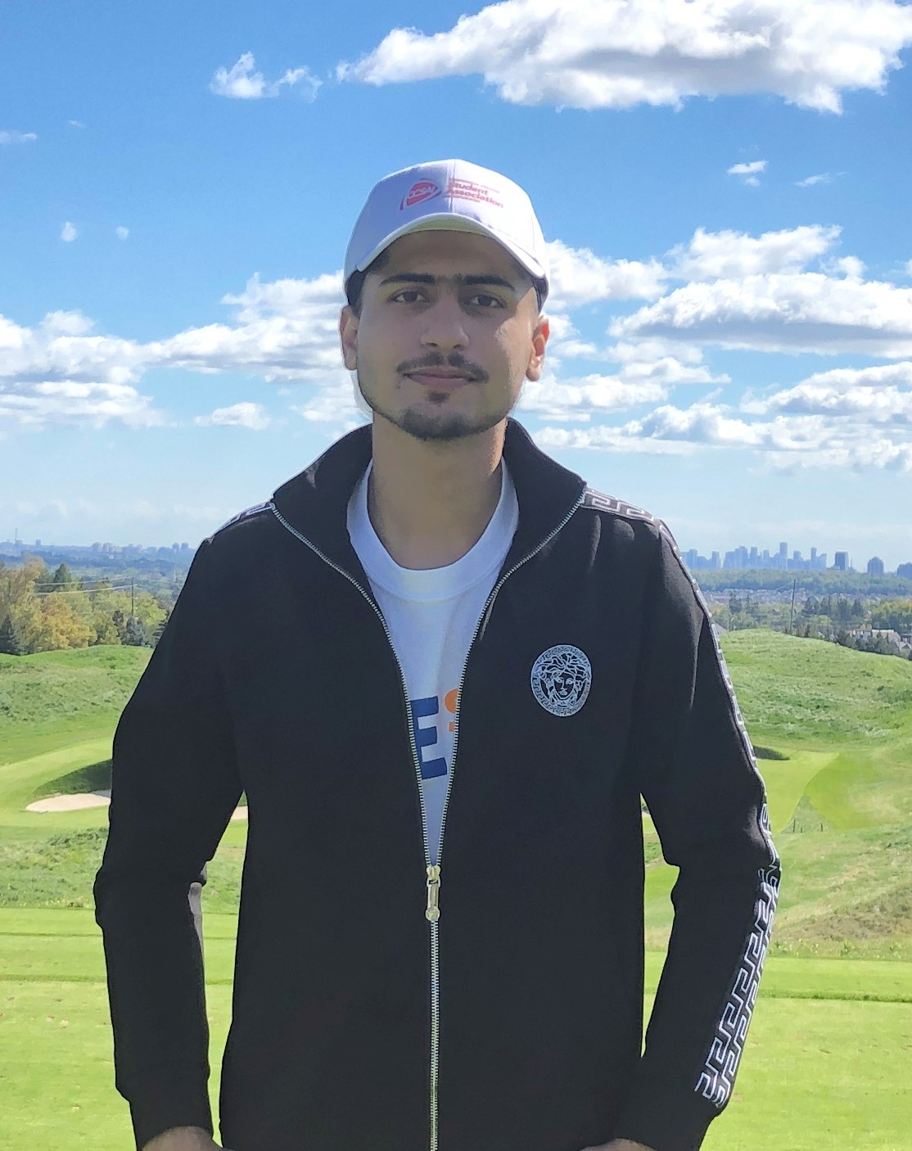
Name-Arshpreet Singh Student Id-301174738 Course code- COMP229 Course name- Web Application Development Midterm Test Fall 2021

