Slide 1
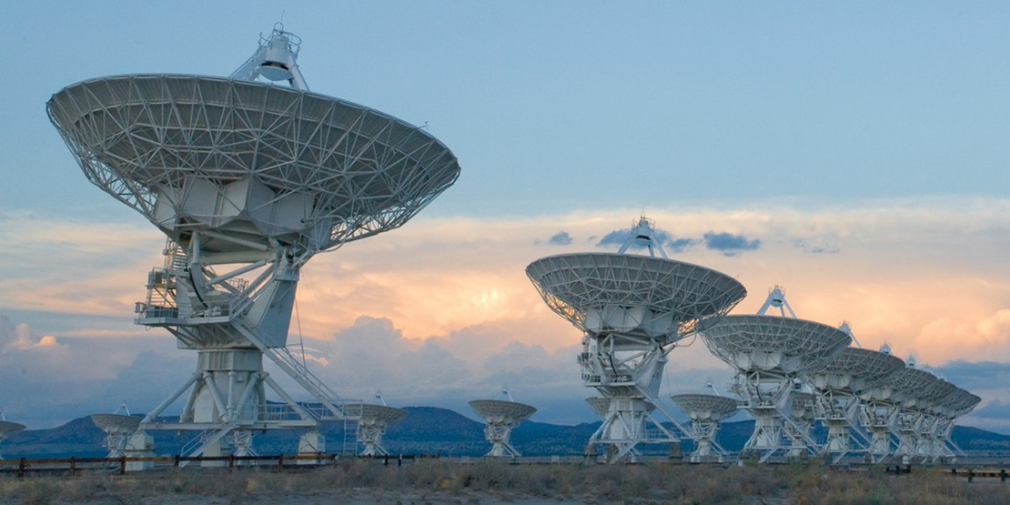
Compressed Sensing Image Reconstruction

Slide 2
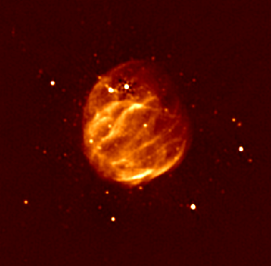
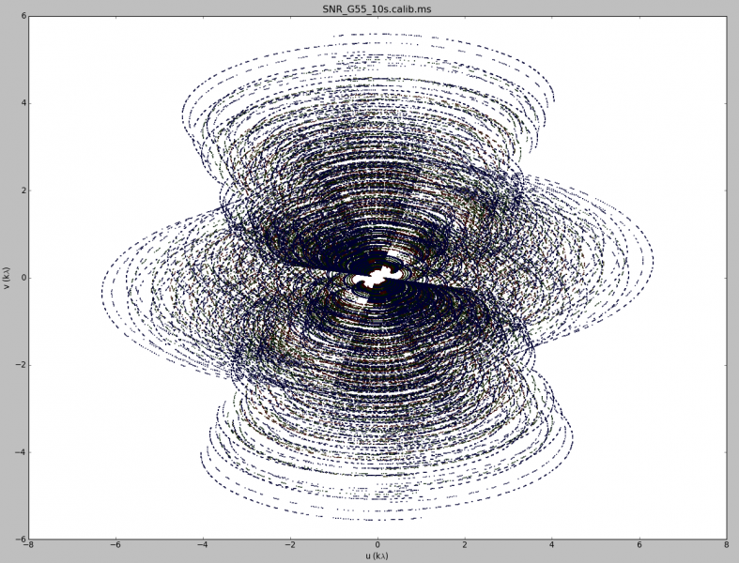
Image Reconstruction

Slide 3
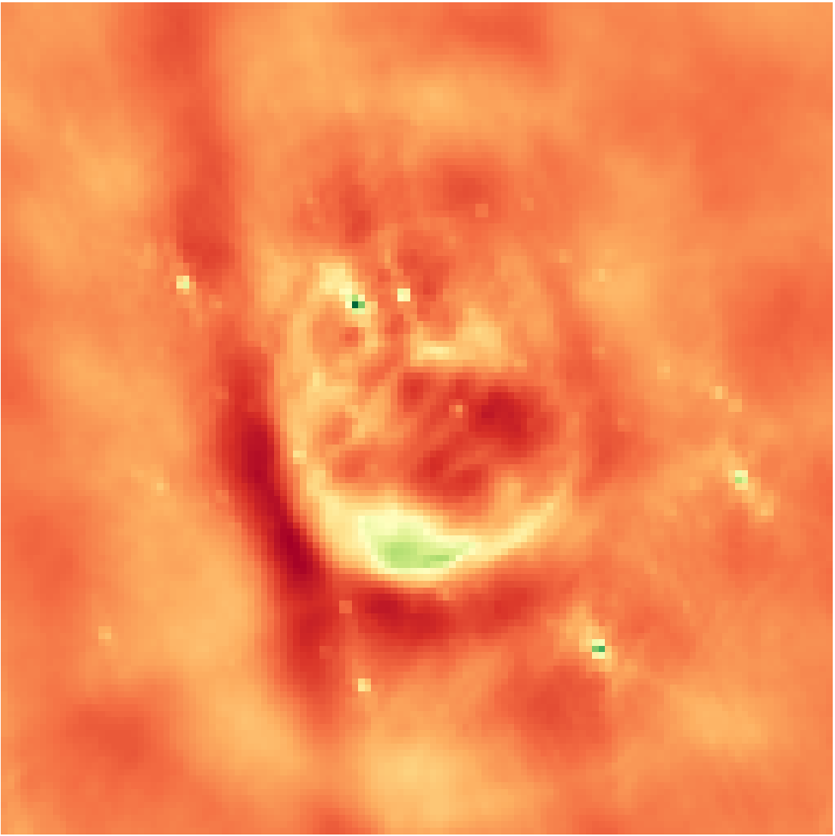
Inverse Fourier Transform
Notes:
Low resolution

Slide 4

Deconvolution
Notes:
From the theory of compressed sensing

Slide 5
CLEAN

Slide 6
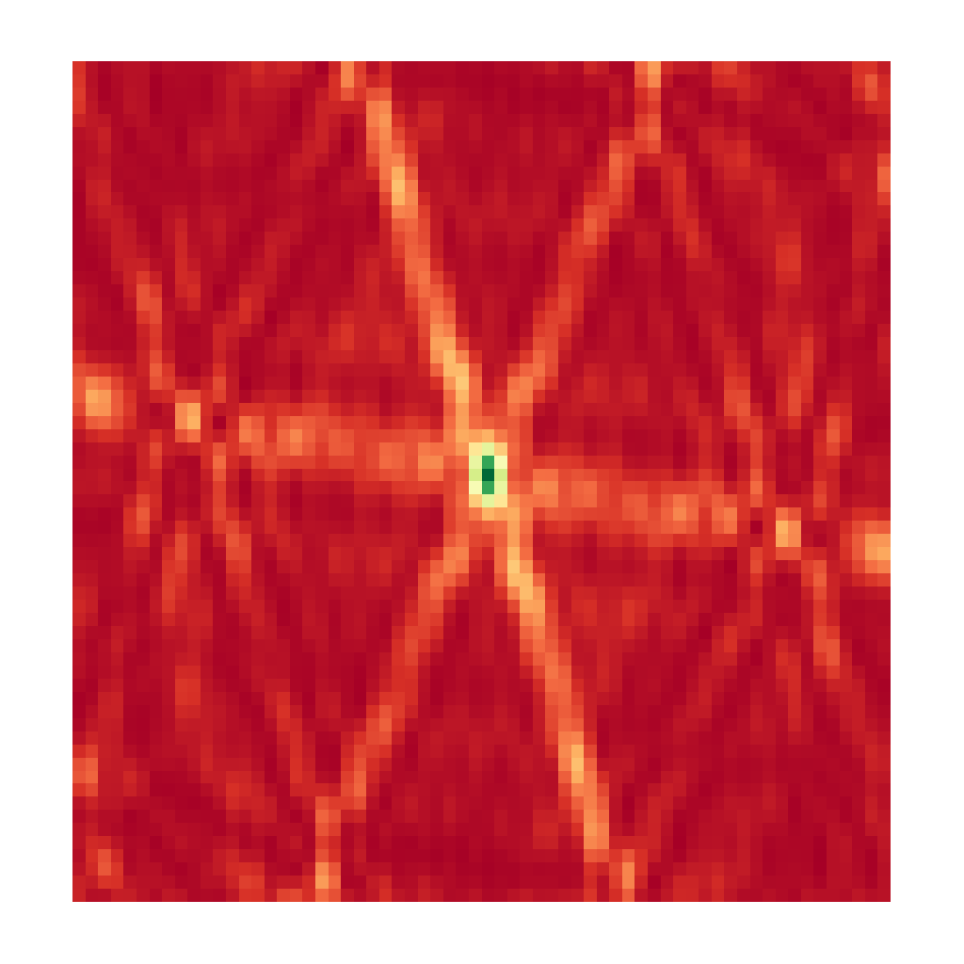
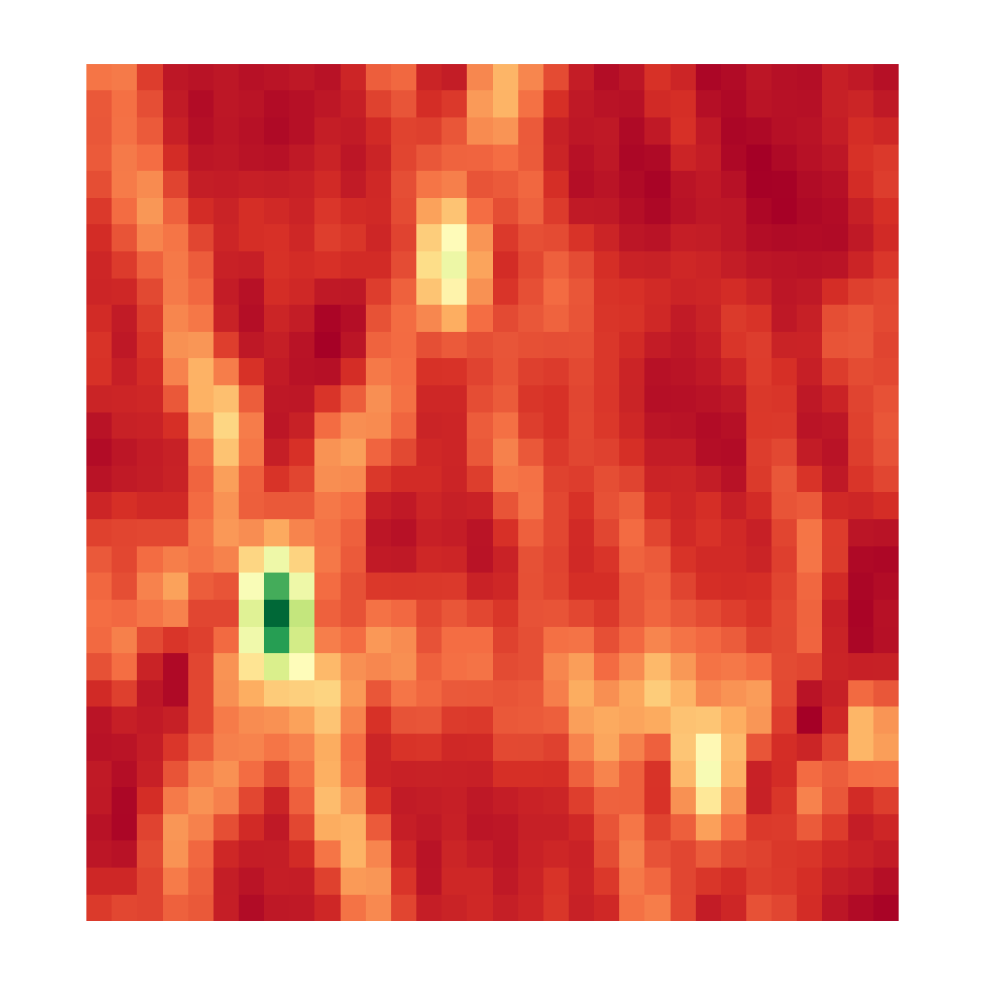

CLEAN, Iteration 0
Dirty Image
Model Image

Slide 7
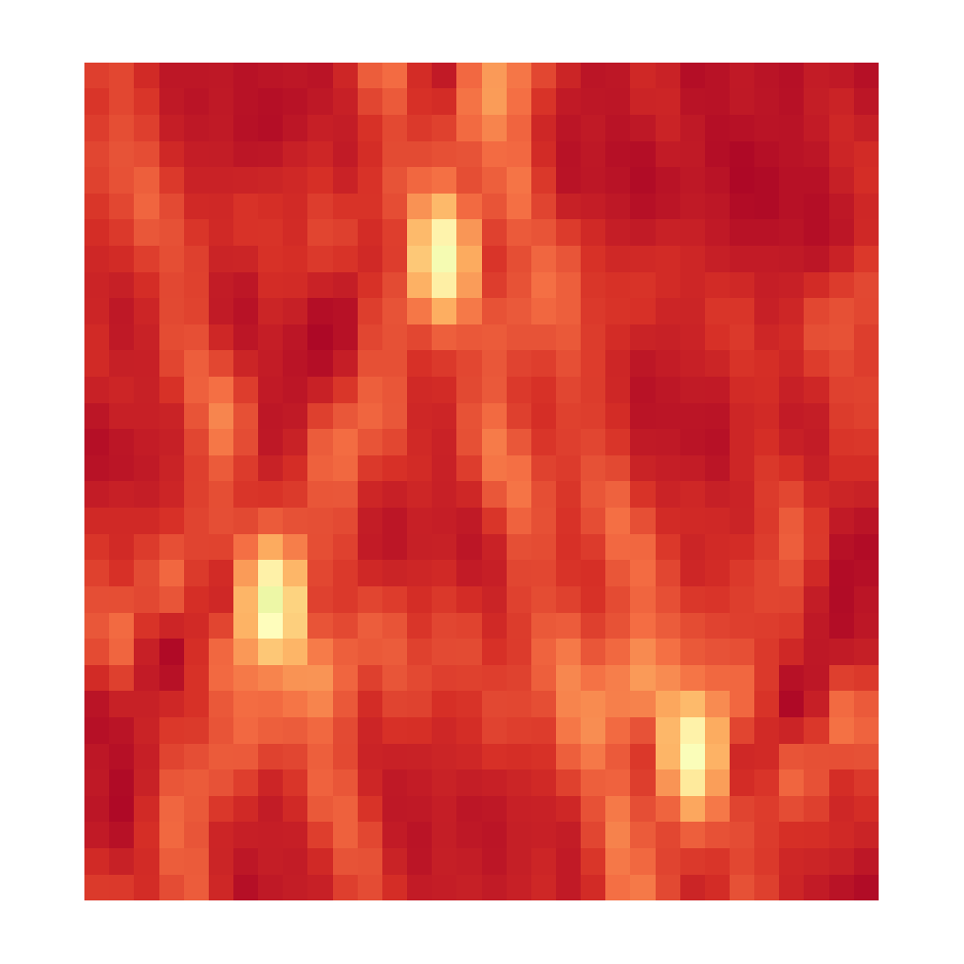

CLEAN, Iteration 1
Dirty Image
Model Image

Slide 8
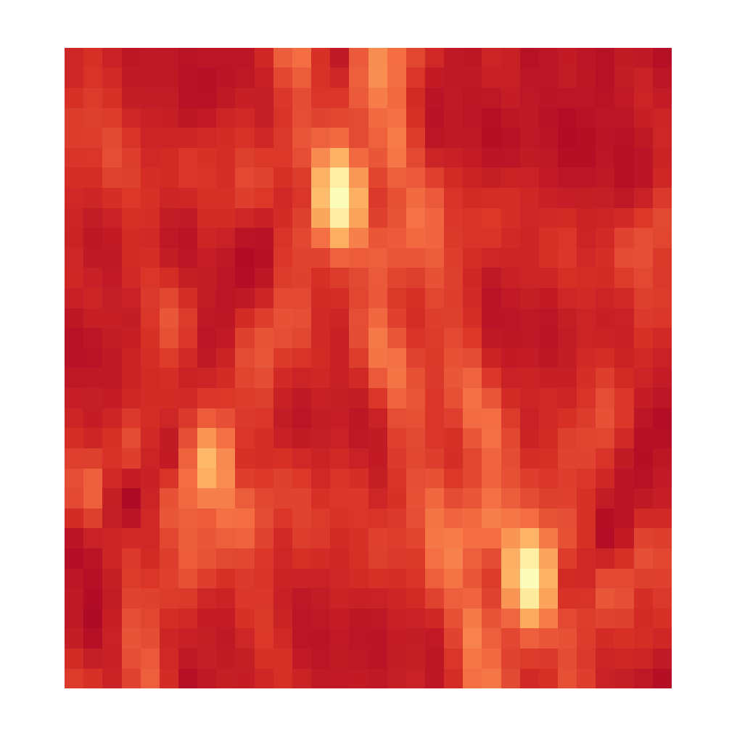

CLEAN, Iteration 2
Dirty Image
Model Image

Slide 9
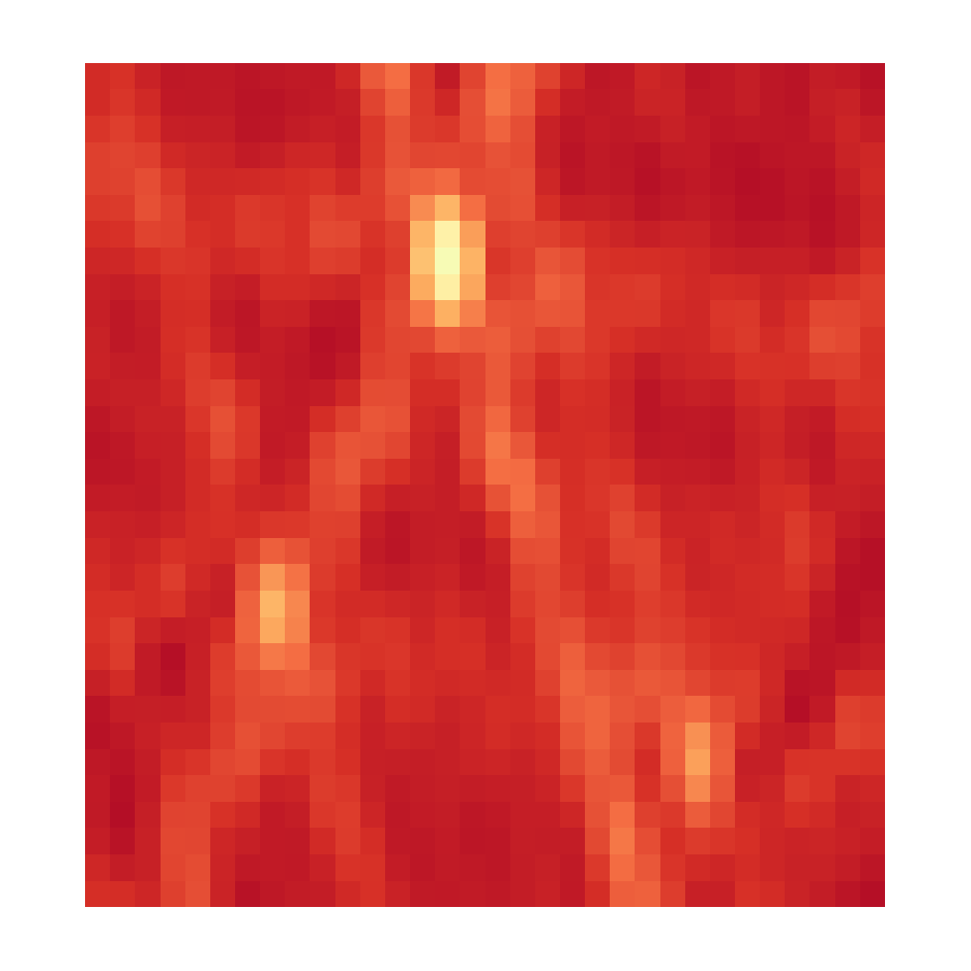

CLEAN, Iteration 3
Dirty Image
Model Image

Slide 10
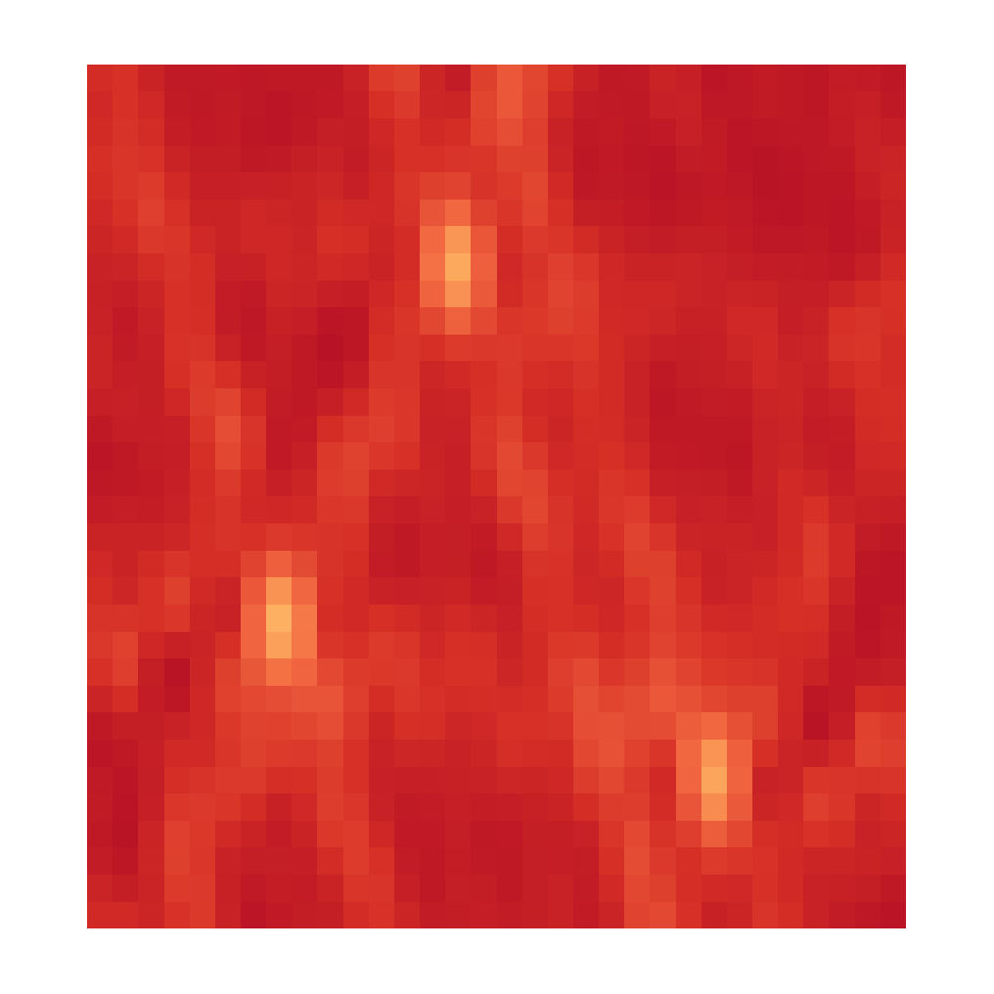

CLEAN, Iteration 4
Dirty Image
Model Image

Slide 11


CLEAN, Iteration X
Dirty Image
Model Image

Slide 12
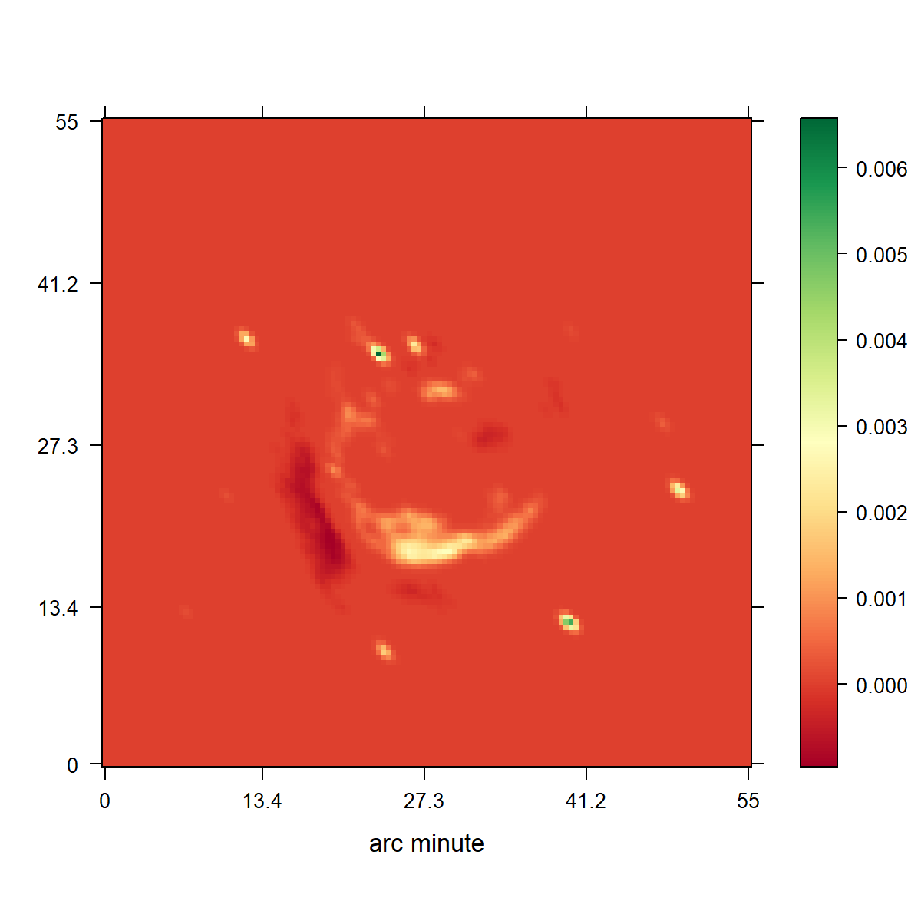
CLEAN
Notes:
Low resolution

Slide 13
CLEAN

Slide 14
Compressed Sensing

Slide 15
Regularizations
L0
L1
L2
Total Variation
L1 + L2
Haar Wavelets
Starlets
…

Slide 16
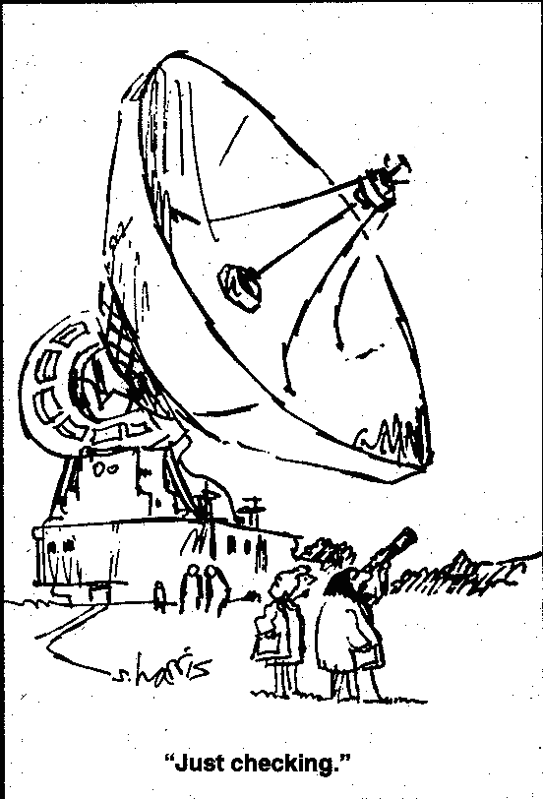

Slide 17
10s VLA Observation
RAO Reconstruction
Notes:
Low resolution

Slide 18
Regularizations
Non negativity

Slide 19
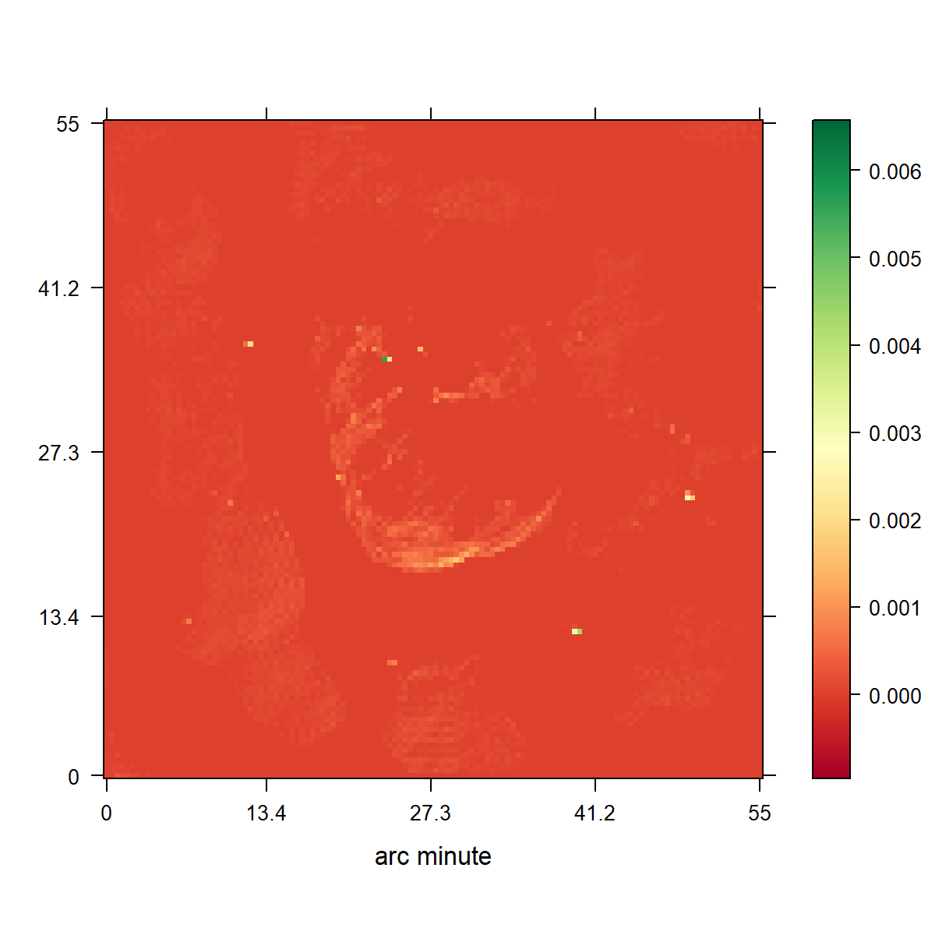
CLEAN
L1 Regularization

Slide 20
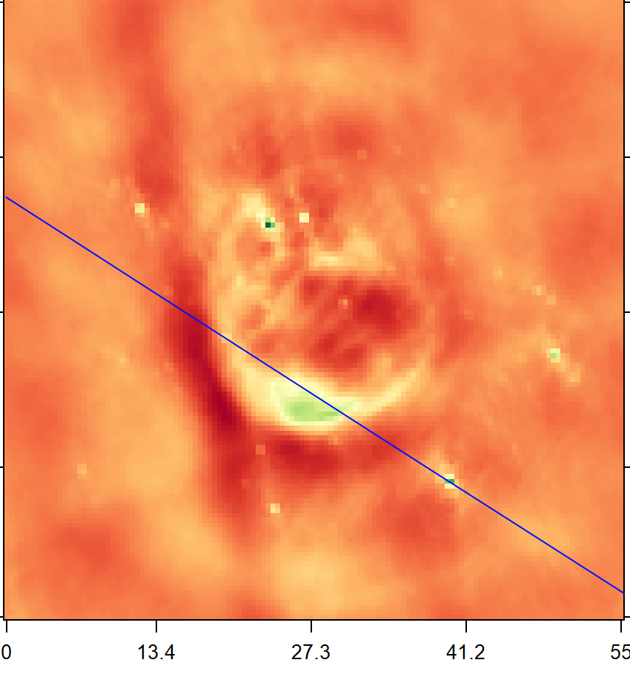
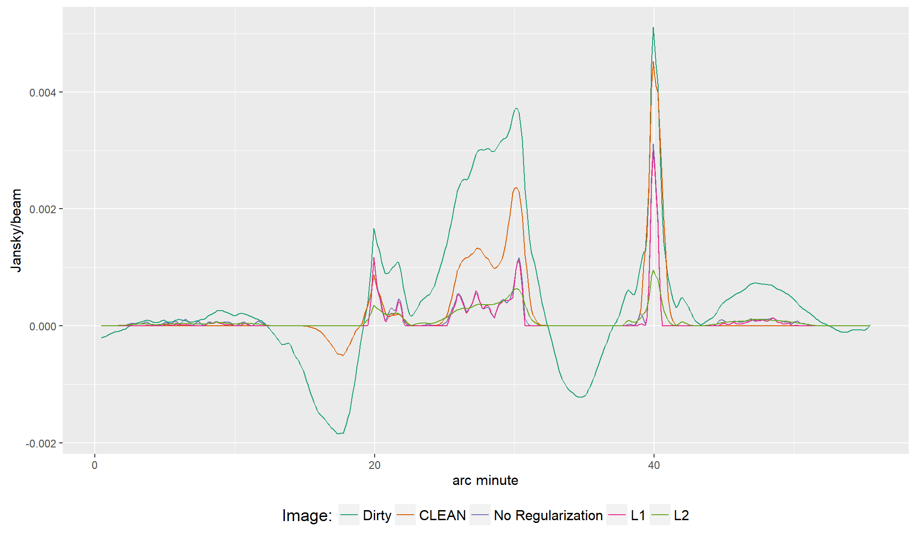

Slide 21
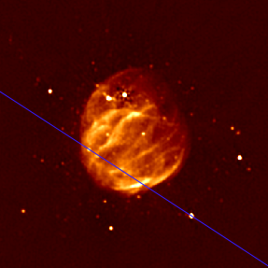

Slide 22
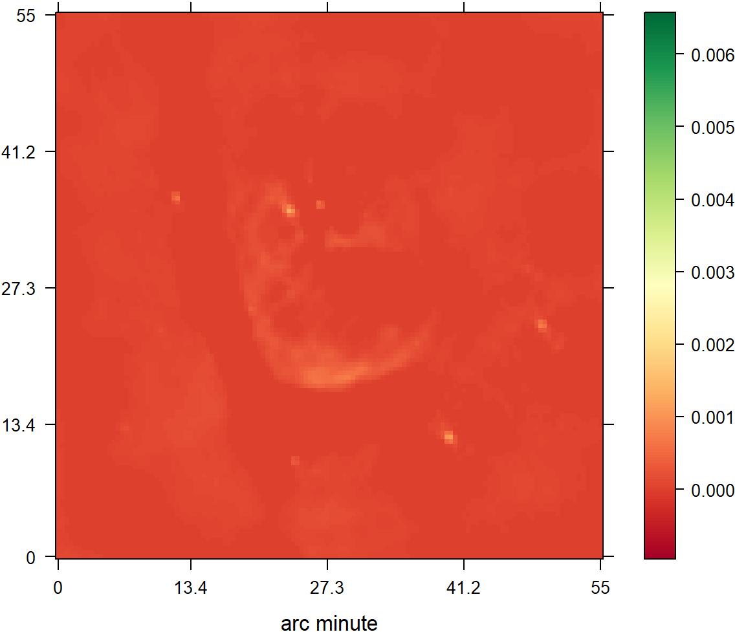
CLEAN
L2 Regularization

Slide 23
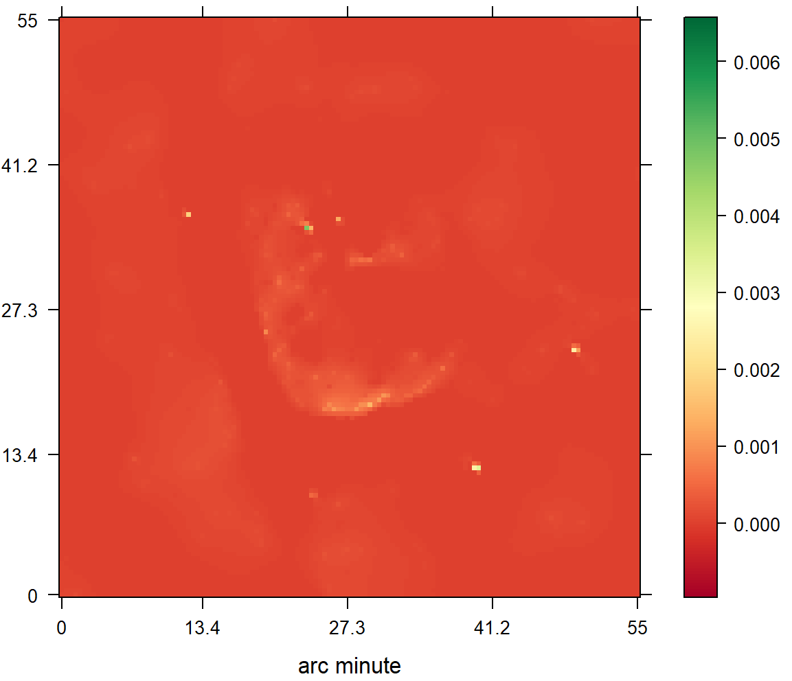
CLEAN
L2 Regularization

Slide 25
Conclusion

Slide 28
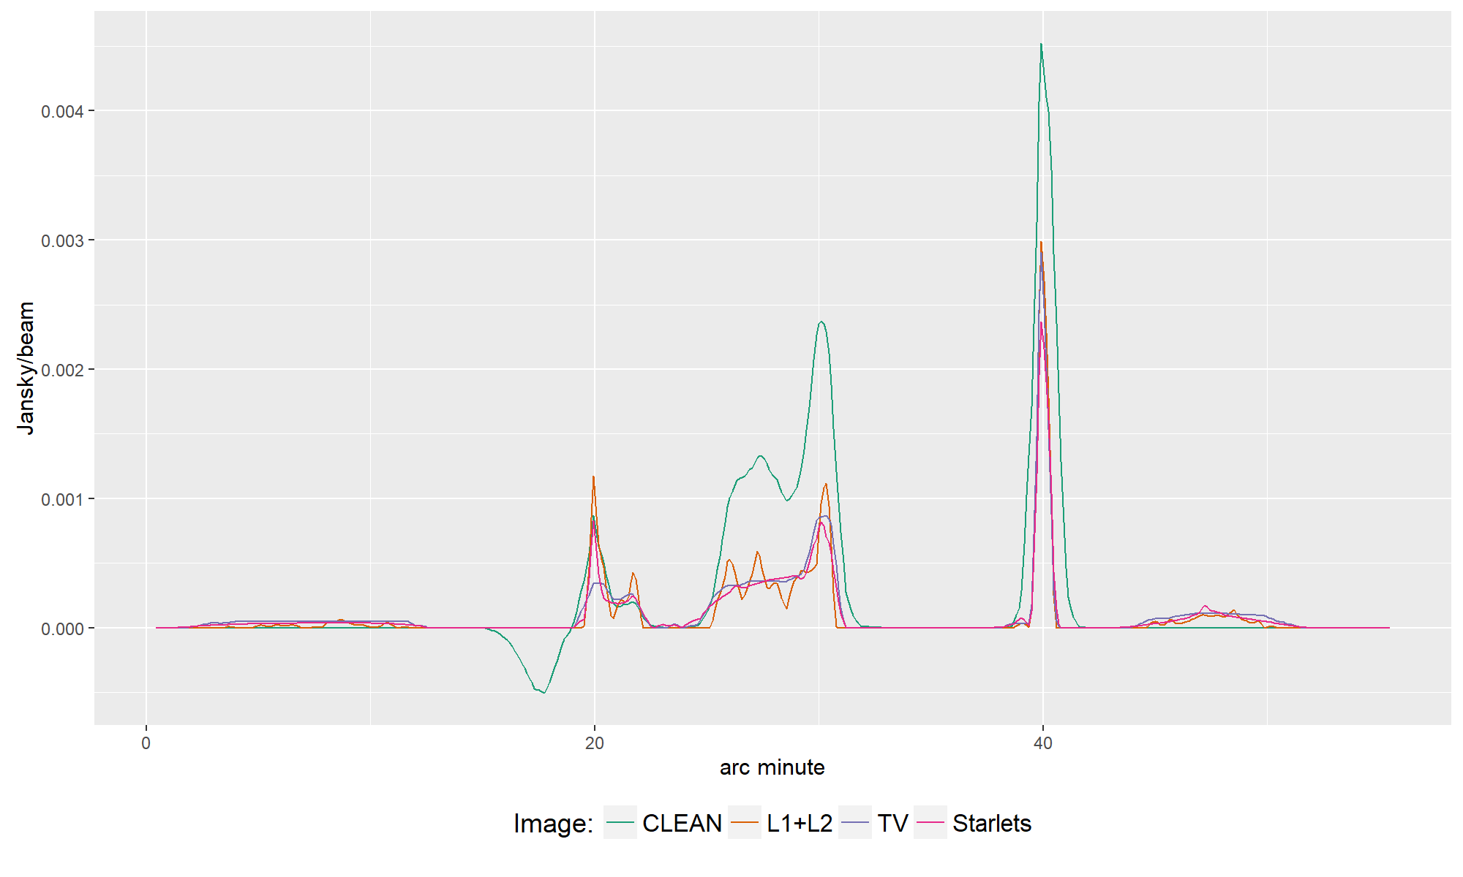

Slide 29
Compressed Sensing

Slide 30
Compressed Sensing Image Reconstruction
Regularization that captures the image properties
Incoherent Measurement and Reconstruction spaces.

Slide 31
CLEAN as a Compressed Sensing Reconstruction
Notes:
Camera Pixels
Many samples, most contain no information

Slide 32
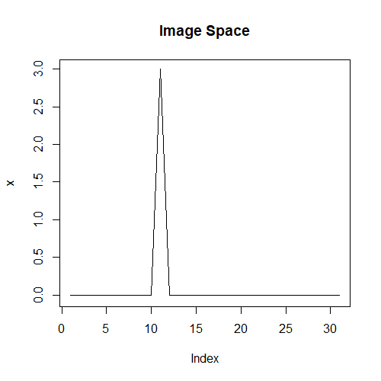
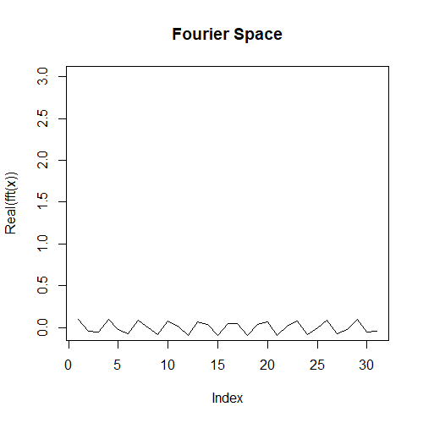
Incoherence

