Slide 1
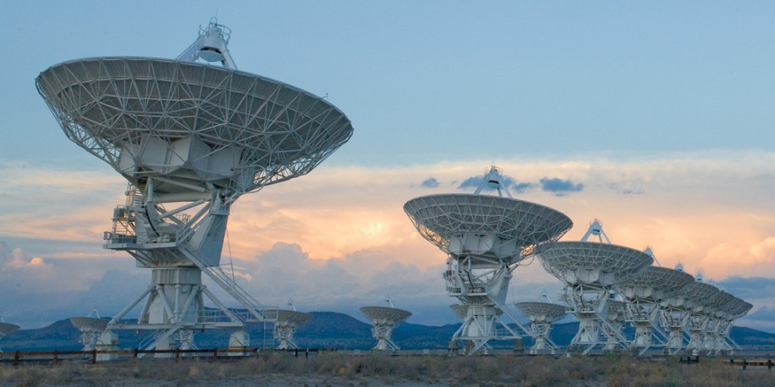
Compressed Sensing Image Reconstruction for CASA

Slide 2
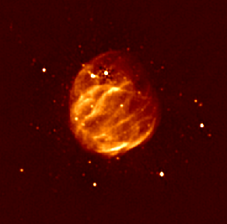
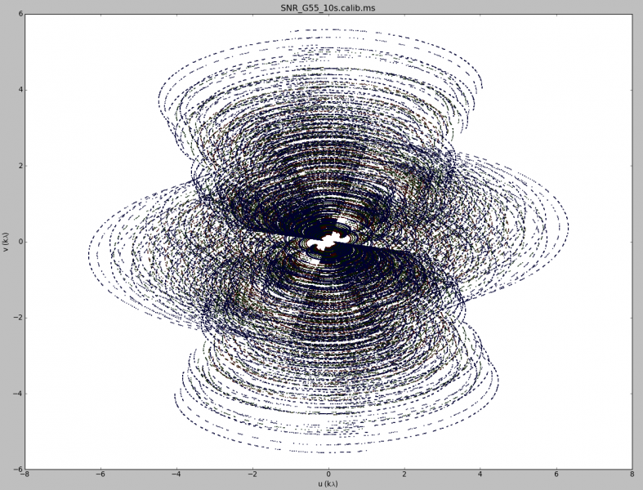
Image Reconstruction

Slide 3
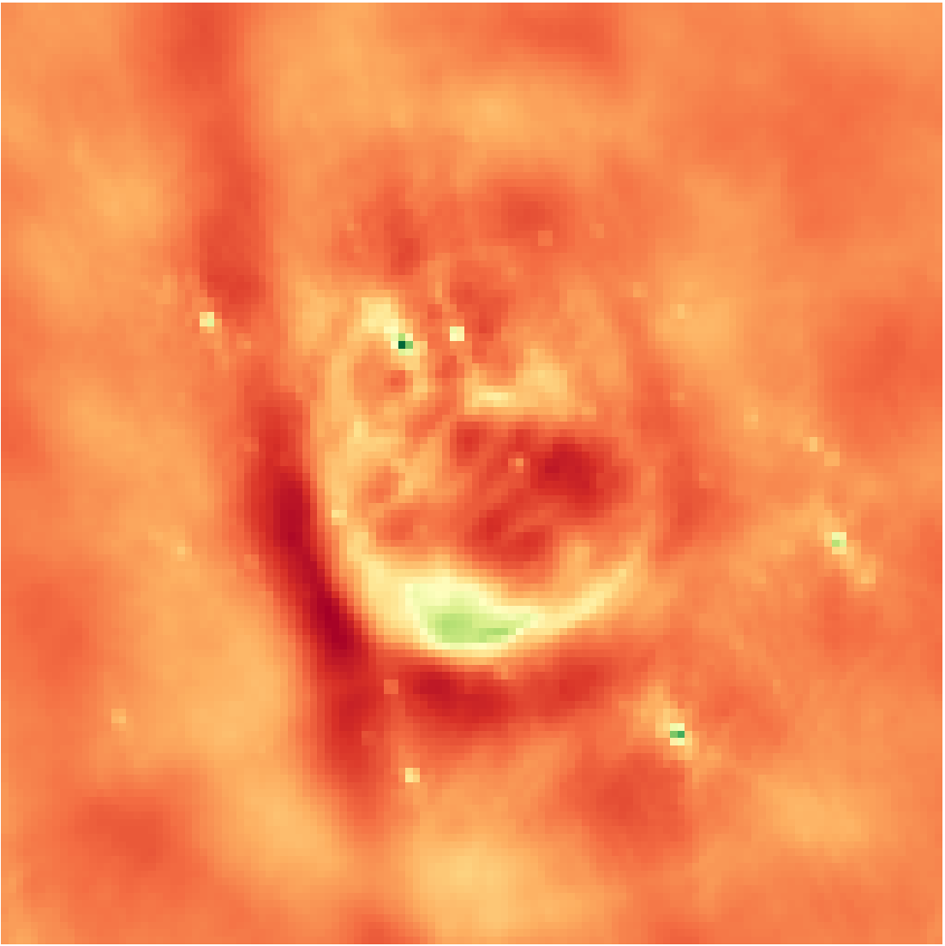
Inverse Fourier Transform
Notes:
Low resolution

Slide 4

Deconvolution
$$x∗PSF+N=I_{dirty}$$
Notes:
From the theory of compressed sensing

Slide 5
CLEAN
Find max

Slide 6
CLEAN
Find max

Slide 7
CLEAN
Chance that the x is the true image?

Slide 8
CLEAN as a Compressed Sensing Reconstruction
Model map, all the information

Slide 9
CLEAN as a Compressed Sensing Reconstruction
Incoherence

Slide 10
CLEAN as a Compressed Sensing Reconstruction

Slide 11
Compressed Sensing

Slide 12
CLEAN

Slide 13
CLEAN as a special case of Compressed Sensing

Slide 14
Super Resolution

Slide 15
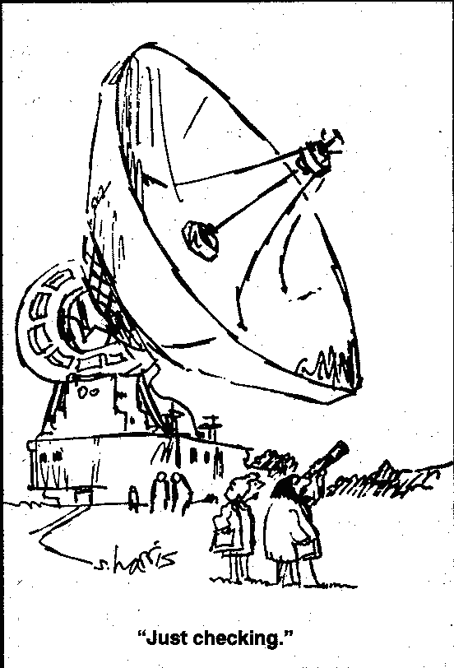
The Problem with Super Resolution…

Slide 16
10 Second Observation Unknown Reconstruction NRAO
Notes:
Low resolution

Slide 17
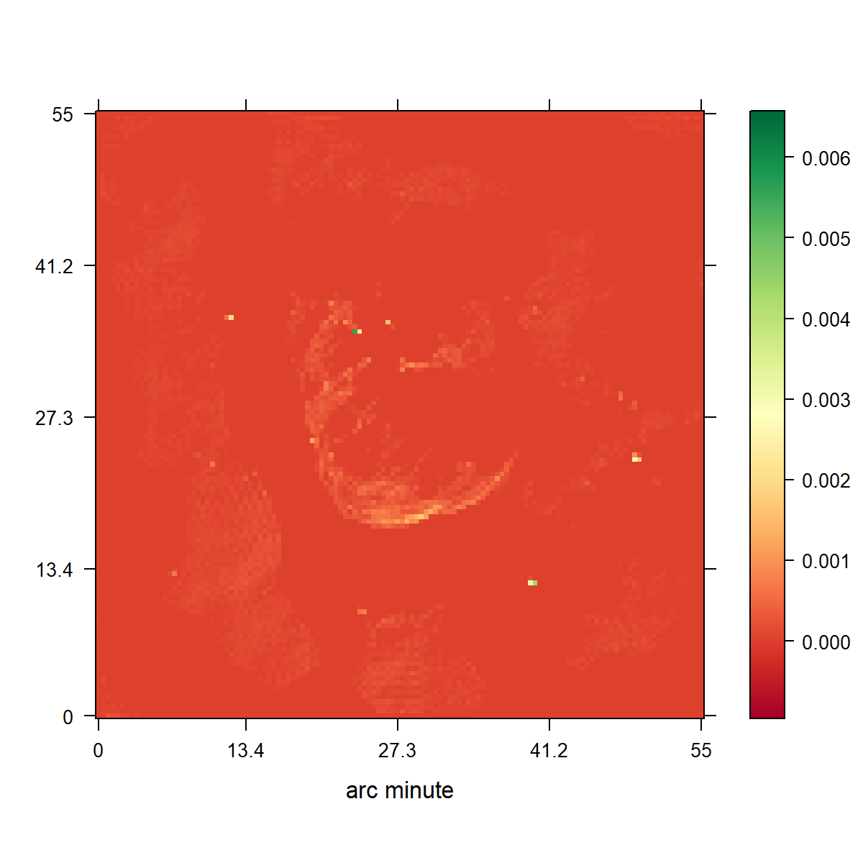
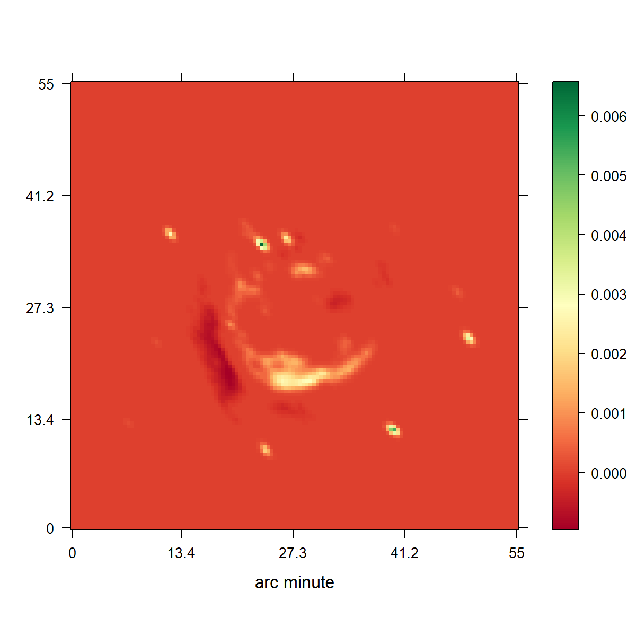
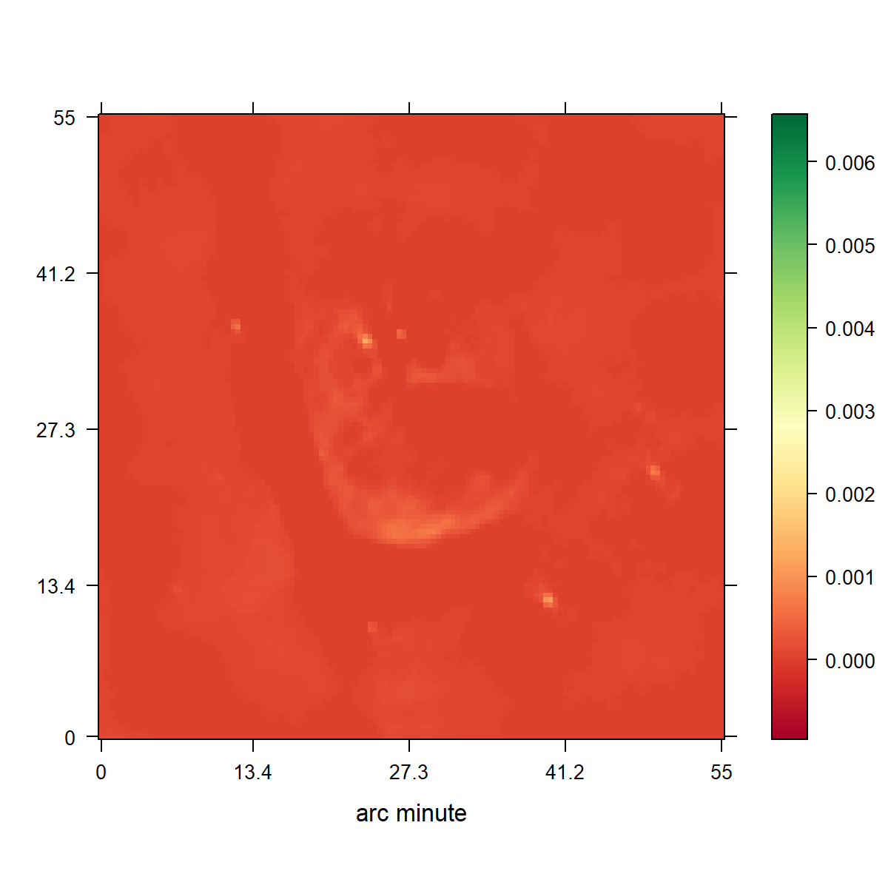
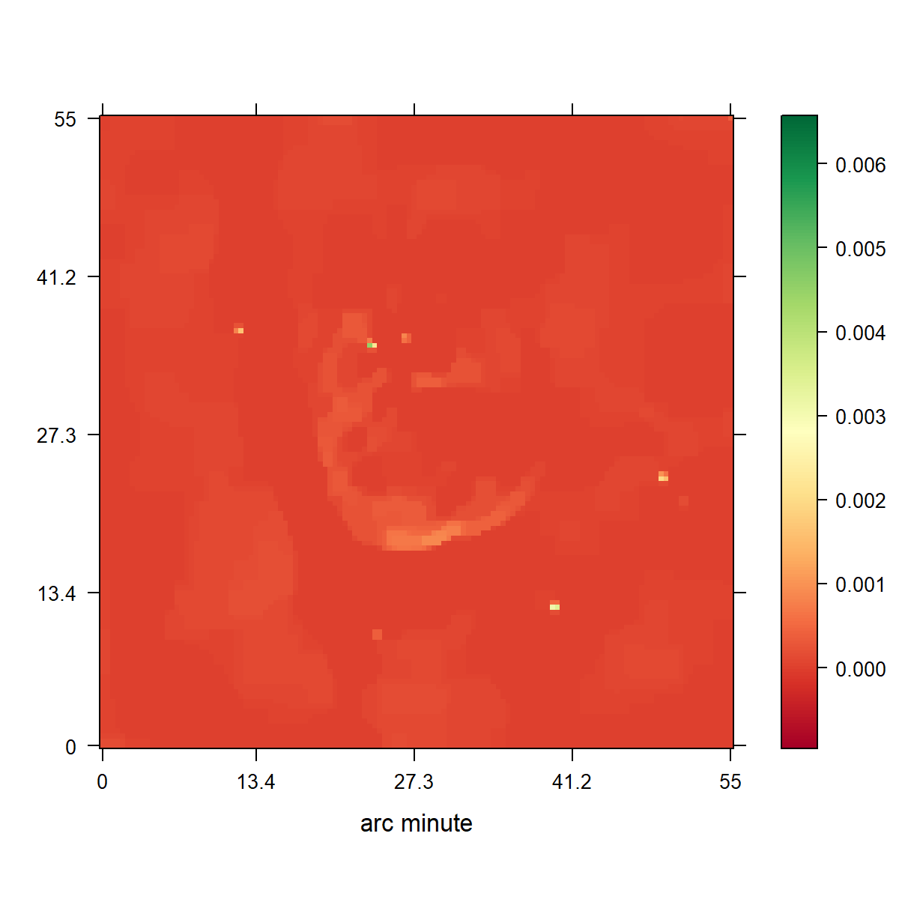

Slide 19
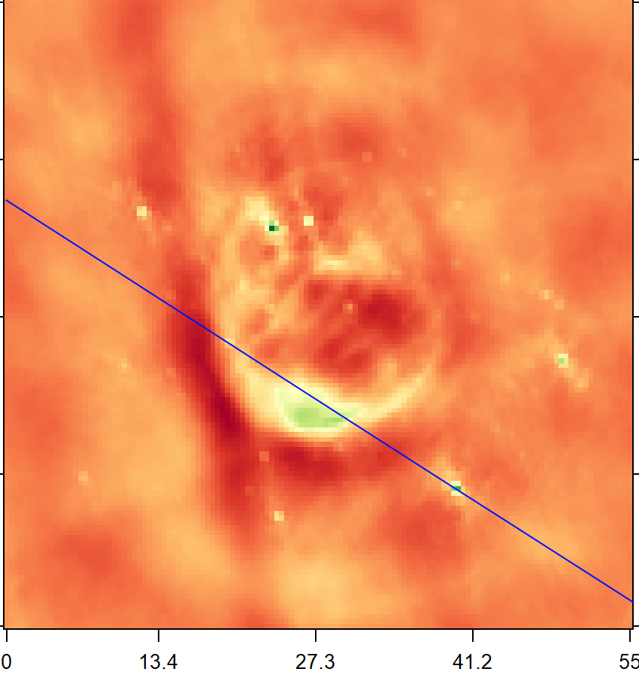
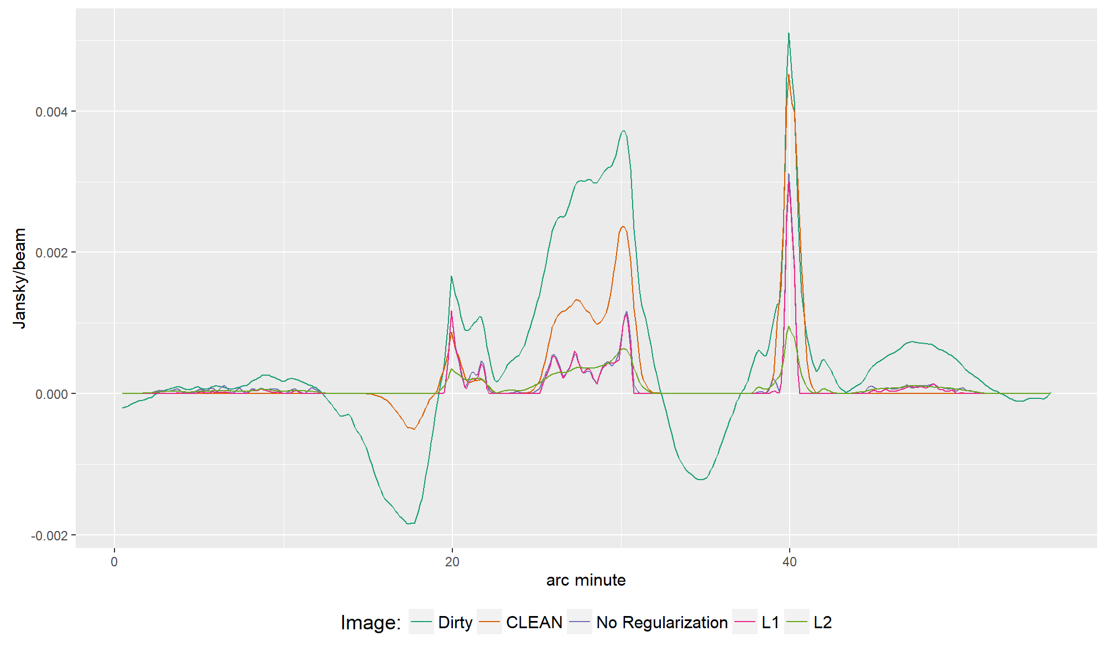

Slide 20
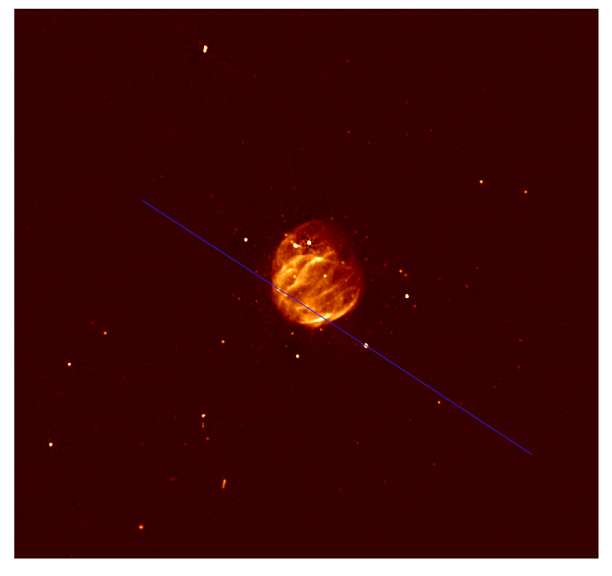

Slide 22
Conclusion

Slide 23
Conclusion

