Slide 1
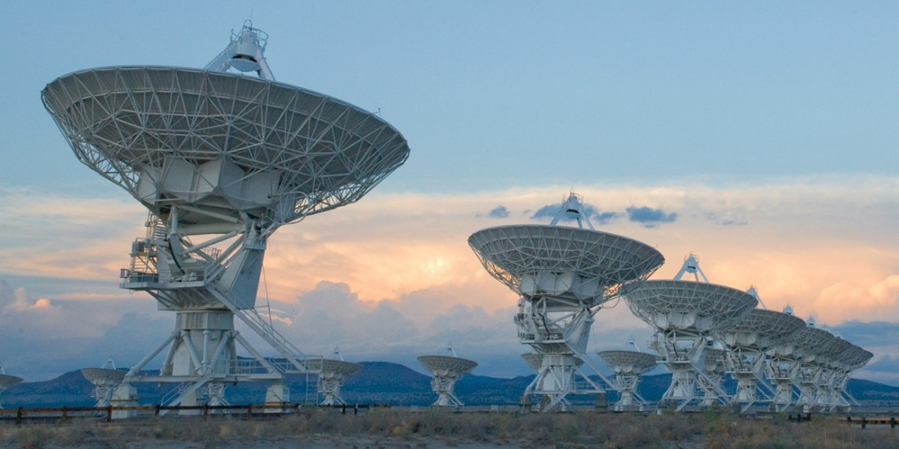
Compressed Sensing Image Reconstruction for CASA

Slide 2
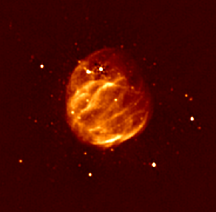
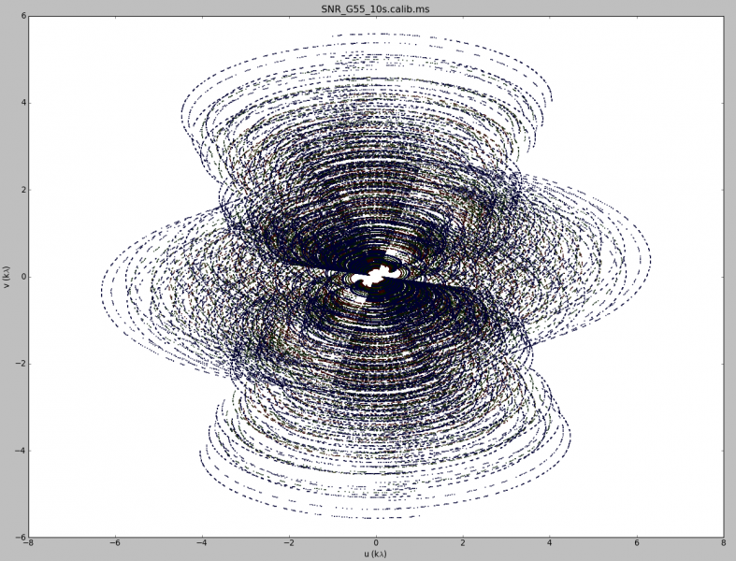
Image Reconstruction

Slide 3
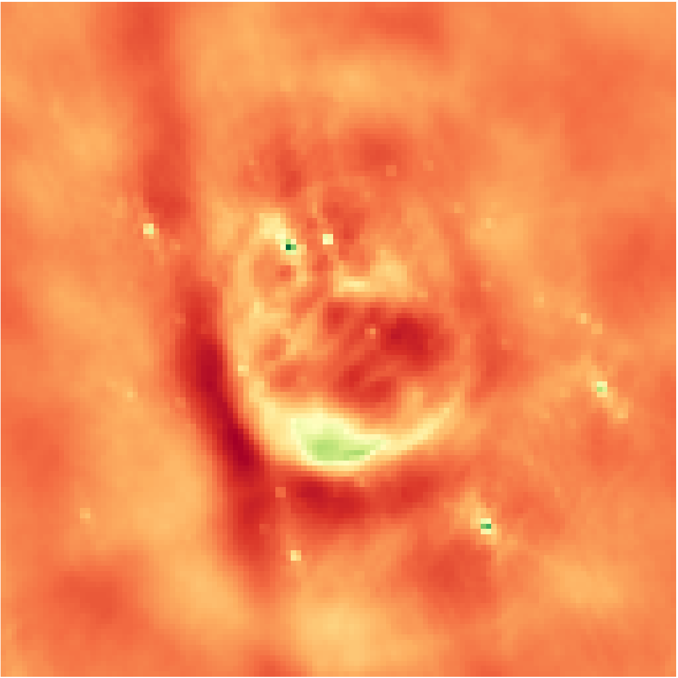
Inverse Fourier Transform
Notes:
Low resolution

Slide 4

Deconvolution
Notes:
From the theory of compressed sensing

Slide 5
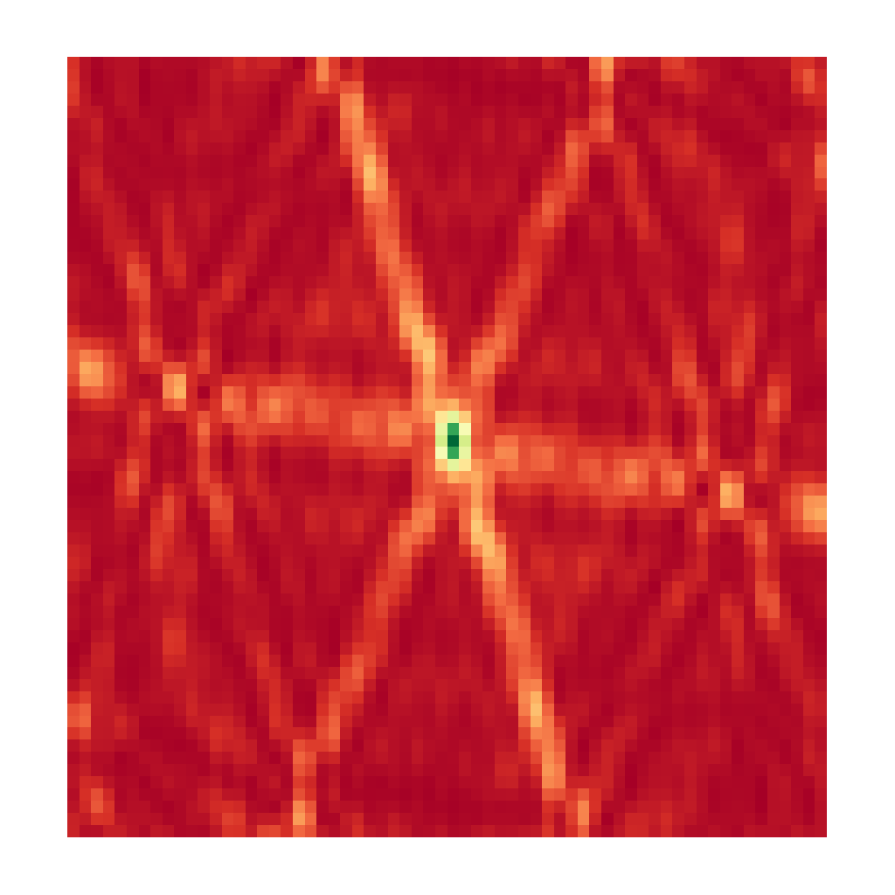
CLEAN

Slide 6
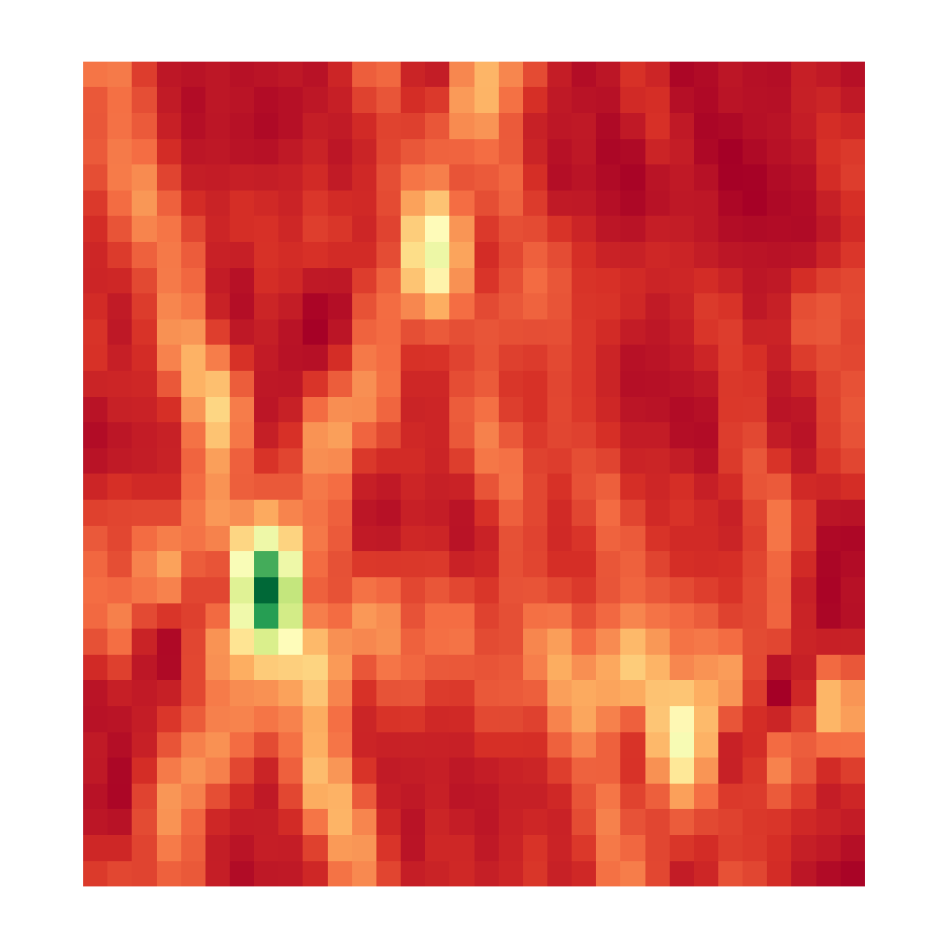

CLEAN, Iteration 0
Dirty Image
Model Image

Slide 7
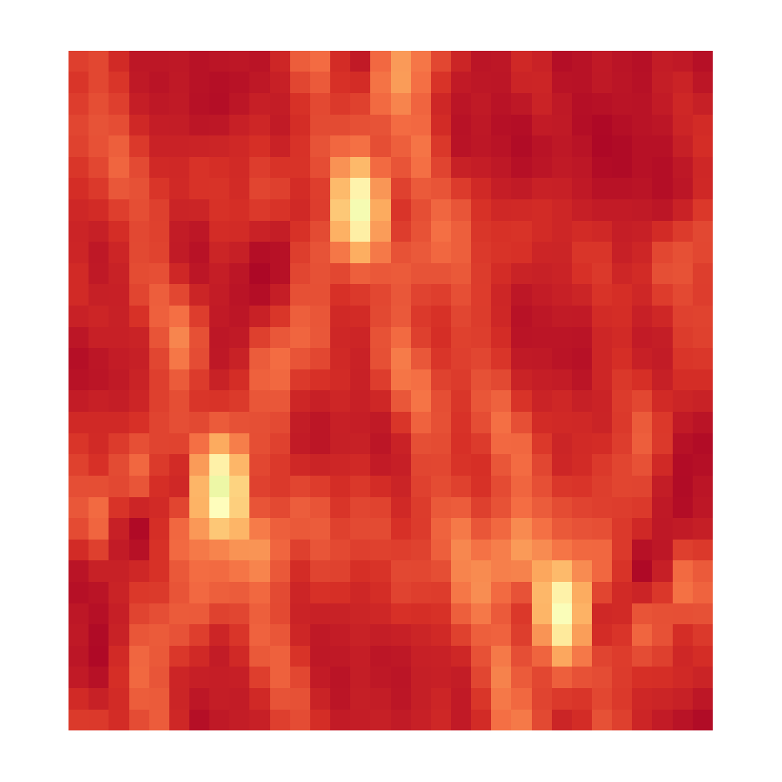

CLEAN, Iteration 1
Dirty Image
Model Image

Slide 8
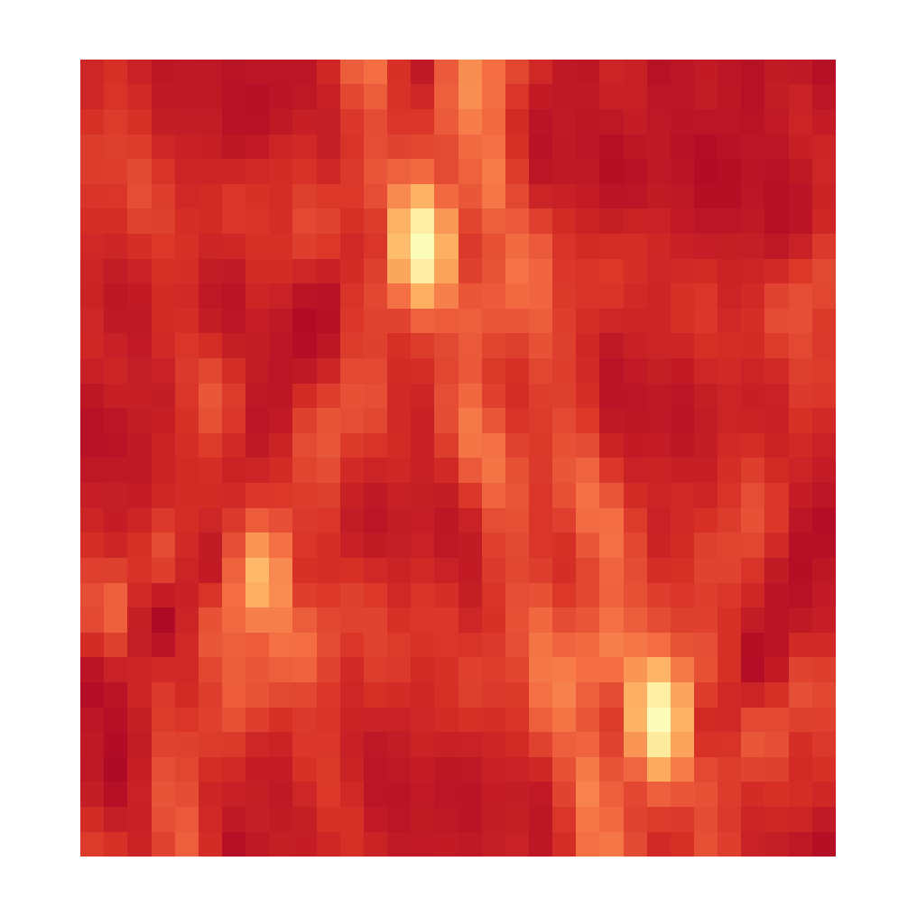

CLEAN, Iteration 2
Dirty Image
Model Image

Slide 9
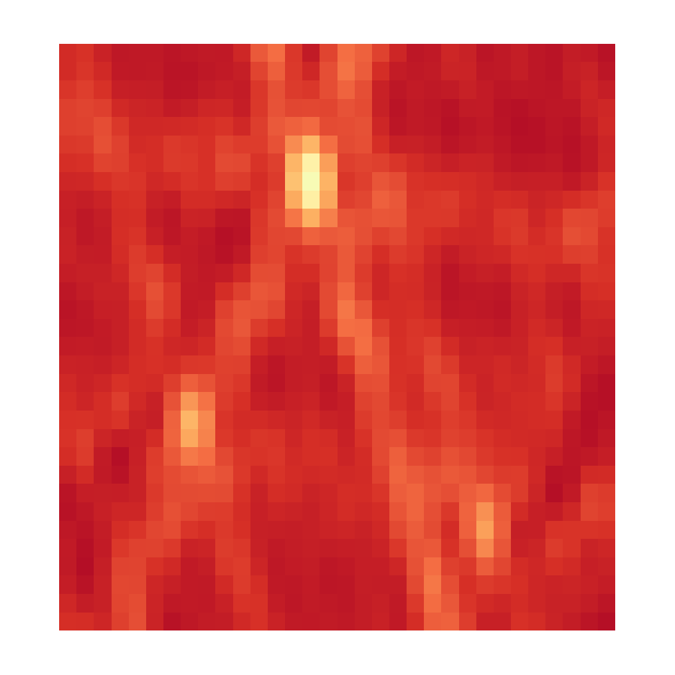

CLEAN, Iteration 3
Dirty Image
Model Image

Slide 10
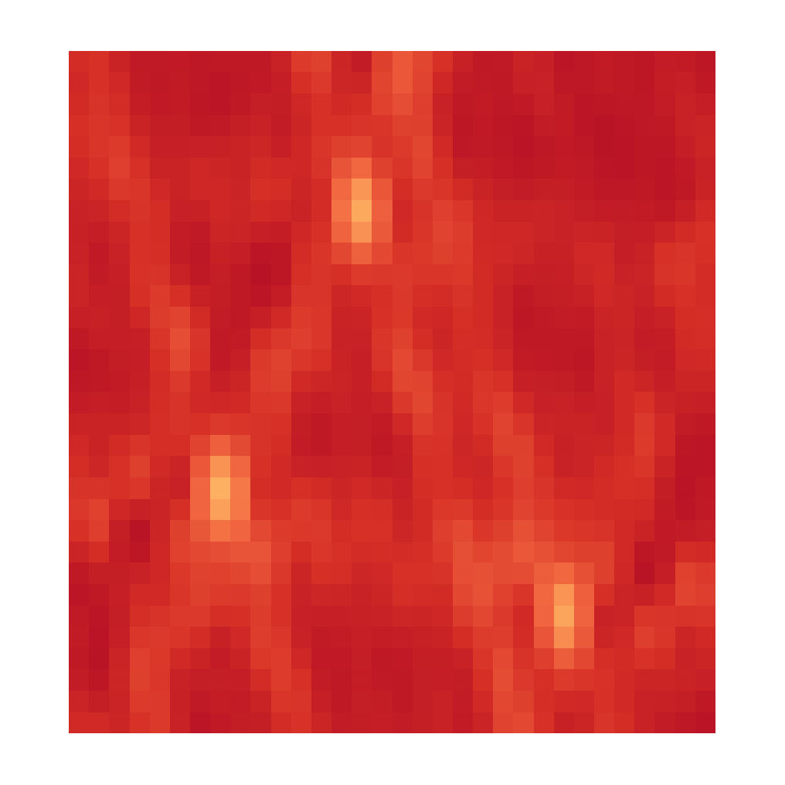

CLEAN, Iteration 4
Dirty Image
Model Image

Slide 11


CLEAN, Iteration X
Dirty Image
Model Image

Slide 12
CLEAN

Slide 13
CLEAN as a Compressed Sensing Reconstruction

Slide 14
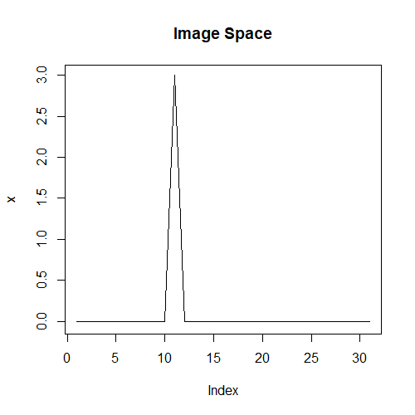
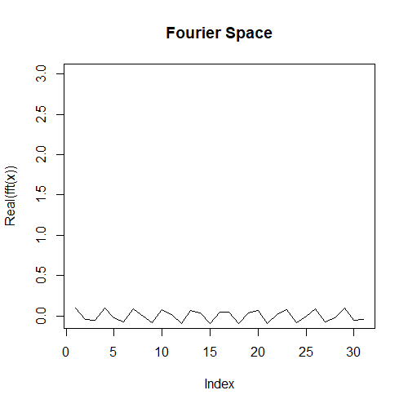
Incoherence

Slide 15
CLEAN as a Compressed Sensing Reconstruction
Number of measurements depends on the sparse pixels

Slide 16
CLEAN

Slide 17
Compressed Sensing

Slide 18
CLEAN as a special case of Compressed Sensing

Slide 19
Super Resolution

Slide 20
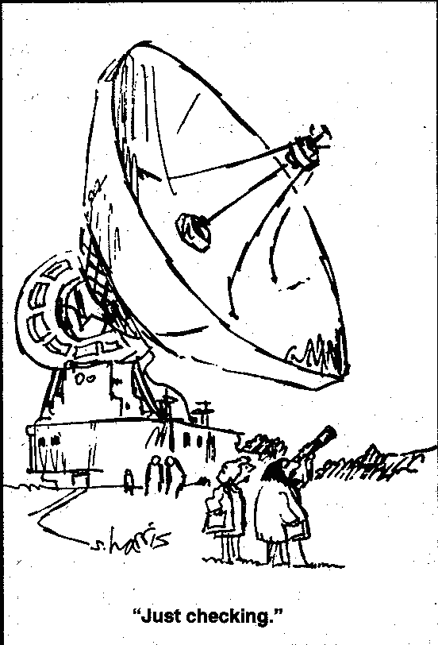
The Problem with Super Resolution…

Slide 21
10 Second Observation Unknown Reconstruction NRAO
Notes:
Low resolution

Slide 22
Regularizations
L1
L2
Total Variation
L1 + L2
Starlet

Slide 23
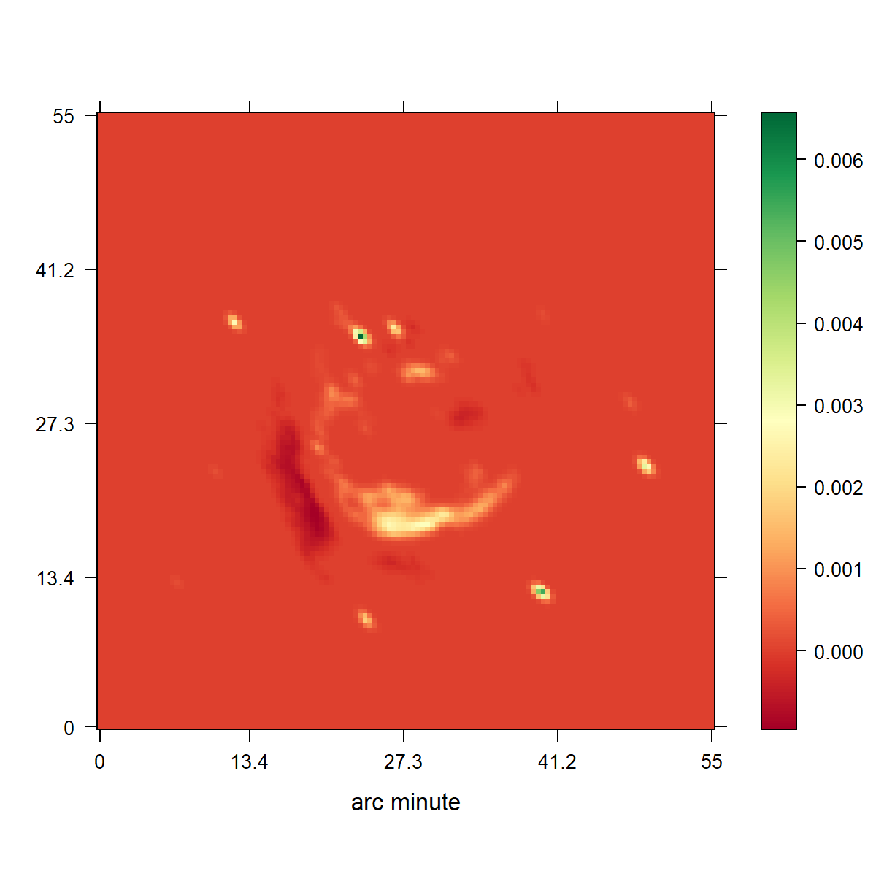
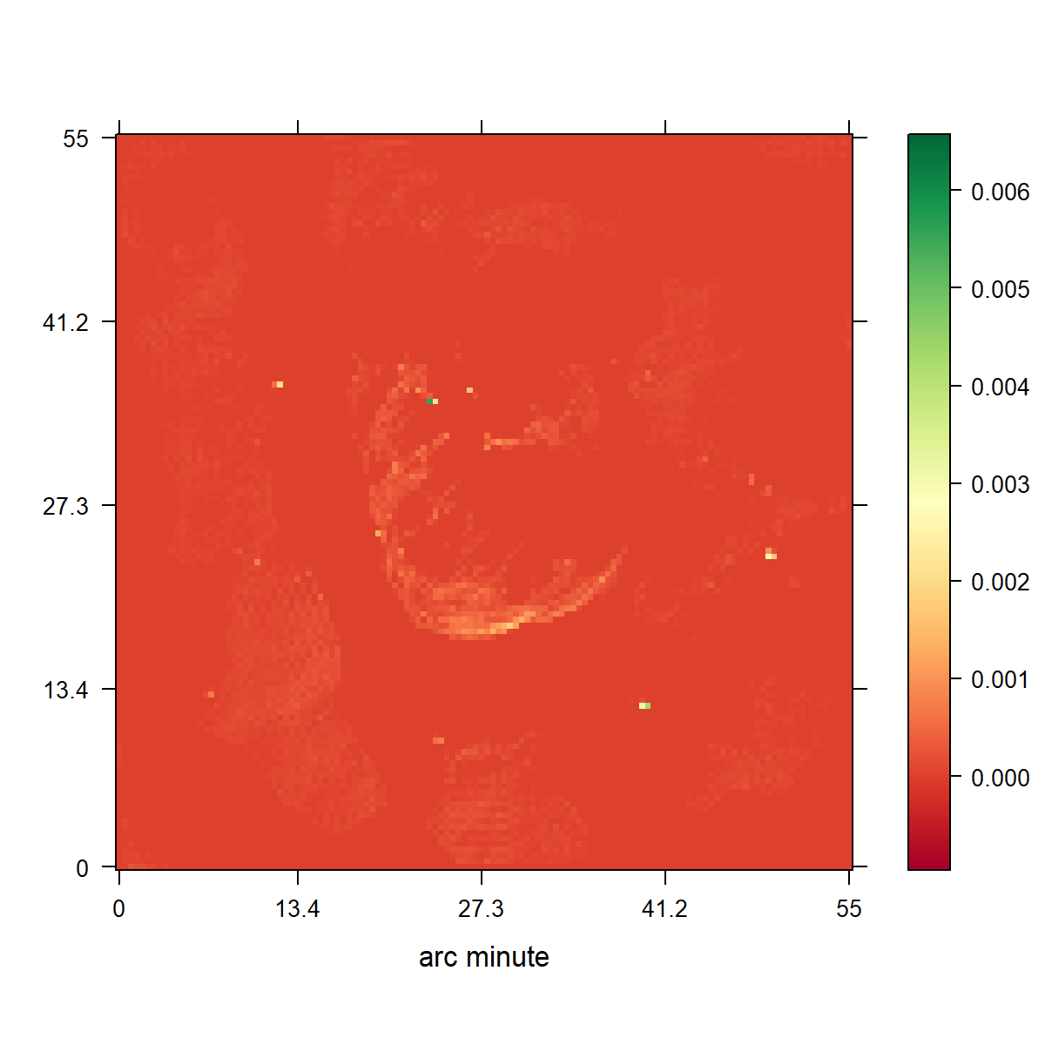
CLEAN
L1 Regulariyation

Slide 24
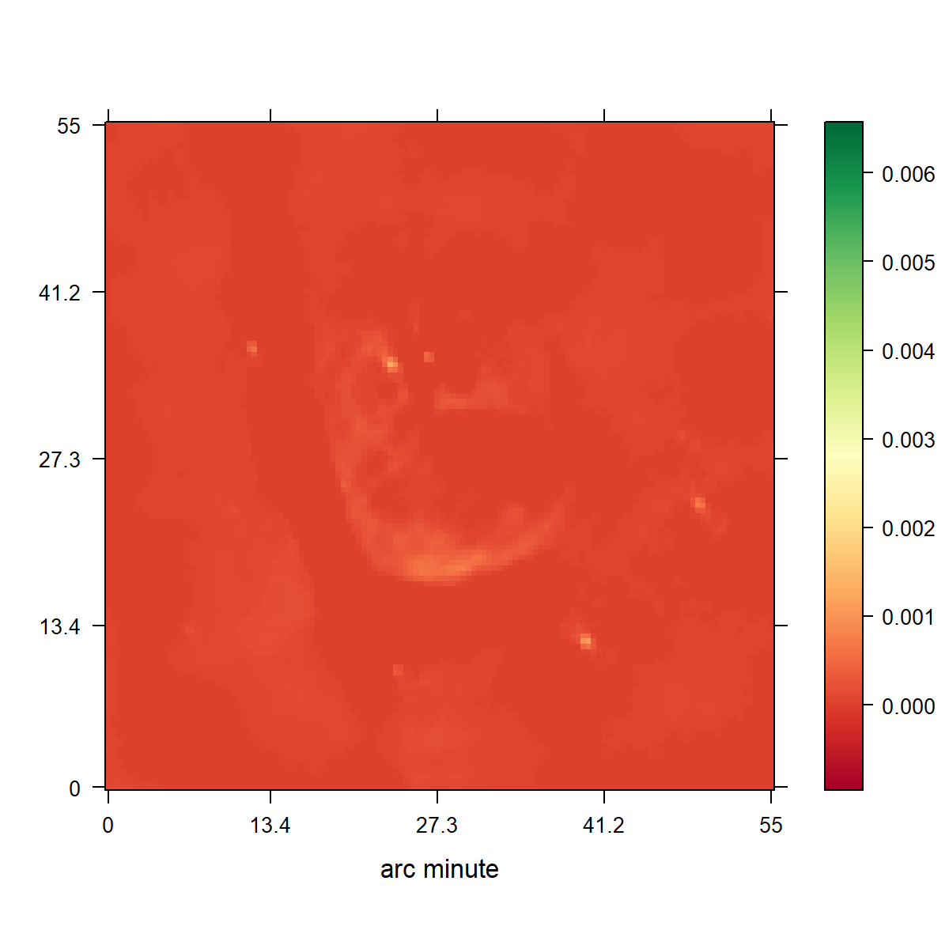
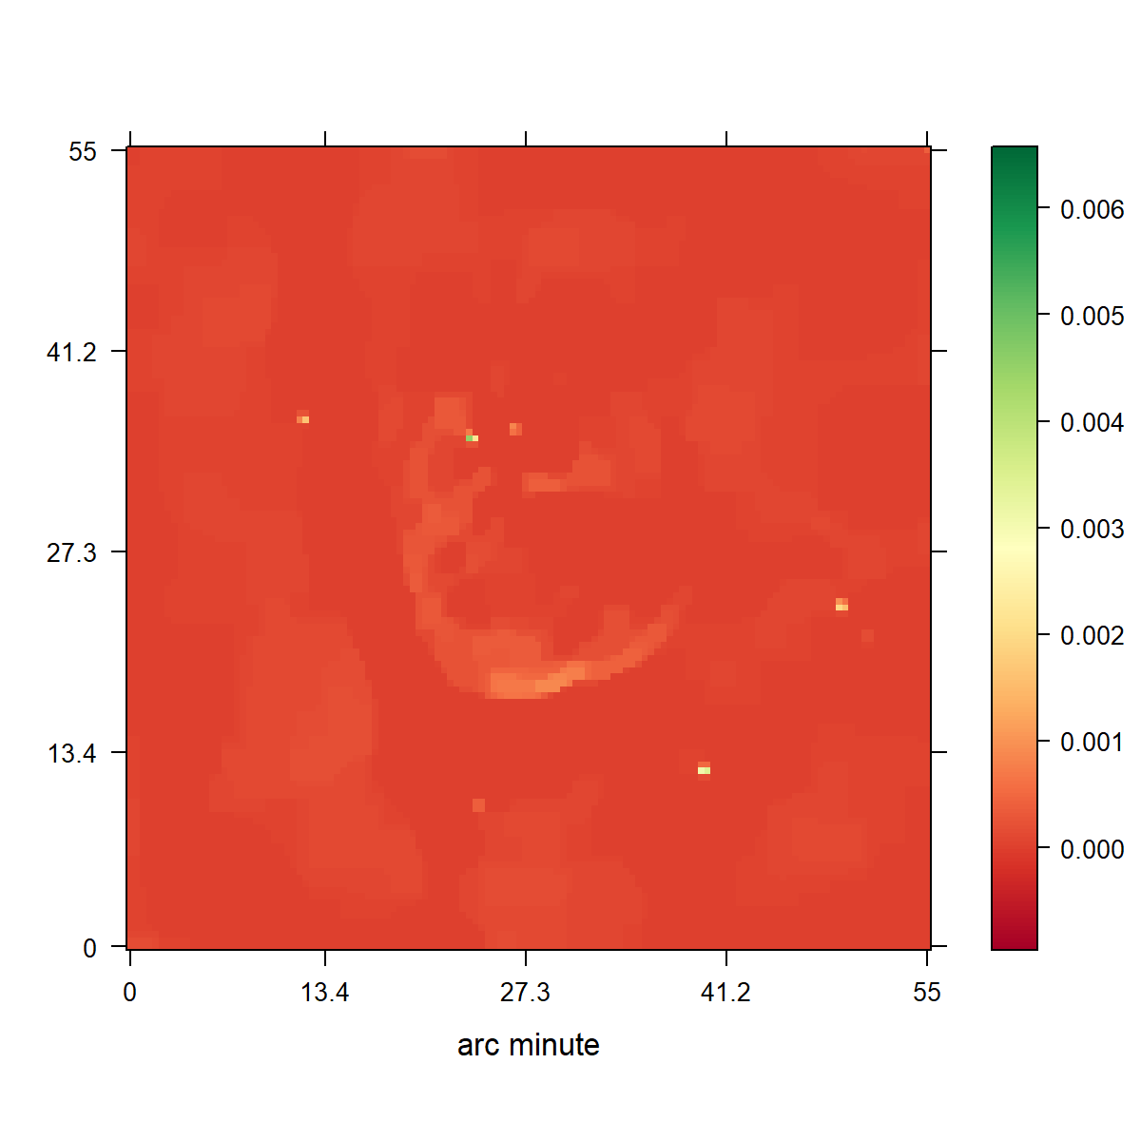

Slide 26
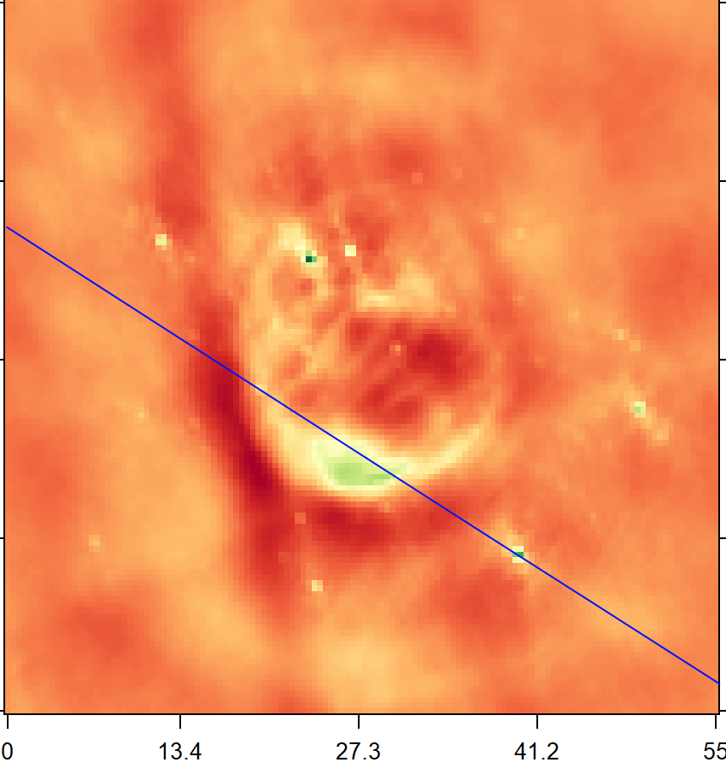
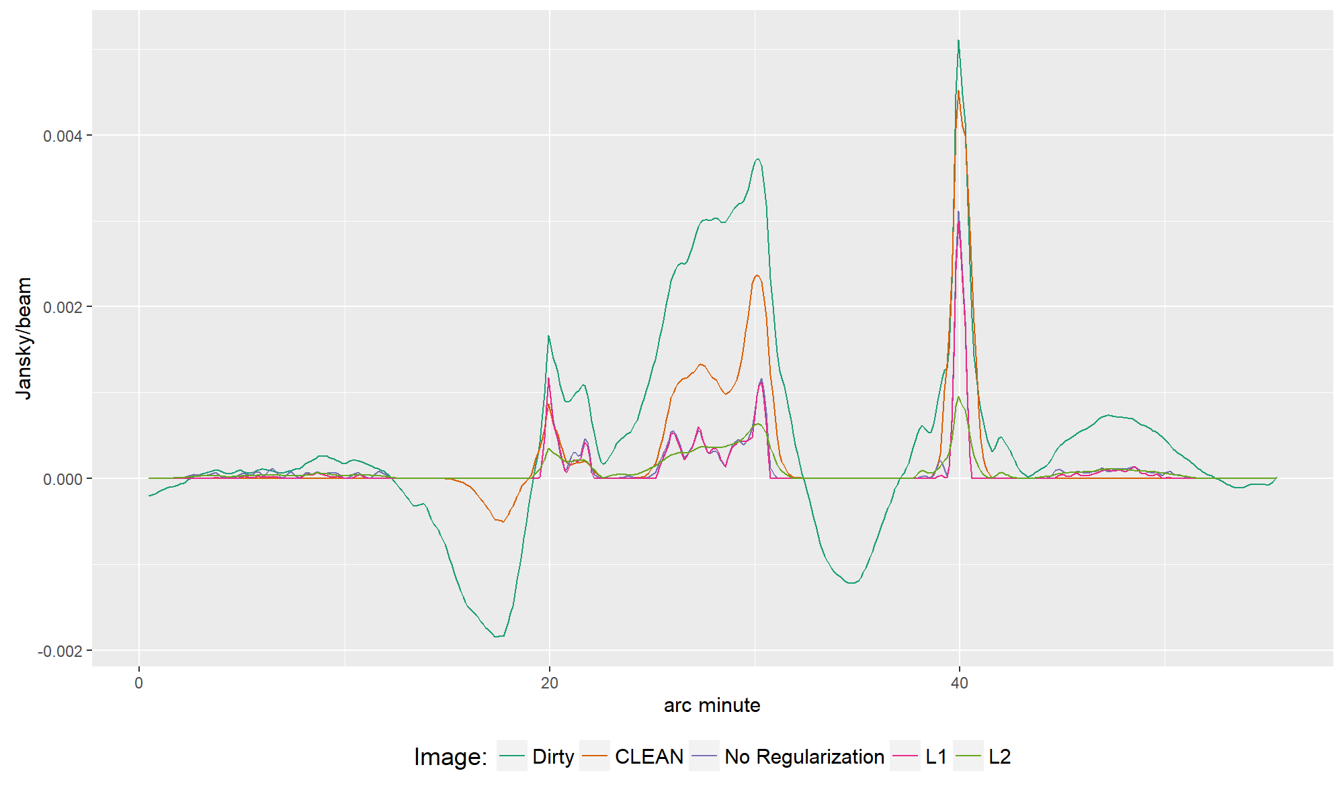

Slide 28
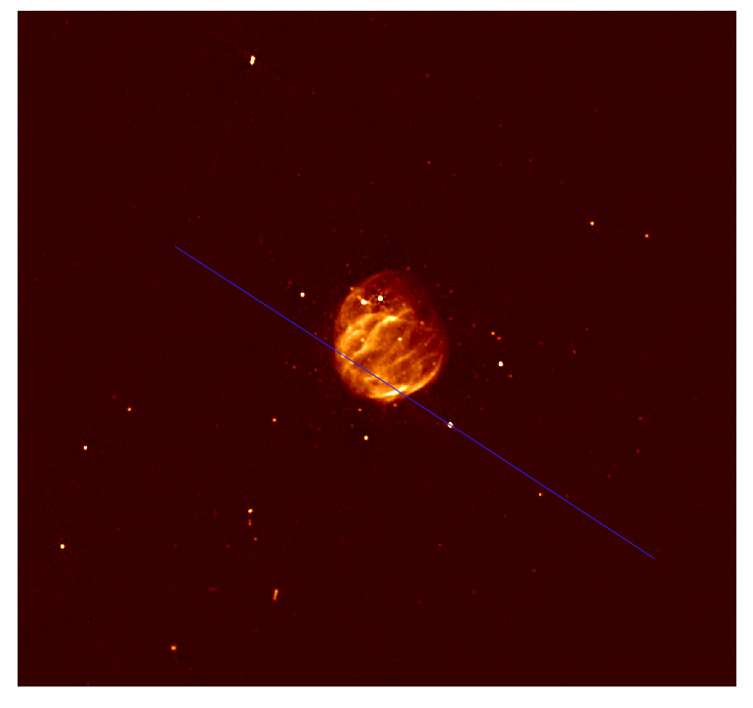

Slide 29
Conclusion

