Slide 1
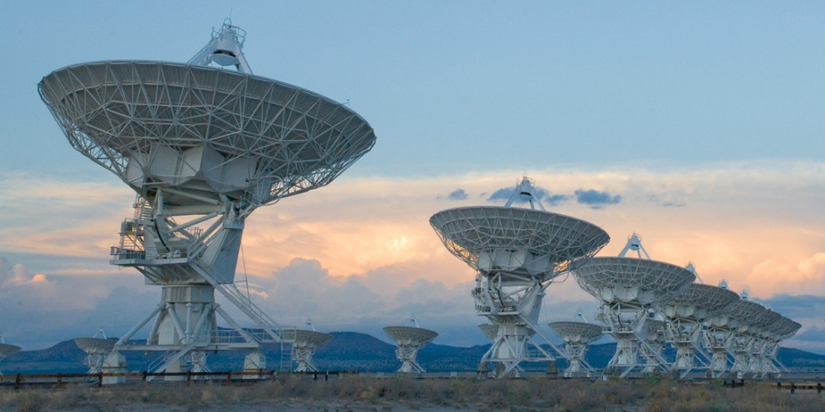
P7 Compressed Sensing Image Reconstruction

Slide 2
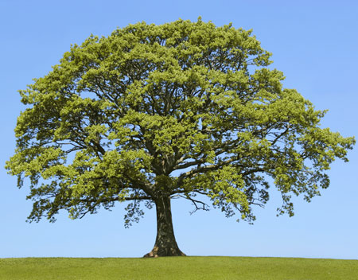

Shannon Nyquist Sampling Rate

Slide 3
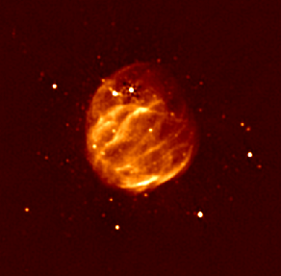
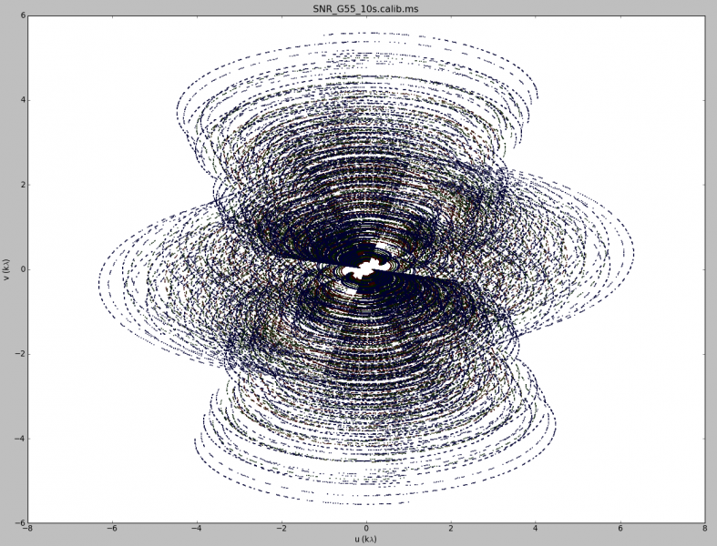
Image Reconstruction

Slide 4
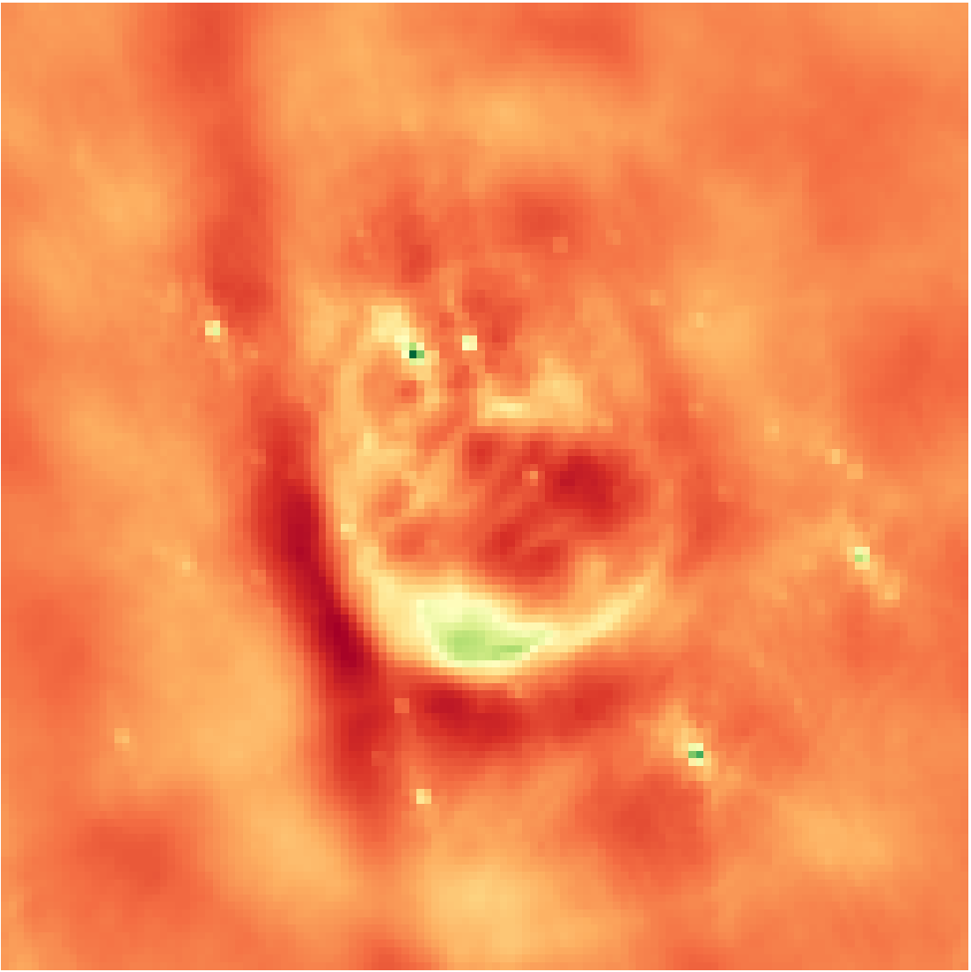
Inverse Fourier Transform
Notes:
Low resolution

Slide 5

Deconvolution
Notes:
From the theory of compressed sensing

Slide 6
Compressed Sensing Reconstruction
Optimization Problem
Objective
Optimizer
A Regularization

Slide 7
CLEAN

Slide 8
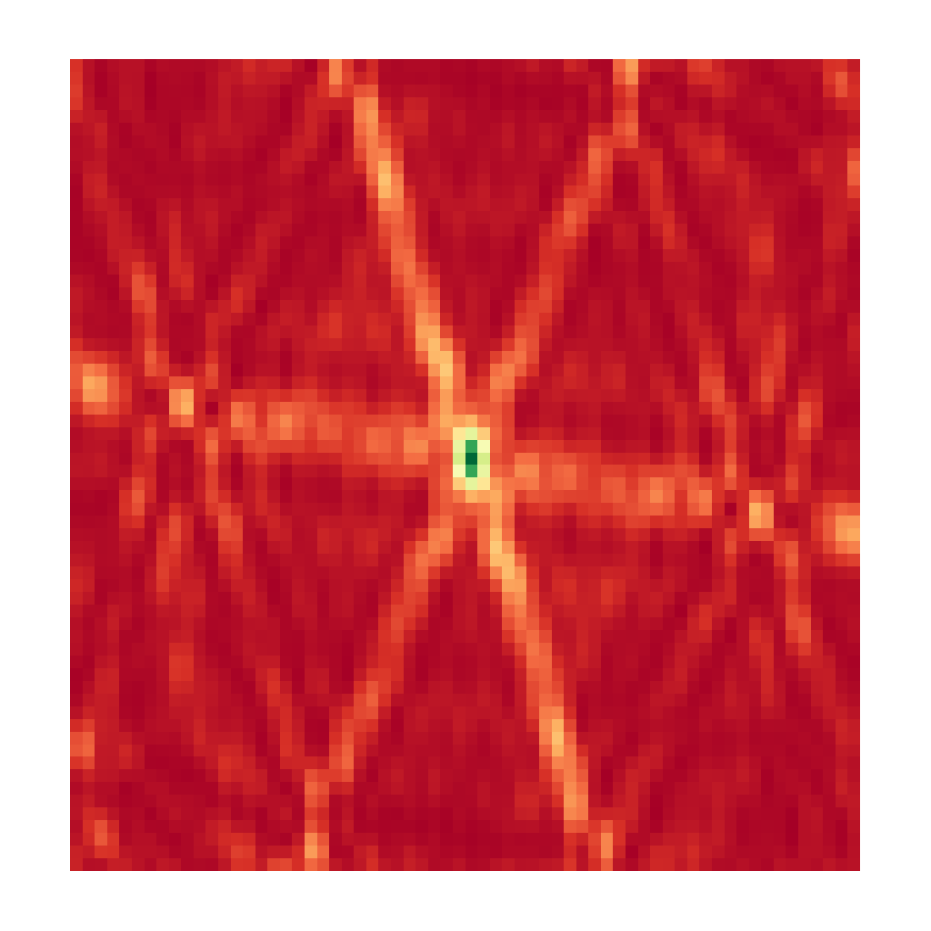
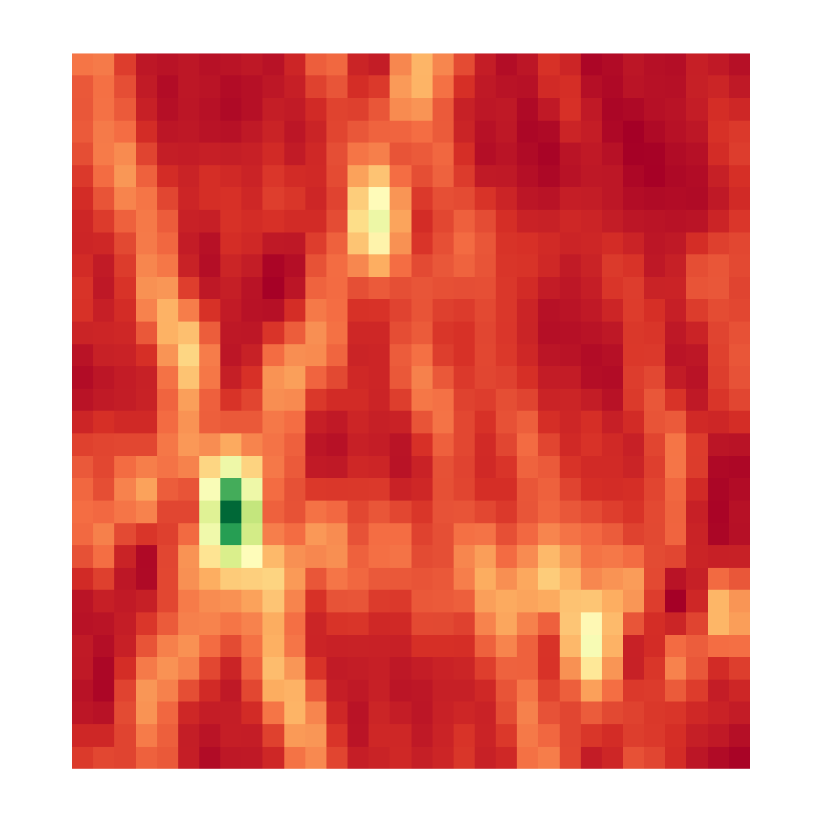

CLEAN, Iteration 0
Dirty Image
Model Image

Slide 9
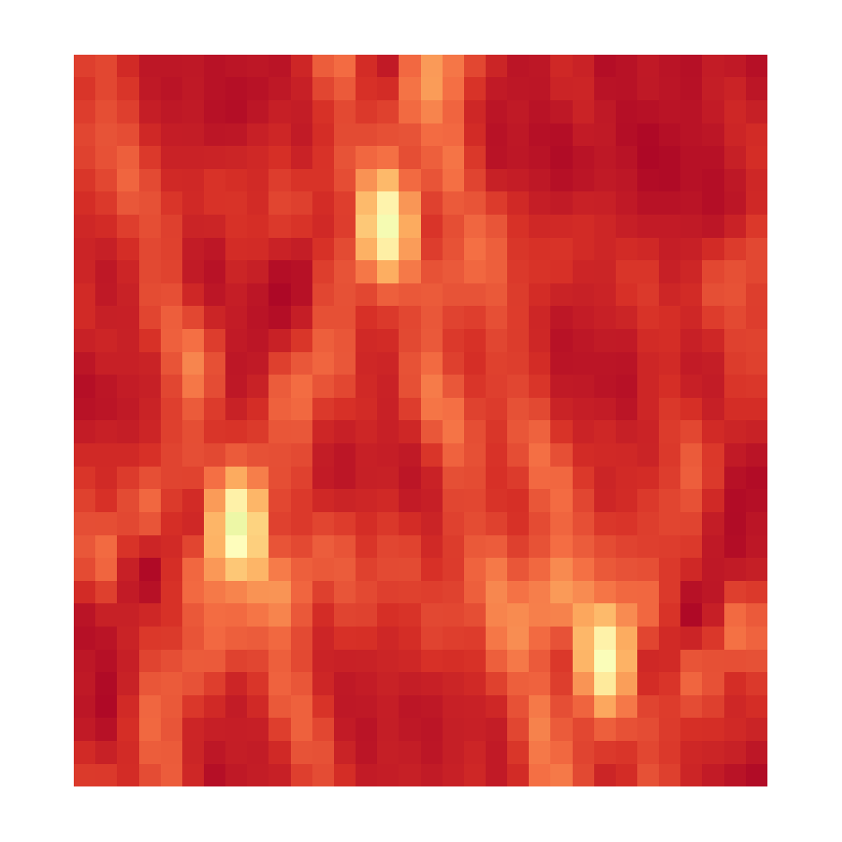

CLEAN, Iteration 1
Dirty Image
Model Image

Slide 10
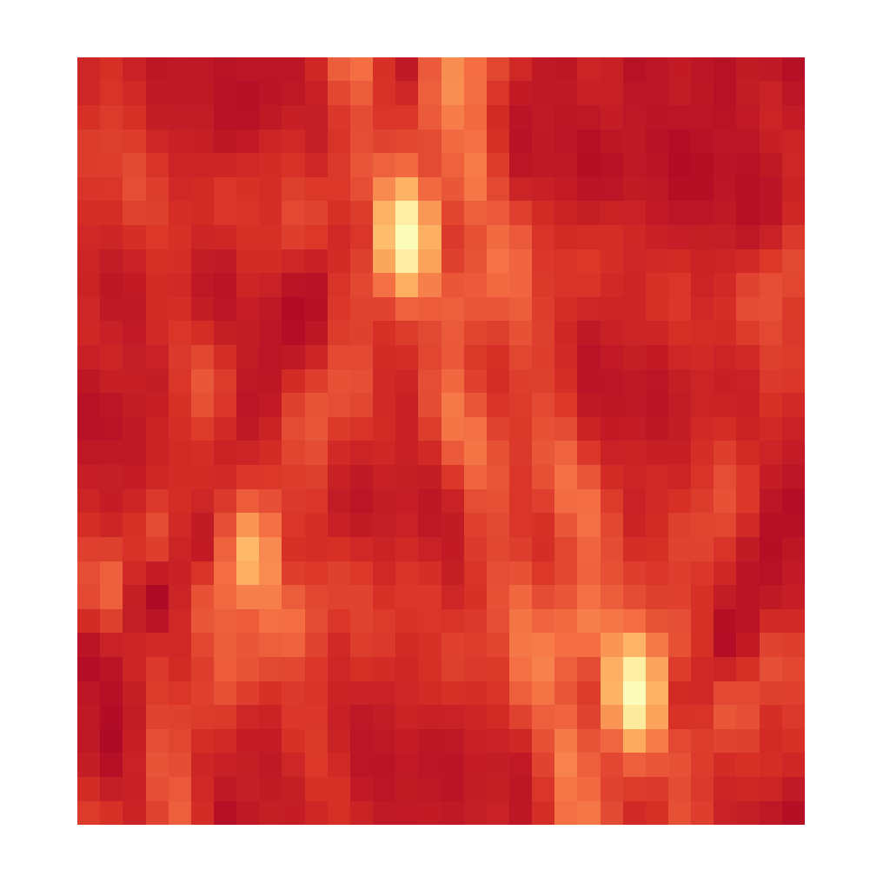

CLEAN, Iteration 2
Dirty Image
Model Image

Slide 11
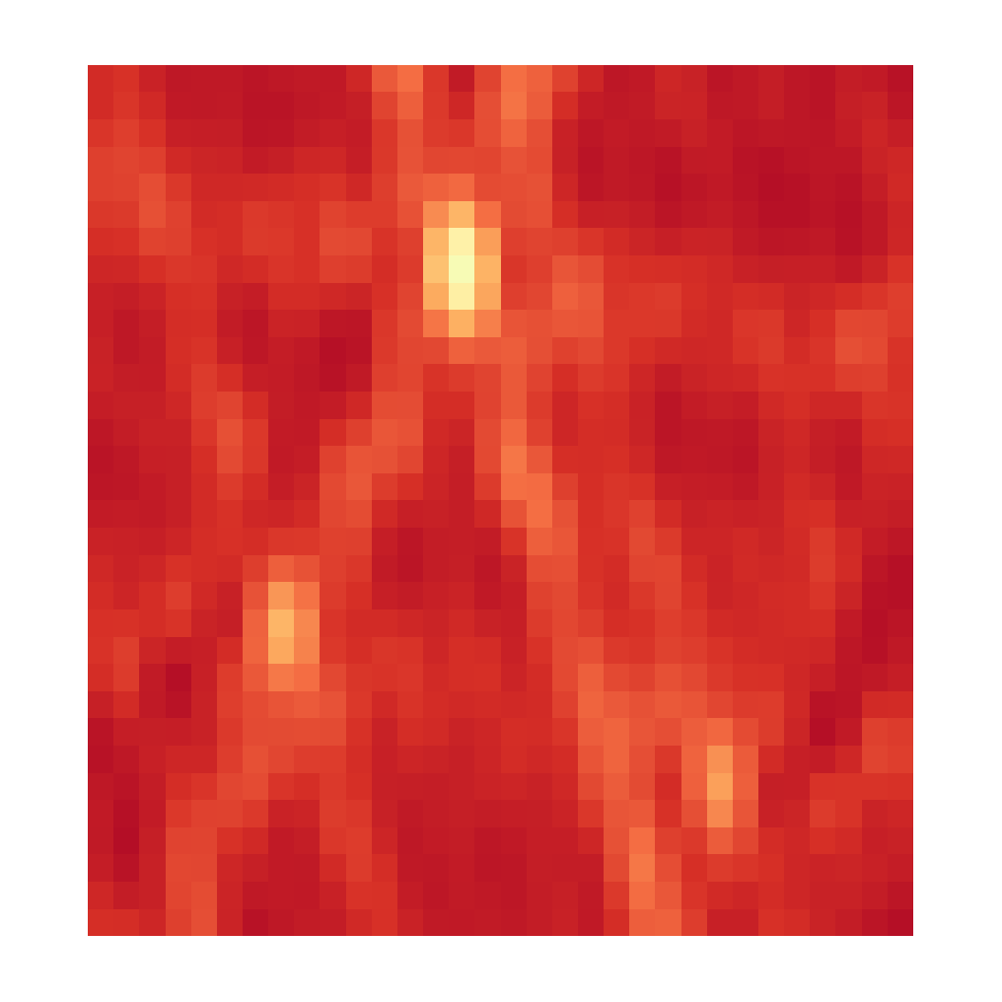

CLEAN, Iteration 3
Dirty Image
Model Image

Slide 12
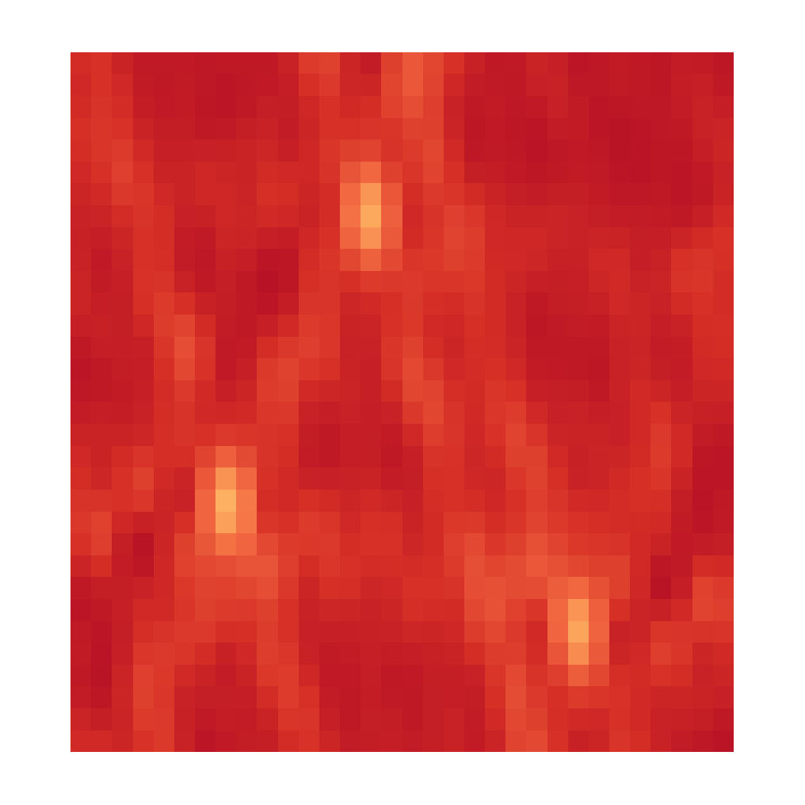

CLEAN, Iteration 4
Dirty Image
Model Image

Slide 13


CLEAN, Iteration X
Dirty Image
Model Image

Slide 14
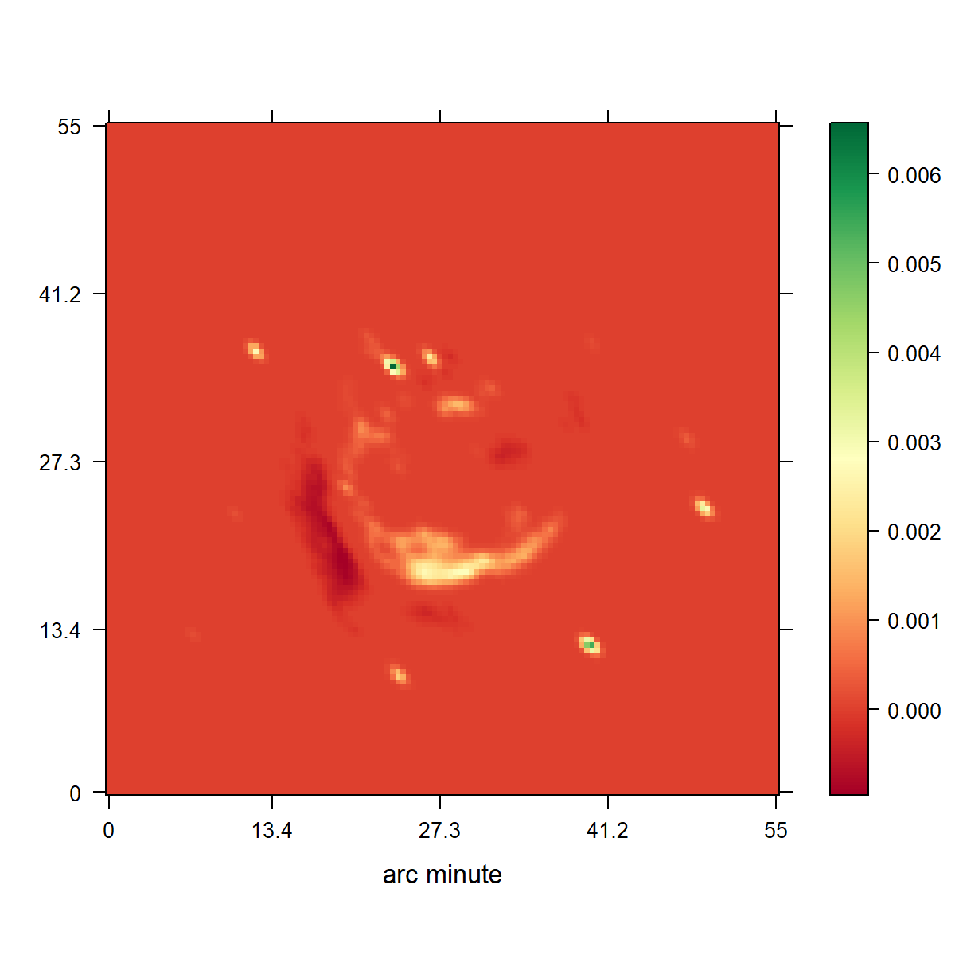
CLEAN
Notes:
Low resolution

Slide 15
Compressed Sensing

Slide 16
Compressed Sensing Image Reconstruction
Regularization that captures the image properties
Incoherent Measurement and Reconstruction spaces.

Slide 17
CLEAN as a Compressed Sensing Reconstruction
Notes:
Camera Pixels
Many samples, most contain no information

Slide 18
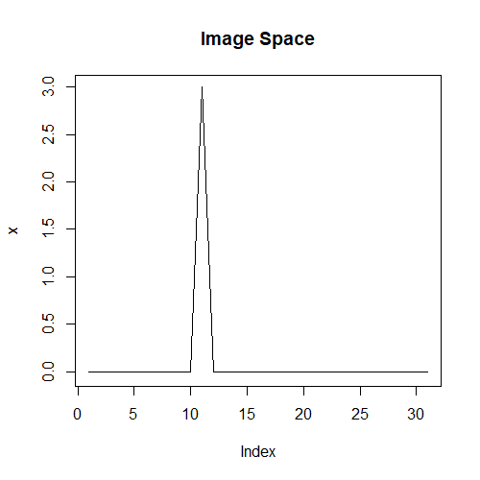
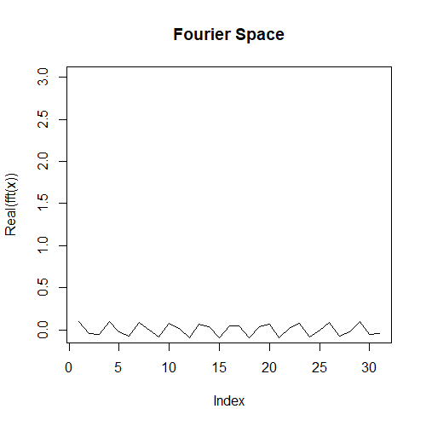
Incoherence

Slide 19
CLEAN as a Compressed Sensing Reconstruction

Slide 20
CLEAN as a Compressed Sensing Reconstruction

Slide 21
10s VLA Observation
NRAO Reconstruction
Notes:
Low resolution

Slide 22
Compressed Sensing Image Reconstruction
Objective with Data + Regularization term
Optimizer → Gurobi
A Regularization
L0
L1
L2
TV
L1 of Haar Wavelets
L1 of Starlets
…

Slide 23
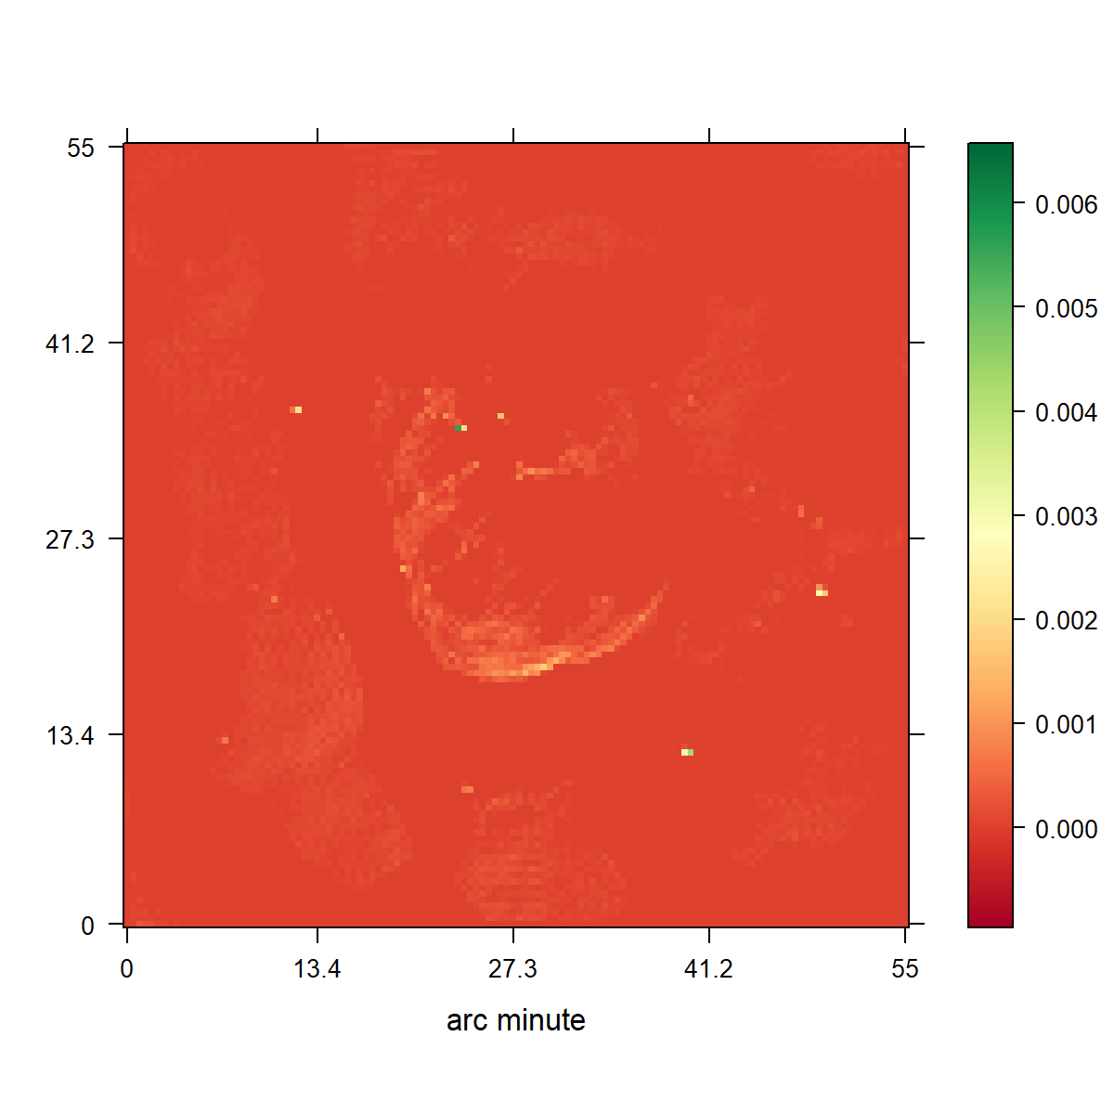
CLEAN
L1 Regularization

Slide 24
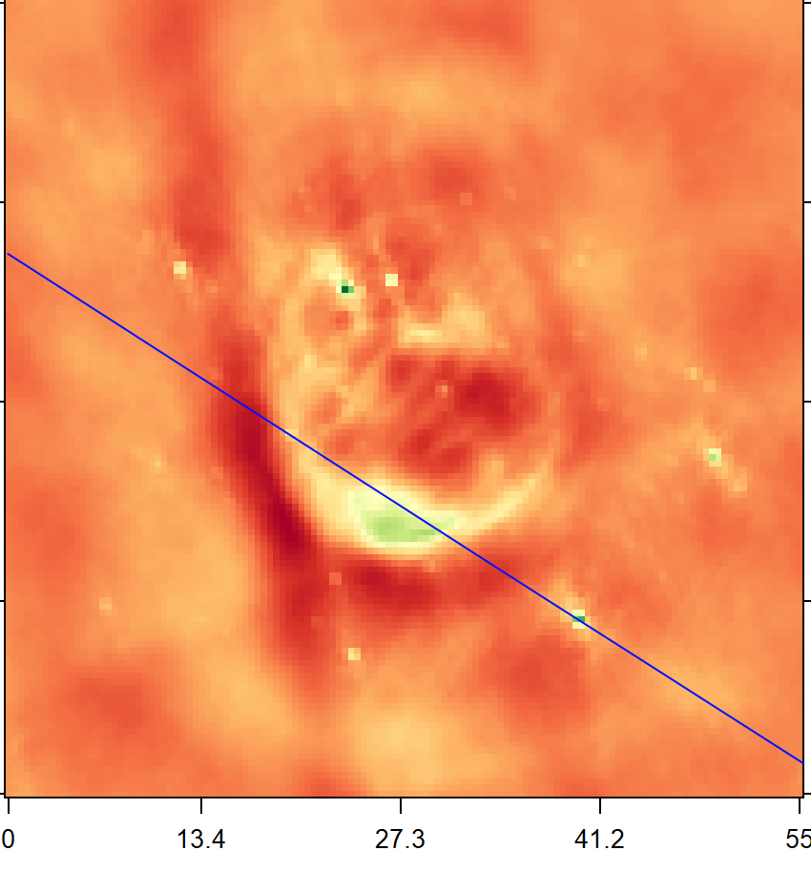
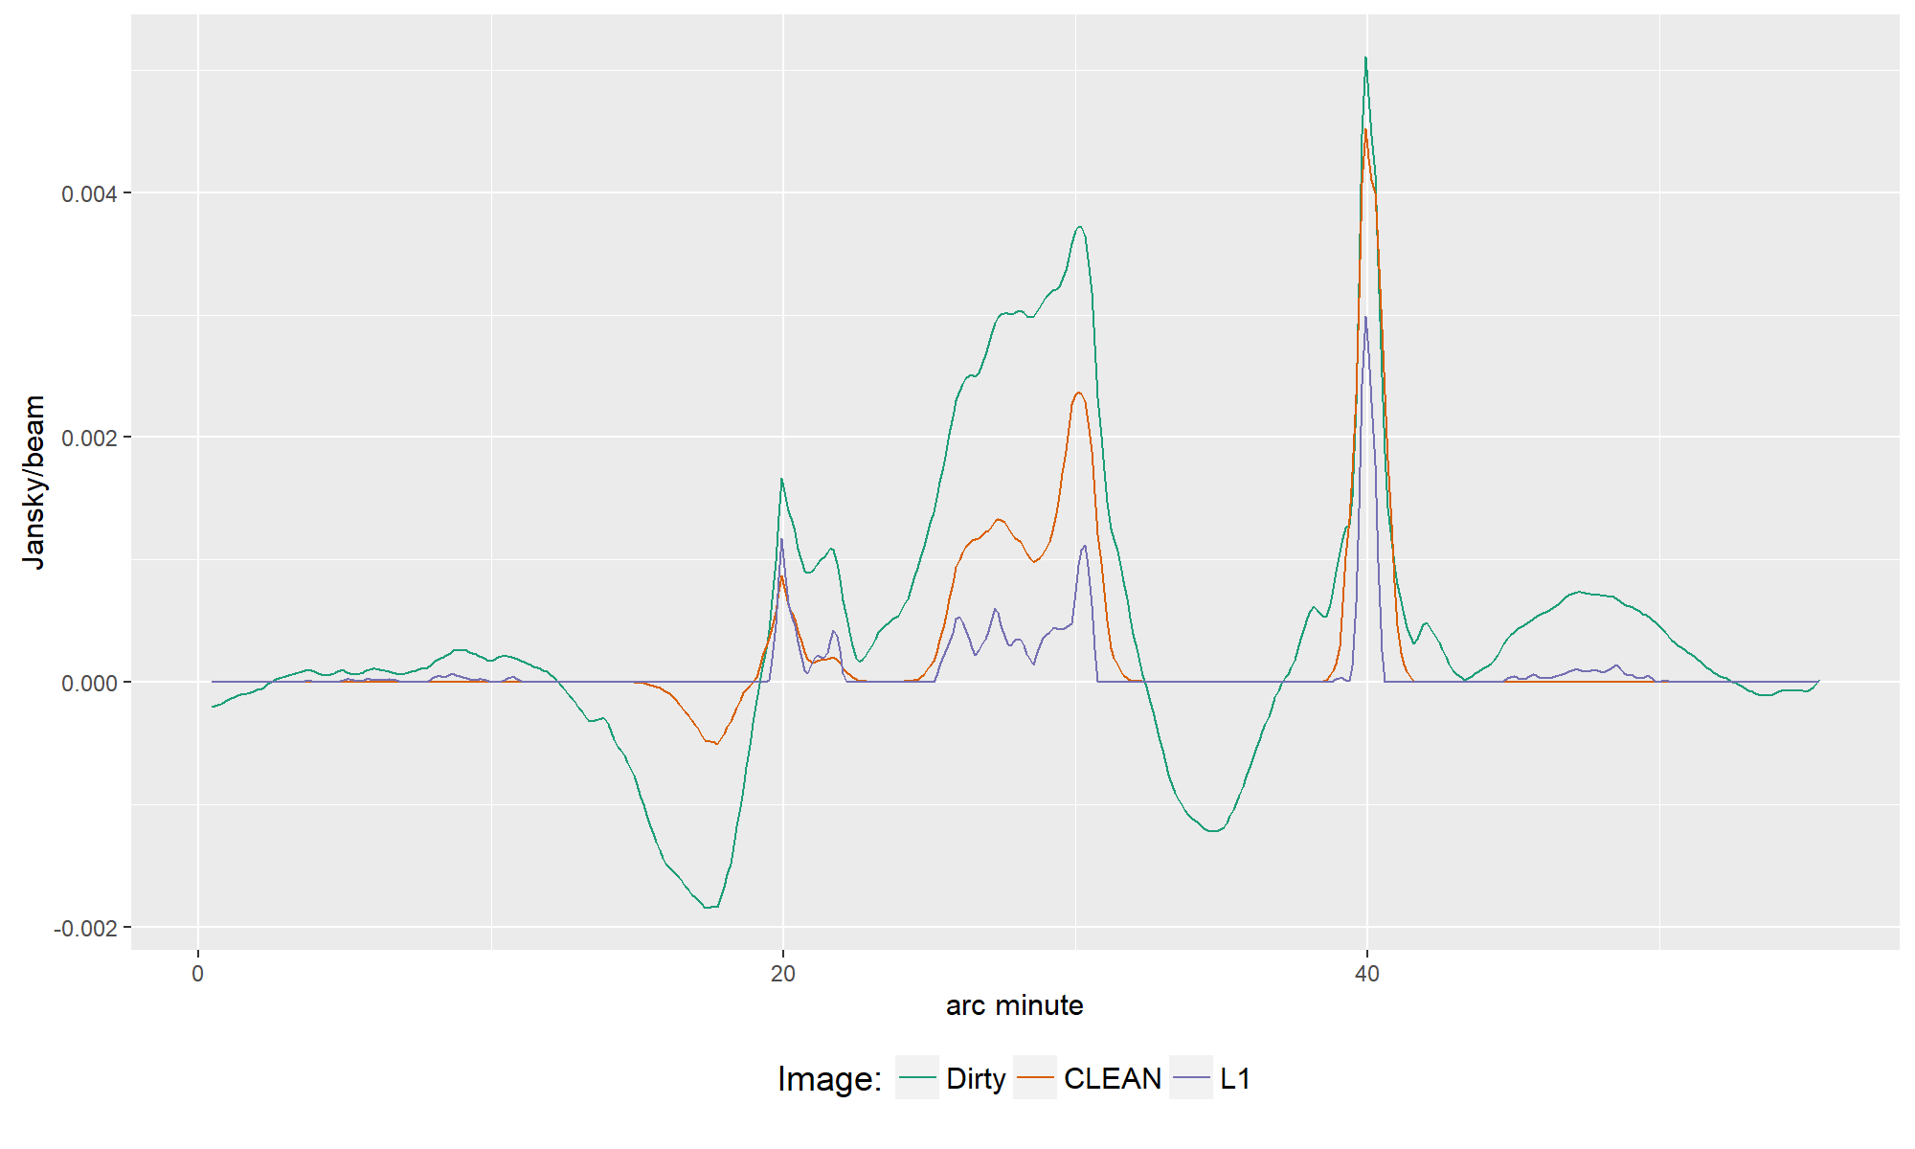

Slide 25
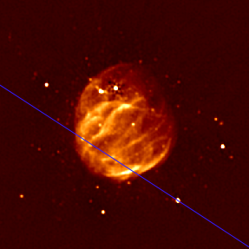

Slide 26
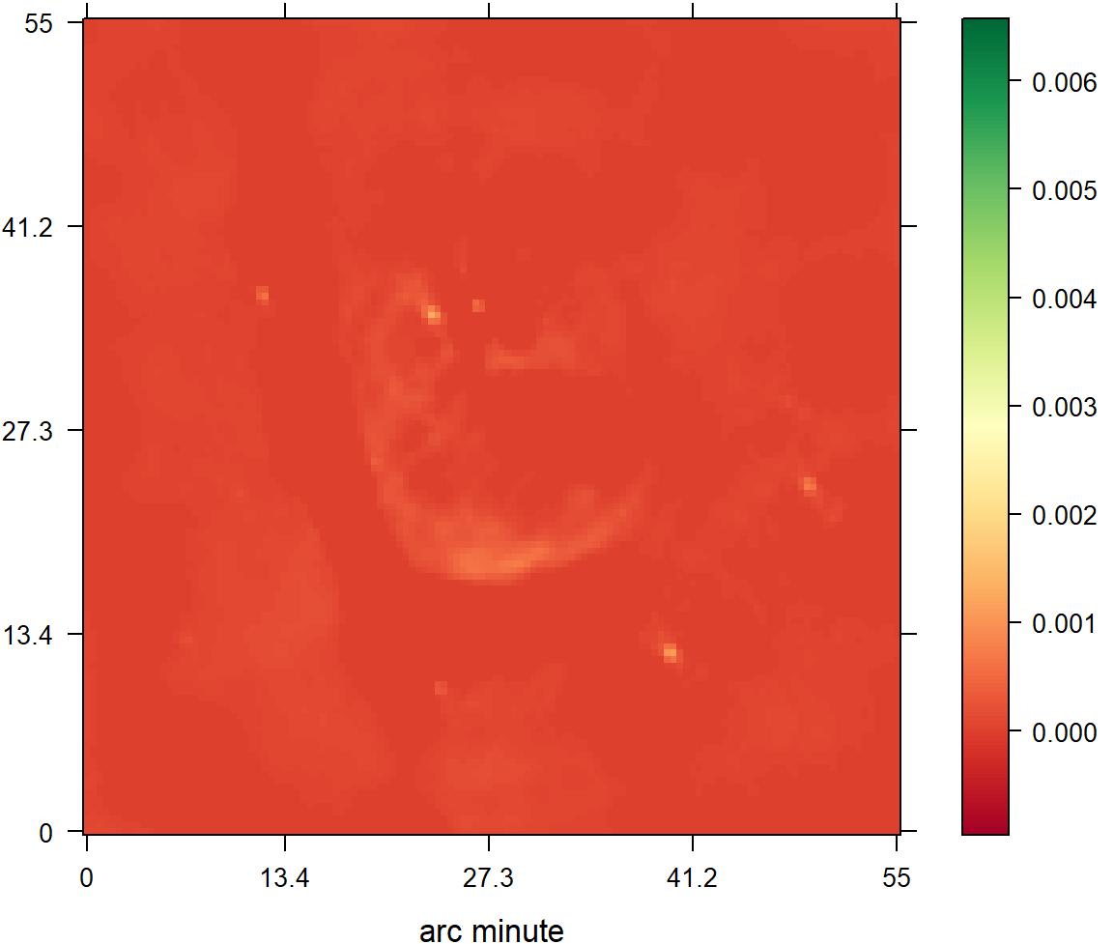
CLEAN
L2 Regularization

Slide 27
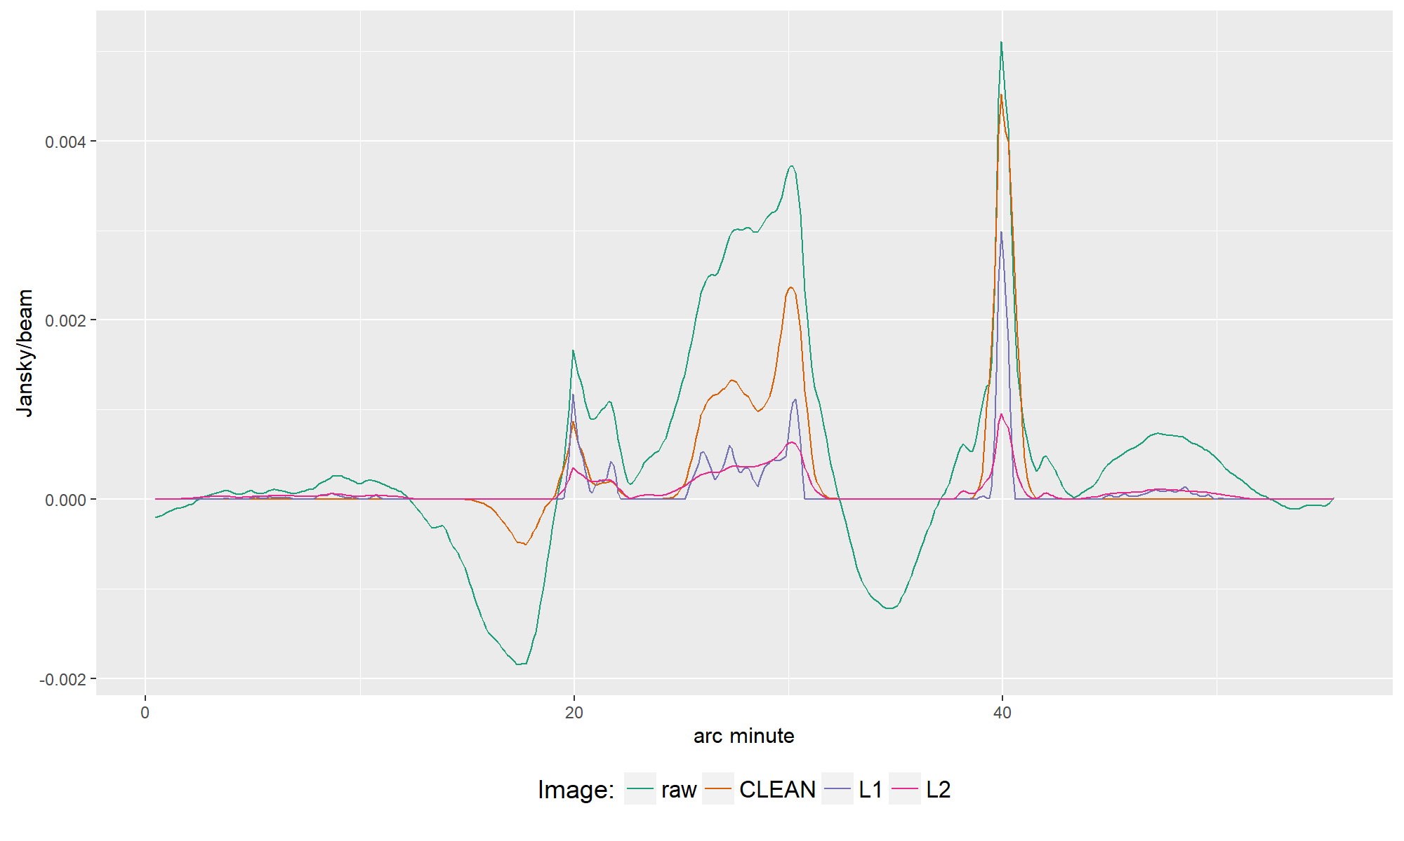

Slide 28
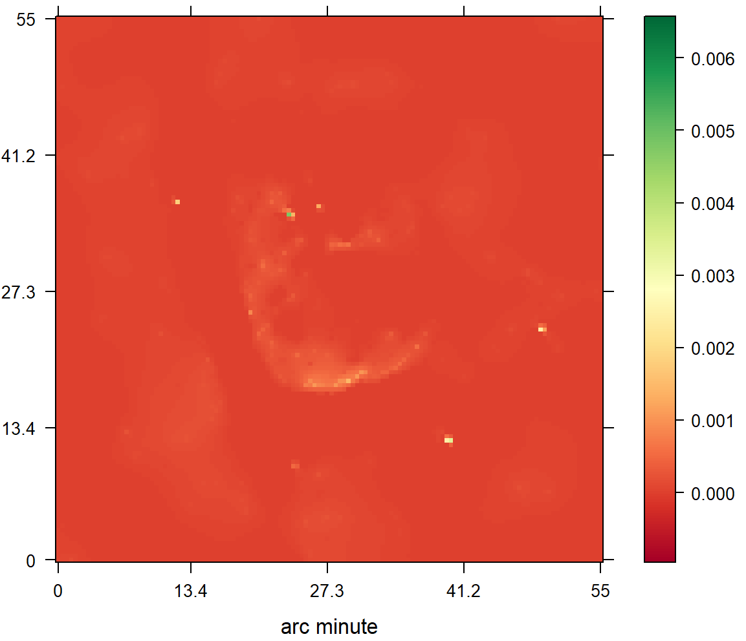
CLEAN
Starlets

Slide 29
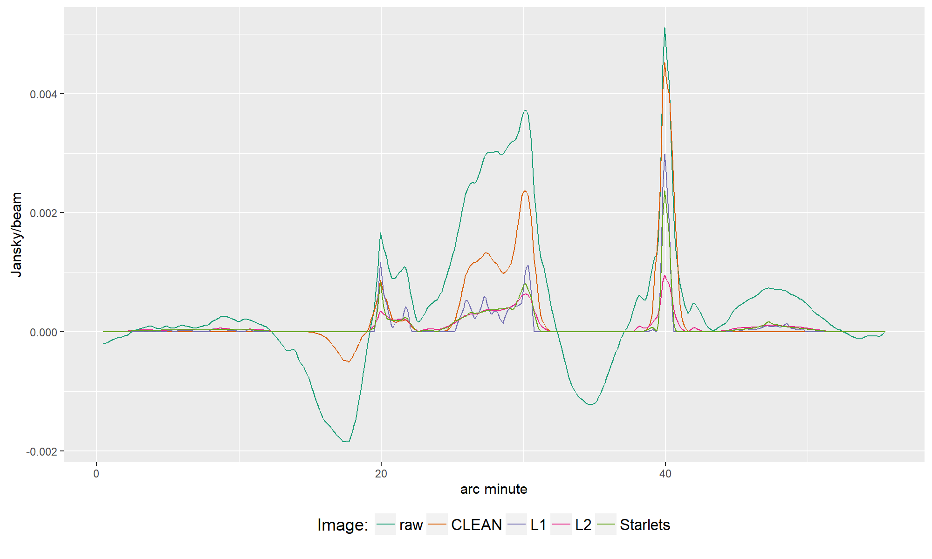

Slide 30
Super Resolution?

Slide 31
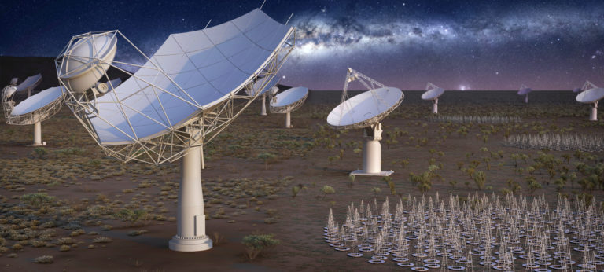
Future

Slide 32
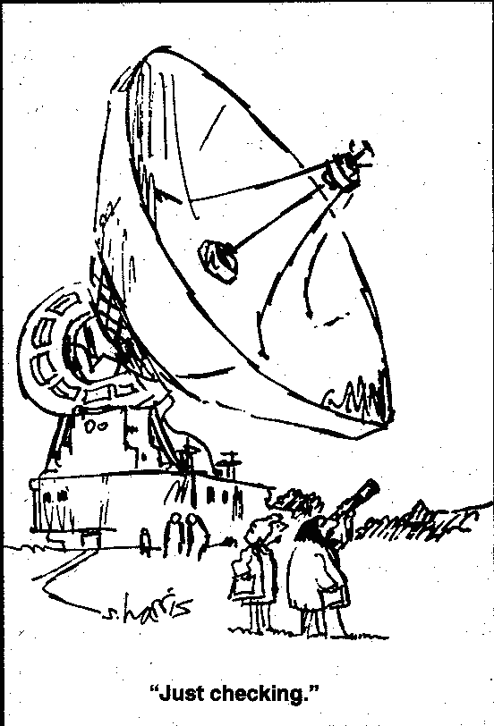

Slide 33
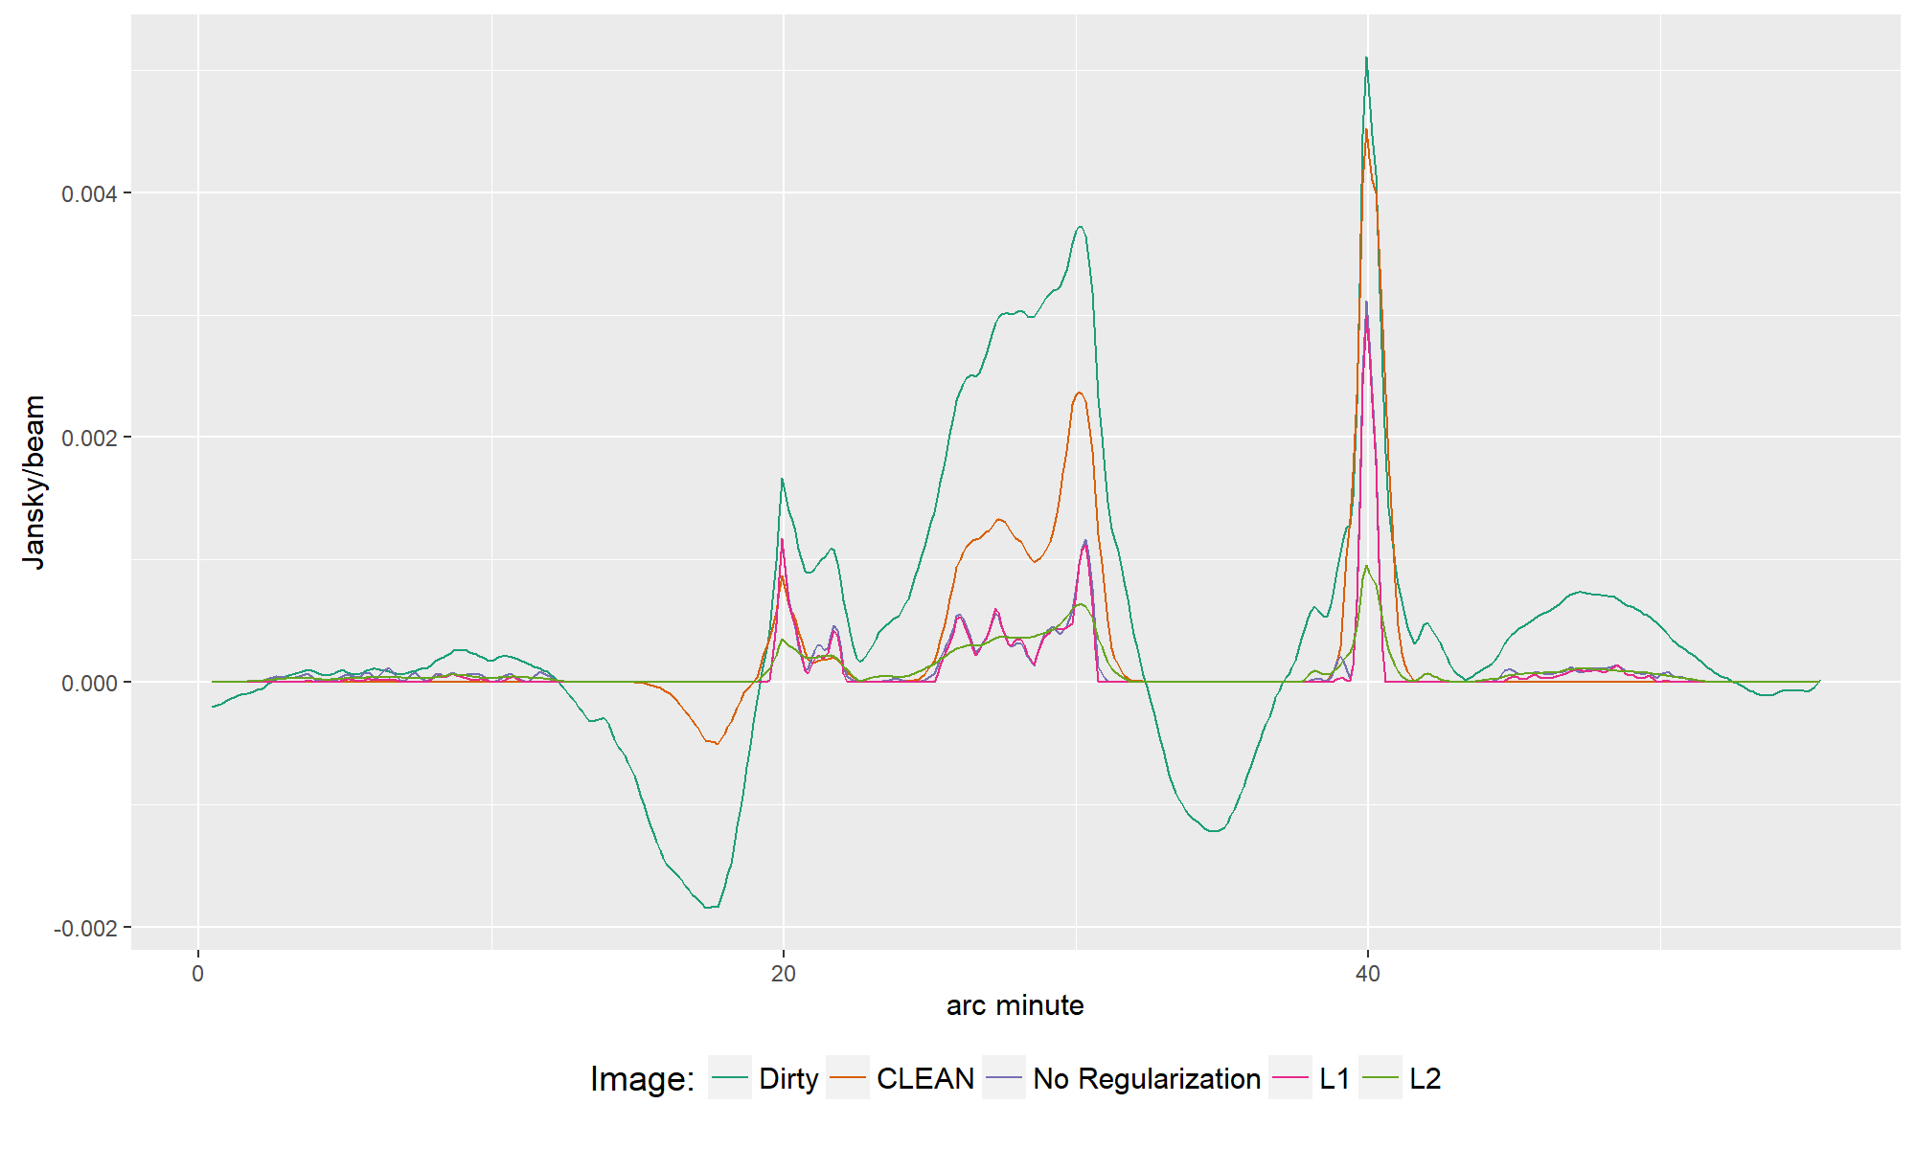

Slide 34
