Slide 1
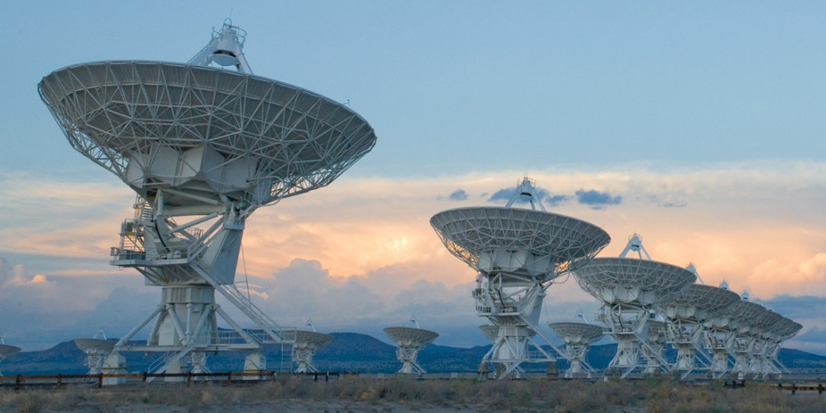
Compressed Sensing Image Reconstruction for CASA

Slide 2
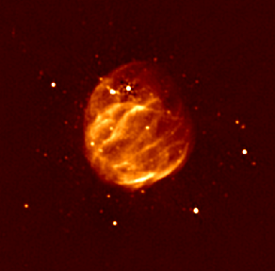
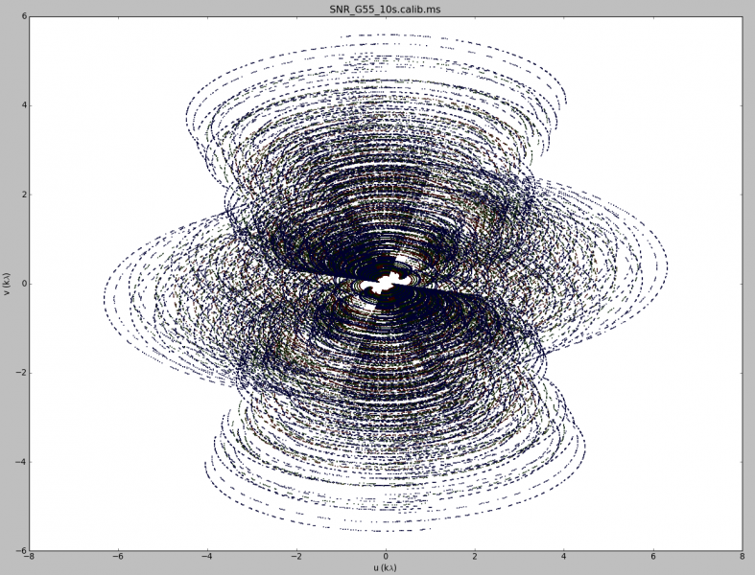
Image Reconstruction

Slide 3
Deconvolution

Slide 4
Deconvolution

Slide 5
CLEAN

Slide 6
CLEAN as a special case of Compressed Sensing

Slide 7
Guarantees

Slide 8
Super Resolution

Slide 9
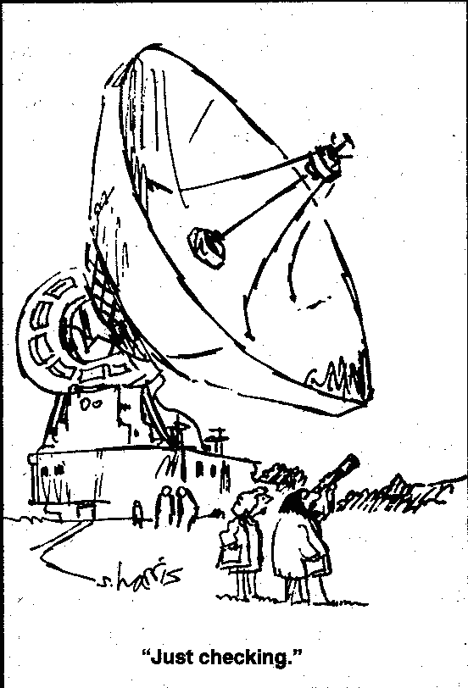
The Problem with Super Resolution…

Slide 10
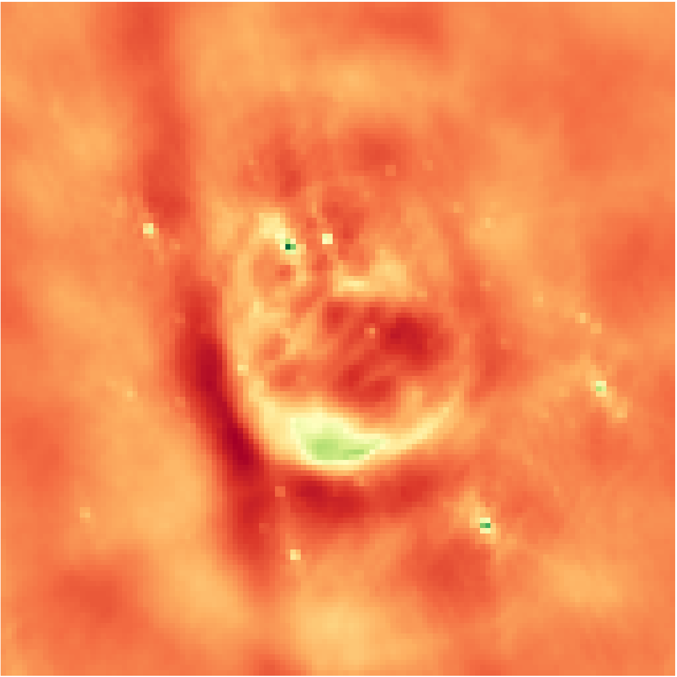
10 Second Observation Unknown Reconstruction NRAO
Notes:
Low resolution

Slide 11
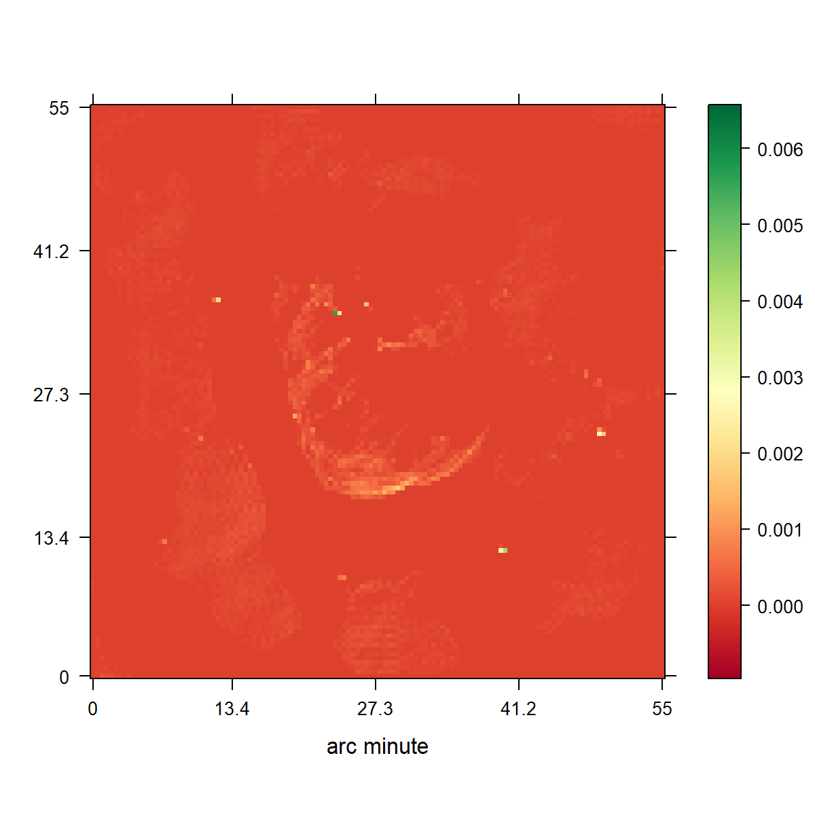
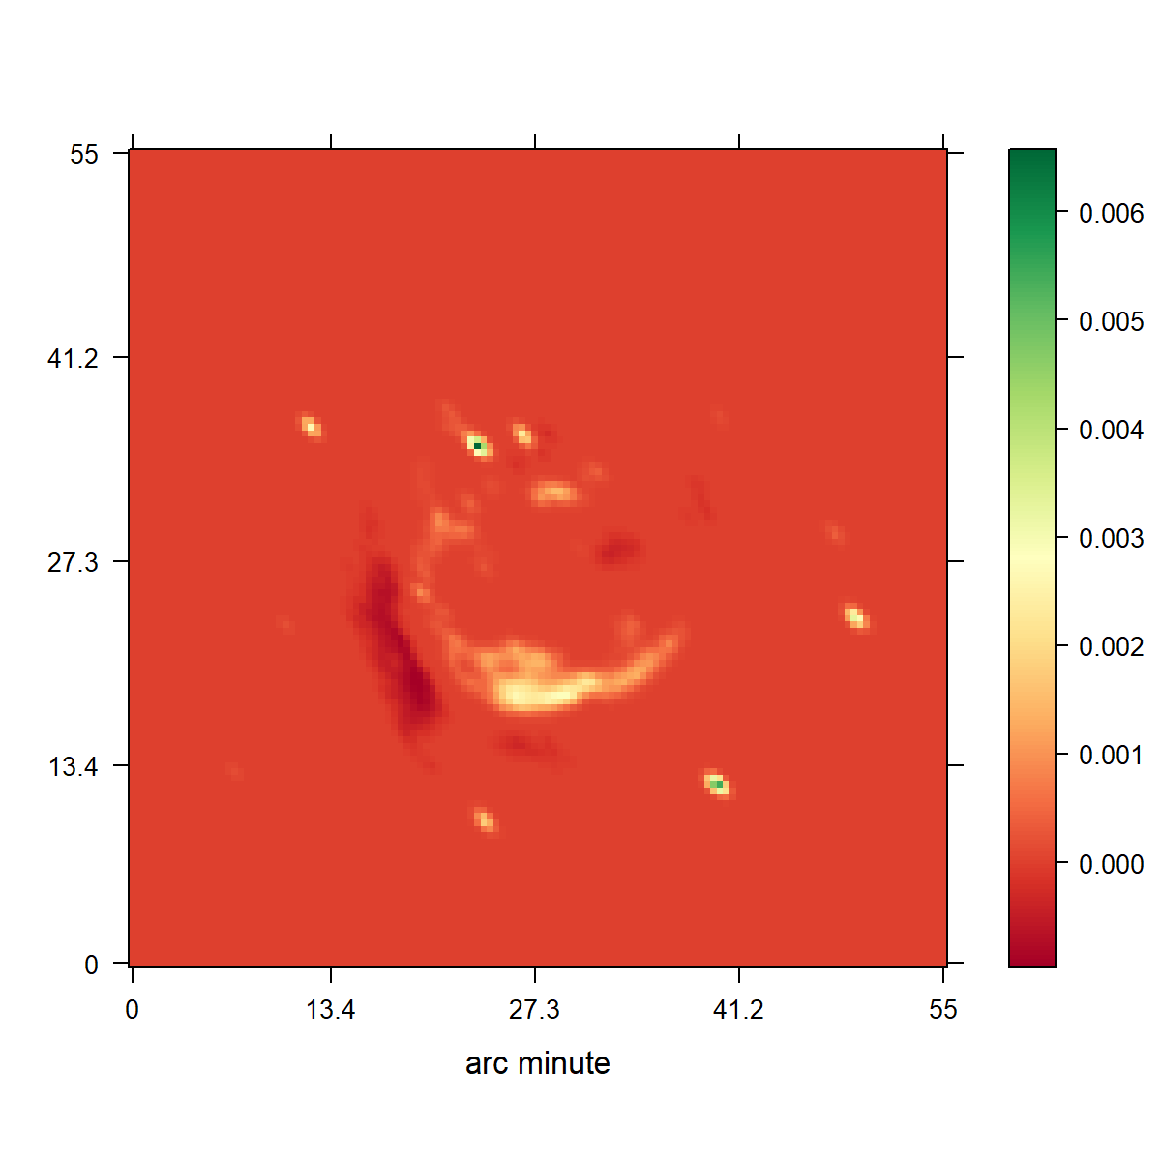
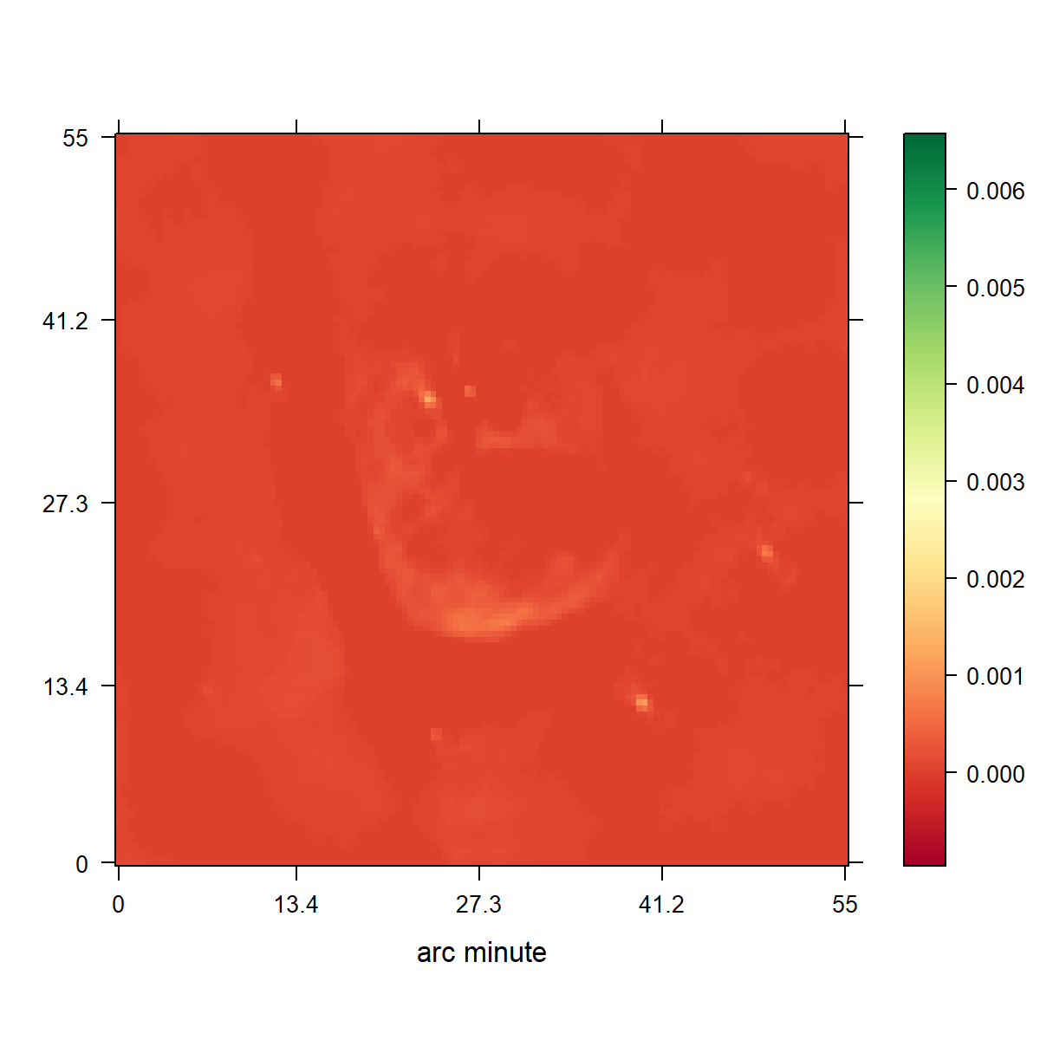
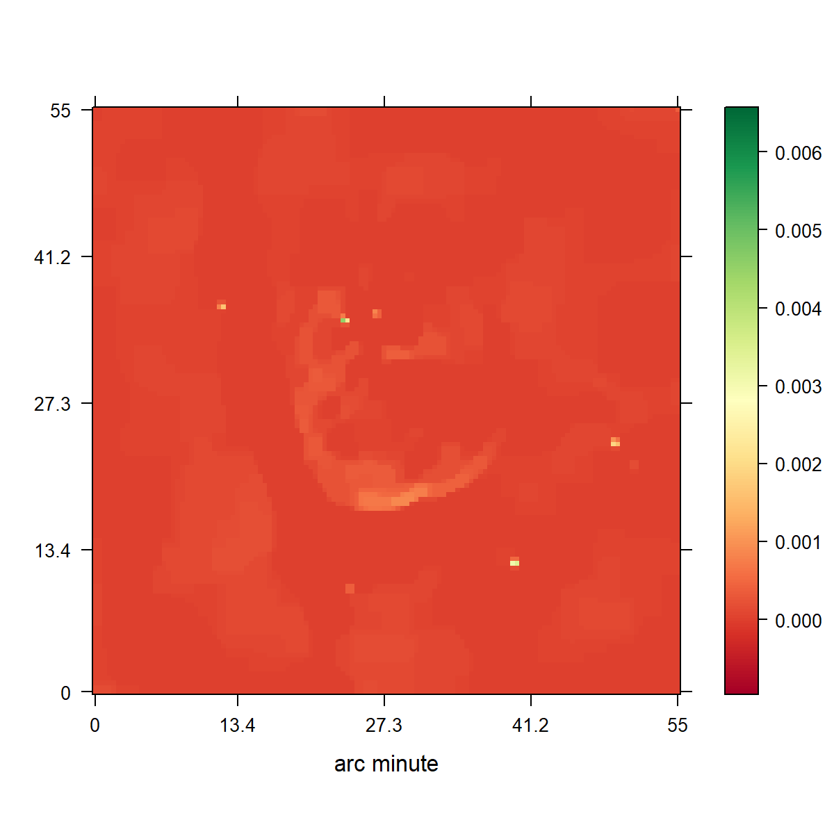

Slide 12
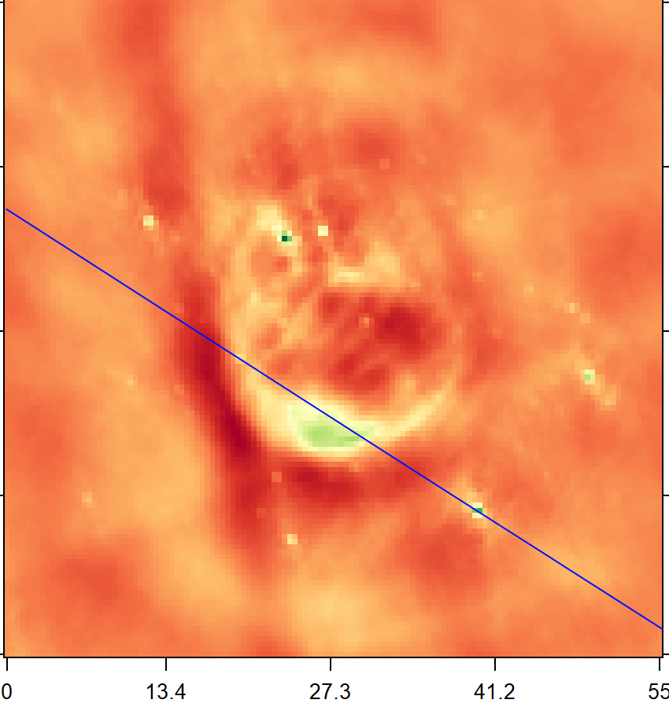
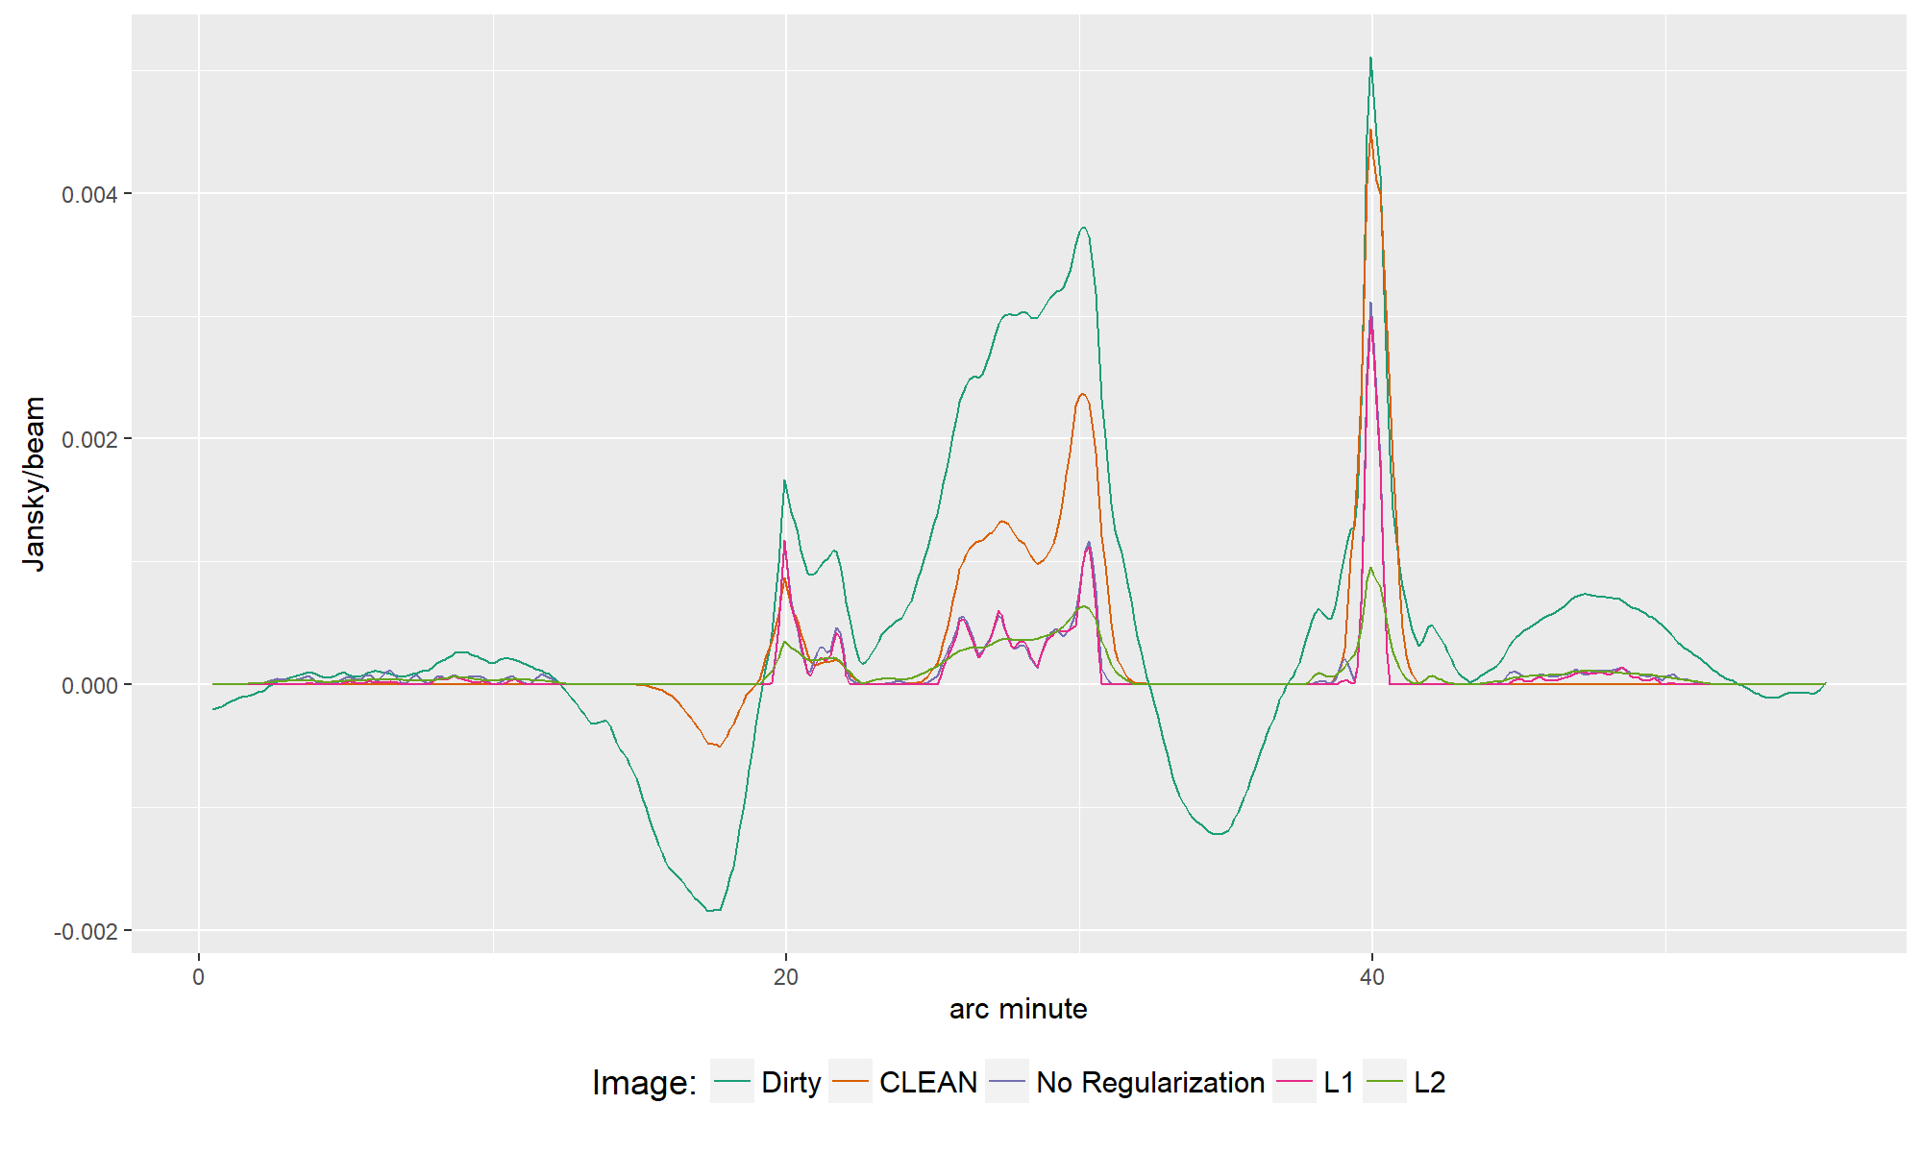

Slide 13
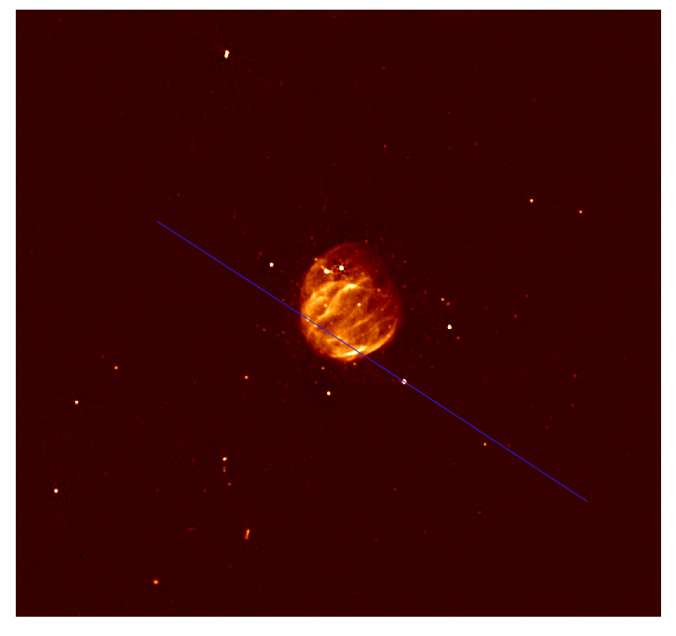

Slide 14
Conclusion

Slide 15
Conclusion

