Slide 1
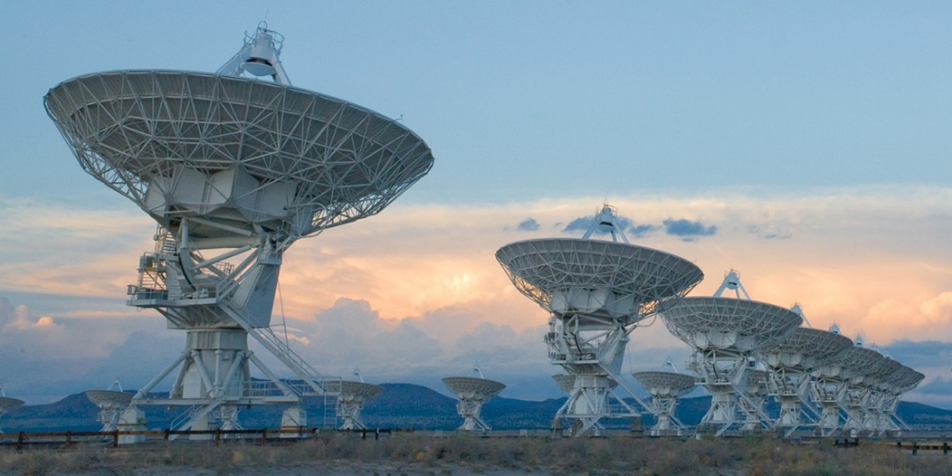
Compressed Sensing Image Reconstruction for CASA

Slide 2
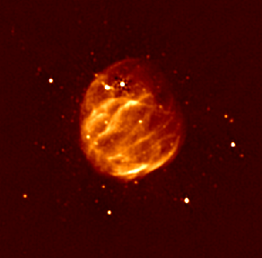
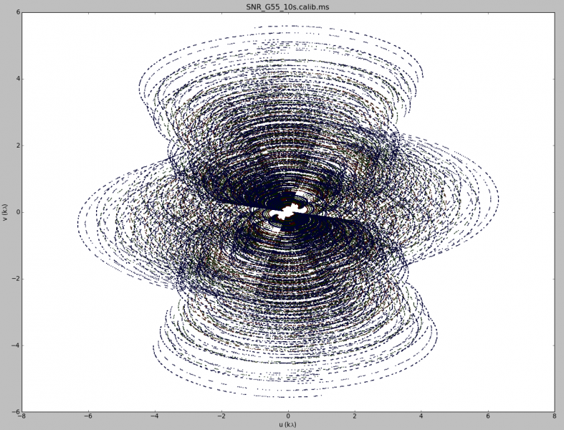
Image Reconstruction

Slide 3
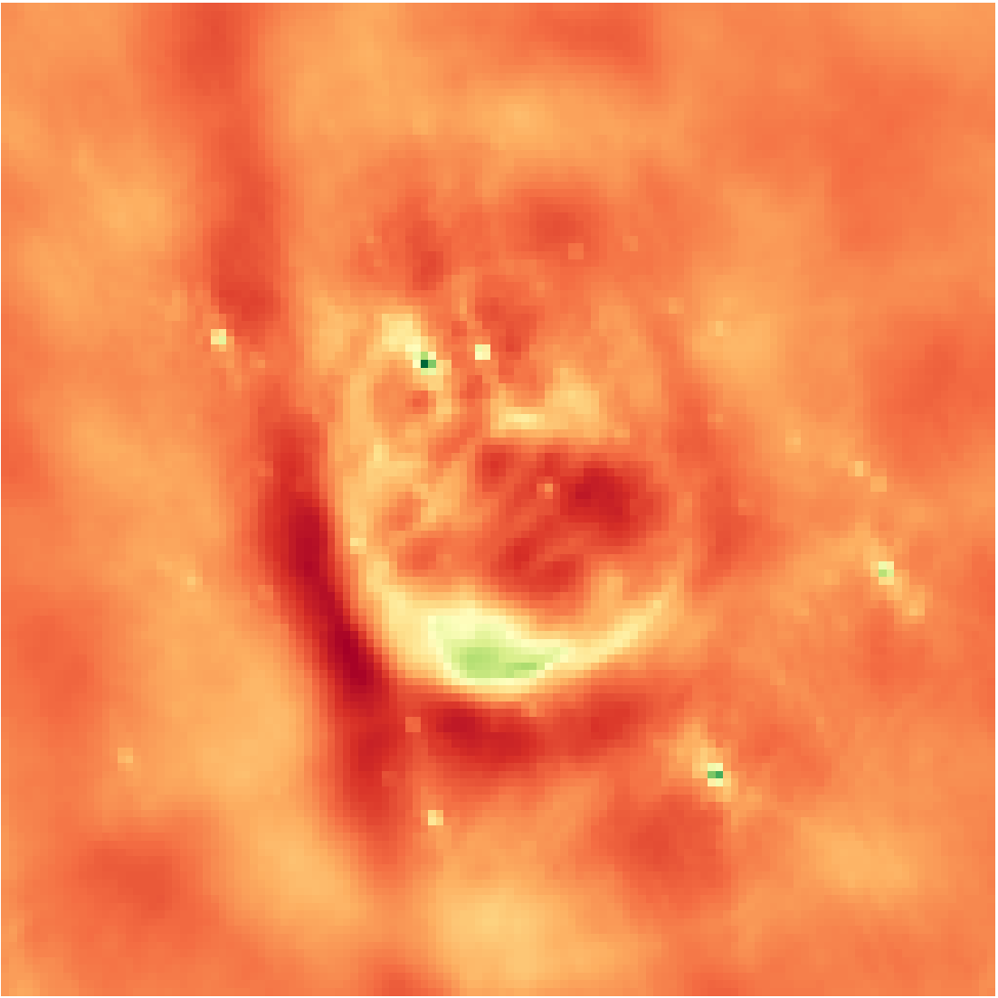
Inverse Fourier Transform
Notes:
Low resolution

Slide 4

Deconvolution
Notes:
From the theory of compressed sensing

Slide 5
Compressed Sensing?
Notes:
From the theory of compressed sensing

Slide 6
CLEAN

Slide 7
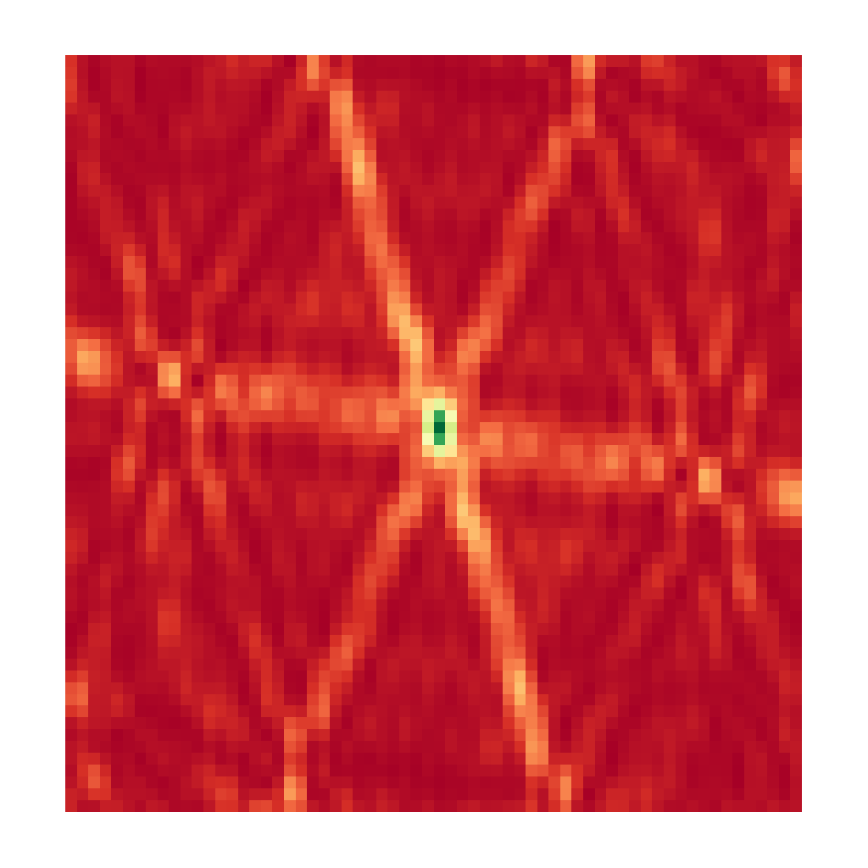
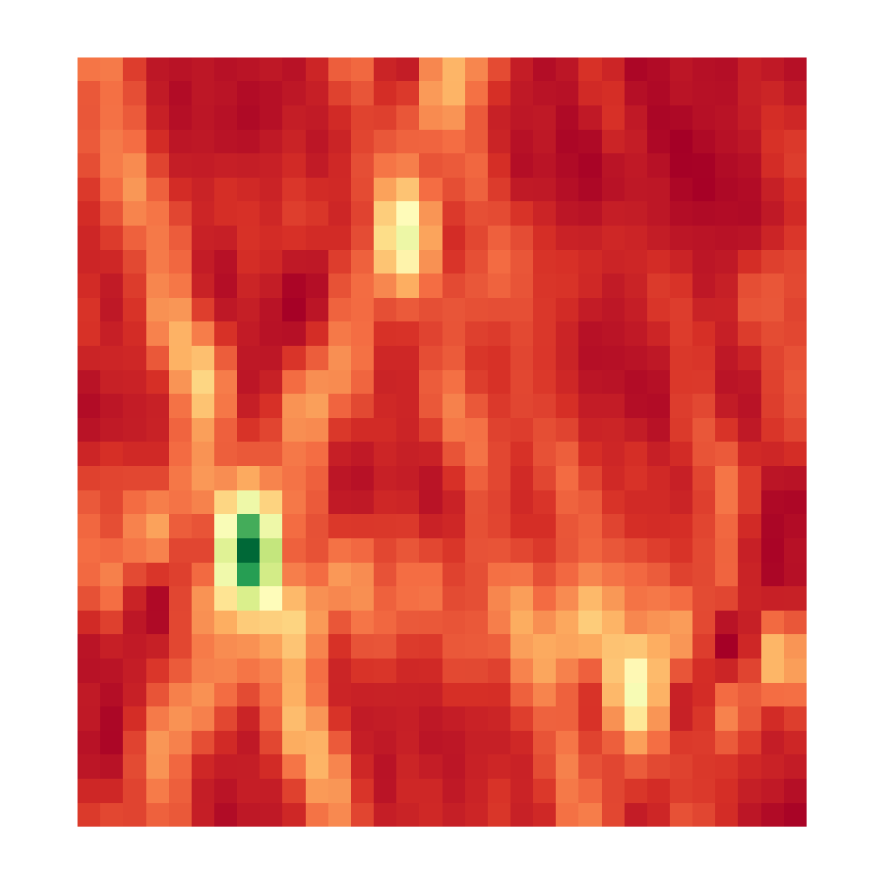

CLEAN, Iteration 0
Dirty Image
Model Image

Slide 8
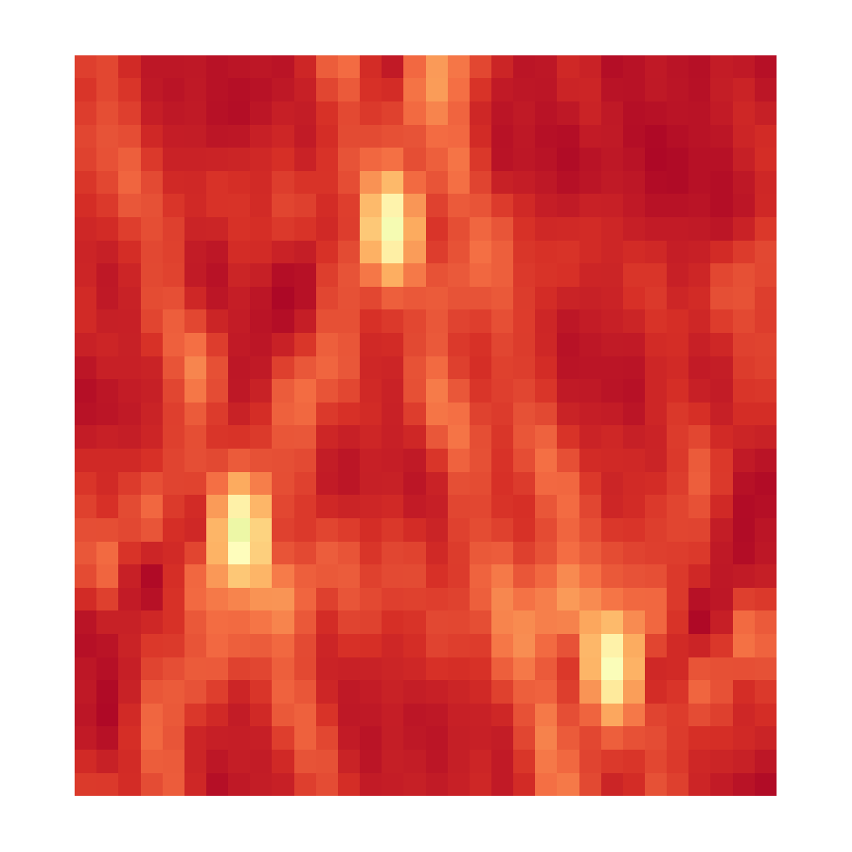

CLEAN, Iteration 1
Dirty Image
Model Image

Slide 9
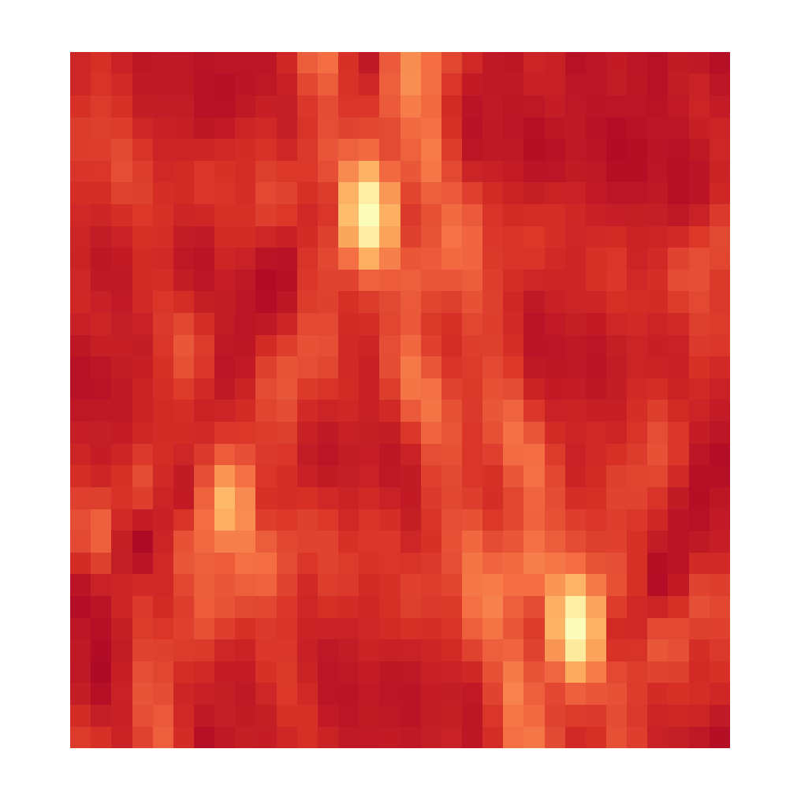

CLEAN, Iteration 2
Dirty Image
Model Image

Slide 10
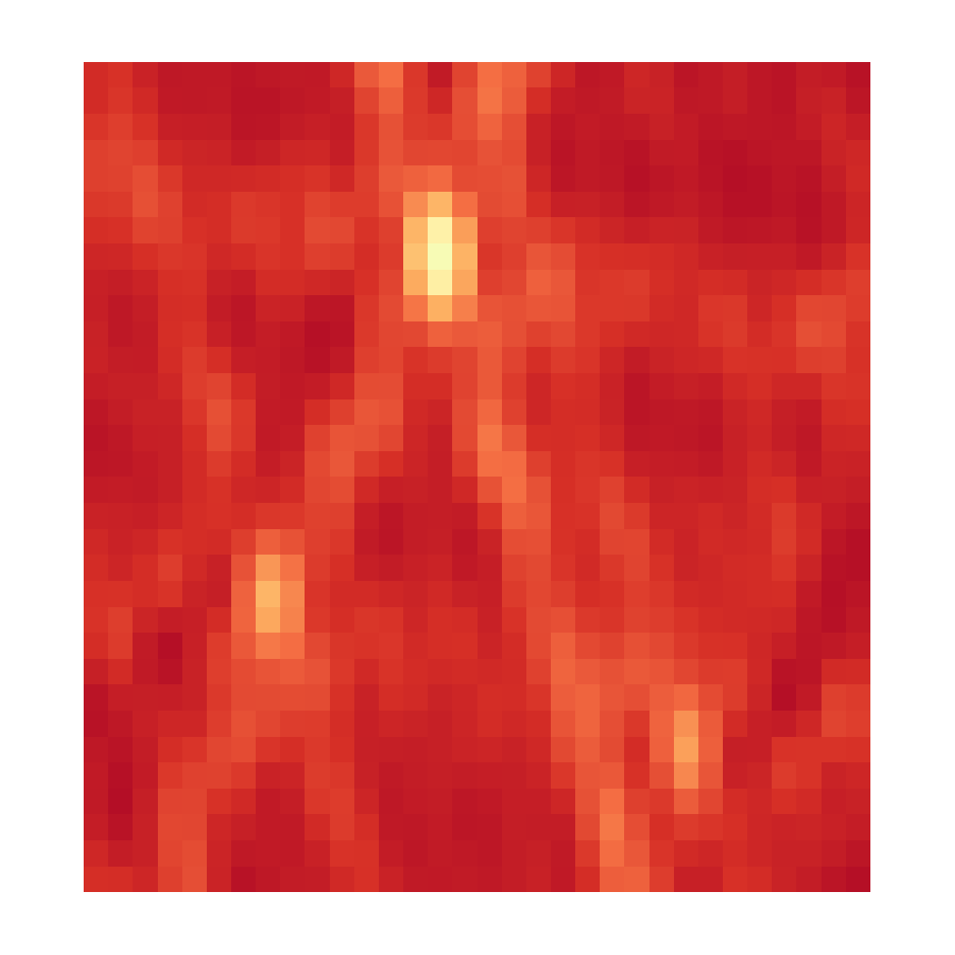

CLEAN, Iteration 3
Dirty Image
Model Image

Slide 11
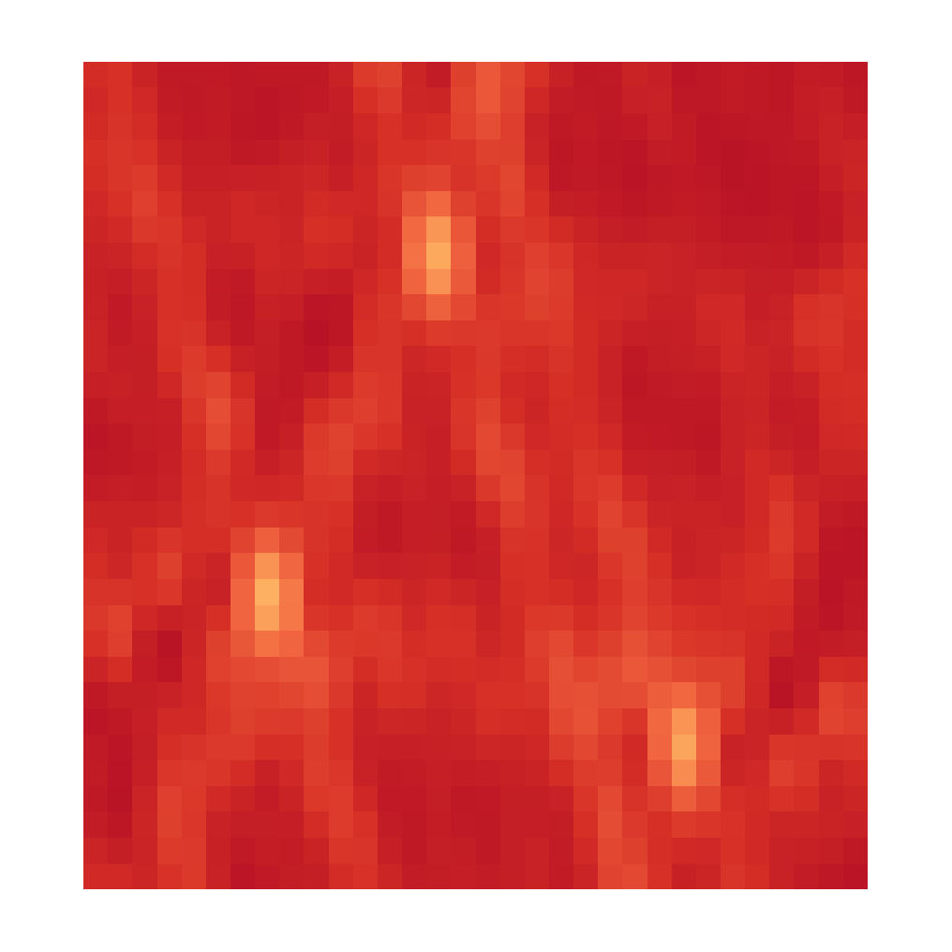

CLEAN, Iteration 4
Dirty Image
Model Image

Slide 12


CLEAN, Iteration X
Dirty Image
Model Image

Slide 13
CLEAN

Slide 14
CLEAN
Find max

Slide 15
CLEAN
Chance that the x is the true image?

Slide 16
CLEAN as a Compressed Sensing Reconstruction
Model map, all the information

Slide 17
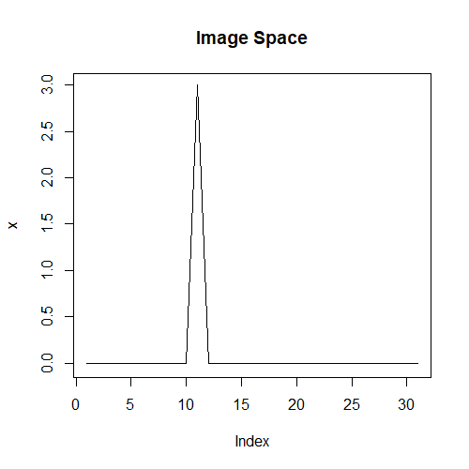
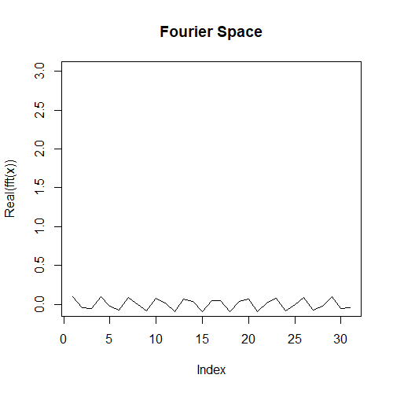
CLEAN as a Compressed Sensing Reconstruction

Slide 18
CLEAN as a Compressed Sensing Reconstruction
Number of measurements depends on the sparse pixels

Slide 19
CLEAN as a Compressed Sensing Reconstruction

Slide 20
Compressed Sensing

Slide 21
CLEAN

Slide 22
CLEAN as a special case of Compressed Sensing

Slide 23
Super Resolution

Slide 24
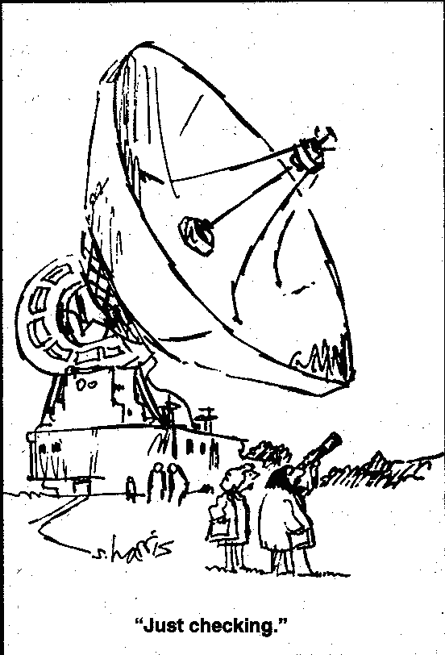
The Problem with Super Resolution…

Slide 25
10 Second Observation Unknown Reconstruction NRAO
Notes:
Low resolution

Slide 26
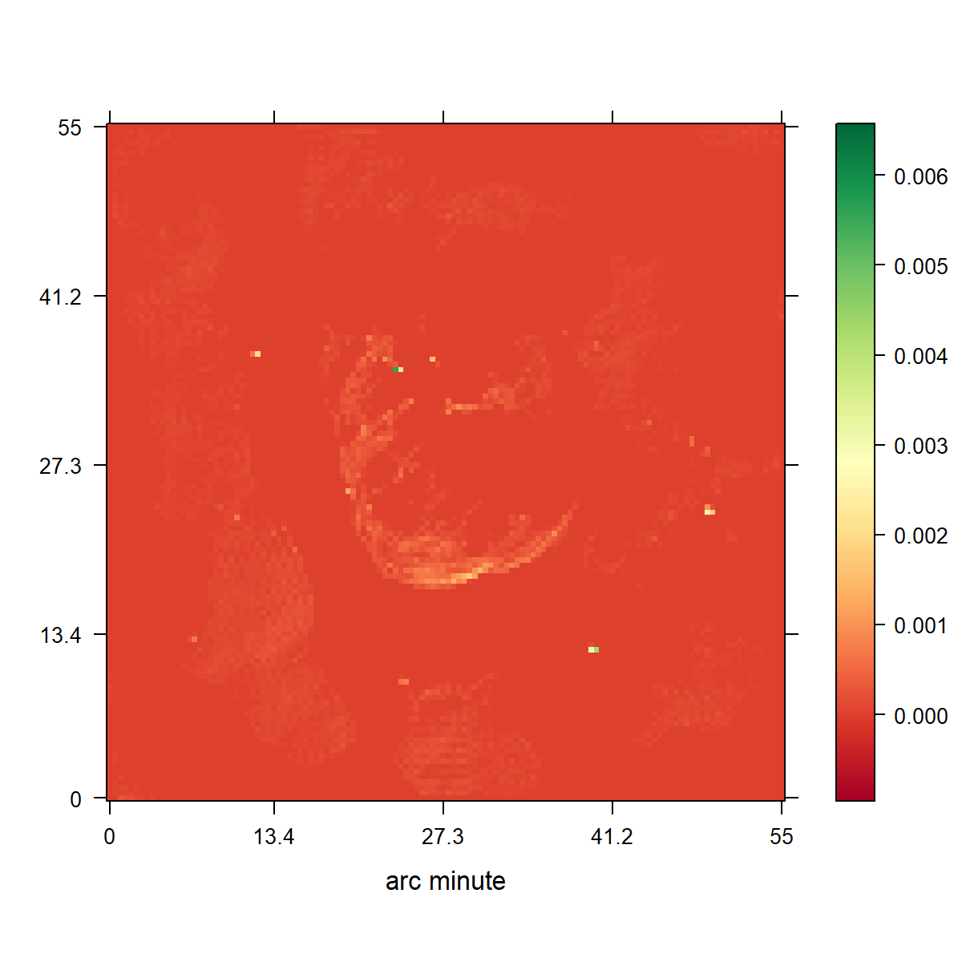
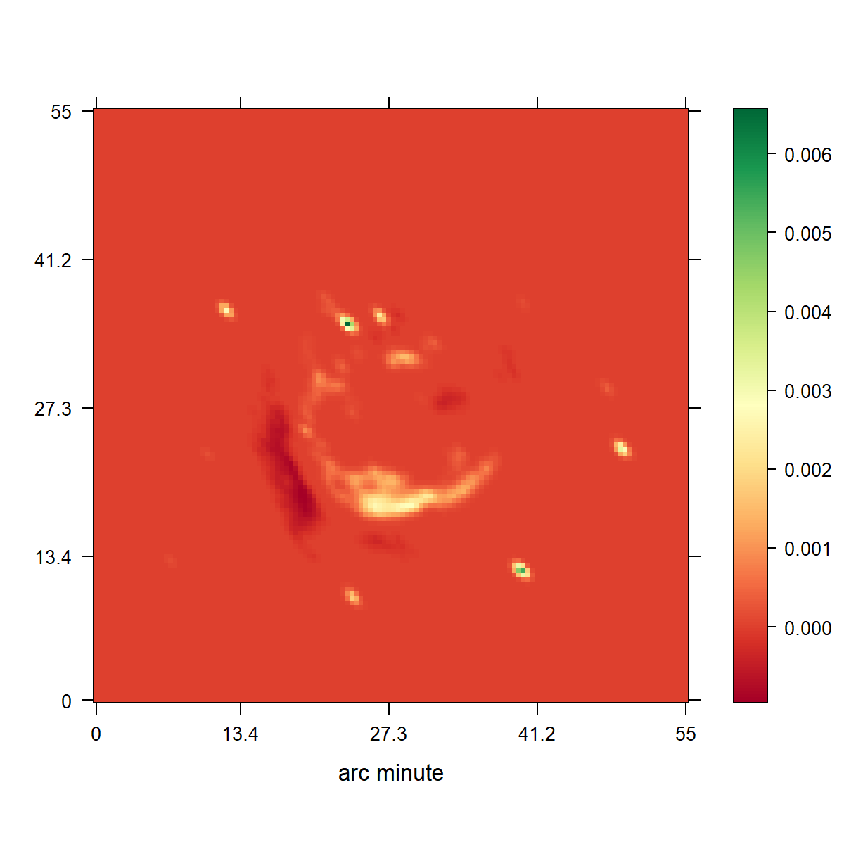
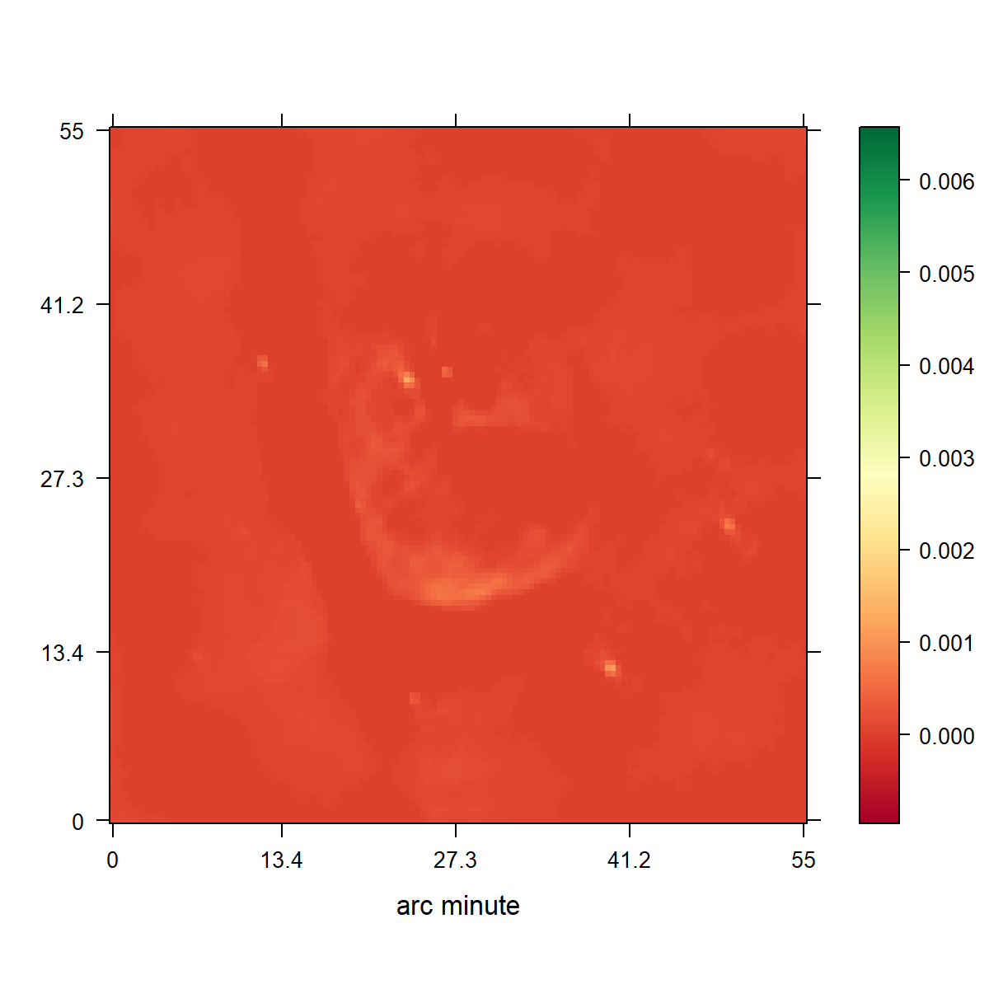
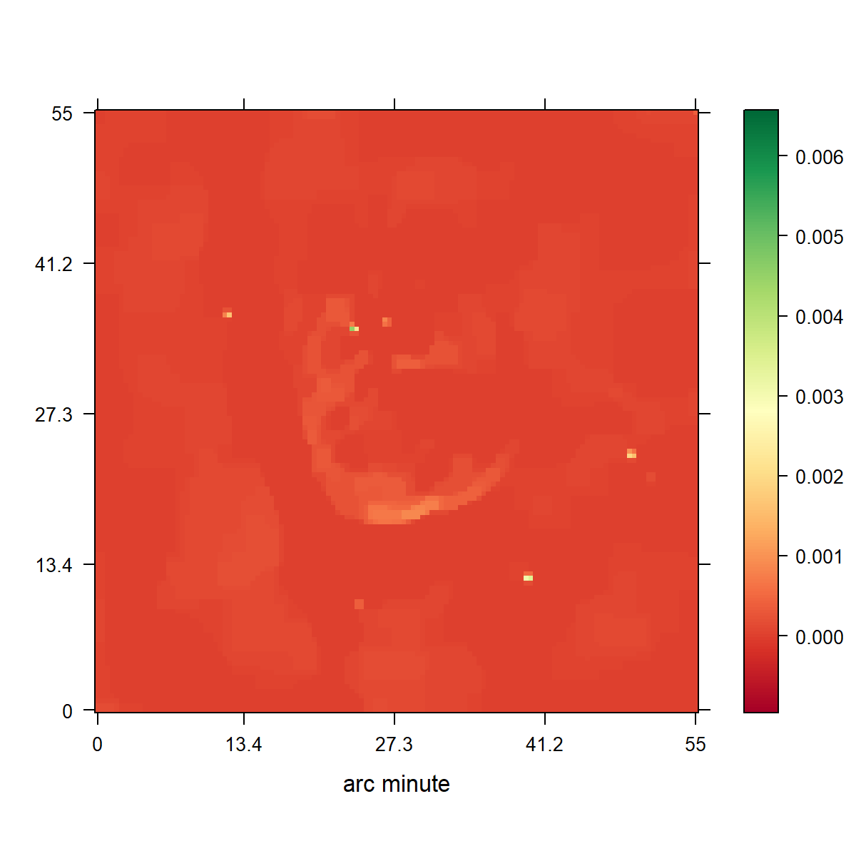

Slide 28
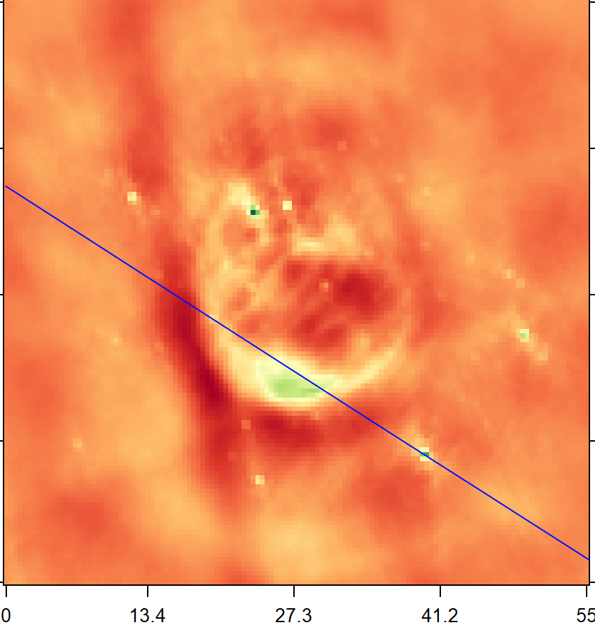
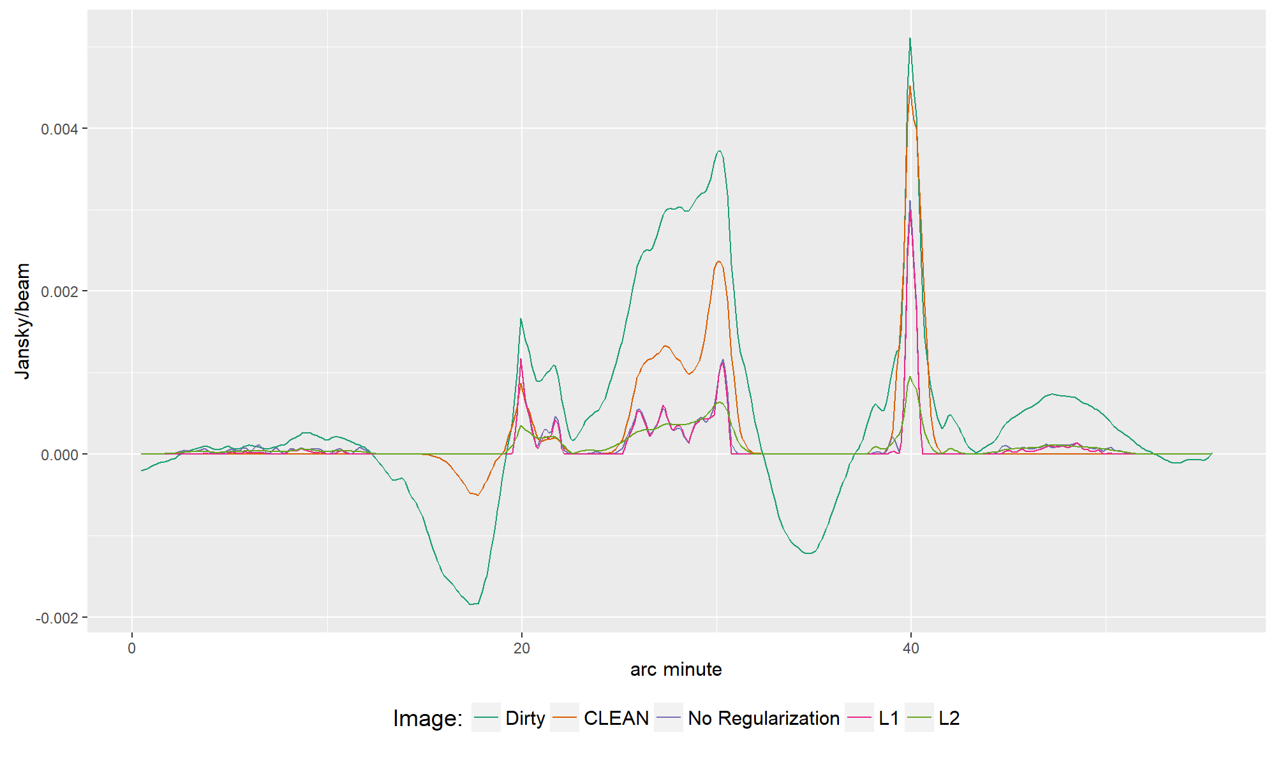

Slide 30
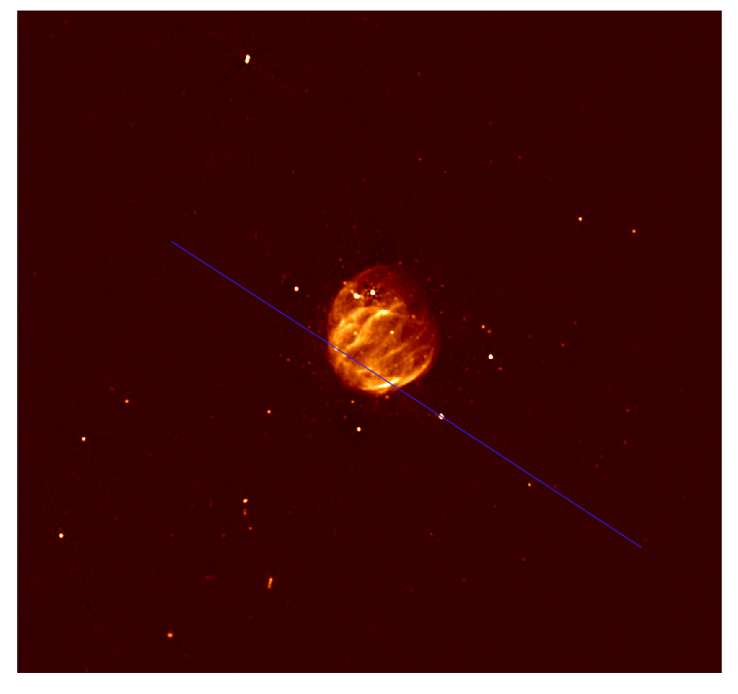

Slide 31
Conclusion

Slide 32
Conclusion

