Slide 1
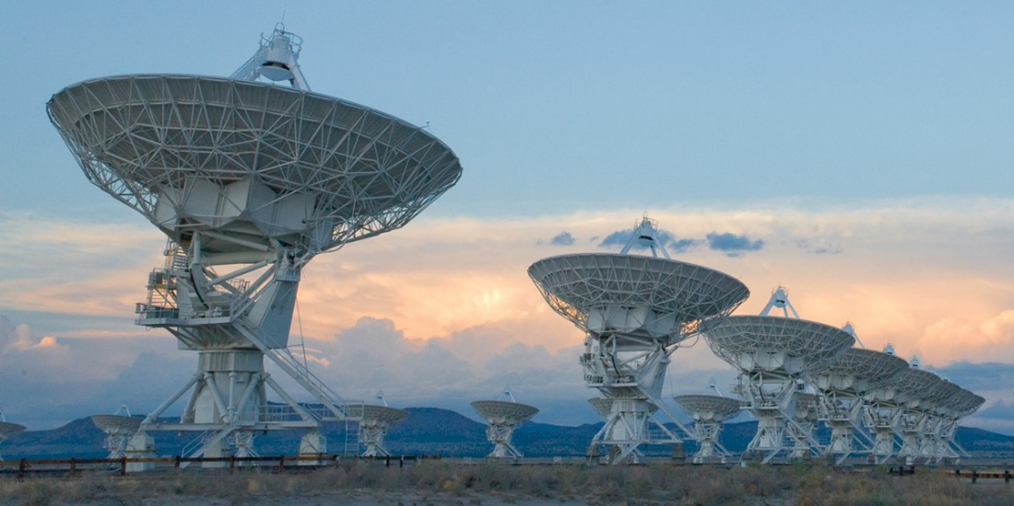
P7 Compressed Sensing Image Reconstruction

Slide 2
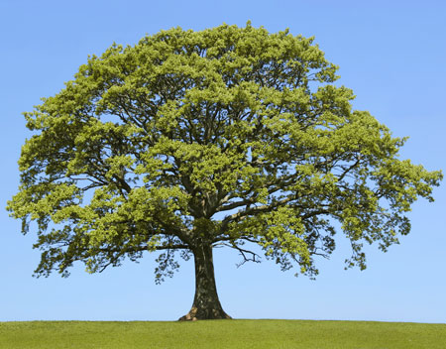

Nyquist Shannon Sampling Rate

Slide 3
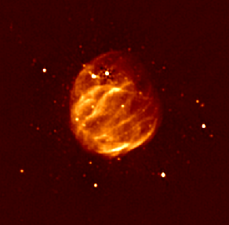
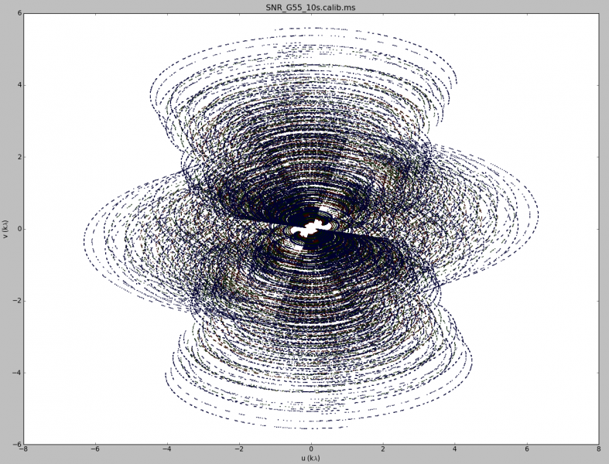
Image Reconstruction

Slide 4
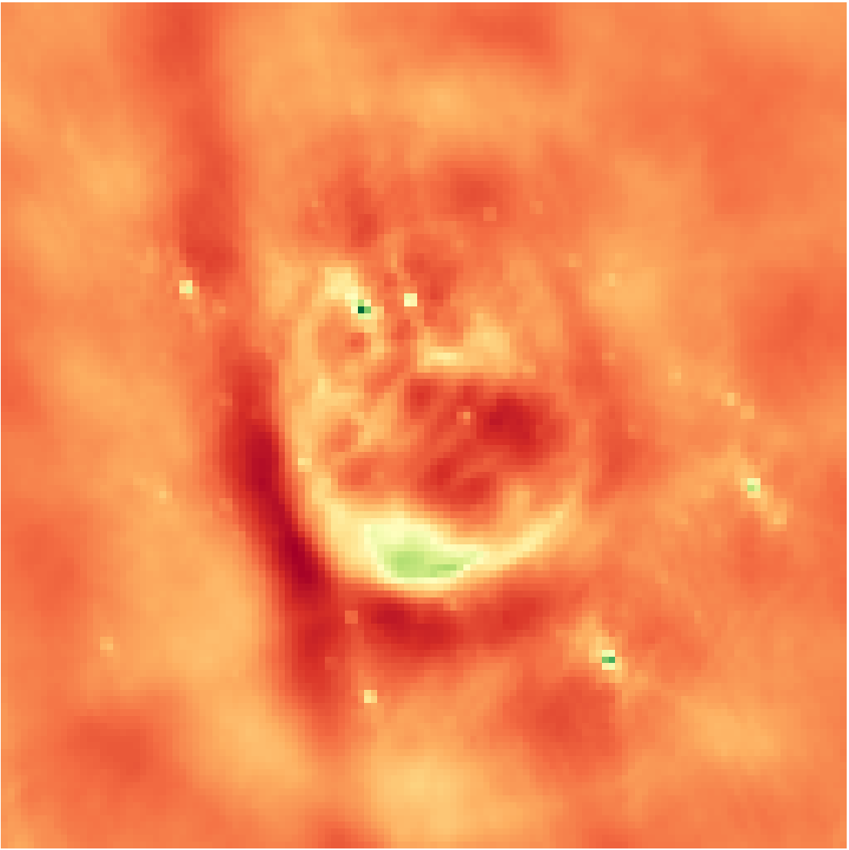
Inverse Fourier Transform
Notes:
Low resolution

Slide 5

Deconvolution
Notes:
From the theory of compressed sensing

Slide 6
Compressed Sensing Reconstruction
Optimization Problem
Objective
Optimizer
A Regularization

Slide 7
CLEAN

Slide 8
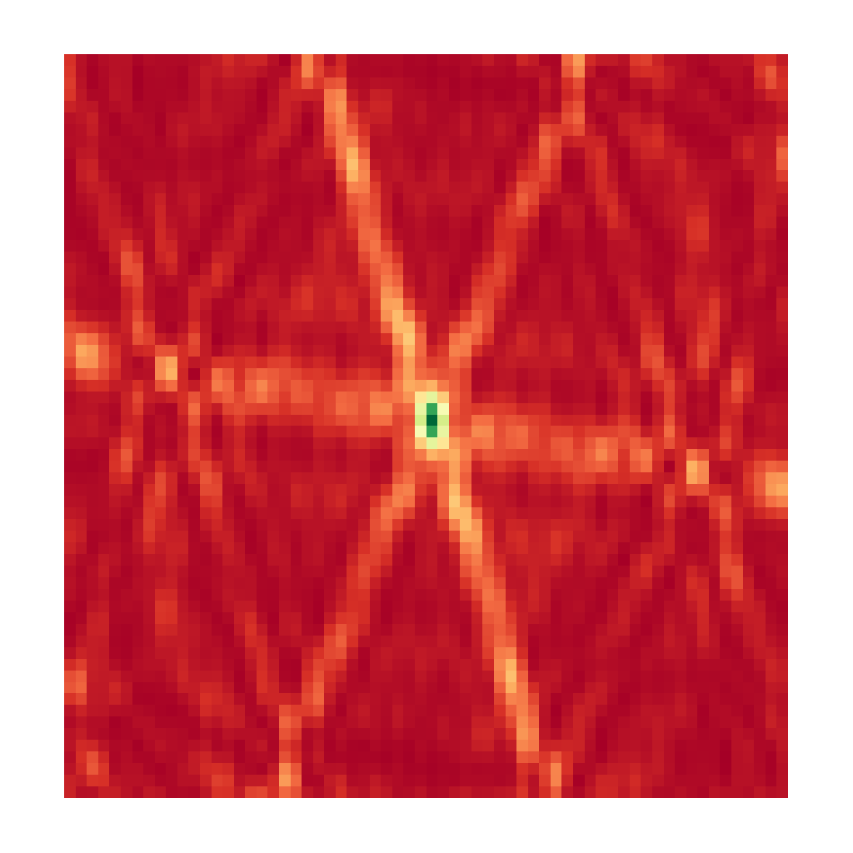
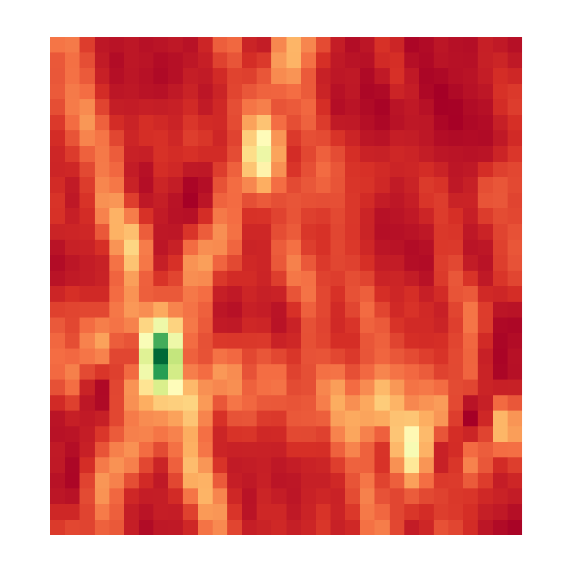

CLEAN, Iteration 0
Dirty Image
Model Image

Slide 9
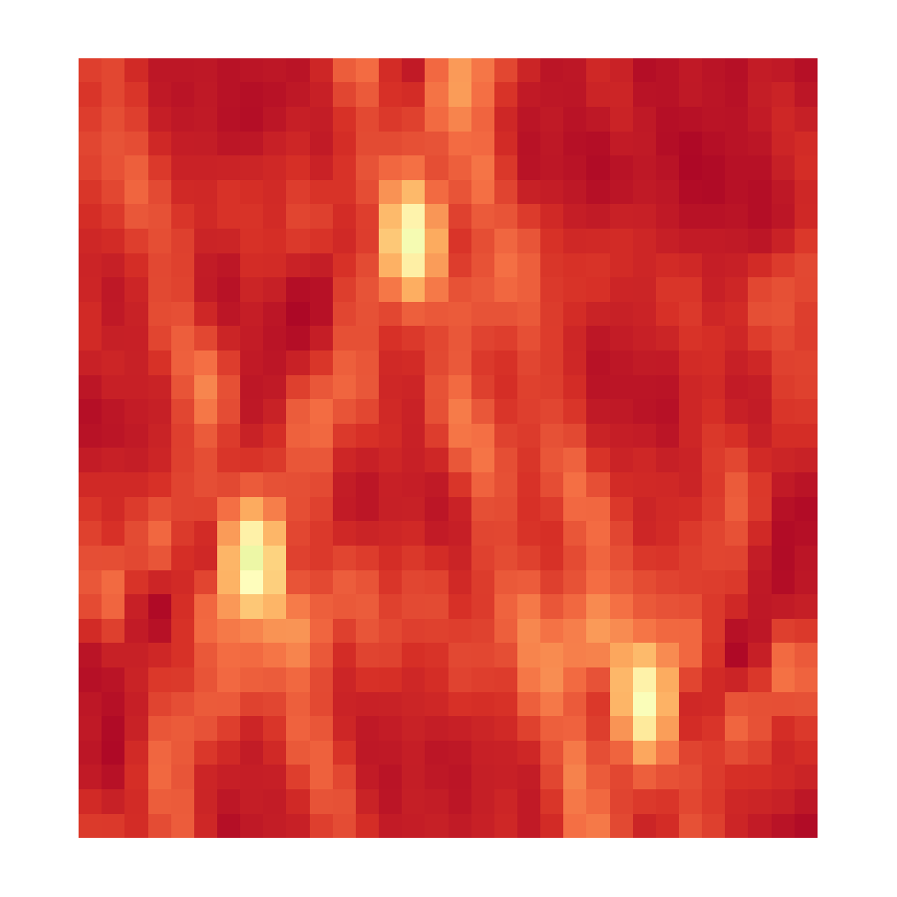

CLEAN, Iteration 1
Dirty Image
Model Image

Slide 10
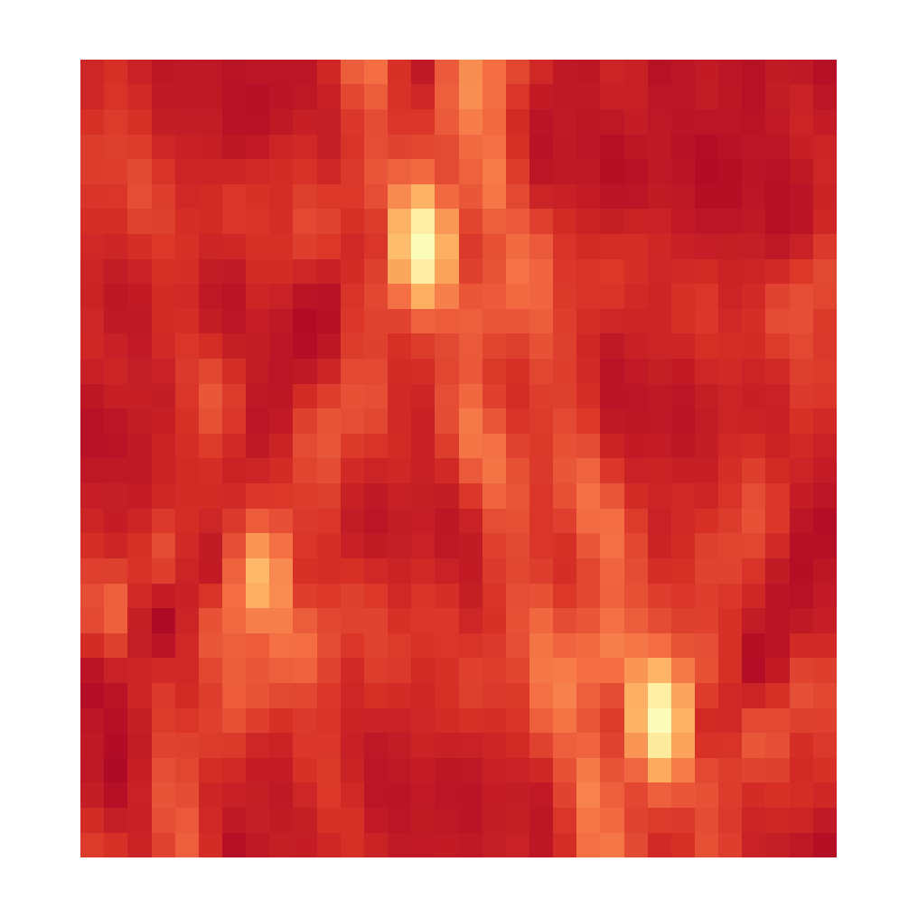

CLEAN, Iteration 2
Dirty Image
Model Image

Slide 11
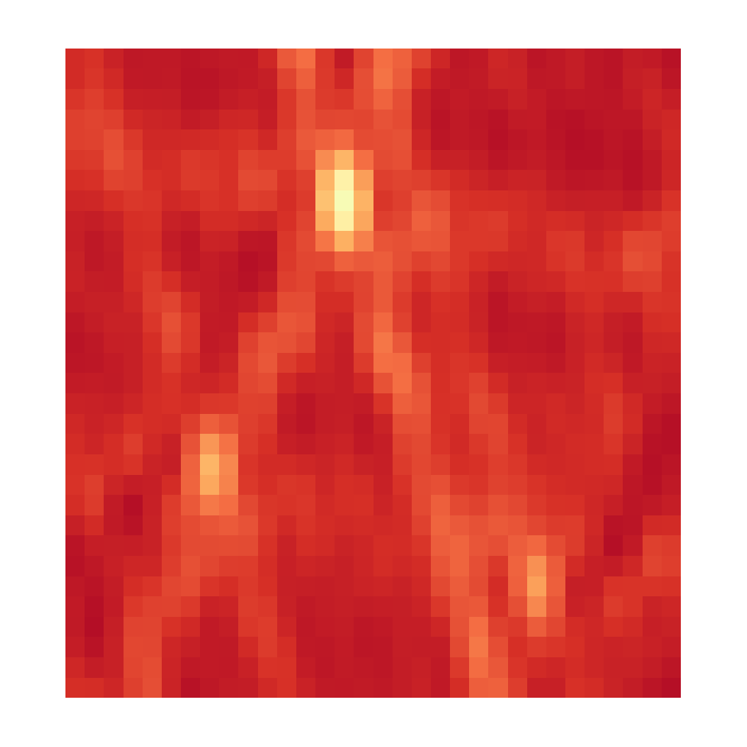

CLEAN, Iteration 3
Dirty Image
Model Image

Slide 12
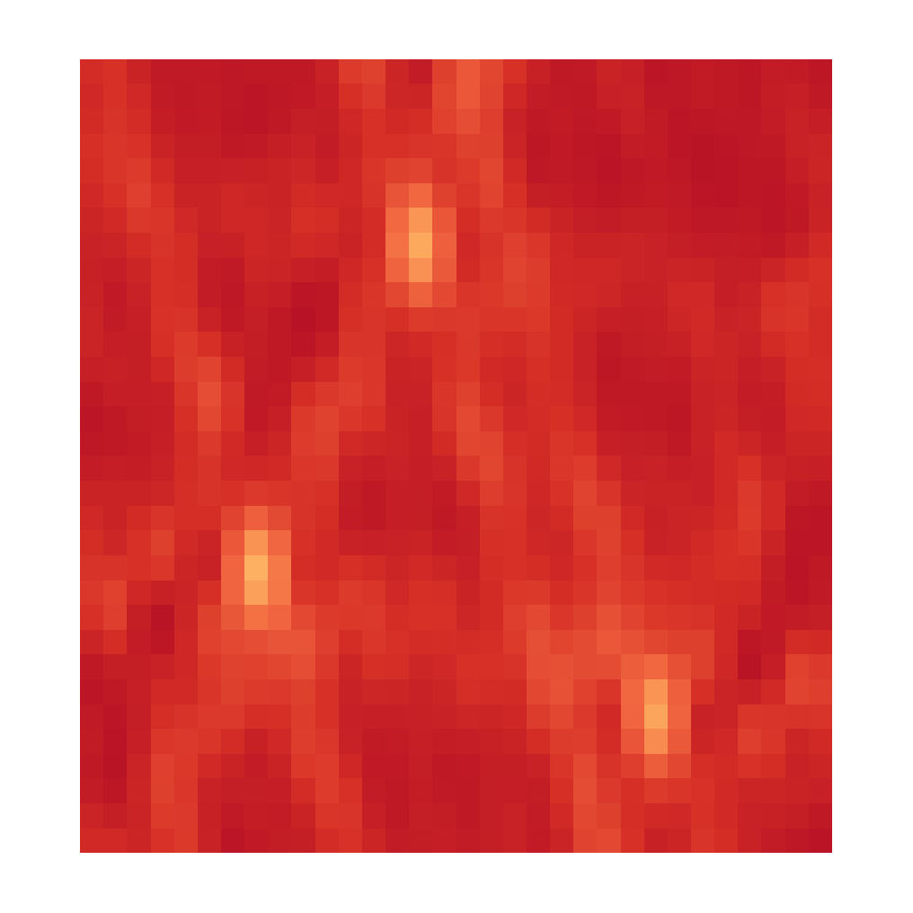

CLEAN, Iteration 4
Dirty Image
Model Image

Slide 13


CLEAN, Iteration X
Dirty Image
Model Image

Slide 14
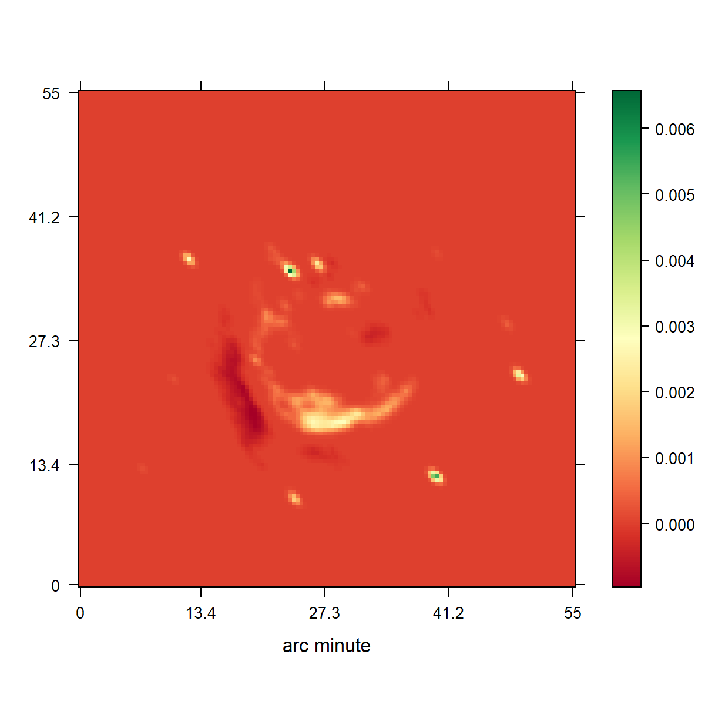
CLEAN
Notes:
Low resolution

Slide 15
Compressed Sensing Image Reconstruction
Regularization that captures the image properties
Incoherent Measurement and Reconstruction spaces.

Slide 16
CLEAN as a Compressed Sensing Reconstruction
Notes:
Camera Pixels
Many samples, most contain no information

Slide 17
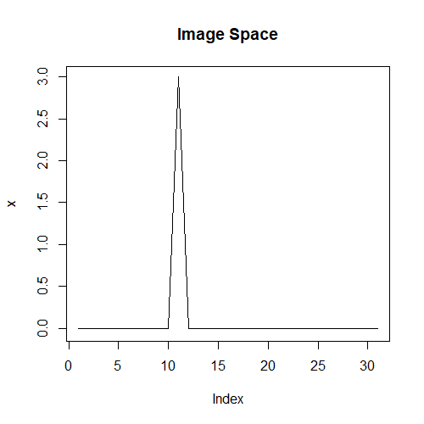
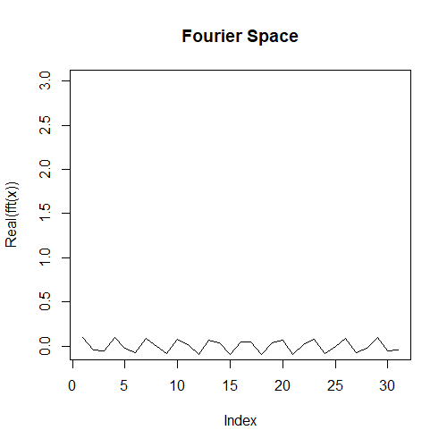
Incoherence

Slide 18
CLEAN as a Compressed Sensing Reconstruction

Slide 19
CLEAN as a Compressed Sensing Reconstruction

Slide 20
Compressed Sensing

Slide 21
10s VLA Observation
NRAO Reconstruction
Notes:
Low resolution

Slide 22
Compressed Sensing Image Reconstruction
Objective
Optimizer → Gurobi
A Regularization
L0
L1
L2
TV
L1 of Haar Wavelets
L1 of Starlets
…

Slide 23
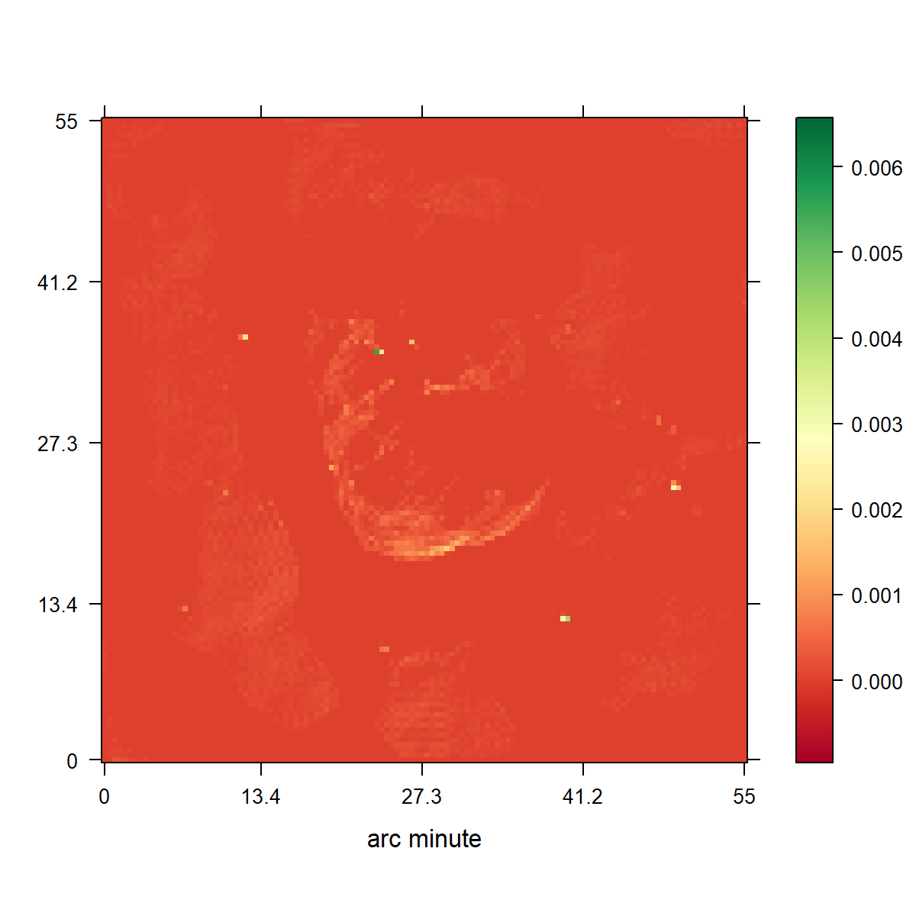
CLEAN
L1 Regularization

Slide 24
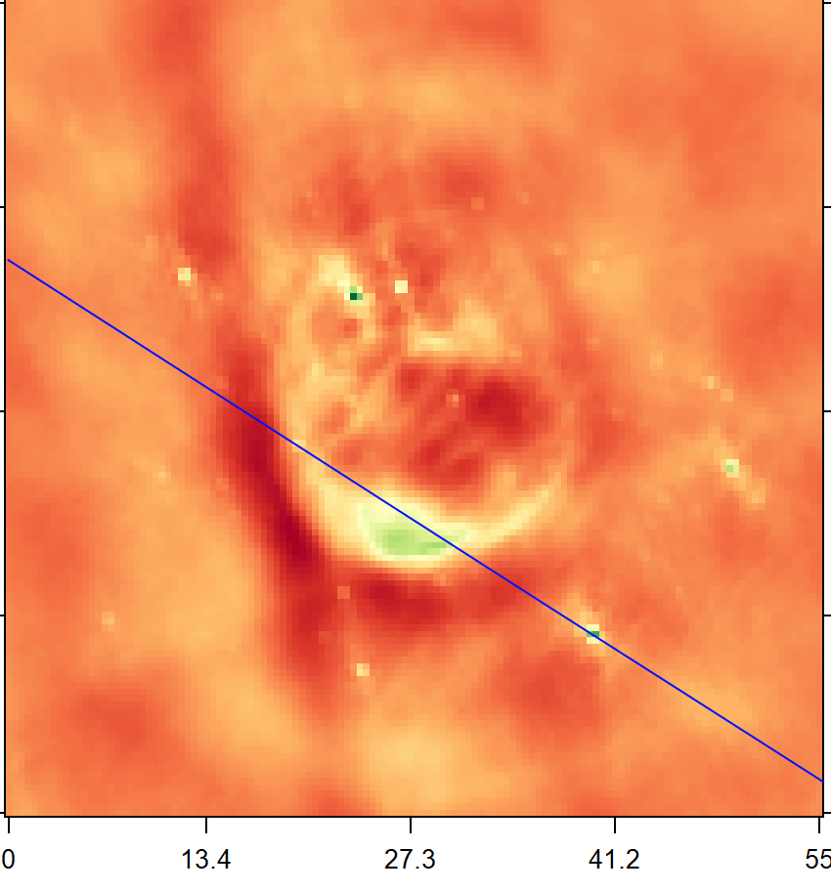
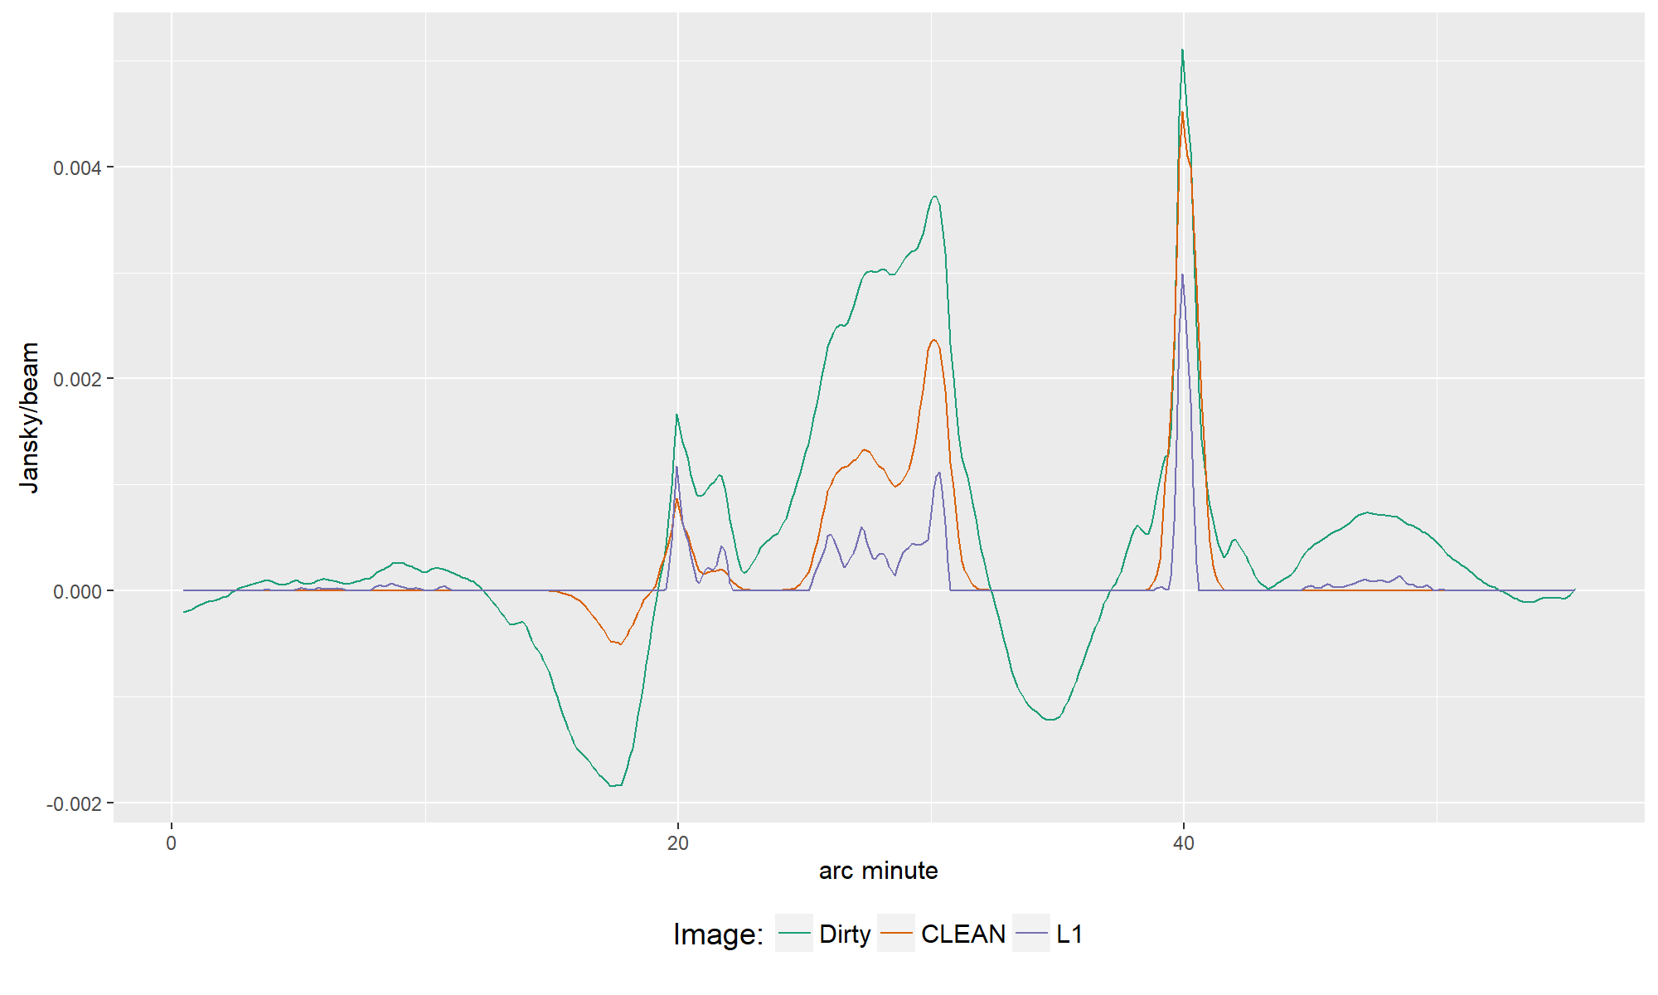

Slide 25
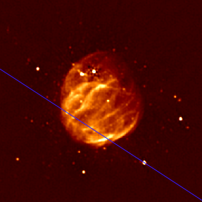
§§§§§§§§§§§§§§§§§§§§§§§§§§§§§§§§§§§§§§§§§§§§§§§§§§§§§§§§§§§§§§§§§§§§§§§§§§§§§§§§§§§§§§§§§§§§§§§§§§§§§§§§§§§§§§§§§§§§§§§§§§§§§§§§§§§§§§§§§§§§§§§§§§§§§§§§§§§§§§§§§§§§§§§§§§§§§§§§§§§§§§§§§§§§§§§§§§§§§§§§§§§§§§§§§§§§§§§§§§§§§§§§§§§§§§§§§§§§§§§§§§§§§§§§§§§§§§§§§§§§§§§§§§§§§§§§§§§§§§§§§§§§§§§§§§§§§§§§§§§§§§§§§§§§§§§§§§§§§§§§§§§§§§§§§§§§§§§§§§§§§§§§§§§§§§§§§§§§§§§§§§§§§§§§§§§§§§§§§§§§§§§§§§§§§

Slide 26
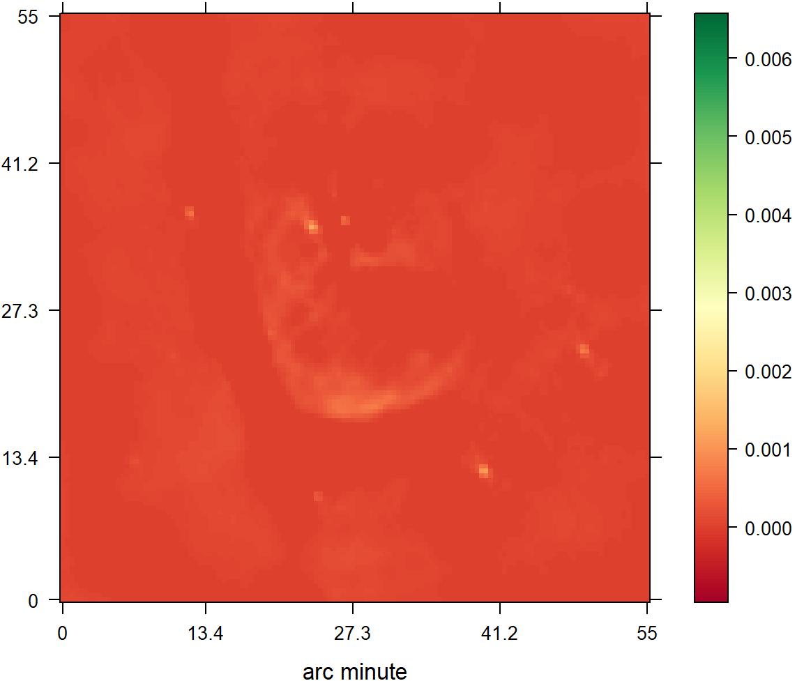
CLEAN
L2 Regularization

Slide 27
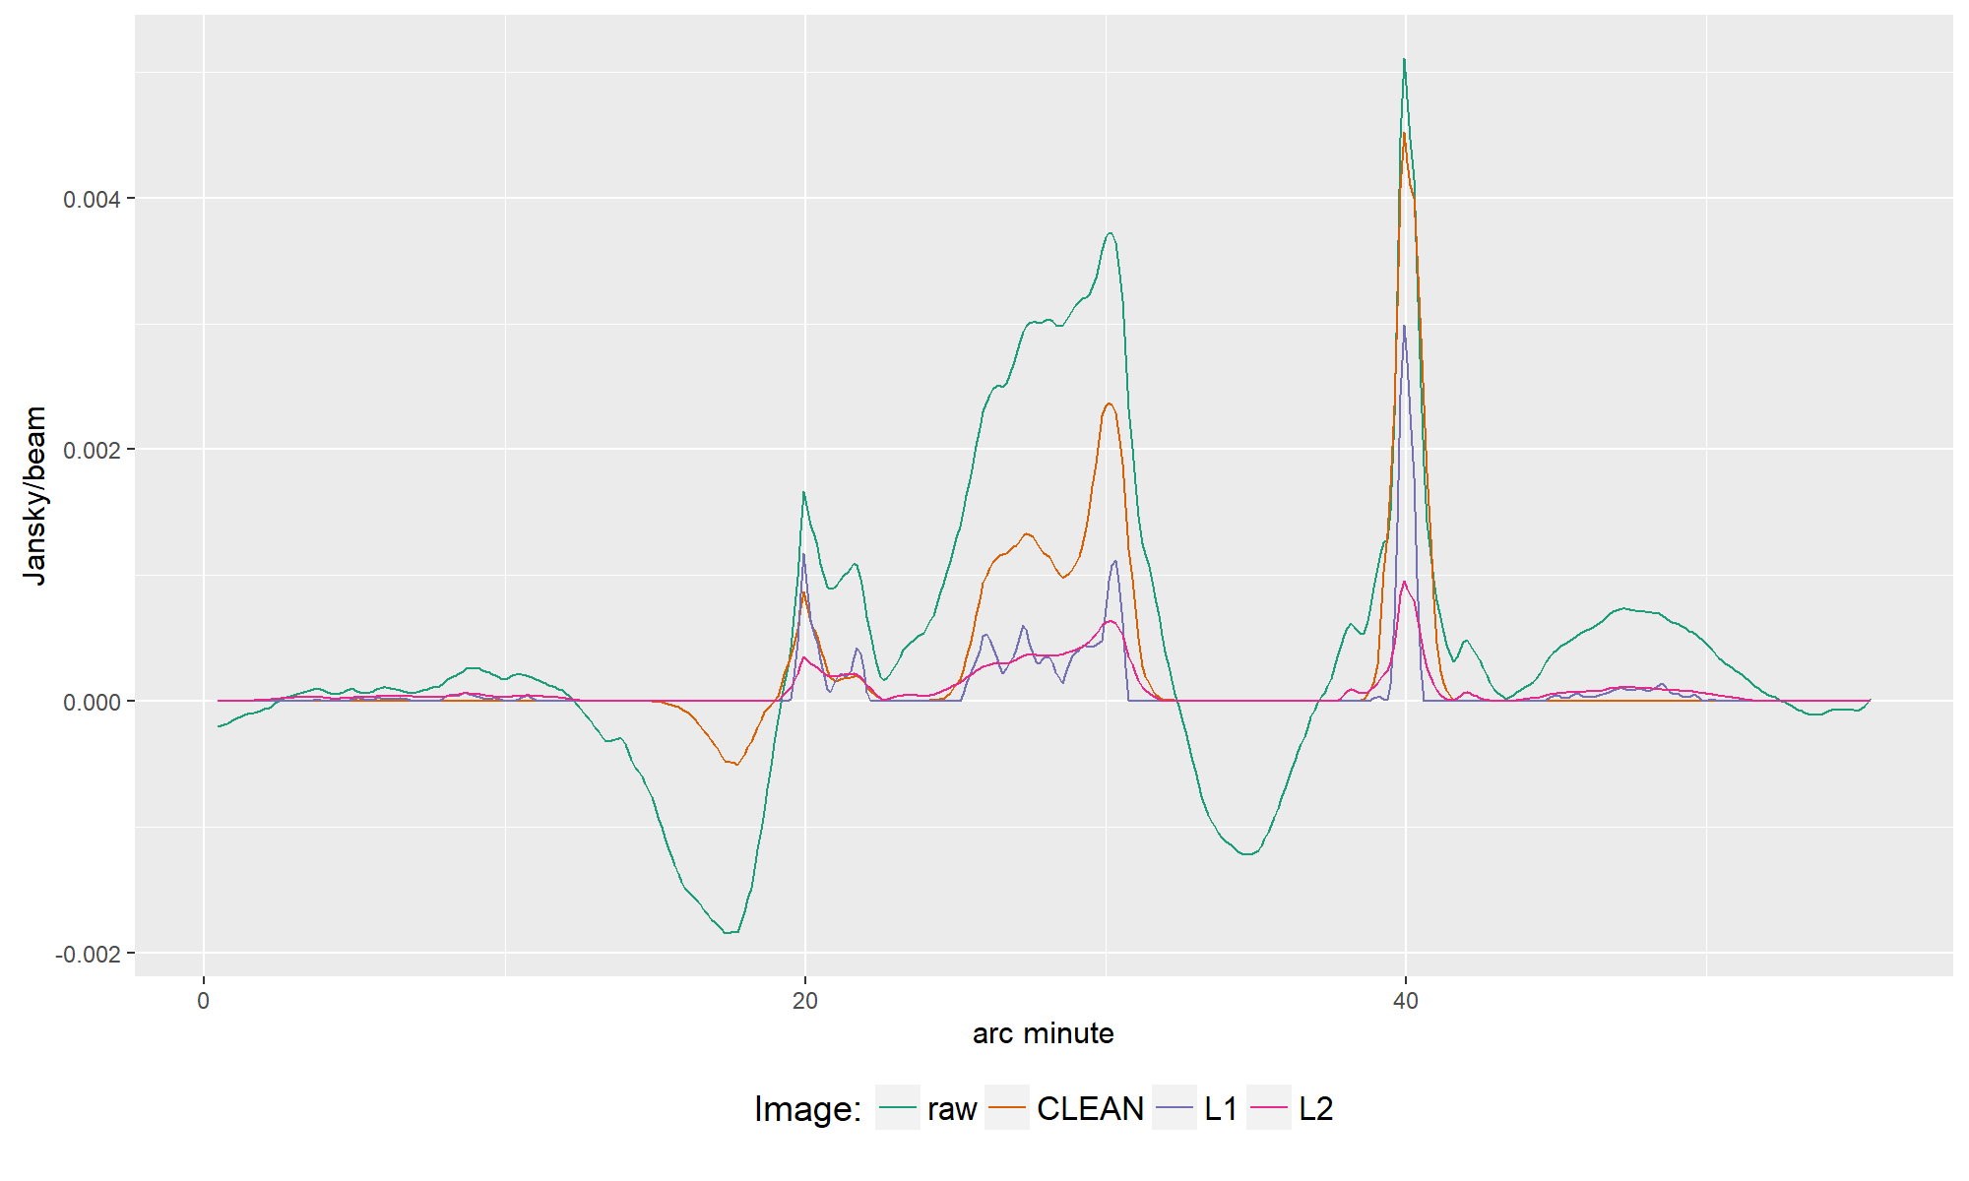

Slide 28
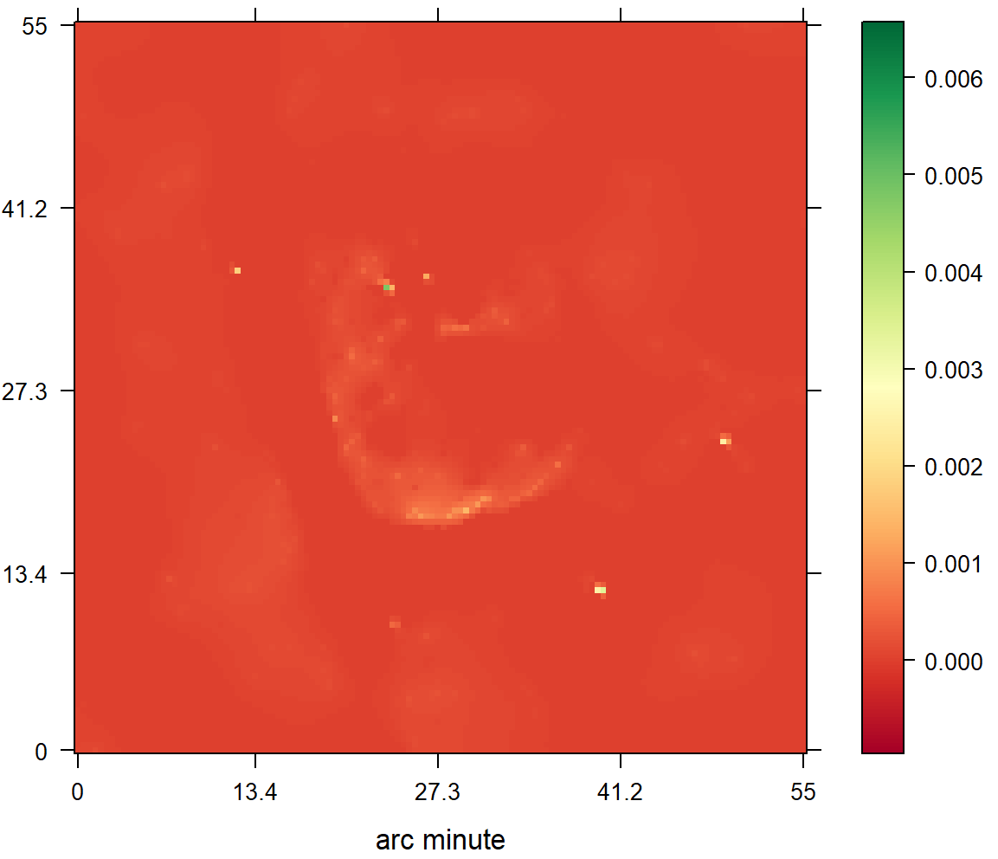
CLEAN
Starlets

Slide 29
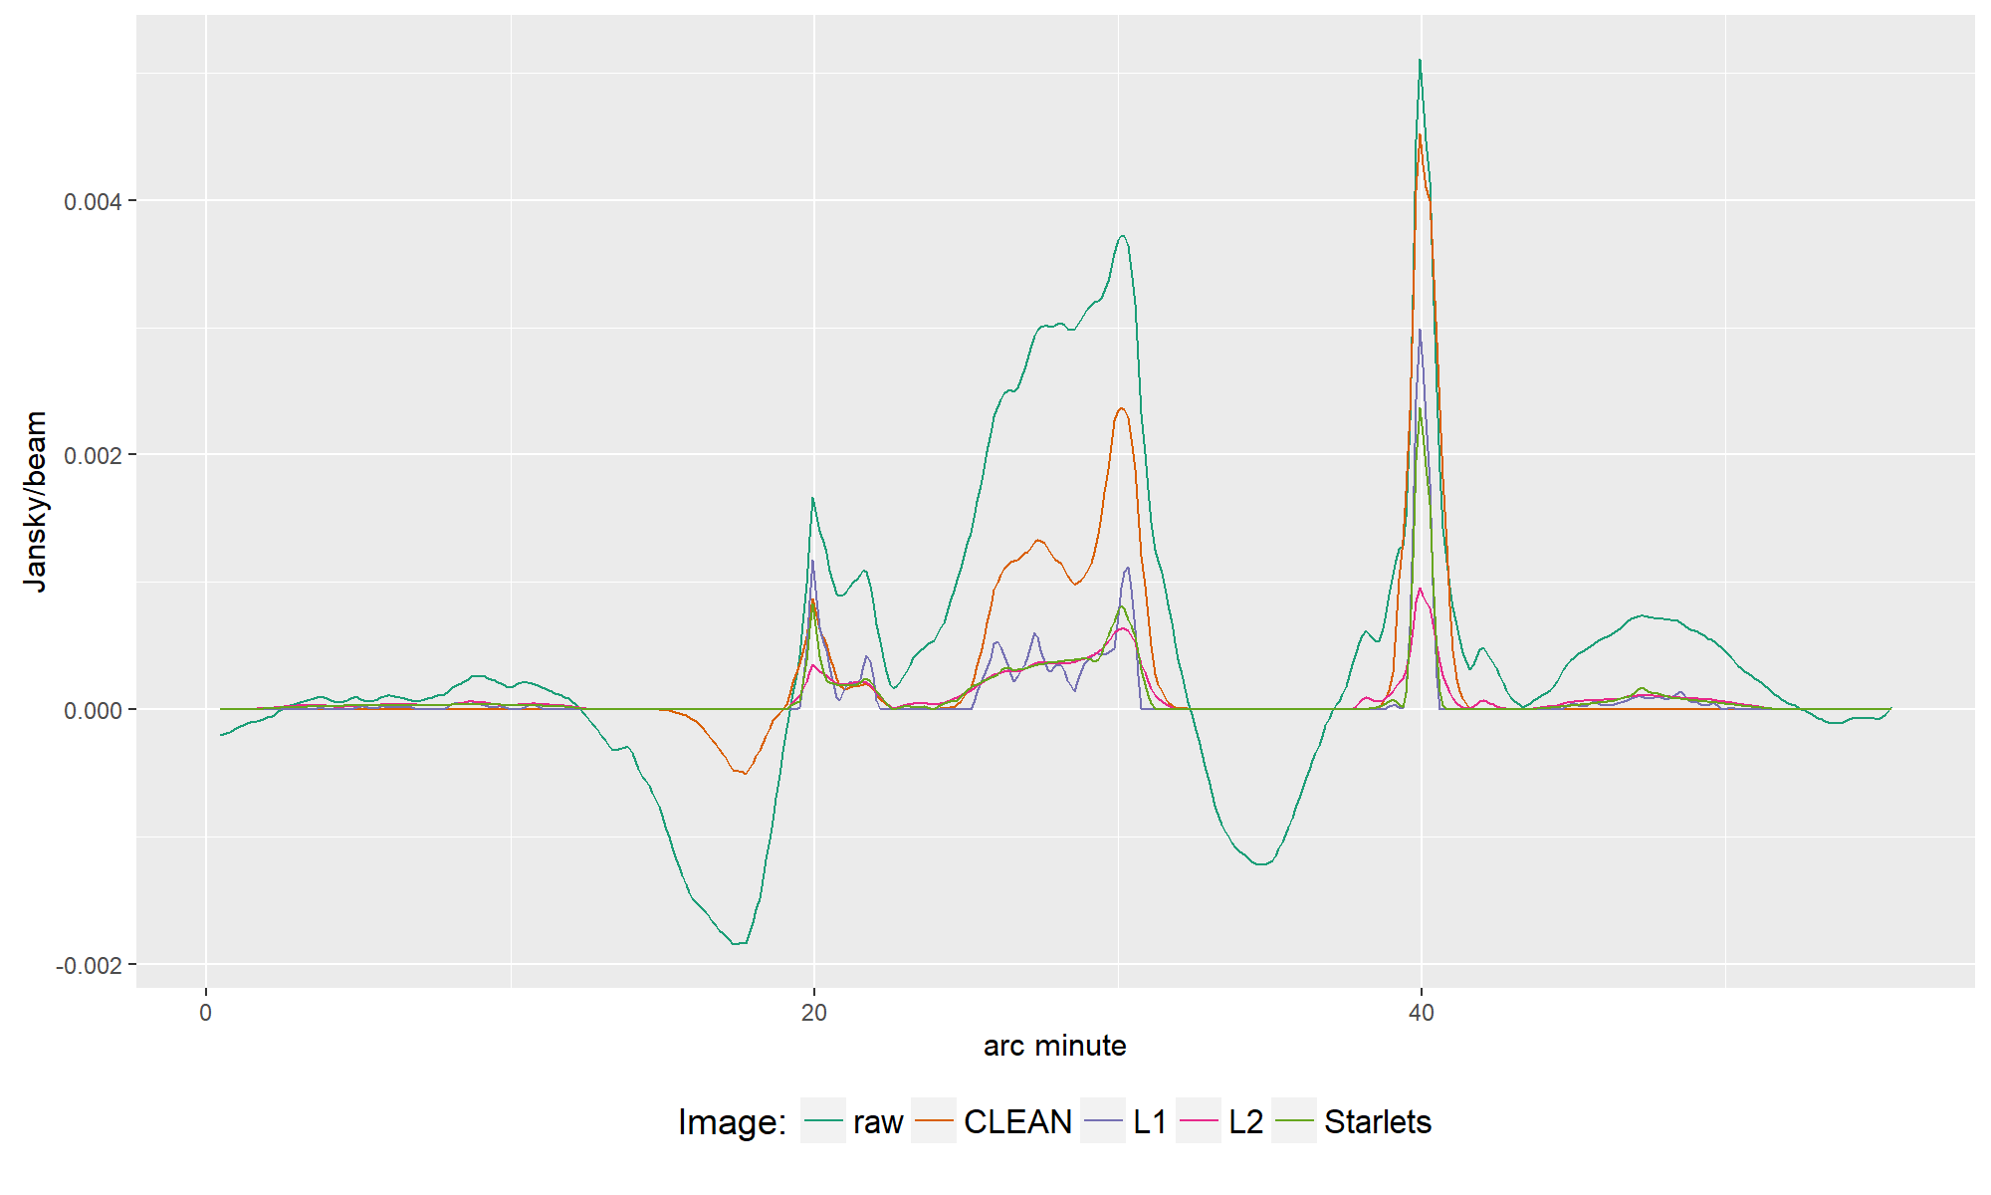

Slide 30
Super Resolution?

Slide 31
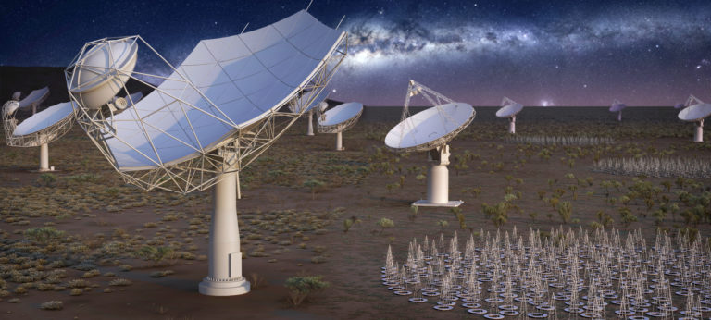
Future

Slide 32
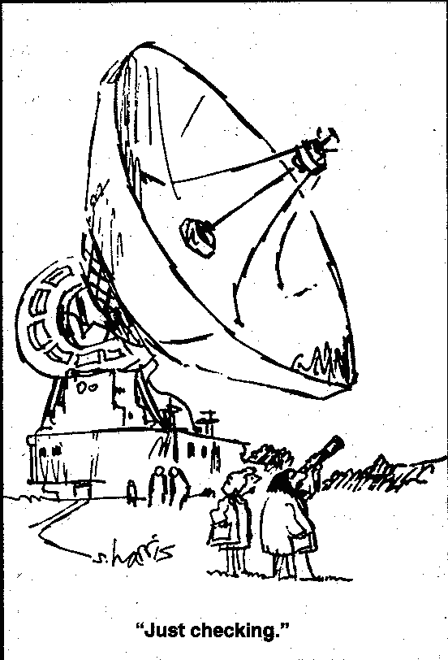

Slide 33
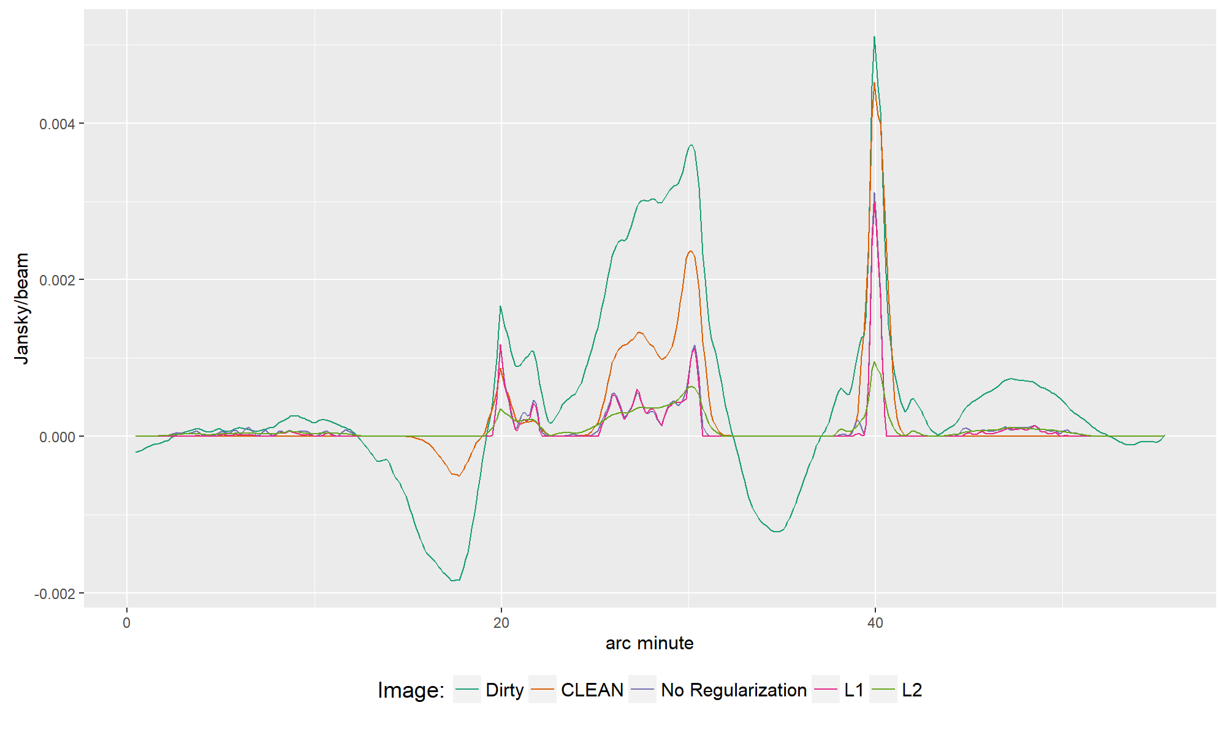

Slide 34
