Slide 1
Compressed Sensing Image Reconstruction

Slide 2
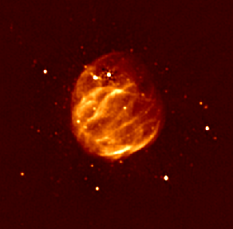
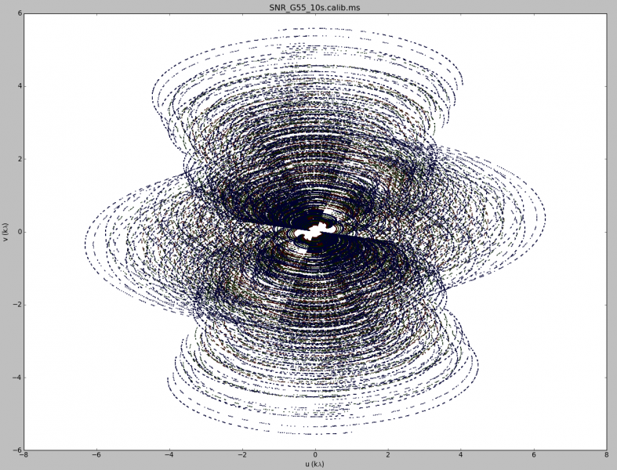
Image Reconstruction

Slide 3
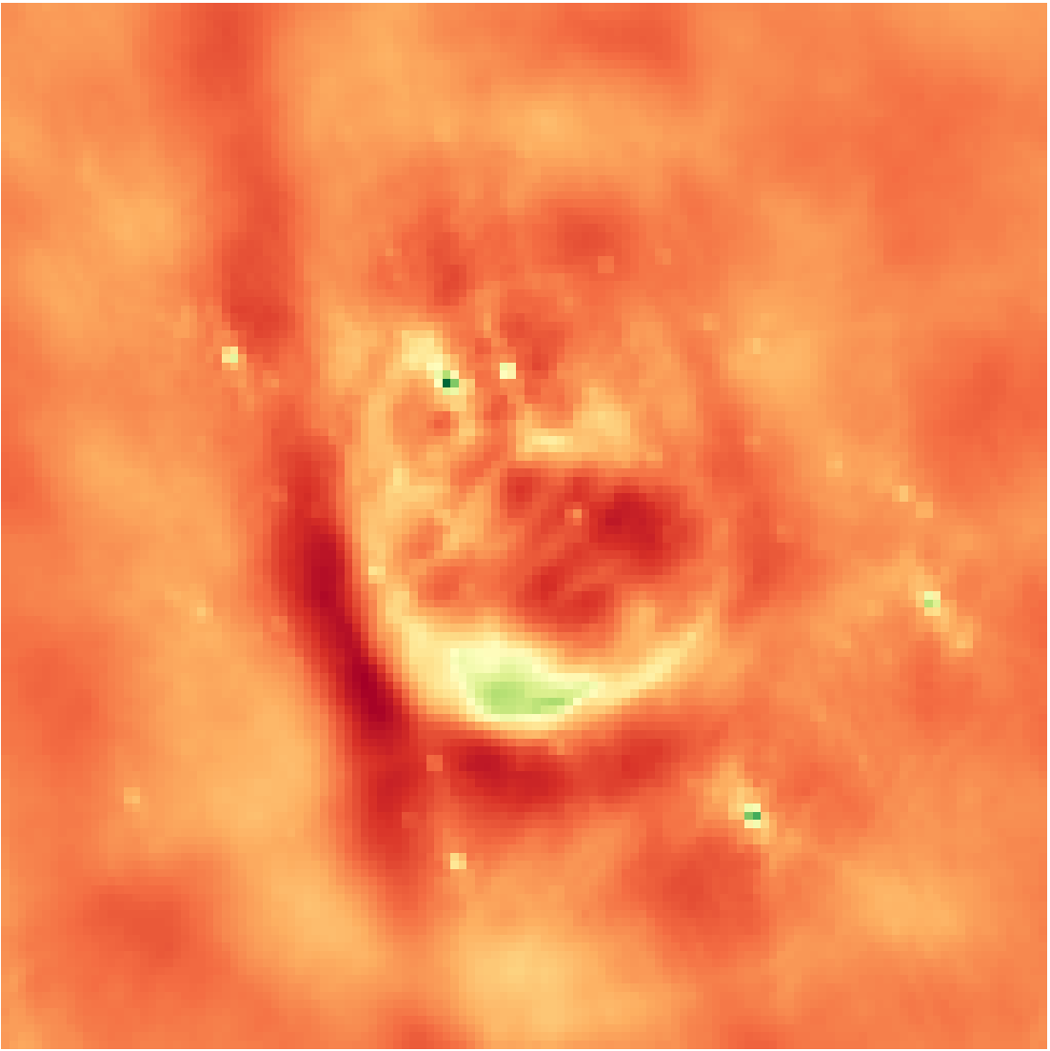
Inverse Fourier Transform
Notes:
Low resolution

Slide 4

Deconvolution
Notes:
From the theory of compressed sensing

Slide 5
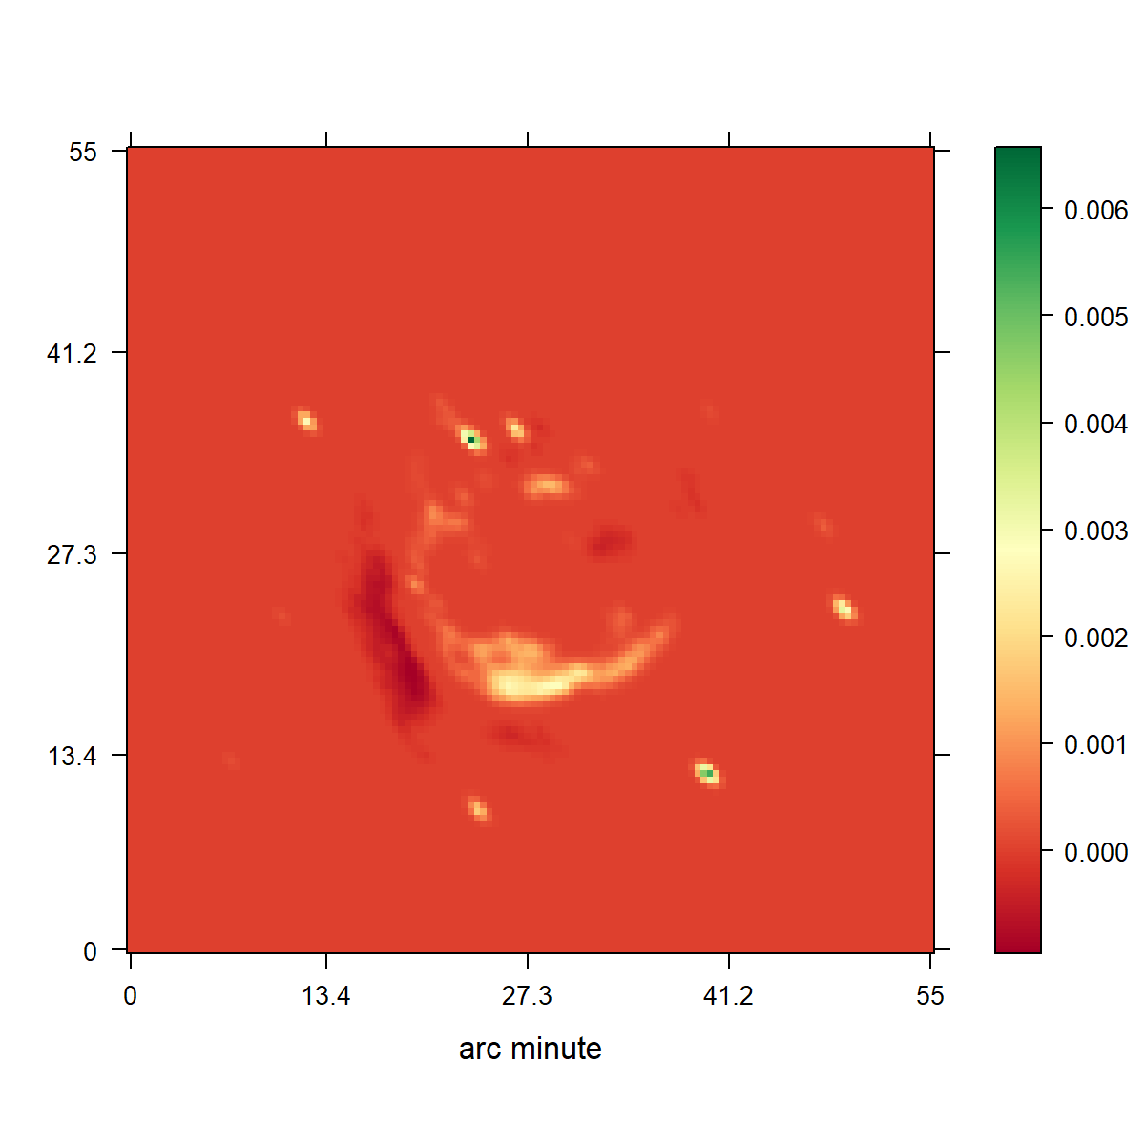
CLEAN
Notes:
Low resolution

Slide 6
CLEAN

Slide 7
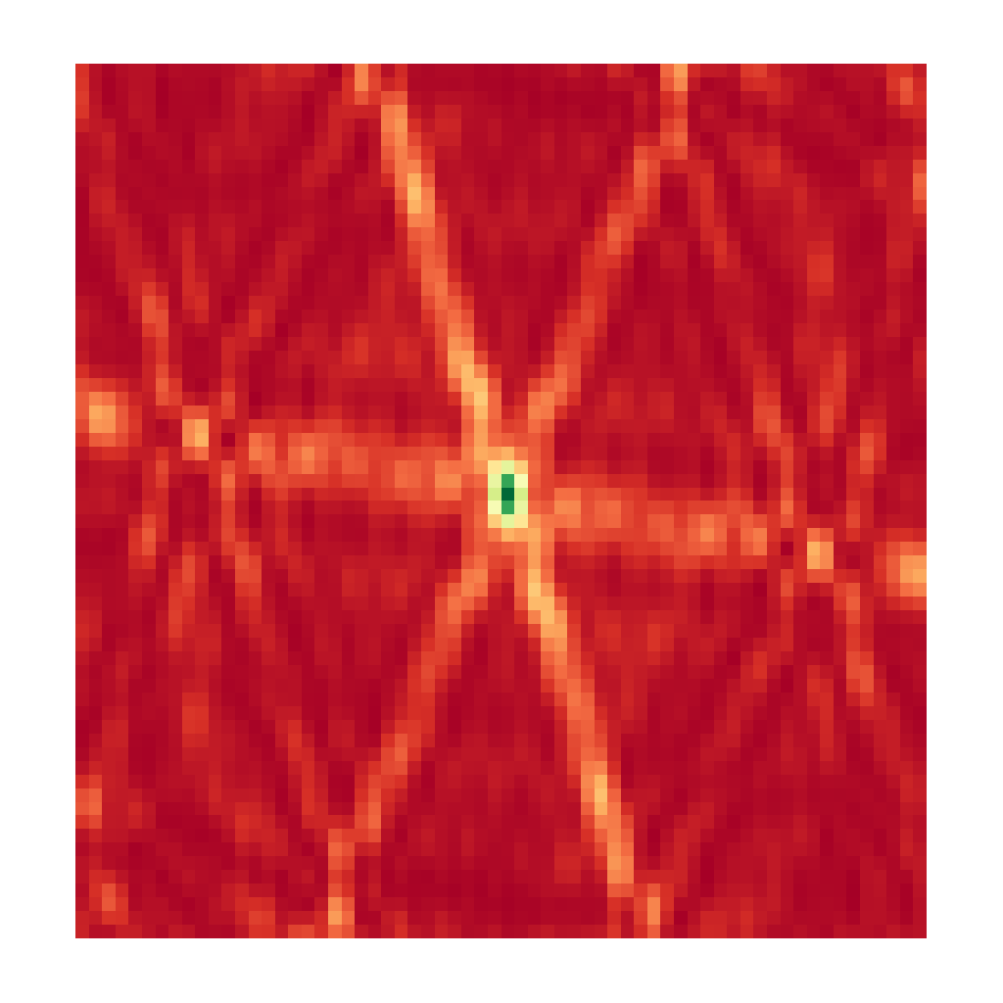
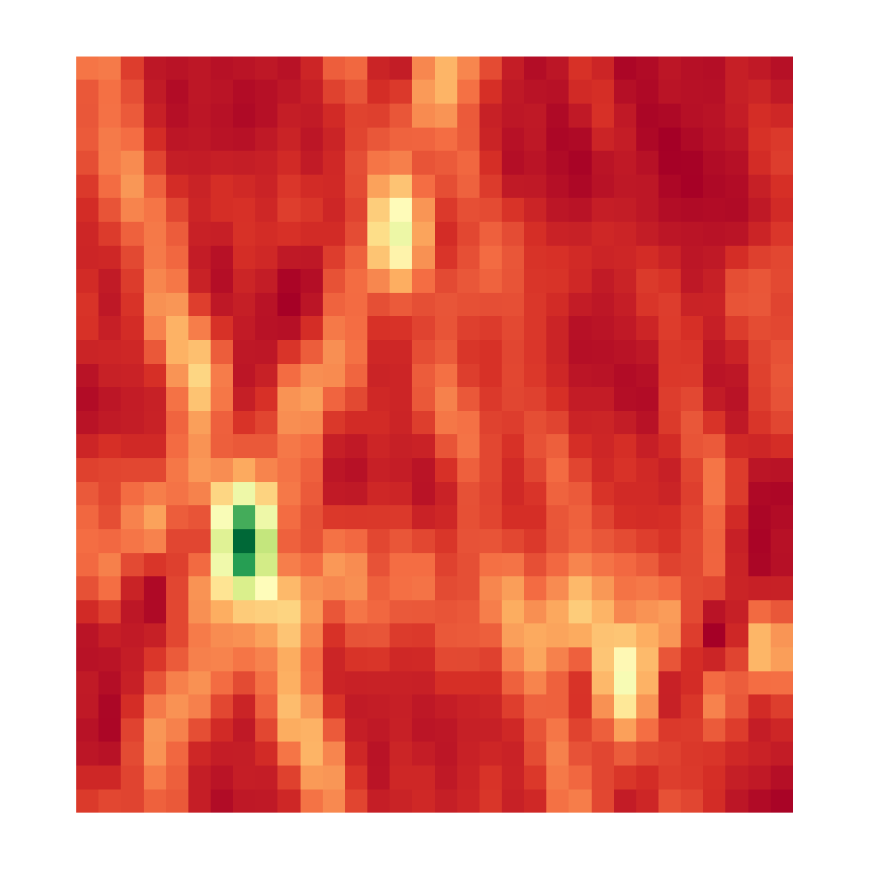

CLEAN, Iteration 0
Dirty Image
Model Image

Slide 8
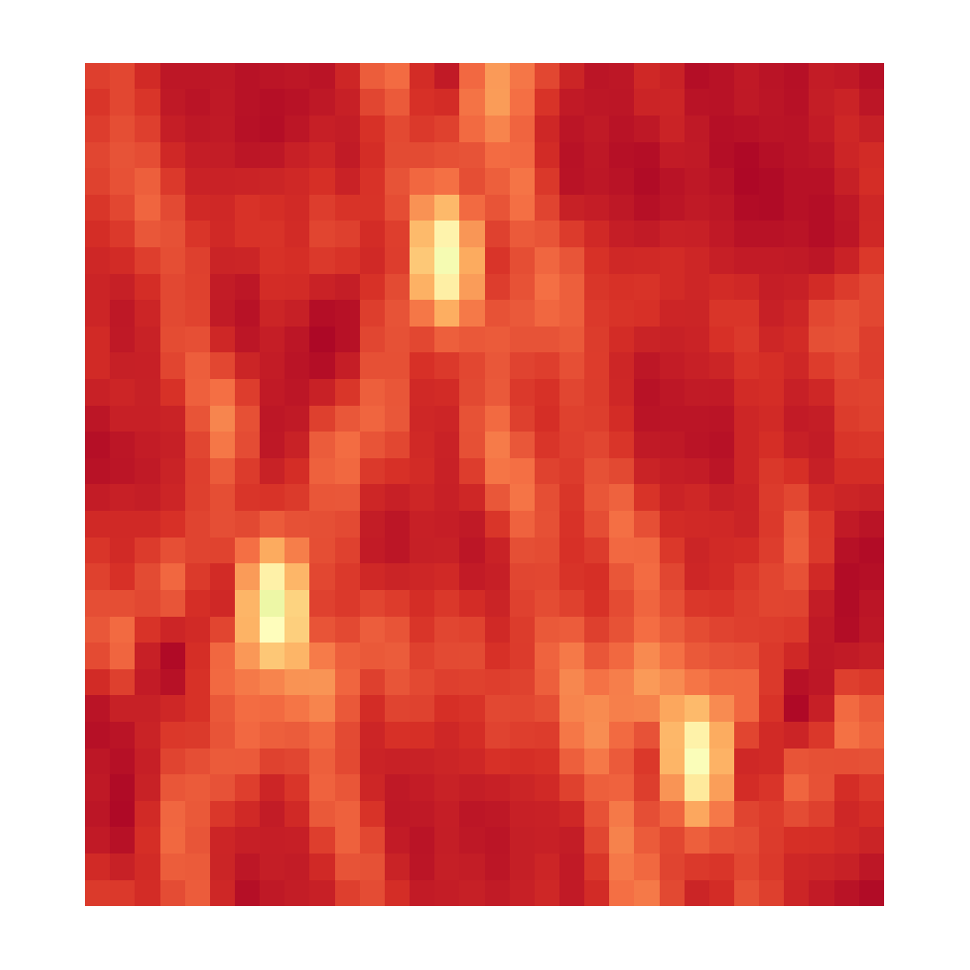

CLEAN, Iteration 1
Dirty Image
Model Image

Slide 9
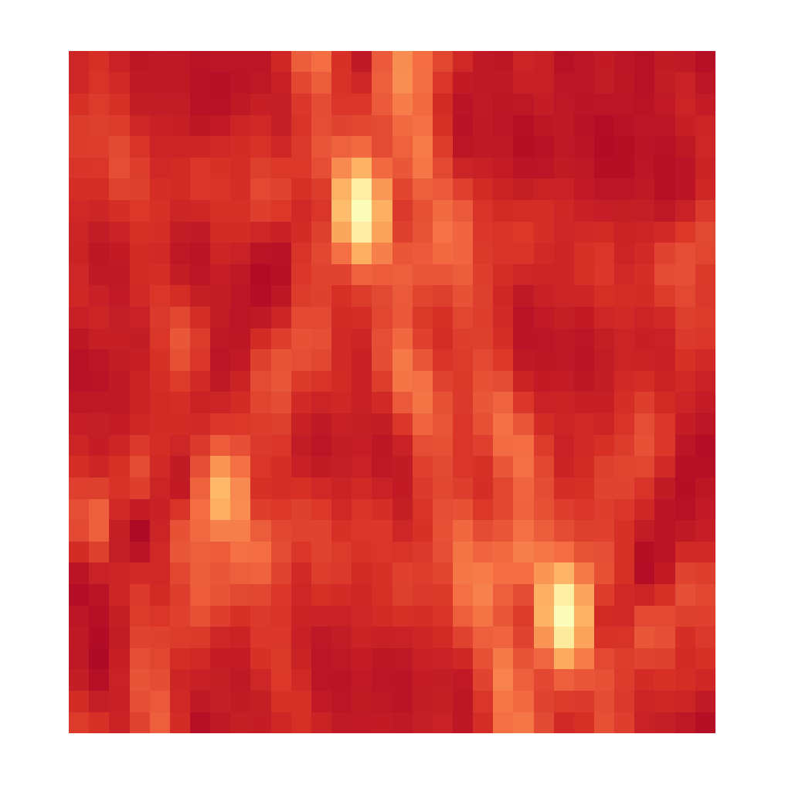

CLEAN, Iteration 2
Dirty Image
Model Image

Slide 10
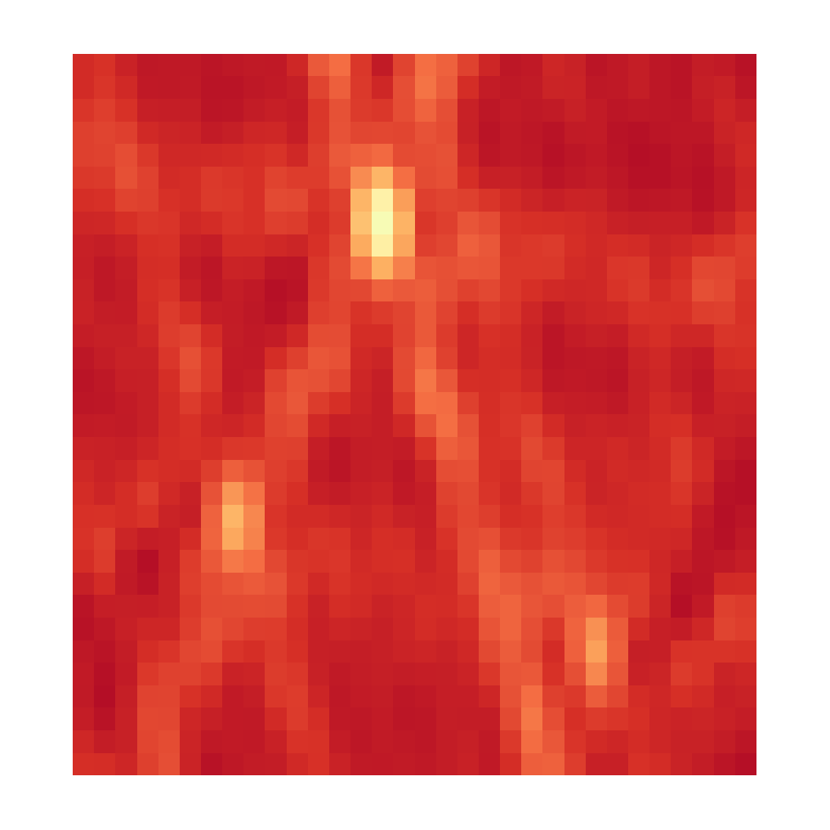

CLEAN, Iteration 3
Dirty Image
Model Image

Slide 11
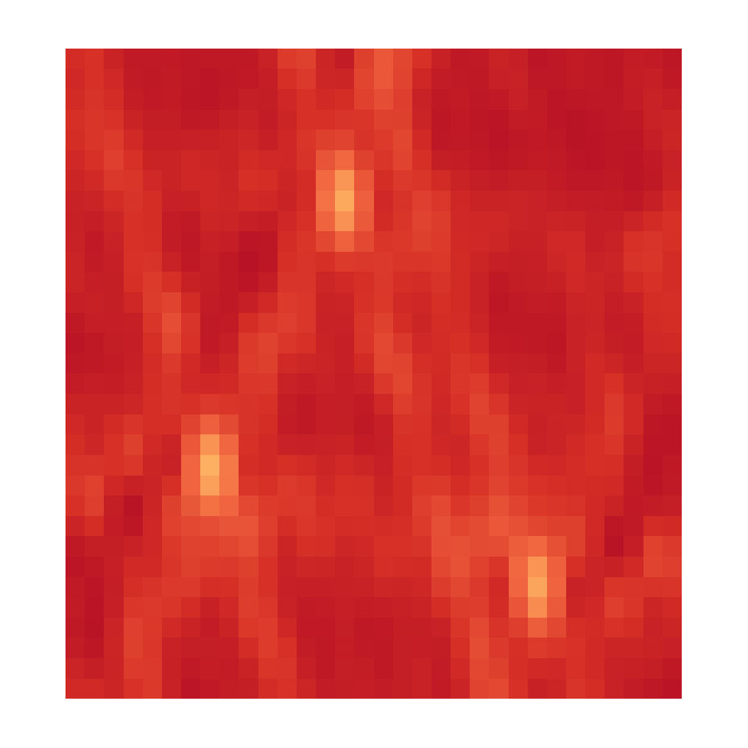

CLEAN, Iteration 4
Dirty Image
Model Image

Slide 12


CLEAN, Iteration X
Dirty Image
Model Image

Slide 13
CLEAN

Slide 14
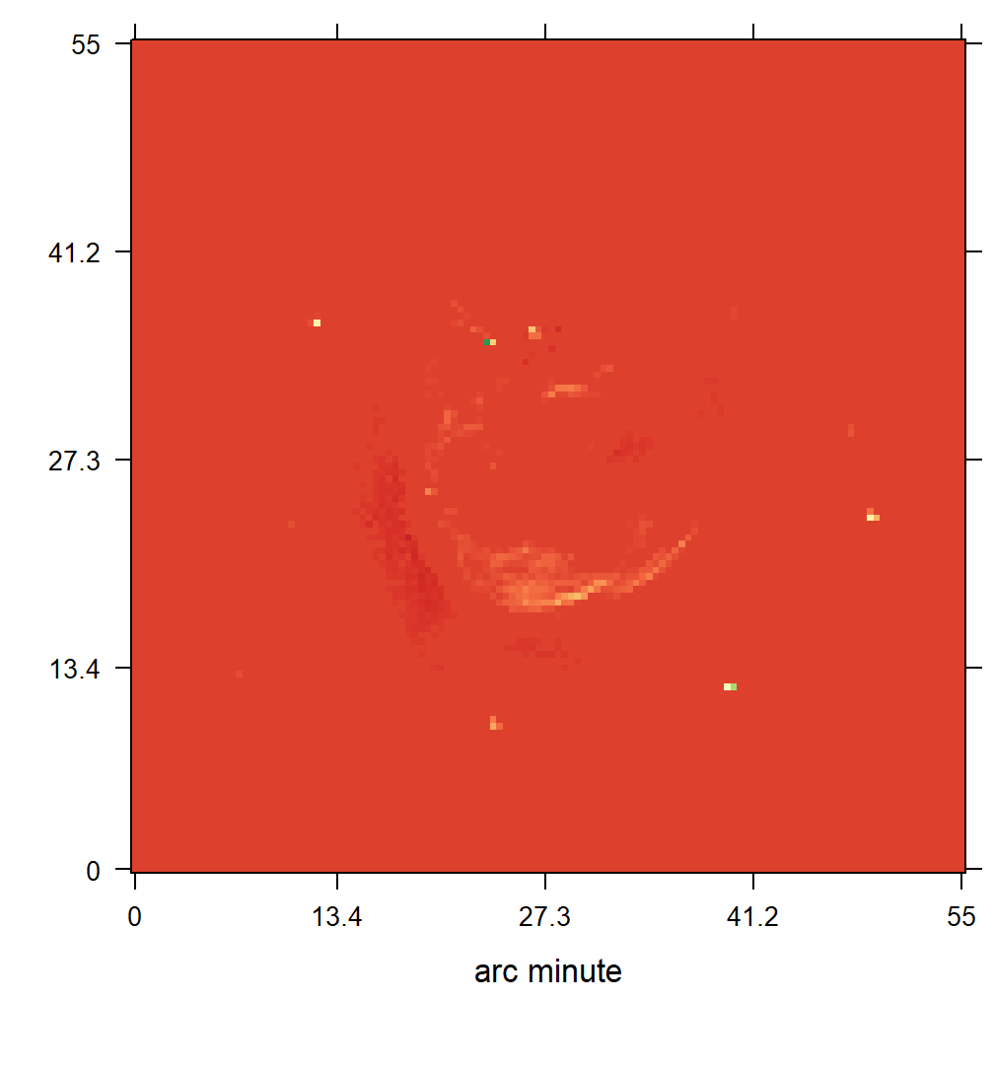
CLEAN blurring
Notes:
Low resolution

Slide 15
Compressed Sensing

Slide 16
Compressed Sensing Image Reconstruction
Regularization that captures the image properties
Incoherent Measurement and Reconstruction spaces.

Slide 17
CLEAN as a Compressed Sensing Reconstruction
Notes:
Camera Pixels
Many samples, most contain no information

Slide 18
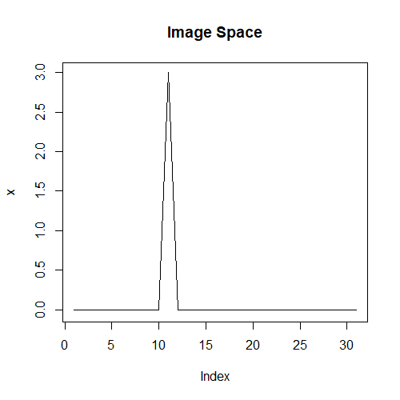
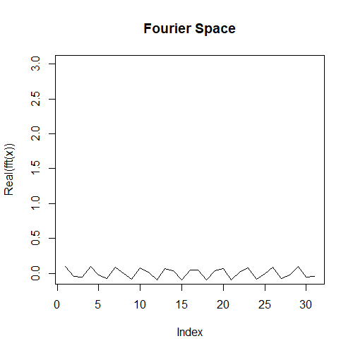
Incoherence

Slide 19
Compressed Sensing

Slide 20
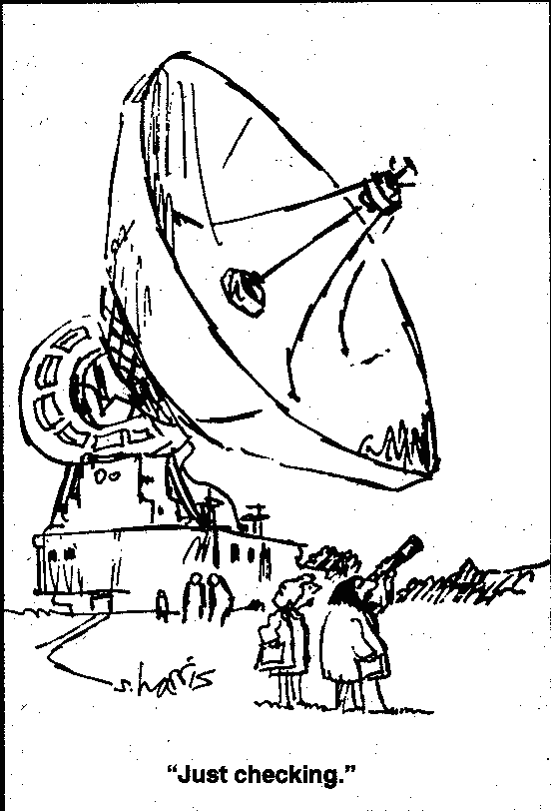

Slide 21
Regularizations
L0
L1
L2
Total Variation
L1 + L2
Starlet

Slide 22
10s VLA Observation
RAO Reconstruction
Notes:
Low resolution

Slide 23
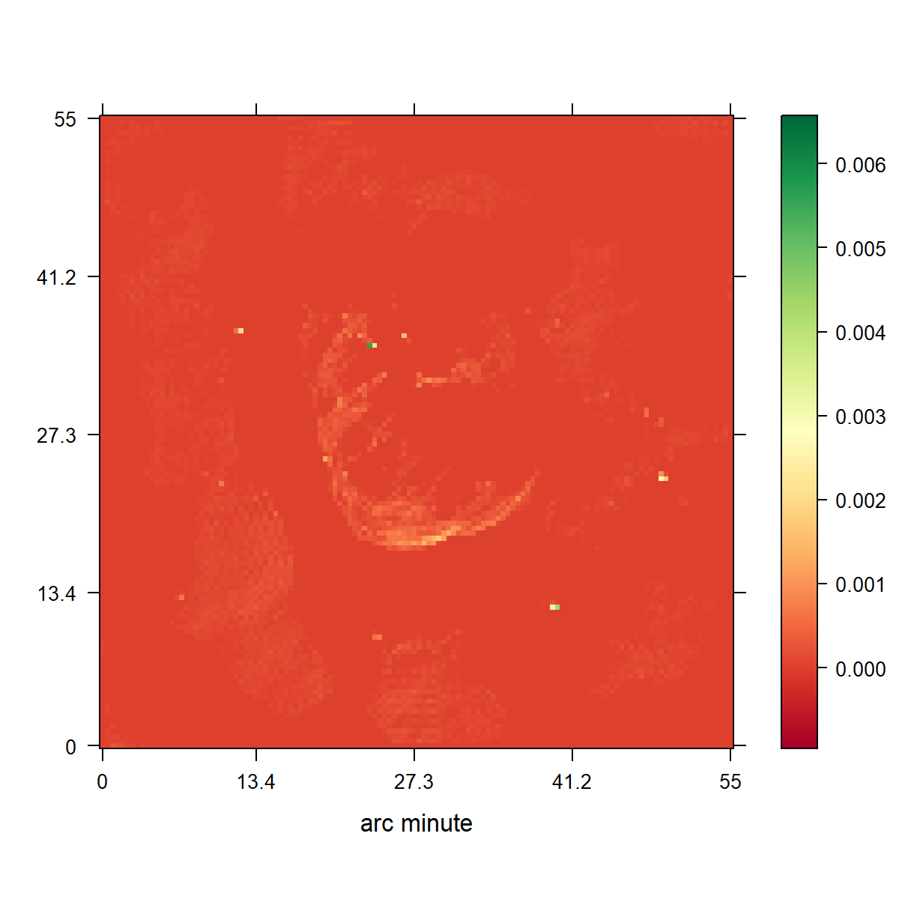
CLEAN
L1 Regularization

Slide 24
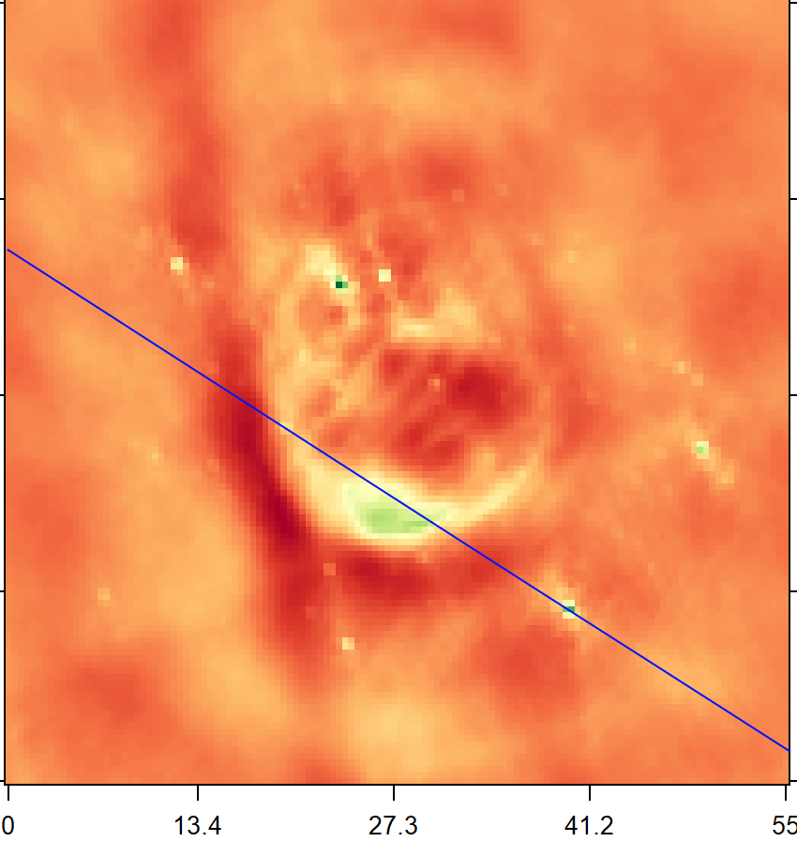
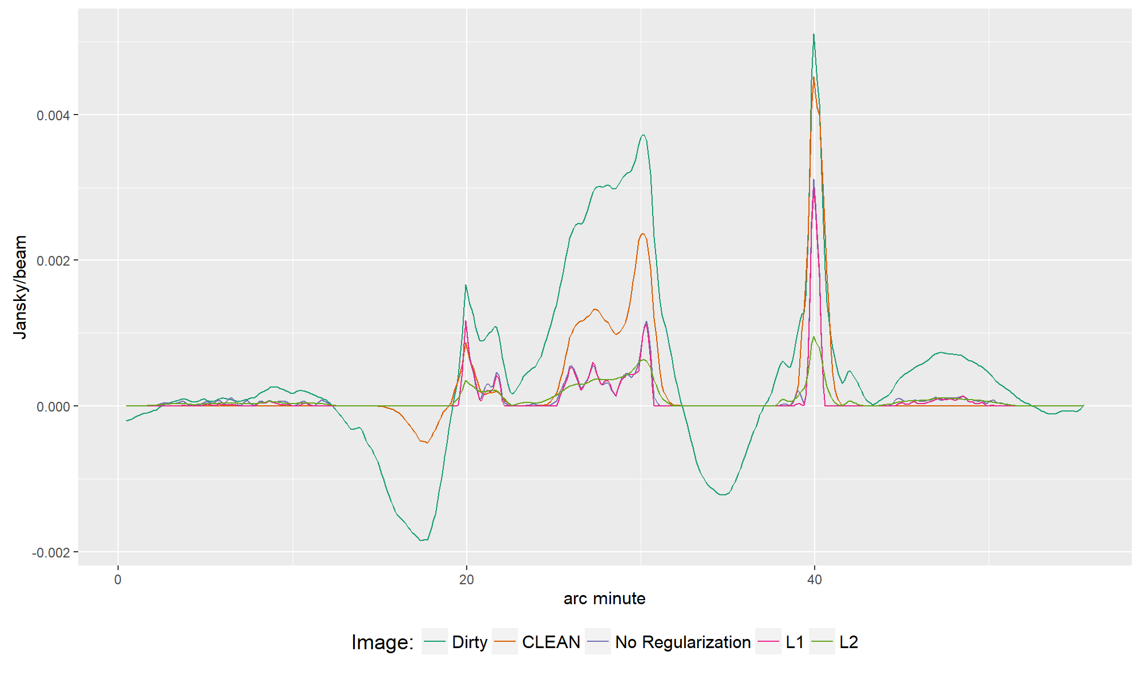

Slide 25
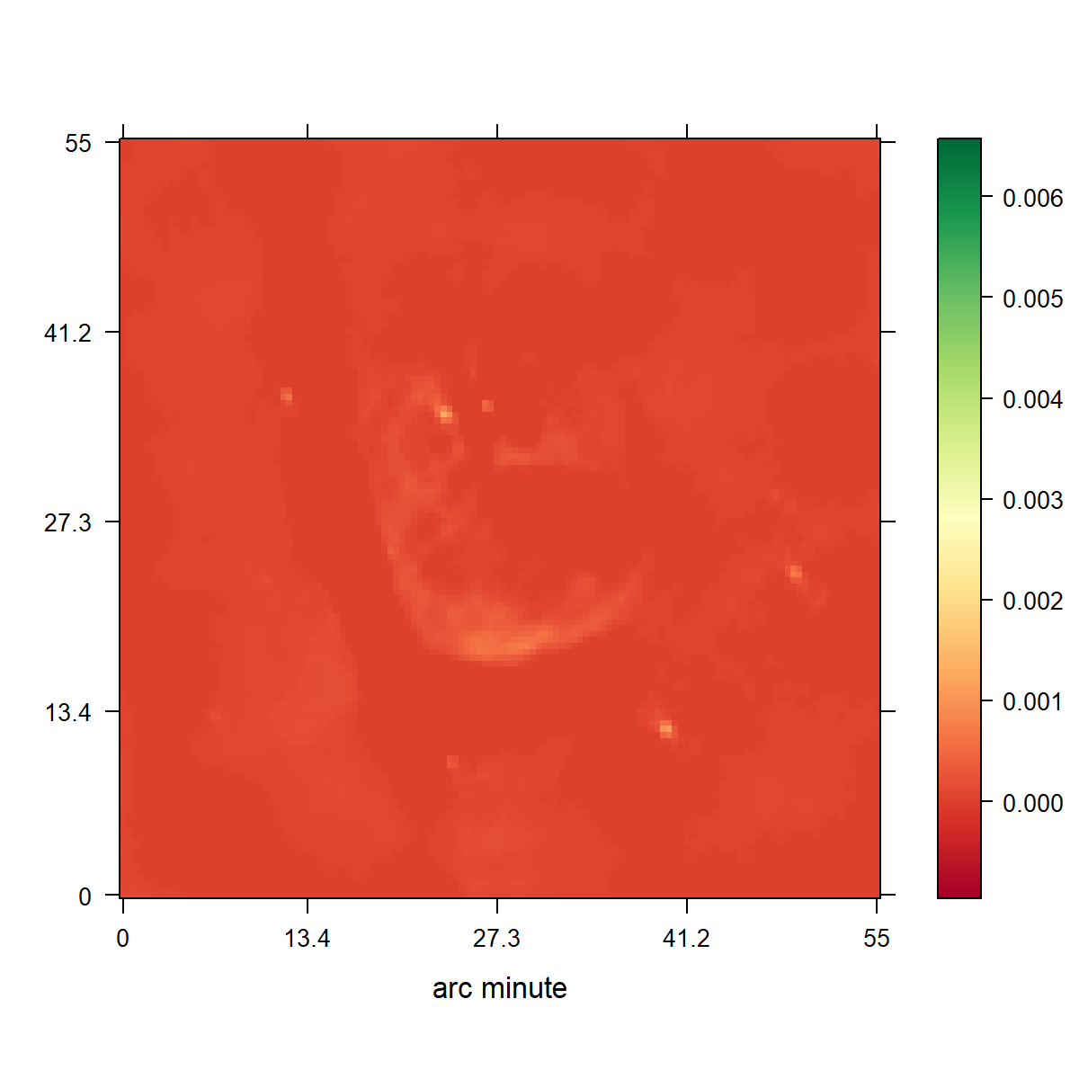
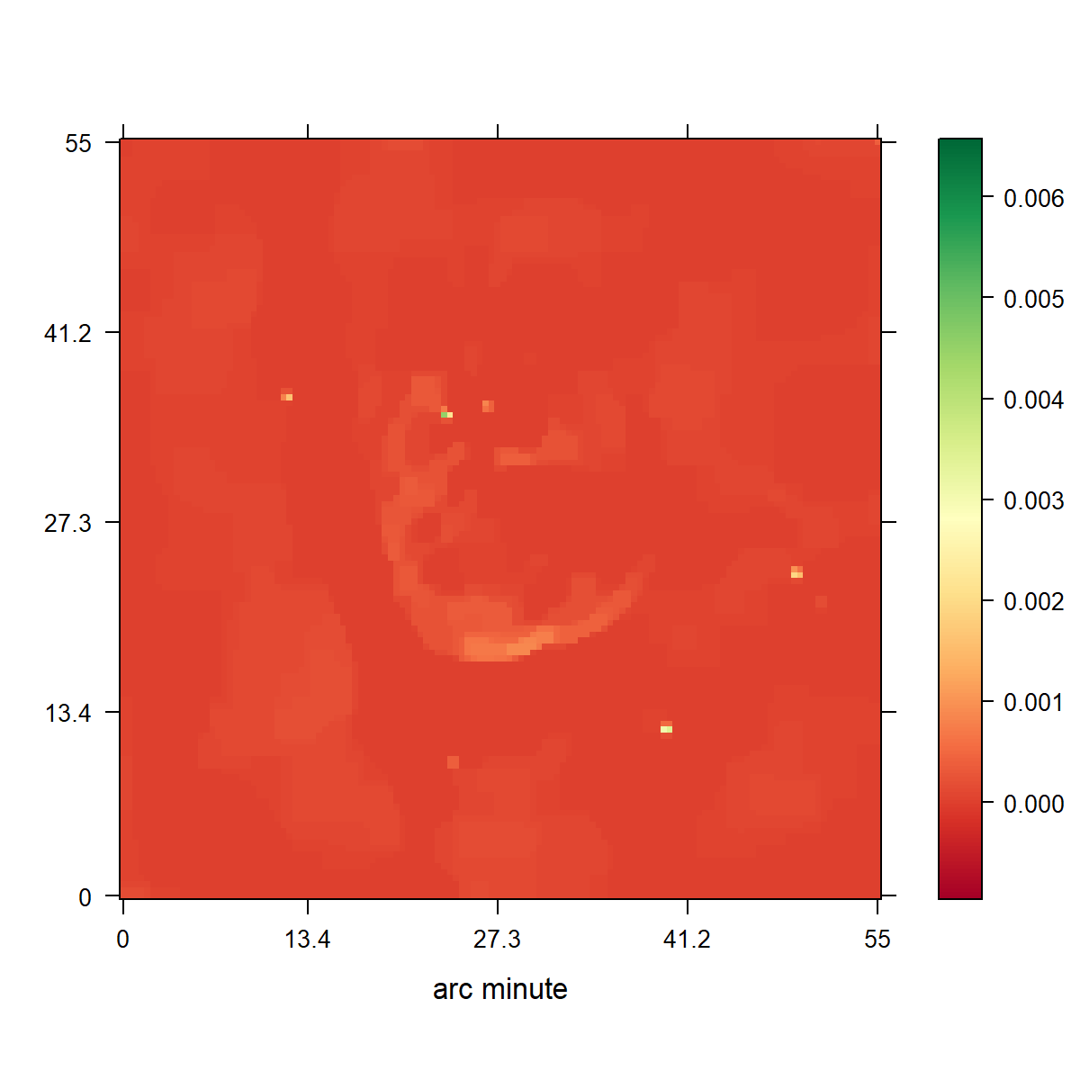

Slide 27
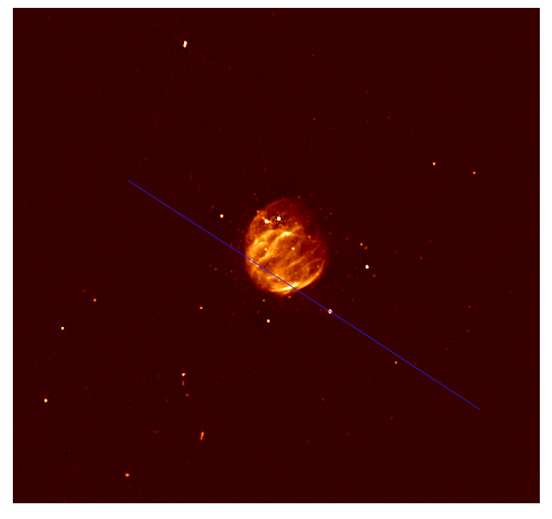

Slide 28
Conclusion

