Slide 1
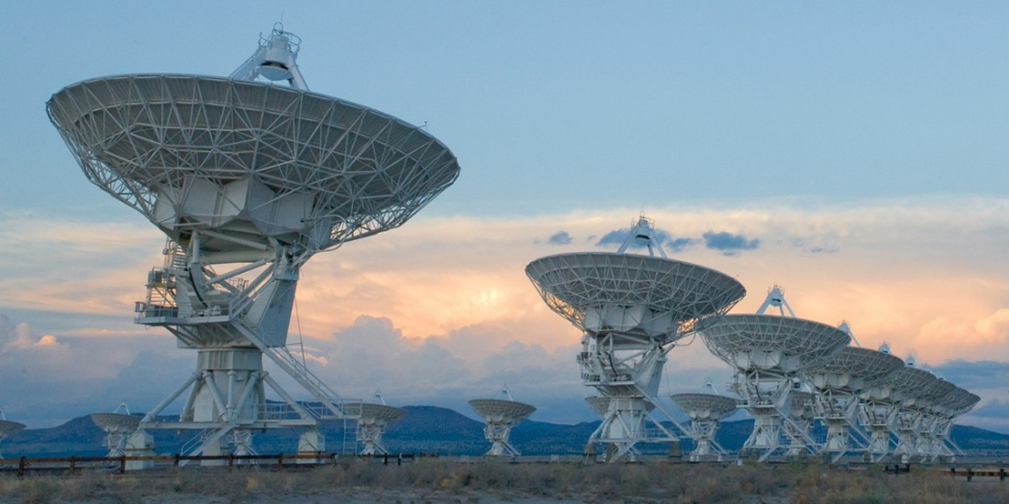
Compressed Sensing Image Reconstruction for CASA

Slide 2
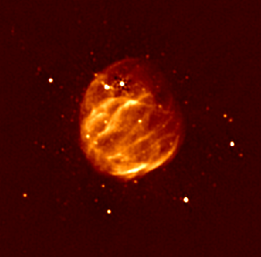
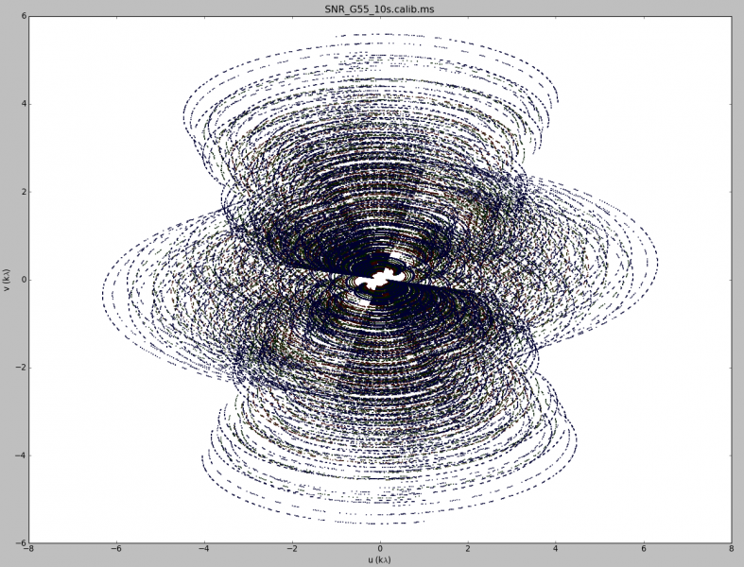
Image Reconstruction

Slide 3
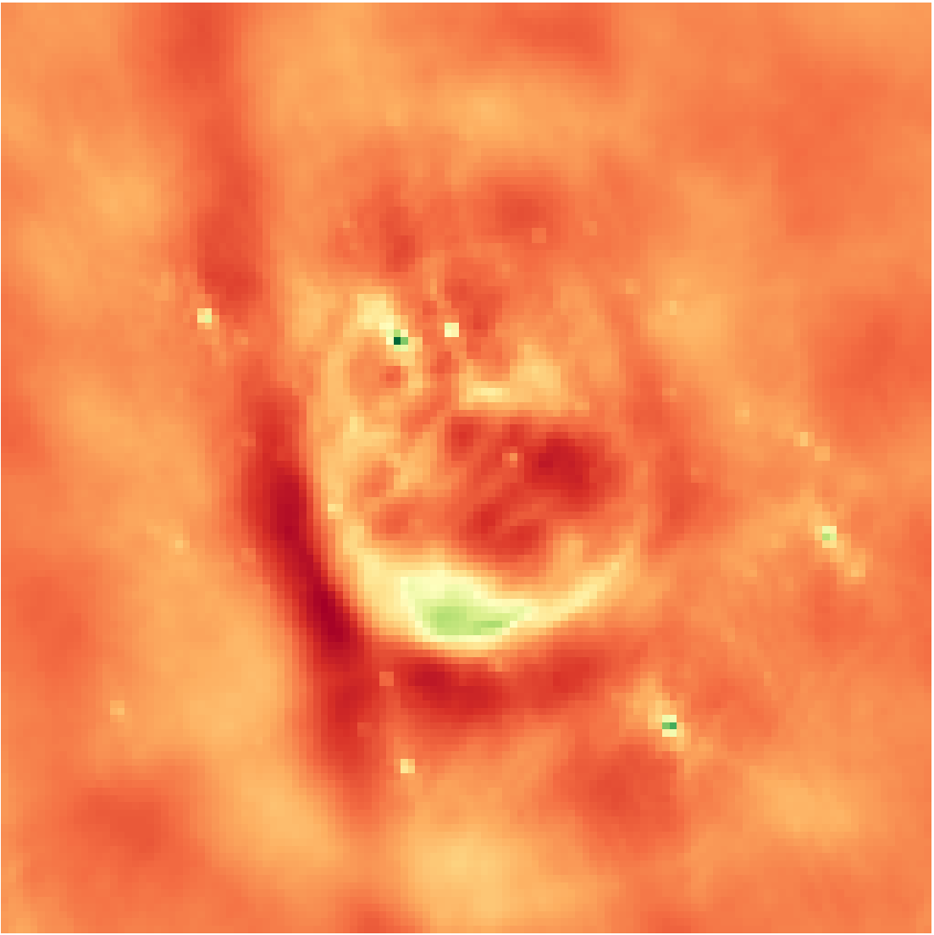
Inverse Fourier Transform
Notes:
Low resolution

Slide 4

Deconvolution
$$x∗PSF+N=I_{dirty}$$
Notes:
From the theory of compressed sensing

Slide 5
CLEAN
Find max

Slide 6
CLEAN

Slide 7
CLEAN
Chance that the x is the true image?

Slide 8
Compressed Sensing

Slide 9
CLEAN

Slide 10
CLEAN as a special case of Compressed Sensing

Slide 11
Guarantees

Slide 12
Super Resolution

Slide 13
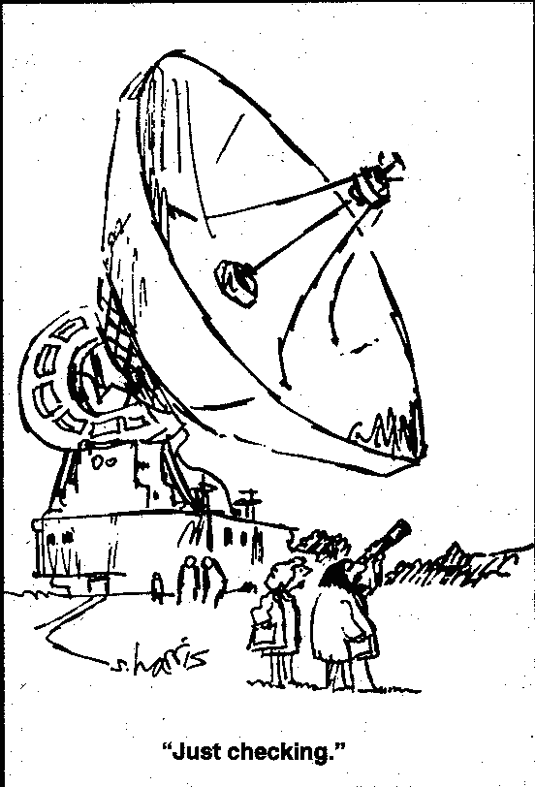
The Problem with Super Resolution…

Slide 14
10 Second Observation Unknown Reconstruction NRAO
Notes:
Low resolution

Slide 15
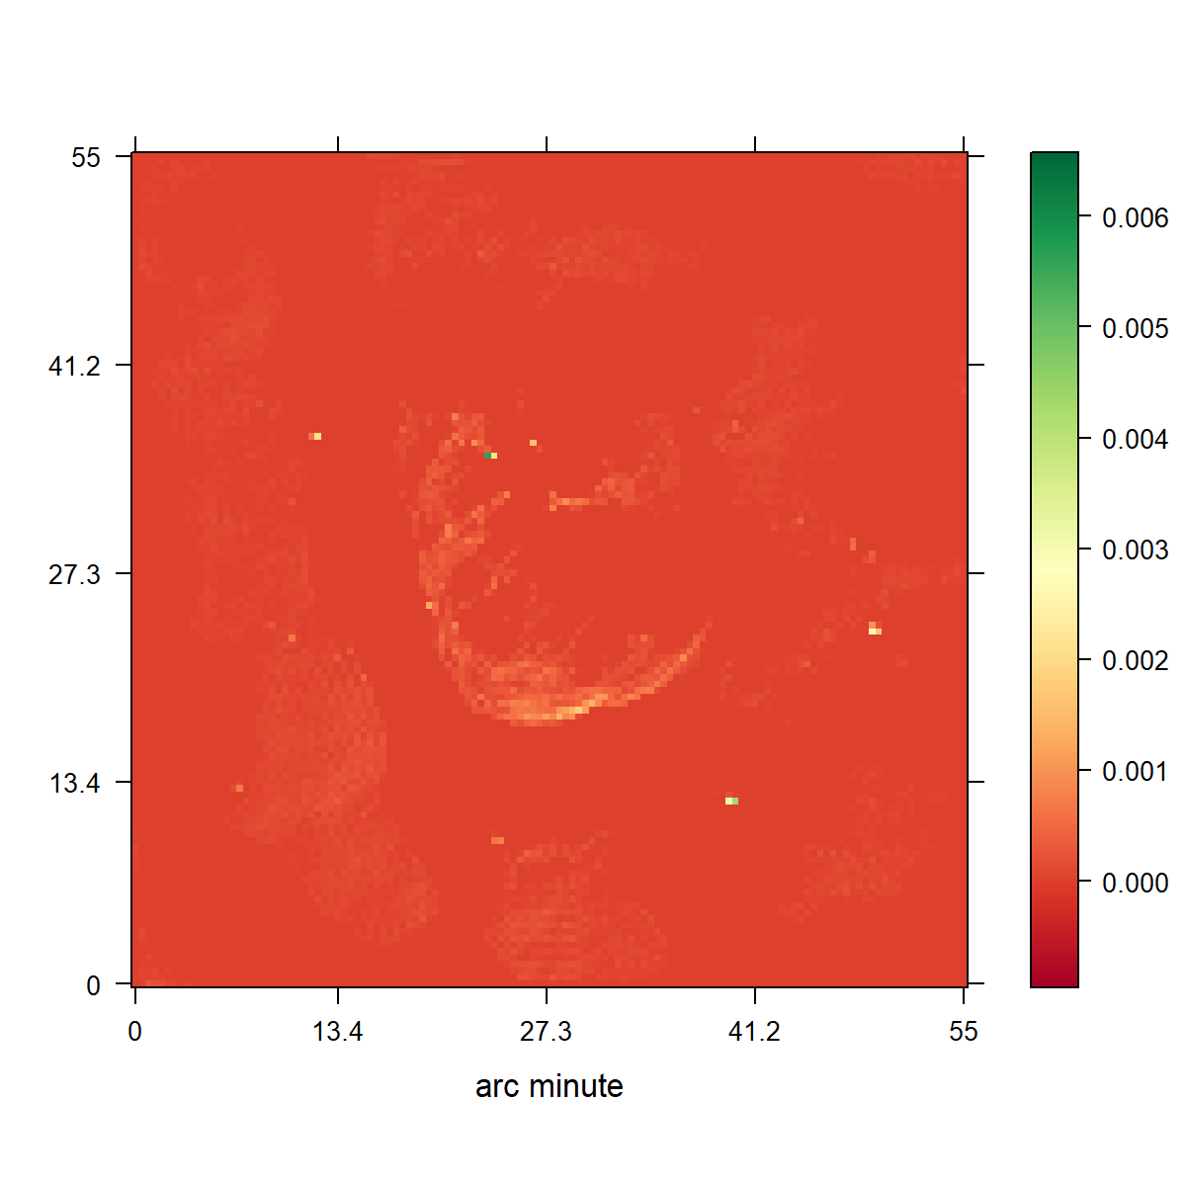
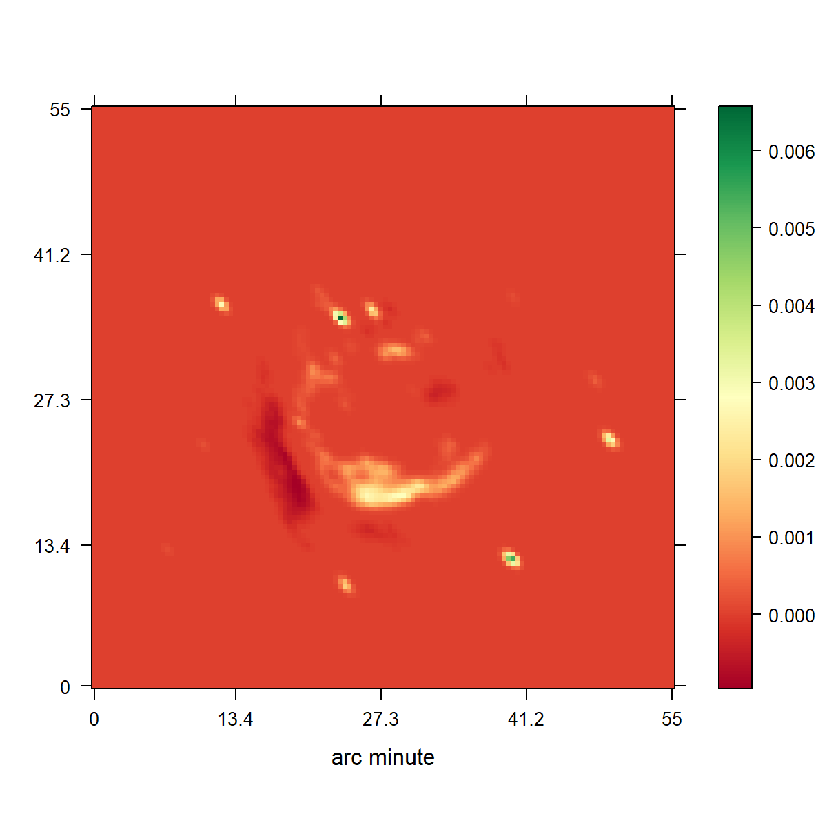
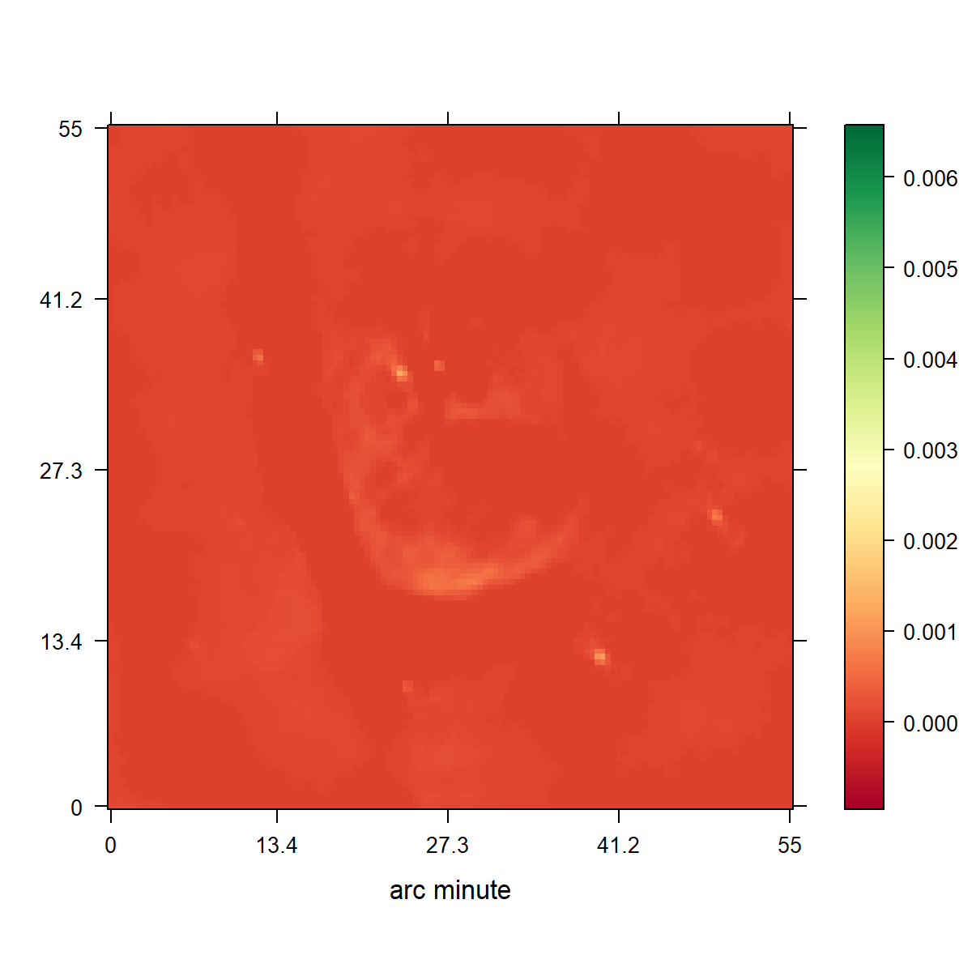
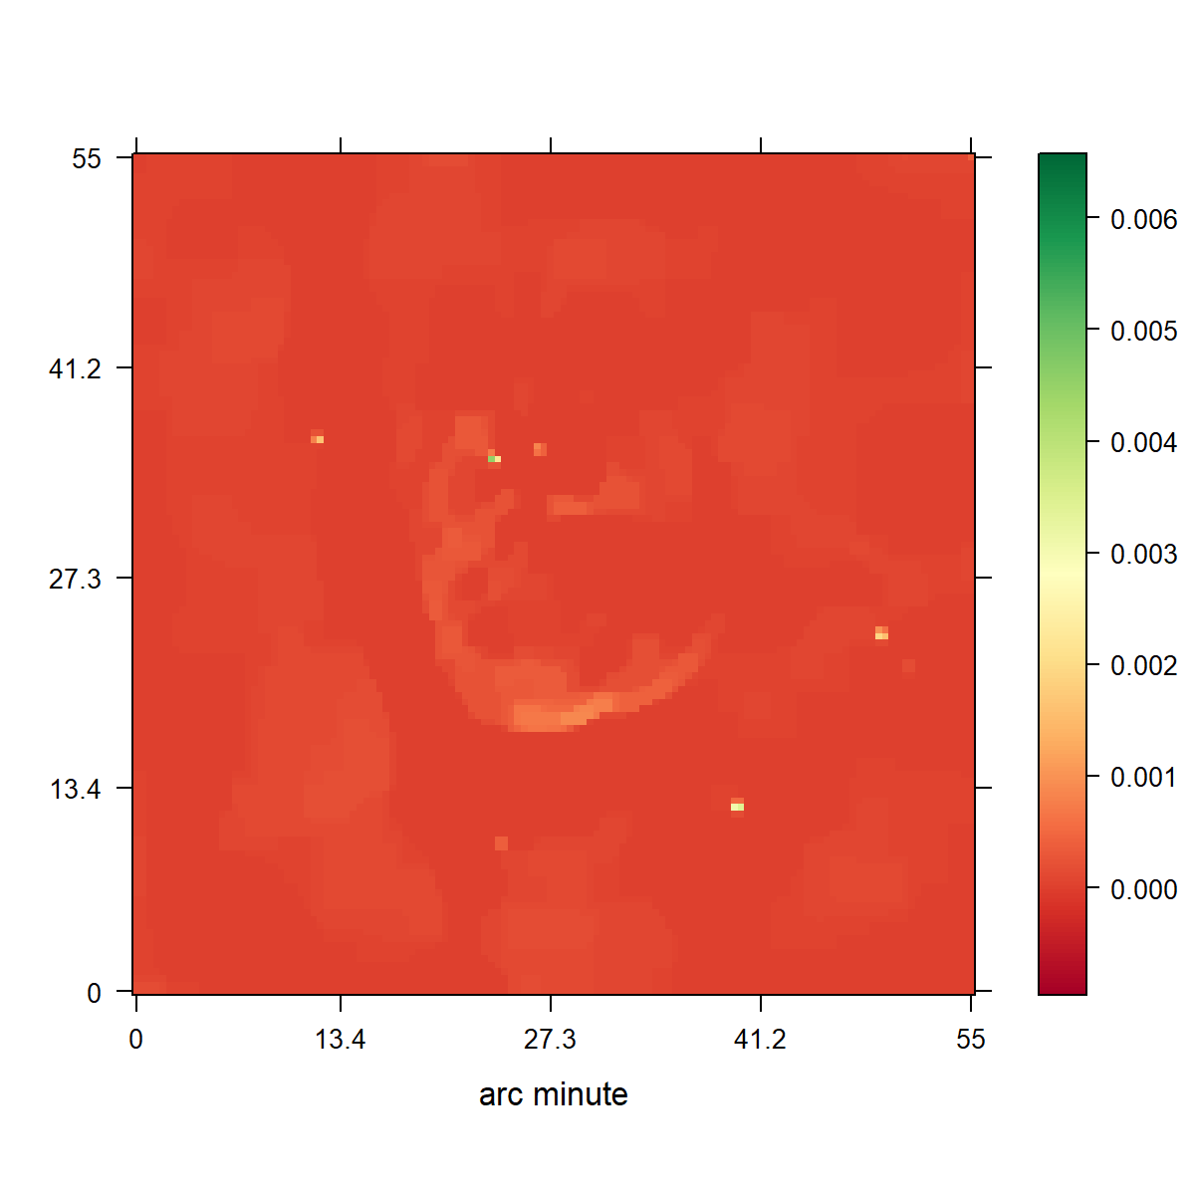

Slide 16
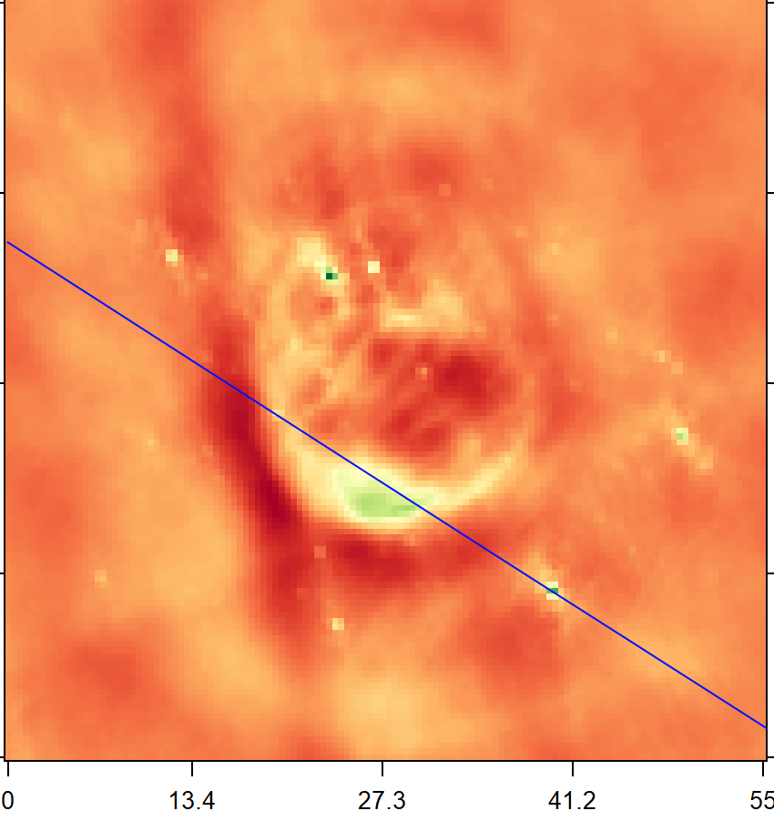
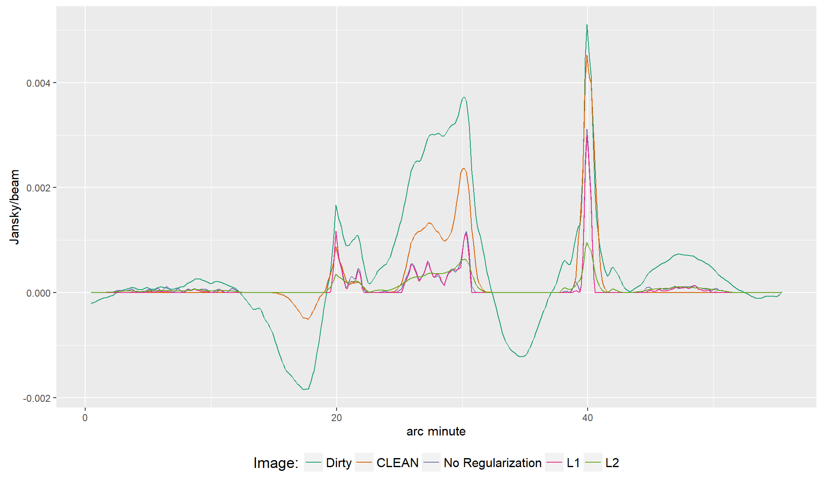

Slide 17
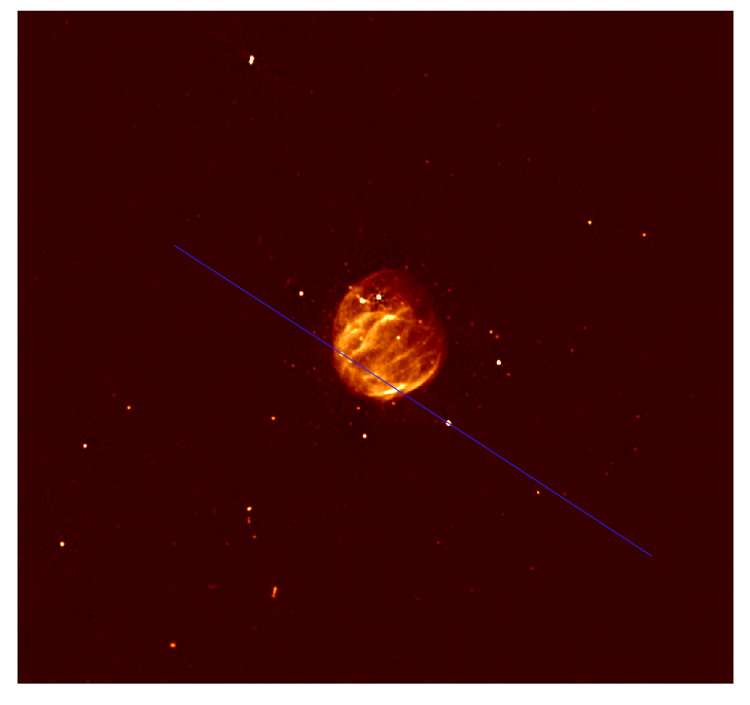

Slide 18
Conclusion

Slide 19
Conclusion

