Slide 1
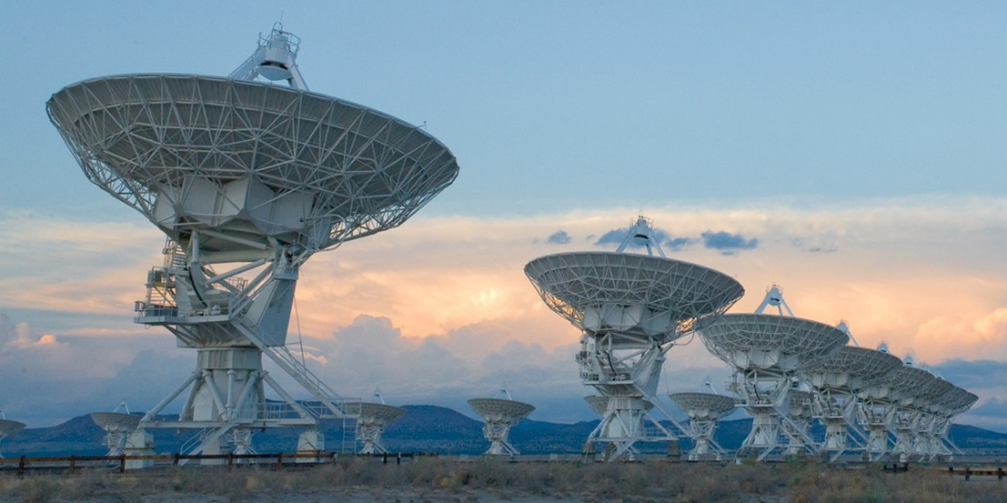
Compressed Sensing Image Reconstruction

Slide 2
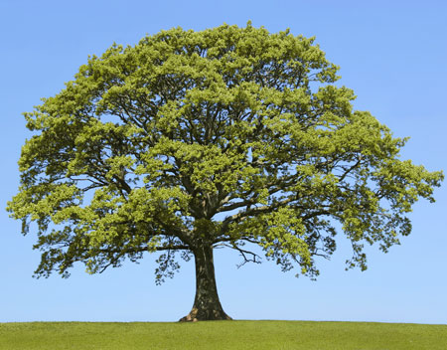

Shannon Nyquist Sampling Rate

Slide 3
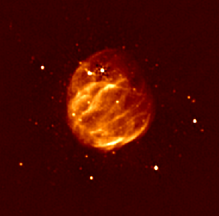
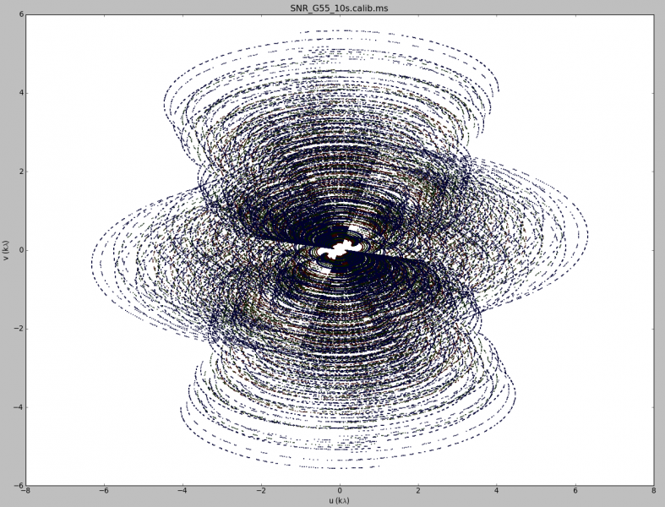
Image Reconstruction

Slide 4
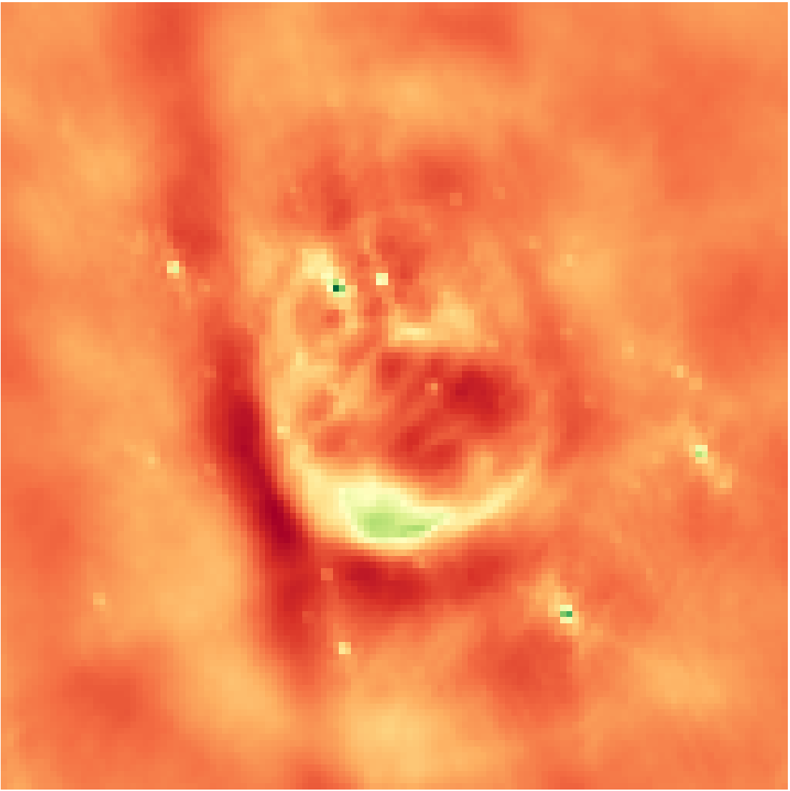
Inverse Fourier Transform
Notes:
Low resolution

Slide 5

Deconvolution
Notes:
From the theory of compressed sensing

Slide 6
Compressed Sensing Reconstruction
A Regularization
Objective with Data + Regularization term
Optimizer

Slide 7
CLEAN

Slide 8
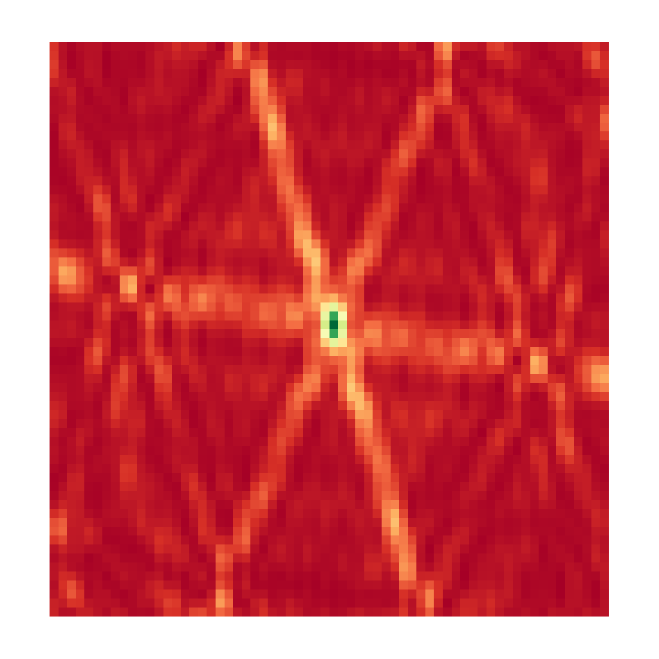
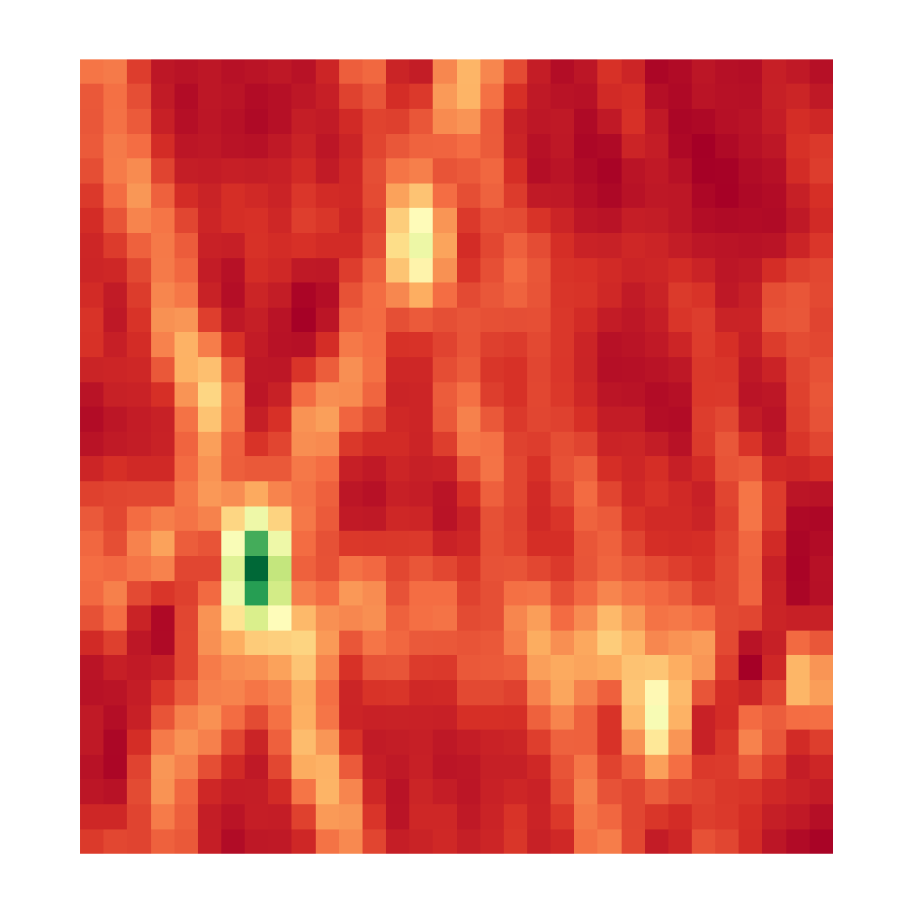

CLEAN, Iteration 0
Dirty Image
Model Image

Slide 9
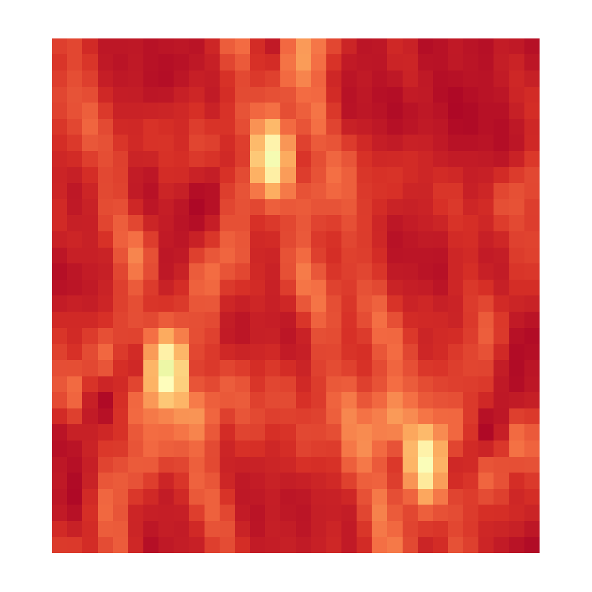

CLEAN, Iteration 1
Dirty Image
Model Image

Slide 10
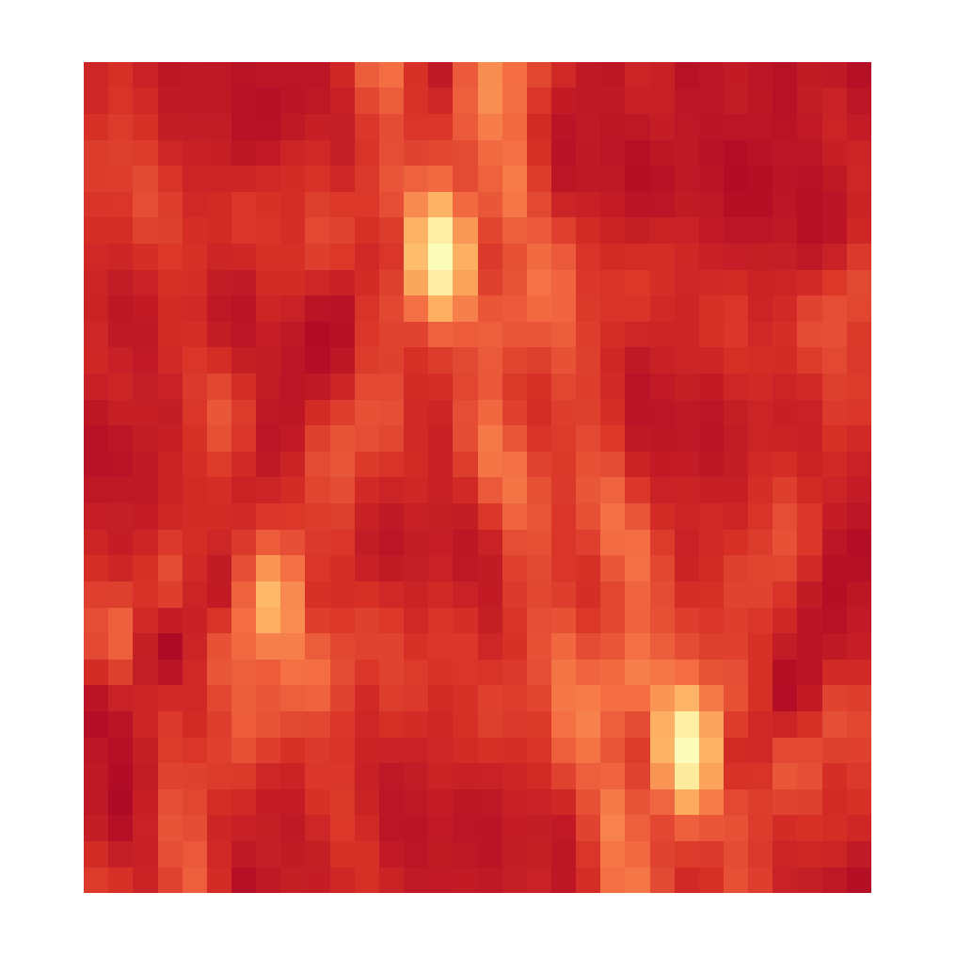

CLEAN, Iteration 2
Dirty Image
Model Image

Slide 11
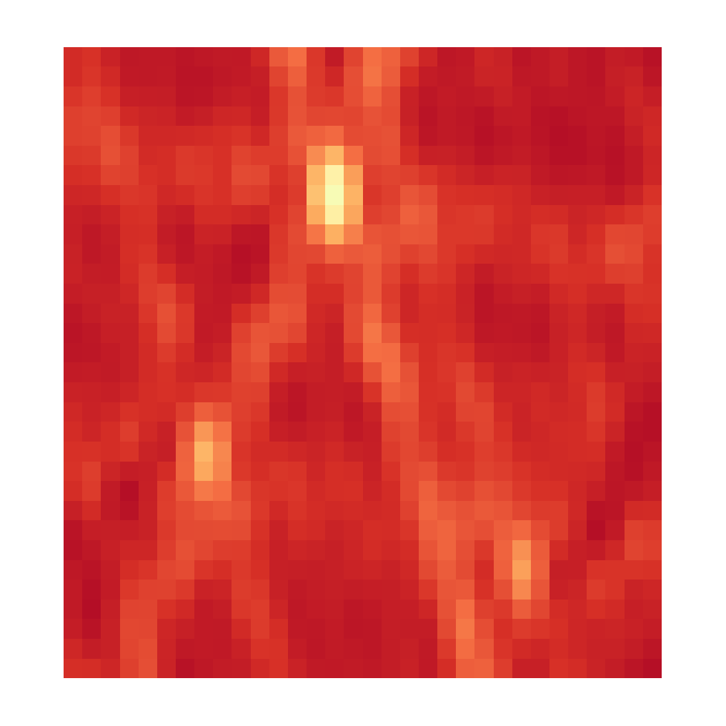

CLEAN, Iteration 3
Dirty Image
Model Image

Slide 12
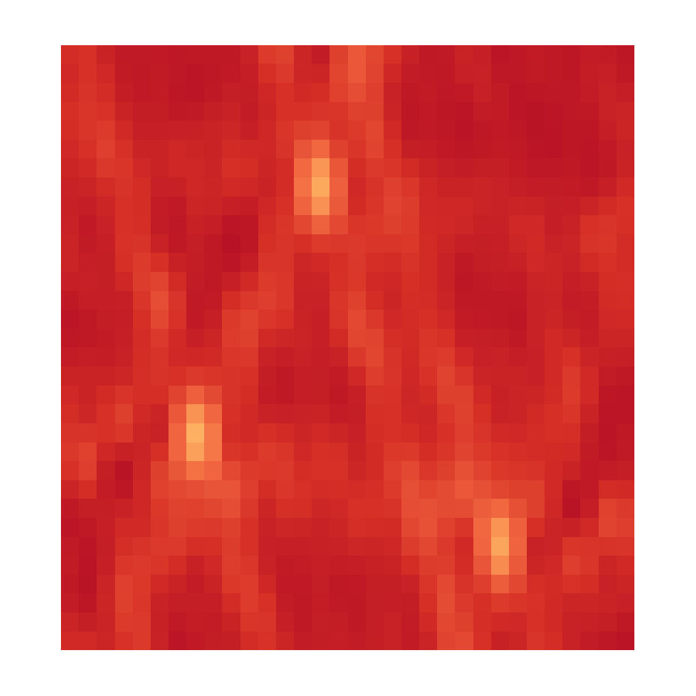

CLEAN, Iteration 4
Dirty Image
Model Image

Slide 13


CLEAN, Iteration X
Dirty Image
Model Image

Slide 14
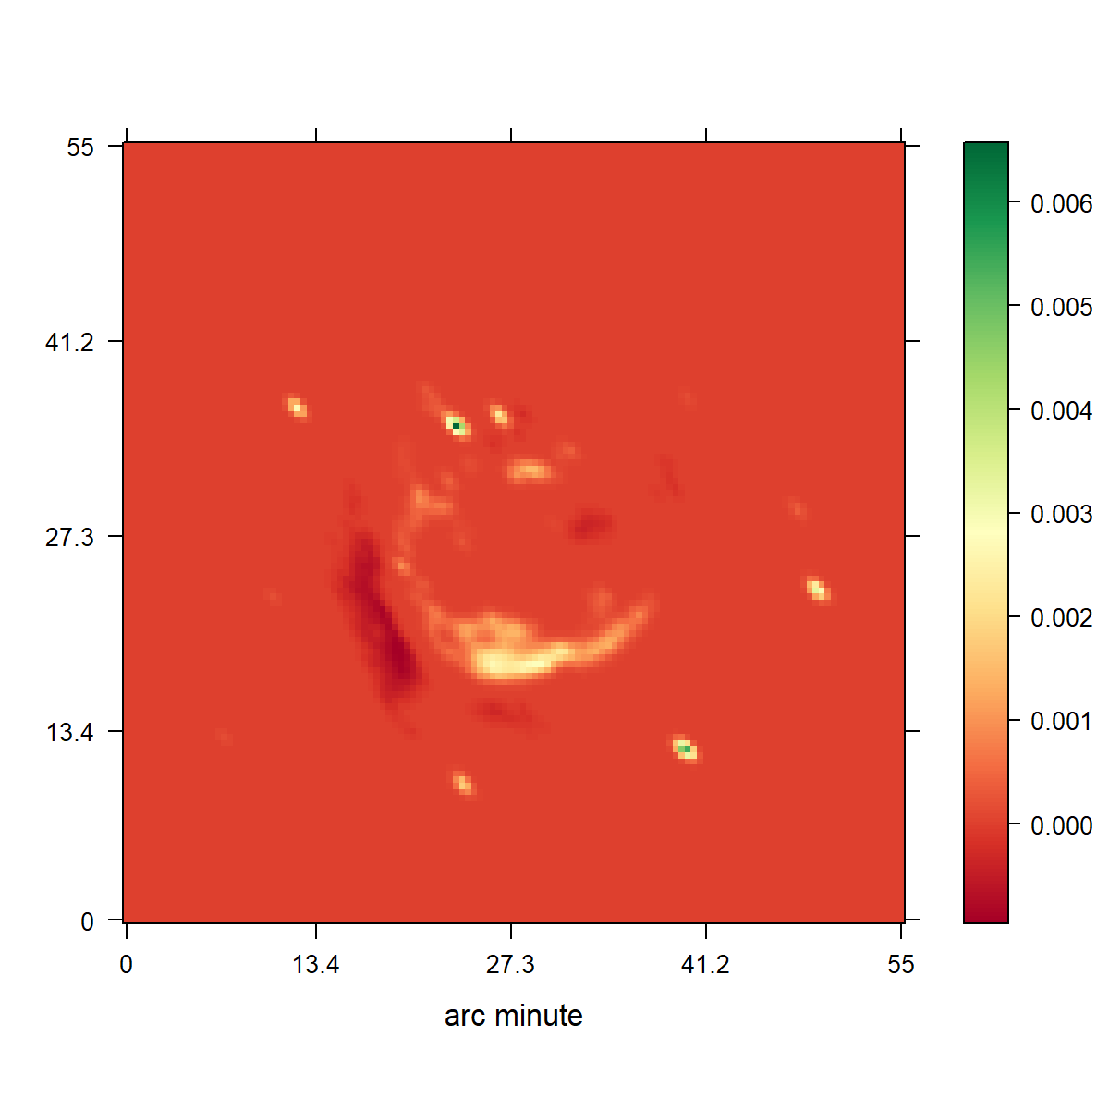
CLEAN
Notes:
Low resolution

Slide 15
Compressed Sensing

Slide 16
Compressed Sensing Image Reconstruction
Regularization that captures the image properties
Incoherent Measurement and Reconstruction spaces.

Slide 17
CLEAN as a Compressed Sensing Reconstruction
Notes:
Camera Pixels
Many samples, most contain no information

Slide 18
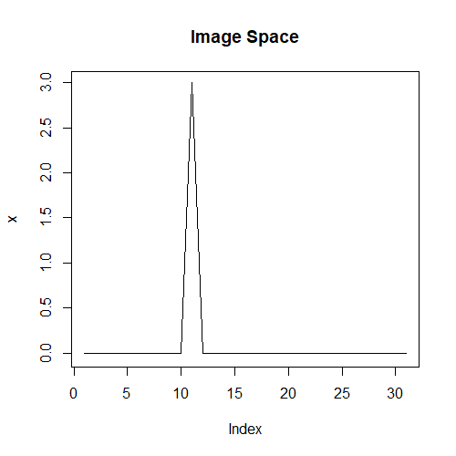
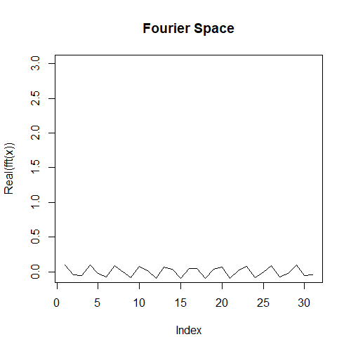
Incoherence

Slide 19
Compressed Sensing Reconstruction

Slide 20
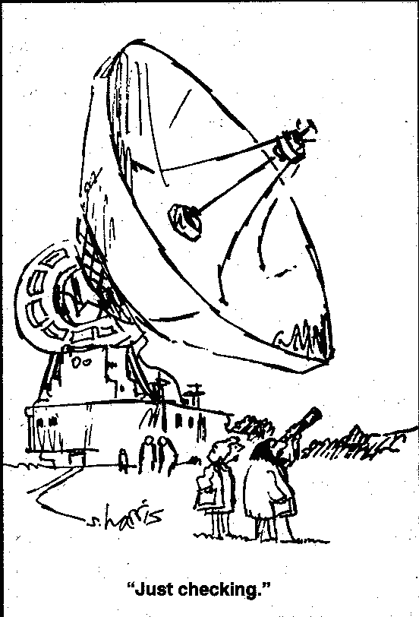

Slide 21
Comparison
Image Resolution

Slide 22
Compressed Sensing
A Regularization
L1
L2
TV
Haar Wavelets
Starlets
…
Objective with Data + Regularization term
Optimizer → Gurobi

Slide 23
10s VLA Observation
RAO Reconstruction
Notes:
Low resolution

Slide 24
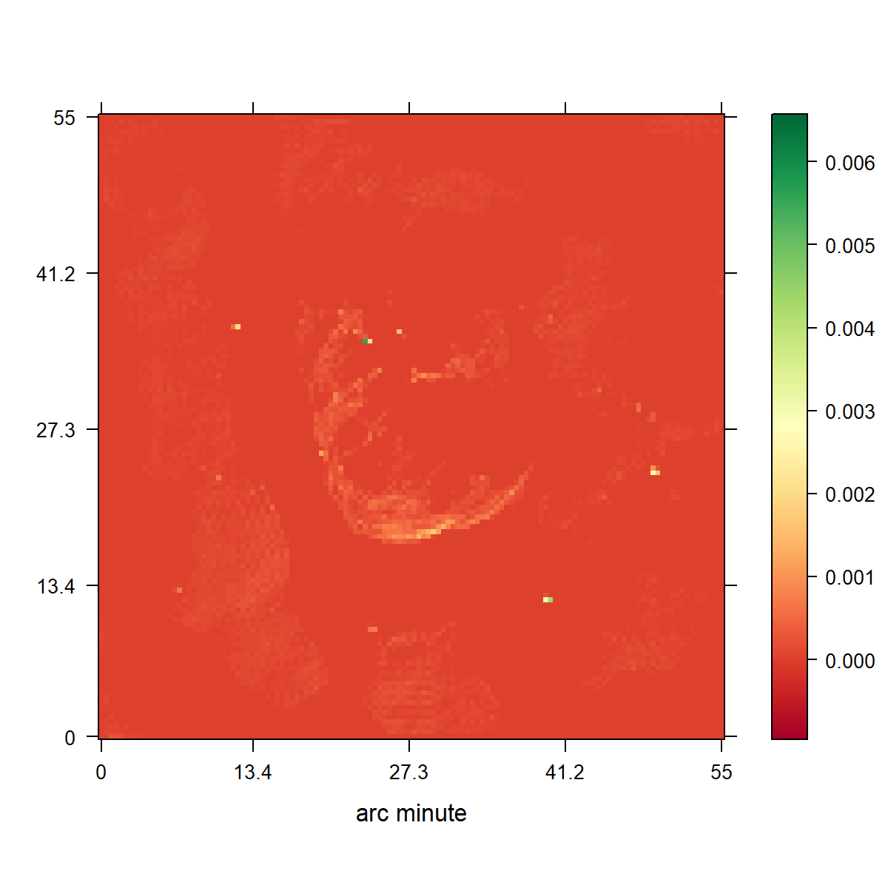
CLEAN
L1 Regularization

Slide 25
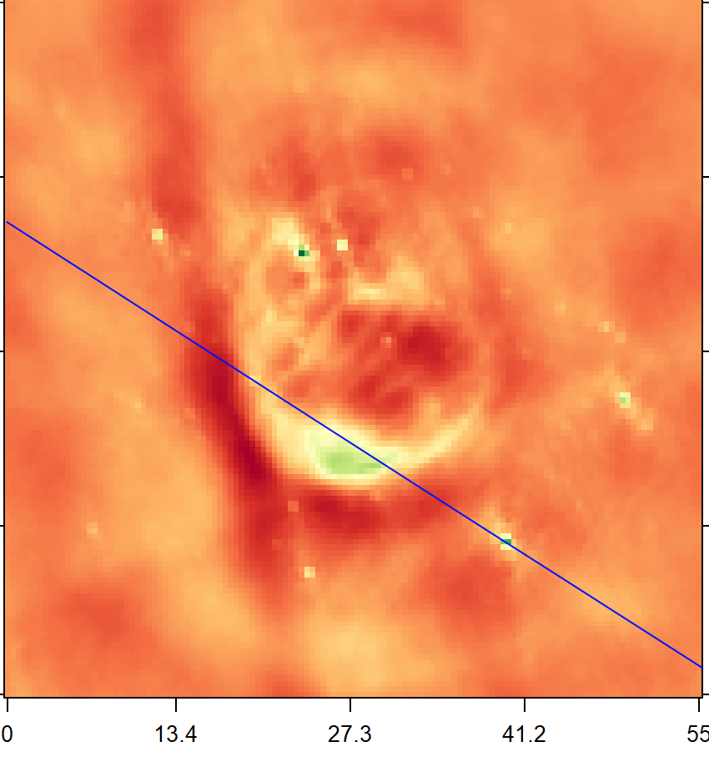
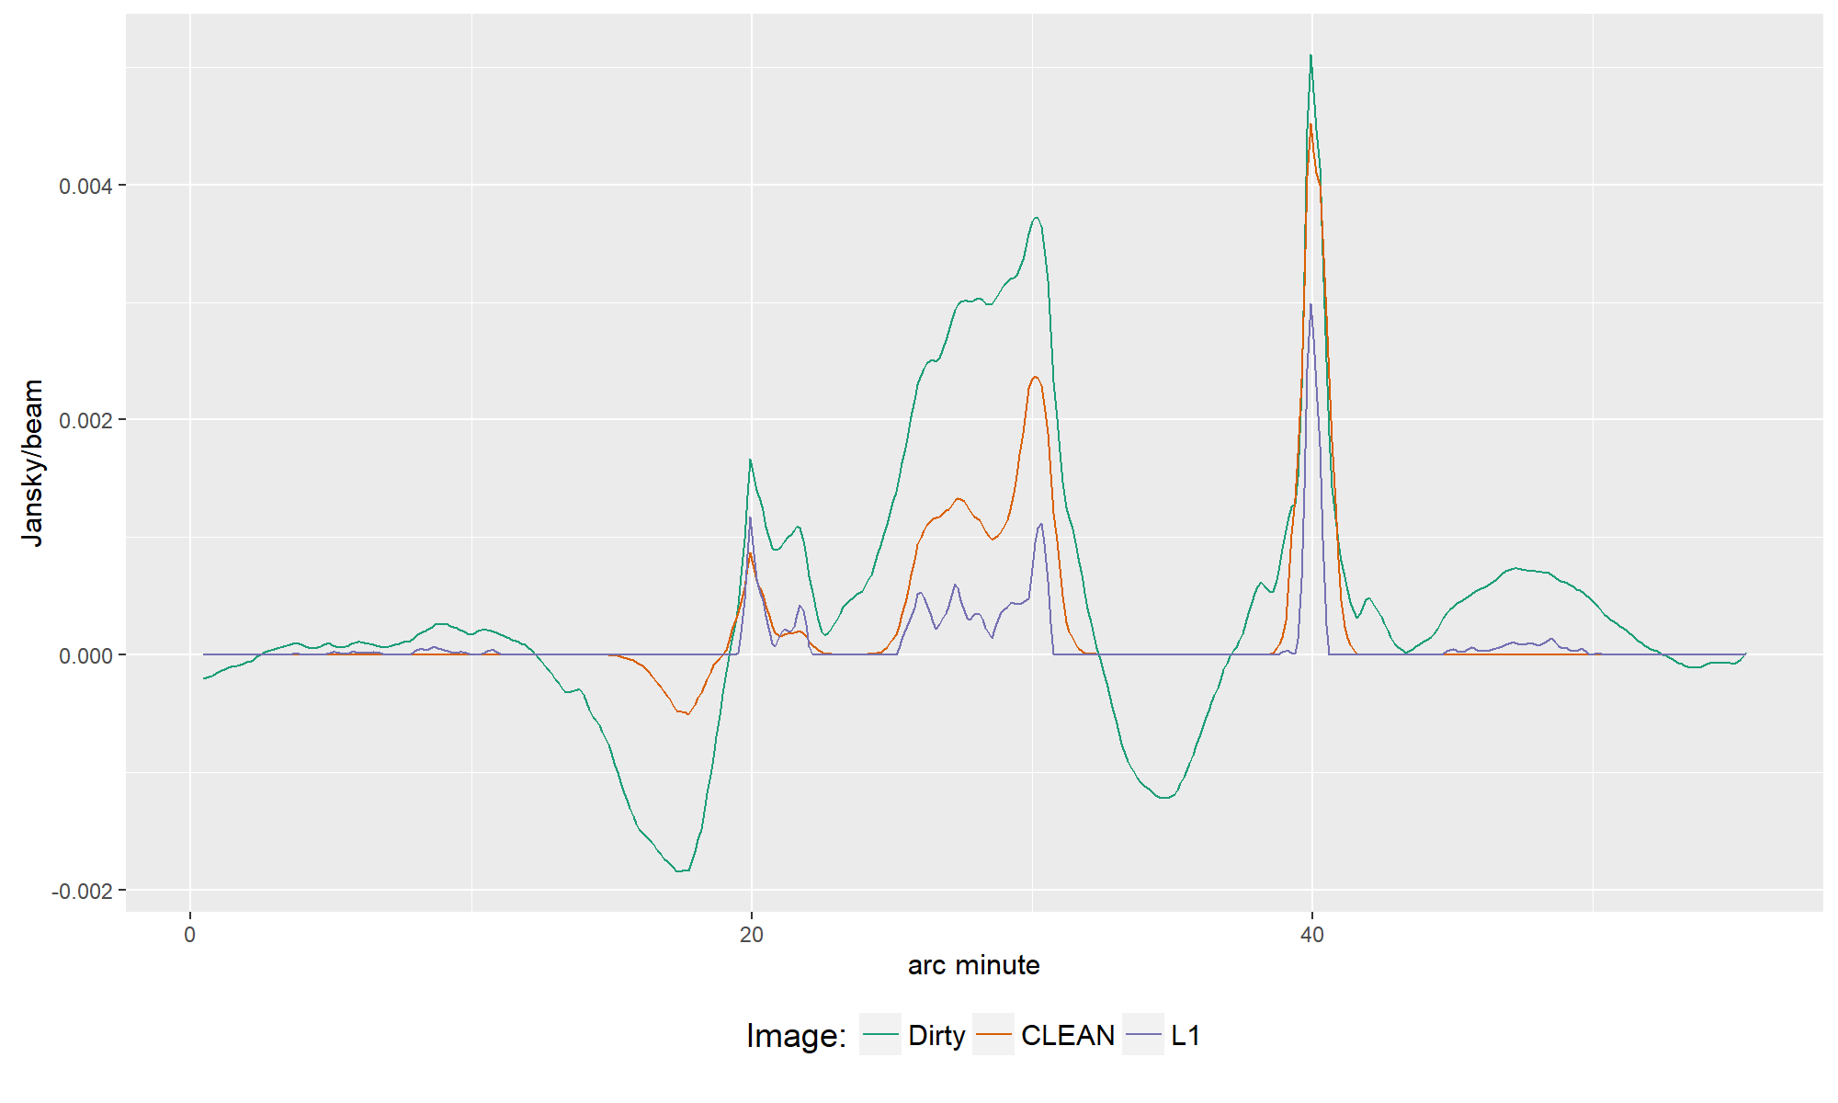

Slide 26
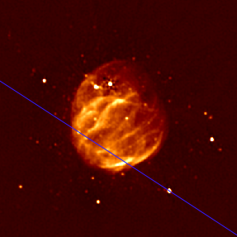

Slide 27
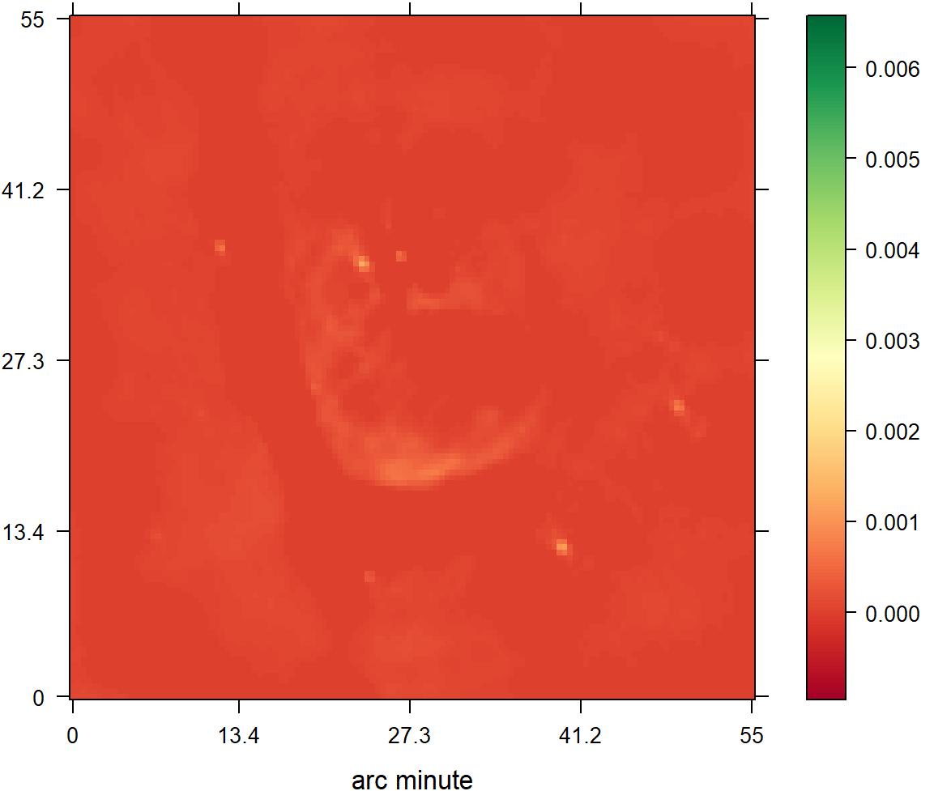
CLEAN
L2 Regularization

Slide 28
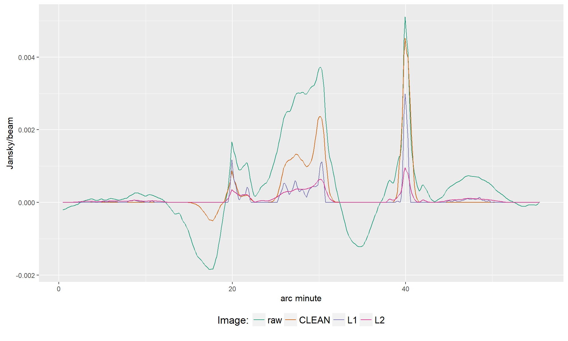

Slide 29
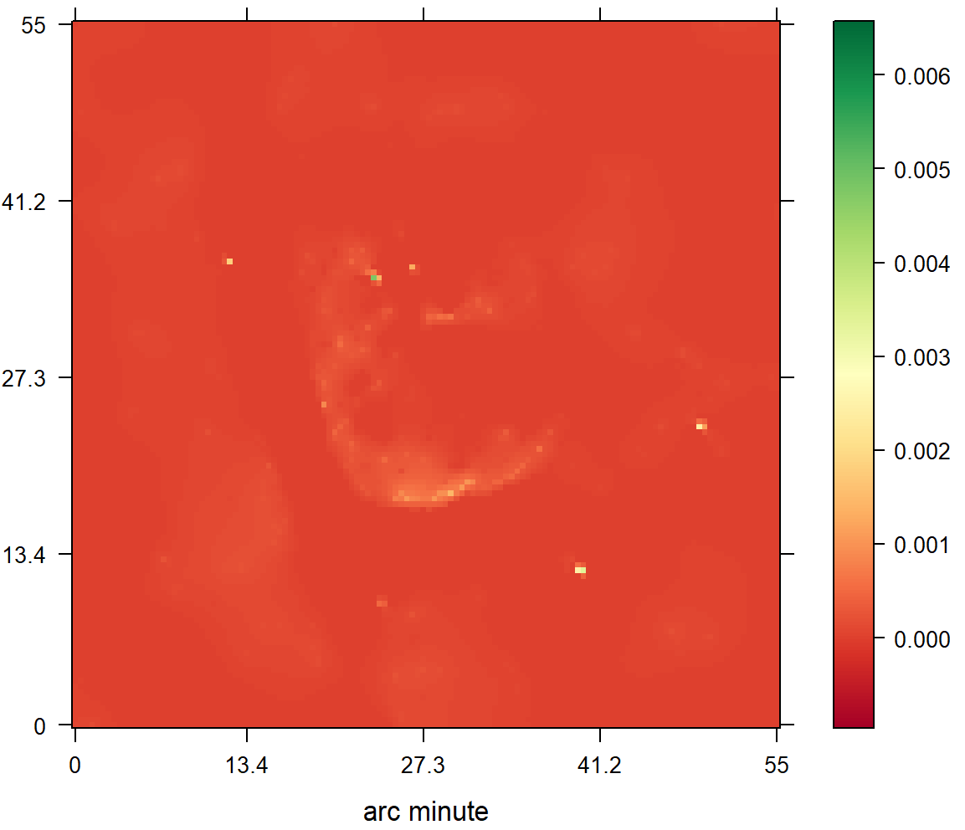
CLEAN
Starlets

Slide 30
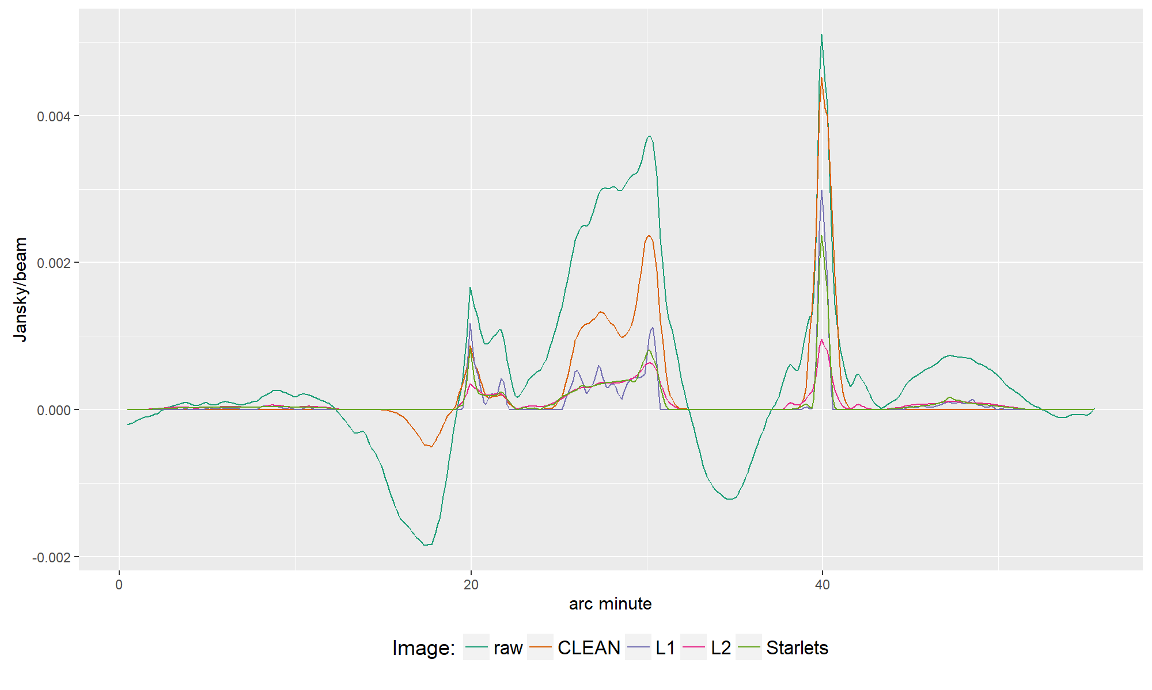

Slide 31
Conclusion

Slide 32
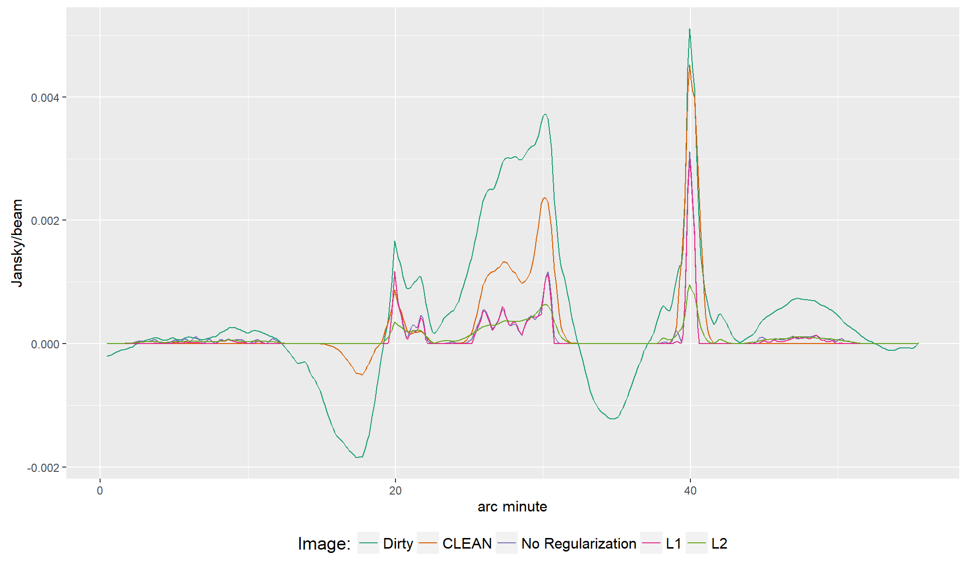

Slide 33
