Slide 1
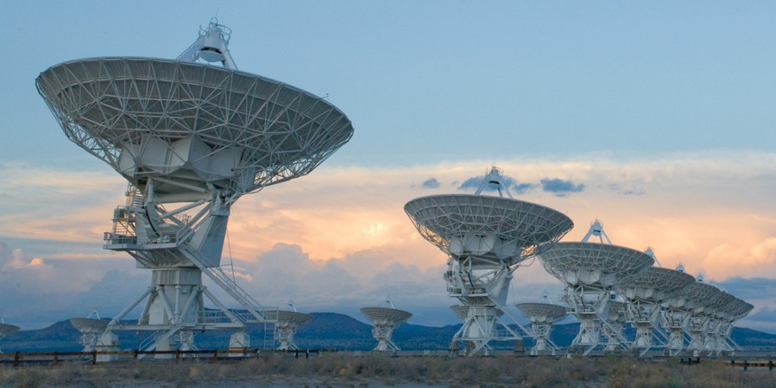
Compressed Sensing Image Reconstruction

Slide 2
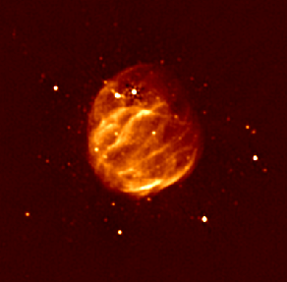
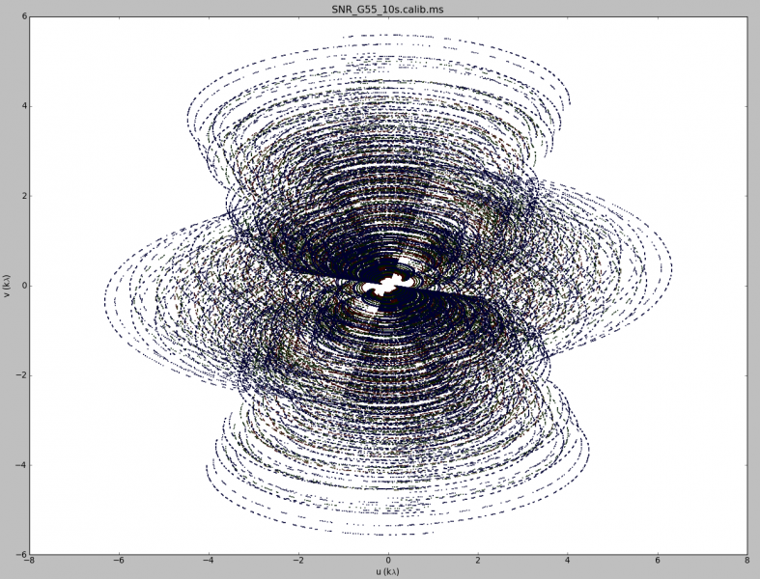
Image Reconstruction

Slide 3
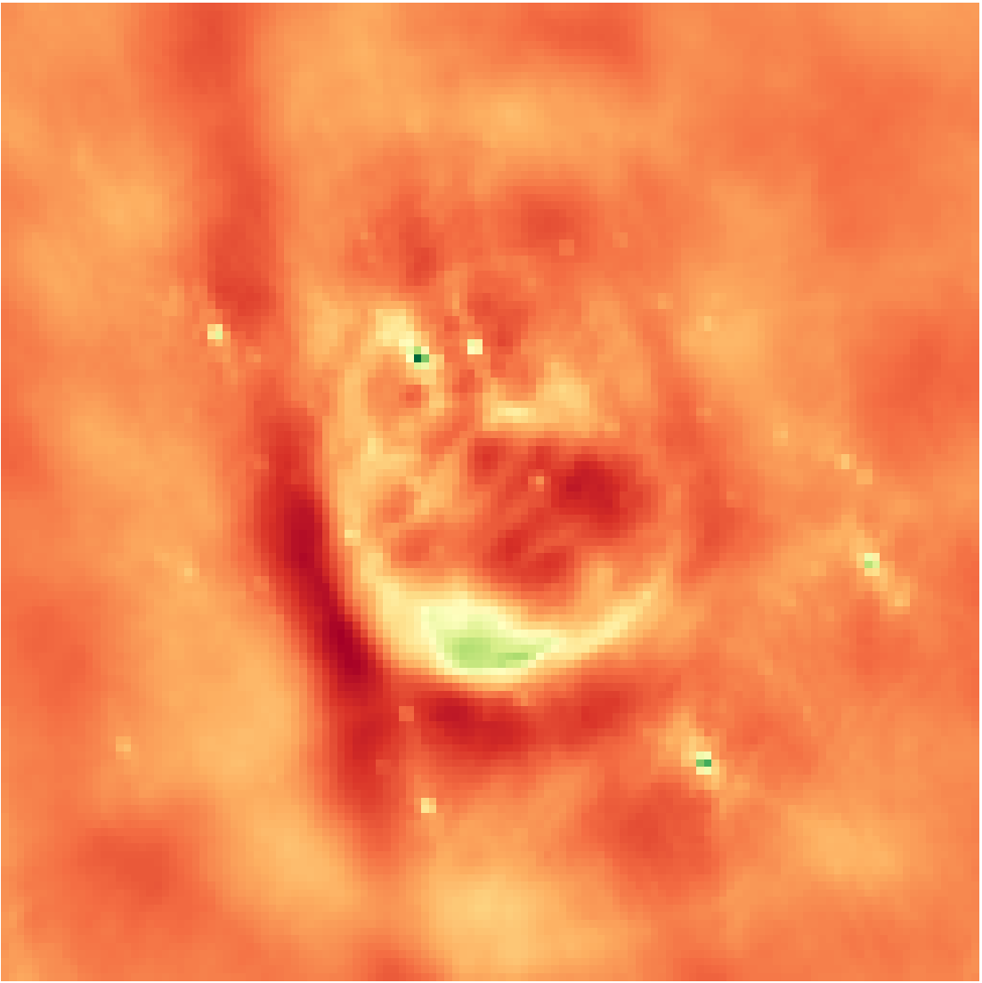
Inverse Fourier Transform
Notes:
Low resolution

Slide 4

Deconvolution
Notes:
From the theory of compressed sensing

Slide 5
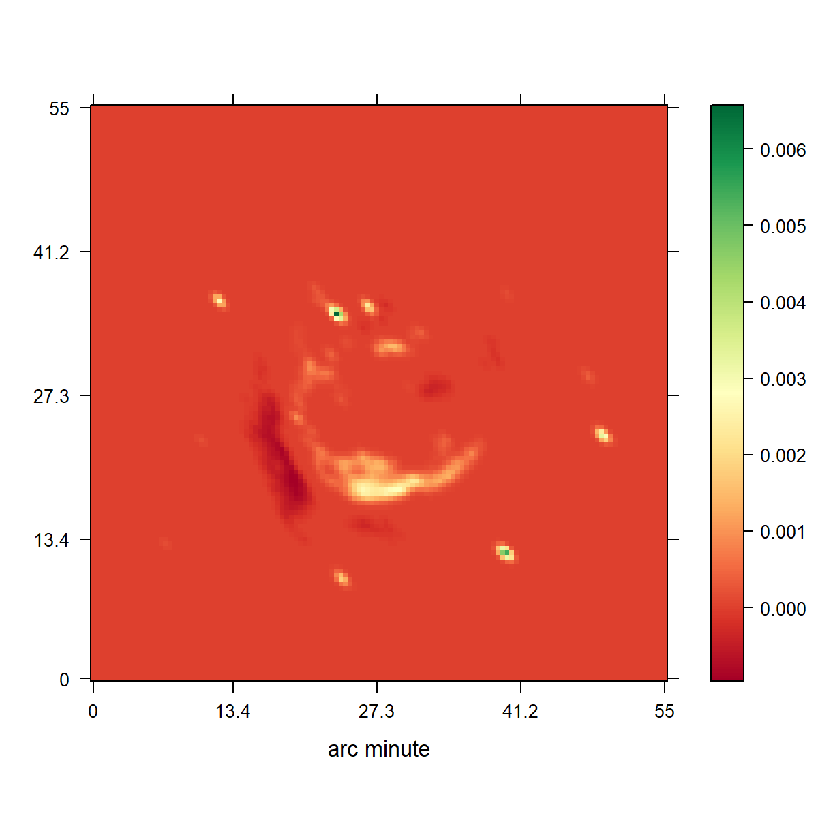
CLEAN
Notes:
Low resolution

Slide 6
CLEAN

Slide 7
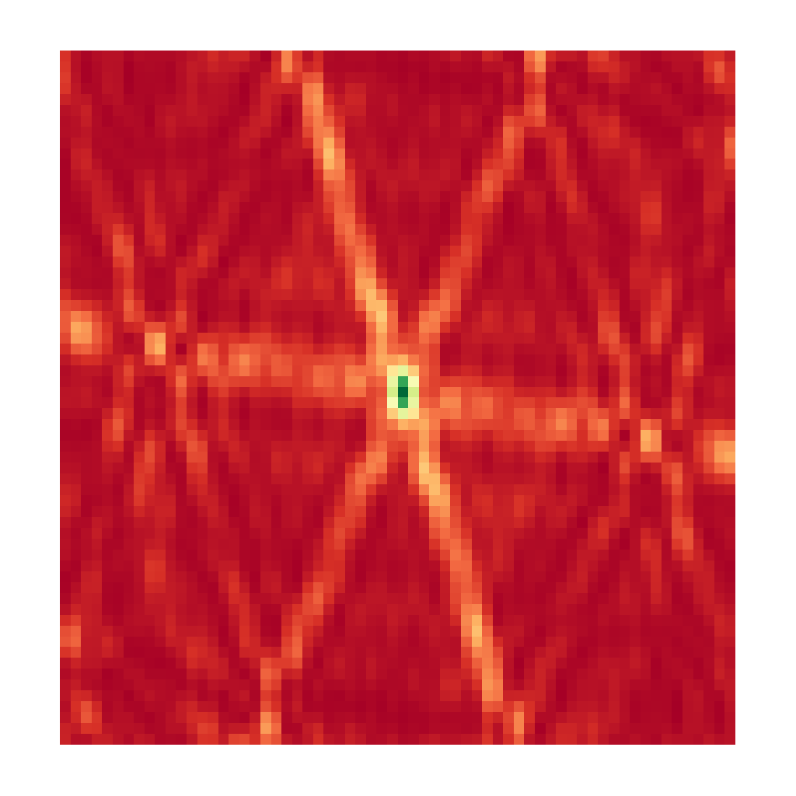
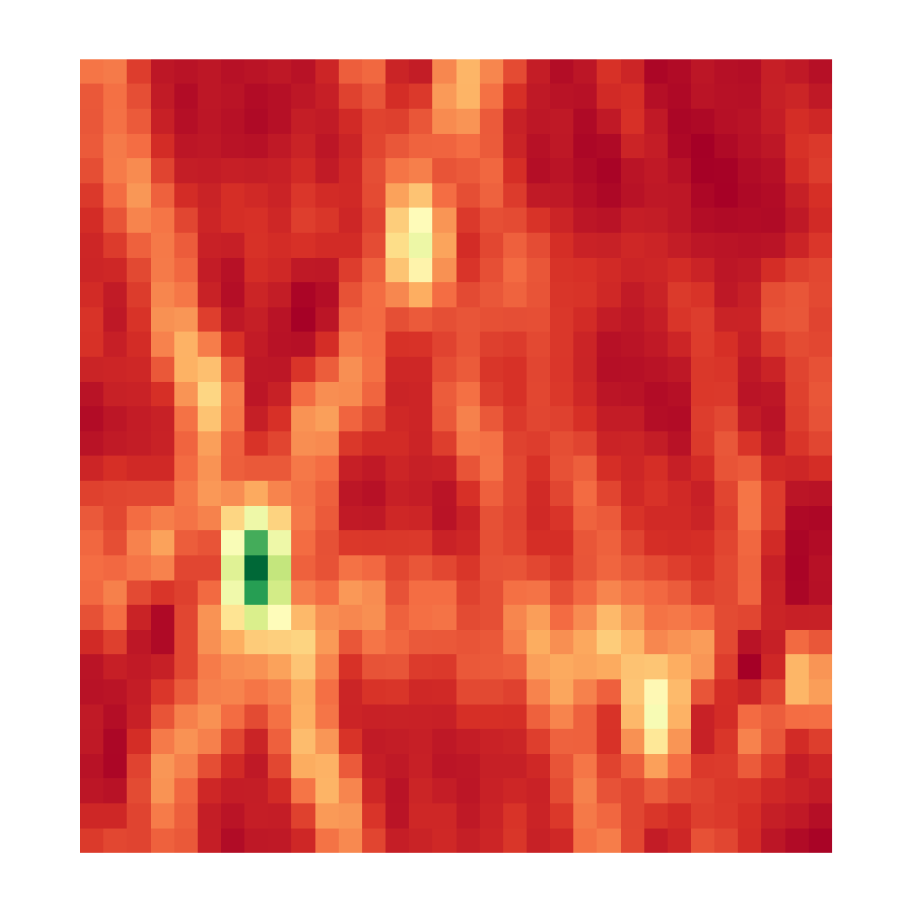

CLEAN, Iteration 0
Dirty Image
Model Image

Slide 8
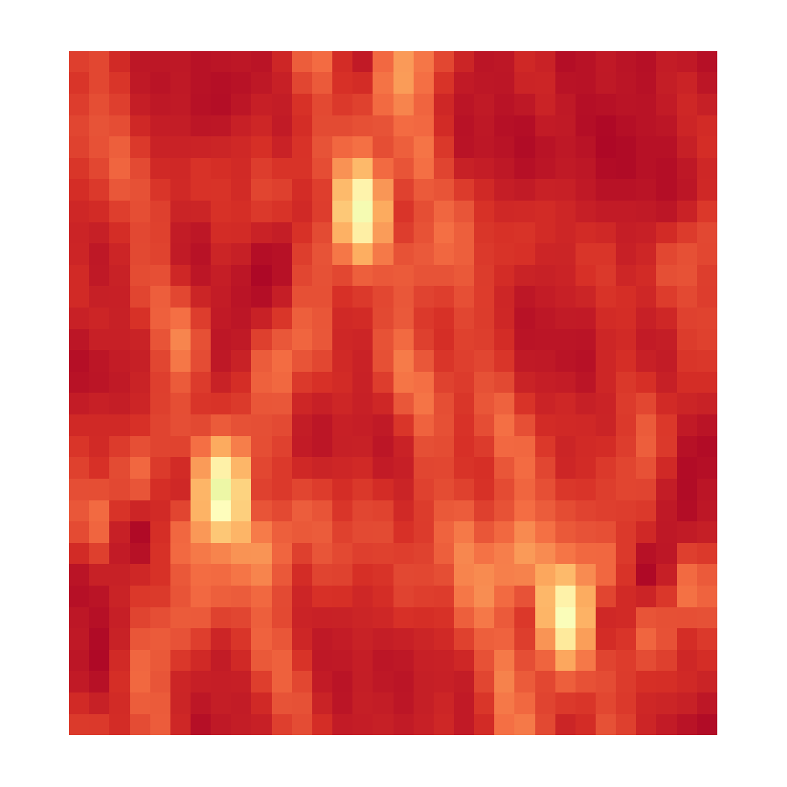

CLEAN, Iteration 1
Dirty Image
Model Image

Slide 9
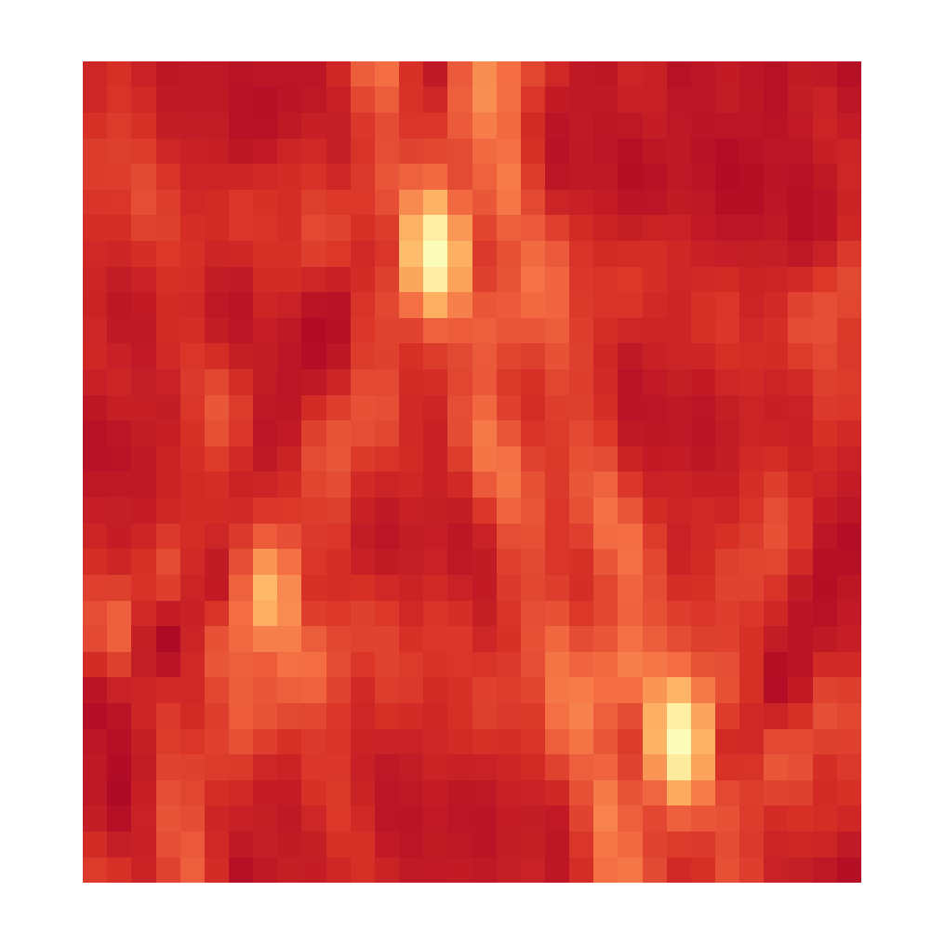

CLEAN, Iteration 2
Dirty Image
Model Image

Slide 10
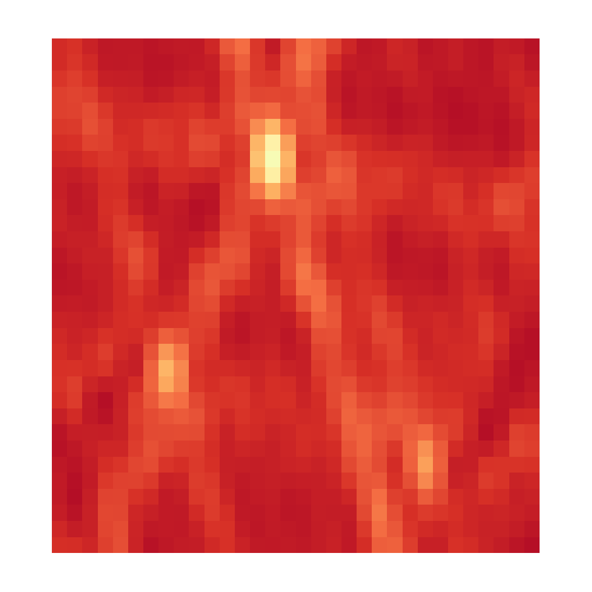

CLEAN, Iteration 3
Dirty Image
Model Image

Slide 11
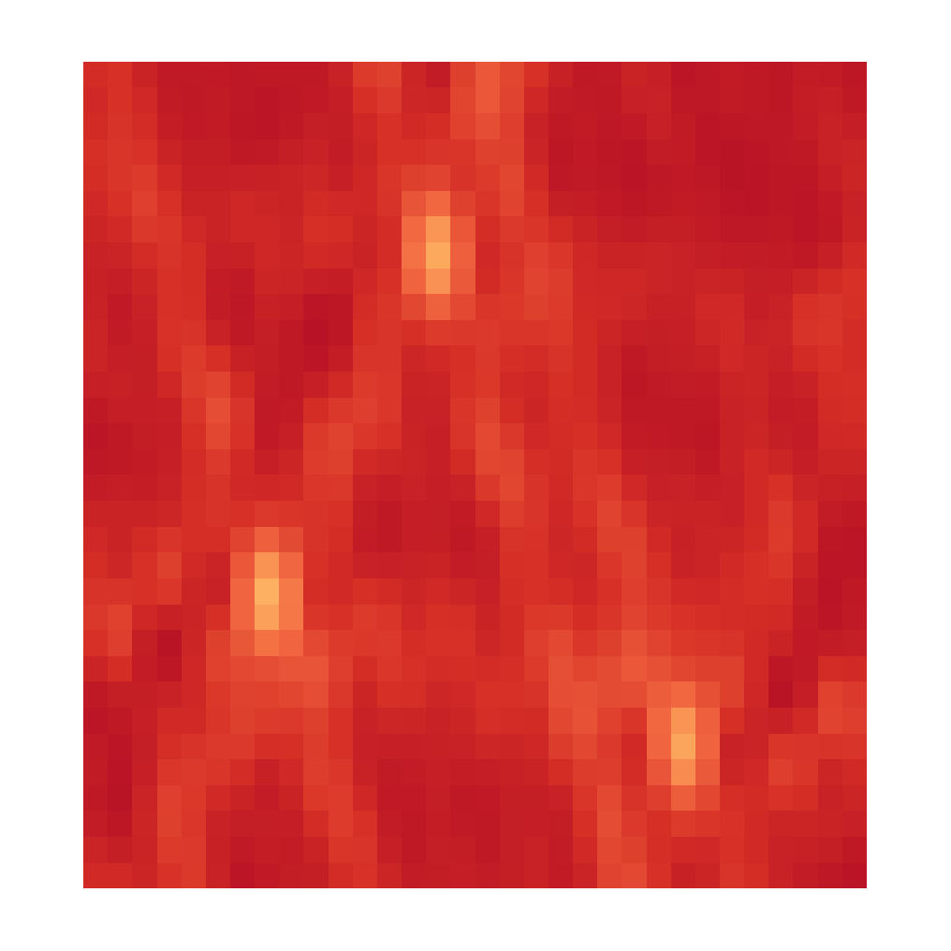

CLEAN, Iteration 4
Dirty Image
Model Image

Slide 12


CLEAN, Iteration X
Dirty Image
Model Image

Slide 13
CLEAN

Slide 14
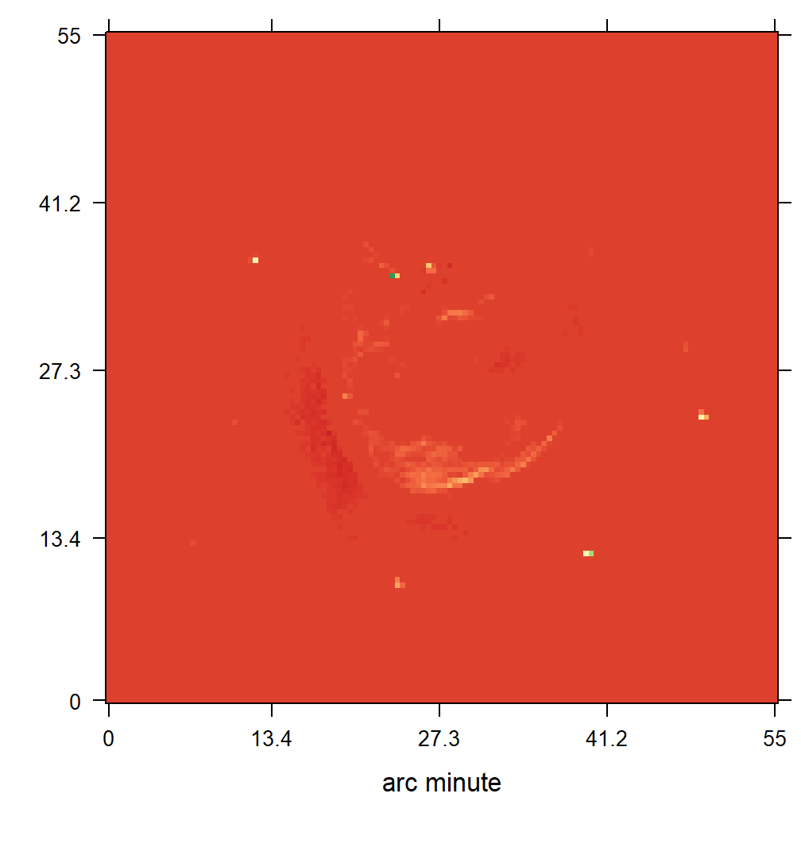
CLEAN blurring
Notes:
Low resolution

Slide 15
Compressed Sensing

Slide 16
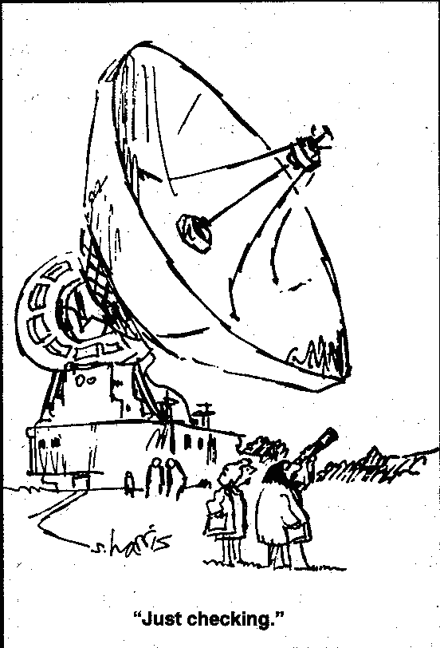

Slide 17
Regularizations
L0
L1
L2
Total Variation
L1 + L2
Starlet

Slide 18
10s VLA Observation
RAO Reconstruction
Notes:
Low resolution

Slide 19
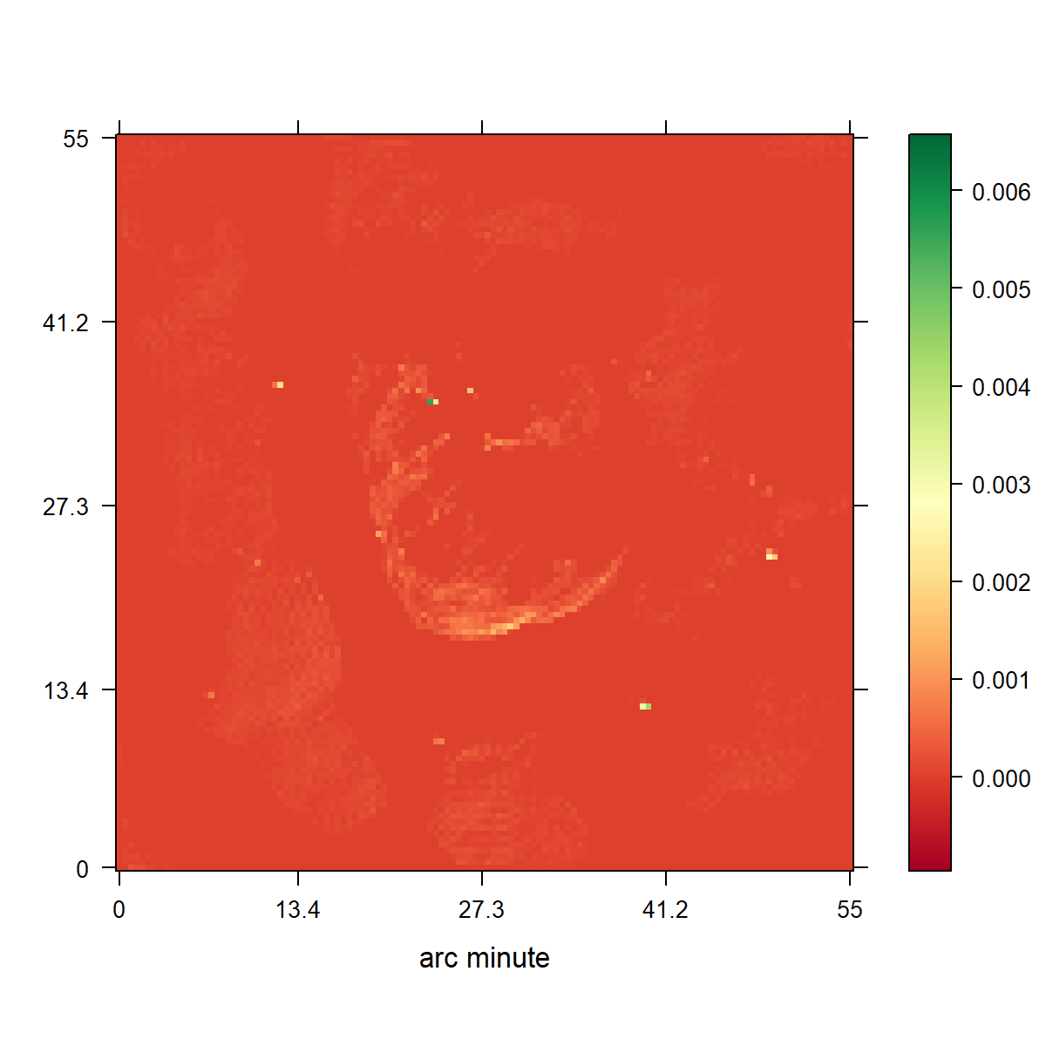
CLEAN
L1 Regularization

Slide 20
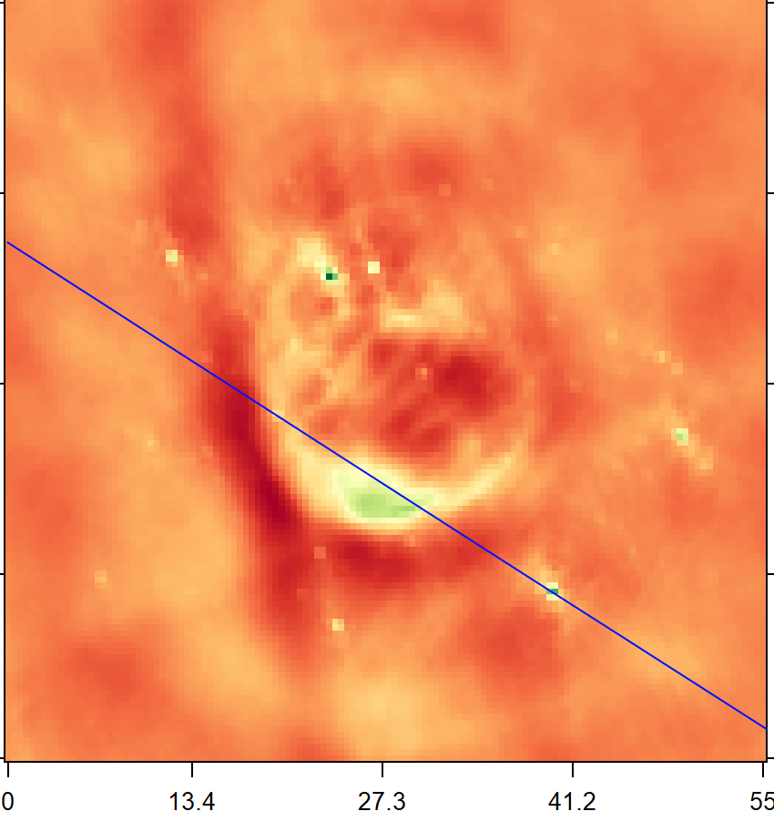
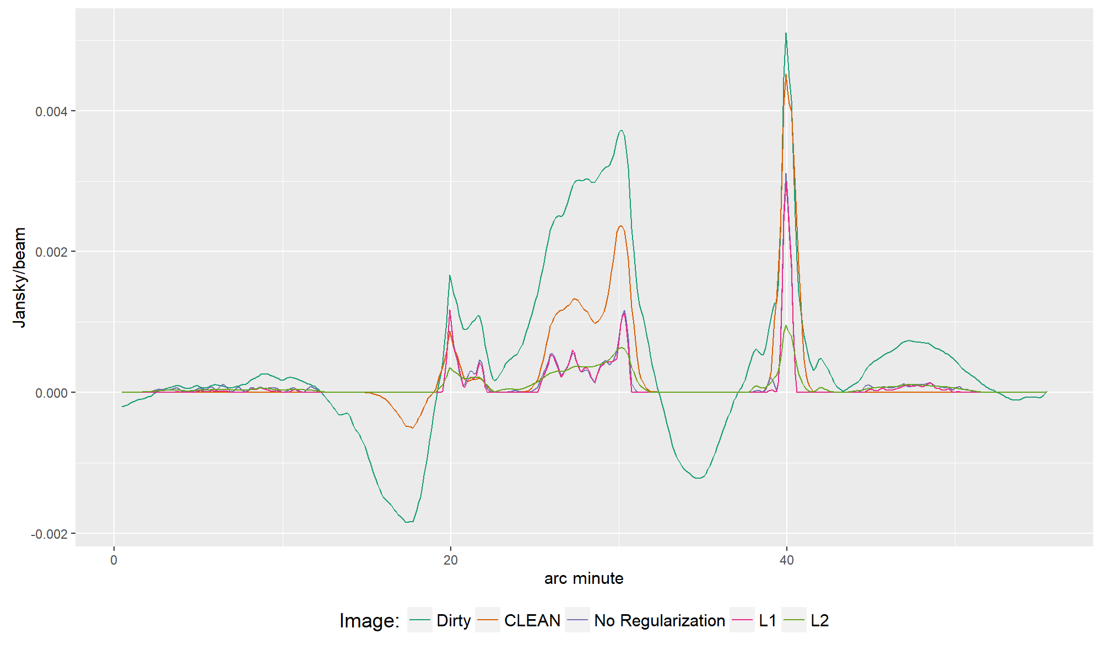

Slide 21
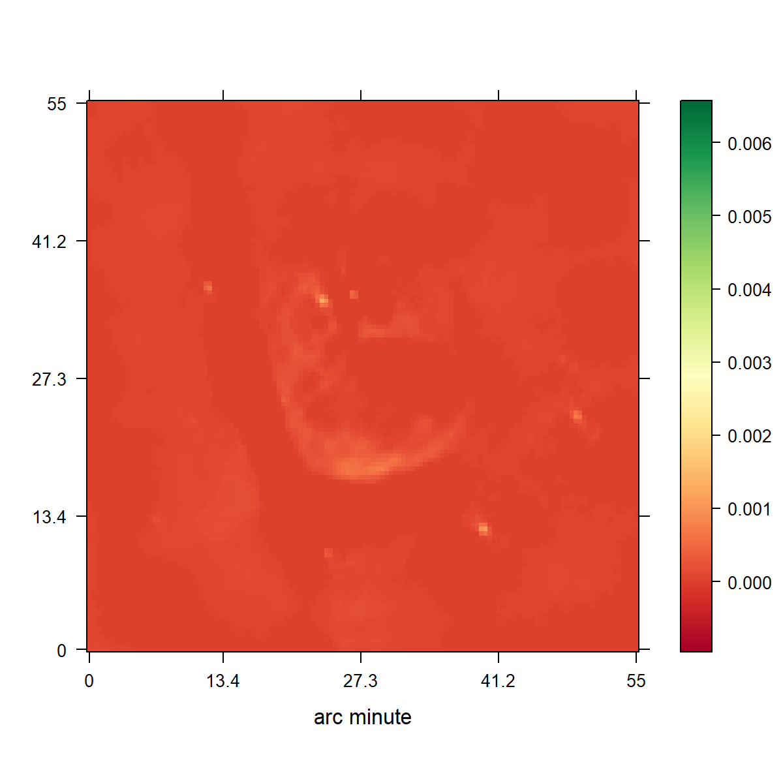
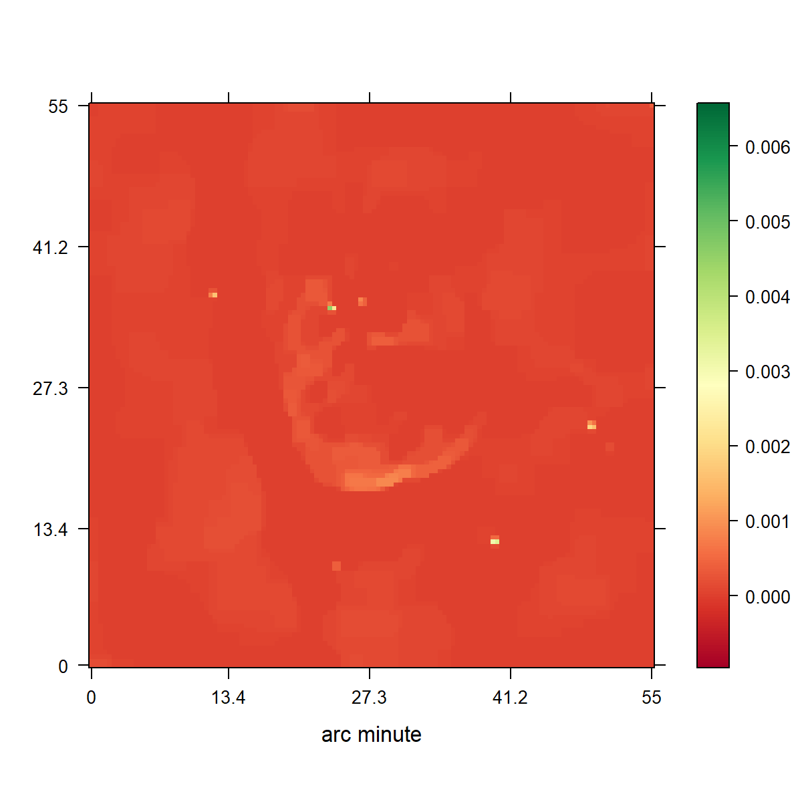

Slide 23
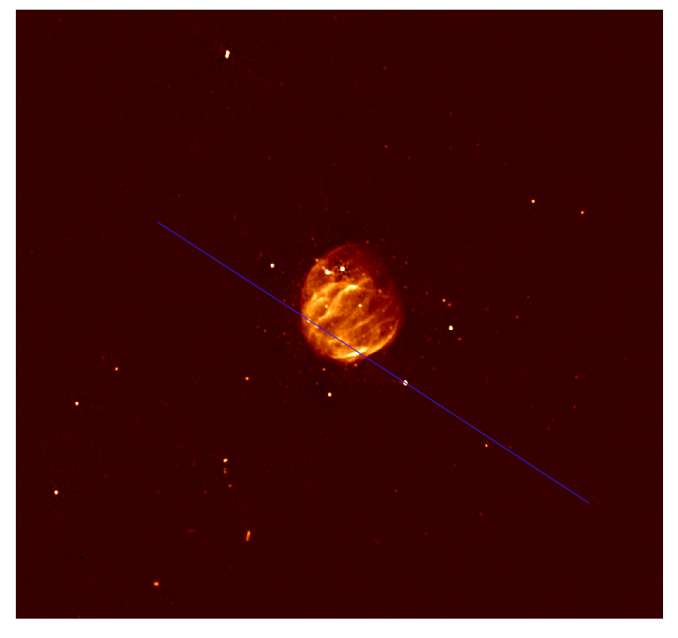

Slide 24
Conclusion

Slide 27
Compressed Sensing

Slide 28
Compressed Sensing Image Reconstruction
Regularization that captures the image properties
Incoherent Measurement and Reconstruction spaces.

Slide 29
CLEAN as a Compressed Sensing Reconstruction
Notes:
Camera Pixels
Many samples, most contain no information

Slide 30
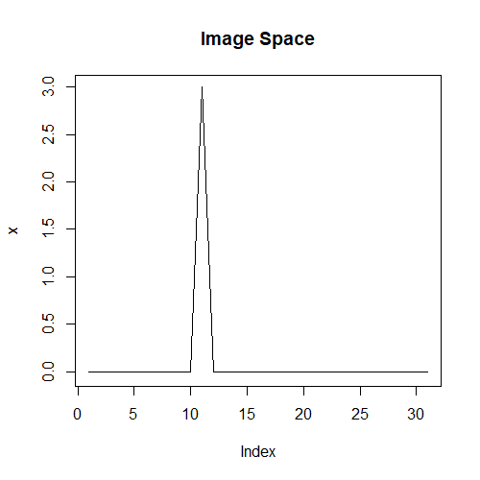
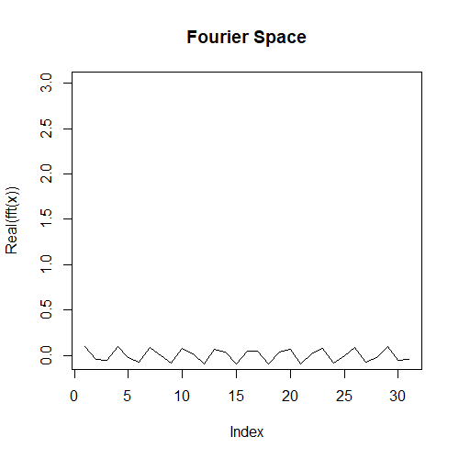
Incoherence

